Slide 1
Public investment and electric vehicle design: a model-based market analysis framework ^{[1]}
Benjamin M. Knisely
Department of Mechanical Engineering, University of Maryland

Slide 2
Overview
Electric vehicles (EVs) could provide social and environmental benefits through reduction of GHG emissions, but struggles with widespread adoption
Government regulation and investment influences adoption
Ancillary services also influence adoption
E.g. Vehicle charging stations (CS)

Slide 3
Overview
A game-theoretic optimization framework analyzing public policy’s effect on the EV market is proposed
Government
Manufacturer
Charge Station Operator

Slide 4
Background – Public Policy and EV Market
Primary barriers to adoption:
Price
Social preference
“Range Anxiety”
Policy can influence:
Consumer choices
Manufacturer decisions
Charge station design

Slide 5
Background – EV Engineering Design
Powertrain governs fuel economy and emissions
Battery, motor, engine size
Final drive ratio
Battery EV Drivetrain
Plug-in Hybrid EV Drivetrain

Slide 6
Background – Design for Market Systems
Maximizes expected value of product, as opposed to engineering performance
Demand model used to estimate profit
Consumer Demand = f(Design Attribute A)
Design Attribute A = f(Design Variables X)

Slide 7
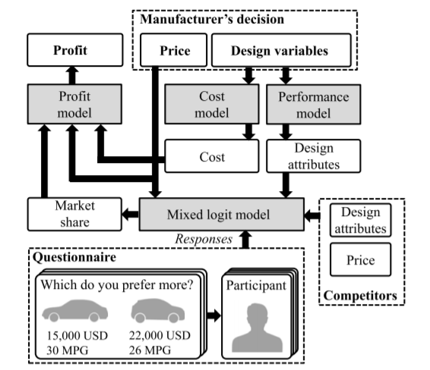
Background – Design for Market Systems
Design for Market Systems Framework

Slide 8
Background – Design for Market Systems
Design for Market Systems Framework [2]

Slide 9
Key Assumptions
Subsidy-related policies only
Time independent
Market consists of 2 manufacturers:
BEV and PHEV producer
Conventional vehicle producer
Study focuses on 2 markets (Central Beijing and Ann Arbor, MI) suited well for charger installation

Slide 10
Key Assumptions
Greenhouse gas emissions estimated based on CO₂ emission from gas consumption and electricity production
Baseline tax and plate fees for all vehicles equal
Gas prices
Ann Arbor: $2.51/gal
Beijing: $4.77/gal

Slide 11
Stakeholder Decisions
Government
Public policies
Manufacturer
Battery design
Powertrain design
Vehicle price
CS Operator
# of stations
Charging price

Slide 12
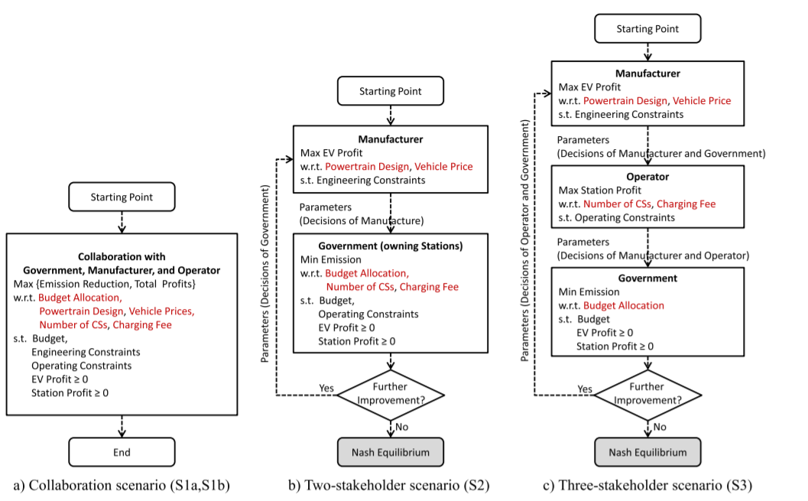
Optimization Models

Slide 13
Variable Overview
EM: Emissions
D: Demand
P: Price
A: Vehicle Attributes
I: Government Investment
C: Cost
Π: Profit

Slide 14
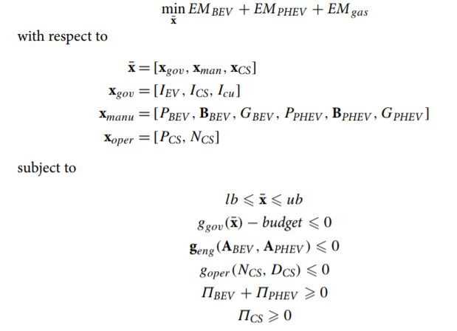
Optimization Models

Slide 15
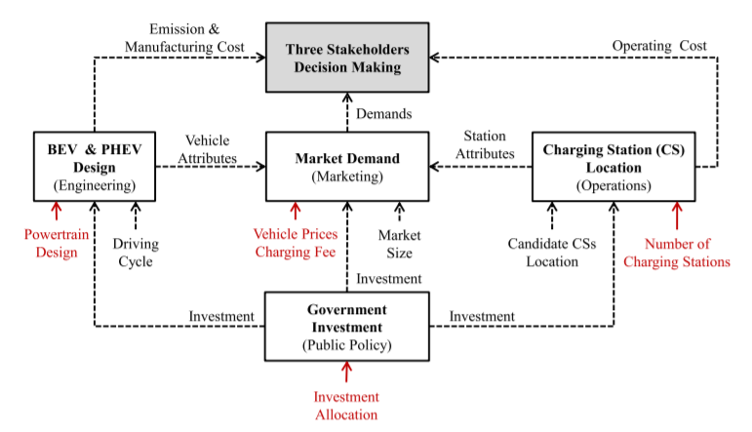
Decision-Making Framework

Slide 16
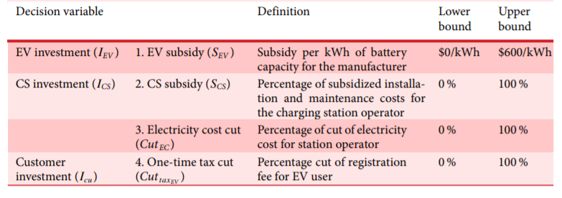
Policy Model
US Policy Model

Slide 17
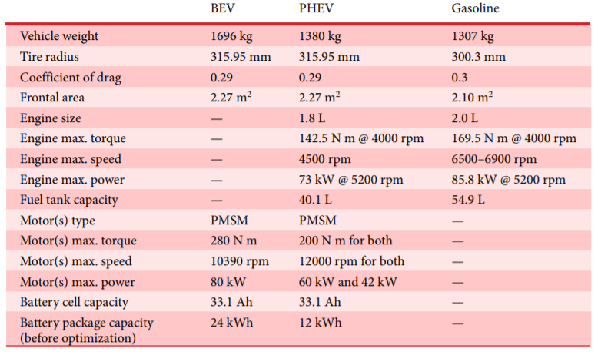
Engineering Model
1 BEV and 1 PHEV
Vehicles simulated with AMESim

Slide 18
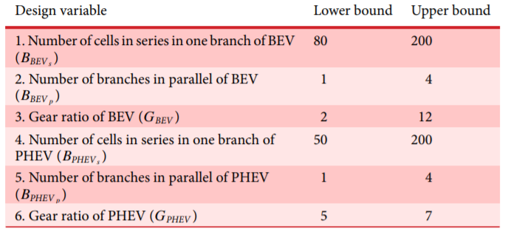
Engineering Model

Slide 19
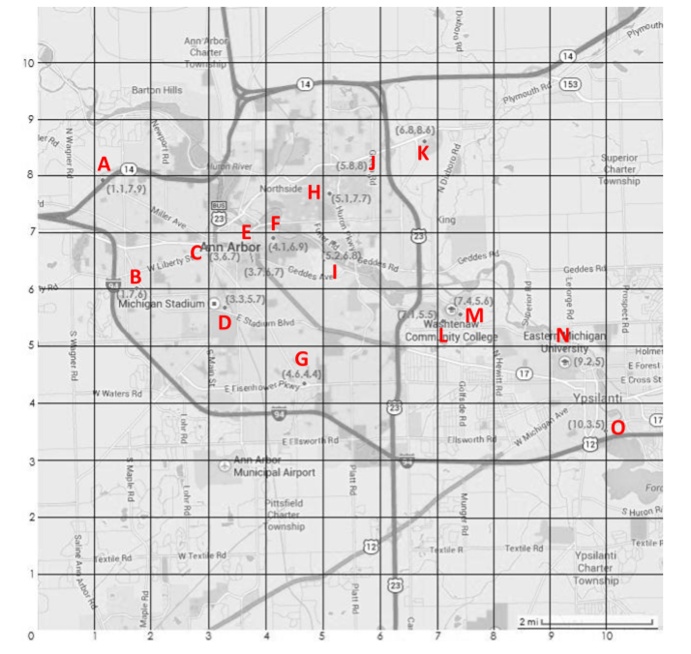
Charging Service Model

Slide 20
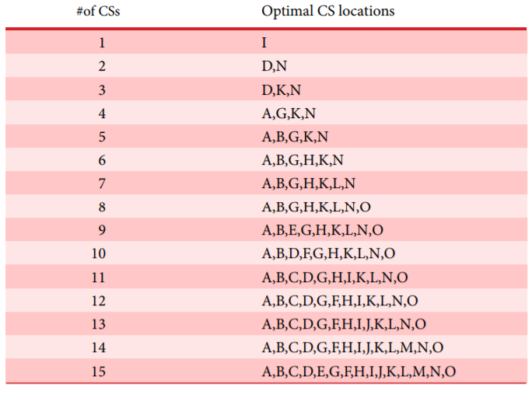
Charging Service Model
Optimal Locations = min distance to each EV user on map
Assumes uniform distribution of users

Slide 21
Charging Service Model
Every charger should serve 12 users/day

Slide 22
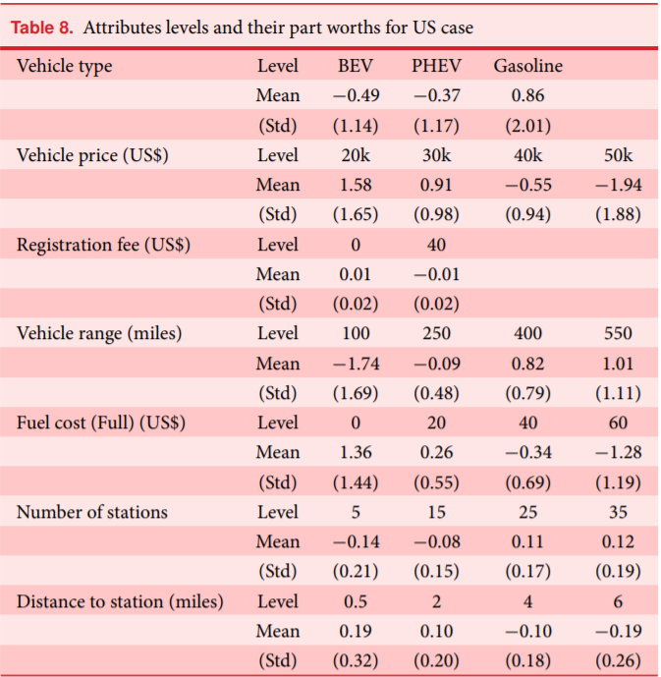
Market Model

Slide 23
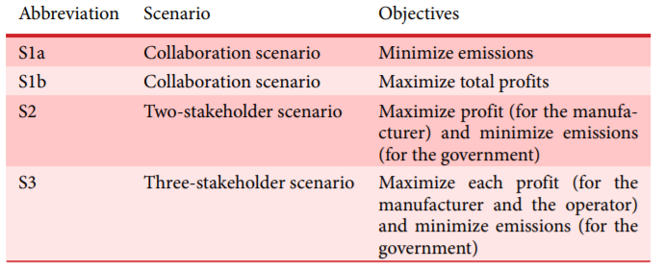
Optimization Model

Slide 24
Results

Slide 25
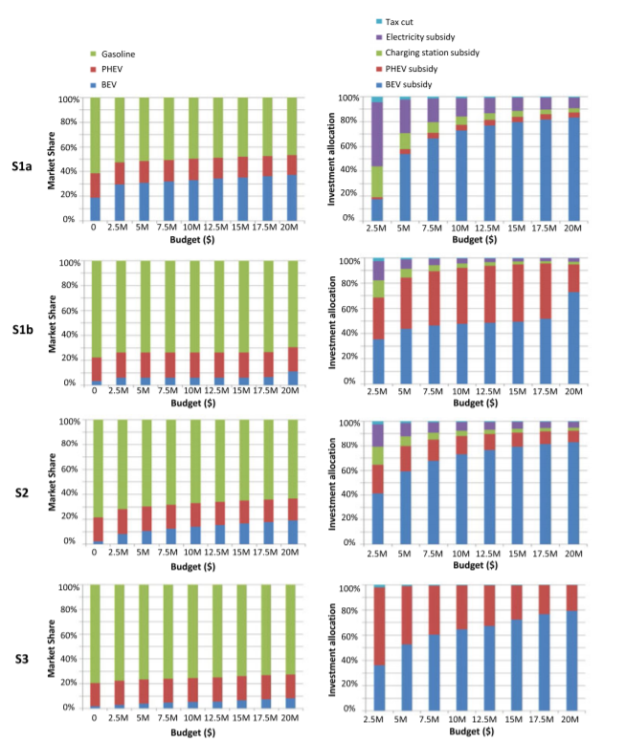
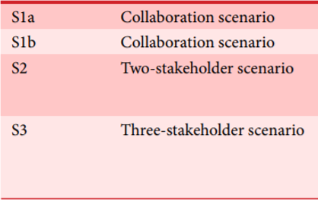

Slide 26
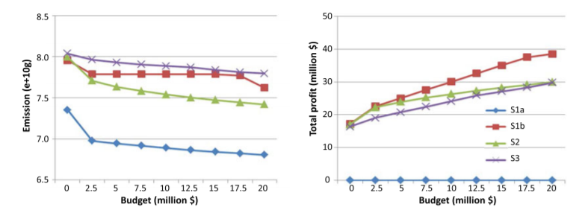

Slide 28
Conclusions
Collaboration is the clear winning strategy
Increasing budget has diminishing returns for EV adoption
High vehicle price combined with low EV acceptance and high sensitivity to price is a adoption bottleneck + inefficient
BEV-investments are most cost-effective
Gas price changes have a significant impact on vehicle demand

Slide 29
References
[1] Kang, N., Ren, Y., Feinberg, F. M., and Papalambros, P. Y., 2016, “Public Investment and Electric Vehicle Design: A Model-Based Market Analysis Framework with Application to a USA–China Comparison Study,” Design Science, 2.
[2] Michalek, J. J., Papalambros, P. Y., and Skerlos, S. J., 2005, “A Study of Fuel Efficiency and Emission Policy Impact on Optimal Vehicle Design Decisions,” J. Mech. Des, 126(6), pp. 1062–1070.

Slide 30
Thank You

Slide 31
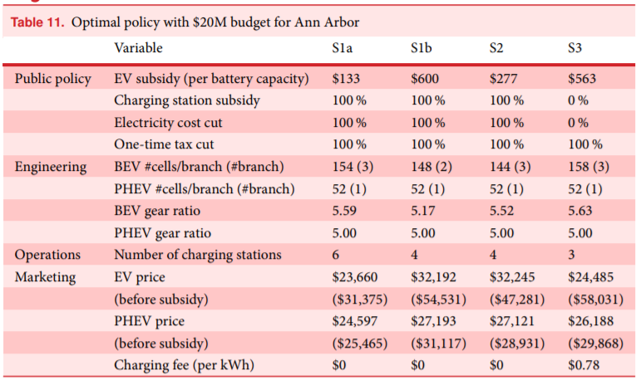

Slide 32
