Slide 1
Fairness, Accountability and Transparency in Machine Learning
Nirat Saini

Slide 2
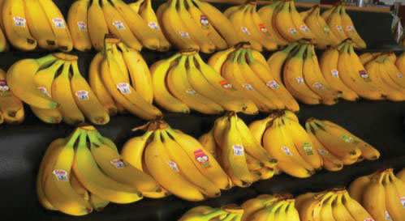
What do you see?
Bananas

Slide 3
What do you see?
Bananas
Bananas at a store

Slide 4
What do you see?
Bananas
Bananas at a store
Bananas on shelves

Slide 5
What do you see?
Bananas
Bananas at a store
Bananas on shelves
Bunches of bananas

Slide 6
What do you see?
Bananas
Bananas at a store
Bananas on shelves
Bunches of bananas
Bananas with stickers on them

Slide 7
What do you see?
Bananas
Bananas at a store
Bananas on shelves
Bunches of bananas
Bananas with stickers on them
Bunches of bananas with stickers on them on shelves in a store

Slide 8
What do you see?
Bananas
Bananas at a store
Bananas on shelves
Bunches of bananas
Bananas with stickers on them
Bunches of bananas with stickers on them on shelves in a store
… We don’t tend to say
Yellow Bananas

Slide 9
What do you see?
Yellow Bananas
Yellow is prototypical for bananas

Slide 10
Prototype Theory
Our purpose of characterization is to reduce the infinite differences among stimuli to behaviorally and cognitively usable proportions
There may be some central, prototypical notions of items that arise from stored typical properties for an object category (Rosch, 1975)

Slide 11
A man and his son are in a terrible accident and are rushed to the hospital in critical care.
The doctor looks at the boy and exclaims “ I can’t operate on this boy, he is my son!”
How could this be?

Slide 12
A man and his son are in a terrible accident and are rushed to the hospital in critical care.
The doctor looks at the boy and exclaims “ I can’t operate on this boy, he is my son!”
How could this be?
FEMALE DOCTOR
contrasted with
DOCTOR

Slide 13
Wapman & Belle, Boston University
The majority of test subjects overlooked the possibility that the doctor is a she– including men, women, and self-described feminists.

Slide 14
Human Reporting Bias
Word learning from text: Gordon and Van Durme, 2013
The frequency with which people write about actions, outcomes, or properties is not a reflection of real-world frequencies or the degree to which a property is characteristic of a class of individuals
Also called ”Black Sheep” problem, “Giraffes problem” in vision/language
Photographer Bias: Natural tendency of photographers to place object of interest in the center
Rest of the talk: Modeling world knowledge (and biases!) with latent variables

Slide 15
Seeing through the Human Reporting Bias: Visual Classifiers from Noisy Human-Centric Labels
Ishan Misra, C. Lawrence Zitnick, Margaret Mitchell, Ross Girshick

Slide 16
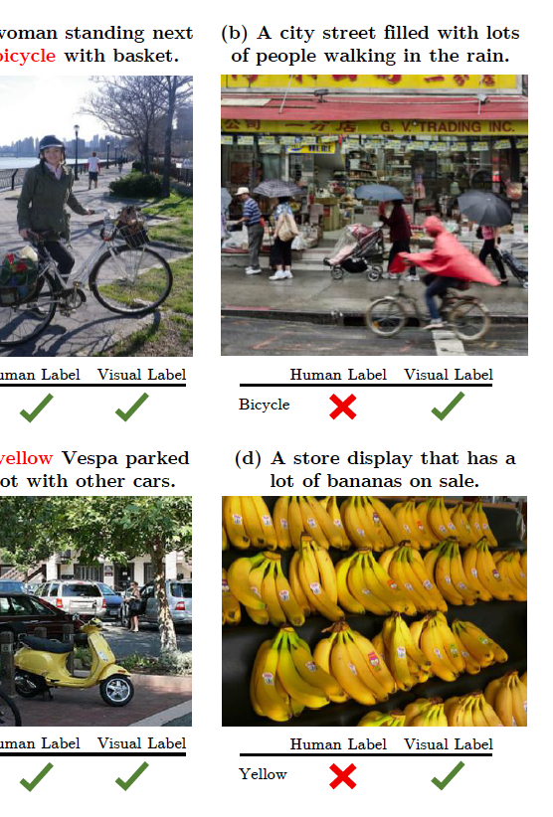
Human-centric annotation
Human-written tags or captions focus on the most important or salient information in an image
lack information on minor objects, information that may be deemed unimportant, known as reporting bias
Training does not yield a credible visual concept classifier
instead
leads to a classifier that attempts to mimic the reporting bias
Humans tend not to mention typical attributes unless required for unique identification or distinguishability
Notes:
Images annotated with human-written tags or captions focus on the most important or salient information in an image, as judged implicitly by the annotator.
These annotations lack information on minor objects or information that may be deemed unimportant, a phenomenon known as reporting bias.
Training directly on human-centric annotations does not yield a credible visual concept classifier, instead, it leads to a classifier that attempts to mimic the reporting bias of the annotators

Slide 17
Related Work: Modeling label noise
Assumes the noise is conditionally independent of the input image
[Mnih and Hinton 2012], [Natarajan et al., 2013], [Reed et al., 2014], [Sukhbaatar et al., 2015], [Izadinia
et al., 2015]

Slide 18
Related Work: Modeling label noise
Assumes the noise is conditionally independent of the input image
[Mnih and Hinton 2012], [Natarajan et al., 2013], [Reed et al., 2014], [Sukhbaatar et al., 2015], [Izadinia
et al., 2015]
Assumes that estimating noise requires access to exhaustively labeled data
[Xiao et al., 2015]

Slide 19
Human-Biased labels
Highly dependent on the input image
The outcome of a complex systematic process [human judgment]
Humans are fairly systematic in such labeling
Humans refer to object properties when it helps distinguishability, conversation etc. [Gregory 1966], [Rosch 1973], [Sedivy et al., 2003], [Koolen et al., 2011]
Goal: train a model that explicitly factors human-centric label prediction into a visual presence classifier and relevance classifier

Slide 20
w ∈ {banana, yellow}
Notation
Output
Banana
Yellow
Input Image
Banana
Yellow
Label
Visually correct ground truth (Unknown)
Available Ground truth
(human-biased)
$$z^{w}$$
$$y^{w}$$

Slide 21
Simple Image Classification
w ∈ {banana, yellow}
Output
Classifier
Linear
Sigmoid
CNN
Banana
Yellow
For each w
Input Image
_{y}w
Ground Truth

Slide 22
Simple Image Classification
w ∈ {banana, yellow}
Output
Classifier
Linear
Sigmoid
CNN
Banana
Yellow
For each w
Input Image
_{y}w
Ground Truth
Human-Biased Labels _{y}w $∈\left\{0,1\right\}.$ (Gold Standard)

Slide 23
Simple Image Classification
w ∈ {banana, yellow}
Output
Classifier
Linear
Sigmoid
CNN
Banana
Yellow
For each w
Input Image
_{y}w
Ground Truth
Human-Biased Labels _{y}w $∈\left\{0,1\right\}.$ (Gold Standard)
Prediction h^{w}(y^{w}|I)

Slide 24
Factoring in label bias: idea
A human-biased prediction h can be factored into two terms
Visual presence v – Is the object visually present?
w ∈ {banana, yellow}
visually correct ground truth (unknown): z

Slide 25
Factoring in label bias: idea
A human-biased prediction h can be factored into two terms
Visual presence v – Is the object visually present?
Relevance r – Is the object relevant for a human?
w ∈ {banana, yellow}
Use z to predict human-biased label y
Unknown

Slide 26
Factoring in label bias: idea
A human-biased prediction h can be factored into two terms
Visual presence v – Is the object visually present?
Relevance r – Is the object relevant for a human?
Unknown

Slide 27
Factoring in label bias: idea
A human-biased prediction h can be factored into two terms
Visual presence v – Is the object visually present?
Relevance r – Is the object relevant for a human?
Given visual presence, _{Is concept present?} is concept relevant?
Unknown

Slide 28
Factoring in label bias: idea
A human-biased prediction h can be factored into two terms
Visual presence v – Is the object visually present?
Relevance r – Is the object relevant for a human?
Given visual presence, _{Is concept present?} is concept relevant?
Allows classifier to not get penalized for correct predictions
Unknown

Slide 29
End-to-end approach

Slide 30
Results
Evaluate both v and h predictions
Microsoft COCO dataset
Human-biased labels y from Captions [1000 categories]
Visually correct labels z from Detection Bounding boxes [73 categories]
#images: 80k train, 20k test
YFCC100M
Yahoo Flickr images with tags [1000 categori
Random subset #images: 75k train, 15k te
y labels z labels: Only for testing
es]
st
Unknown
A hungry dog looks at the food on the
dog, chair, pizza, donut
table.

Slide 31
Evaluating using y (human-biased) and z (annotated)
NN: Nouns VB: Verbs
JJ: Adjectives DT: Determiner PRP: Pronouns IN: Prepositions
.

Slide 32
Qualitative Results
Mentioned by humans (h)
v
h
fence

Slide 33
Qualitative Results
Mentioned by humans (h)
Mentioned by humans (h)
fence
hat
oven
tie
brick
green
pink
red
trees
orange

Slide 34
Corrected Error Modes
Corrected False Positives
Corrected False Negatives
Corrected False Positives
Corrected False Negatives
desert
net
fridge
night
beach
waves
sheep
drinking

Slide 36
Improvement in Image captioning
<s>
A
Ferris
Wheel
</s>
Image
<s>
A
Ferris
Wheel
</s>
null
Model

Slide 37
References
Misra, et al. (2016). Seeing through the Human Reporting Bias: Visual Classifiers from Noisy Human-Centric Labels. CVPR.

