Slide 1
When Security Games Go Green
^{Suraj Nair}

Slide 2
Outline
Green Security Game
Planning algorithms
Planning and learning
Results
Notes:
I will go through Green Security Game model, and provide the high level ideas of the planning and learning algorithm, followed by experimental results

Slide 3
Green Security Domains: Protecting Fish and Wildlife
Notes:
Application of traditional game theoretic models to green security domains
The work is motivated by green security problems, including protecting wildlife
A similar challenge is faced by officers who try to protect fish stocks from illegal fishing.

Slide 4
Features
Green security games
Generalized Stackelberg assumption
Repeated and frequent attacks
Significant amounts data
Attacker bounded rationality
Limited surveillance/planning
Notes:
Green Security Games can be viewed as generalized Stackelberg assumption. The SA is the standard assumption used in infrastructure security games that the defender will commit to a strategy first, and then the attacker will conduct surveillance to fully observe the defender’s strategy before taking action. However, this assumption may not always hold as the poachers or the illegal fishmen take actions frequently and may not have time to fully observe the defender’s current strategy.
when the defender decides to change her strategy in one day, the poachers may not get a timely update about this change, and may still respond to what they believe the defender strategy is, which is already outdated. So the defender can benefit from the strategy change if planned carefully.

Slide 5
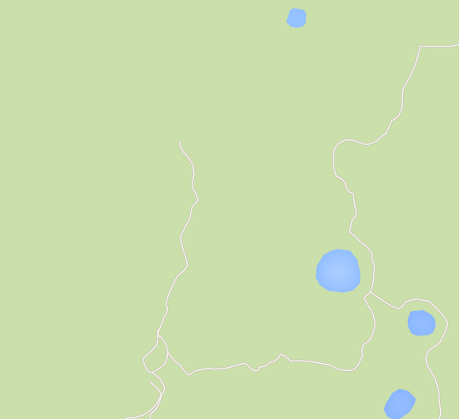
Green Security Game Model
$T$ round game, K defenders, N targets where$N≥K$
Coverage vector $c=\left\langle c_{i}\right\rangle$ where
$c_{i}$ denotes probability that target i is covered
$ct$ denotes the defender strategy profile for round t
Jan | Feb | Mar | Apr | May
0.3 | 0.4 | 0.1 | 0.2 | 0.5 | 0 | 0.1 | 0.7
0.2 | 0.2 | 0.3 | 0.3 | 0.4 | 0.5 | 0.6 | 0.1
0.6 | 0.7 | 0.1 | 0.2 | 0.3 | 0.2 | 0 | 0.9
0.4 | 0.5 | 0.6 | 0.3 | 0.1 | 0.2 | 0.3 | 0
0.1 | 0.2 | 0.3 | 0.4 | 0.5 | 0.3 | 0.4 | 0.1
0.3 | 0.4 | 0.5 | 0.5 | 0.5 | 0.1 | 0.1 | 0.1
0.2 | 0.2 | 0.2 | 0.3 | 0.3 | 0.3 | 0.4 | 0.5
0.1 | 0.1 | 0.6 | 0.3 | 0.4 | 0.2 | 0.4 | 0.4
Notes:
To model the frequent and repeated interaction, we model the problem as a repeated game with T rounds, each round corresponds to a period of time, say a month The protected area is discretized into multiple subareas, each can be seen as a target. In each round, the defender chooses a mixed strategy, for example
There are K patrollers who will decide where to patrol every day. In this talk, we consider the special case where each patroller will choose a sub-area every day and do extensive patrols in that area. The defender is faced with a population of attackers, and each attacker will choose in which subarea to place snares every day.

Slide 6
Green Security Game Model
L attackers who respond to convex combination of defender strategy in recent rounds
$η^{t}$denotes the strategy of attacker for round t
Payoff values for target i ${ P}_{i}^{a}, R_{i}^{a}, P_{i}^{d}, R_{i}^{d}$
Where P stands for Penalty, R for reward
a for attacker, d for defender
Expected utility for defender d if attacker targets i
$U_{i}^{d}\left(c\right)=c_{i}R_{i}^{d}+\left(1−c_{i}\right)P_{i}^{d}$
Jan | Feb | Mar | Apr | May
$$c^{1}$$ | $$c^{2}$$ | $c^{3}$=?
$$η^{3}=0.3c^{1}+0.7c^{2}$$
Notes:
We know that the attackers may not have up-to-date information about the defender strategy. For example, on one day in March, when the poacher needs to decide where to place snares, he does not know what is the defender strategy that is currently used in March. Naturally, he will take into account what he observed or learned from other poachers from the past. So we estimate the attackers’ belief about the defender strategy in current round, denoted by eta^t, as a convex combination of the defender strategies used in recent rounds. This is a generalization of the perfect Stackelberg assumption which says the attackers belief is always up-to-date. This generalized assumption provides more flexibility and better fits the situation in green security domains.

Slide 7
Green Security Game Model
Attacker chooses target with bounded rationality
Following the SUQR model
Choose more promising targets with higher probability
Probability that an attacker attacks target i is
$q_{i}\left(ω,η\right)=\frac{e^{ω_{1}η_{i}+ω_{2}R_{i}^{a}+ω_{3}P_{i}^{a}}}{\sum_{j}{e^{ω_{1}η_{i}+ω_{2}R_{i}^{a}+ω_{3}P_{i}^{a}}}}$
Create a defender strategy profile $\left\lfloor c\right\rfloor =⟨c^{1},…,c^{T}⟩$
Expected utility of defender in round t
$E^{t}\left(⌊c⌋\right)= \sum_{l}{\sum_{i}{q_{i}\left(ω^{l},η^{t}\right)U_{i}^{d}(c^{t})}}$
Notes:
We also know that the attackers are boundedly rational in choosing targets, meaning they may not always go for the target with the highest expected utility. So we adopt the SUQR model, the best model for attackers’ bounded rationality when tested against human subjects. This models says that the attacker will choose more promising targets with higher probability. And the judgement on which target is more promising is based on the attacker’s evaluation on key properties of the targets
will choose a target i with probability q_i, which is a non-convex function of the reward, penalty and defender strategy. Note that omega 1, 2, 3 are parameters that describes how the attacker evaluate different targets and the parameters are different from attacker to attacker.

Slide 8
Outline
Green Security Game Model
Planning algorithms
Planning and Learning
Results
Notes:
Based on this model, when all the parameters are known, we propose planning algorithms that design defender strategies for each round of the game. In this talk, I will use a special case as an example, which is the attackers always respond to the defender strategy in the last round, meaning the attackers’ understanding about the defender strategy is always delayed by one round.
8

Slide 9
Planning
Exploit attackers’ delayed observation ($η^{t}=c^{t−1}$)
A simple example:
Patrol Plan A: always uniformly random
Patrol Plan B: change her strategy deliberately, detect more snares overall
N
 | Jan | Feb
N | 80% | 20%
S | 20% | 80%
S
Notes:
In this case, we need to plan for defender strategy change to exploit the attackers’ delayed observation. Assume, w is fixed

Slide 10
Planning
x
Solve directly
Optimize over all rounds $→$ computationally expensive
Jan | Feb | Mar | Apr | May
? | ? | ? | ? | ? | ? | ? | ?
? | ? | ? | ? | ? | ? | ? | ?
? | ? | ? | ? | ? | ? | ? | ?
? | ? | ? | ? | ? | ? | ? | ?
? | ? | ? | ? | ? | ? | ? | ?
? | ? | ? | ? | ? | ? | ? | ?
? | ? | ? | ? | ? | ? | ? | ?
? | ? | ? | ? | ? | ? | ? | ?
Notes:
Build a large Mathematical Program (MP), optimize over all rounds simultaneously
Non-convex, large number of variables $→$ computationally expensive when $T$ is large

Slide 11
PlanAhead-M
PlanAhead-M
Look ahead M steps: find an optimal strategy for current round as if it is the Mth last round of the game
Sliding window of size M. Example with M=2
$$E^{1}+{\overline{E}}^{2}$$
$$E^{3}+{\overline{E}}^{4}$$
Jan | Feb | Mar | Apr | May
$$E^{2}+{\overline{E}}^{3}$$
$$E^{4}+E^{5}$$
Add discount factor $γ$ to compensate the over-estimation
Notes:
We play as if on M'th last round of game.

Slide 12
PlanAhead-M
Mathematical program

Slide 13
FixedSequence-M
Require the defender to execute the sequence of length M repeatedly
Example with M=2: find best strategy A and B
Theoretical guarantee: $\left(1−\frac{1}{M}\right)$ approximation of the optimal strategy profile
Jan | Feb | Mar | Apr | May
A | B | A | B | A

Slide 14
FixedSequence-M
Notes:
We use an example to illustrate the problem, three targets moves between terminals A and B. The schedule of a target F_q is a mapping from time to distance.
A patroller moves along AB, and provide protection to targets within protection radius. In this example, patroller P1 is protecting target F2.

Slide 15
Outline
Green Security Game Model
Planning algorithms
Planning and Learning
Results
Notes:
Based on this model, when all the parameters are known, we propose planning algorithms that design defender strategies for each round of the game. In this talk, I will use a special case as an example, which is the attackers always respond to the defender strategy in the last round, meaning the attackers’ understanding about the defender strategy is always delayed by one round.
15

Slide 16
Planning and Learning
Learn parameters in attackers’ bounded rationality model from attack data
Previous work
Apply Maximum Likelihood Estimation (MLE)
May lead to highly biased results
Proposed learning algorithm
Calculate posterior distribution for each data point
Notes:
Focus on learning the omega parameters that describe the attackers’ characteristic in choosing which target to attack. Previous work on learning these parameters in green security domains focus on maximum likelihood estimation, which may lead to highly biased results. as there may not be sufficient number of data, and in many cases, the data in green security domains could be anonymous. For example, the patrollers may only find the snares placed on the ground without knowing who placed it.

Slide 17
Planning and Learning
$χ_{i}$ - number of attacks on target i
discrete set $\left\{\hat{ω}\right\}$ - $\left\{{\hat{ω}}^{1},…,{\hat{ω}}^{S}\right\}$
prior $p$ - $⟨p_{1},…,p_{S}⟩$
Notes:
learning algorithms calculates a posterior distribution of each data point in every round, and use the average distribution to calculate the strategy for next round.

Slide 18
General Framework of Green Security Game
Defender plans her strategy
Start New Round
Learn from data: Improve model
Local guards executes patrols
Poachers attack targets
Notes:
So the framework of green security games is that the defender first plans her strategy, local guards then executes patrols, and the poachers will choose where to attack based on a maybe-delayed observation about the defender strategy. Then the defender can learn from the attack data collected, improve her model about the poachers’ behavior and re-plan her strategy for next round.

Slide 19
Outline
Green Security Game Model
Planning algorithms
Planning and Learning
Results
Notes:
19

Slide 20
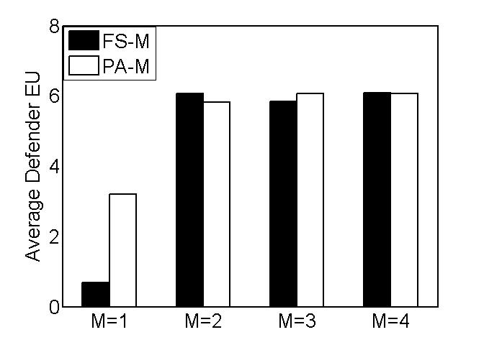
Experimental Results Planning
Baseline: FS-1 (Stackelberg), PA-1 (Myopic)
Attacker respond to last round strategy, 10 Targets, 4 Patrollers
Baseline

Slide 21
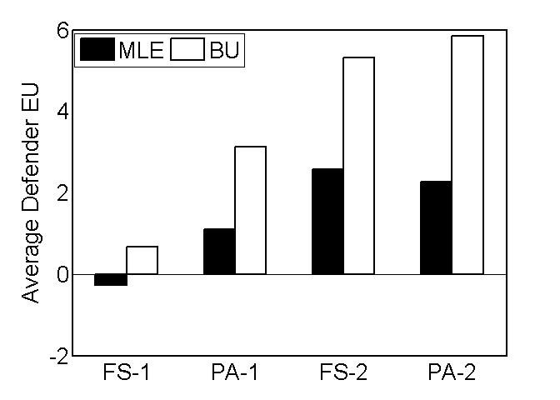
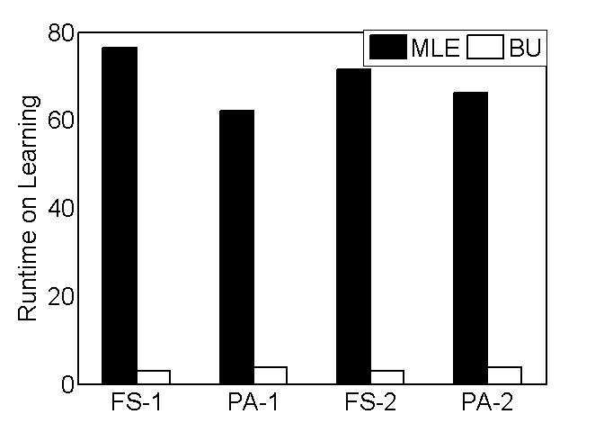
Experimental Results Planning and Learning
Baseline: Maximum Likelihood Estimation (MLE)
Solution Quality
Runtime

Slide 22
Thank you!

