Slide 1
Introduction to modern cryptology
Samuel Ranellucci
Notes:
Défacne de these
Date
To many slides

Slide 2
Doing online Banking
How do you know you are connecting with the bank’s website
How do you exchange a secret key with your bank
How does your password stay secret
Even if the hacker accesses the database of passwords
How does the bank hide the information it sends you
When you make a transfer, how can we verify
amount
recipient

Slide 3
Private-key primitive
Definition of encryption
Definition of authentication
Block ciphers
Modes of encryption
Authentication
Authenticate encryption

Slide 4
Hash function
Map a long string to a shorter string
Collision-resistance
Hard to find $(x,y)$ such that $h(x) = h(y)$
Useful to protect integrity of systems
Protect passwords

Slide 5
Public-key encryption
Public (encryption) key
Anyone can encrypt a message
Private (decryption) key
Only the creator can decrypt a ciphertext
Allows client to send a secret key to the bank

Slide 6
Ethymology
Kryptos$⇒$Hidden, concealed, secret
-graphy $⇒$ writing
-ology $⇒$ branch of learning

Slide 7
Why cryptology and not cryptography
A cryptosystem uses cryptography to protect either
Confidentiality
Integrity
Cryptography is the art of making cryptosystems
Cryptology is the science (math) of making cryptosystems

Slide 8
How is it science?
Clear definitions of security
Formal protocol descriptions
Proofs of security
Why a science?
Crypto is hard

Slide 9
Bad things can happen when crypto is bad
Millions of bitcoins stolen
Fake windows updates
Adobe leaked password database

Slide 10
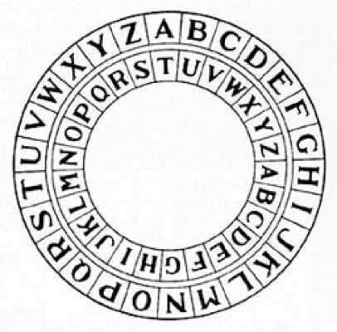
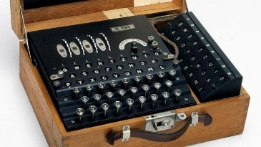
Historical perspective on computational encryption scheme
Caesar cipher
Enigma
Lessons from historical perspective

Slide 11
Perfect security
Samuel Ranellucci
Notes:
Défacne de these
Date
To many slides

Slide 12
Assumption
Key is always assumed hidden from the adversary
One-time means that the key is discarded after use

Slide 13
Overview
One-time pad
One-time mac
Disavantages of perfect security

Slide 14
Trap game #1
Alice tells Bob either to go left or right
Eve can then place trap on either
Left side
Right side
Eve wins if
trap placed is on the same side that Bob went

Slide 15
How eve can win game #1
Left
Left
Goes left
Eve reads the message and places trap based on message
Eve always wins.

Slide 16
Encryption
When Alice and Bob want to hide messages from Eve.
Prevents Eve from knowing where to put the trap.

Slide 17
Encryption scheme
$𝒦 ≔Secret Key space$
$ℳ ≔Message space$
$𝒞 ≔ciphertext space$
$Keygen({\{1\}}^{s})→𝒦$
$Enc:𝒦×ℳ→𝒞$
$Dec:𝒦×𝒞→ℳ$
Correctness: $Dec\left(k,Enc\left(k,m\right)\right)=m$
Hiding property: comes in many flavors

Slide 18
One-time pad
$𝒦 ≔{\left\{0,1\right\}}^{n}$
$ℳ ≔{\left\{0,1\right\}}^{n}$
$𝒞 ≔{\left\{0,1\right\}}^{n}$
$keygen$
$k∈_{R} {\left\{0,1\right\}}^{n}$
$Encrypt$
$Enc\left(k,m\right) ≔k⊕m$
$⊕ ≔denotes the bitwise exclusive or of two string$ (110 $⊕$ 101 = 011)
Decrypt
$Dec\left(k,c\right) ≔k⊕c$

Slide 19
Security one-time pad
Correctness
$Dec\left(k,Enc\left(k,m\right)\right)=$
$Dec\left(k,k⊕m\right) =$
$k⊕k⊕m =$
m
Perfect security
$\operatorname{Pr}\left[m=m_{1} \right| C=c]=Pr⁡[m=m_{1}]$

Slide 20
Perfect security for $n=1$
m=0
m=1
k=0
0
1
k=1
1
0

Slide 21
One-time pad vs Eve
$$c=0$$
$$k= ?$$
$$m= ?$$
$$c=0$$
$$k= ?$$
$$c= ?$$
$$m= ?$$
?????????
$$left→0$$
$$right→1$$

Slide 22
Bob could go left
$$c=0$$
$$k=0$$
$$m=0$$
$$c=k⊕m=0$$
$$k=0$$
$$c=0$$
$$m=k⊕c=0$$
?????????
$$left→0$$
$$right→1$$

Slide 23
Bob could go right
$$c=0$$
$$k=1$$
$$m=1$$
$$c=k⊕m=0$$
$$k=1$$
$$c=1$$
$$m=k⊕c=1$$
?????????
$$left→0$$
$$right→1$$

Slide 24
Trap game #2
Eve places a trap
Alice tells which side to go to Bob
She knows where trap is
Eve wins if
Bob goes where the trap is

Slide 25
How eve can win game #2
Left
Right
Goes Right
Eve places trap on right side.
Eve replaces message
Eve always wins.

Slide 26
Authentication
Allows Bob to know that a message really came from Alice
Prevents Eve from redirecting Bob towards the trap

Slide 27
Message authentication code
$𝒦 ≔Secret key space$
$ℳ ≔Message space$
$𝒯 ≔Tag space$
$keygen({\{1\}}^{s})→𝒦$
$mac :𝒦×ℳ→𝒯$
$verify :𝒦×M×𝒯→\left\{accept,reject\right\}$
Properties
correctness
unforgeability

Slide 28
Unforgeability game
m
$k←keygen$()
$$t←mac(k,m)$$
t
$$(m^{′},t′)$$
Win if
$m≠m′$
$verify\left(m^{′},t^{′}\right)=accept$

Slide 29
Review
Encryption: Hide the message from Eve
Authentication: Allows Bob to verify that the message came from Alice
Message can be perfectly encrypted using one-time pad
Requires key as long as the message
One-time mac
2s bits of keys can authenticate an arbitrary long message by viewing the message as a polynomial

Slide 30
Disadvantages of perfect security
Perfect encryption
key as long as message
Perfect authentication
2s bits of key per message sent

Slide 31
Computational cryptography
Reuse the same key to encrypt multiple messages
Since it is not longer perfectly secure, what we want is the amount of effort it requires to break is larger than all the computational power in the universe

Slide 32
Historical perspective
Caesar cipher
Reusing one-time pad
Substitution cipher

Slide 33
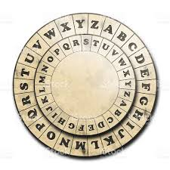
Caesar cipher
Keygen
Select a random key $k∈ [1,26]$
Encryption
Convert each letter to a number
$\left(a,…,z\right)→ (0,…,25)$
Encrypt each number letter using the key
$c_{i}← m_{i}+k (mod 26)$
Convert the result back to number
$\left(0,…,25\right)→(a,z)$
Example
k$= 4$
m$= Caesar$
$c =geiwev$

Slide 34
Very easy to break
Trivial attack: Only 26 keys.
Lesson: A good computational encryption scheme needs long keys.
How large must a key be?
It should require at least $2^{60}$ operations to break the key

Slide 35
Permutation cipher
Key generation
Sample permutation $π:\left[a,…,z\right] →[a,…,z]$
Encryption
Apply the permutation to each letter
Decryption
Apply the inverse permutation to each letter

Slide 36
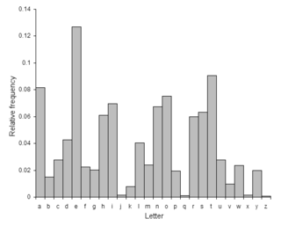
Frequency of letters in the English language

Slide 37
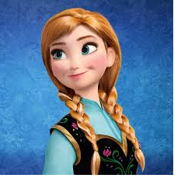
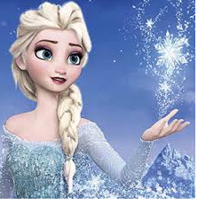
Which princess are they plotting to kidnap?
WMMW
Anna
Elsa

Slide 38
Security of permutation cipher
# Keys = 26! = 2^88
Lesson: Encryption scheme should break correlations
Lesson: Encryption scheme should not allow an attacker to distinguish between any two messages

Slide 39
Computational encryption
Samuel Ranellucci
Notes:
Défacne de these
Date
To many slides

Slide 40
Computational Security
Encrypt many messages using short keys
Limitations of perfect secrecy can be bypassed
We can achieve a strong but necessarily weaker notion than perfect secrecy

Slide 41
Computational approach to secure encryption
A computation encryption scheme can be broken given enough time
Try all the keys until you find the right one
Guess keys until you find the right one
Under certain assumptions, it should take millions of years to break an encryption scheme even given all the (current and future) computation power available on earth

Slide 42
Security
An cryptographic scheme is secure if
there exists no efficient algorithm which breaks the scheme with non-negligible probability.

Slide 43
Encryption game
$$m_{0},m_{1}$$
$$m_{0},m_{1}$$
$$c←Enc(m_{0})$$
$$c←Enc(m_{1})$$
c
c
$$G_{0}$$
$$G_{1}$$
An encryption scheme is secure if any adversary can only guess with very small probability which of these two games he is playing.

Slide 44
Is the previous definition sufficient?
$$m_{0},m_{1}$$
$$m_{0},m_{1}$$
$$c←Enc(m_{0})$$
$$c←Enc(m_{1})$$
c
c
$$G_{0}$$
$$G_{1}$$
If an encryption scheme is deterministic (a message always gets encrypted to the same ciphertext) then an adversary can learn if the same message was encrypted twice

Slide 45
Midway islands (non-CPA secure)
American cryptanalysts thought: * = Midway Island
Americans sent: “Midway is low on water”
Japanese sent: “* blah blah”
Americans confirmed that * = Midway Island
Lesson: Adversaries can influence what is being encrypted

Slide 46
Chosen-plaintext security
$$m_{0},m_{1}$$
$$m_{0},m_{1}$$
c
$$c←Enc(m_{0})$$
c
$$c←Enc(m_{1})$$
m
m
c
$$c←Enc(m)$$
c
$$c←Enc(m)$$
Repeat as many times as the distinguisher wants
Repeat as many times as the
distinguisher wants
$$G_{0}$$
$$G_{1}$$

Slide 47
On the (in)security of deterministic encryption scheme
An encryption scheme is deterministic
Each plaintext maps to a unique ciphertext
Can deterministic encryption scheme be CPA-secure?
No!
Encrypting the same plaintext twice results in the same ciphertext.
Lesson: Secure encryption requires randomness

Slide 48
Pseudo-random function
A class of functions $(F_{1},…,F_{2^{n}})$ is pseudo-random if the following two games are indistinguishable
k $∈_{R}{\left\{0,1\right\}}^{n}$
$$F ←random$$
$$function$$
$$F ←F_{K}$$
m
m
$$w←F(m)$$
$$w$$
$$w←F(m)$$
$$w$$
Repeat as many times as the
distinguisher wants
Repeat as many times as the
distinguisher wants
$$G_{0}$$
$$G_{1}$$

Slide 49
CPA-secure encryption scheme from PRF
$Keygen\left({\{1\}}^{s}\right)$
$k∈_{R}{\left\{0,1\right\}}^{s}$ (pick a random key)
$Enc_{k}\left(m\right)$
$r∈_{R}{\left\{0,1\right\}}^{n}$ (sample some randomness r)
$c←\left(r, F_{k}\left(r\right)⊕m\right)$ (pick a random key)
$Dec_{k}\left(c\right)$
$\left(r,d\right)←c$
$m←F_{k}\left(r\right)⊕d$

Slide 50
Block cipher
A block cipher is simply a PRF where the input sizes and output sizes are the same
k $∈_{R}{\left\{0,1\right\}}^{n}$
$$F ←random$$
$$function$$
$$F ←F_{K}$$
m
m
$$w←F(m)$$
$$w$$
$$w←F(m)$$
$$w$$
Repeat as many times as the
distinguisher wants
Repeat as many times as the
distinguisher wants
$$G_{0}$$
$$G_{1}$$

Slide 51
Block cipher and mode of encryptions

Slide 52
Block cipher
Other name for fixed-length encryption scheme

Slide 53
Problem with just encrypting each block of the message using a randomized encryption scheme
Each block uses k bits of randomness
If we have $d$ blocks, it requires $dk$ bits of randomness.
Randomness is expensive to communicate for each block

Slide 54
Solution to minimize randomness
Create an initial state
May use some randomness (called Nonce or IV).
Encrypt the current block using the current state
Update the state after each use of the block cipher

Slide 55
Goals of encryption
Security
Is it secure?
What level of security does it have?
Parallelizable: Can we encrypt/decrypt each block in parallel
We don’t need to wait for the previous part to encrypt the next part.
Forward: Do we need to use decryption operation
Better if we don’t
Error-resilient: If one block of the ciphertext becomes corrupted

Slide 56
ECB mode
$Init()$
$S_{1}←0$
$Output\left(m_{i},S_{i}\right)$
$c_{i}←Enc_{k}(m_{i})$
$Update({m_{i}, s}_{i})$
$S_{i+1}←S_{i}$

Slide 57
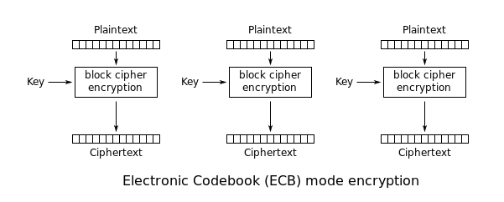
Electronic codebook mode (ECB)

Slide 58
Electronic codebook mode (ECB)
Secure? | Parallelizable | Forward | Error-resilient
No | yes | no | yes
Unless each block is different

Slide 59
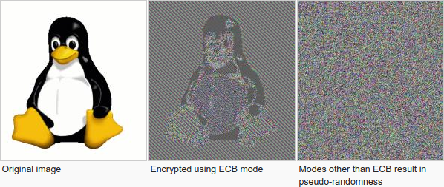
Problem with ECB mode

Slide 60
Counter mode (CM)
$Init()$
${nonce∈_{R}\left\{0,1\right\}}^{s/2}$
$S_{1}←(nonce,{\left\{0\right\}}^{s/2})$
$Output\left(m_{i},S_{i}\right)$
$c_{i}←Enc_{k}\left(S_{i}\right)⊕m_{i}$
$Update\left({m_{i}, s}_{i}\right)$
$s_{i+1}←s_{i}+1$

Slide 61
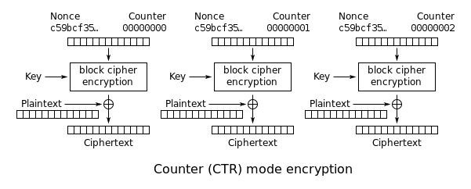
Counter mode (CM)

Slide 62
Counter mode
Secure? | Parallelizable | Forward | Error-resilient
Yes but | yes | yes | yes
IV security reduced by half

Slide 63
Cipher block chaining
$Init()$
$IV∈_{R}{\left\{0,1\right\}}^{s}$
$S_{1}←IV$
$Output\left(m_{i},S_{i}\right)$
$c_{i}←Enc_{k}\left(m_{i}⊕S_{i}\right)$
$Update\left({m_{i}, s}_{i}\right)$
$s_{i+1}←c_{i}$

Slide 64
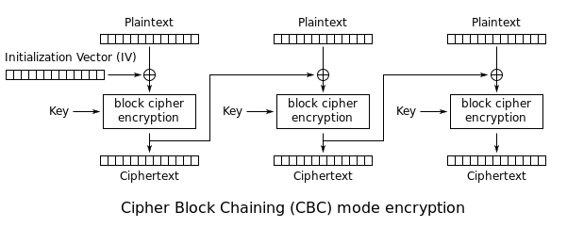
Cipher block chaining (CBC)

Slide 65
Cipher block chaining
Secure? | Parallelizable | Forward | Error-resilient
Yes | no | no | no

Slide 66
Computational message authentication code

Slide 67
Message authentication code
Prevents the adversary from tampering with the message
$keygen$: generates a key
$auth$(m) : creates a tag for the message
$verify$ (m,t): verifies that t is a valid tag for message m
Adversary cannot construct a tag for a message for which he has not already seen a tag

Slide 68
Mac forgery game
$$M ←\{\}$$
k $∈_{R}{\left\{0,1\right\}}^{s}$
$$m′$$
$$M←M∪\{m′\}$$
Repeat as many times
as the adversary wants
$$t′$$
$$t′ ←mac_{k}(m′)$$
$$(m,t)$$
Wins if
$m ∉M$
$verify\left(m,t\right)=1$

Slide 69
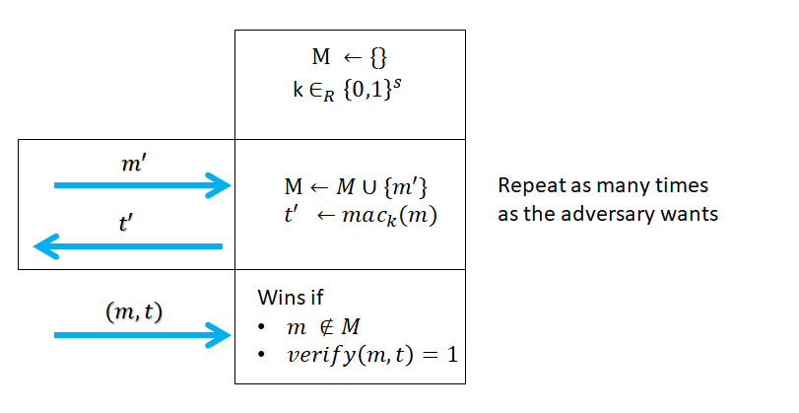
Mac forgery game
Allow the adversary to learn tags for as many message as he wants
A mac scheme is secure if
$\operatorname{Pr}\left[adv wins the forgery game\right]$ is very small

Slide 70
Does encryption imply authentication
Let’s take as example the one-time pad
What happens if the adversary flips a bit of the ciphertext?
Lesson: Encryption does not imply authentication

Slide 71
Fixed-length mac from PRF
Keygen
$k∈_{R}{\left\{0,1\right\}}^{n}$
Authenticate
m
m
$$F_{k}$$
t
t

Slide 72
Pitfalls of authenticating arbitrary length message
Add an index to each block and authenticate each block (cut and paste attack)
${\tilde{auth}}_{k}\left(m_{1},…,m_{n}\right) ≔auth\left(1,m_{1}\right),…,auth\left(n,m_{n}\right)$
$\left(t_{1},t_{2}\right)←auth\left(1,m_{1}\right),auth\left(2,m_{2}\right)$
$\left(t_{3},t_{4}\right)←auth\left(1,m_{3}\right),auth\left(2,m_{4}\right)$
$\left(t_{1},t_{4}\right)=auth\left(1,m_{1}\right), auth\left(2,m_{4}\right) ={\tilde{auth}}_{k}\left(m_{1},…,m_{n}\right)$
Buy x for 100, sell y for 10
Sell a for 10, sell y for 10
Buy a for 100, sell y for 10

Slide 73
CBC-mac (fixed-length extension)
$$Auth(m)$$
$m_{1},…,m_{d}←m$
$t_{0}←0^{n}$
For $i=1,…,d$
$t_{i}←F_{k}(t_{i−1}⊕m_{i})$
Output $t_{d}$
Insecure if we authenticate messages of different length
${M= m}_{1},…,m_{d}$ creates tag $t_{d}$
$M_{2}= m_{1},…,m_{d}, m_{d+1 }$ creates tag $t_{d+1}^{′}$
$M_{3}= (t_{d}, m_{d+1})$ creates tag $t_{d+1}^{′}$

Slide 74
Does authentication imply encryption?
No
Take any authentication scheme and modify the authentication algorithm to produce both the tag of the original scheme and the message it authenticated
The tag in this new scheme will leak the authenticated message
This scheme is still secure

