Slide 1
Introduction to modern cryptology
Samuel Ranellucci
Notes:
Défacne de these
Date
To many slides

Slide 2
Doing online Banking
How does the bank hide the information it sends you
$⇒$ Encryption
When you make a transfer, how can we verify
amount
Recipient
$⇒Authentication$
How does your password stay secret
Even if the hacker accesses the database of passwords
How do you know you are connecting with the bank’s website
How do you exchange a secret key with your bank

Slide 3
Private-key primitive
Encryption
Hide the message
Definition of authentication
Prevents tampering

Slide 4
Hash function
Map a string to a shorter string
Collision-resistance
Hard to find $(x,y)$ such that $H(x) =H(y)$
Useful to protect integrity of systems
Protect passwords

Slide 5
Collision resistance
$wins$ if
$$H\left(x\right)=H(x′)$$
$$x≠x′$$
$$x,x′$$

Slide 6
Storing passwords (salting)
Storing password (done for each entry)
Pick a random seed
Store (seed, $H(pwd || seed)$)
$|| ≔ concatenation$

Slide 7
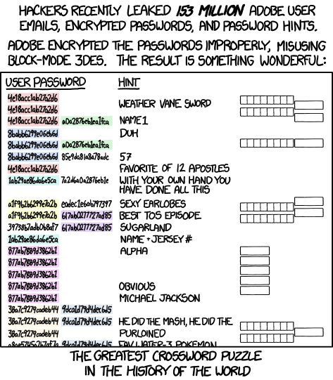
Bad way to hash passwords (xkcd)

Slide 8
File Integrity
How do you know that a file has not been tampered with?
Storage of hash
$h←H(file)$
Verification
$H(file) = h$

Slide 9
Virus fingerprinting
Hash the virus using the hash function
To lookup a virus, simply look at the output of the function and see if it maps to a known virus
False positives imply collision

Slide 10
Deduplication
Avoid storing the same thing in memory many times
Uses hash function to index values so that we don’t need to copy the same thing many times.

Slide 11
Authentication code for long messages
$Authentication$
$m^{′}←H(m)$
$t←auth_{k}(m′)$
Security
Secure as long as adversary doesn’t
Break security of the mac
Break security of the message authentication code

Slide 12
Key-exchange
Samuel Ranellucci
Notes:
Défacne de these
Date
To many slides

Slide 13
Key-exchange
Alice and Bob start with no shared key
Alice and Bob run key exchange
At the end of the protocol Alice and Bob share a secret key $k$
Passive eavesdropper learn no information about the key

Slide 14
Key-exchange
$$k$$
$$k$$
$$F_{key−exchange}$$
$$|k|$$
$≔$ secure channel

Slide 15
Diffie-Helman key exchange
Values
$g, n$
Operations
Modular exponentiation
2^3 (mod 5) = 8 (mod 5) = 3
Assumption
Hard to distinguish between
$\{g^{x},g^{y},g^{xy} | x,y∈_{R}\left[1,n\right]\}$
$\{g^{x},g^{y},r | x,y,r∈_{R}\left[1,n\right]\}$

Slide 16
Diffie-Hellman key-exchange
$x∈_{R}G$
$$g^{x}$$
y $∈_{R}G$
$$g^{y}$$
$k= {(g^{y})}^{x} =g^{xy}$
$k= {(g^{x})}^{y} =g^{xy}$

Slide 17
Security of Diffie-Hellman key-exchange
$x∈_{R}G$
$$k$$
$$k$$
y $∈_{R}G$
$$k←g^{xy}$$
$$g^{x},g^{y}, |k|$$

Slide 18
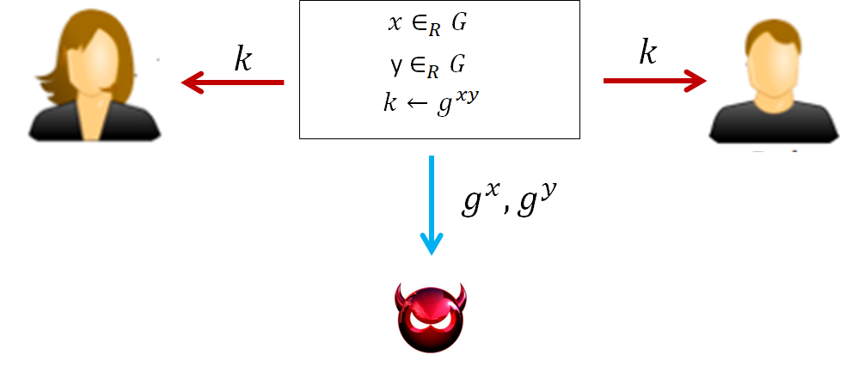
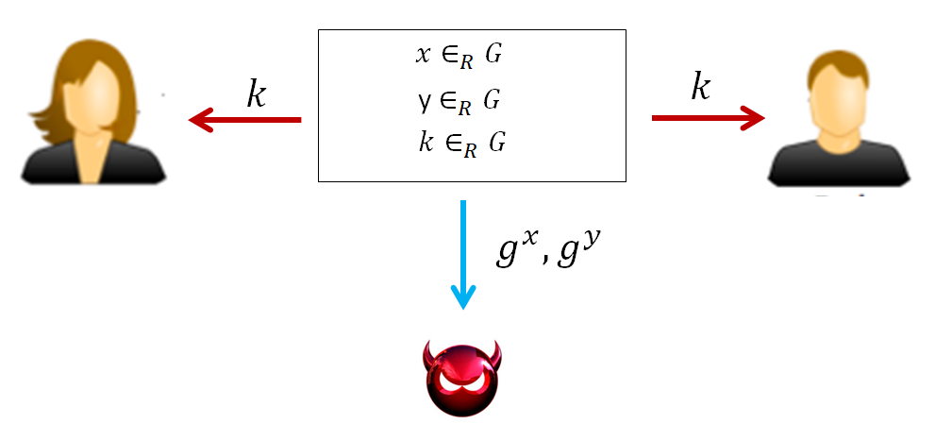
Security of Diffie-Hellman key-exchange
$$≈$$
$≔$ secure channel

Slide 19
Insecurity against man-in-the-middle adversary
$$g^{x}$$
$$g^{\overline{x}}$$
$x∈_{R}G$
$\overline{x}∈_{R}G$
y $∈_{R}G$
$\overline{y}∈_{R}G$
$$g^{\overline{y}}$$
$$g^{y}$$
$k_{1}= g^{x\overline{y}}$
$k_{1}= g^{x\overline{y}}$
$k_{2}= g^{\overline{x}y}$
$k_{2}= g^{\overline{x}y}$

Slide 20
Public key-encryption
How can people send encrypted messages to google, steam, your bank, even though they have never exchanged secret keys with those companies?
Public-key encryption allows you to do it
Public key is revealed publicly so that everyone can encrypt messages
Secret key is kept hidden and only the owner is allowed is able to decrypt the ciphertext

Slide 21
Public-key encryption
The Gen algorithm takes security parameter $1^{s}$ and outputs both a secret key and a public key
The encrypt algorithm takes a public key $pk$ and a message $m$ and outputs a ciphertext $c$
The decrypt algorithm takes a secret key $sk$ and a ciphertext $c$ and outputs the message m

Slide 22
Formal definition
$Gen\left(1^{s}\right)→(sk,pk)$
$Enc_{pk}\left(m\right)→c$ where $m∈M, c∈C$
$Dec_{sk}\left(c\right)→m$ where $m∈M, c∈C$
Correctness:
$Pr[{Dec}_{sk}\left(Enc_{pk}\left(m\right)\right) =m | \left(sk,pk\right)←Gen\left(1^{s}\right)]=1$

Slide 23
Chosen-plaintext security
$$pk$$
$$pk$$
$$\left(sk,pk\right)←Gen(1^{s})$$
$$\left(sk,pk\right)←Gen(1^{s})$$
$$m_{0},m_{1}$$
$$m_{0},m_{1}$$
c
$$c←Enc_{pk}(m_{0})$$
c
$$c←Enc_{pk}(m_{1})$$
$$≈$$
m
m
c
$$c←Enc_{pk}(m)$$
c
$$c←Enc_{pk}(m)$$
Repeat as many times as the distinguisher wants
Repeat as many times as the distinguisher wants
$$G_{0}$$
$$G_{1}$$

Slide 24
Key-encapsulation
Why not use public-key encryption to encrypt long messages?
Public-key encryption is hundreds to thousand of times slower than private key-encryption
Key-encapsulation attempts to combine the properties of a public key encryption with the speed of private key-encryption

Slide 25
Key-encapsulation (hybrid-encryption)
$Gen,Enc_{pk},Dec_{sk}$ is a public-key encryption
$Enc_{k},Dec_{k}$ is a private key encryption
$$k∈_{R}{\left\{0,1\right\}}^{n}$$
$$m$$
$$c_{1}←Enc_{pk}(k)$$
$$(c_{1},c_{2})$$
$$(c_{1},c_{2})$$
$$k←Dec_{sk}(c_{1})$$
$$m$$
$$c_{2}←Enc_{k}(m)$$
$$m←Dec_{k}(c_{2})$$
$$Enc$$

Slide 26
What is a digital signature
A digital signature allows the holder of the secret key (the signing key) to sign a document
Everyone who knows the verification key can verify that the signature is valid (correctness)
No one can forge a signature even given the verification key even though he is given a signature

Slide 27
Structure of digital signature
$Gen\left(1^{n}\right) → (sk,vk)$
${Sign}_{sk}\left(m\right) → sig$
$Ver_{vk}\left(m,sig\right)→ \{0,1\}$

Slide 28
Structure of digital signature scheme (DSS)
$Gen\left(1^{n}\right) → (sk,vk)$
${Sign}_{sk}\left(m\right) → sig$
$Ver_{vk}\left(m,sig\right)→ \{0,1\}$
Correctness
$Ver_{vk}\left(m,Sign_{sk}(m)\right)=1$
Unforgeability
Cannot create a signature for a new message without the signing key

Slide 29
DSS VS MAC
$Gen\left(1^{n}\right) → (sk,vk)$
${Sign}_{sk}\left(m\right) → sig$
$Ver_{vk}\left(m,sig\right)→ \{0,1\}$
$Gen\left(1^{n}\right) → k$
${mac}_{k}\left(m\right) → t$
$ver_{k}\left(m,t\right)→ \{0,1\}$

Slide 30
Certifying a website is correct
Each website will have a certificate saying that this website is the correct
What is a certificate?
Some information and a signature that say’s that this information is correct

Slide 31
Validating updates
How do we know that updates from Microsoft, Google, Adobe, … are valid
Microsoft, Google, Adobe sign their updates

Slide 32
Secure Credit cards
Credit card has two signatures
One which is used by the card to sign transactions
The other signature comes from the bank saying that the information on the card is real
Includes the verification key for the cards signature
The chip in your credit cards

Slide 33
Summary of what we have seen
Private-key Encryption
Message authentication code
Hash functions
Public-key Encryption
Signatures

Slide 34
Doing online Banking
How does the bank hide the information it sends you
$⇒$ Encryption
When you make a transfer, how can we verify
amount
Recipient
$⇒$ Authentication
How does your password stay secret
Even if the hacker accesses the database of passwords
$⇒$ Hashing
How do you know you are connecting with the bank’s website
$⇒$ Digital signature
How do you exchange a secret key with your bank
$⇒$ Public Key encryption

Slide 35
How to not f*%k up cryptography
DO NOT CREATE YOUR OWN CRYPTO ALGORITHM
Would you trust a butcher to do heart surgery
Would you trust a butcher to design a cornary surgical procedure
Cryptocurrency: IOTA tried to make their own hash function, trivially broken

Slide 36
How to not f*%k up cryptography
DON’T USE ANTIQUATED CRYPTO
Encryption
DES
RC4
3DEX
Hash functions
SHA1
MD5

Slide 37
How to not f*%k up cryptography
DON’T IMPLEMENT CRYPTO
Side Channel attacks
Non-constant time code
Bugs

Slide 38
How to not f*%k up cryptography
IF YOU DO IMPLEMENT CRYPTO, FOLLOW THE DAMN STANDARD
In particular, if the standard say’s generate two random primes, don’t generate primes from some weird distribution
All Estonian national voting cards and Microsoft identity cards had to be revoked

Slide 39
How to not f*%k up cryptography
USE LONG ENOUGH KEYS AND DON’T USE BAD MODES OF ENCRYPTION
Don’t use ECB
Often the standard in some libraries
Larry Page (Google) was being impersonated by someone who figured out that google was using signing keys that were too short (changed very quickly)

Slide 40
How to not f*%k up cryptography
SEED AND HASH PASSWORDS

