Slide 1

Lecture 10.1
Time Series (Dis)Similarity
(Dynamic Time Warping)
CMSC 818W : Spring 2019
Tu-Th 2:00-3:15pm
CSI 2118
Nirupam Roy
Apr. 25th 2019

Slide 2
Similarity between two time series
Signal A:
Signal B:

Slide 3
Similarity between two time series: Euclidian distance
(a1, a2)
Sqrt((a1-b1)² + (a2-b2)² )
(b1, b2)

Slide 4

Similarity between two time series: Euclidian distance
N number of points
Signal A:
Signal B:
Euclidian distance:

Slide 5
Similarity between two time series: Euclidian distance
N number of points
Signal A:
Signal B:
Euclidian distance:

Slide 6
Similarity between two time series: Euclidian distance
Euclidian distance

Slide 7
Similarity between two time series: Euclidian distance
Desired approach

Slide 8
Similarity between two time series: Euclidian distance
Desired approach

Slide 9
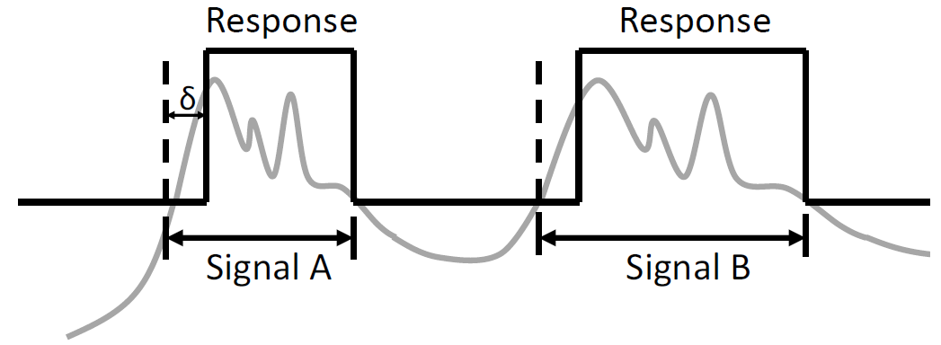
Similarity between two time series: Applications

Slide 10
Similarity between two time series: Applications
Citation:

Slide 11
Similarity between two time series: Applications

Slide 12
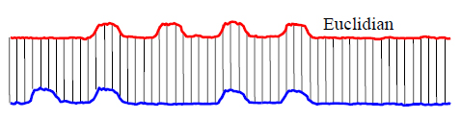
Similarity between two time series: Euclidian distance

Slide 13
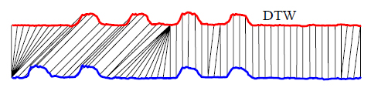
Dynamic Time Warping

Slide 14
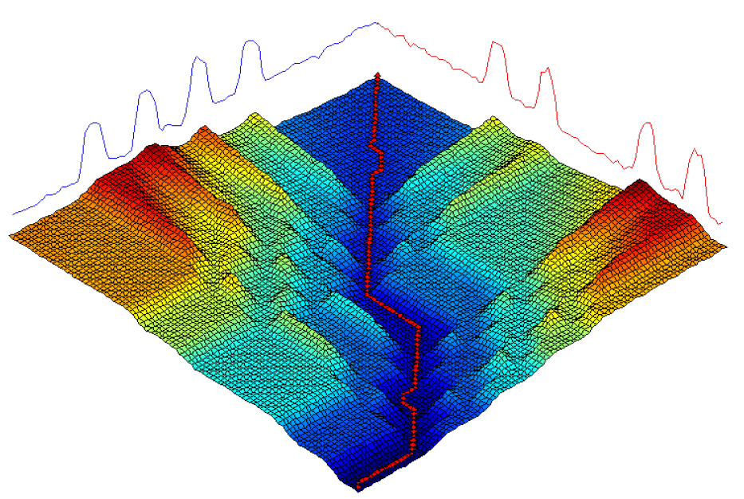
Dynamic Time Warping
Slides by Quim Llimona Torras https://lemonzi.files.wordpress.com/2013/01/dtw.pdf

Slide 15
DTW : An example
[Citation] Slides take from Thales Sehn Körting https://www.youtube.com/watch?v=_K1OsqCicBY

Slide 16
3
7
5
1
2
8
9
4
3
1
1 | 6 | 2 | 3 | 0 | 9 | 4 | 3 | 6 | 3

Slide 17
3
7
5
1
2
8
9
4
3
1
1 | 6 | 2 | 3 | 0 | 9 | 4 | 3 | 6 | 3

Slide 18
|Ai-Bj| + min{ D[i-1,j-1],
D[i-1,j],
D[i,j-1]}
3
7
5
1
2
8
9
4
3
1
33
31
25
21
21
20
13 | 7 | 11 | 11
5 | 4 | 5 | 5 | 8 | 12 | 12 | 13 | 15 | 16
2 | 3 | 4 | 4 | 7 | 13 | 14 | 14 | 17 | 17
0 | 5 | 6 | 8 | 9 | 17 | 20 | 22 | 27 | 29
|9-3| + min{ 5, 5, 11}
= 6 + 5
= 11
A _{i}
1 | 6 | 2 | 3 | 0 | 9 | 4 | 3 | 6 | 3
B _{j}

Slide 19
min{ D[i-1,j-1],
D[i-1,j],
D[i,j-1]}
3
7
5
1
2
8
9
4
3
1
33 | 23 | 19 | 16 | 19 | 23 | 18 | 17 | 18 | 15
31 | 20 | 18 | 16 | 19 | 17 | 17 | 18 | 15 | 18
25 | 19 | 13 | 12 | 16 | 15 | 14 | 15 | 14 | 16
21 | 18 | 10 | 11 | 11 | 19 | 14 | 13 | 17 | 18
21 | 13 | 9 | 10 | 12 | 16 | 11 | 12 | 16 | 17
20 | 9 | 13 | 16 | 19 | 9 | 12 | 17 | 18 | 21
13 | 7 | 11 | 11 | 14 | 8 | 13 | 18 | 16 | 21
5 | 4 | 5 | 5 | 8 | 12 | 12 | 13 | 15 | 16
2 | 3 | 4 | 4 | 7 | 13 | 14 | 14 | 17 | 17
0 | 5 | 6 | 8 | 9 | 17 | 20 | 22 | 27 | 29
A _{i}
1 | 6 | 2 | 3 | 0 | 9 | 4 | 3 | 6 | 3
B _{j}

Slide 20
min{ D[i-1,j-1],
D[i-1,j],
D[i,j-1]}
3
7
5
1
2
8
9
4
3
1
33 | 23 | 19 | 16 | 19 | 23 | 18 | 17 | 18 | 15
31 | 20 | 18 | 16 | 19 | 17 | 17 | 18 | 15 | 18
25 | 19 | 13 | 12 | 16 | 15 | 14 | 15 | 14 | 16
21 | 18 | 10 | 11 | 11 | 19 | 14 | 13 | 17 | 18
21 | 13 | 9 | 10 | 12 | 16 | 11 | 12 | 16 | 17
20 | 9 | 13 | 16 | 19 | 9 | 12 | 17 | 18 | 21
13 | 7 | 11 | 11 | 14 | 8 | 13 | 18 | 16 | 21
5 | 4 | 5 | 5 | 8 | 12 | 12 | 13 | 15 | 16
2 | 3 | 4 | 4 | 7 | 13 | 14 | 14 | 17 | 17
0 | 5 | 6 | 8 | 9 | 17 | 20 | 22 | 27 | 29
A _{i}
1 | 6 | 2 | 3 | 0 | 9 | 4 | 3 | 6 | 3
B _{j}

Slide 21
DTW : An example

Slide 22
min{ D[i-1,j-1],
D[i-1,j],
D[i,j-1]}
3
7
5
1
2
8
9
4
3
1
33 | 23 | 19 | 16 | 19 | 23 | 18 | 17 | 18 | 15
31 | 20 | 18 | 16 | 19 | 17 | 17 | 18 | 15 | 18
25 | 19 | 13 | 12 | 16 | 15 | 14 | 15 | 14 | 16
21 | 18 | 10 | 11 | 11 | 19 | 14 | 13 | 17 | 18
21 | 13 | 9 | 10 | 12 | 16 | 11 | 12 | 16 | 17
20 | 9 | 13 | 16 | 19 | 9 | 12 | 17 | 18 | 21
13 | 7 | 11 | 11 | 14 | 8 | 13 | 18 | 16 | 21
5 | 4 | 5 | 5 | 8 | 12 | 12 | 13 | 15 | 16
2 | 3 | 4 | 4 | 7 | 13 | 14 | 14 | 17 | 17
0 | 5 | 6 | 8 | 9 | 17 | 20 | 22 | 27 | 29
A _{i}
1 | 6 | 2 | 3 | 0 | 9 | 4 | 3 | 6 | 3
B _{j}

Slide 23
DTW : An example

Slide 24
DTW : An example

Slide 25
DTW : An example

Slide 26
DTW : Recap
Reference: http://www.cs.ucr.edu/~eamonn/KAIS_2004_warping.pdf

Slide 27
DTW : Recap

Slide 28
DTW : Recap
|Ai-Bj| + min{ D[i-1,j-1],
D[i-1,j],
D[i,j-1]}
3
7
5
1
2
8
9
4
3
1
33
31
25
21
21
20
13 | 7 | 11 | 11
5 | 4 | 5 | 5 | 8 | 12 | 12 | 13 | 15 | 16
2 | 3 | 4 | 4 | 7 | 13 | 14 | 14 | 17 | 17
0 | 5 | 6 | 8 | 9 | 17 | 20 | 22 | 27 | 29
|9-3| + min{ 5, 5, 11}
= 6 + 5
= 11
A _{i}
1 | 6 | 2 | 3 | 0 | 9 | 4 | 3 | 6 | 3
B _{j}

Slide 29
min{ D[i-1,j-1],
D[i-1,j],
D[i,j-1]}
3
7
5
1
2
8
9
4
3
1
33 | 23 | 19 | 16 | 19 | 23 | 18 | 17 | 18 | 15
31 | 20 | 18 | 16 | 19 | 17 | 17 | 18 | 15 | 18
25 | 19 | 13 | 12 | 16 | 15 | 14 | 15 | 14 | 16
21 | 18 | 10 | 11 | 11 | 19 | 14 | 13 | 17 | 18
21 | 13 | 9 | 10 | 12 | 16 | 11 | 12 | 16 | 17
20 | 9 | 13 | 16 | 19 | 9 | 12 | 17 | 18 | 21
13 | 7 | 11 | 11 | 14 | 8 | 13 | 18 | 16 | 21
5 | 4 | 5 | 5 | 8 | 12 | 12 | 13 | 15 | 16
2 | 3 | 4 | 4 | 7 | 13 | 14 | 14 | 17 | 17
0 | 5 | 6 | 8 | 9 | 17 | 20 | 22 | 27 | 29
A _{i}
1 | 6 | 2 | 3 | 0 | 9 | 4 | 3 | 6 | 3
B _{j}

Slide 30
DTW : An example

Slide 31
DTW : Complexity
What is the complexity of DTW algorithm?

Slide 32
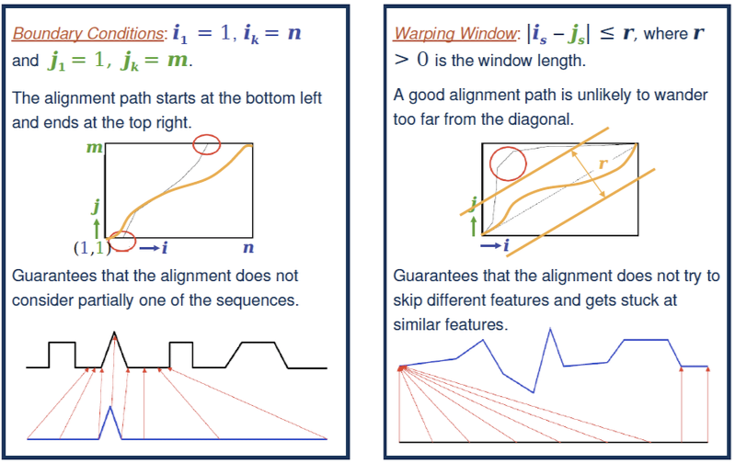
DTW : Constraints
Slides by Quim Llimona Torras https://lemonzi.files.wordpress.com/2013/01/dtw.pdf

Slide 33
DTW : Warping Window

Slide 34
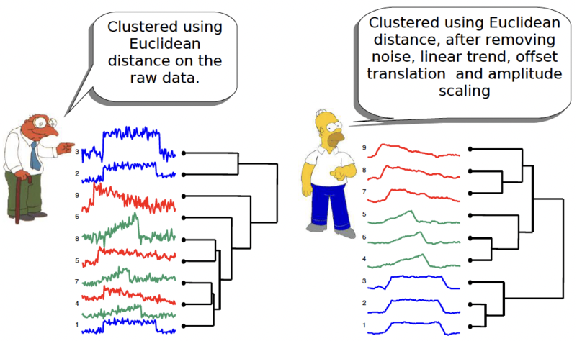
DTW : Preprocessing

Slide 35
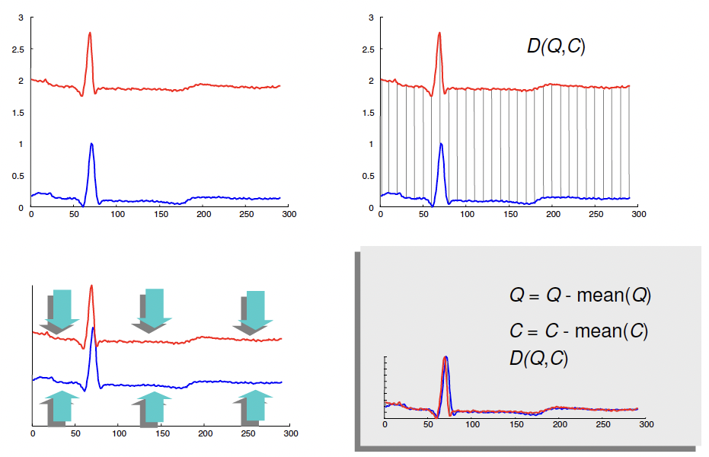
DTW : Preprocessing – Remove DC offset

Slide 36
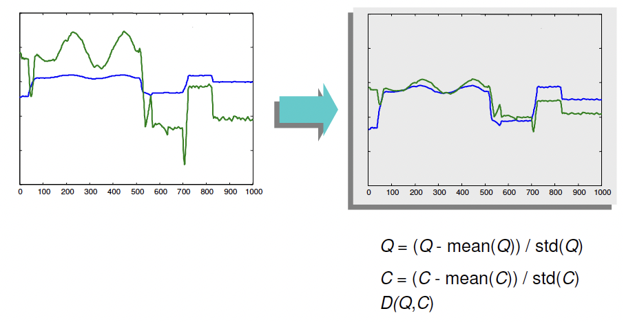
DTW : Preprocessing – Adjust amplitude

Slide 37
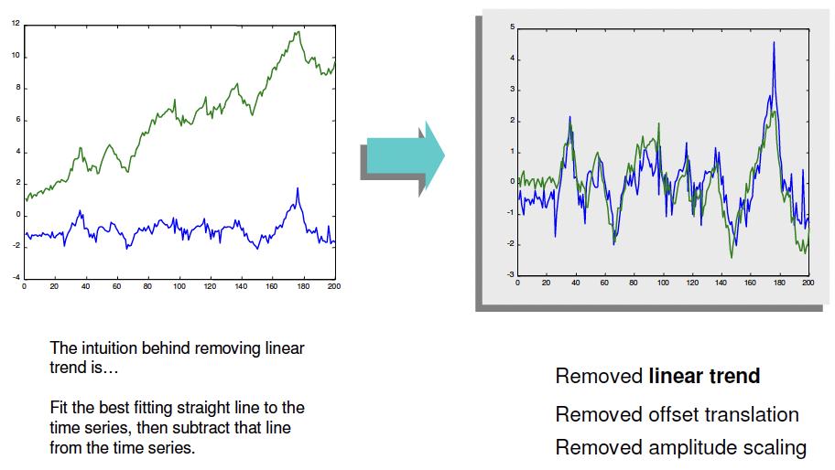
DTW : Preprocessing – Remove linear trend

Slide 38
Extra slides

Slide 39
3
7
5
1
2
8
9
4
3
1
1 | 6 | 2 | 3 | 0 | 9 | 4 | 3 | 6 | 3

Slide 43
3
7
5
1
2
8
9
4
3
1
33
31
25
21
21
20
13 | 7 | 11 | 11
5 | 4 | 5 | 5 | 8 | 12 | 12 | 13 | 15 | 16
2 | 3 | 4 | 4 | 7 | 13 | 14 | 14 | 17 | 17
0 | 5 | 6 | 8 | 9 | 17 | 20 | 22 | 27 | 29
A _{i}
1 | 6 | 2 | 3 | 0 | 9 | 4 | 3 | 6 | 3
B _{j}

Slide 44
3
7
5
1
2
8
9
4
3
1
33 | 23 | 19 | 16 | 19 | 23 | 18 | 17 | 18 | 15
31 | 20 | 18 | 16 | 19 | 17 | 17 | 18 | 15 | 18
25 | 19 | 13 | 12 | 16 | 15 | 14 | 15 | 14 | 16
21 | 18 | 10 | 11 | 11 | 19 | 14 | 13 | 17 | 18
21 | 13 | 9 | 10 | 12 | 16 | 11 | 12 | 16 | 17
20 | 9 | 13 | 16 | 19 | 9 | 12 | 17 | 18 | 21
13 | 7 | 11 | 11 | 14 | 8 | 13 | 18 | 16 | 21
5 | 4 | 5 | 5 | 8 | 12 | 12 | 13 | 15 | 16
2 | 3 | 4 | 4 | 7 | 13 | 14 | 14 | 17 | 17
0 | 5 | 6 | 8 | 9 | 17 | 20 | 22 | 27 | 29
1 | 6 | 2 | 3 | 0 | 9 | 4 | 3 | 6 | 3

