Slide 1
CarSpeak:
A Content-Centric Network for Autonomous Driving
~ Presented by ~
Michael Reininger and Yuval Reiss
Lixin Shi, Stephanie Gil, Nabeel Ahmed, Dina Katabi, and Daniela Rus

Slide 2
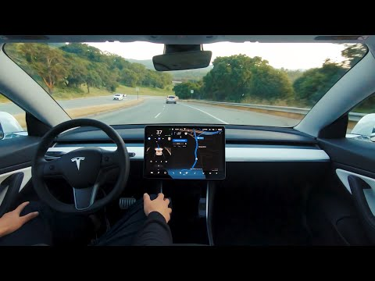
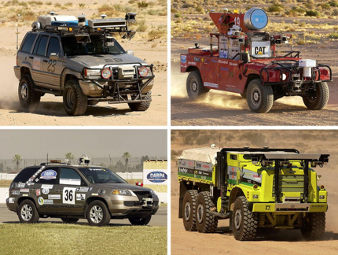
Where We Are Now
Consumer-grade self-driving vehicles are a reality (partial and conditional autonomy)
Ongoing research into more efficient, productive and cost-effective autonomous vehicles would save $100B/yr in the US [WPI ‘07].

Slide 3
Key Challenge
Autonomous vehicles need detailed, realtime information from on-board sensors.
These sensors (eg. laser rangefinder) strictly provide 3D-point-cloud information of nearby, line-of-sight objects.
  Settings: busy campus, downtown, etc.
What about hidden, non-line-of-sight objects?
Notes:
Yuval

Slide 4
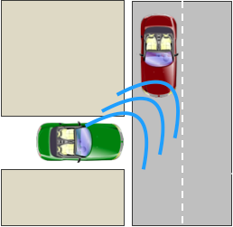
General Solution & Vision
Nearby vehicles can communicate with each other via wireless.
Exchange their own collected sensor data as well as sensor data that they are “interested” in.
Notes:
Yuval

Slide 5
Novelty of System
Prior work focuses on:
  Perception (sensing), efficient path planning, obstacle detection, etc.
  Uses Vehicular ad-hoc nets (VANETs) for efficient routing, reliable delivery of emergency messages, and detecting risks.
This work focuses on:
  Designing a communication protocol for sharing sensor data between autonomous vehicles, depending on the needs of the application.
  Redesigns the MAC protocol for resource sharing of objects at multi-resolution.
    Adopts CCN approach where endpoints communicate based on named data instead of IP addresses.

Slide 6
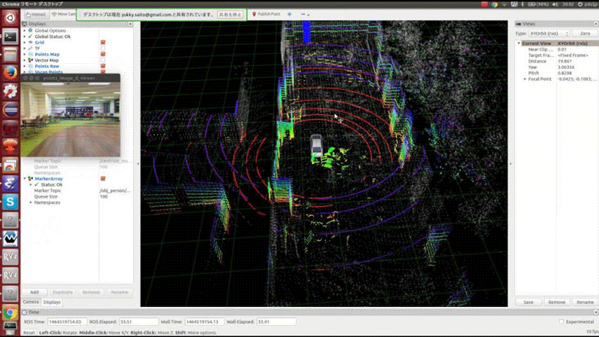
Existing Approach
Autonomous vehicles already collect local sensor data about the environment around them.
  This is accomplished via ranging sensors that measure the distance between the vehicle and objects around it.
  Robot Operating System (ROS) enables pub/sub mechanism for sensor data collection and sharing (eg. /sensor_data).
Notes:
Yuval

Slide 7
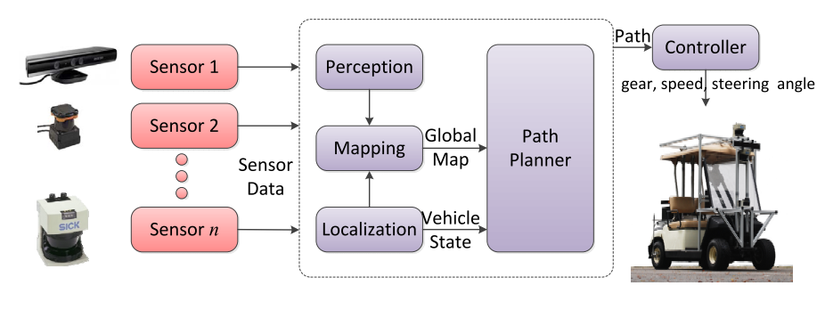
Autonomous Vehicle Architecture
Raw sensor data is transformed into a generic sensor format (eg. 3D-point cloud).
    <(x, y, z)-coords, t> of points on the surface of obstacles + ts.
Find obstacle-free path for vehicle.
    Perception (subs: point cloud) → pubs: obstacle detection
    Localization → pubs: position, via GPS, odometry or other sensors
    Mapper (subs: localization/perceptron) → pubs: map with obstacles
    Path planner (subs: localization and mapper) → pubs: path

Slide 8
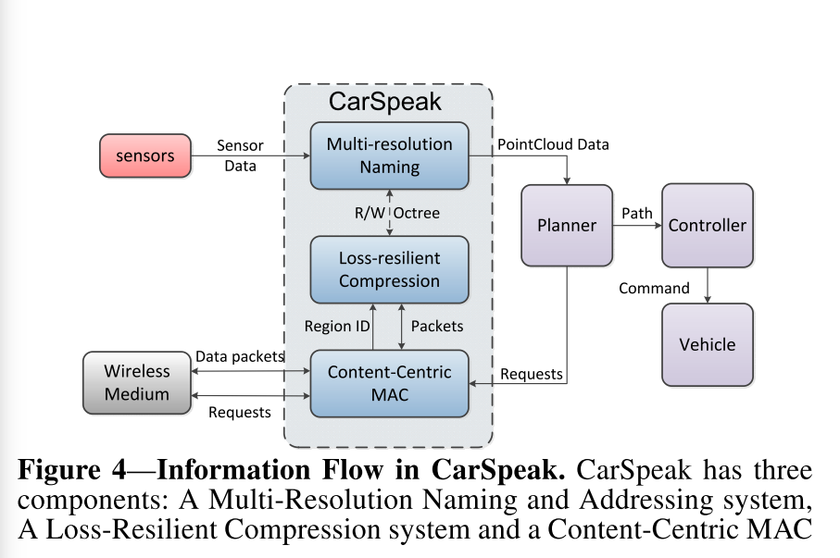
CarSpeak Life-cycle
CarSpeak receives raw sensor data from other vehicles such that the planner ingests data from other vehicles as if the receiving vehicle collected the data itself.
  CarSpeak subs to /query_region → planner pubs region requests here
  CarSpeak transmits requests to other vehicles
CarSpeak pubs to /car_speak → planner subs here for region responses.
Notes:
Yuval

Slide 9
Best-Effort Communications
CarSpeak tries to use the all bandwidth to send as much relevant sensor data as possible.
Three components:
  1. Content-Centric MAC:
    Subs: region-requests from planner
    Pubs: requests on medium
  2. Multi-Resolution Naming and Addressing Scheme:
    Subs: 3D-point cloud information from local sensors
    Builds: Octree-representation of data
    Pubs: Updates to the Octree from external data as 3D-Point to /car_speak
  3. Loss-Resilient Compression System:
    Triggered by MAC
    Generates compressed data packets for transmission
    Decodes received data packets to insert into Octree

Slide 10
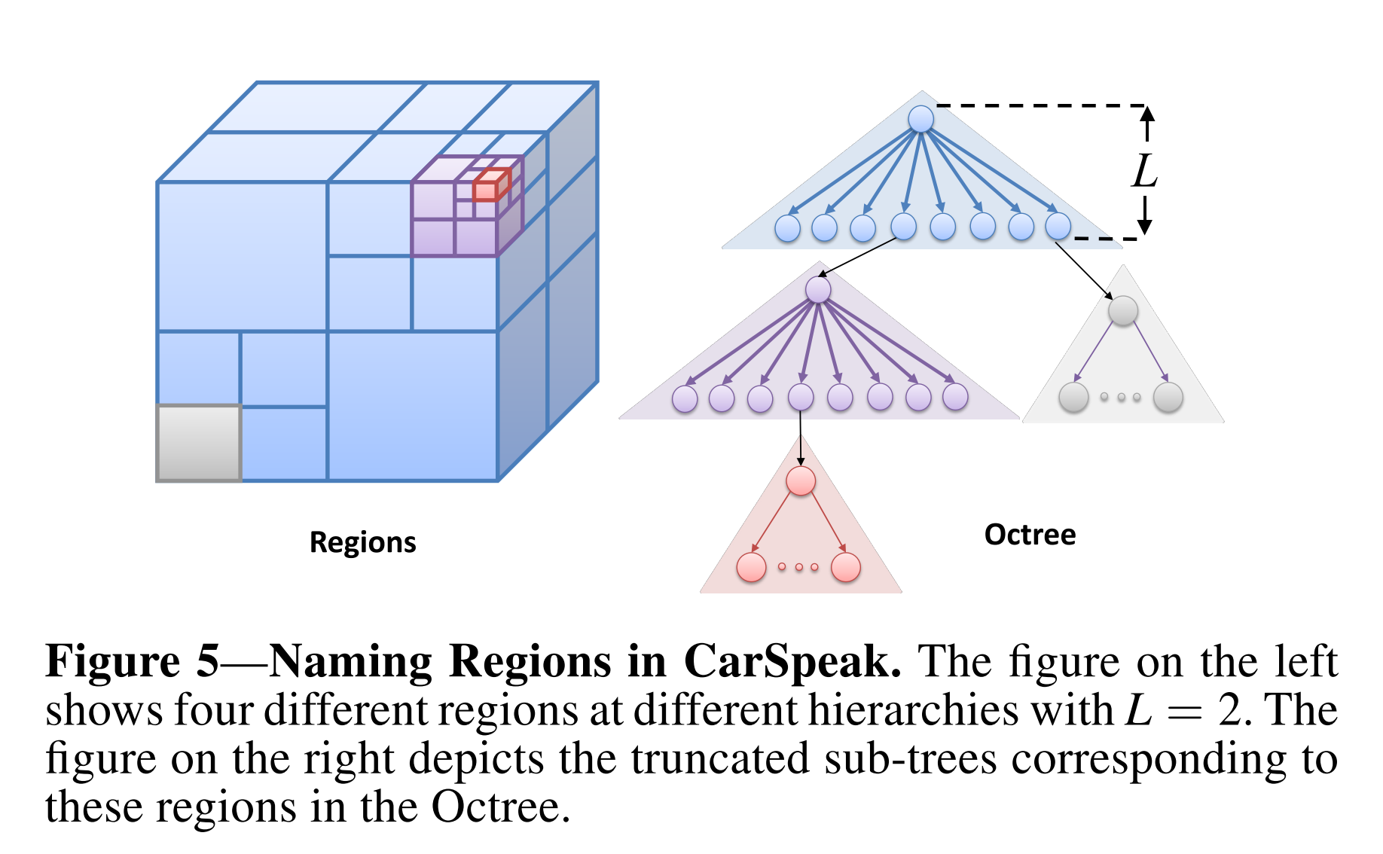
Octree
CarSpeak divides the world recursively into cubes, where smaller cubes provide finer descriptions of the encompassing cube.
  Root cube is world; everyone concurs with this.
  Regions are named by referring to the root of the region’s sub-tree, based on the depth from the root of the region’s sub-tree.
Octree data structure (common in 3D graphics)
  Storage is efficient since each car needs to only know the Octree in its neighborhood.
Notes:
Yuval

Slide 11
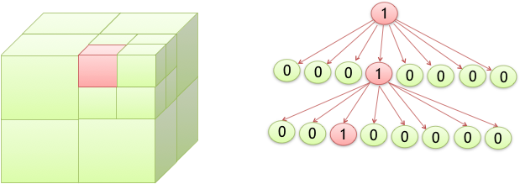
Multi-Resolution Naming
Sharing information across vehicles requires a specific naming system.
3 types of nodes:
  Occupied: point-cloud representation has points (ie. object is obstructing)
  Unoccupied: no points within the cube (ie. car can drive through it)
  Unknown: not enough information (yet) to discern
Parent is occupied if any of its descendents are occupied. Parent is unoccupied if all of its descendants are unoccupied. Else, parent is unknown.
Benefits: Facilitates requesting and accessing sensory data at different resolutions. Compresses the data for storage and transmission.
  Example: only need to send root of sub-tree if entire sub-tree is occupied/unoccupied.
Notes:
Yuval

Slide 12
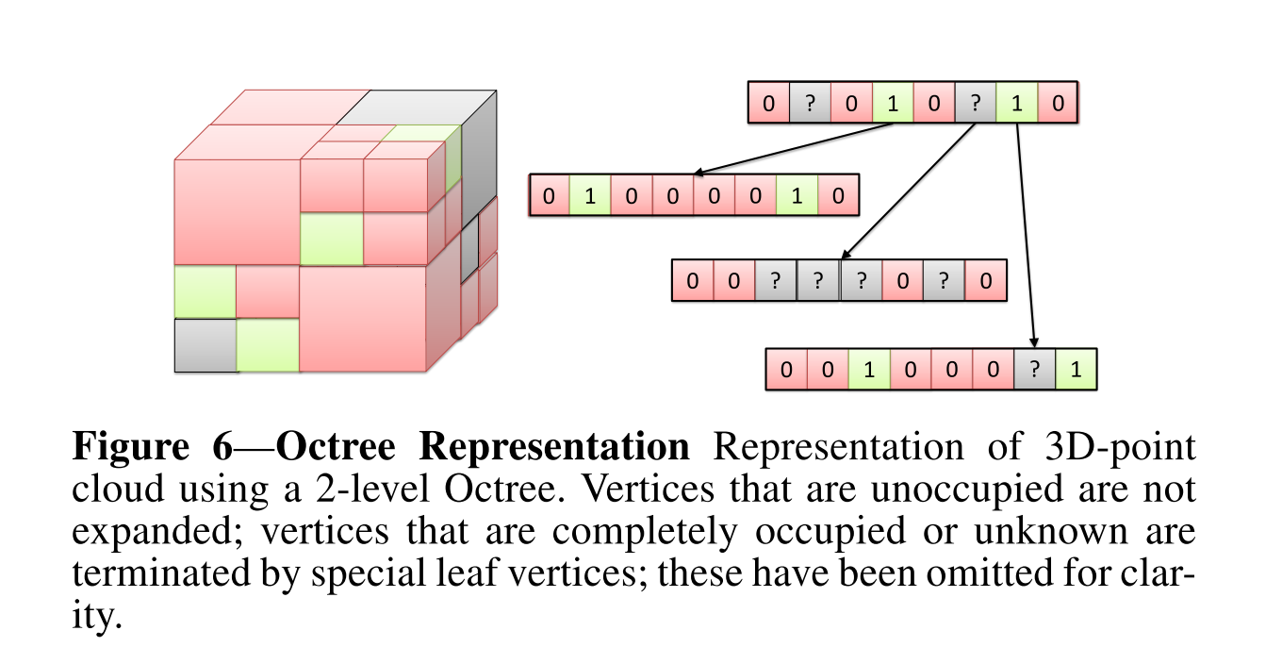
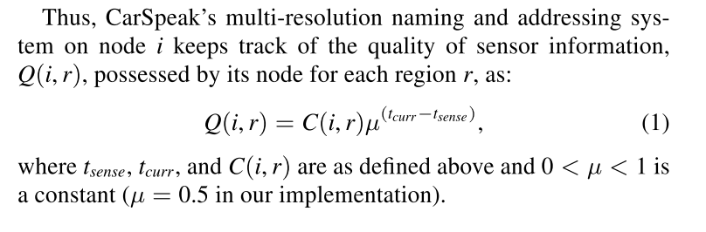
Retrieving and Maintaining Information Quality
Multi-resolution naming and addressing module fuses data from local and other vehicles’ sensor data.
  Each node has a time_stamp field set to the most recent sensor information stored in this cube.
  Garbage collection thread periodically traverses Octree removes expired (older than current time + E) vertices.
Sensor data quality is ranked based on two factors: time and completeness.
  μ^{(t curr - t sense)}: More recent sensor data → higher quality
  C(i,r): More complete the info about a node is → higher quality

Slide 13
Loss-Resilient Compression
3D-point cloud data can be very redundant, especially when occupied/unoccupied/unknown cubes tend to be co-located/near each other → significant overlap.
  1) Low computational overhead
  2) Not require cars to track how their information relates to each other
  3) Should be resilient to packet loss.
Can a compression algorithm be taken from the graphics community (specific to Octrees)? YES!
  1) Computationally efficient because it is linear in the size of the region’s Octree
  2) Robust to losses because each packet is self-contained
  3) Packets received from different cars that sense the same region have minimal overlap because at any point in time, they transmit different parts of the region’s Octree
  4) Unequal error protection because the transmitted subtrees contain paths of all vertices to the root of the region.
Bottom line: vertices at higher levels in the tree are less likely to be lost than vertices at lower levels → loss of a packet leads to loss of resolution rather than a complete loss of information.

Slide 14
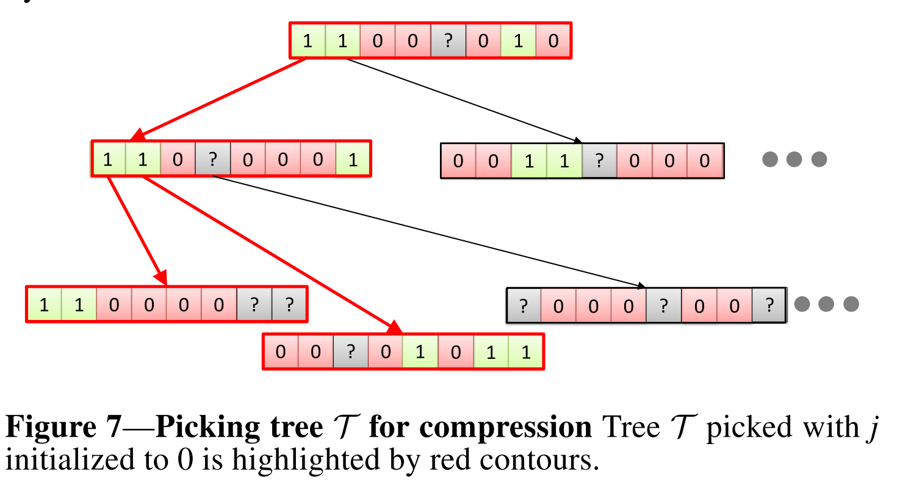
Compression Algorithm via Random Walks
Input:
r ← region requested
O_{r} ← truncated sub-tree in the Octree corresponding to r.
v_{o}, v₁, …, v_{K-1} denotes the leaf vertices.
j ← random integer [0, K-1]
T ← empty tree
Algorithm:
Add vertex v_{j} to tree T as well as all its ancestors tracing all the way to root O_{r}.
Set j ← j + 1 and repeat step (1), while the encoding of T fits within the maximum size of the packet.
Notes: Algorithm writes Octree encoding of T and transmits it. If two packets are generating the same region, the one with the more recent timestamp will have the more current information. Less chance of transmitting an overlapped sensor data packet of the same region since nodes pick different random seeds. Can be improved by using predictive coding. If one car transmits → eventually finishes walk. If multiple cars transmit → overlap is minimum.

Slide 15
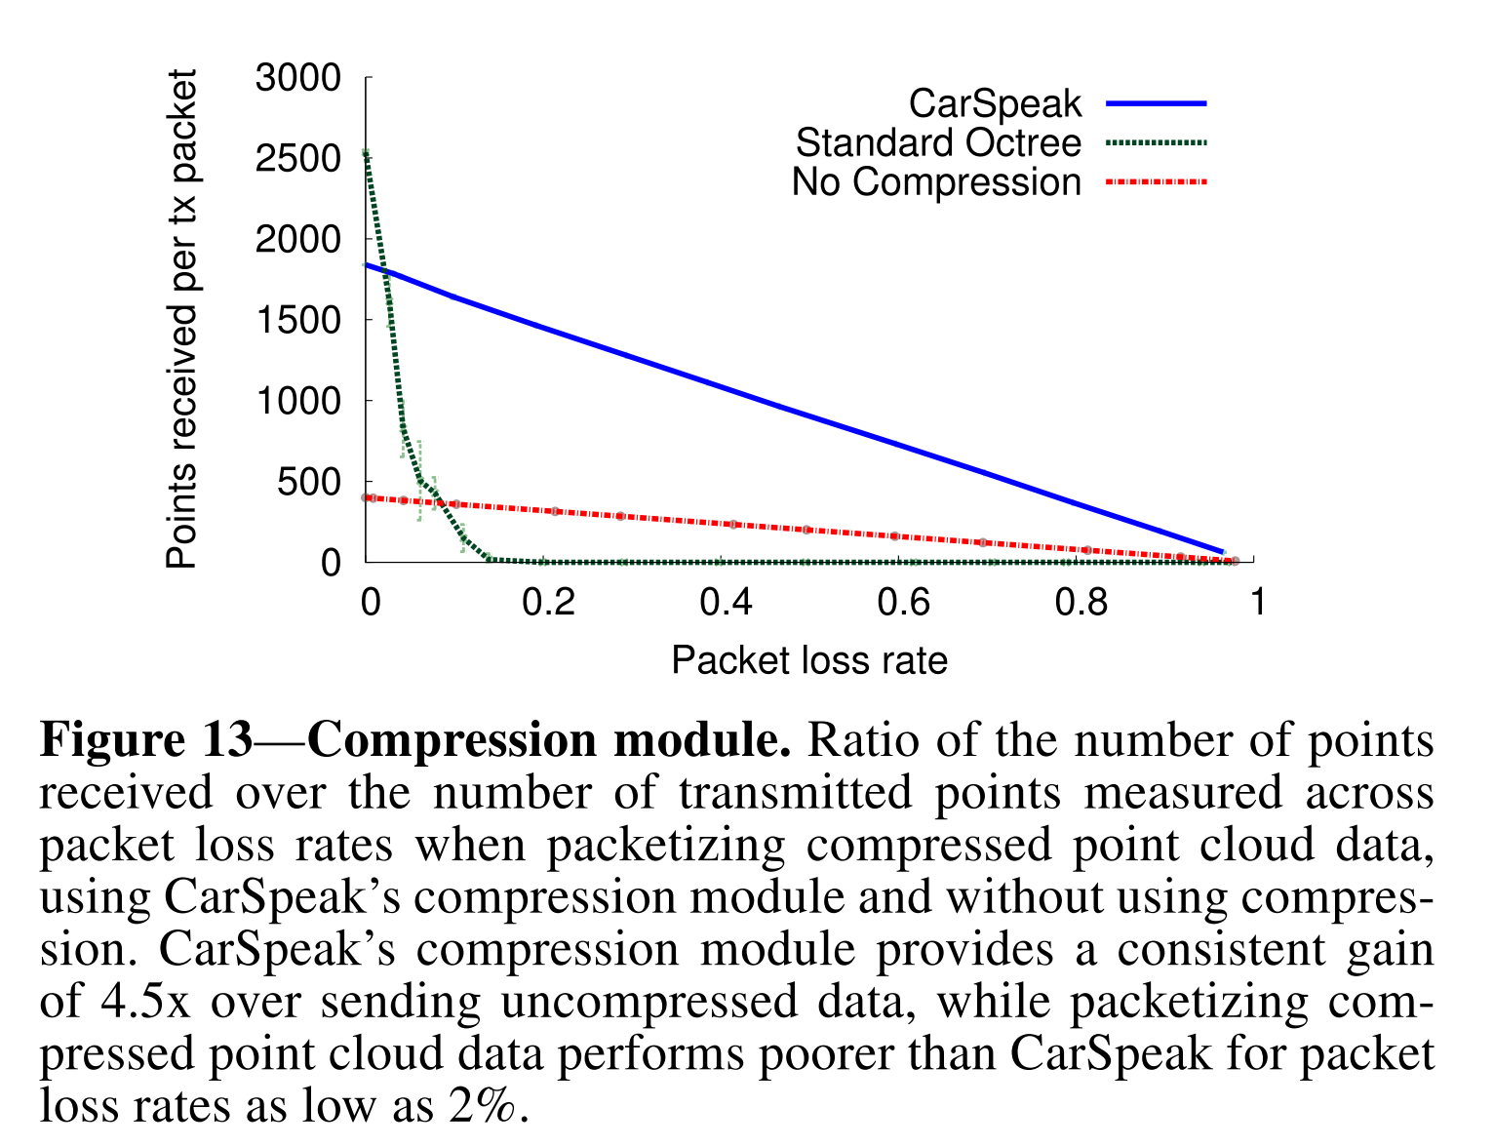
Compression Results
Authors verify algorithm in a typical outdoor setting with several buildings and obstacles.
  Make use of the Kinect sensors to receive depth information (collected during the afternoon when it’s not sunny).
Comparing to CarSpeak, they varied distance between robots to achieve wide range of loss rates using:
  No Compression: 3D-point cloud transmitted without compression but with random sub-sampling.
  Standard Octree Compression: 3D-point cloud data from environment obtained from the sensor at regular intervals is compressed using the standard Octree compression algorithm (not discussed), subsequently broadcasting the packets.

Slide 16
Content Centric MAC: What is it?
CarSpeak adopts a Content-Centric MAC (Medium Access Control)
  Regions instead of senders (the cars) are the ones contending for the medium.
But how does a region contend for medium?
  The MAC tracks region requests and allocates each region with a share proportional to the amount of requests for that region.
  The MAC tracks how many transmissions a node makes based on the quality of the information a node has about a region.
Notes:
Yuval

Slide 17
Content Centric MAC: Tracking Region Requests
Internal Requests:
  When the MAC receives requests from it’s own car it broadcasts them to other vehicles, and keeps track of those requests, timing them out after a minute. When region packets arrive, the MAC checks whether they answer any previous requests, and if so sends them to the compressions model for decoding
External Requests:
  The MAC listens for any requests made for various regions, and when a vehicle receives a request for a certain region, the MAC increments the request count for that region which in turn will cause the MAC to transmit more information about that region.
Notes:
Yuval

Slide 18
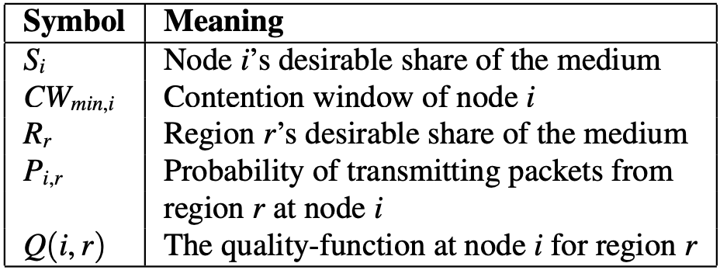
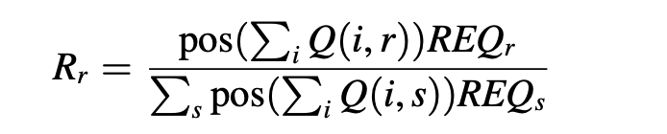
Content Centric MAC: Region Contention
Carspeak’s goal is to share the medium among regions proportionally to the number of requests they recieve, the more requests for a specific region the more transmissions are sent describing that region.
Regions that no node have sensed do not get a share of the medium.
Each Carspeak packet sent by a node includes a list of regions which that node has information paired with the Q(i, r) (quality ranking) for that region, other nodes listen and use the Q(i,r) information to determine which region should have a greater share of the medium.
A garbage collection thread runs every 10 seconds ages out quality information that is outdated.
Notes:
Yuval

Slide 19
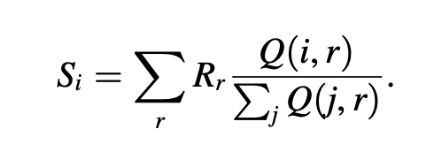
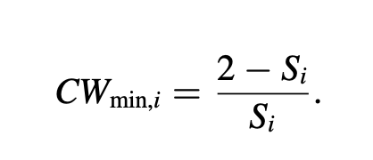
Content Centric MAC: Region Contention
A node calculates how often it should transmit, or its share (S_{i} ), based on the sum of the medium share of each region for which the node (autonomous vehicle) has information.
Each node has a contention window, CW_{min}, in which it is able to transmit.
Notes:
Yuval

Slide 20
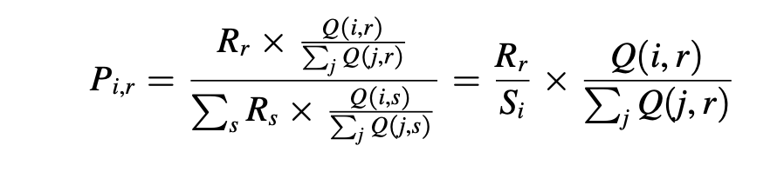
Content Centric MAC: Region Contention
We now understand how a node receives its proportional share of the medium, but how does it divide it’s transmissions between the different regions?
It does so based on two data points:
  Each region’s share of the medium.
  The quality of information the node has about each region.
Whenever the socket has space for a new packet, the node picks those packets from the regions according to the probabilities P_{i,r} .
Notes:
Yuval

Slide 21
Content Centric MAC: Scaling
The presence of many simultaneous 802.11 senders can lead to excessive collisions and a congestion collapse.
CarSpeak scales with a large number of senders because senders do not contend for the medium, hence there are no collisions between senders.
It also scales with a large number of regions because as the number of regions increases the share of each region decreases because a regions desirable share of the medium (R_{r} ) depends on a region’s share of the total number of requests.
Notes:
Yuval

Slide 22
Implementation Considerations
Communicating Processed Information
  Should CarSpeak send processed sensor information (eg. locations of pedestrians or if a road is congested)?
  No. Not suited for general-purpose. Native info better for understanding traffic, pedestrians, collision avoidance, localization, etc.

Slide 23
Implementation Considerations
Communicating Processed Information
  Should CarSpeak send processed sensor information (eg. locations of pedestrians or if a road is congested)?
  No. Not suited for general-purpose. Native info better for understanding traffic, pedestrians, collision avoidance, localization, etc.
One Hop vs Multi-Hops
  Should CarSpeak nodes relay to others in order to find relevant info?
  No. CarSpeak targets urban environments < 20 MPH. Car should know about immediate area (100-200 m away ~ within radio range). Urgency.

Slide 24
Implementation Considerations
Communicating Processed Information
  Should CarSpeak send processed sensor information (eg. locations of pedestrians or if a road is congested)?
  No. Not suited for general-purpose. Native info better for understanding traffic, pedestrians, collision avoidance, localization, etc.
One Hop vs Multi-Hops
  Should CarSpeak nodes relay to others in order to find relevant info?
  No. CarSpeak targets urban environments < 20 MPH. Car should know about immediate area (100-200 m away ~ within radio range). Urgency.
Regular Traffic
  Should CarSpeak support any (unrelated to CarSpeak) 802.11 traffic?
  Yes. Designer can weigh this region in comparison to CarSpeak regions.

Slide 25
Implementation
CarSpeak implemented as a ROS (Ubuntu 11.04) module on ASUS netbooks attached to iRobot Create robots.
Octree with 8 levels, 3 levels of region sub-trees.
Garbage collector thread runs every 10 seconds for freshness of data.
ROS (3D) PointCloud data based on UDP packets from MAC layer.
Using open-source Atheros 802.11n-based ath9k driver+firmware:
  RX:
    Driver receives packet from either over-the-air (from other cars) or userspace (itself)
    Searches packet’s payload for CarSpeak header
    If packet from userspace, driver places it in queue for corresponding region
  TX:
    Separate high-priority queue thread schedules packets based on region probabilities
    Once region is chosen, that queue is dequeued and packet is sent via hardware
    High-Resolution Timers in 2.6.x Linux used for rapid thread scheduling

Slide 26
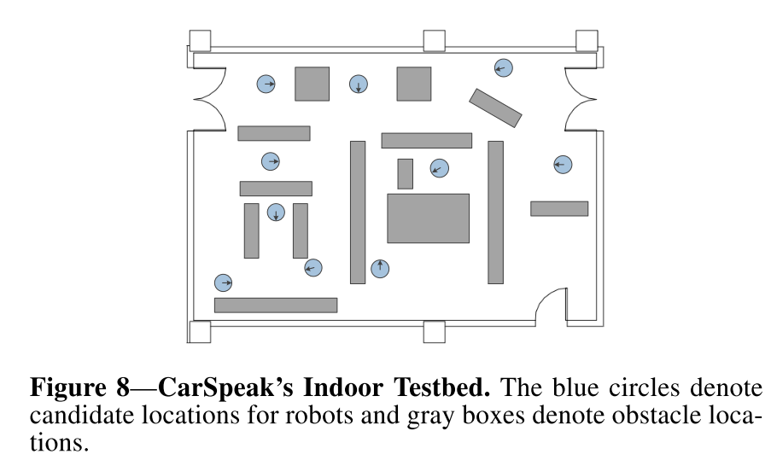
Evaluation Environment
Indoor Testbed:
  Vicon motion capture system (localization). 10 iRobot Create robots equipped with XBox 360 Kinect sensors.
  Asus EEPC 1015PX netbooks equipped with Atheros AR9285 adapters.
  Several large and small obstacles. Divided into 40 high resolution regions.
  Low resolution regions specified on a per experiment basis.
Notes:
Yuval

Slide 27
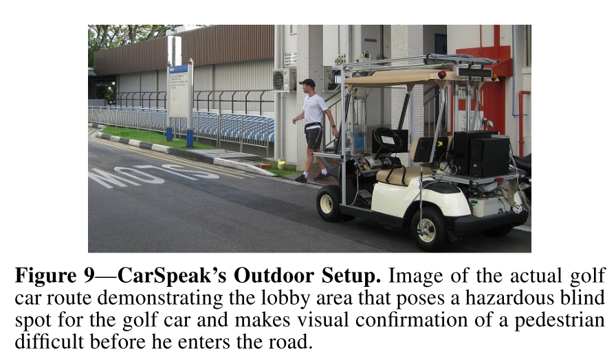
Evaluation Environment
Outdoor Testbed:
  Autonomous Yamaha G22E golf car with various sensors (eg. cameras, SICK and Hoyuko range finders).
  Navigates through campus-like environ.
  iRobot Create robots stationed at different locations.
  20 x 40 m area.
Notes:
Yuval

Slide 28
Evaluation Metric of Schemes
802.11 (standard MAC protocol)
  Inter-vehicle communication system; vehicles can request regions. Responses in UDP/bcast from all wireless nodes who posses info about requested region.
  Discards requests older than 1 minute. Discards sensor data older than 10 seconds.
  Does not implement Octree and Content-Centric MAC.
802.11+Naming
  Uses Octree based naming and compression modules.
  Tracks requests and transmits packets from each region proportional to number of requests.
  Discards requests older than 1 minute. Discards sensor data older than 10 seconds.
  Does not implement region-based contention or other CarSpeak MAC functions.
CarSpeak
  All components including Content-Centric MAC.
“Rate of useful sensor information per second” → utility function.
  3D-point cloud “useful” if contains sensor info. from only requested region at high resolution.

Slide 29
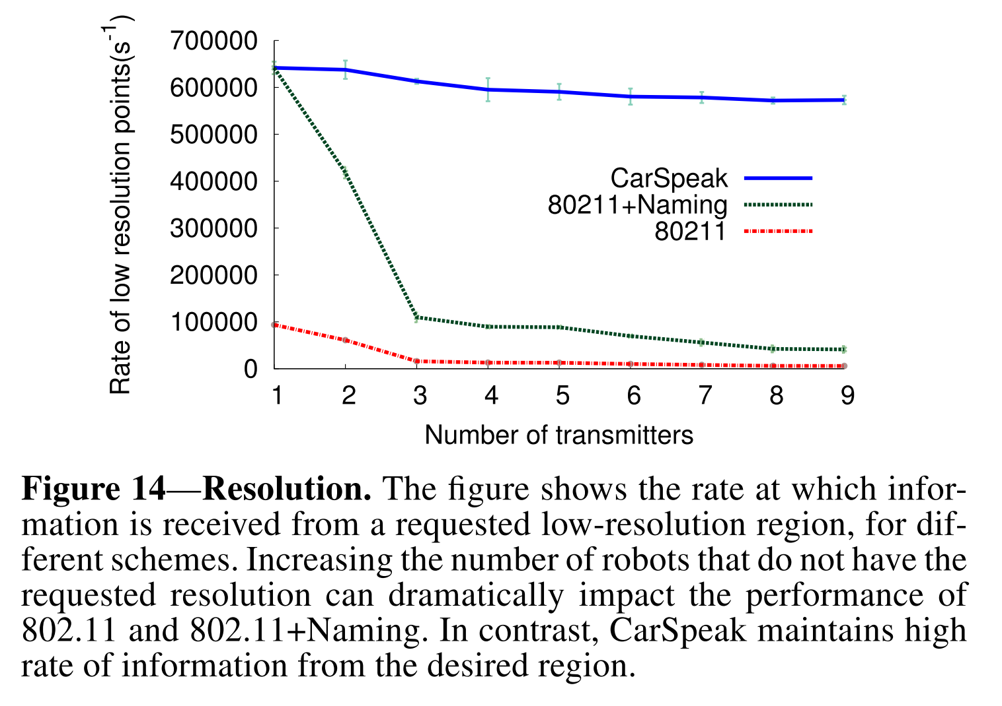
Resolution Results
How well does CarSpeak’s resolution perform?
  Experiment: 1 robot requests region at a low resolution. Other robots request incomplete/higher resolution information
  Measurement: Number of 3D-points received from the large region at the requester.
  Repeat: 20 times.
Results:
  CarSpeak’s devlier rate of the desired data is 4.5x higher than 802.11+Naming and over 29x higher than 802.11.

Slide 30
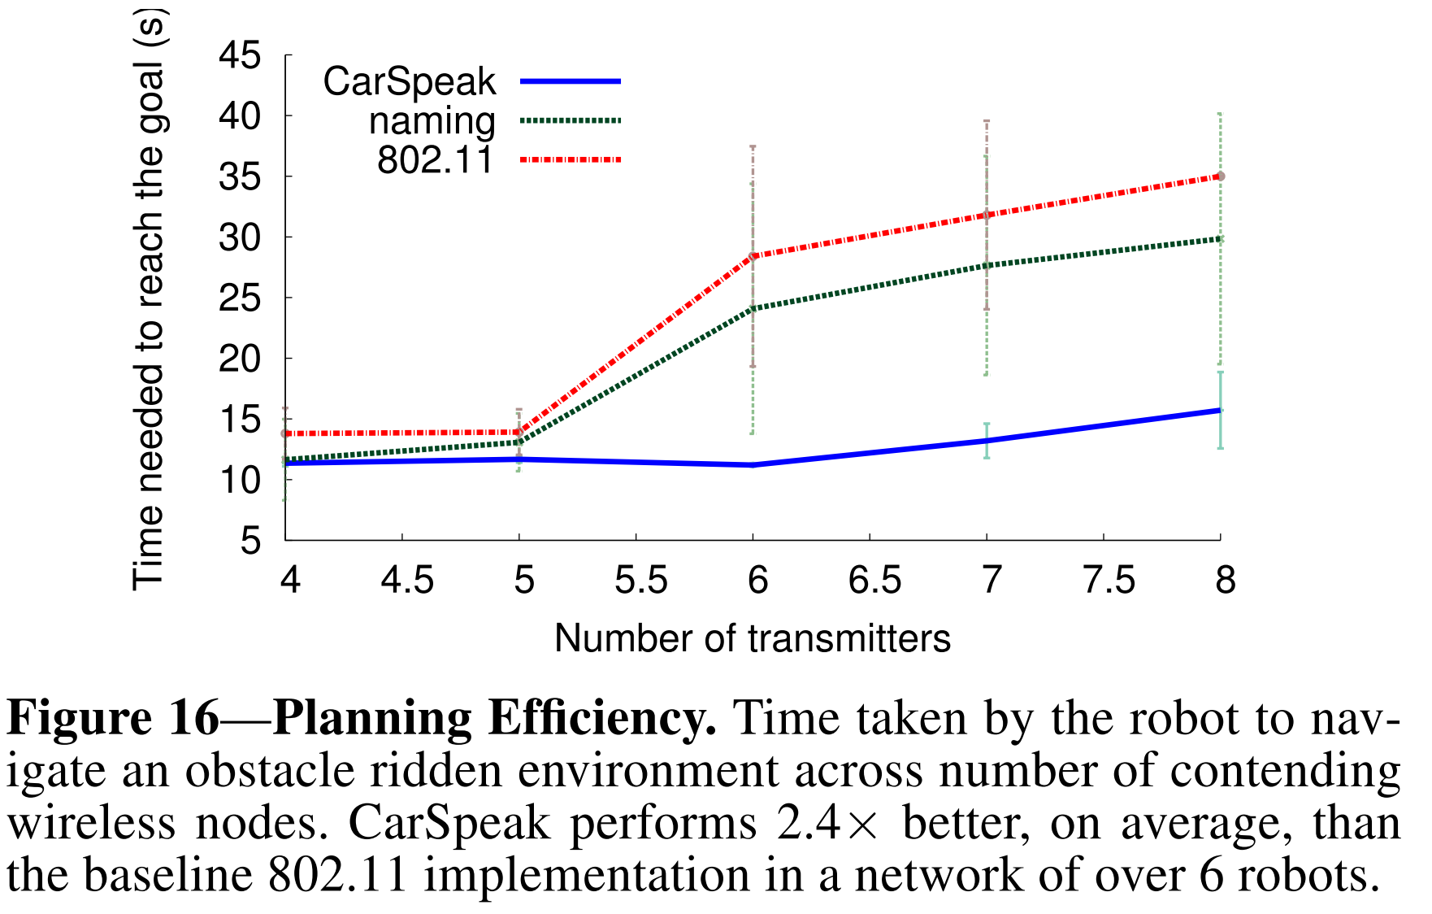
Planning Efficiency Results
How efficient are the routes CarSpeak provides to the path planner?
  Authors demonstrate in a two-robot experiment (A & B) that CarSpeak on robot A receives sensory information from robot B faster than competing protocols.

Slide 31
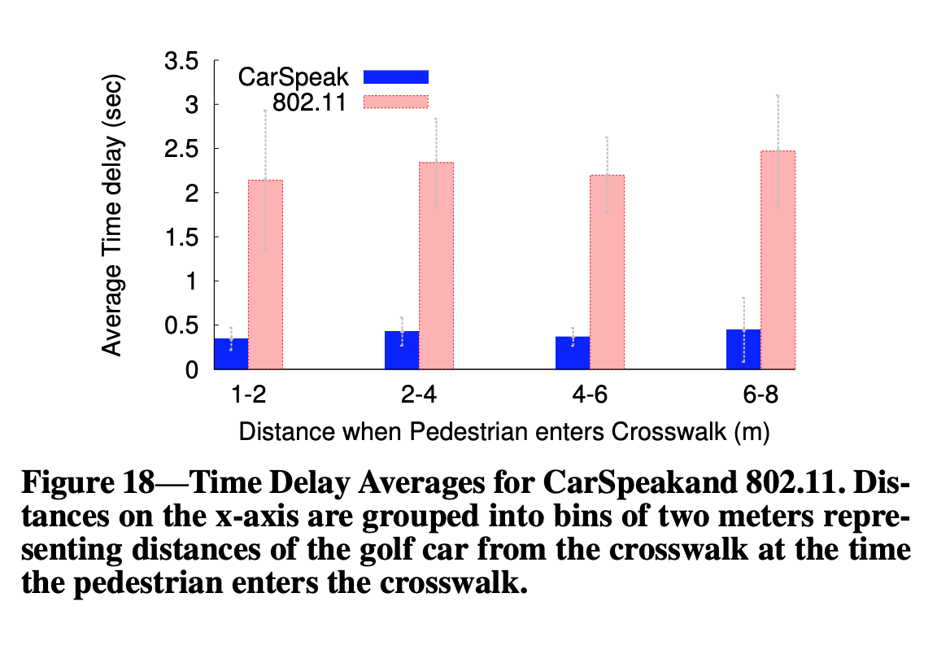
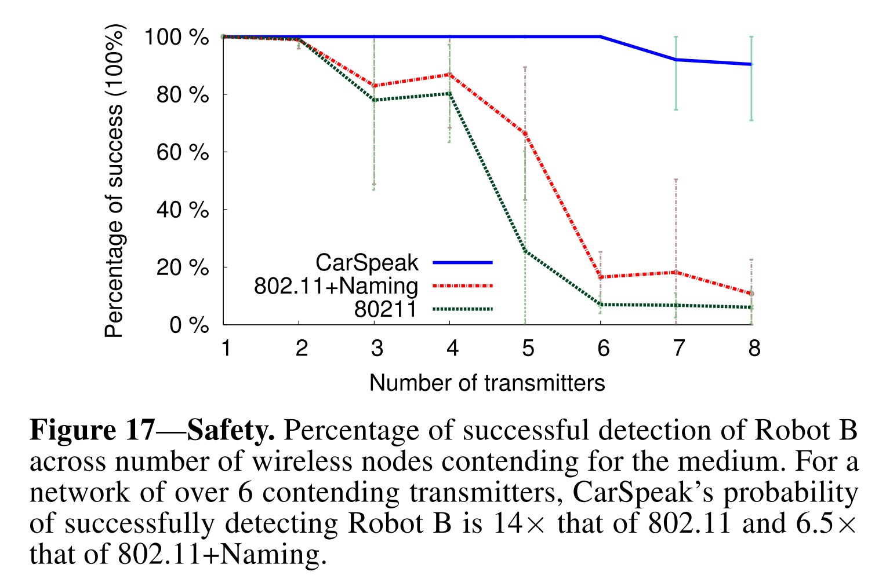
Safety
How safe are autonomous vehicles with CarSpeak?
  The maximum average delay of a positive pedestrian detection using CarSpeak is 4.75 times smaller than the minimum delay of 2.14s using 802.11.
  CarSpeak reduces the time for navigating around obstacles by 2.4 and reduces the probability of a collision due to limited visibility by 14.
Security wise:
  “Sharing information requires a notion of trust. One option is to use the IEEE1609.2 security standard for inter-vehicular networks to digitally sign and verify all messages.”
Notes:
Yuval

Slide 32
Applications of CarSpeak
Emergency Responders - Using CarSpeaks content centric MAC, emergency services can adaptively allocate emergency response resources without having those in need contend with each other.
  Crossing intersections with lights & sirens
Military - Makes the coordination and organization of personnel/infantry and equipment more efficient and safe by providing real time data on movements to prevent friendly fire incidents and reduce reliance on GPS/Radio.
  Virtual reality
Internet of Things - Embedded, network-connected devices such as wearables, in-home systems, and exterior sensors can make use of Content Object-based messaging schemes similar to that of CarSpeak for sharing collected sensor data.
  Collaborative robotics

Slide 33

Conclusion
“CarSpeak enables cars to request and access sensory information from other cars, as well as static infrastructure sensors, in a manner similar to how they access their own sensory information.”
Questions?
Notes:
Yuval

