Slide 1
Lecture 3.1
Acoustics for IoT
CMSC 818W : Spring 2019
Tu-Th 2:00-3:15pm
CSI 2118
Nirupam Roy
Feb. 14th 2019

Slide 2
Waves

Slide 3
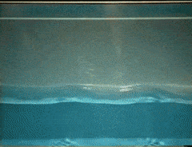
Waves: Transfer of energy, not mass

Slide 4
Sound
Visible light
Physical vibrations
WiFi signal
Ripples in water
Infrared
…
…

Slide 5
Mechanical Wave
Electromagnetic Wave
Sound
Visible light
Physical vibrations
WiFi signal
Ripples in water
Infrared
…
…

Slide 6
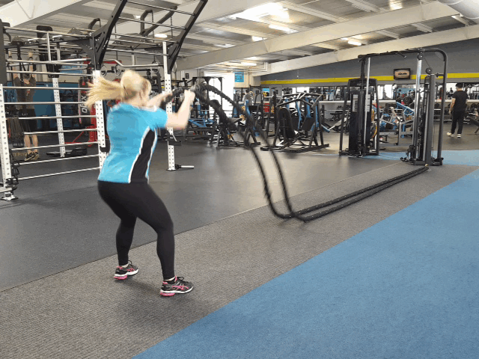
Mechanical waves
Transverse wave

Slide 7
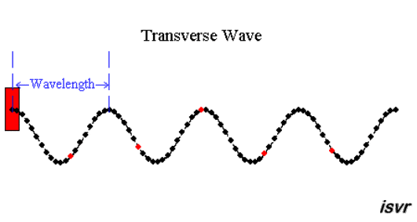
Mechanical waves
Transverse wave

Slide 8
Mechanical waves
Transverse wave
Longitudinal wave

Slide 9
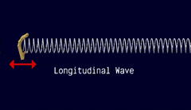
Mechanical waves
Transverse wave
Longitudinal wave

Slide 10
Mechanical waves

Slide 11
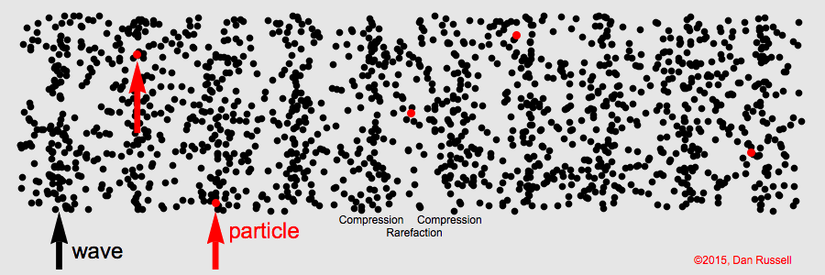
Mechanical waves

Slide 12
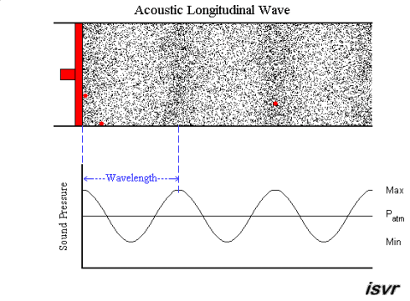
Mechanical waves

Slide 13
Mechanical waves: Time and space
Amplitude
Distance (meters)
0.00
0.25
0.50
0.75
1.00

Slide 14
Mechanical waves: Time and space
Phase of the signal changes over distance/space
Amplitude
Distance (meters)
0.00
0.25
0.50
0.75
1.00

Slide 15
Mechanical waves: Time and space
Wavelength = λ meters
Amplitude
Distance (meters)
0.00
0.25
0.50
0.75
1.00

Slide 16
Mechanical waves: Time and space

Slide 17
Mechanical waves: Time and space
Wavelength = λ meters

Slide 18
Mechanical waves: Time and space
Sound wave observed over time at a point in space

Slide 19
Mechanical waves: Time and space
Amplitude
Cycles per sec = frequency = f Hz
Time (sec)
0.00
0.50
1.00
1.50
2.00
Sound wave observed over time at a point in space

Slide 20
Time and space
Cycles per sec = frequency = f Hz

Slide 21
Time and space
Cycles per sec = frequency = f Hz
Distance per cycle = wavelength = λ meters

Slide 22
Time and space
Cycles per sec = frequency = f Hz
Distance per cycle = wavelength = λ meters
Distance per second = speed = C meters/sec

Slide 23
Time and space
Cycles per sec = frequency = f Hz
Distance per cycle = wavelength = λ meters
Distance per second = speed = C meters/sec
C = f . λ

Slide 24
Time and space
Cycles per sec = frequency = f Hz
Distance per cycle = wavelength = λ meters
Distance per second = speed = C meters/sec
C = f . λ
Speed of sound in air: 343 m/s
Speed of sound in water: 1493 m/s
Speed of sound in iron: 5130 m/s
Speed of electromagnetic waves: 3*10⁸ m/s
(~ a million times faster than sound)

Slide 25
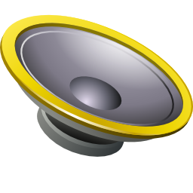
Time and space
$$A . sin⁡(2πft)$$

Slide 26
Time and space
$$sin⁡(2πft)$$

Slide 27
Time and space
Distance = d meter
$$sin⁡(2πft)$$

Slide 28
Time and space
Distance = d meter
$$sin⁡(2πft)$$
Sound is delayed by = d/C sec

Slide 29
Time and space
Distance = d meter
$$sin⁡(2πft)$$
Sound is delayed by = d/C sec
= (d/C).f cycles

Slide 30
Time and space
Distance = d meter
$$sin⁡(2πft)$$
Sound is delayed by = d/C sec
= (d/C).f cycles
$$= 2π\left(\frac{d}{C}\right)f \text{radians} \text{in} \text{phase}$$

Slide 31
Time and space
Distance = d meter
$$sin⁡(2πft)$$
Sound is delayed by = d/C sec
= (d/C).f cycles
$$= 2π\left(\frac{d}{C}\right)f \text{radians} \text{in} \text{phase}$$
$$= 2πd/\text{λ} \text{radians} \text{in} \text{phase}$$

Slide 32
Time and space
Distance = d meter
$$sin⁡(2πft−2πd/\text{λ})$$
$$sin⁡(2πft)$$
Sound is delayed by = d/C sec
= (d/C).f cycles
$$= 2π\left(\frac{d}{C}\right)f \text{radians} \text{in} \text{phase}$$
$$= 2πd/\text{λ} \text{radians} \text{in} \text{phase}$$

Slide 33
Frequency, Amplitude, and Phase
$$2π angles per cycle$$
$$f cycles per second$$
A
𝚹
time = t second
$$=$$
$$A . sin⁡(θ)$$
$$=$$
$$A . sin⁡(2πft)$$

Slide 34
Time and space
Distance = d meter
$$sin⁡(2πft−2πd/\text{λ})$$
$$sin⁡(2πft)$$
Sound is delayed by = d/C sec
= (d/C).f cycles
$$= 2π\left(\frac{d}{C}\right)f \text{radians} \text{in} \text{phase}$$
$$= 2πd/\text{λ} \text{radians} \text{in} \text{phase}$$

Slide 35
Time and space
$$sin⁡(2πft−2πd/\text{λ})$$
d meter
Distance = d meter
$$sin⁡(2πft−2πd/\text{λ})$$
$$sin⁡(2πft)$$
Sound is delayed by = d/C sec
= (d/C).f cycles
$$= 2π\left(\frac{d}{C}\right)f \text{radians} \text{in} \text{phase}$$
$$= 2πd/\text{λ} \text{radians} \text{in} \text{phase}$$

Slide 36
Time and space
$$sin⁡(2πft−2πd/\text{λ})$$
d meter
Distance = d meter
$$sin⁡(2πft−2πd/\text{λ})$$
$$sin⁡(2πft)$$
Sound is delayed by = d/C sec
= (d/C).f cycles
$$= 2π\left(\frac{d}{C}\right)f \text{radians} \text{in} \text{phase}$$
$$= 2πd/\text{λ} \text{radians} \text{in} \text{phase}$$

Slide 37
Time and space
$$sin⁡(2πft−2πd/\text{λ})$$
d meter
Distance = d meter
$$sin⁡(2πft−2πd/\text{λ})$$
Equation of the sine wave in time and space:
F(x,t) = $A.sin⁡(2πft±2πx/\text{λ})$
$$sin⁡(2πft)$$
Sound is delayed by = d/C sec
= (d/C).f cycles
$$= 2π\left(\frac{d}{C}\right)f \text{radians} \text{in} \text{phase}$$
$$= 2πd/\text{λ} \text{radians} \text{in} \text{phase}$$

Slide 38
Time and space
$$sin⁡(2πft)$$

Slide 39
Time and space
X meter
$$sin⁡(2πft)$$

Slide 40
Time and space
X meter
$$Θ$$
$$sin⁡(2πft)$$

Slide 41
Time and space
X.sin($Θ$)
X meter
$$Θ$$
$$sin⁡(2πft)$$

Slide 42
Time and space
d = X.sin($Θ$)
X meter
$$Θ$$
$$sin⁡(2πft)$$

Slide 43
Time and space
d = X.sin($Θ$)
$$sin⁡(2πft−2πd/\text{λ})$$
X meter
$$Θ$$
$$sin⁡(2πft)$$

Slide 44
Reflection of sound

Slide 45
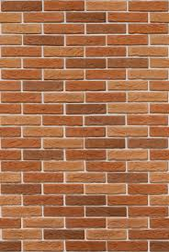
Reflection

Slide 46
Reflection
$$Θ$$
$$Θ$$

Slide 47
Reflection
d1
$$Θ$$
$$Θ$$
d2

Slide 48
Reflection
Time = t1

Slide 49
Reflection
Time = t1
Absorption
+
Reflection

Slide 50
Reflection
Time = t1
Absorption
+
Reflection
echo
t2

Slide 51
Reflection
Time = t1
Absorption
+
Reflection
d
echo
t2
Sound travelled (2d) distance

Slide 52
Reflection
Time = t1
Absorption
+
Reflection
d
echo
t2
Sound travelled (2d) distance
C(t2-t1) = 2d

Slide 53
Reflection
Time = t1
Absorption
+
Reflection
d
Echolocation
echo
t2
Sound travelled (2d) distance
C(t2-t1) = 2d

Slide 54
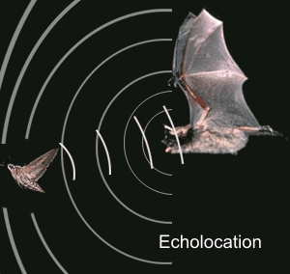
Echolocation in nature
Bat

Slide 55
Echolocation in nature
Beluga whale

Slide 56
Acoustic imaging

Slide 57
Acoustic imaging
Sonogram

Slide 58
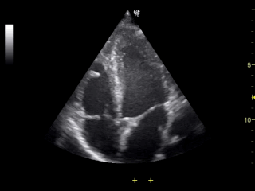
Acoustic imaging
Sonogram

Slide 59
Multipath

Slide 60
Multipath

Slide 61
Multipath: Convolution
Amplitude
Time (sec)
0.00
0.25
0.50
0.75
1.00
1.25

Slide 62
Multipath: Convolution
Amplitude
Time (sec)
0.00
0.25
0.50
0.75
1.00
1.25
Direct path
Amplitude
Time (sec)
0.00
0.25
0.50
0.75
1.00
1.25

Slide 63
Multipath: Convolution
Amplitude
Time (sec)
0.00
0.25
0.50
0.75
1.00
1.25
Direct path
Echo
Amplitude
Time (sec)
0.00
0.25
0.50
0.75
1.00
1.25

Slide 64
Multipath: Convolution
Amplitude
Time (sec)
0.00
0.25
0.50
0.75
1.00
1.25
Direct path
Echo
Amplitude
Time (sec)
0.00
0.25
0.50
0.75
1.00
1.25

Slide 65
Multipath: Convolution
Amplitude
Time (sec)
0.00
0.25
0.50
0.75
1.00
1.25
Direct path
Echo
Amplitude
Time (sec)
0.00
0.25
0.50
0.75
1.00
1.25

Slide 66
Multipath: Convolution
Amplitude
Time (sec)
0.00
0.25
0.50
0.75
1.00
1.25
Amplitude
Time (sec)
0.00
0.25
0.50
0.75
1.00
1.25

Slide 67
Impulse response
Impulse
Amplitude
Time (sec)
0.00
0.25
0.50

Slide 68
Impulse response
Impulse
Room’s acoustic environment (reflections, absorption etc.)
Amplitude
Time (sec)
0.00
0.25
0.50

Slide 69
Impulse response
Impulse
Room’s acoustic environment (reflections, absorption etc.)
Amplitude
Time (sec)
0.00
0.25
0.50
Impulse Response

Slide 70
Impulse response

Slide 71
Impulse response
Impulse
SYSTEM
Impulse Response

Slide 72
Impulse response
Impulse Response
Input
SYSTEM
X
Input

Slide 73
Impulse response
Impulse Response
Input
SYSTEM
X
Input
Convolution

Slide 74
Sound production and recording

Slide 75
Sound recording with microphone
Sound

Slide 76
Sound recording with microphone
Analog signal (voltage)
Sound
ADC
ADC = Analog-to-Digital Converter

Slide 77
Sound recording with microphone
Analog signal (voltage)
Sound
ADC
S6 S5 S4 S3 S2 S1 S0
Audio Sample Buffer
ADC = Analog-to-Digital Converter

Slide 78
Sound production with speaker
S6 S5 S4 S3 S2 S1 S0
Audio Sample Buffer

Slide 79
Sound production with speaker
S6 S5 S4 S3 S2 S1 S0
Analog signal (voltage)
Audio Sample Buffer
DAC
DAC = Digital-to-Analog Converter

Slide 80
Sound production with speaker
S6 S5 S4 S3 S2 S1 S0
Analog signal (voltage)
Audio Sample Buffer
DAC
Sound
DAC = Digital-to-Analog Converter

Slide 81
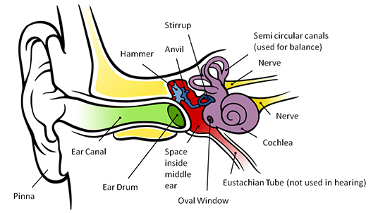
Human hearing

Slide 82
Human hearing
20Hz – 20kHz (Human hearing range)
0
10
100
1000
10,000
100,000
Frequency (log scale)

Slide 83
Human hearing
Infra-sound
Audible sound
Ultrasound
20Hz – 20kHz (Human hearing range)
0
10
100
1000
10,000
100,000
Frequency (log scale)

Slide 84
Human hearing
Dog /Cat
(45/65kHz)
Bat/Dolphin
(120/150kHz)
Infra-sound
Audible sound
Ultrasound
20Hz – 20kHz (Human hearing range)
0
10
100
1000
10,000
100,000
Frequency (log scale)

Slide 85
Near-ultrasound
Audible
Inaudible Ultrasound
Amplitude
20k
40k
60k
Frequency

Slide 86
Near-ultrasound
Audible
Inaudible Ultrasound
Near-ultrasound
Amplitude
20k
40k
60k
Frequency

Slide 87
Acoustic ranging: Case study
BeepBeep – SenSys 2007

Slide 88
Distance = d
Device A
Device B

Slide 89
Time = t1
Distance = d
Device A
Device B

Slide 90
Time = t1
Time = t2
Distance = d
Device A
Device B

Slide 91
Bluetooth/WiFi
Time = t1
Time = t1
Time = t2
Distance = d
Device A
Device B

Slide 92
Bluetooth/WiFi
Time = t1
Time = t1
Time = t2
Distance = d
Device A
Device B
d = C . (t2-t1)

Slide 93
Bluetooth/WiFi
Time = t1
Time = t1
Time = t2
Distance = d
Problem: Clock synchronization
Device A
Device B
d = C . (t2-t1)

Slide 94
The root cause of inaccuracy – three uncertainties
Clock synchronization uncertainty
time

Slide 95
The root cause of inaccuracy – three uncertainties
Clock synchronization uncertainty
Sending uncertainty
time

Slide 96
The root cause of inaccuracy – three uncertainties
Clock synchronization uncertainty
Sending uncertainty
software issuing command
...
t0 = wall_clock();
write(sound_dev, signal);
...
time

Slide 97
The root cause of inaccuracy – three uncertainties
Clock synchronization uncertainty
Sending uncertainty
software issuing command
...
t0 = wall_clock();
write(sound_dev, signal);
...
unknown delays (software, system, driver, hardware, …) ?
sound leaves
speaker
time

Slide 98
The root cause of inaccuracy – three uncertainties
Clock synchronization uncertainty
Sending uncertainty
Receiving uncertainty
software issuing command
...
t0 = wall_clock();
write(sound_dev, signal);
...
unknown delays (software, system, driver, hardware, …) ?
sound leaves
speaker
time

Slide 99
The root cause of inaccuracy – three uncertainties
Clock synchronization uncertainty
Sending uncertainty
Receiving uncertainty
software issuing command
...
t0 = wall_clock();
write(sound_dev, signal);
...
unknown delays (software, system, driver, hardware, …) ?
sound leaves
speaker
sound
reaches mic
time

Slide 100
The root cause of inaccuracy – three uncertainties
Clock synchronization uncertainty
Sending uncertainty
Receiving uncertainty
software issuing command
...
t0 = wall_clock();
write(sound_dev, signal);
...
unknown delays (software, system, driver, hardware, …) ?
sound leaves
speaker
sound
reaches mic
unknown delays (hardware, interrupt, driver, scheduling, …) ?
time

Slide 101
The root cause of inaccuracy – three uncertainties
Clock synchronization uncertainty
Sending uncertainty
Receiving uncertainty
software issuing command
software aware of arrival
...
t0 = wall_clock();
write(sound_dev, signal);
...
...
read(sound_dev, signal);
t1 = wall_clock();
...
unknown delays (software, system, driver, hardware, …) ?
sound leaves
speaker
sound
reaches mic
unknown delays (hardware, interrupt, driver, scheduling, …) ?
time

Slide 102
Beepbeep’s basic procedure
Device A emits a beep while both recording
Device B emits another beep while both continue recording
Both devices detect TOA of the two beeps and obtain respective ETOAs
Exchange ETOAs and calculate the distance
Device A
Device B
A’s recording
B’s recording
ETOA_{A}
ETOA_{B}
D_{AB}=|ETOA_{A}-ETOA_{B}|/2

Slide 103
Timeline
Device A
Device B

Slide 104
Timeline
Device A
Device B
1st Beep
t_{A0}

Slide 105
Timeline
Device A
Device B
1st Beep
t_{A0}
t_{A1}
t_{B1}

Slide 106
Timeline
Device A
Device B
1st Beep
t_{A0}
t_{A1}
t_{B1}
2nd Beep
t_{B2}

Slide 107
Timeline
Device A
Device B
1st Beep
t_{A0}
t_{A1}
t_{B1}
2nd Beep
t_{B2}
t_{B3}
t_{A3}

Slide 108
Timeline
Device A
Device B
1st Beep
t_{A0}
t_{A1}
t_{B1}
ETOA_{A}
2nd Beep
t_{B2}
t_{B3}
t_{A3}

Slide 109
Timeline
Device A
Device B
1st Beep
t_{A0}
t_{A1}
t_{B1}
ETOA_{B}
ETOA_{A}
2nd Beep
t_{B2}
t_{B3}
t_{A3}

Slide 110
Timeline
Device A
Device B
1st Beep
t_{A0}
t_{A1}
P
t_{B1}
ETOA_{B}
ETOA_{A}
2nd Beep
t_{B2}
t_{B3}
t_{A3}

Slide 111
Timeline
Device A
Device B
1st Beep
t_{A0}
t_{A1}
P
t_{B1}
ETOA_{B}
ETOA_{A}
2nd Beep
t_{B2}
t_{B3}
P
t_{A3}

Slide 112
Timeline
Device A
Device B
1st Beep
t_{A0}
t_{A1}
P
t_{B1}
ETOA_{B}
Q
ETOA_{A}
2nd Beep
t_{B2}
t_{B3}
P
t_{A3}

Slide 113
Timeline
Device A
Device B
1st Beep
t_{A0}
t_{A1}
P
t_{B1}
ETOA_{B}
Q
|ETOA_{A}-ETOA_{B}|
ETOA_{A}
2nd Beep
t_{B2}
= (P+Q+P) – (Q)
t_{B3}
P
t_{A3}

Slide 114
Timeline
Device A
Device B
1st Beep
t_{A0}
t_{A1}
P
t_{B1}
ETOA_{B}
Q
|ETOA_{A}-ETOA_{B}|
ETOA_{A}
2nd Beep
t_{B2}
= (P+Q+P) – (Q)
t_{B3}
P
= 2P
t_{A3}
= 2 (time of flight)

Slide 115
Project ideas: Inertial motion sensing
1. Car location in multistory parking lot.
2. Driver-passenger detection using smartphone
3. Driver’s / Biker’s driving pattern detection, dangerous
driving/biking alert
4. WiFi AP hand-off based on the motion pattern
5. 3D image by combining video and motion info.

