Slide 1

Lecture 3.2
Ranging and tracking using sound
(Part 1)
CMSC 818W : Spring 2019
Tu-Th 2:00-3:15pm
CSI 2118
Nirupam Roy
Feb. 19th 2019

Slide 2
Recap
I am sampling at 10 GHz.
The signal contains 2 GHz and 6 GHz frequencies.
What frequencies will I see after sampling?

Slide 3

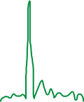

Aliasing: Finding the aliased frequency
Sampling frequency = 10Hz
Nyquist frequency = 5Hz
Amplitude
Received
signal
Amplitude
0
2
4
6
8
0
2
4
6
8
Frequency (Hz)
Frequency (Hz)
f_{s} = Sampling frequency
f = Frequency to record
N = Non-negative integer
f_{a} = Aliased(perceived) frequency
f_{a} = min(abs(N*f_{s} - f))

Slide 4
Recap
How does a complementary filter work?

Slide 5
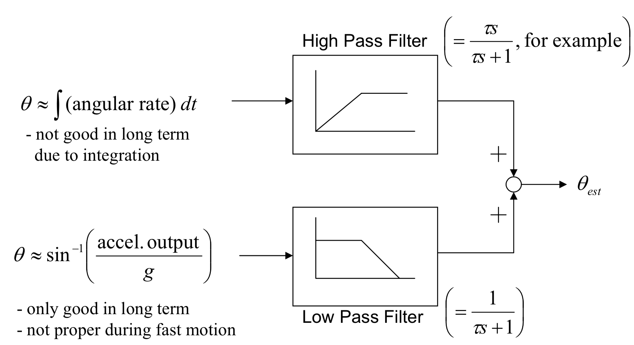
Accelerometer and Gyroscope Fusion
Complementary filter
Angle from gyro.
Angle from accel.
Angle from the gravity
vector

Slide 6
Recap
We discussed the paper “I am a Smartphone and I can Tell my User’s Walking Direction”.
What problem does this paper solve?

Slide 7
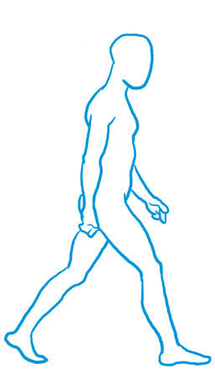
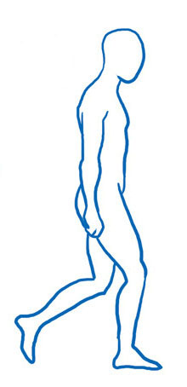
Walking Direction
Force
Force

Slide 8
Recap
If a 10 kHz sound wave propagates at the speed of 343m/s, what will be the speed of a 20 kHz sound wave?

Slide 9
Time and space
Cycles per sec = frequency = f Hz
Distance per cycle = wavelength = λ meters
Distance per second = speed = C meters/sec
C = f . λ

Slide 10
Finding distance using waves
(Ranging)

Slide 11
Sonogram
(imaging)
…
SONAR
(detection)
Gesture

Slide 12
Depth imaging
…
SONAR
(detection)
Gesture
Finding distance using waves
(Ranging)

Slide 13
Depth imaging
…
SONAR
(detection)
Gesture
Finding distance using waves
(Ranging)
Speed
Amplitude
Frequency
Phase

Slide 14
1. Distance from the speed information
a. Techniques
b. Signal detection
2. Distance from the amplitude information
a. Absorption
b. Propagation loss
3. Distance from the frequency information
a. Doppler effect
b. A case study (Doppler + Triangulation)
4. Distance from the phase information
a. Overview
b. Impulse function, Impulse response, Convolution
c. A case study

Slide 15
1. Distance from the speed information
a. Techniques
b. Signal detection
2. Distance from the amplitude information
a. Absorption
b. Propagation loss
3. Distance from the frequency information
a. Doppler effect
b. A case study (Doppler + Triangulation)
4. Distance from the phase information
a. Overview
b. Impulse function, Impulse response, Convolution
c. A case study

Slide 16
Distance from the speed information
Dist. = (speed) X (time of travel)
Time of Arrival (ToA)
Signal source
observer

Slide 17
Distance from the speed information
Dist. = (speed) X (time of travel)
Time of Arrival (ToA)
Signal source
observer
Signal source
Time Difference of Arrival (TDoA)
observer 1
observer2

Slide 18
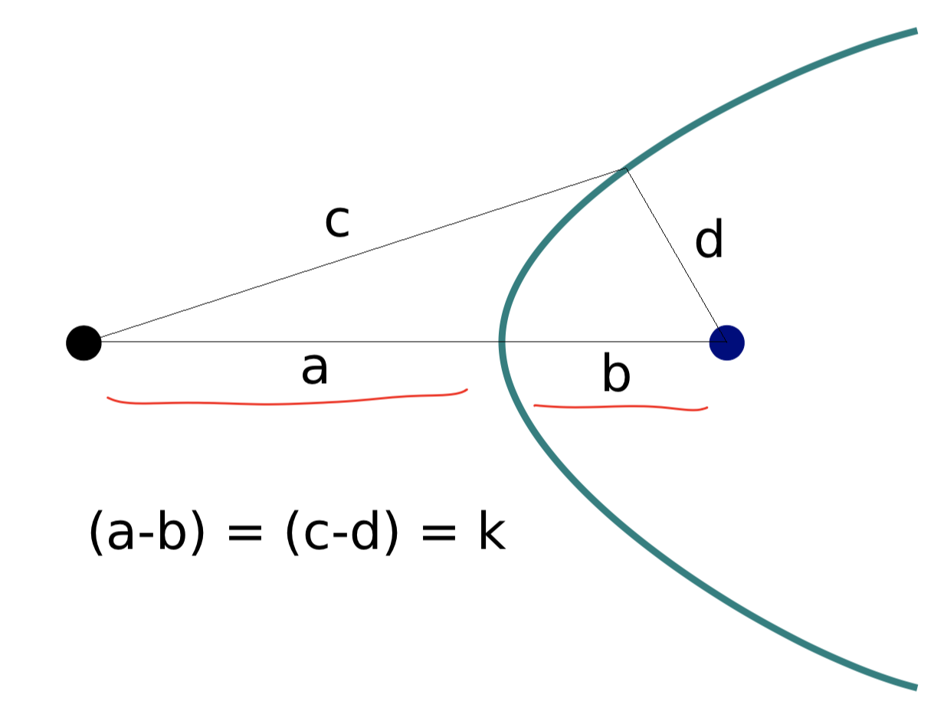
TDoA

Slide 19
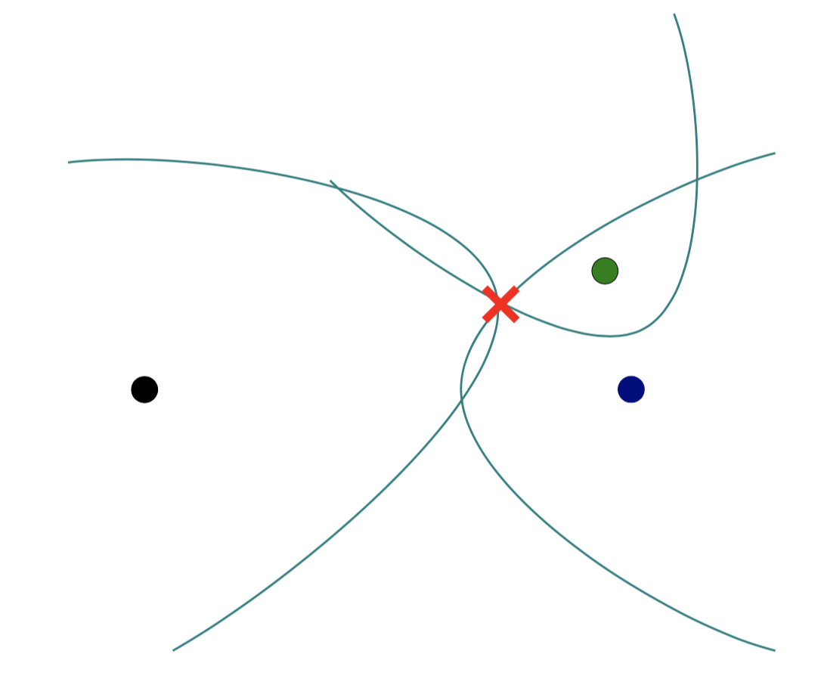
TDoA

Slide 20
Distance from the speed information
Dist. = (speed) X (time of travel)
Time of Arrival (ToA)
Signal source
observer
Signal source
Time Difference of Arrival (TDoA)
observer 1
observer2
Round-trip Time of Flight (RToF)
Signal source
+ observer
Reflector

Slide 21
Distance from the speed information
Dist. = (speed) X (time of travel)
Time of Arrival (ToA)
Signal source
observer
How to detect the signal at the receiver/observer?
Signal source
Time Difference of Arrival (TDoA)
observer 1
observer2
Round-trip Time of Flight (RToF)
Signal source
+ observer
Reflector

Slide 22
Signal detection
Amplitude
Time/Sample
Transmitter signal

Slide 23
Signal detection
Amplitude
Amplitude
Time/Sample
Time/Sample
Transmitter signal
Receiver signal

Slide 24
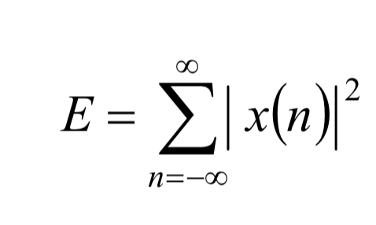
Signal detection
Amplitude
Amplitude
Time/Sample
Time/Sample
Transmitter signal
Receiver signal
Energy based signal detector
Energy of a discrete signal x(n),

Slide 25
Signal detection
Amplitude
Amplitude
Time/Sample
Time/Sample
Transmitter signal
Receiver signal

Slide 26
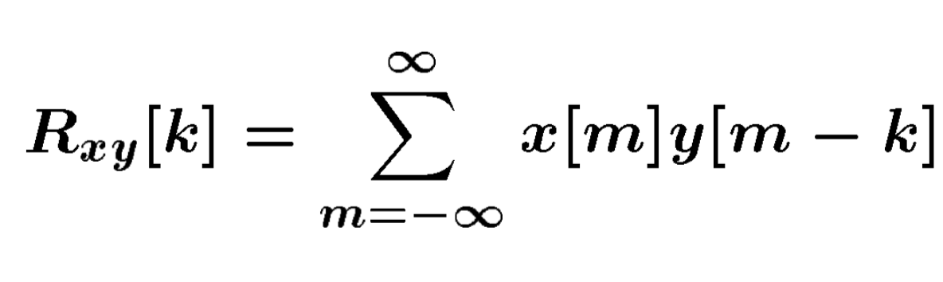
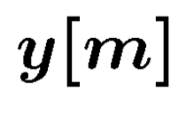
Signal detection
Received signal
Signal matching
Transmit signal template

Slide 27
Signal detection
Received signal
Signal matching
Transmit signal template
Correlation

Slide 28
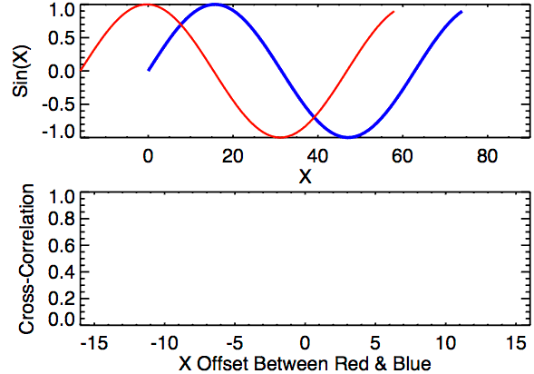
Signal detection
Correlation

Slide 29
Signal detection
Received signal
Problem: Received signal is distorted due to multipath, attenuation etc.
Signal matching
Transmit signal template
Correlation

Slide 30
Signal detection: Work-around for signal distortion
Two identical replicas
Amplitude
Time/Sample
Transmitter signal

Slide 31
Signal detection
Two identical replicas
Two similarly
distorted replicas
Amplitude
Amplitude
Time/Sample
Time/Sample
Transmitter signal
Receiver signal

Slide 32
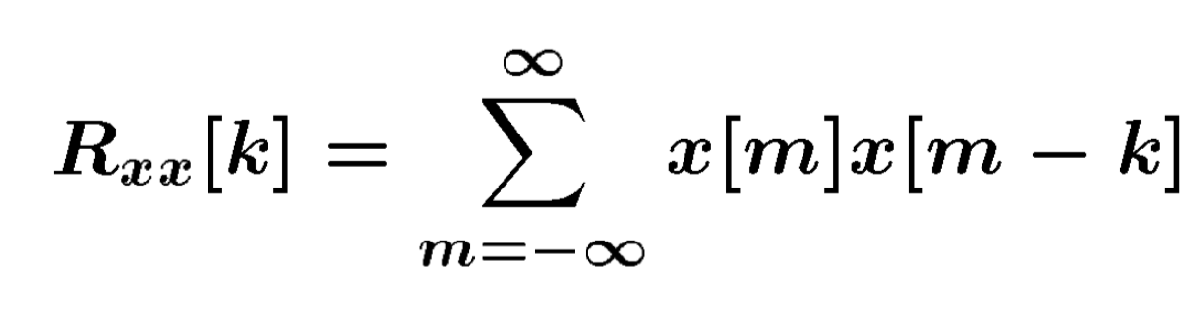
Signal detection
Received signal
Matching with itself
(window size = half of the signal length)
Auto-Correlation

Slide 33
Signal detection
Cross-Correlation
Auto-Correlation

Slide 34
Distance from the speed information
Dist. = (speed) X (time of travel)
Time of Arrival (ToA)
Signal source
observer
Time Difference of Arrival (TDoA)
Signal source
observer 1
observer2
Round-trip Time of Flight (RToF)
Signal source
+ observer
Reflector
Notes:
Slide 23: 20 minutes

Slide 35
1. Distance from the speed information
a. Techniques
b. Signal detection
2. Distance from the amplitude information
a. Absorption
b. Propagation loss
3. Distance from the frequency information
a. Doppler effect
b. A case study (Doppler + Triangulation)
4. Distance from the phase information
a. Overview
b. Impulse function, Impulse response, Convolution
c. A case study

Slide 36

Distance from the amplitude information
Amplitude
Time (sec)
$$AS . sin⁡(2πft)$$

Slide 37

Distance from the amplitude information
Dist. = d
Amplitude
Time (sec)
Amplitude
Time (sec)
$$AS . sin⁡(2πft)$$
$$AO . sin⁡(2πft)$$

Slide 38
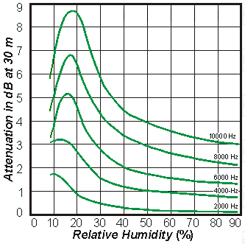
Distance from the amplitude information
Dist. = d
Amplitude
Time (sec)
Amplitude
Time (sec)
$$AS . sin⁡(2πft)$$
$$AO . sin⁡(2πft)$$
Attenuation due to atmospheric absorption and diffraction

Slide 39
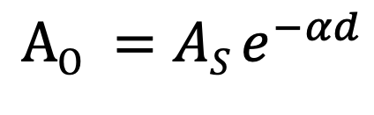
Distance from the amplitude information
Dist. = d
Amplitude
Time (sec)
Amplitude
Time (sec)
$$AS . sin⁡(2πft)$$
$$AO . sin⁡(2πft)$$
$$AO =AS e^{−αd}$$
α = attenuation coefficient
Depends on frequency and
environment ( temperature, humidity etc.)

Slide 40
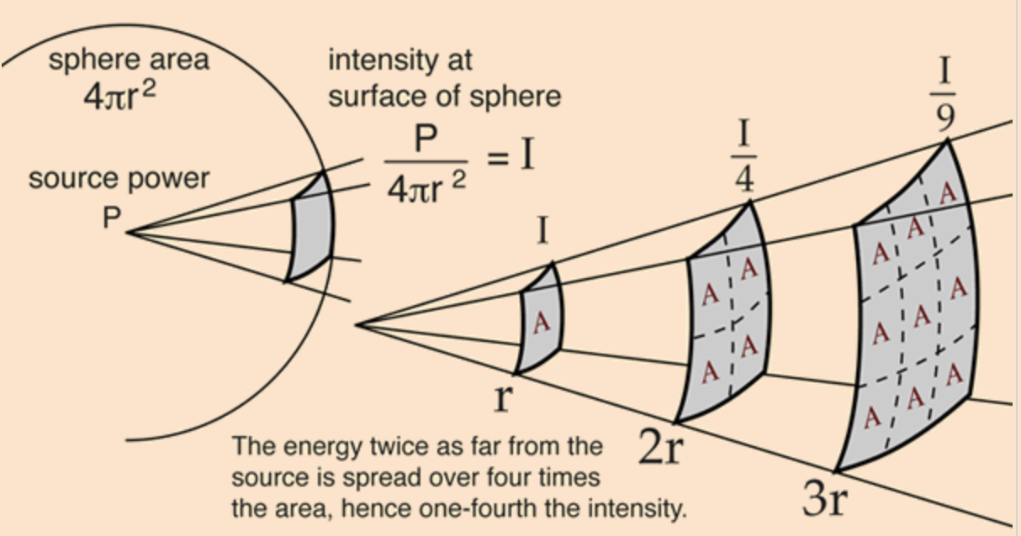
Distance from the amplitude information
Propagation loss

Slide 41
Distance from the amplitude information
Propagation loss
Notes:
Slide 30: 25 minutes

Slide 42
1. Distance from the speed information
a. Techniques
b. Signal detection
2. Distance from the amplitude information
a. Absorption
b. Propagation loss
3. Distance from the frequency information
a. Doppler effect
b. A case study (Doppler + Triangulation)
4. Distance from the phase information
a. Overview
b. Impulse function, Impulse response, Convolution
c. A case study

Slide 43
Distance from the frequency information
Motion of the sound source and/or the observer changes the frequency of the observed signal.
The change depends on the velocity of the source/observer.
This phenomena is known as Doppler effect or Doppler shift.

Slide 44
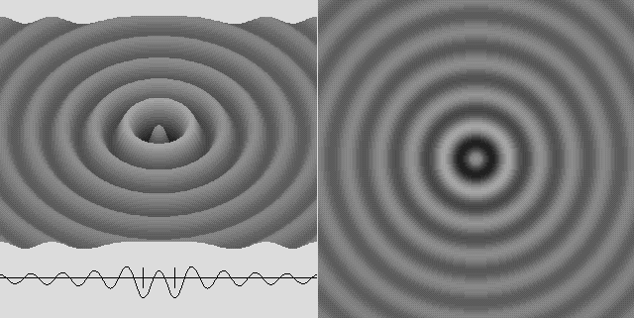
Doppler effect

Slide 45
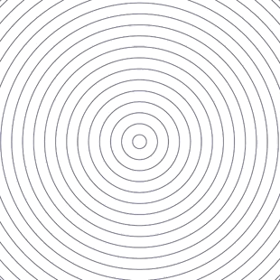
Doppler effect

Slide 46
Doppler effect

Slide 47
Doppler effect
Simple wave model: Stationary source

Slide 48
Doppler effect
Simple wave model: Stationary source
Time = t1

Slide 49
Doppler effect
Simple wave model: Stationary source
Time = t2

Slide 50
Doppler effect
Simple wave model: Stationary source
Time = t2

Slide 51
Doppler effect
Simple wave model: Stationary source
Time = t3

Slide 52
Doppler effect
Simple wave model: Stationary source
Time = t3

Slide 53
Doppler effect
Simple wave model: Stationary source
Wavelength = λ meters
Time = t3

Slide 54
Doppler effect
Simple wave model: Moving source

Slide 55
Doppler effect
Simple wave model: Moving source
Time = t1

Slide 56
Doppler effect
Simple wave model: Moving source
Time = t2

Slide 57
Doppler effect
Simple wave model: Moving source
Time = t2

Slide 58
Doppler effect
Simple wave model: Moving source
Time = t2

Slide 59
Doppler effect
Simple wave model: Moving source
Time = t3

Slide 60
Doppler effect
Simple wave model: Moving source
Time = t3

Slide 61
Doppler effect
Simple wave model: Moving source
Time = t3

Slide 62
Doppler effect
Simple wave model: Moving source
Actual wavelength = λ meters
Wavelength = λ₂ meters
Wavelength = λ₁ meters
Time = t3
Notes:
Slide 19: 2 minutes 30 seconds

Slide 63
Doppler effect
Simple wave model: Moving source
Actual wavelength = λ meters
Observer
Wavelength = λ₂ meters
Wavelength = λ₁ meters
Time = t3
Notes:
Slide 19: 2 minutes 30 seconds

Slide 64
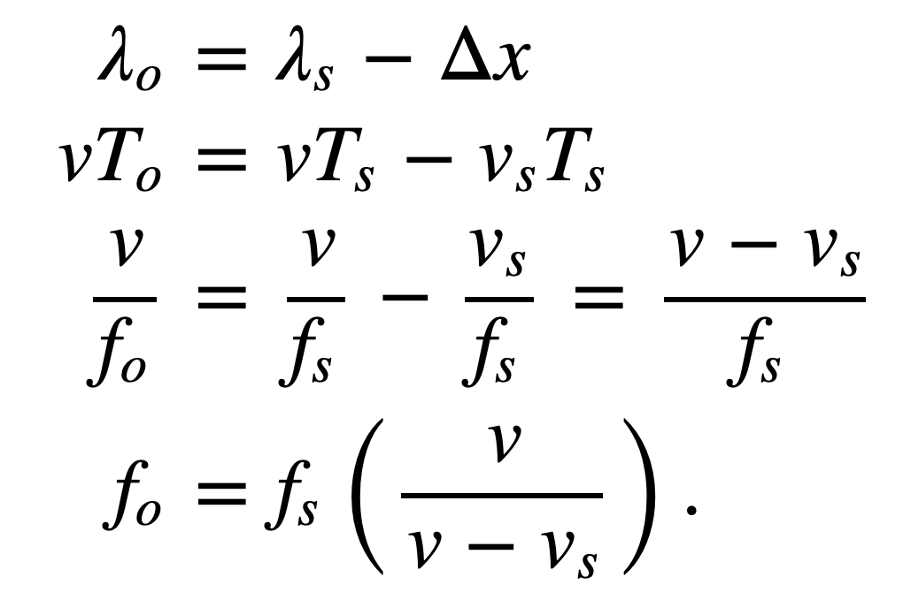
Doppler effect
Simple wave model: Moving source
Source moving towards the observer
v = Velocity of the signal (sound, light etc.)
v_{O} , T_{O} , f_{O} = Velocity of the observer and observed period and frequency
v_{S} , T_{S} , f_{S} = Velocity of the source and original period and frequency
Notes:
Slide 19: 2 minutes 30 seconds

Slide 65
Doppler effect
Simple wave model: Moving observer
Observer

Slide 66
Doppler effect
Simple wave model: Moving observer
t
t
Observer

Slide 67
Doppler effect
Simple wave model: Moving observer
t’ <t
t’ <t

Slide 68
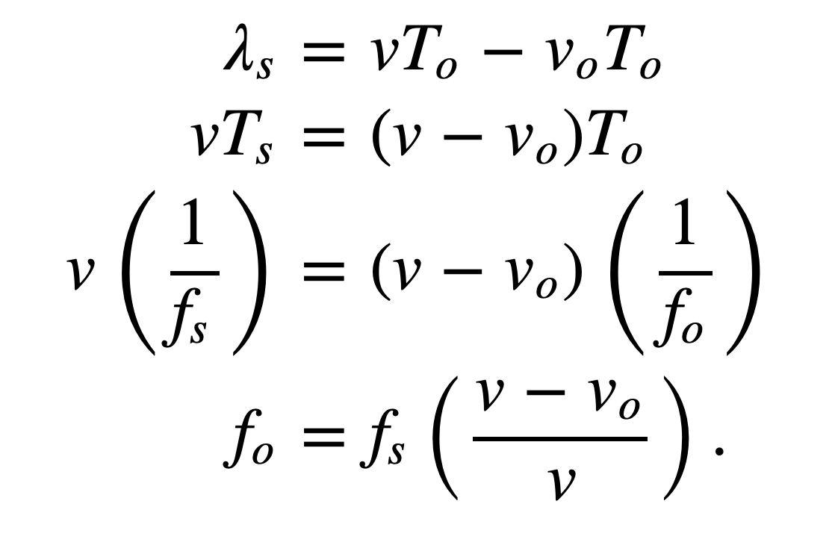
Doppler effect
Simple wave model: Moving observer
Observer moving towards the stationary source
+
+
+
+
v_{O} , T_{O} , f_{O} = Velocity of the observer and observed period and frequency
v_{S} , T_{S} , f_{S} = Velocity of the source and original period and frequency

Slide 69
Doppler effect
Simple wave model: Moving observer
Observer moving towards the stationary source
+
Doppler shift, Δf = f_{O}-f_{S} = f_{S} (v_{O}/v)
+
+
Effects of signal’s velocity and frequency
+
v_{O} , T_{O} , f_{O} = Velocity of the observer and observed period and frequency
v_{S} , T_{S} , f_{S} = Velocity of the source and original period and frequency

Slide 70
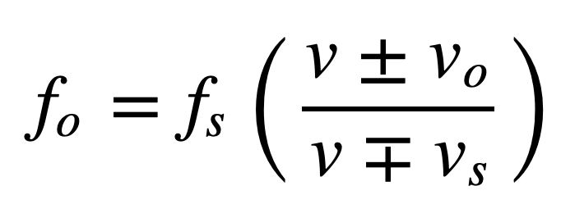
Doppler effect
Simple wave model: Moving observer
Both the source and the observer are moving
v_{O} , T_{O} , f_{O} = Velocity of the observer and observed period and frequency
v_{S} , T_{S} , f_{S} = Velocity of the source and original period and frequency
Notes:
Slide 58: 30 minutes

Slide 71
Doppler effect
Demo

Slide 72
Triangulation
base1
d
observer

Slide 73
Triangulation
base1
base2
d
d’
observer

Slide 74
Turning a Mobile Device into a Mouse in the Air
Case study
Sangki Yun, Yi-Chao Chen and Lili Qiu
Department of Computer Science
The University of Texas at Austin
ACM MobiSys 2015, Florence, Italy

Slide 75

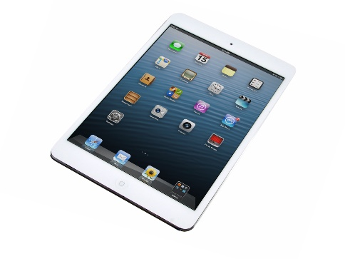
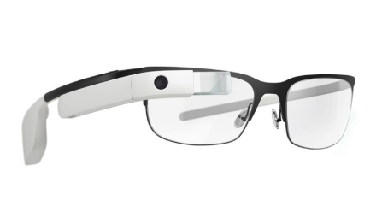
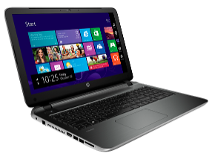
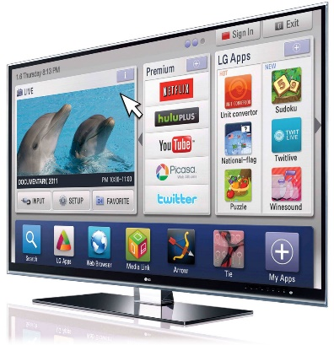
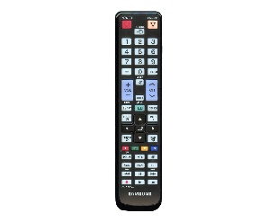
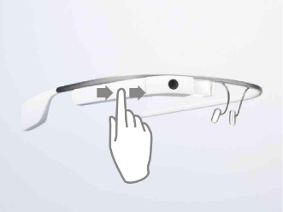
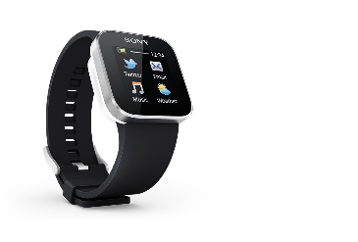
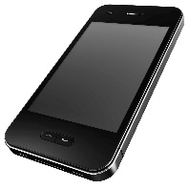
Era of Smart Devices
Smart Devices
Notes:
These days, people are surrounded by smart devices such as smart phone, laptop, smart TV and smart watch. According to some survey, a person carriers 2.9 smart devices in average. For some of the smart devices, they require sophisticated user interface to fully utilize the functionality, but the provided controller is not sufficient. For example, with smart TV, we can do almost all things we do with laptop or tablet such as web-browsing, social network and gaming, but the traditional remote controller is not good enough to utilize them. Similarly, smart glasses usually has small touch pad and we can use it to make a few simple commands such swiping and tapping, but the number of distinct gestures are limited and it significantly reduces the usability of the smart glasses.

Slide 76
Our goal
Controlling smart devices using existing mobile devices
How to enable precise mobile device position tracking?

Slide 77
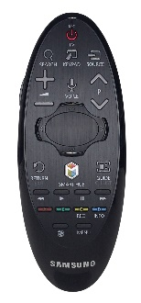
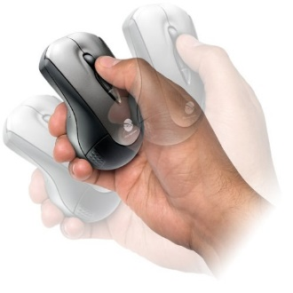
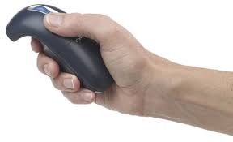
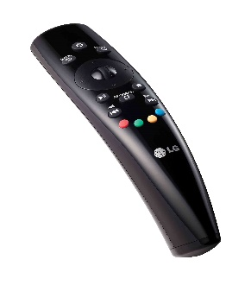
Possible solutions
WiFi signal based device localization – sub-meter level accuracy
Accelerometer based device tracking – not feasible due to large error
Gyroscope – track the rotational movement of the device
Notes:
In order to track the device movement, one possible way is using RF signal, which is very popular in indoor localization. However, it only achieves sub-meter level accuracy which our application requires cm level accuracy. Another possible way will be using the accelerometer in the mobile device. If the device is moving, the acceleration is generated and we can use it to track the position. However, the measured acceleration has huge noise and the tracking is not feasible. Using the gyroscope, we can track the rotational movement of the device. It is indeed used for commercial air mouse products and remote controllers for smart TVs. The problem of this approach is it tracks the rotational movement of our wrist while the mouse pointer is moving is 2D plane. The disparity between the rotational movement and 2D movement makes the users experience difficulties in controlling the pointer using gyroscope.

Slide 78
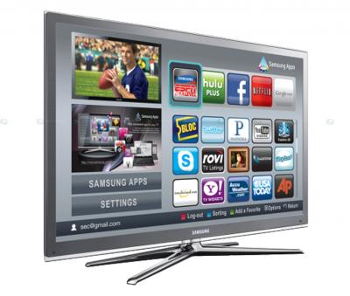
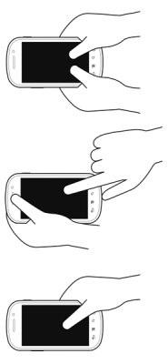
Our Approach
Audio based movement tracking using Doppler effect
Speakers emit audio signals in inaudible frequencies
The device position is tracked by the Doppler shift of the recorded audio signal
Notes:
In this work, we track the device movement using the audio signal. In particular, we use the Doppler shift generated while the device is moving. Here, the device to be tracked has two speakers, and each speaker emit pure sinusoid tones in different inaudible frequencies. The mobile device records the audio signal and sends it back to the processor, where it tracks the movement by analyzing the Doppler shift.

Slide 79
Why not accelerometer?
Small hand vibration causes non-negligible error
Track the device position by double integration of the acceleration
Quick error accumulation
Movement estimated from the accelerometer
Measured acceleration

Slide 80
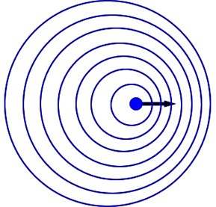
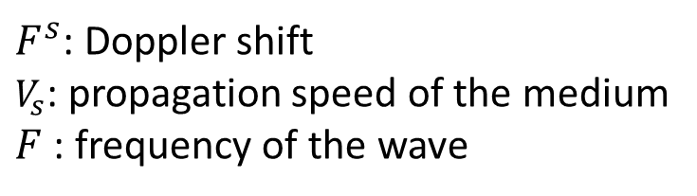
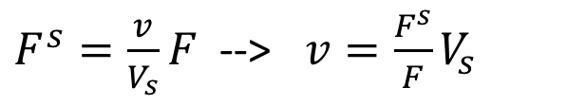
Doppler Effect
Doppler shift – change in the frequency due to the movement of the sender or the receiver
$F^{s}=\frac{v}{V_{s}}F$ --> $v=\frac{F^{s}}{F}V_{s}$
$F^{s}$: Doppler shift
$V_{s}$: propagation speed of the medium
$F$: frequency of the wave
Lower
frequency
Higher
frequency
Notes:
Doppler shift is the change of the center frequency incurred by the movement of the sender or the receiver of the wave signal. The mathematical relationship between the velocity and the frequency shift is like this. Let’s say the sender position is the fixed. The propagation speed and the center frequency of the original wave is constant, so by observing the frequency shift, we can calculate the velocity of the receiver.

Slide 81
Doppler based device tracking
From the measured Doppler shift, we can get the velocity and the moving distance of the device
`
Measured Doppler shift
Movement estimated
from Doppler shift
Notes:
Regarding the device tracking, one might wonder why don’t we simply use accelerometer instead of the Doppler. Accelerometer is equipped in almost all smart phones, and it is very cheap to read the acceleration in terms of the energy efficiency. However, the accelerometer has two fundamental problems. One is that it is easily affected by the gravity so small hand vibration causes non-negligible acceleration. And it tracks the position by the double integration where one integration of the acceleration gives the velocity and another integration gives the position. It is very sensitive to noise and small acceleration measurement error quickly explodes over time. Here we measure the acceleration while the device is moving in one direction. We see that the difference while the device is moving and stopped is small. And because of the accumulated error, the tracked position infinitely goes wrong direction even if the device has stopped. One the other hand, in the measured Doppler shift, we can clearly tell when the device is moving, and the movement distance tracked by the Doppler is much more accurate than the Doppler.

Slide 82
Outline
Accurate estimation of the Doppler shift
Locate the device (Assume speaker distance & initial position known)
Finding the distance between speakers
Notes:
In order to enable Doppler shift

Slide 83
Outline
Accurate estimation of the Doppler shift
Locate the device (Assume speaker distance & initial position known)
Finding the distance between speakers
Notes:
In order to enable Doppler shift

Slide 84
Doppler shift estimation
Frequency domain analysis by Short-term Fourier Transform (STFT)
Detect the Doppler shift by finding the peak frequency with maximum magnitude
Spectrogram of the audio signal
Doppler shift estimated by peak detection
Notes:
To estimate the Doppler shift, we need to analyze the signal in the frequency domain. Given the received audio signals, we perfom STFT to observe the change of the spectrum over time, and we estimate the Doppler shift by finding the frequency with the maximum magnitude. This is the spectrogram we got from STFT while device is drawing a circle. This is the Doppler shift estimated by the peak detection. By itself it has significant error so the tracking is inaccurate.

Slide 85
Improving the frequency shift estimation accuracy
Utilize larger spectrum
Send multiple audio tones in 200 Hz interval
Outlier removal
Doppler shift change larger than 10 Hz
Maximal Ratio Combining
Doppler shift from multiple channels
MRC with outlier removal
Notes:
So we use several techniques to improve the accuracy. First, we use larger spectrum to estimate the Doppler shift. Instead of sending one audio, we send multiple tones in different frequencies and measures Doppler shift in multiple channels, which we can achieve diversity effect. Another observation is sometimes the measured Doppler error is unreasonably high and deviates Gaussian distribution. Considering the human hand movement speed limit, we can filter out the Doppler measurement samples where the difference from the previous measurement is significant. We regard the Doppler shift change larger than 10 Hz is measurement error and remove them. After that, we perform MRC that is widely used in receiver antenna diversity. This is the measured Doppler in 5 different frequencies. This is MRC result with and without outlier removal, and you can see the result with outlier removal is more smooth, which is likely to include less amount of error.

Slide 86
Outline
Accurate estimation of the Doppler shift
Locate the device (Assume speaker distance & initial position known)
Finding the distance between speakers
Notes:
In order to enable Doppler shift

Slide 87
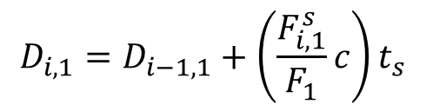
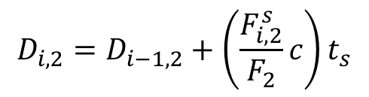
Tracking the device position - 1
Assumptions
The distance between speakers is known
The initial device position is known
Measure Doppler shift from two speakers
Using the previous position and Doppler, update new distance from speakers
$$D_{i,1}=D_{i−1,1}+\left(\frac{F_{i,1}^{s}}{F_{1}}c\right)t_{s}$$
$$D_{i,2}=D_{i−1,2}+\left(\frac{F_{i,2}^{s}}{F_{2}}c\right)t_{s}$$
Current distance
from speaker 1
Doppler sampling interval
Previous distance
from speaker 1
Change of the distance
tracked by Doppler
Notes:
Now I will explain how to track the position using the Doppler shift measurement. Here, I will first assume that the distance between speakers the device initial position are known, and later I will explain how to address the assumption. Given the Doppler shift estimation and the information on the current position, finding the new distance from the speakers is pretty simple. From the Doppler shift, we can calculate how much device has moved during the Doppler sampling interval, and by adding it to the previous distance. We can find the current distance from the two speakers.

Slide 88













Tracking the device position - 2
Having the distance from two speakers, finding the position is finding the intersection of two circles
$$(0,0)$$
$$(D,0)$$
$$D_{3,2}$$
$$D_{3,1}$$
$$(x_{4},y_{4})$$
$$D_{2,2}$$
$$D_{2,1}$$
$$(x_{3},y_{3})$$
$$D_{1,1}$$
$$(x_{2},y_{2})$$
$$D_{1,2}$$
$$(x_{1},y_{1})$$
$$(x_{0},y_{0})$$
Notes:
Once the distances from the two speakers are known, finding the position is finding the intersection of the two circles. Here I illustrate how to continuously track the device. For the tracking, we construct a virtual coordinate where the position of the left speaker is 0,0 and the position of the right speaker is D,0, and D is the distance between speakers. In each interval, the tracker measures the new distance from the speakers using the previous position information and Doppler shift. Using it, the tracker find the intersection of the two circles where the radius are the distance from the two speakers and the center points are the location of the speakers. In the next interval, it finds the new distances and the new position, and this is repeated until the tracking is completed.

Slide 89
Outline
Accurate estimation of the Doppler shift
Locate the device (Assume speaker distance & initial position known)
Finding the distance between speakers
Notes:
In order to enable Doppler shift

Slide 90
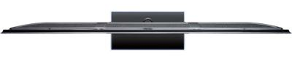




Finding the distance between speakers
Calibration to find the exact speaker distance using Doppler
Moves the device from left to right
T₁: $F_{s}^{1}$ changes from positive to negative
T₂: $F_{s}^{2}$ changes from positive to negative
Measure the distance using Doppler shift between T₁ and T₂
Speaker 1
Speaker 2
$$T_{1}$$
$$T_{2}$$
Notes:
Now I explain how to find the distance between the speakers. We provide a simple but effective calibration method that use can easily perform. Here, we again use Doppler shift to estimate the distance. During the calibration, the speakers are emitting the sound in inaudible frequency to estimate Doppler shift. The user goes close to the device to be tracked, and moves the mobile devices from left to right and come back to the left. From the measured Doppler shift, we can easily find the timing that the device passes the left and right speaker, because the Doppler shift changes from positive to negative. Then, we can easily find the distance from the measure Doppler shift between these two intervals.

Slide 91
Drawing evaluation
Drawing error
The distance between original shape and the drawn image
Camera
AAMouse
Gyroscope
Samples from the 80th percentile drawing error

Slide 92
1. Distance from the speed information
a. Techniques
b. Signal detection
2. Distance from the amplitude information
a. Absorption
b. Propagation loss
3. Distance from the frequency information
a. Doppler effect
b. A case study (Doppler + Triangulation)
4. Distance from the phase information
a. Overview
b. Impulse function, Impulse response, Convolution
c. A case study

Slide 93
To be continued…

