Slide 1
Lecture 3.3
Direction/Angle of Arrival (DoA, AoA)
(Beamforming and Phased Array)
CMSC 818W : Spring 2019
Tu-Th 2:00-3:15pm
CSI 2118
Nirupam Roy
Feb. 21st 2019

Slide 2
Spatial filtering
Omni-directional

Slide 3
Spatial filtering

Slide 4
Spatial filtering

Slide 5
Spatial filtering

Slide 6
Spatial filtering

Slide 7
Applications of spatial filtering

Slide 8
Superimposition of sinusoids
$$A1 . sin⁡(2πf1t+Θ1)$$
Amplitude
Amplitude
$$A2 . sin⁡(2πf2t+Θ2)$$

Slide 9
Superimposition of sinusoids
$$A1 . sin⁡(2πf1t+Θ1)$$
Amplitude
Amplitude
$$A2 . sin⁡(2πf2t+Θ2)$$
$Received signal= A1 .\sin\left(2πf1t+Θ1\right)$ $+A2 . sin⁡(2πf2t+Θ2)$

Slide 10
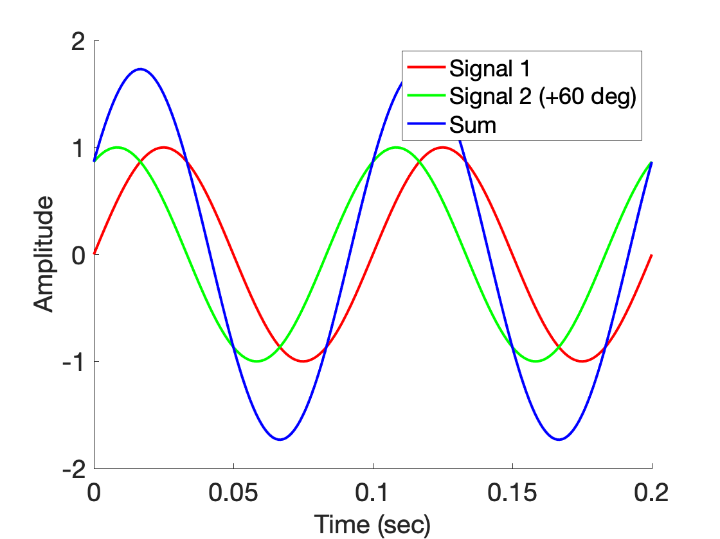
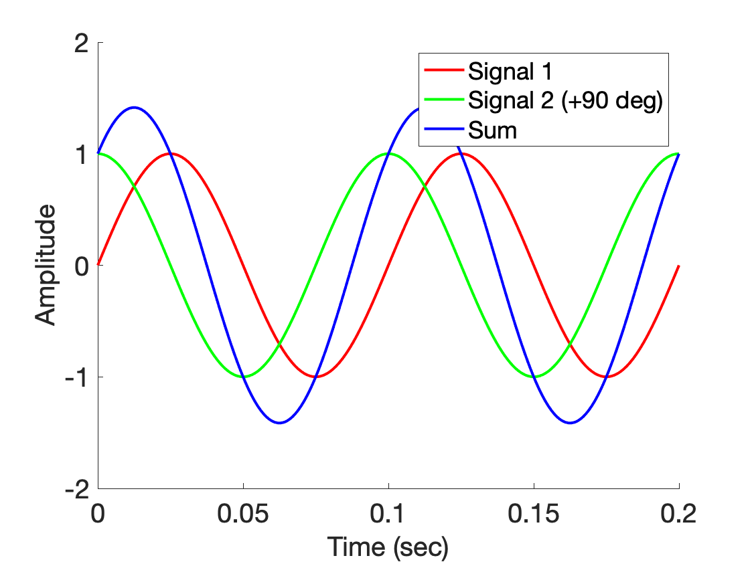
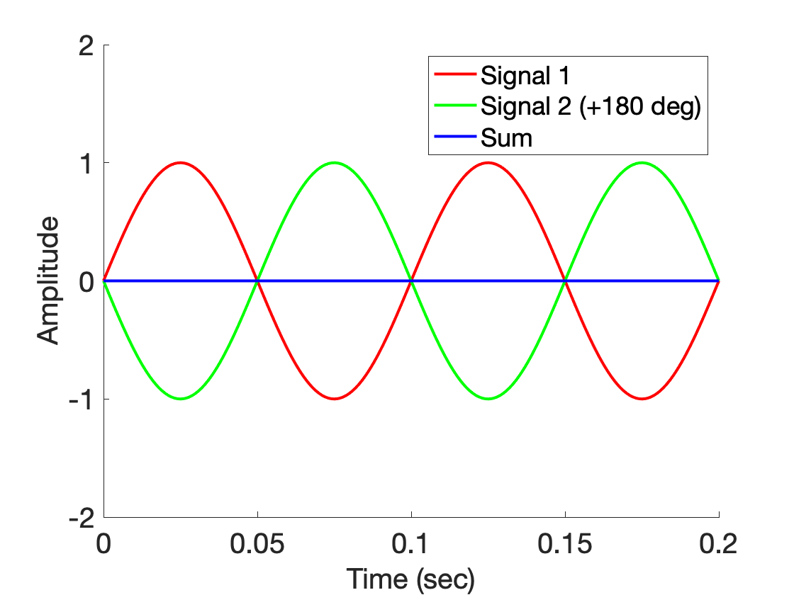
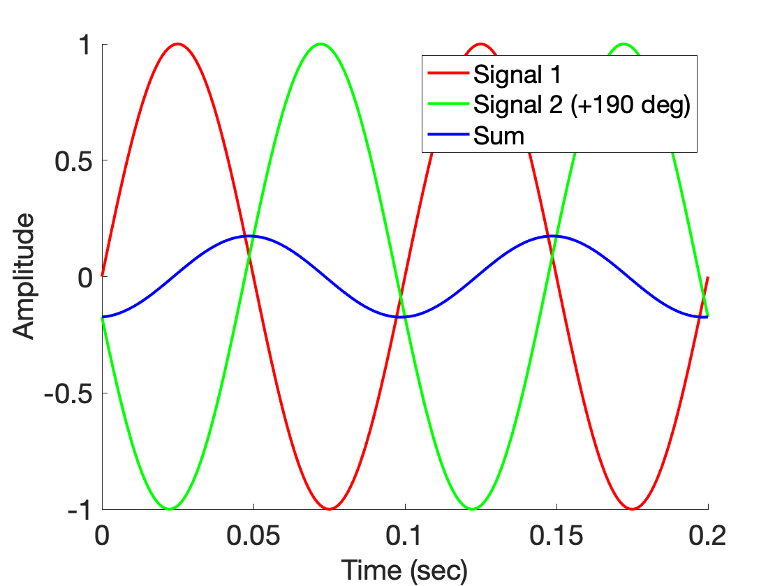
Superimposition of sinusoids

Slide 11
Superimposition of sinusoids
$$sin⁡(2πft)$$

Slide 12
Superimposition of sinusoids
$$sin⁡(2πft)$$
$$d$$
$$sin⁡(2πft+2πd/λ)$$

Slide 13
Superimposition of sinusoids
$$sin⁡(2πft)$$
$$d=λ/2$$
$$\sin\left(2πft+\frac{2πd}{λ}\right)$$
= $\sin\left(2πft+π\right)$
= $− sin\left(2πft\right)$
Signal nullified
Signal nullified

Slide 14
Superimposition of sinusoids
Signal amplified
(perfect constructive interference)
$$d=λ/2$$
$$\sin\left(2πft+\frac{2πd}{λ}\right)$$
= $\sin\left(2πft+π\right)$
= $− sin\left(2πft\right)$
Signal nullified
Signal nullified
(perfect destructive interference)

Slide 15
Superimposition of sinusoids
Beamforming in 1D space
Signal amplified
(perfect constructive interference)
Controlling spatial signal gain
using multiple signal sources.
Depends on distance between
the elements and signal
wavelength.
$$d=λ/2$$
$$\sin\left(2πft+\frac{2πd}{λ}\right)$$
= $\sin\left(2πft+π\right)$
= $− sin\left(2πft\right)$
Signal nullified
Signal nullified
(perfect destructive interference)

Slide 16
Beamforming in 1D space
Signal amplified
$$d$$
Constant phase difference of $\frac{2πd}{λ}$

Slide 17
Array gain
Signal amplified
$$d=λ/2$$
Power gain due to the array structure
Plotting the ‘gain’ of the array
Distance from the center of the array
$$−λ/4$$
$$0$$
$$λ/4$$

Slide 18
Array gain
Signal amplified
Find out the array gain when the separation between
the elements is λ/4
$$d=λ/2$$
Power gain due to the array structure
Plotting the ‘gain’ of the array
Distance from the center of the array
$$−λ/4$$
$$0$$
$$λ/4$$

Slide 19
Beamforming in 2D space
$$d$$

Slide 20
Beamforming in 2D space
$$φ$$
$$d$$

Slide 21
Beamforming in 2D space
Phase difference between these two paths
$$φ$$
$$d$$

Slide 22
Beamforming in 2D space
Approximation for ‘far field’
$$?$$
$$φ$$
$$d$$

Slide 23
Beamforming in 2D space
Approximation for ‘far field’
$$?$$
$$φ$$
$$φ$$
$$d$$

Slide 24
Beamforming in 2D space
Approximation for ‘far field’
Along this line
$d cos$($φ$)
$$φ$$
$$φ$$
$$d$$
Combined signal = $\sin\left(2πft+\frac{2π d cos(φ)}{λ}\right)$
+ $\sin\left(2πft\right)$

Slide 25
Beamforming in 2D space
Approximation for ‘far field’
Parameters: d, $φ$, $λ$ (or f)
Along this line
$d cos$($φ$)
$$φ$$
$$φ$$
$$d$$
Combined signal = $\sin\left(2πft+\frac{2π d cos(φ)}{λ}\right)$
+ $\sin\left(2πft\right)$

Slide 26
Beamforming in 2D space
Approximation for ‘far field’
Parameters: d, $φ$, $λ$ (or f)
Does the gain depend on the distance from the array?
Along this line
$d cos$($φ$)
$$φ$$
$$φ$$
$$d$$
Combined signal = $\sin\left(2πft+\frac{2π d cos(φ)}{λ}\right)$
+ $\sin\left(2πft\right)$

Slide 27
Beamforming in 2D space
Approximation for ‘far field’
$$φ$$
$$d$$

Slide 28
Beamforming in 2D space
Approximation for ‘far field’
$$φ$$
$$d$$
+
Combined signal = $\sin\left(2πft+\frac{2π d cos(φ)}{λ}\right)$
+ $\sin\left(2πft\right)$

Slide 29
Beamforming in 2D space
Directional gain of an array

