Slide 1

Lecture 3.3 (Part 2)
Direction/Angle of Arrival (DoA, AoA)
(Beamforming and Phased Array)
CMSC 818W : Spring 2019
Tu-Th 2:00-3:15pm
CSI 2118
Nirupam Roy
Feb. 26th 2019

Slide 2
Project ideas
1. Smartphone “walking stick” for visually impaired persons
2. Locate an intruder by tracking footsteps
3. Parametric speaker for directional sound projection
4. Head mounted microphone array for augmenting user’s acoustic environment
5. Using smartphone camera to detect cardiac wave and use it for authentication
6. Voice liveness detection
7. Using brainwave as password

Slide 3

Beamforming in 2D space
$$d$$

Slide 4

Beamforming in 2D space
$$φ$$
$$d$$

Slide 5

Beamforming in 2D space
Phase difference between these two paths
$$φ$$
$$d$$

Slide 6

Beamforming in 2D space
Approximation for ‘far field’
$$dcos(φ)$$
$$φ$$
$$d$$

Slide 7
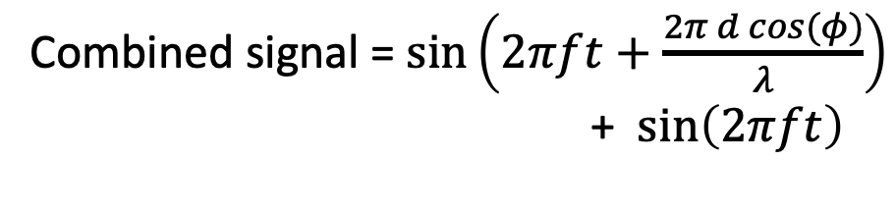

Beamforming in 2D space
Approximation for ‘far field’
Along this line
$$dcos(φ)$$
$$φ$$
$$φ$$
$$d$$
Combined signal = $\sin\left(2πft+\frac{2π d cos(φ)}{λ}\right)$
+ $\sin\left(2πft\right)$

Slide 8
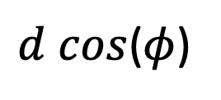

Beamforming in 2D space
Approximation for ‘far field’
Parameters: d, $φ$, $λ$ (or f)
Along this line
$d cos$($φ$)
$$φ$$
$$φ$$
$$d$$
Combined signal = $\sin\left(2πft+\frac{2π d cos(φ)}{λ}\right)$
+ $\sin\left(2πft\right)$

Slide 9
Beamforming in 2D space
Approximation for ‘far field’
Parameters: d, $φ$, $λ$ (or f)
Does the gain depend on the distance from the array?
Along this line
$d cos$($φ$)
$$φ$$
$$φ$$
$$d$$
Combined signal = $\sin\left(2πft+\frac{2π d cos(φ)}{λ}\right)$
+ $\sin\left(2πft\right)$

Slide 10
Beamforming in 2D space
Approximation for ‘far field’
$$φ$$
$$d$$

Slide 11
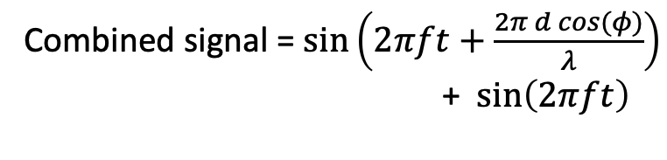
Beamforming in 2D space
Approximation for ‘far field’
$$φ$$
$$d$$
+
Combined signal = $\sin\left(2πft+\frac{2π d cos(φ)}{λ}\right)$
+ $\sin\left(2πft\right)$

Slide 12
Beamforming in 2D space
Directional gain of an array

Slide 13
Uniform Linear Array (ULA)

Slide 14









Beamforming in 2D space
$d cos$($φ$)
$$φ$$
$$E1$$
$$E2$$
$$E3$$
$$E4$$
…
N elements
$$d$$
$$d$$
$$d$$

Slide 15
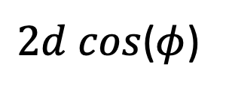
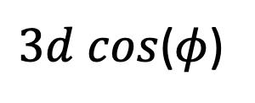
Beamforming in 2D space
$3d cos$($φ$)
$2d cos$($φ$)
$d cos$($φ$)
$$φ$$
$$E1$$
$$E2$$
$$E3$$
$$E4$$
…
N elements
$$d$$
$$d$$
$$d$$

Slide 16
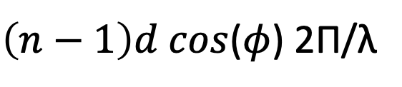
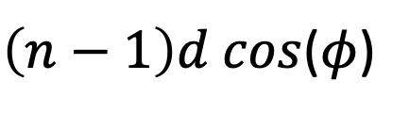
Beamforming in 2D space
$3d cos$($φ$)
$2d cos$($φ$)
$d cos$($φ$)
$$φ$$
$$E1$$
$$E2$$
$$E3$$
$$E4$$
…
N elements
$$d$$
$$d$$
$$d$$
Path difference with n^{th} element:
$\left(n−1\right)d cos$($φ$)
Phase difference with n^{th} element:
$\left(n−1\right)d cos$($φ$) 2Π/λ

Slide 17
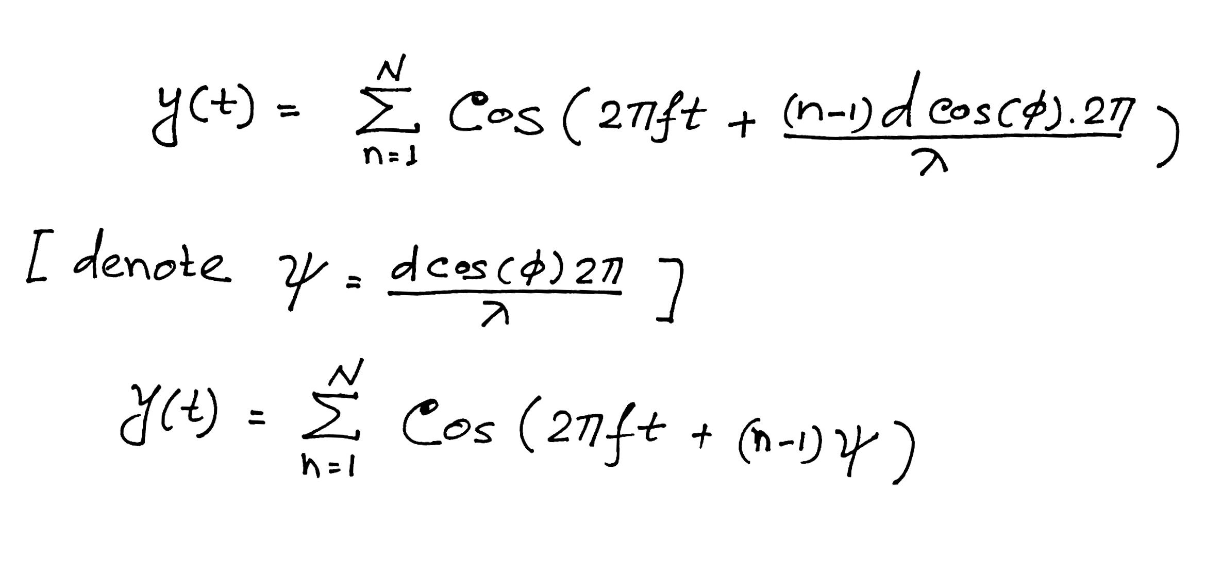





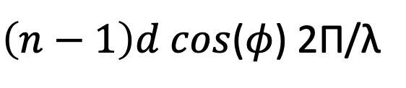
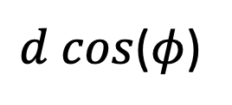



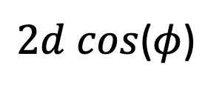

$3d cos$($φ$)
$2d cos$($φ$)
Beamforming in 2D space
$d cos$($φ$)
$$φ$$
$$E1$$
$$E2$$
$$E3$$
$$E4$$
…
N elements
$$d$$
$$d$$
$$d$$
Path difference with n^{th} element:
$\left(n−1\right)d cos$($φ$)
Phase difference with n^{th} element:
$\left(n−1\right)d cos$($φ$) 2Π/λ
Original signal:
$$cos⁡(2πft)$$
Combined signal:

Slide 18
Complex number recap
Z = r (cos(𝚹) + j sin(𝚹)), e^{j 𝚹} = cos(𝚹) + j sin(𝚹)
Re{Z} = x = r cos(𝚹), Im{Z} = y = r sin(𝚹)

Slide 19
Complex number recap
Z = r (cos(𝚹) + j sin(𝚹)), e^{j 𝚹} = cos(𝚹) + j sin(𝚹)
Re{Z} = x = r cos(𝚹), Imag(Z) = y = r sin(𝚹)
Re{e^{j 𝚹}} = cos(𝚹)

Slide 20
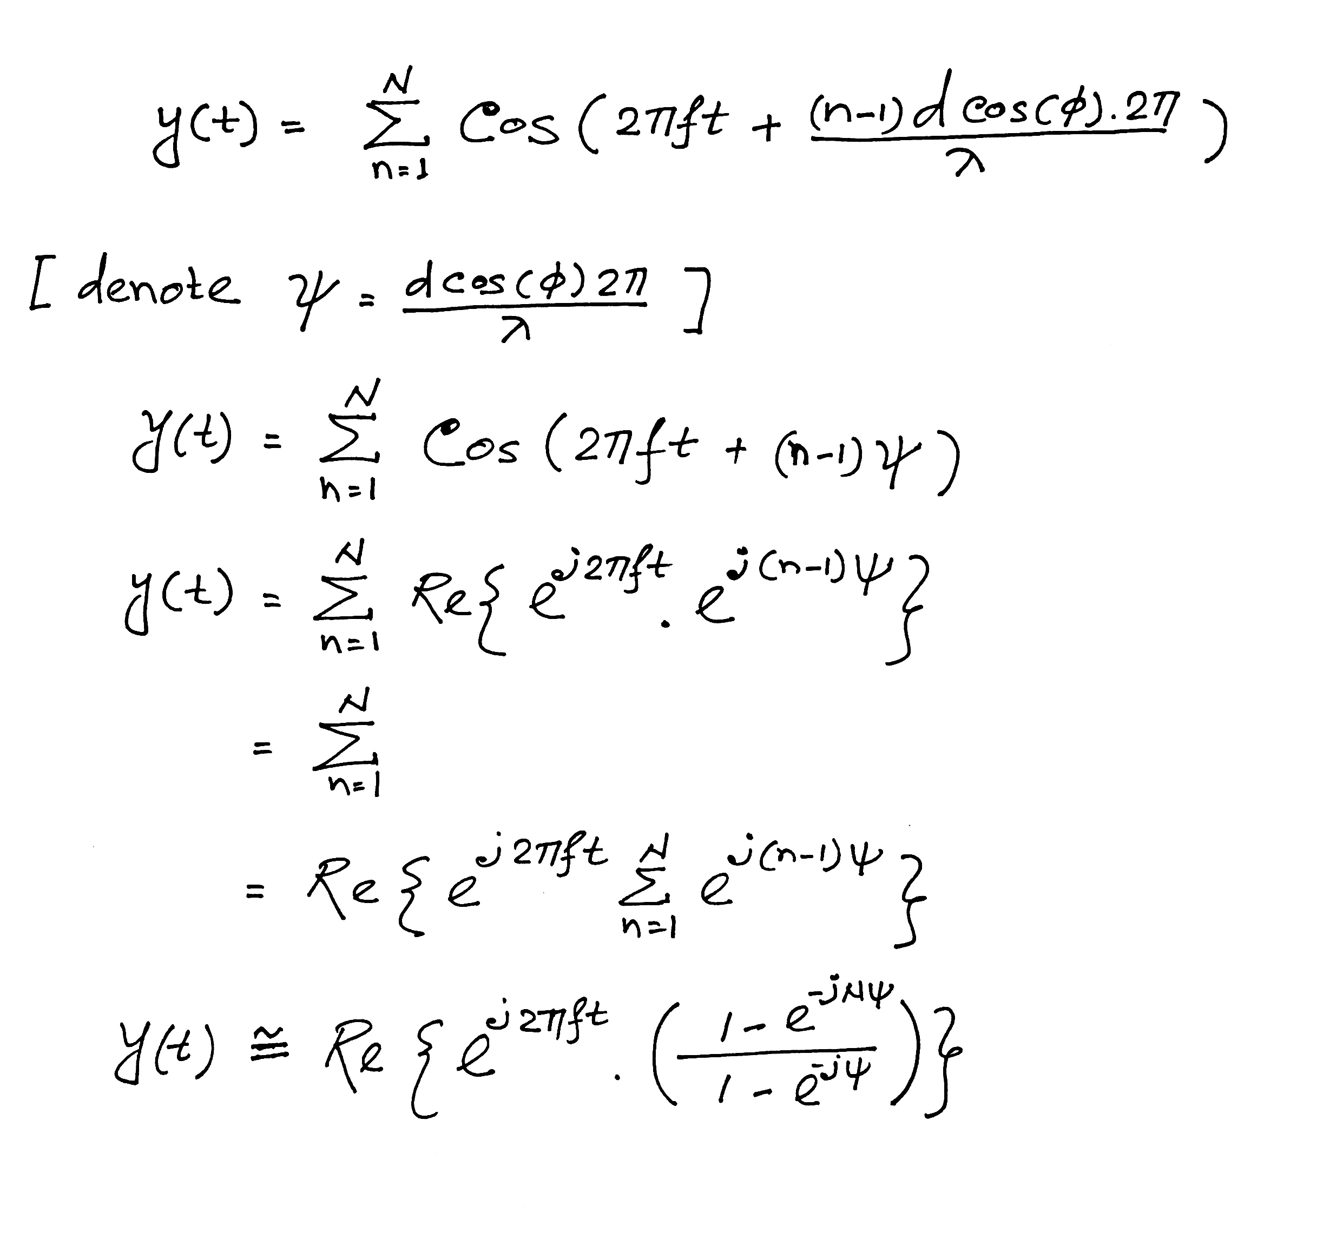
Beamforming in 2D space
Notes:
http://www.waves.utoronto.ca/prof/svhum/ece422/notes/15-arrays2.pdf

Slide 21
Beamforming in 2D space
Notes:
http://www.waves.utoronto.ca/prof/svhum/ece422/notes/15-arrays2.pdf

Slide 22
Beamforming in 2D space
=
Notes:
http://www.waves.utoronto.ca/prof/svhum/ece422/notes/15-arrays2.pdf

Slide 23
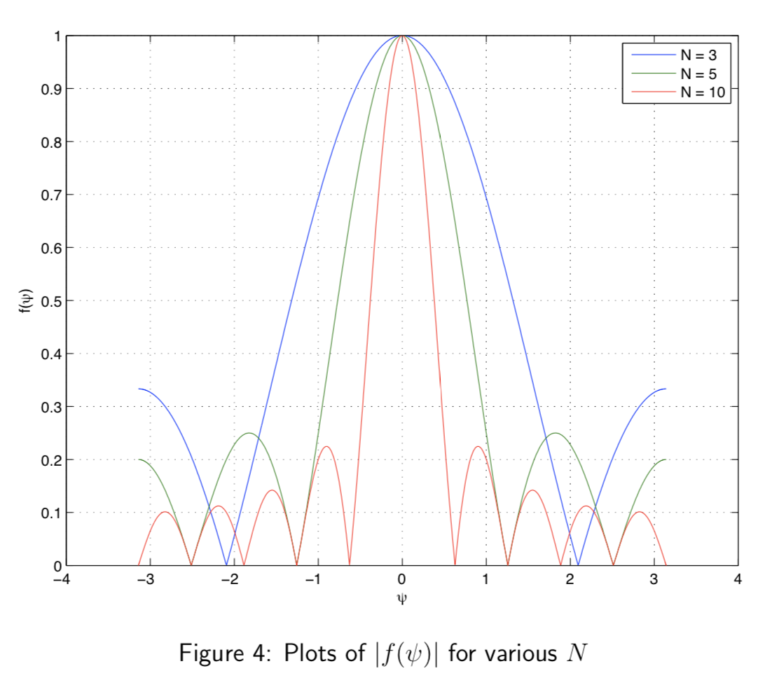
Beamforming in 2D space
Notes:
http://www.waves.utoronto.ca/prof/svhum/ece422/notes/15-arrays2.pdf

Slide 24
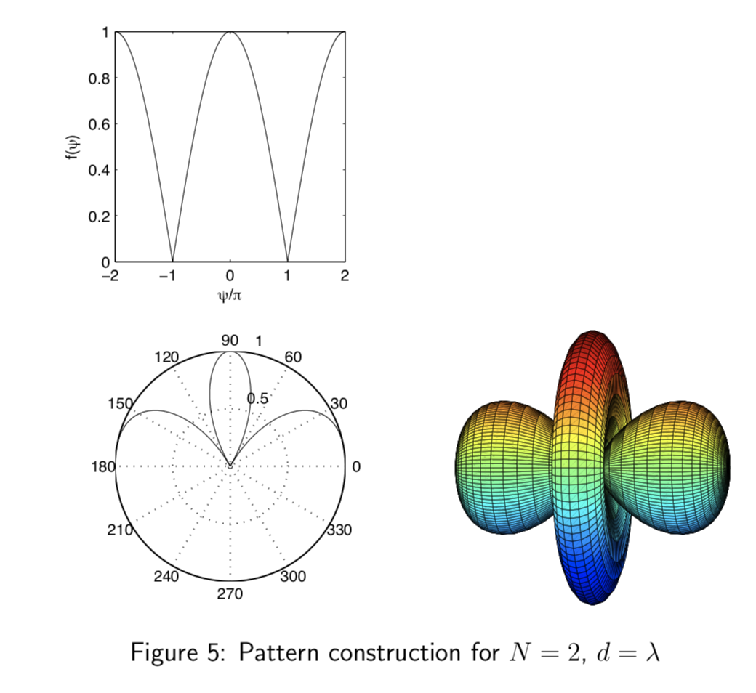
Beamforming in 2D space
Notes:
http://www.waves.utoronto.ca/prof/svhum/ece422/notes/15-arrays2.pdf

Slide 25
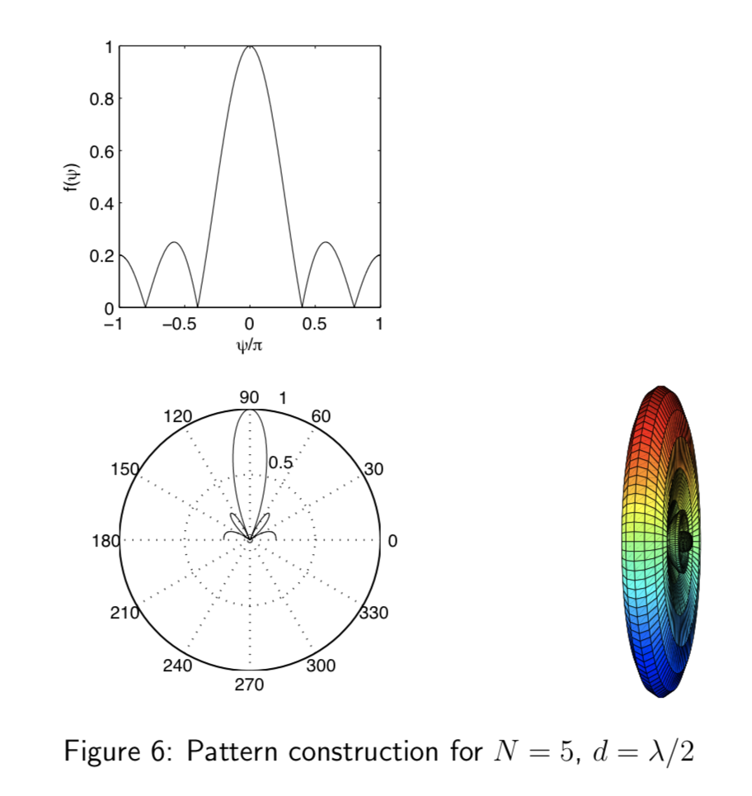
Beamforming in 2D space
Notes:
http://www.waves.utoronto.ca/prof/svhum/ece422/notes/15-arrays2.pdf

Slide 26
Angle-of-Arrival (AoA) or Direction-of-Arrival (DoA)
Delay-sum beamformer or Phased array
Notes:
http://www.waves.utoronto.ca/prof/svhum/ece422/notes/15-arrays2.pdf

Slide 27
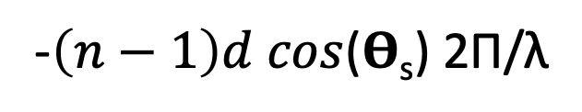
Angle-of-Arrival (AoA) or Direction-of-Arrival (DoA)
Delay-sum beamformer or Phased array
Add addition phase:
-$\left(n−1\right)d cos$(𝚹_{s}) 2Π/λ
Notes:
http://www.waves.utoronto.ca/prof/svhum/ece422/notes/15-arrays2.pdf

Slide 28
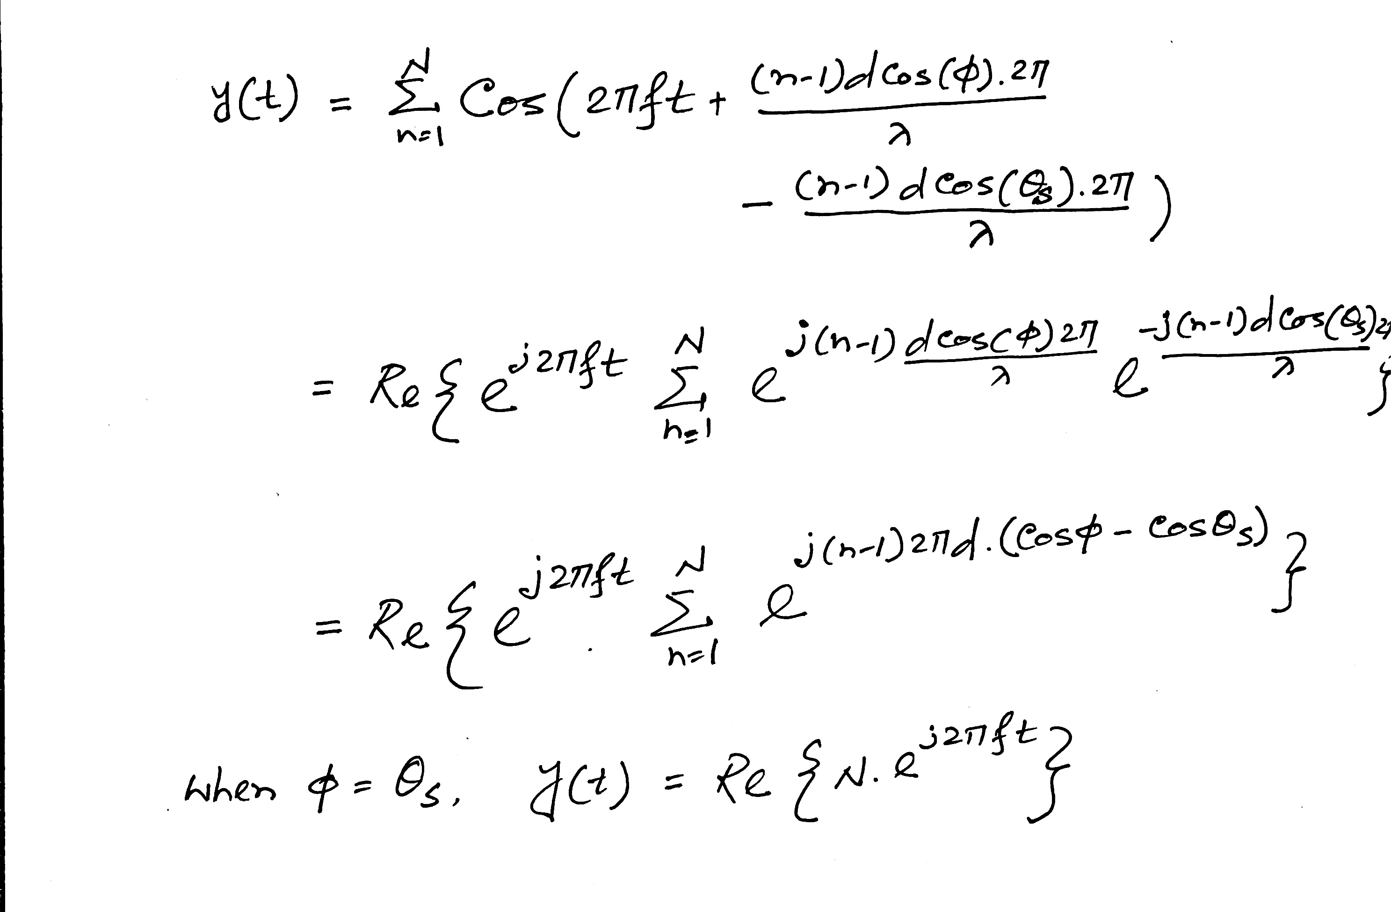
Angle-of-Arrival (AoA) or Direction-of-Arrival (DoA)
Notes:
http://www.waves.utoronto.ca/prof/svhum/ece422/notes/15-arrays2.pdf

Slide 29
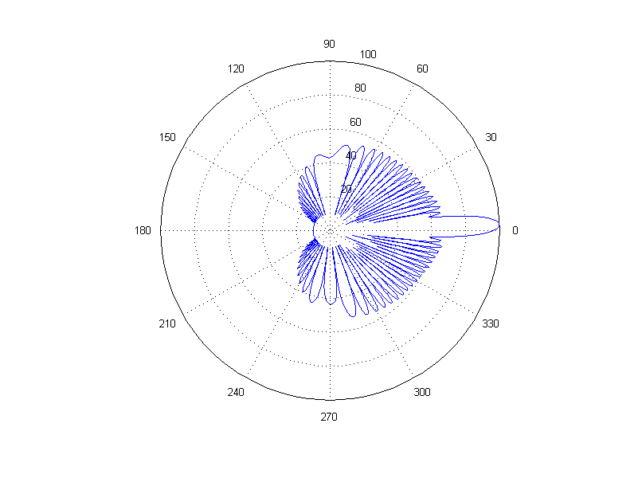
Angle-of-Arrival (AoA) or Direction-of-Arrival (DoA)
Number of elements - 30, wave length - 10cm, distance between elements - 6.5 cm
Notes:
http://www.waves.utoronto.ca/prof/svhum/ece422/notes/15-arrays2.pdf

