Slide 1
GPS, Differential GPS, and Applications
to Drones

Slide 2
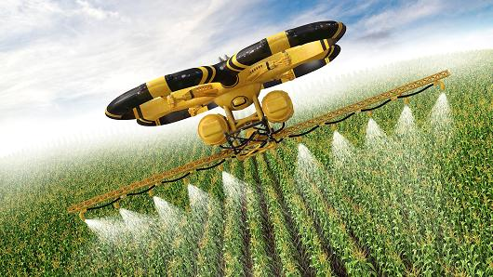
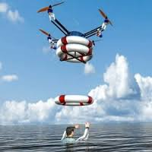
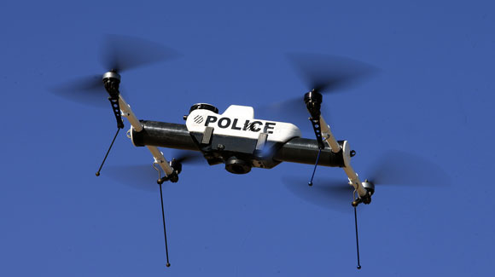
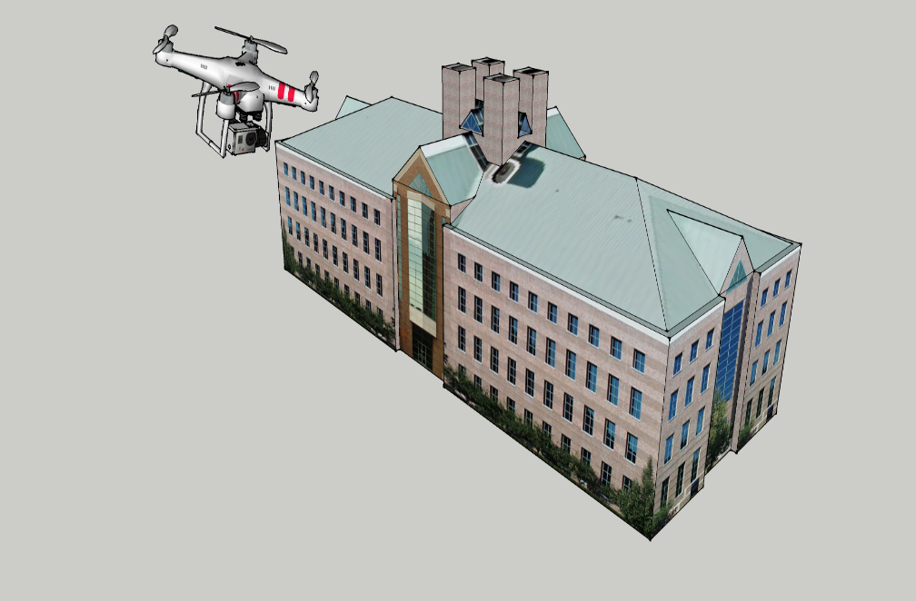
Tremendous excitement with drones

Slide 3
Despite the excitement …

Slide 4
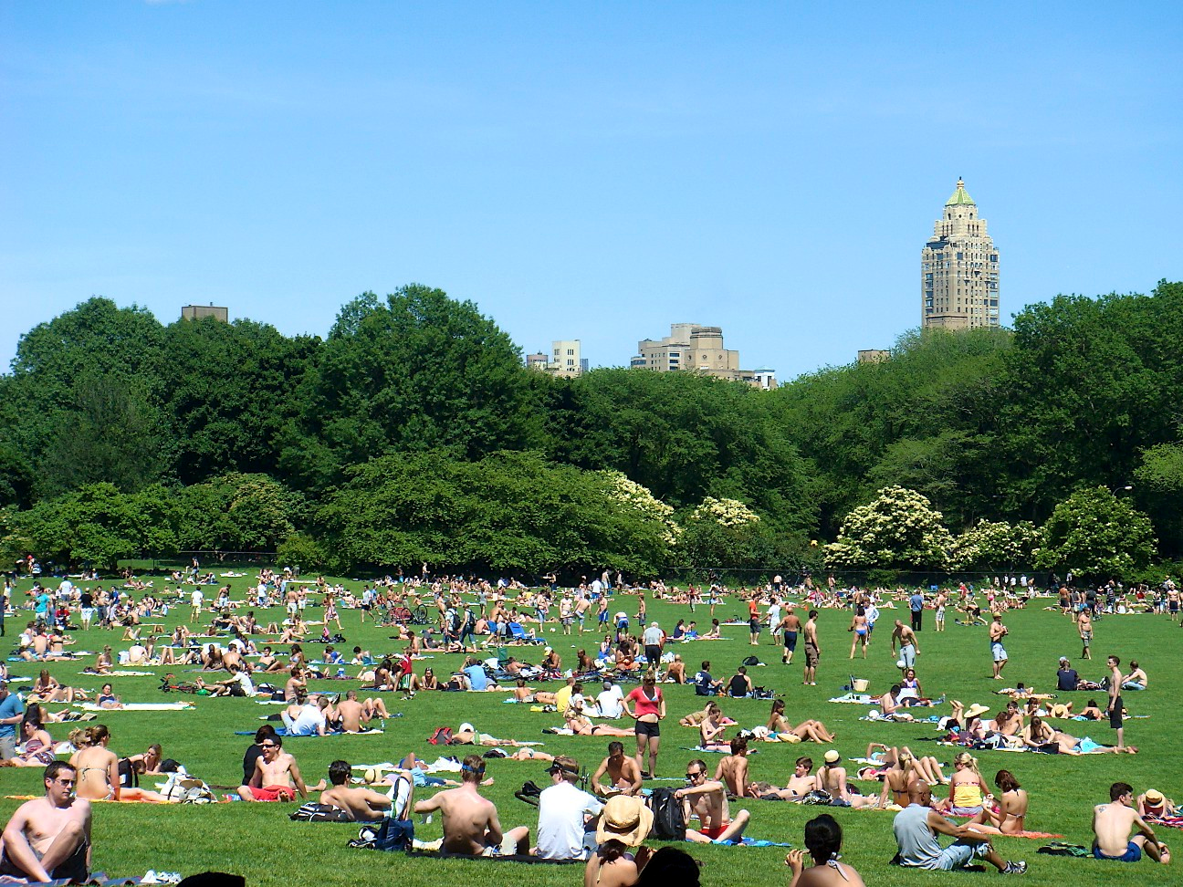
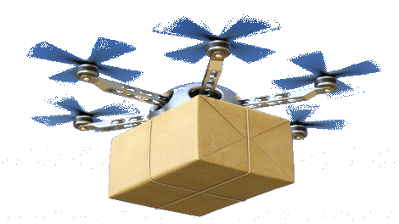
Drones still not ready for public places

Slide 5
Several instances of crashes and failure …
Notes:
Drone accidents are very common .. Severely threateninig life and property

Slide 6
Why do drones crash?

Slide 7
Drone Stabilization
IMU
Accelerometer
Gyroscope
Magnetometer
Inertial Measurement Unit (IMU) crucial for tracking 3D orientation → stabilization, control

Slide 8
IMU can fail
IMU
Accelerometer
Gyroscope
Magnetometer
Inertial Measurement Unit (IMU) crucial for tracking 3D orientation → stabilization, control
However, rotor vibration and magnetic interference derails
the sensors … causing correlated failures

Slide 9
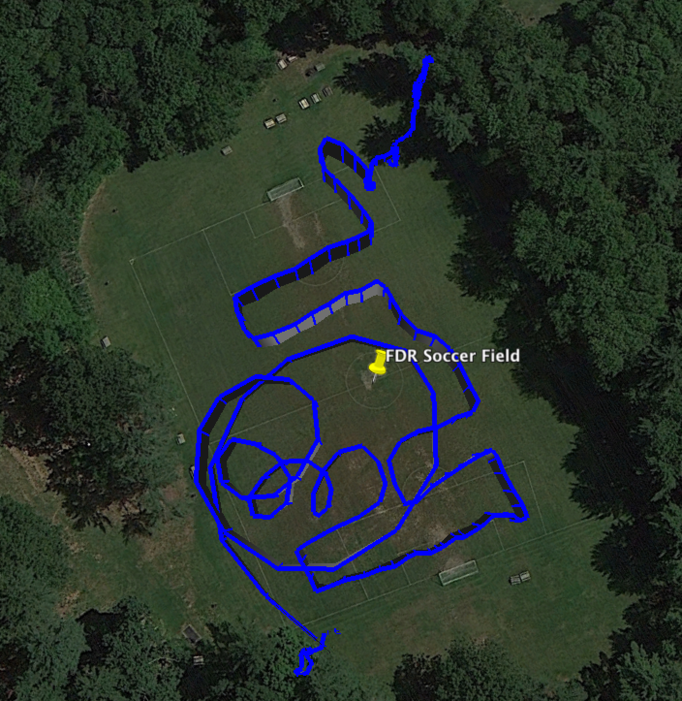
45% of drone crashes due to IMU failures [DJI Drone Survey 2015]
We ask: can we design a Plan-B for IMU failure?
Drones already use GPS for localization …
recent drones using multiple GPS for reliability
Can we leverage multiple GPS receivers to compute
3D orientation (i.e., a backup for IMU sensor failure)

Slide 10
Use multiple GPS to compute 3D orientation

Slide 11
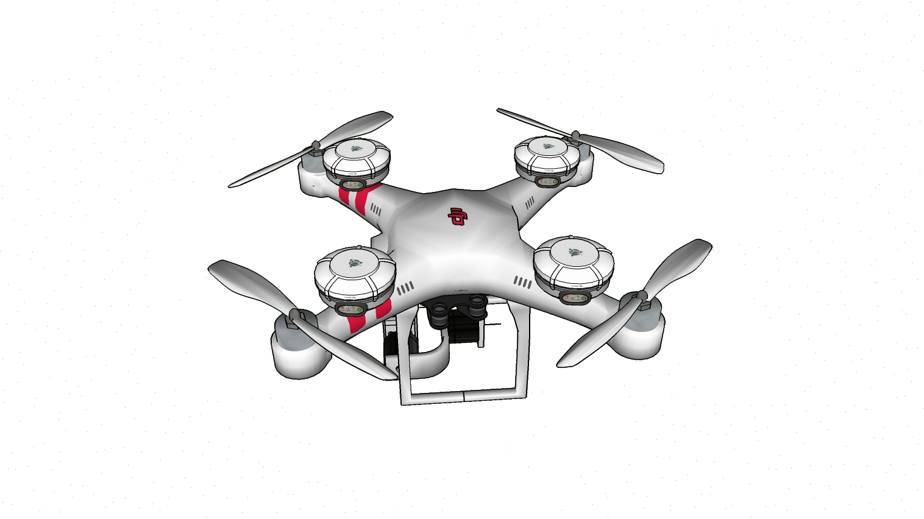
Use multiple GPS to compute 3D orientation

Slide 12
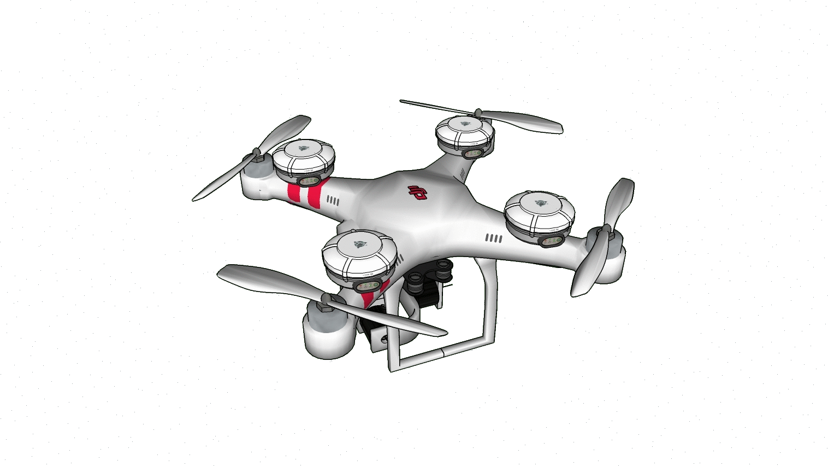
Use multiple GPS to compute 3D orientation

Slide 13
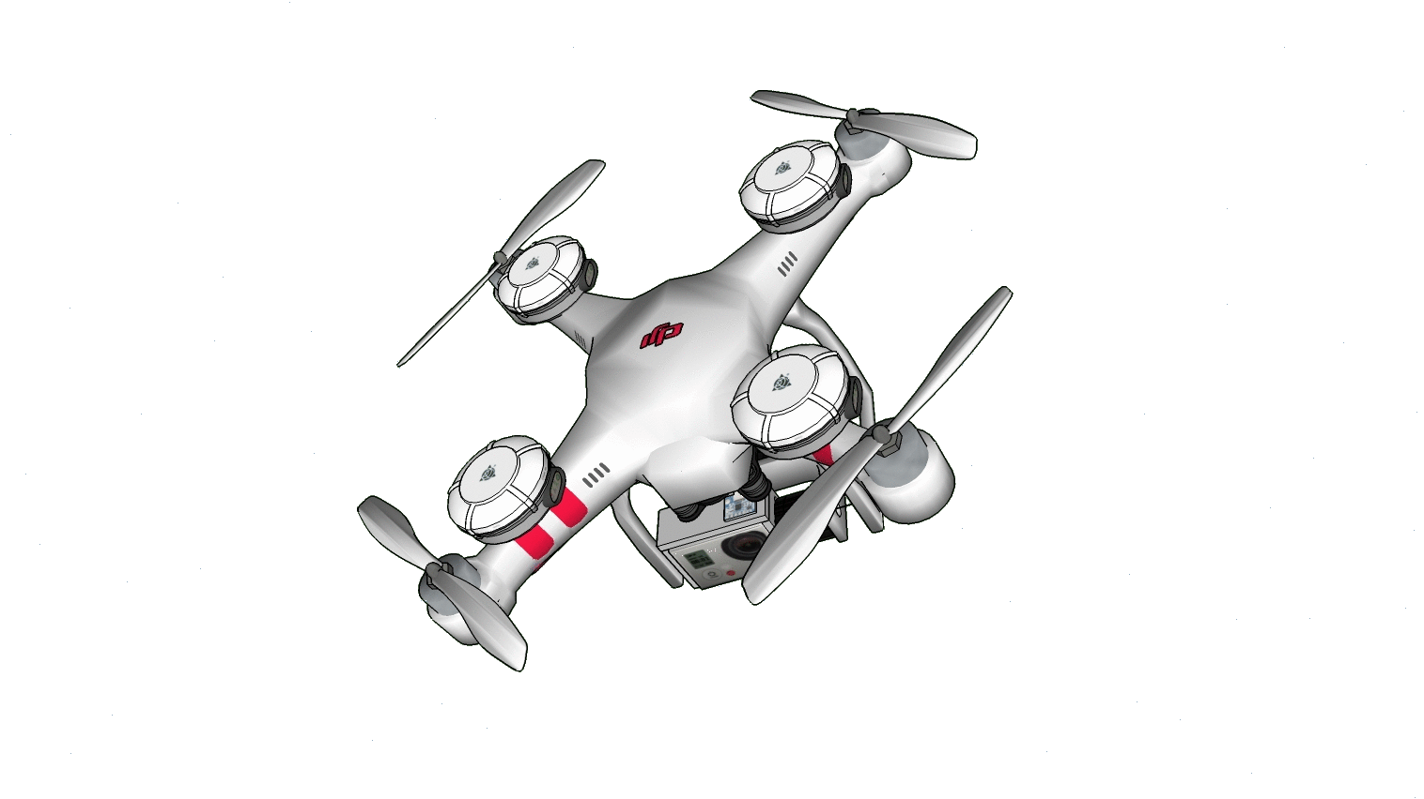
Use multiple GPS to compute 3D orientation

Slide 14
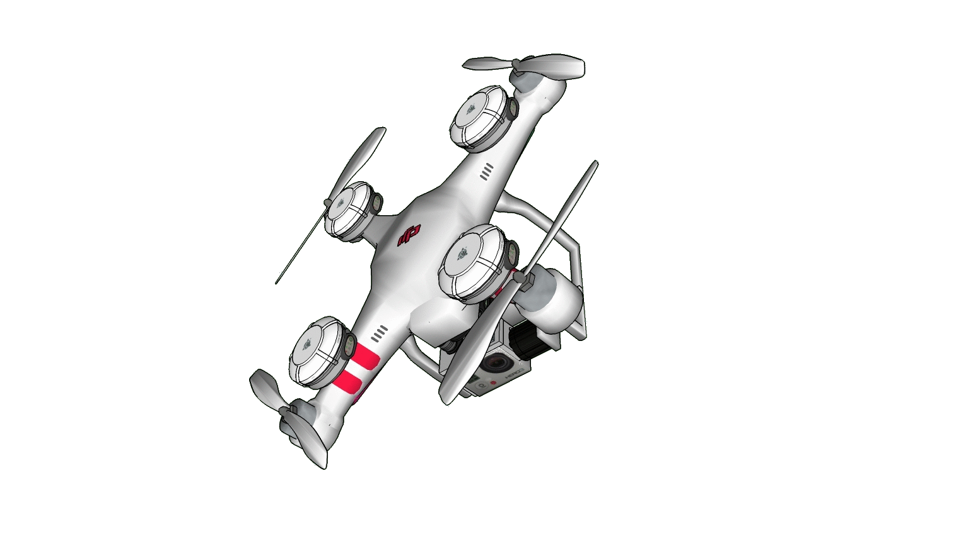
Use multiple GPS to compute 3D orientation

Slide 15
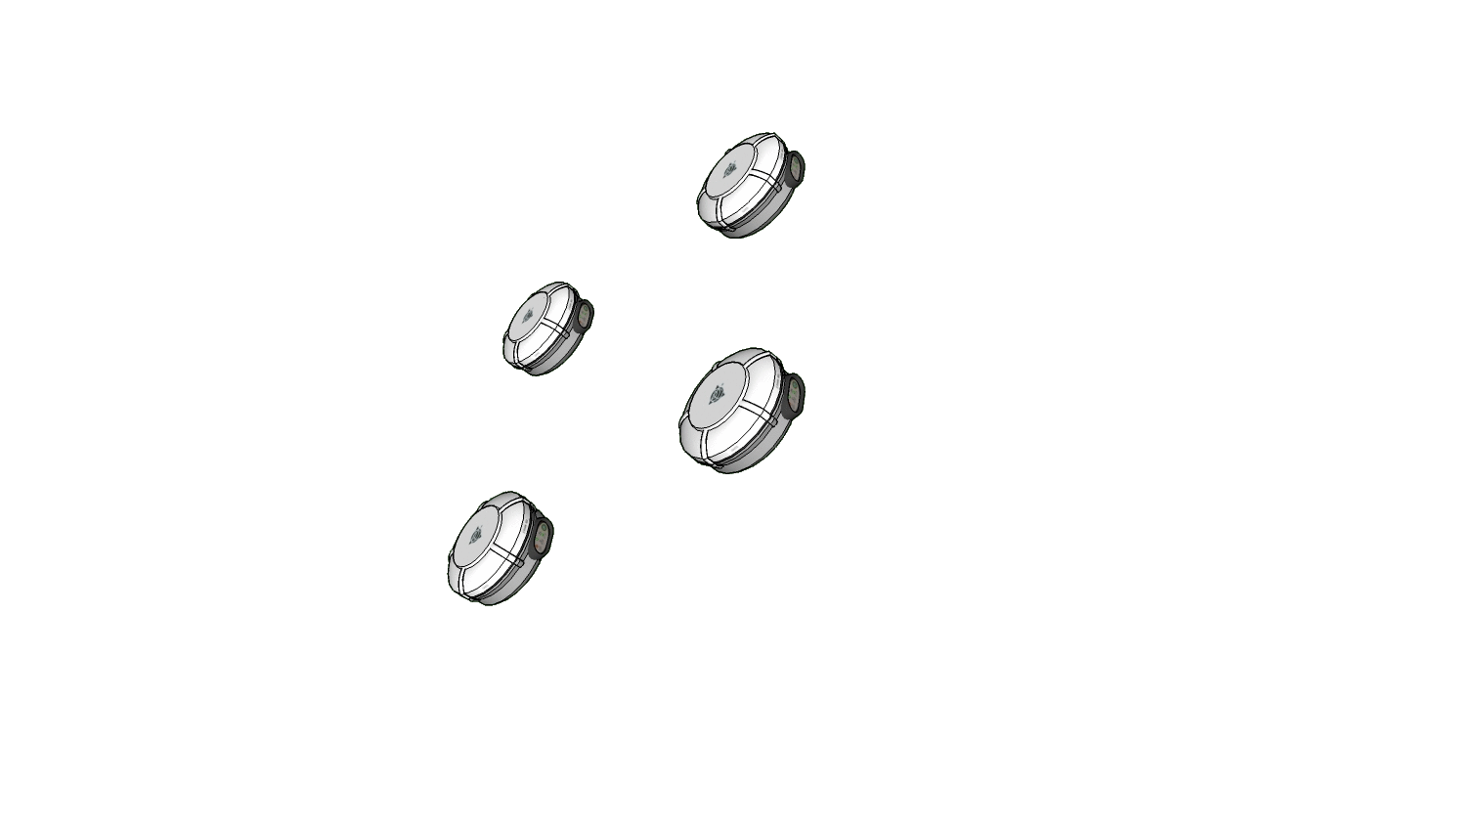
Use multiple GPS to compute 3D orientation
Translate Relative Positions into 3D Orientation
To match IMU accuracy (~2 deg.)
Relative vector estimates have to be ~2cm

Slide 16
To match IMU, we require <2cm error for each 3D vector
Basic GPS → 3m absolute position error
3D vector
Opportunity:
We do not care about absolute location …
we only need relative
Differential GPS → relative →15cm error
Parkinson et al, GPS 96, Cohen et al, Journal of Satellite Communication 96
Hedgecock et al, Mobisys 13, Sensys 14
We bring additional spatio-temporal information fusion techniques …
for these small sized drones

Slide 17
Some background on GPS
Basic satellite trilateration: 300km error
GPS Localization (phones): 1-3m error
Differential GPS (airplanes): 15cm error
For drone orientation (< $2^{∘}$ ): ~2cm error

Slide 18
A brief review of GPS literature
(300 km to 15 cm)

Slide 19
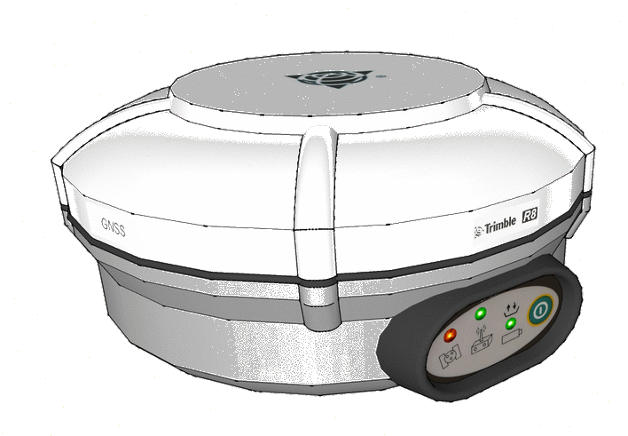
Basic GPS Localization
GPS Signal
.

Slide 20
Basic GPS Localization
GPS Signal
.
However, 3D location needs 3 equations … hence, use 3 satellites

Slide 21
Basic GPS Localization
GPS Signal
.
However, 3D location needs 3 equations … hence, use 3 satellites

Slide 22
Basic GPS Localization
GPS Signal
.
.
However, 3D location needs 3 equations … hence, use 3 satellites
Satellite
Geometry
Matrix
$\left[\begin{matrix} & ⋯ & \\ ⋮ & ⋱ & ⋮ \\ & ⋯ & \end{matrix}\right]\left[\begin{aligned}X \\ Y \\ Z\end{aligned}\right]$ = $\left[\begin{aligned}R_{1} \\ R_{2} \\ R_{3}\end{aligned}\right]$
300 Km of error
due to unsynchronized clocks

Slide 23
Basic GPS Localization
GPS Signal
.
New unknown … use 4th satellite and estimate both location and
$\left[\begin{matrix} & ⋯ & \\ ⋮ & ⋱ & ⋮ \\ \begin{aligned} \\ \end{aligned} & \begin{aligned}⋯ \\ \end{aligned} & \begin{aligned} \\ \end{aligned}\end{matrix} \right]\left[\begin{aligned}X \\ Y \\ Z \\ δ_{clk}\end{aligned}\right]$ = $\left[\begin{aligned}R_{1} \\ R_{2} \\ R_{3} \\ R_{4}\end{aligned}\right]$
Satellite Geometry Matrix
$$\begin{matrix}c \\ c \\ \begin{aligned}c \\ c\end{aligned}\end{matrix}$$
1-3m error

Slide 24
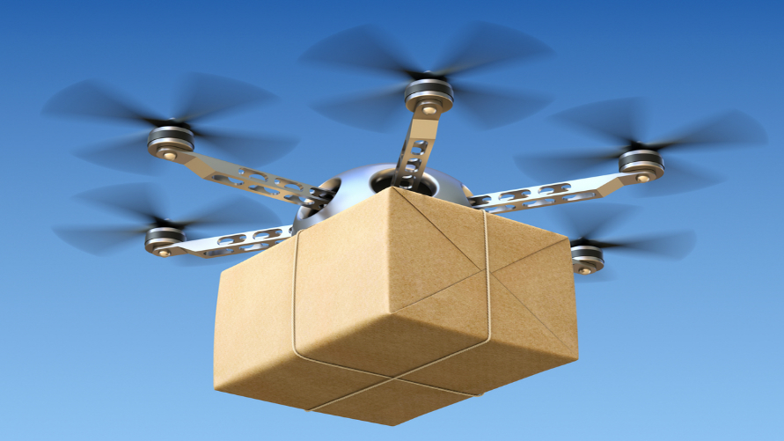
1-3m error acceptable to smartphones, car GPS
Drone orientation warrants cm level accuracy
Differential GPS
using phase of the signals

Slide 25
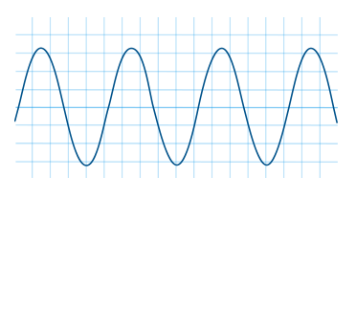
Differential GPS (using carrier phase)

Slide 26
GPS Carrier Phase
GPS Satellite
True Range
Phase
GPS Carrier Wave
GPS Receiver
Possible to measure precisely
(2-5 mm error)
However, difficult to
estimate N

Slide 27
GPS Carrier Phase
GPS Satellite
True Range
Phase
GPS Carrier Wave
GPS Receiver
Real systems more difficult:
However, since we only care about relative distances …
Possible to eliminate some errors by subtracting phase equations
across receivers, satellites, time, etc.
For example …

Slide 28
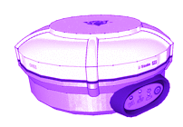
(I) Single Differential Across Receivers – Cancelling Satellite Errors
S
$$φ_{1}^{s}=R_{1}^{s}+λN_{1}^{s}+Clk^{s}+Clk_{1}+Del_{atm}$$
$$φ_{2}^{s}=R_{2}^{s}+λN_{2}^{s}+Clk^{s}+Clk_{2}+{Del}_{atm}$$
Range = $R_{2}^{s}$
$Δφ_{12}^{s}={ΔR}_{12}^{s}+λN_{12}^{s}+Δ{Clk}_{12}$
Range = $R_{1}^{s}$
$Δφ_{12}^{s}=R_{12}\hat{l_{s}}+λN_{12}^{s}+Δ{Clk}_{12}$
$$R_{12}$$
Clock Errors can be eliminated further
2
1
Relative Position (Baseline)

Slide 29
(II) Satellite Double Differential: Cancel Receiver Errors
S
K
$Δφ_{12}^{s}=R_{12}\hat{l_{s}}+λN_{12}^{s}+Δ{Clk}_{12}$
$Δφ_{12}^{k}=R_{12}\hat{l_{k}}+λN_{12}^{k}+Δ{Clk}_{12}$
$$Δφ_{12}^{s}−Δφ_{12}^{k}=R_{12}.( \hat{l_{s}} −\hat{l_{k}})+λ(N_{12}^{s}−N_{12}^{k})$$
$$Δφ_{12}^{sk}=R_{12}(\hat{l_{s}} −\hat{l_{k}})+λ(N_{12}^{sk})$$
$$R_{12}$$
2
1
R₁₂ = Relative vector (BaseLine) between two GPSs
Can be translated into Orientation
However, integer ambiguity remains

Slide 30
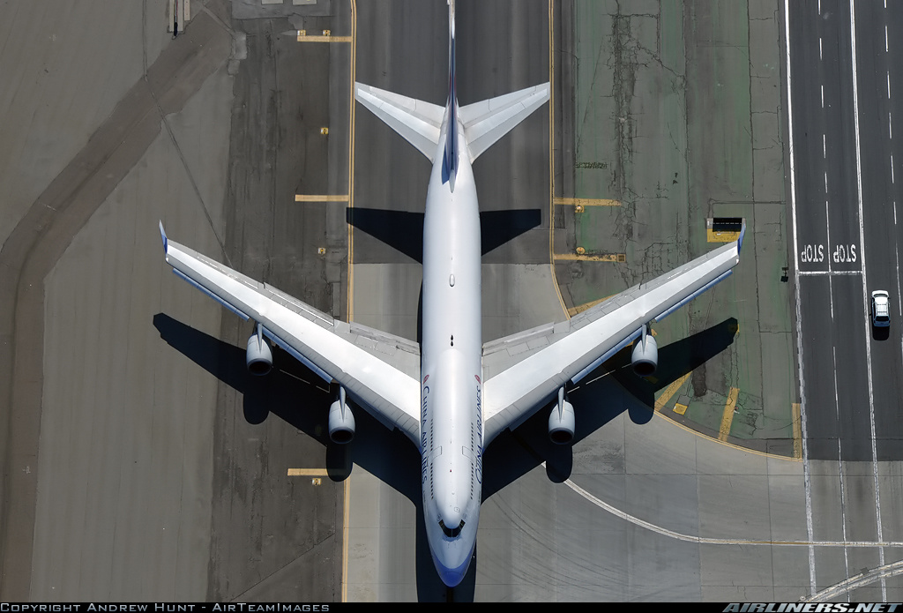
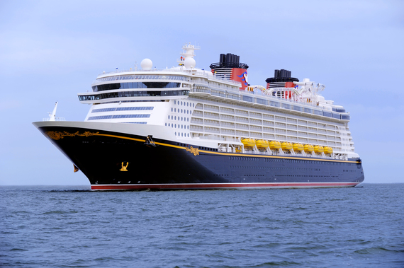
Differential GPS community has exploited such techniques to achieve orientation estimation on big planes, ships
For a small drone we need very high accuracy
Need to handle dynamic errors

Slide 31
(III) Time Double Differentials
S
$Δφ_{12}^{s}(t_{1})={ΔR}_{12}^{s}\left(t_{1}\right)+λN_{12}^{s}+Δ{Clk}_{12}(t_{1})$
$Δφ_{12}^{s}(t_{2})={ΔR}_{12}^{s}\left(t_{2}\right)+λN_{12}^{s}+Δ{Clk}_{12}(t_{2})$
$$R_{1}^{s}{(t}_{1})$$
$$R_{2}^{s}{(t}_{1})$$
$$Δφ_{12}^{s}\left(t_{12}\right)=f(R_{12}\left(t_{1}\right)−R_{12}\left(t_{2}\right)$$
$$,Clk_{12}(t_{12}))$$
$$R_{1}^{s}{(t}_{2})$$
$$R_{12}{(t}_{1})$$
$$R_{2}^{s}{(t}_{2})$$
Change in orientation
$$R_{12}{(t}_{2})$$
No Integer Ambiguity

Slide 32
Two Observations on Orientation
Satellite Double Differentials
Time Double Differential
$$Δ$$
Drone Absolute Orientation, but polluted by Integer Ambiguity
Change in Orientation, but unpolluted by Integer Ambiguity
Naturally amenable to a process filtering model

Slide 33
Bayesian Filtering Approach
Transition
q
q
q
pitch, roll, yaw
pitch, roll, yaw
pitch, roll, yaw
Measurement
Notes:
We can model orientation as states that evolve in time and by using the two different perspectives, we can derive suitable transition and emission models as follows ..

Slide 34
Measurement Model
Trans.
q
q
q
Meas.
$$φ_{12}^{sk}=f(R_{12},N_{12}^{sk})$$
Satellite Double
Differentials
$$φ_{13}^{sk}=f(R_{13},N_{13}^{sk})$$
$$φ_{14}^{sk}=f(R_{14},N_{14}^{sk})$$

Slide 35
Measurement Model
Trans.
q
q
q
Meas.
$$φ_{ij}^{sk}=f(q,N_{ij}^{sk})$$
Satellite Double
Differentials
Integer Ambiguity ?

Slide 36
Transition Model
$$Δφ_{12}^{s}\left(Δt\right)=f({ΔR}_{12},Clk_{12})$$
$$Δφ_{13}^{s}\left(Δt\right)=f({ΔR}_{13},Clk_{13})$$
$$Δφ_{13}^{s}\left(Δt\right)=f({ΔR}_{14},Clk_{14})$$
Time Double
Differentials
Trans.
$$Δq$$
$$Δq$$
q
q
q
Meas.
36

Slide 37
Bayesian Filtering Approach
$$Δφ_{12}^{s}\left(Δt\right)=f(Δq,Clk_{12})$$
Time Double
Differentials
Trans.
$$Δq$$
$$Δq$$
q
q
q
Meas.
37

Slide 38
Bayesian Filtering Approach
$$Δφ_{12}^{s}\left(Δt\right)=f(Δq,Clk_{12})$$
Time Double
Differentials
Trans.
$$Δq$$
$$Δq$$
q
q
q
Meas.
$$φ_{ij}^{sk}=f(q,N_{ij}^{sk})$$
Satellite Double
Differentials
Integer Ambiguity ?
38

Slide 39
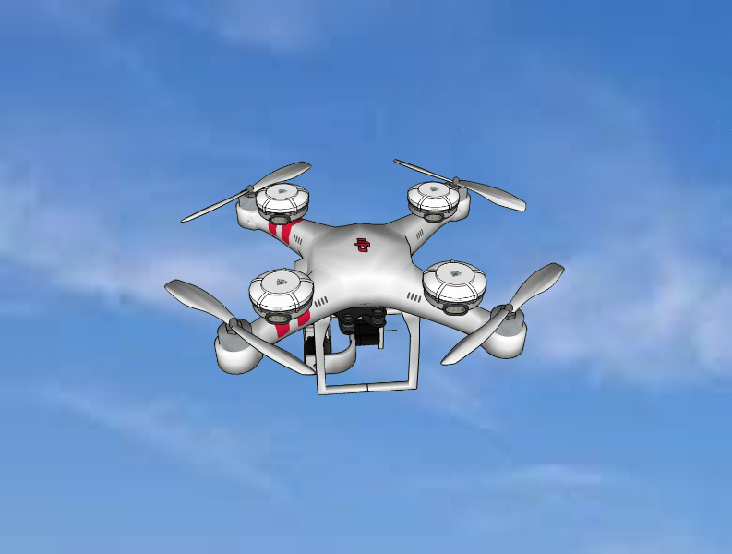
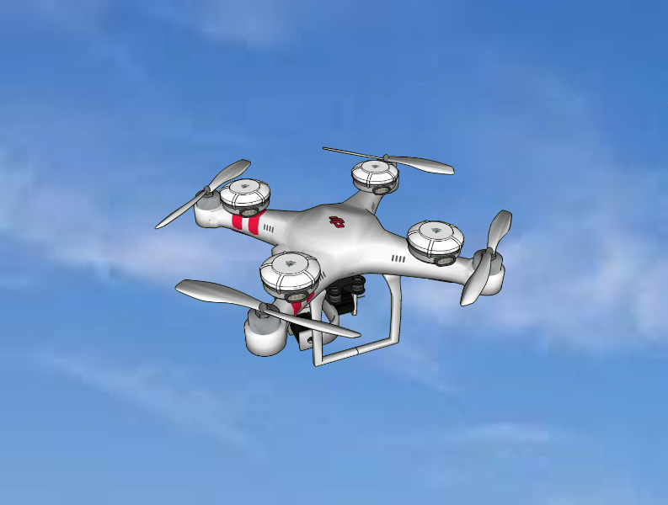
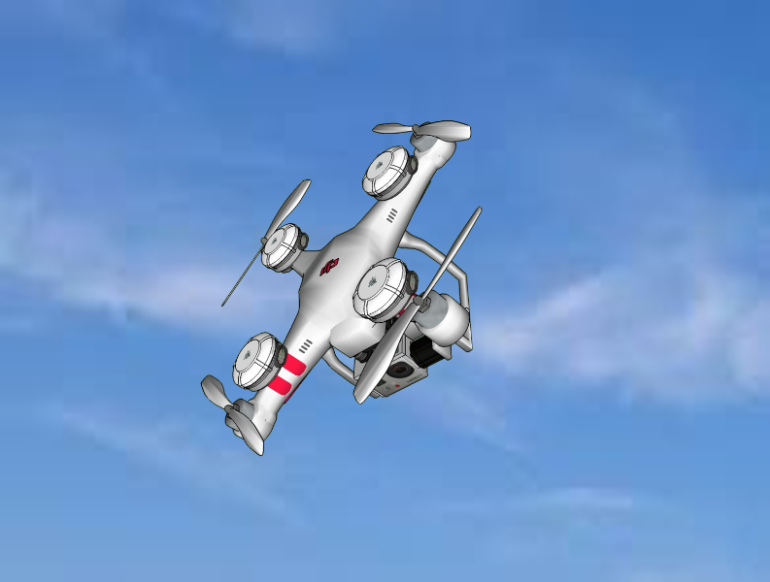
Integer Ambiguity Resolution depends on Flight Aggressiveness
Two regimes of aggressiveness
Low Dynamic Flights
Kalman Filter
Highly Aggressive flights
Particle Filter

Slide 40
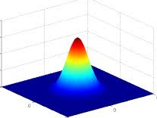
Orientation Estimation - Low Dynamic flights
$$\hat{q_{2}}=q1+Δq$$
$$\hat{q_{2}}$$
Pitch, Roll, Yaw
[$q_{1}$]
$$Δq$$
Pitch, Roll, Yaw
[$q_{2}$]
Pitch, Roll, Yaw
[$q_{3}$]
Trans.
Static Drone
Meas.
$$φ_{ij}^{sk}=f(q,N_{ij}^{sk})$$
$q_{1}$ known
$$\hat{N_{ij}^{sk}}=⌊f\left( ,φ_{ij}^{sk}\right)⌋$$
Kalman Filter
$$\tilde{q_{2}}=f\left(φ_{ij}^{sk},\hat{N_{ij}^{sk}}\right)$$

Slide 41
Highly Aggressive Flights: Cycle Slips
$$\hat{q_{2}}=q1+Δq$$
Pitch, Roll, Yaw
[$q_{1}$]
$$Δq$$
Pitch, Roll, Yaw
[$q_{2}$]
Pitch, Roll, Yaw
[$q_{3}$]
Trans.
Cycle Slips
Static Drone
Meas.
$$φ_{ij}^{sk}=f(q,N_{ij}^{sk})$$
$q_{1}$ known
Kalman filter derailed
$$\hat{N_{ij}^{sk}}=⌊f\left( ,φ_{ij}^{sk}\right)⌋$$
Kalman Filter
$$\hat{q_{2}}$$
$$\tilde{q_{2}}=f\left(φ_{ij}^{sk},\hat{N_{ij}^{sk}}\right)$$

Slide 42
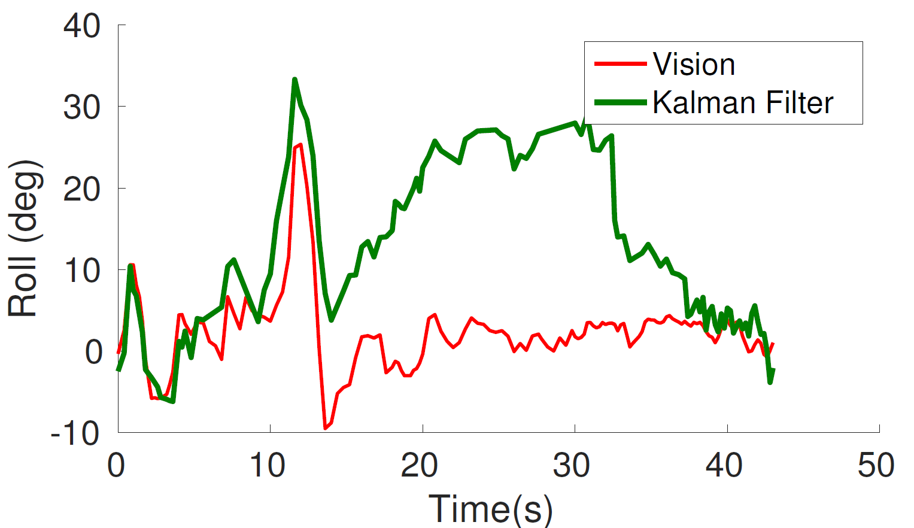
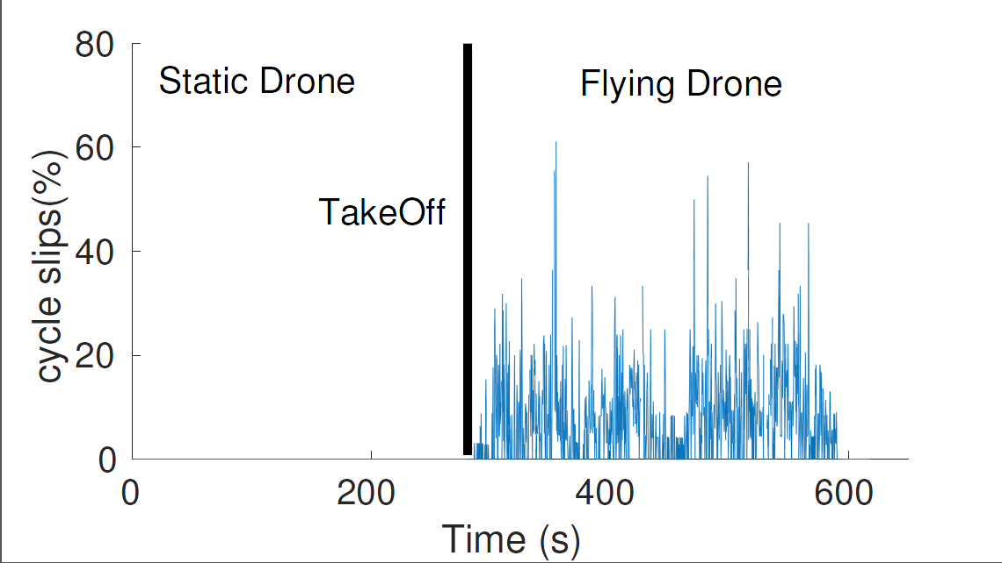
Divergence due to cycle slips
Cycle Slips trigger divergence
Several Cycle Slips during flight

Slide 43
Handling Aggressive Flights and Cycle Slips

Slide 44
Main Question
Kalman Filters are optimal under Gaussian error
When estimates of N incorrect, error no longer Gaussian
We need 2 solutions:
Identify when estimates of N are poor
Correct estimates in real time to prevent divergence

Slide 45
1. Identifying Poor Estimates of N
Measurement Model
$$φ_{ij}^{sk}=f(q,N_{12}^{sk})$$
$$N_{ij}^{sk}=f(q,φ_{ij}^{sk})$$
$${cos⁡(2πN}_{ij}^{sk})=cos⁡(2πf\left(q,φ_{ij}^{sk}\right))$$
$$cosmetric(q)=Σ_{\{ij,sk\}}cos⁡(2πf\left(q,φ_{ij}^{sk}\right))$$
Correct Orientation → $cosmetric≈1$

Slide 46
2. Correcting N via Particle Filters
Trigger Particle Filter
Keep doing
Kalman
Back to
Kalman
v
v
v
v
v
v
v
v
v
v
v
v
~
1
~
<
~
~
1
~
1
1
~
1
~
~
High Conf.
Low
Conf.
.
.
.

Slide 47
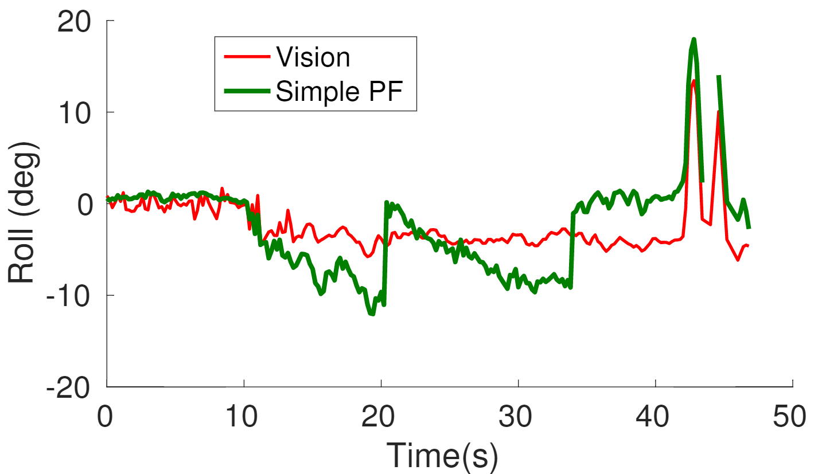
Simple Particle Converges slowly

Slide 48
Simple Particle Filter
$${time}_{0}$$
$${time}_{1}$$
Weigh and Propagate
$$Δq$$
Initial
Particles
Measurement (q)

Slide 49
Adjusted Particle Filter
Propagate the Adjusted State
$${time}_{0}$$
$${time}_{1}$$
$${time}_{2}$$
$$Δq$$
Provides near optimal combining for correct particles
Initial
Particles
Measurement (q)
Accelerates convergence with few particles
Combine Trans. And Meas. like Kalman Filter

Slide 50
Adjusted Particle Tracks Well

Slide 51
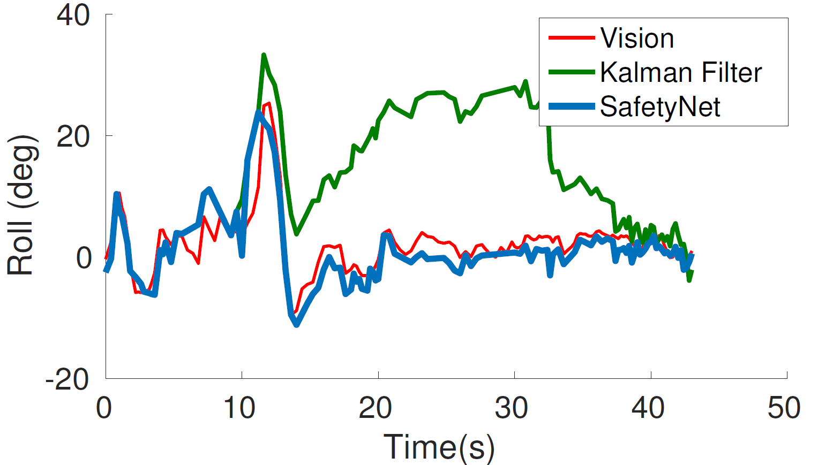
Adjusted Particle Tracks Well

Slide 52
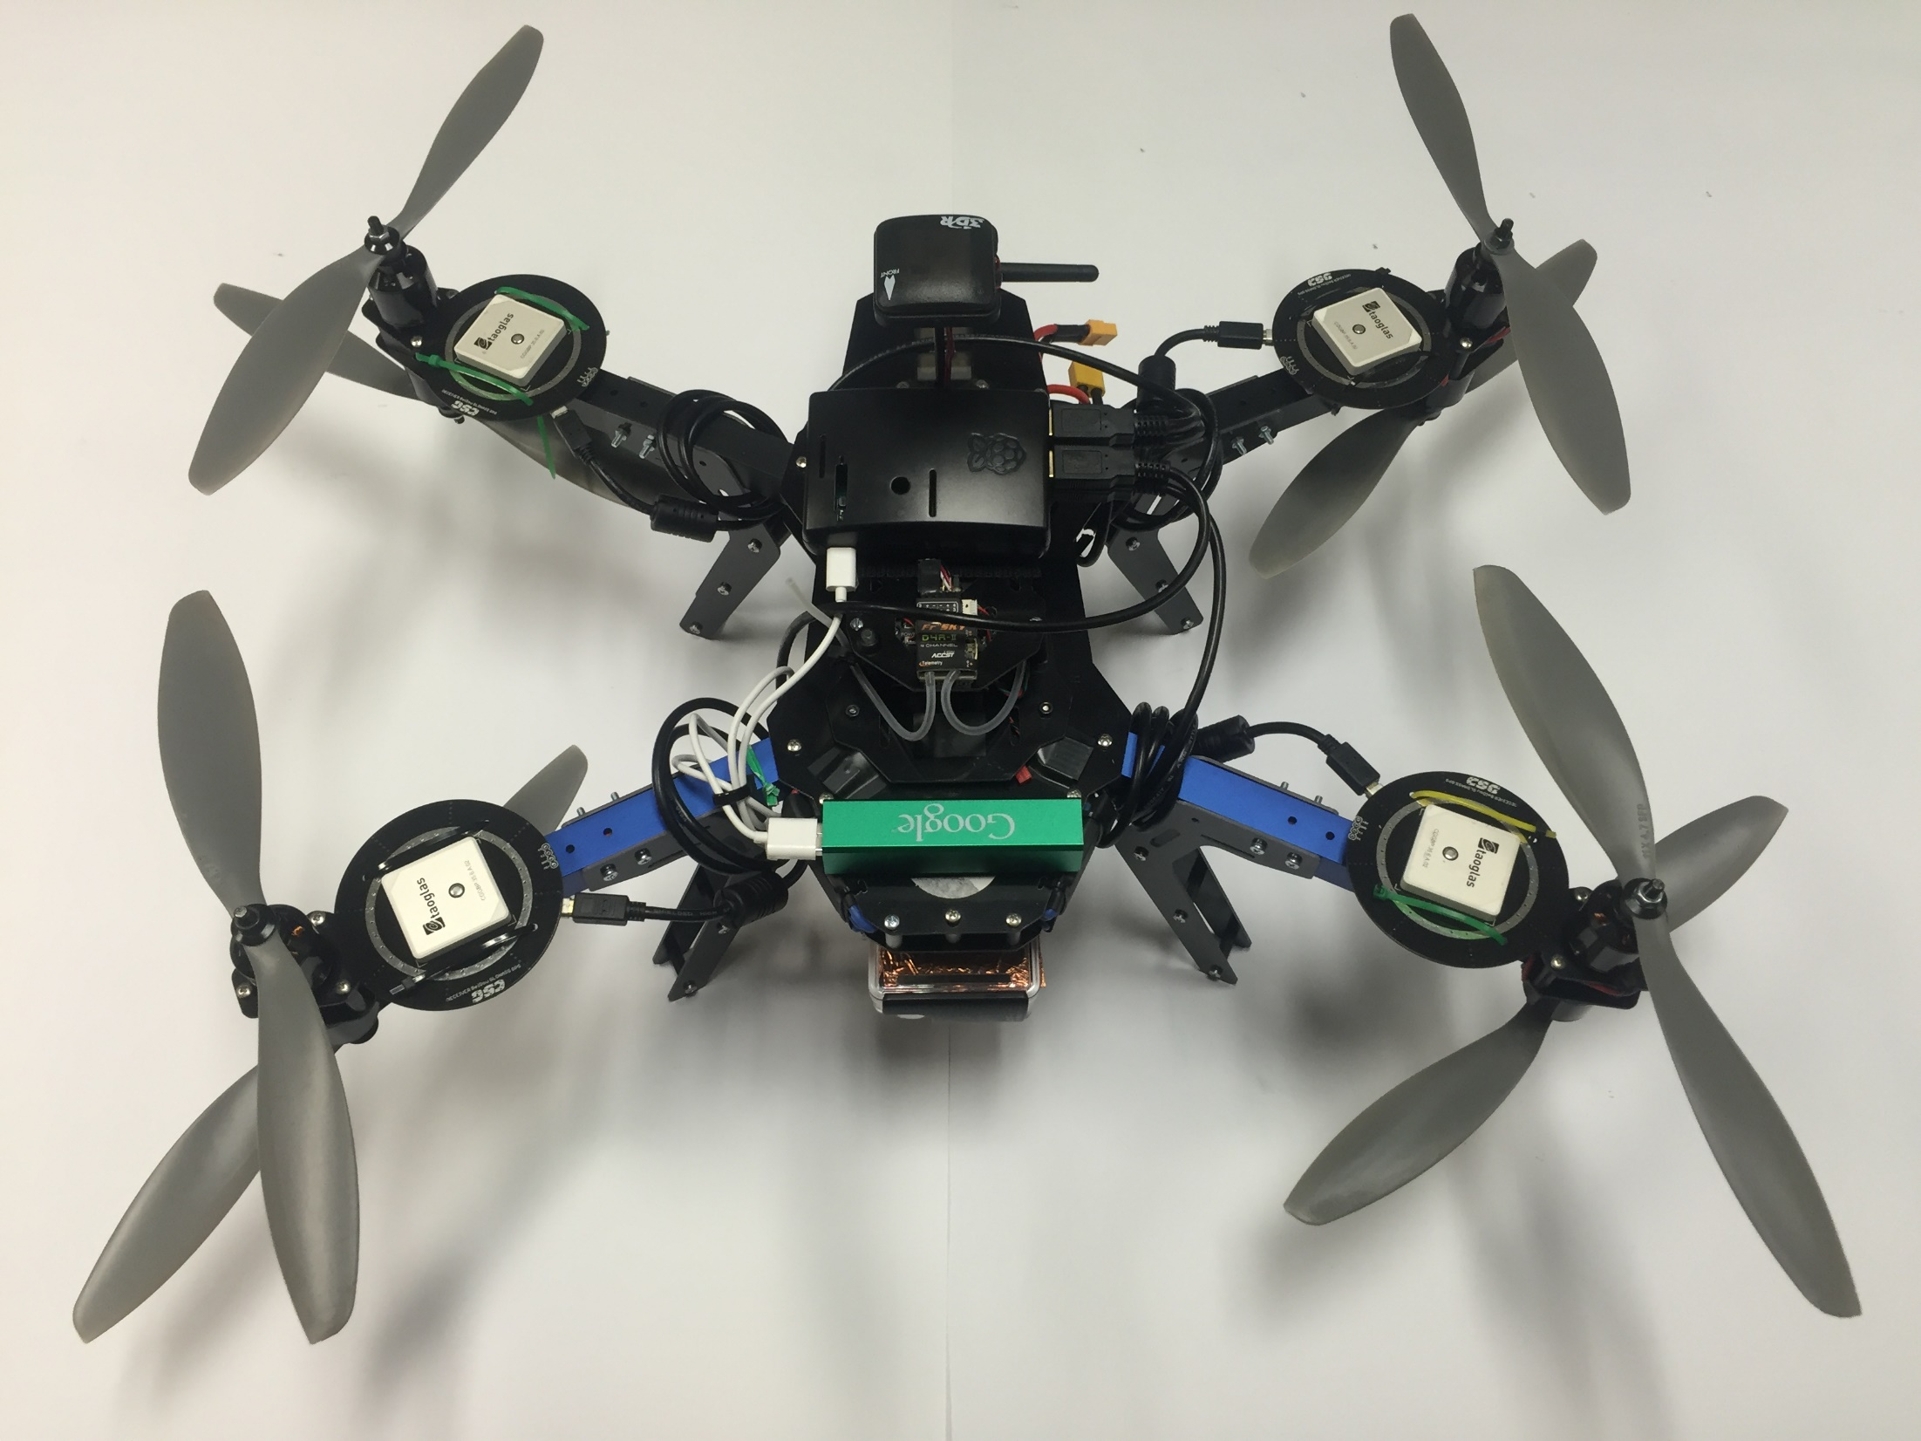
Evaluation Platform
Pi
GPS
IMU
GoPro

Slide 53
Performance
Vision Ground Truth
GPS vs IMU

Slide 54
SafetyNet can track aggressive turns
Sharp Angles
(Truth)
Tilt Orientation (degree)

Slide 55
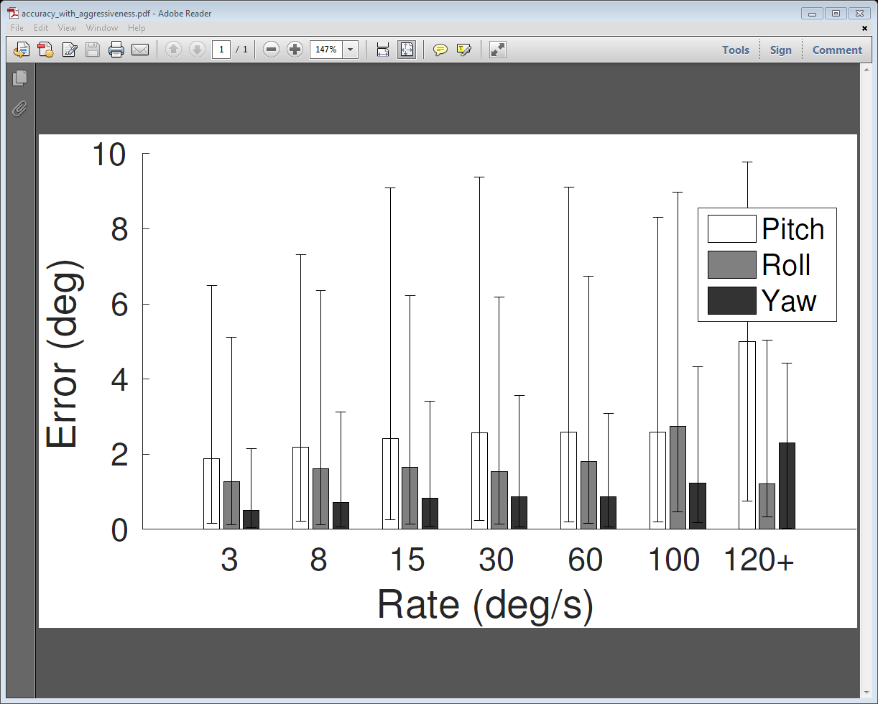
SafetyNet can track aggressive turns
Sharp Angles

Slide 56
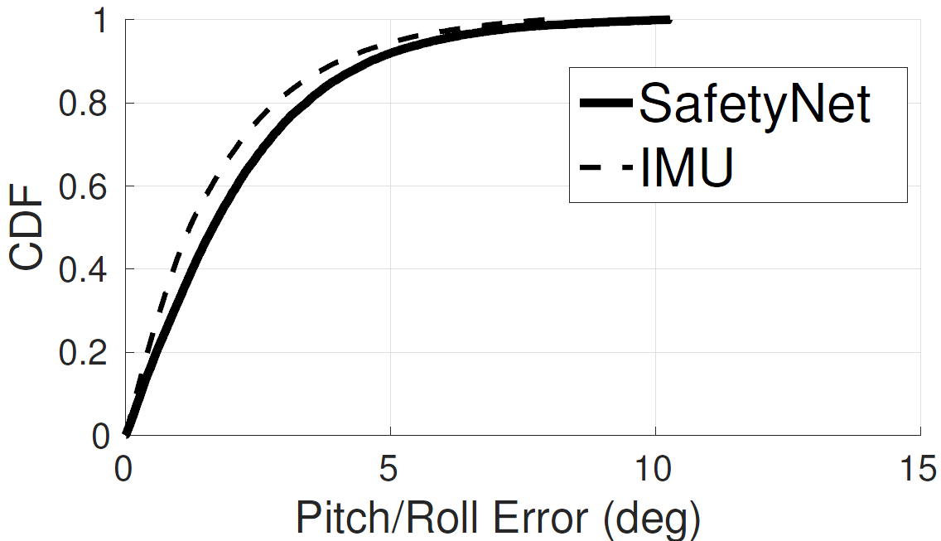
Comparison with IMU
Only 30% worse than IMU

Slide 57
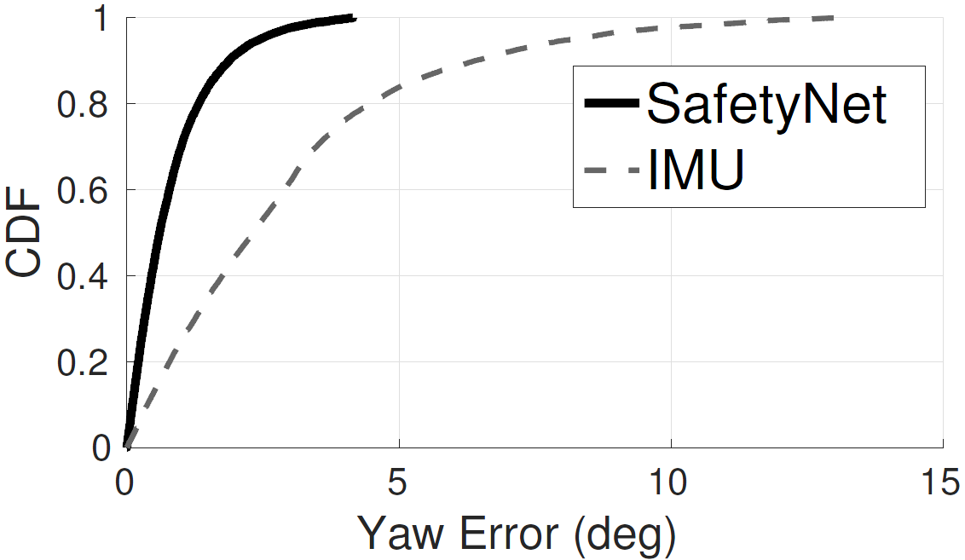
Comparison with IMU
4x better than IMU

Slide 58
Conclusion
Despite Excitement, poor relability is the show stopper for disruptive drone applications
We propose an orthogonal approach for drone state estimation using carrier phase GPS
We developed a Particle filter do systematically combine carrier phase data for orientation
Real Extensive flight tests achieve an accuracy comparable to IMU

Slide 59
Not Completely Solved Yet …
Cannot tolerate Jamming Attacks
Fusion of Carrier Phases with IMU can achieve better accuracy
Multipath decoupling can enable flying between buildings at low altitude
Orientation Estimation of Self Driving Cars can add to reliability

Slide 60
Thoughts?

