Slide 1
RADAR: An In-Building RF-based User Location and Tracking System
Paramvir Bahl and Venkata N. Padmanabhan
Microsoft Research
Presented By:
Swati Singhal
Marguerite McDaniel

Slide 2
Overview
Introduction/vision of the work
Core concepts
Novelty of proposed system compared to existing solutions
System design and implementation
Discussion on observations and results
Applications and broader impacts

Slide 3
Introduction to RADAR
Locating and tracking user location in indoor locations --> location-aware services and applications
Radio frequency based wireless network in a in-building environment
Features
  Is independent on specialized hardware
  Uses propagation model
  Can be adapted to setup changes
  Factors in orientation
  High accuracy - estimate user location with range of 2-3 meters.
Notes:
Swati

Slide 4
Core Concepts
Use of Radio Frequency transmitted by user device to 3 base stations- uses Signal Strength(SS) (and Signal to Noise Ratio(SNR))
Use of triangulation from the location estimate received from base stations to determine the approximate user location.
Offline phase
  Baseline dataset: Detect/compute the signal strength at specific locations with 4 different user orientations - User is stationary
  Process the data collected using two alternative approaches: Empirical and Radio Propagation model
Real time phase
  Detect the signal strength at a random user location- User is in motion.
  Run NNSS (nearest neighbors in signal space) algorithm to search the fittest location that minimizes the difference between observed SS and recorded SS of baseline dataset
Notes:
Explain Signal to Noise ratio and Signal Strength
Radio Frequency: Frequency ranges from twenty thousand times per second (20 kHz) to around three hundred billion times per second (300 GHz).
In telecommunications, particularly in radio frequency, signal strength (also referred to as field strength) refers to the transmitter power output as received by a reference antenna at a distance from the transmitting antenna. It is expressed as dB(decibels) per meter or dBm. 10*Log(s/0.001) where s is watts. Lower limit to Infrared ferquencies
The ratio of the strength of an electrical or other signal carrying information to that of interference, generally expressed in decibels.

Slide 5
Existing work: Limitations
InfraRed (IR) Wireless based systems
Example: Active badge
  Accurate but scales poorly due to the limited range of IR
  Significant installation and maintenance cost
  Performs poorly in the presence of direct sunlight
GPS - Not suitable to Indoors
Existing RF based wide-area cellular system
  Locate cellular phone by measuring the
    Signal attenuation
    Angle of arrival (AOA)
    Time difference of arrival (TDOA)
  Used only in outdoor environment
Duress Alarm Location System (DALS)
Requires specialized hardware and software
Doesn’t account for user orientation
Notes:
Swati:
Try to be brief.

Slide 6
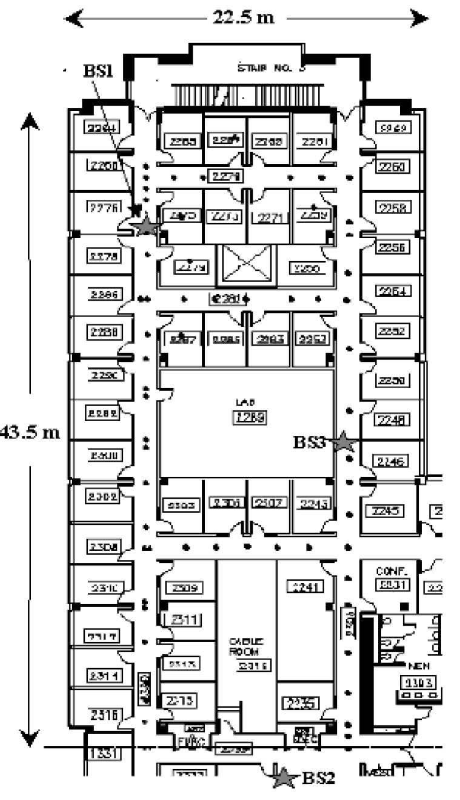
System Design and Implementation: Experimental Testbed
Testbed is located on second floor of a 3-story building.
  Measurements:
    43.5m by 22.5m, 980 sq. m (more than 50 rooms)
3 base stations placed on the floor
  overlapping coverage
Mobile host
  laptop computer running Windows
  broadcast packets periodically
SS and SNR available through wireless network.

Slide 7
System Design and Implementation
Two approaches to detect the signal strength at specific location
  Empirical method
  Radio propagation model

Slide 8
Empirical Method
  Synchronize the clock.
  Mobile host broadcast UDP (User Datagram Protocol) packet at rate of 4/sec.
    Each BS records tuple (t, bs, ss) and
(t, x, y, d). (former tuple will also be record at real
time phase)
    Merge tuples using timestamp t
(x, y, d, ss_{i}) i = 1,2,3
Sample for 70 locations (each combination at least 20 times).
Utilize sample mean value instead of raw data.

Slide 9
Radio propagation model
Motivation
  Reduce the dependence on empirical data
Use the mathematical model of indoor signal propagation, which considers the reflection, diffraction, scattering of radio
  Rayleigh fading model : unrealistic
  Racian distribution model : difficult to determine the model parameters
  Floor Attenuation Factor propagation model : accept!
Notes:
Swati

Slide 10
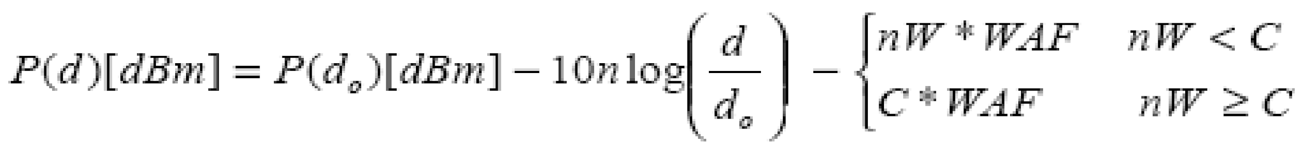
FAF propagation model
P(d) : the signal strength at distance d
n : the rate at which the path loss increase
with distance (Fixed and determined once)
d₀ : the distance of the reference point (Fixed and determined once)
C : the maximum number of obstructions (walls) up to which the attenuation factor makes a difference (Fixed and determined once )
nW : the walls between Transmitter-Receiver
WAF : the wall attenuation factor (Fixed and determined once)
Notes:
Swati

Slide 11
Determine the parameter of FAF model
WAF
n
P(d₀)
Depends on building layout and construction material
Step 1: WAF Estimation
WAF = 3.1 dBm and C = 4
Average distance of signal strength values collected from line of sight distances and with varying (known) number of obstacles.
Step 2: P(d₀) and n Estimation
P(d₀) = 58.48, n = 1.523 (Choosed across 3 stations)
Linear regression model for parameter estimation
Notes:
Swati: May want to talk about C if have time else not important
Linear relation between theoretically predicted SS and log of distance between transmitter and receiver.

Slide 12
Real time phase
First synchronize the clock
The mobile host broadcast UDP packet at the rate of 4/sec
Each BS records the tuple (t, bs, ss)
Run NNSS (nearest neighbors in signal space) algorithm to search the fittest location - use the Euclidean distance i.e.,
sqrt((ss₁-ss’₁)²+(ss₂-ss’₂)²+(ss₃-ss’₃)²)
Notes:
Swati
NNSS: Trying to estimate the user location wrt to the fixed locations where SS was recorded during offline phase.

Slide 13
Analysis – Empirical Method
Use 70*4 = 280 combinations.
Pick one of the location and orientation at random.
Conduct an NNSS (Nearest Neighbor(s) Signal Strength) search for the remaining 69 points times 4 direction.
Comparison to other approaches:
  Strongest BS selection
  Random selection

Slide 14
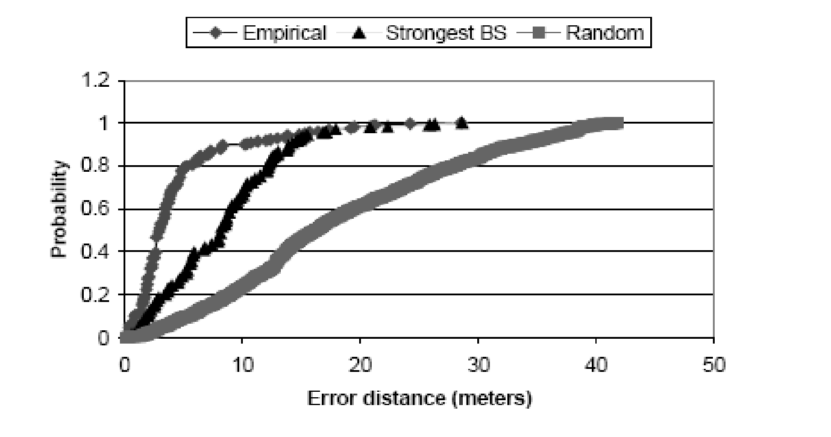
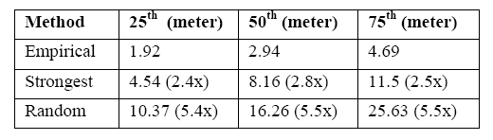
Analysis – Empirical Method

Slide 15
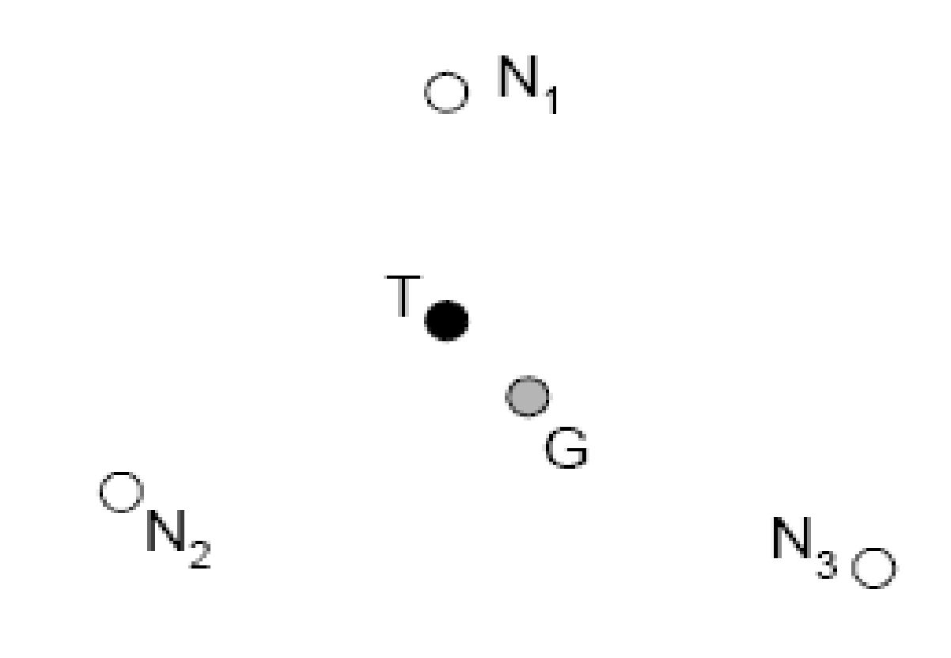
Analysis – Empirical Method
Multiple nearest neighbors
  The intuition is that often there are multiple neighbors that are at roughly the same distance from the point of interest (in signal space).
  Average k nearest neighbors to estimate the user location

Slide 16
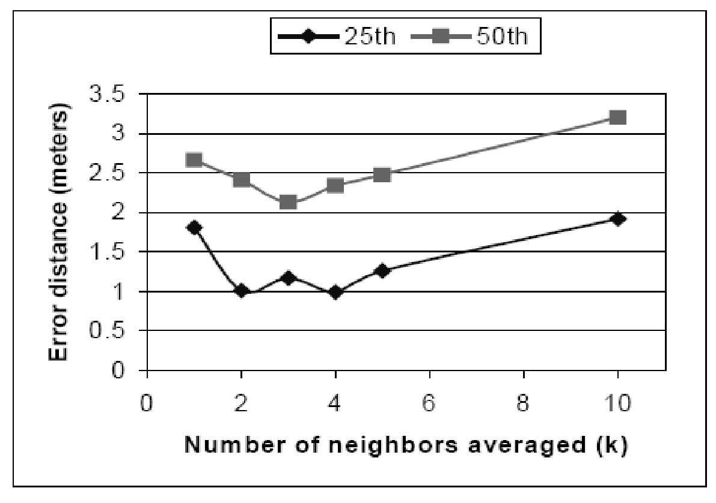
Analysis – Empirical Method
Impact of Nearest Neighbors:

Slide 17
Analysis – Empirical Method
Scenarios for further analysis:
  Impact of number of samples.
  Tracking a mobile user
    Reduce problem of tracking mobile user
    Minimal samples
      Compute mean signal strength on continuous basis.

Slide 18
Analysis – Radio Propagation model
Uses a theoretically estimate of SS for certain fixed locations (using FAF model) - each location is a grid cell on the floor
Conduct an NNSS search for the random user location in real phase using the above data
Less accurate than Empirical Model but better than Strongest Base and Random methods.
Notes:
Swati: Go over it quickly. All of it is already covered..Just a recap

Slide 19
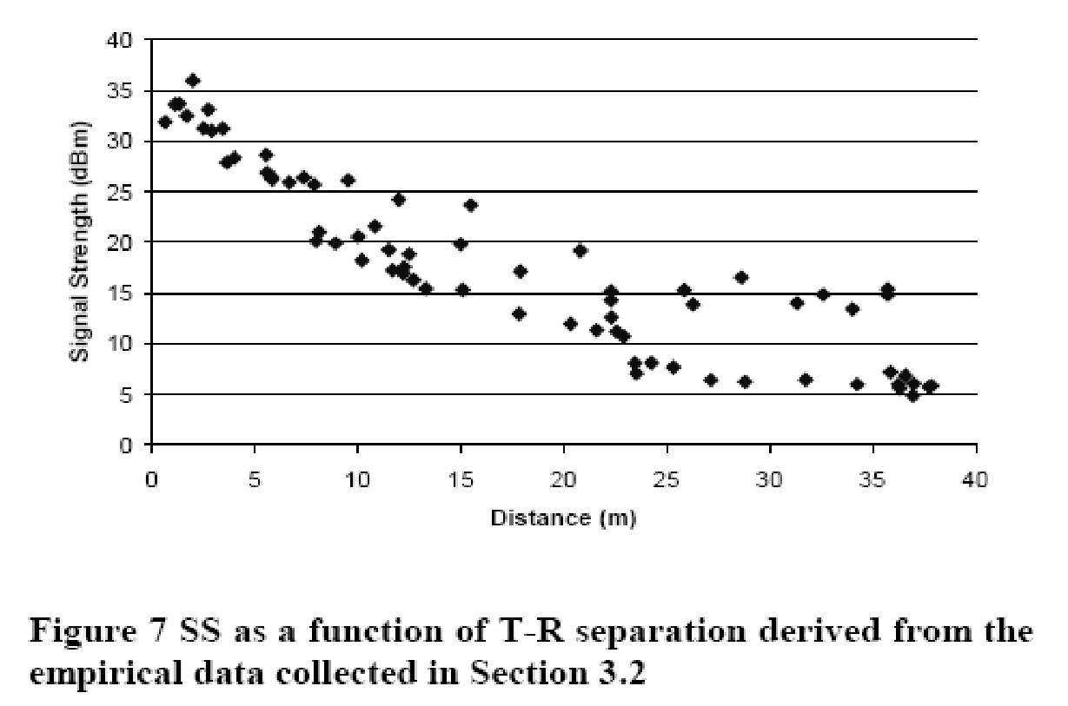
Analysis – radio propagation model
Notes:
Swati:
The Signal Strength decreases with increase in distance. Variations occur due to obstacles between the different base stations and the transmitter at same location.

Slide 20
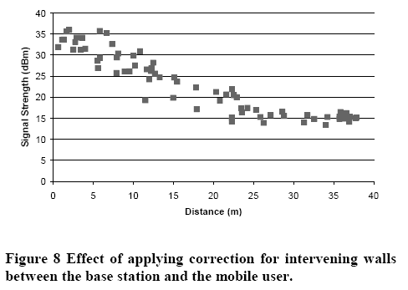
Analysis – radio propagation model
Notes:
Swati
Similar to Empirical data, thus the model is well configured for the experiment testbed.

Slide 21
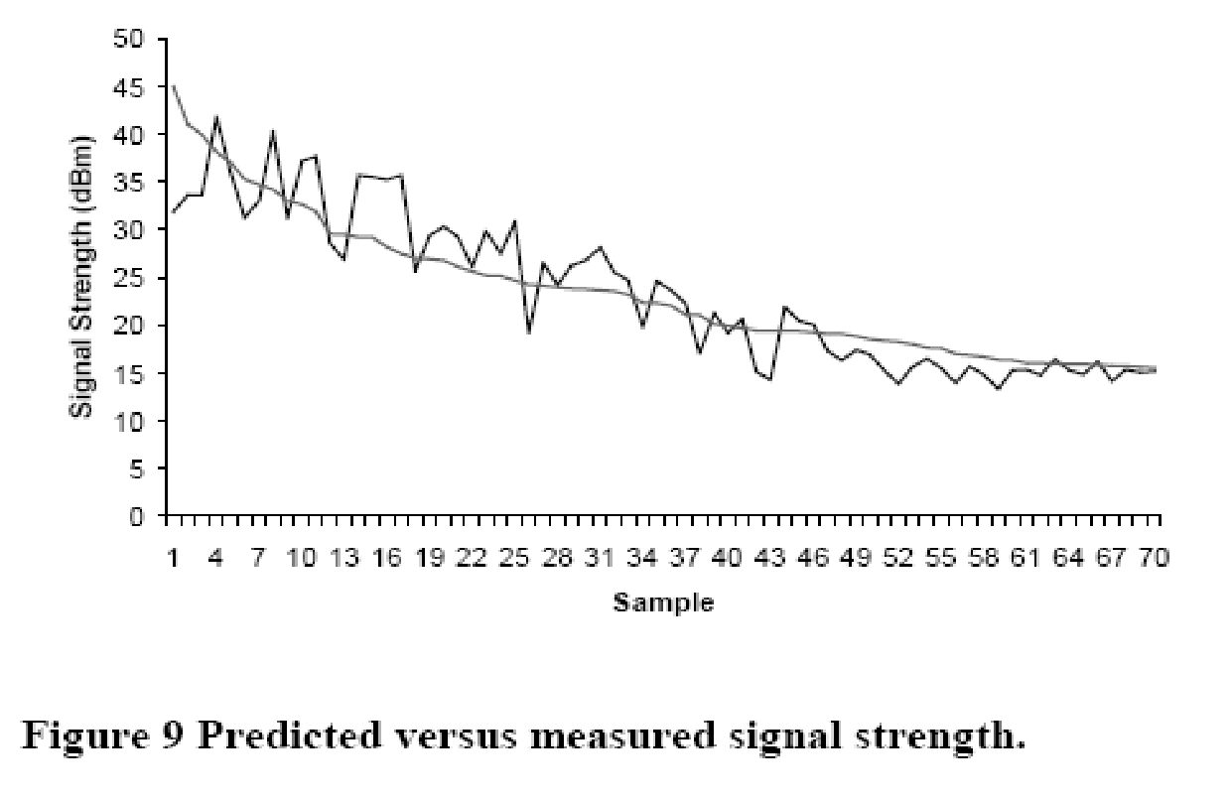
Analysis – radio propagation model
Notes:
Swati
Plot for one base station. Signal Strength variation based on number of samples processed

Slide 22
Applications and Broader Impacts
Applications:
  Location-aware systems
    Printing services
Broader Impacts:
  Internet-of-Things
    User-mobility profiles

Slide 23
Thank you!!
Questions?

