Slide 1
Lecture 5.2
Security and Privacy – II
CMSC 818W : Spring 2019
Tu-Th 2:00-3:15pm
CSI 2118
Nirupam Roy
Apr. 2nd 2019

Slide 2
VoiceLive:
A Phoneme Localization based Liveness Detection for Voice Authentication on Smartphones
Zhang et al, FSU
CCS 2016
Notes:
So...lets get started…

Slide 3
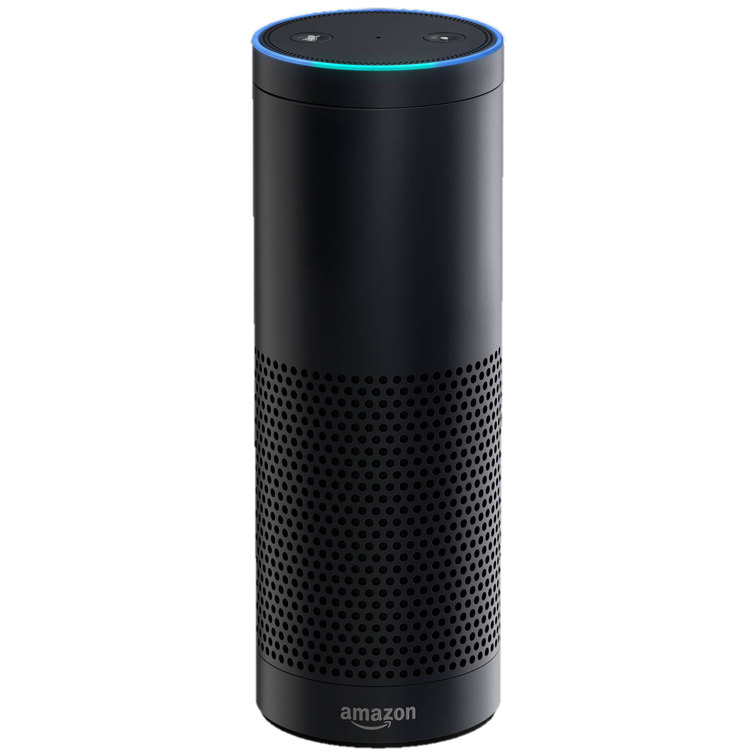
Threats: Inaudible Acoustic Attack
Ok
Jamming
911 calls
Inaudible
Voice Commands
Notes:
Or can even jam all the 911 phone calls before a bank robbery.
While various applications are possible … this paper focuses on enabling the core capability … and understanding what is, or is not, possible …

Slide 4
Accidental voice-commands from TV!
Alexa order dollhouse!
Ok

Slide 5
Voice authentication: Replay attack
Record
Replay

Slide 6
Voice authentication: Impersonation attack

Slide 7
Voice authentication: Impersonation attack

Slide 8
Voice liveness detection
Human voice
OR
electronic sound?
Is there any difference in the recorded sound?

Slide 9
Human voice production

Slide 10
Human voice production

Slide 14
Ampl.
Time/Sample

Slide 15
Ampl.
Ampl.
Time/Sample

Slide 16
Ampl.
Ampl.
Time/Sample
Cross-Correlation

Slide 17
Ampl.
Ampl.
Time/Sample
Cross-Correlation
TDoA
(in number of samples)

Slide 18
Cross-Correlation
TDoA
(in number of samples)
Repeat for all phonemes

Slide 20
Effect of phone’s orientation and location

