Slide 1
LoRa Backscatter
Enabling The Vision of Ubiquitous Connectivity
By Vamsi Talla, Mehrdad Hessar, Bryce Kellogg, Ali Najafi,
Joshua R. Smith, and Shyamnath Gollakota (University of Washington)
Presented by Joshua Fleming and Blue Keleher
Notes:
(Blue)
Paul G. Allen School of Computer Science and Engineering, UW

Slide 2
Motivation
Design
Hardware Implementation
Results
Challenges & Future Work
Notes:
(Blue)

Slide 3
Motivation: Ubiquitous Connectivity
Implementing communication between billions of devices
Requirements
Reliable and long range communication
Low power
Inexpensive to manufacture
Issues
No existing technology combines all three factors
E.g., backscattering is low power and cheap, but short ranged
Solution
LoRa Backscatter

Slide 4
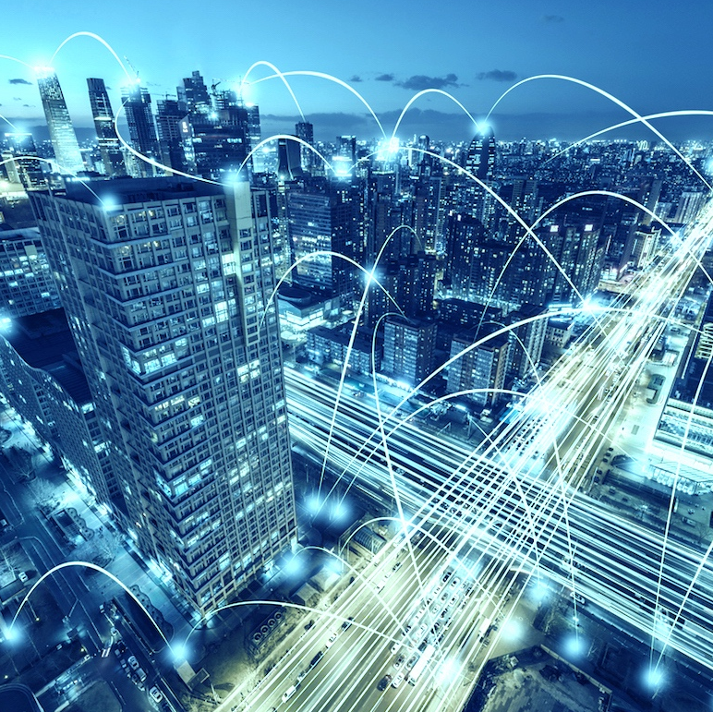
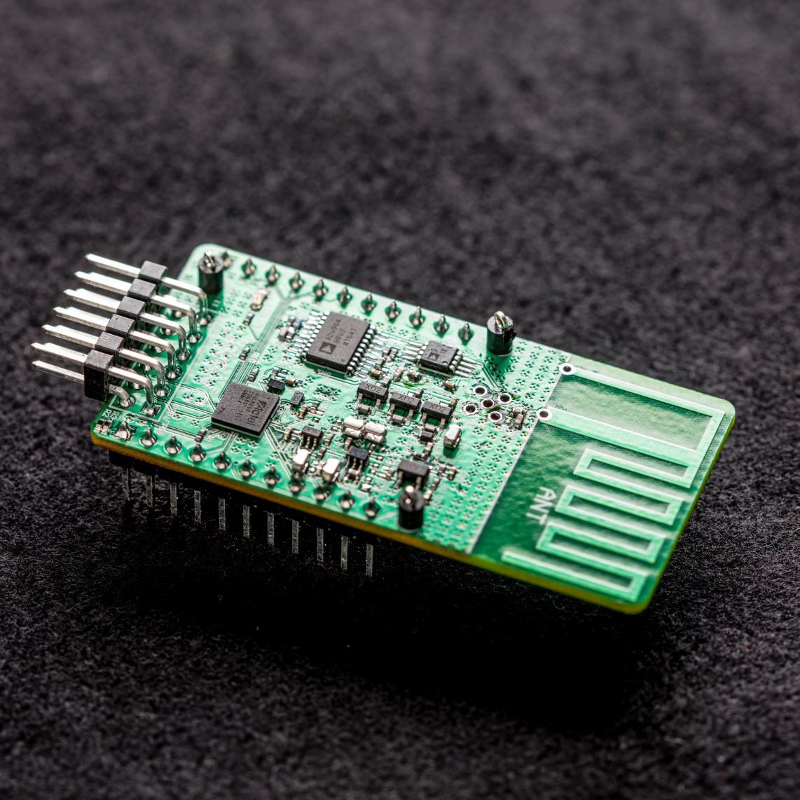
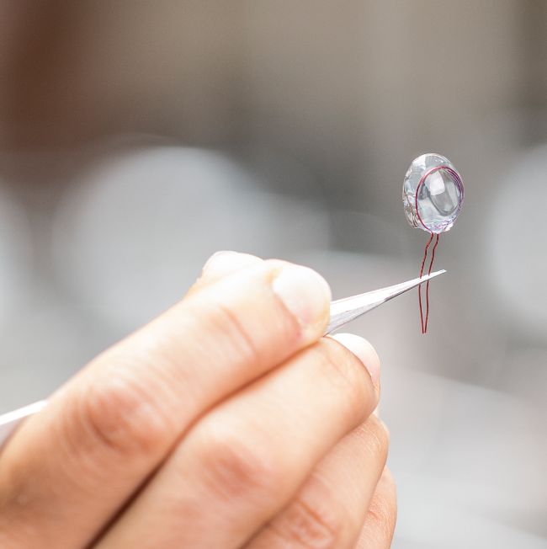
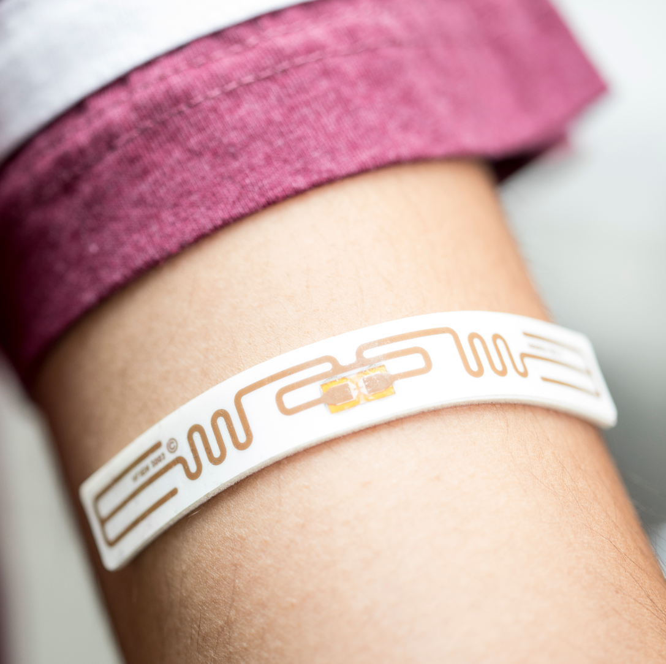
Applications
Smart cities
Precision agriculture
Whole-home and -office sensing
Body-mounted medical sensing
Images courtesy of longrange.cs.washington.edu

Slide 5
Motivation
Design
Hardware Implementation
Results
Challenges & Future Work

Slide 6
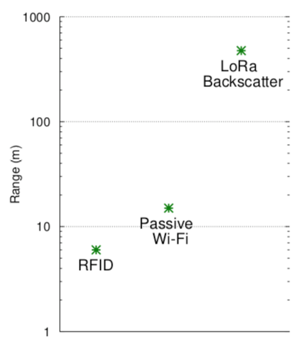
Why LoRa Backscatter?
Advantages:
Low power consumption (three orders of magnitude lower than radios; not significantly better than other backscatter modes)
High operating range (100s of meters compared to tens for other backscatter modes)
Low cost and size (primarily digital construction materials)
Alternatives Explored:
Radios
Wi-Fi
BLE
ZigBee
SigFox
Backscatter
RFID
Passive Wi-Fi
Notes:
(Blue)

Slide 7
Why LoRa Backscatter?
Notes:
(Blue)

Slide 8
Synthesizing CSS with Backscatter
Recall: Chirp spread spectrum (CSS) encodes data as cyclic time shifts of the baseline “chirp,” which appear as frequency shifts after an FFT.
Notes:
(Blue)

Slide 9
Synthesizing CSS with Backscatter
Recall: Chirp spread spectrum (CSS) encodes data as cyclic time shifts of the baseline “chirp,” which appear as frequency shifts after an FFT.
Bit rate: BW/(2^{SF})•SF (BW = bandwidth; SF = spreading factor)
Notes:
(Blue)

Slide 10
Synthesizing CSS
Synthesizing CSS with Backscatter
Challenge: complexity of generating CSS signals scales exponentially with spreading factor (SF) → need 2^{SF} freqs
LoRa typically uses spreading factors between 6 and 12 → 64–4096 freqs
Solution: hybrid digital-analogue backscatter design
Notes:
(Blue)

Slide 11
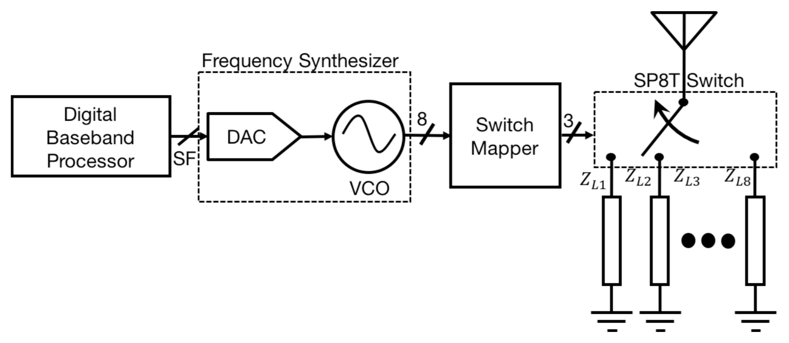
Synthesizing CSS with Backscatter
Challenge: complexity of generating CSS signals scales exponentially with spreading factor (SF) → need 2^{SF} freqs
LoRa typically uses spreading factors between 6 and 12 → 64–4096 freqs
Solution: hybrid digital-analogue backscatter design
Notes:
(Blue)

Slide 12
Synthesizing Negative Frequencies
Challenge: CSS-encoded packets vary from negative to positive frequencies, but the VCO can only output positive frequencies
Solution: use square waves to approximate in-phase cosine and out-of-phase sine signals to form complex signals
Notes:
(Blue)

Slide 13
Synthesizing Negative Frequencies
Challenge: CSS-encoded packets vary from negative to positive frequencies, but the VCO can only output positive frequencies
Solution: use square waves to approximate in-phase cosine and out-of-phase sine signals to form complex signals
New challenge: approximating sinusoids with square waves creates out-of-band harmonics
Notes:
(Blue)

Slide 14
Backscatter Harmonic Cancellation
Issues in signal approximation with square waves
Creates mirror copies at third and fifth harmonics
Prior systems ignored these signals (out-of-band)
Noisy for LoRa due to high sensitivity
Solution
Use different signal than a square wave
Square waves have two voltage levels → high frequency components
Multilevel signal to better approximate sinusoid
Designed such that third and fifth harmonics are cancelled

Slide 15
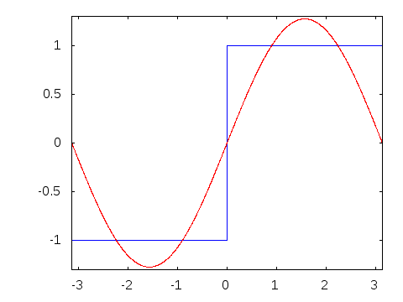
Backscatter Harmonic Cancellation

Slide 16
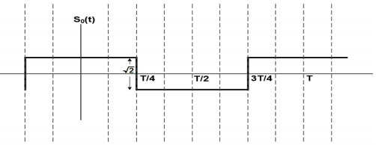
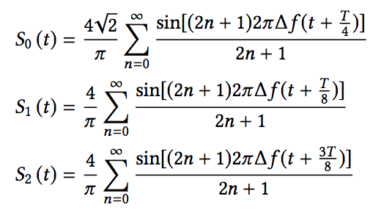
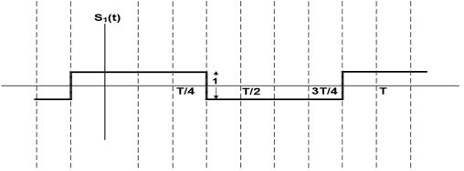
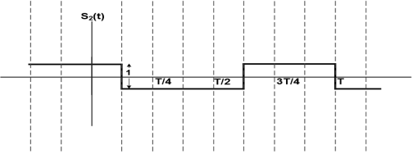
Backscatter Harmonic Cancellation

Slide 17
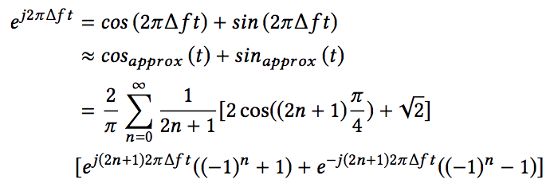
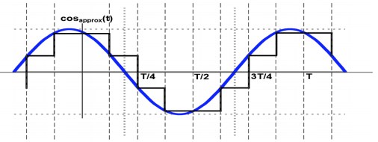
Backscatter Harmonic Cancellation

Slide 18
Backscatter Harmonic Cancellation
n = 0: (first harmonic) negative exponential reduces to 0, leaving only the positive frequency
n =1, 2: (third, fifth harmonics) 2cos(2n+1)(𝜋/4) = -√2, Reducing the entire equation to 0.
This new equation thus cancels the third and fifth harmonics
More harmonics can be cancelled with more voltage levels
Switch’s finite delay adds additional filtering and suppresses higher harmonics (e.g. >9) automatically

Slide 19
Reverse-Engineering LoRa Packet Structure
Challenge: physical layer specification for LoRa is proprietary
Solution:
Reverse-engineer LoRa physical layer using Semtech patents
Analyze transmissions from LoRa chipsets on a Universal Software Radio Peripheral (USRP)
Notes:
(Blue)

Slide 20
Reverse-Engineering LoRa Packet Structure
Challenge: physical layer specification for LoRa is proprietary
Solution:
Reverse-engineer LoRa physical layer using Semtech patents
Analyze transmissions from LoRa chipsets on a Universal Software Radio Peripheral (USRP)
Notes:
(Blue)
CRC = cyclic redundancy check (an error-detecting code)

Slide 21
Setting LoRa Parameters
LoRa bit rate determined by 3 factors:
chirp bandwidth
spreading factor
error correction coding rate
BW and SF set in advance, known by transmitter & receiver
High sensitivity: phase of chirps must change continuously with time and have same value at each end of chirp
At each frequency, increase phase by 2𝜋/SF
To comply with FCC, frequency-hop the single-tone chirp transmitter
Backscatter device continues to be offset by Δf
Notes:
(Blue)

Slide 22
Link-Layer Protocol
Use TDMA to allocate wireless channel between different backscatter devices
Challenge: must recognize the beginning of each single tone
Use on-off keying as preamble sequence to avoid confusing with random transmissions
Challenge: synchronize slots across backscatter devices
Use unique on-off keying sync pattern at beginning of TDMA round robin
Challenge: concurrent LoRa backscatter transmissions?
Transmit on each of the 64 LoRa channels from one RF source
Using CSS transmissions with different spreading factors, transmit on same channel
Notes:
(Blue)

Slide 23
Motivation
Design
Hardware Implementation
Results
Challenges & Future Work

Slide 24
Hardware Implementation
Digital Baseband Processor sends the spreading factor (SF) to the DAC to be converted to an analog voltage
The DAC’s output controls the oscillation speed of the VCO
VCO’s output is mapped to used to select appropriate impedance

Slide 25
Hardware Implementation
VCO can only output positive frequencies, while negative frequencies are needed as well
This can be achieved by selecting impedances to produce complex values to match the exponential signal output

Slide 26
Hardware Implementation
Proof of concept developed with readily available parts
Four-layer PCB for RF parts
Three cascaded ADG904 multiplexers for the SP8T switch
2 dBi whip antenna
Eight impedances for four positive signals and four negative compliment signals
Terasic DE0-CV with an Altera Cyclone V FPGA
Generate CSS modulated packets in VHDL
Send two square waves for the real and imaginary parts of the signal to the SP8T switch

Slide 27
Hardware Implementation
Designed custom IC to minimize costs
Consists of three main components
Baseband Processor
Creates LoRa packet using SF, BW, and code rate
Sends packet data to Frequency Synthesizer to create the CSS signal
Uses 1.25𝜇W to make packet with SF=12, BW=3.25kHz, and an (8, 4) Hamming code

Slide 28
Hardware Implementation
Frequency Synthesizer
DAC combined with VCO: simply up-converts low frequencies to high
Conversion ratio controlled by baseband processor to generate CSS
Johnson counter used to create four clock signals offset by 1/8th time period, and four more complementary signals
Eight total clock signals
Used to represent eight clock phases
Uses 4.5𝜇W to make 31.25kHz CSS packets with SF=12 and 3MHz offset
Notes:
8 clock phases for four positive and negative frequencies required by the CSS symbols
Recall: four leveled signal is required to cancel the third/fifth harmonics

Slide 29
Hardware Implementation
Backscatter Switch Network
Uses eight clock signals as input to RF switches
Each input corresponds to their respective impedance values
Switches implemented in NMOS transistors
Impedances implemented with resistors and capacitors
Inductors take up large surface area
Prohibitively expensive
3dB signal power loss for cheap cost
Requires 3.5𝜇W to backscatter CSS packets at a 3MHz offset
Total power consumption: 1.25𝜇W + 4.5𝜇W + 3.5𝜇W = 9.25𝜇W

Slide 30
Hardware Implementation
Uses an extremely small amount of power
Other systems use complex analog components
Backscatter systems use switches to modulate reflections
Costs extremely cheap
IC costs proportional to size of chip
Active radio devices like for Wi-Fi, LoRa, BLE have about 10mm² die area used for RF components
Backscatter systems like RFID use about 0.15mm² of die area
This LoRa backscatter system uses <0.01mm² of die area
Switches use space efficient resistors and capacitors
Metal in metal capacitors made on metal layers on top of MOS structures
Notes:
Cheap because efficient use of space

Slide 31
Motivation
Design
Hardware Implementation
Results
Challenges & Future Work

Slide 32
Results Overview
Receiver Characterization
Resilience to Out-of-Band Interference
Operational Range
Efficacy of Harmonic Cancellation
Concurrent Backscatter Transmissions
Wide-Area Applications
Whole-Home and Office Sensing
RF-Challenged Applications
Smart Contact Lens
Flexible Epidermal Patch Sensor
Notes:
(Blue)

Slide 33
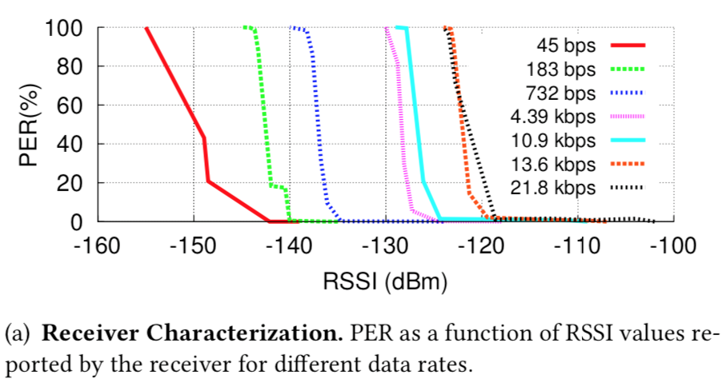
Receiver Characterization
Wired setup (avoid multipath complications)
Semtech SX1276 chipsets are both CSS transmitter and receiver
Conclusion: sensitivity is inversely proportional to the data rate of the packet
Below -142 dBm, receiver cannot correctly decode packets
RSSI values reported by chipset do not correspond to actual power level of received packet, but proportional
Notes:
(Blue)
PER = packet error rate
RSSI = received signal strength indication

Slide 34
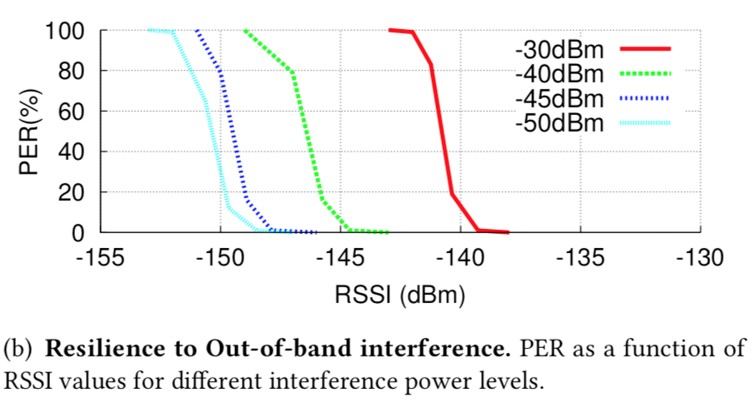
Out-of-Band Interference
OOB interference comes from the RF source
Using a circulator setup with RF source and backscatter hardware connected via variable attenuators and receiver w/ RF cable
Configuration: receiving packets at 906 MHz; backscattering packets w/ SF = 12, BW = 31.25 kHz, (8,4) hamming code, 8-byte payload, 2-byte CRC, Δf = 1 MHz
Conclusion: receiver sensitivity is inversely proportional to OOB int.
If offset (Δf) is increased, it can increase sensitivity when facing higher interference
Notes:
(Blue)
PER = packet error rate
RSSI = received signal strength indication

Slide 35
Operational Range
Setup
SX1276 LoRa development kit with power amplifier as RF source
Transmitting 30 dBm signals in 6 dBi patch antenna at 915 MHz
Backscatter device to transmit LoRa packets at offset 3 MHz, SF=12, BW=31.25 kHz, (8,4) hamming code (3-byte payload, 2-byte CRC)
Two deployment scenarios
Notes:
Source transmitting at max power permitted by FCC on 900MHz ISM (instructional, scientific, medical) band

Slide 36
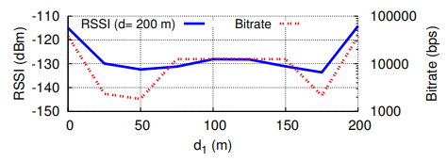
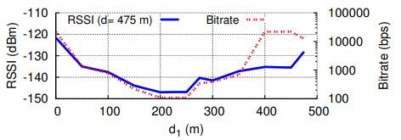
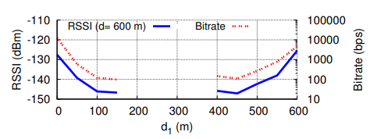
Operational Range
Scenario 1
RF source and receiver separate with backscatter device somewhere in between
Backscatter device moved along a straight line between TX and RX
Tested with three different TX and RX distances on open road next to open fields
Conclusion: fully operational in scenario with TX/RX spaced no more than 475 m
Notes:
Source transmitting at max power permitted by FCC on 900MHz ISM (instructional, scientific, medical) band

Slide 37
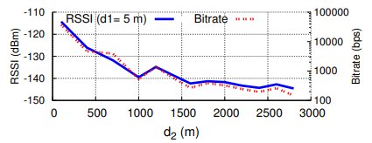
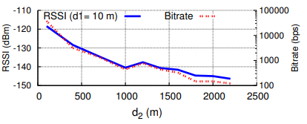
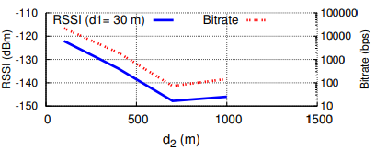
Operational Range
Scenario 2
RF source and backscatter device distance fixed; variable receiver distance
Tested three different distances between source and backscatter device
Conclusion: packets can be received at very long distances depending on backscatter device proximity to RF source.
Notes:
Source transmitting at max power permitted by FCC on 900MHz ISM (instructional, scientific, medical) band
Max RX distance of 2.8 km with 5m TX/device separation

Slide 38
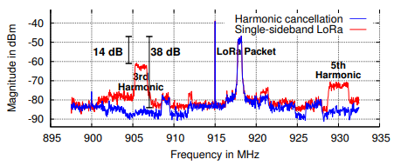
Harmonic Cancellation
Test harmonic cancellation technique against baseline hardware without cancellation
Wi-Fi hardware adapted to transmit LoRa packets as baseline
Semtech SX1276 development kit to transmit single 915MHz tone
Spectrum analyzer used to capture signal in a circulator setup
Backscatter device transmit with SF=6, BW=500KHz, (8,4) hamming code with 8-byte payload and 2 byte CRC at 3MHz offset
Conclusion: harmonic cancellation technique works well to reduce noise in the neighboring bands
Notes:
Harmonics in red appear at opposite sides due to single sideband architecture
Harmonics reduced to roughly noise level in blue graph

Slide 39
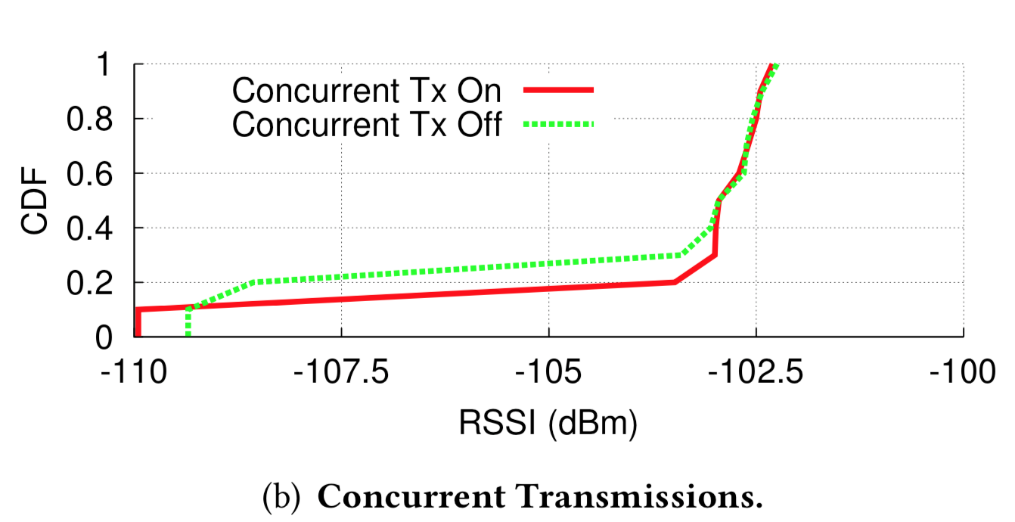
Concurrent Transmissions
Two backscatter devices continuously transmit packets at different frequency offsets (Δf=0.75 MHz, Δf=1 MHz)
Deployed in large atrium (104 x 32 ft), RF source opposite 2 receivers; backscatter 1 at center of atrium, backscatter 2 moving across
The figure above shows CDF of RSSI values for backscatter 1 as backscatter 2 does its thing
Conclusion: concurrent transmissions have negligible impact on the performance of one backscatter device
Notes:
(Blue)
RSSI = received signal strength indication

Slide 40
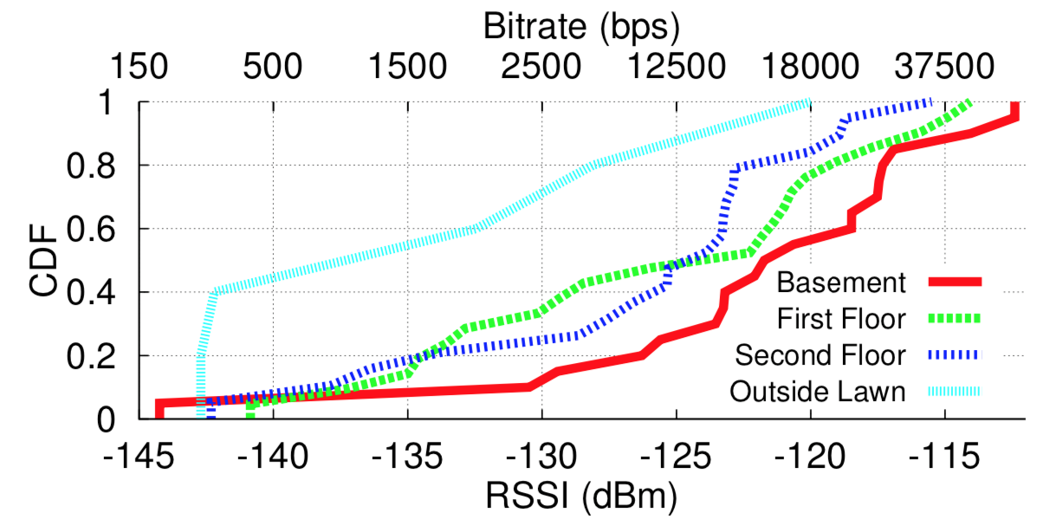
Applications: Whole-Home Sensing
Previously: limited range and coverage preclude whole-home sensing
LoRa backscattering deployment: 4,800 ft² three-story house (Δf = 1 MHz)
Backscattering device moved through house in 6x6-ft. grid
Conclusion: coverage is equivalent to typical wireless coverage; sufficient for smarthome IoT devices
Notes:
(Blue)
RSSI = received signal strength indication

Slide 41
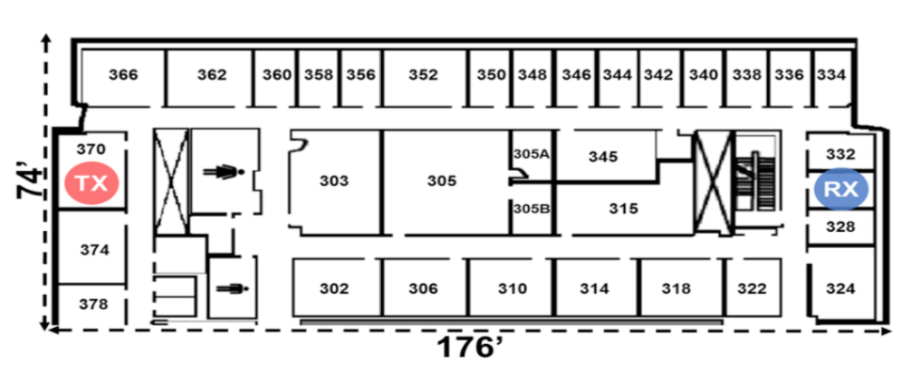
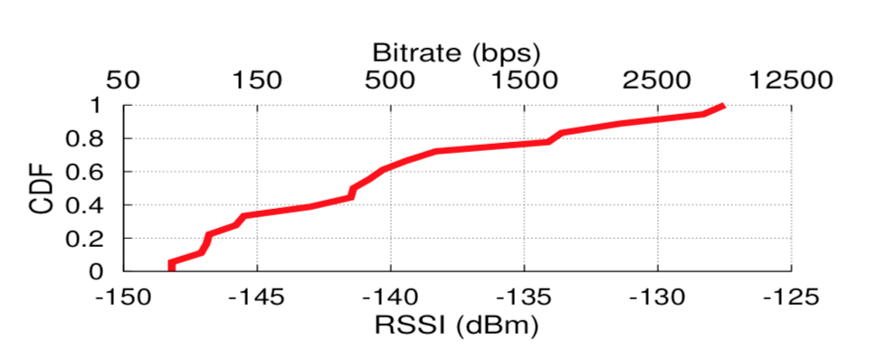
Applications: Office Sensing
LoRa backscattering deployment: 13,024 ft² office with 41 rooms (Δf = 3 MHz)
Backscattering device moved through office in 26x26-ft. grid; source and receiver have sheet-rock, metal, insulation, and offices between them
Conclusion: able to achieve wide-area backscatter coverage in significant multi-path environments
Notes:
(Blue)
RSSI = received signal strength indication

Slide 42
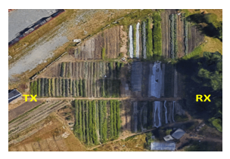
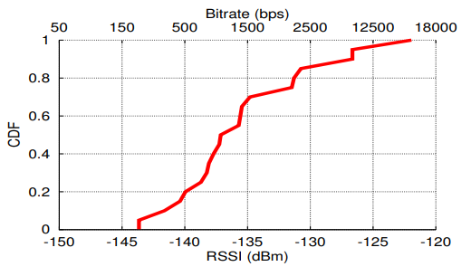
Applications: Precision Agriculture
Deployed on one-acre (~43560 ft²) farm
RF source and receiver on opposite sides
Farm divided into 45ft x 45ft grids
Backscatter device w/ 1MHz offset placed at ground level, between plants and bushes
RSSI measured across 20 locations at center of the grids
Median RSSI = -137 dBm, minimum RSSI = -143 dBm
Conclusion: reliable backscatter communication across a one-acre farm with only one transmitter and receiver
Notes:
CDF = cumulative distribution function (remember stats)

Slide 43
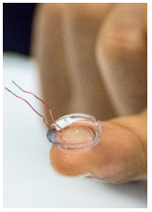
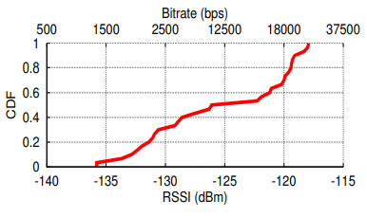
Applications: Smart Contact Lens
Can measure various health indicators (glucose, sodium, cholesterol) in tears
IC not currently possible to place in lens
1 cm diameter loop of 30 AWG wire between two contact lenses
Deployed in 104ft x 32ft atrium with RF source and receiver at opposite ends of the room
Driven by FPGA PoC and sends LoRa packets at 1MHz offset
RSSI measured at center of 12ft x 10ft grids in the room
Conclusion: smart contact lens can communicate via CSS backscatter at farther distances than prior approaches

Slide 44
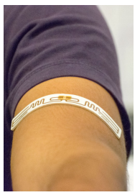
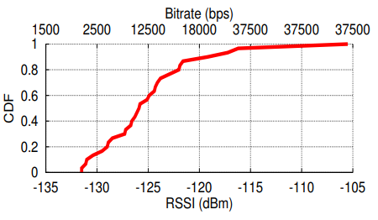
Applications: Epidermal Patch Sensor
Measure temperature, sweat, ECG, and other vitals in real time
Sticker RFID antenna (Alien’s Squiggle inlay) connected to FPGA PoC driver
Utilize cheap RFID tags with LoRa backscatter system to create cheap patch sensors
RF transmitter and receiver at opposite ends of 3,328 ft² atrium
Measuring RSSI of 1MHz offset backscatter signals just as the lens
Conclusion: patch sensor provides reliable connectivity with RSSI greater than -132 dBm
Notes:
ECG = electrocardiogram

Slide 45
Motivation
Design
Hardware Implementation
Results
Challenges & Future Work

Slide 46
Conclusion
LoRa backscatter is the first wireless system that operates at km distances while consuming less than 10 µW
Inexpensive, flexible form factor connectivity solutions which can be integrated into everyday objects
Feasible for wide-area deployment: whole-home coverage, precision agriculture, long-range medical implants, and more
Notes:
(Blue)

Slide 47
Future Work
Achieving higher data rates
Currently limited by LoRa
Use multiple frequency bands or multiple antenna designs?
LoRa-independent design
Reliance on CSS modulation suggests key innovation is independent of LoRa
Networking high volumes of devices
Currently limited by TDMA’s upper bound on throughput
Other power sources
RF power harvesting?
Notes:
(Blue)

Slide 48
Questions?

Slide 49
Testing LoRa Backscatter
Wide-area backscatter system
Consumes 9.25 𝜇W of power
Manufacturing costs of <$0.10 at scale
Long range for deployment
Placed between RF source and receiver 475 m apart
Placed with RF source and receiver up to 2.8 km away
Variety of tested deployment settings
4,800 ft² three-story house
13,024 ft² office with 41 rooms
1 acre (43,560 ft²) vegetable farm
Across 3,328 ft² room on a contact lens

