Slide 1
Location Determination
Framework and Technologies

Slide 2

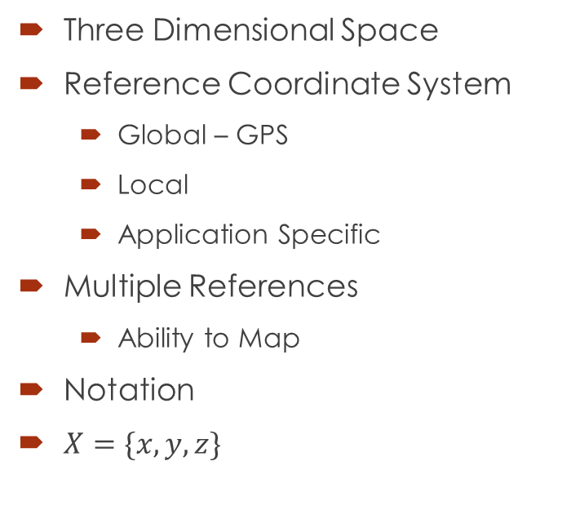



Meaning of Location
Three Dimensional Space
Reference Coordinate System
  Global – GPS
  Local
  Application Specific
Multiple References
  Ability to Map
Notation
$X=\{x,y,z\}$
$$z$$
$$y$$
$$\{0,0,0\}$$
$$x$$

Slide 3
Location Uses
All levels of accuracies have applications
Outdoors
  Navigation
    Automobiles/ Road Vehicles
    Aircrafts
    Boats/Ships
    Personal – walking/jogging/running
  Targetting
  Finding Hospitals/Gas Stations….
Indoors
  Advertising
  Finding …
System based vs. device based

Slide 4
How
Benchmarks
  Known locations (Accuracy?)
  Unknown Location WRT the location of Benchmarks
What Form ??
  Physical, marked locations
  Location of devices
What do I measure??
  Proximity
  Distance
  Some function of distance
  Direction
  Some function of direction
How many measurements
  3
  4
Use Geometry
  Triangulation
  Trilateration

Slide 5
Desirable Features
In Doors and Out Doors operation
Independent of GPS
Rapidly Deployable
Agnostic to Frequency Band or Protocol
Accurate
Scalable
…

Slide 6
Proximity
Detect the presence close to a known location
RFID
  Passive
    Read by putting in a field of RF and reading the scatter pattern
    Inventory Control
    EZPass
  Active
    iBeacon
      Using low power Bluetooth
    Estimotes
    ….
How does Passive RFID approach compare with barcodes?
FingerPrinting Based approach in WiFi Field

Slide 7
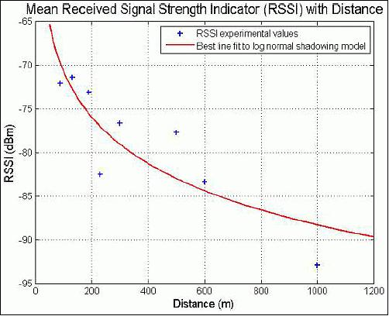
RF Field Based - WiFi
AP – Generate Beacons 100 ms
Can measure signal Strength
  RSSI – Received Signal Strength Indicator
  Included in spec to support handovers.
RSSI – Relative scale or dbm
  Most devices now report dbm
  Range (-50 to -90 dbm)
  Integer values only

Slide 8
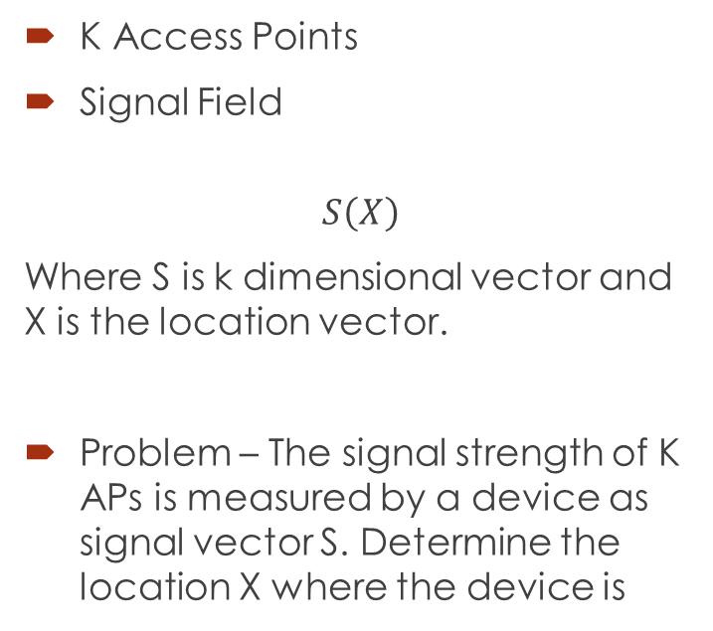
Problem Formulation
K Access Points
Signal Field
$$S\left(X\right)$$
Where S is k dimensional vector and X is the location vector.
Problem – The signal strength of K APs is measured by a device as signal vector S. Determine the location X where the device is
Issues:
  Is S an invertible function?
  Does S have a closed form?
  Is S deterministic or do the measurements vary with time

Slide 9
Signal Function
Closed Form
  Maxwell Equations
  Affected by
    Decay
    Reflections
    Refraction
    Diffusion
    Scattering
  Some Approximations have been attempted
  Outdoor – Cellular Phone
    Accuracies ~200 meters
  Indoor – WiFi
    Accuracies 5-10 meters
What should be K, the number of signal generators – APs.
Most WiFi deployment is for supporting networking access and not for location.
At a location one can only hear a small number of APs.
  There are ~4500 APs on campus. How do we efficiently handle this 4500 dimensional function?

Slide 10
Stochastic nature of Signals
Repeated measurements vary when nothing has changed
There is some correlation among samples
Signal Vector has to be treated as a stochastic vector
As it is reasonable to assume that all APs operate independently the signals from them can be treated as independent random variables.
Analytical models require the modeling of the randomness

Slide 11
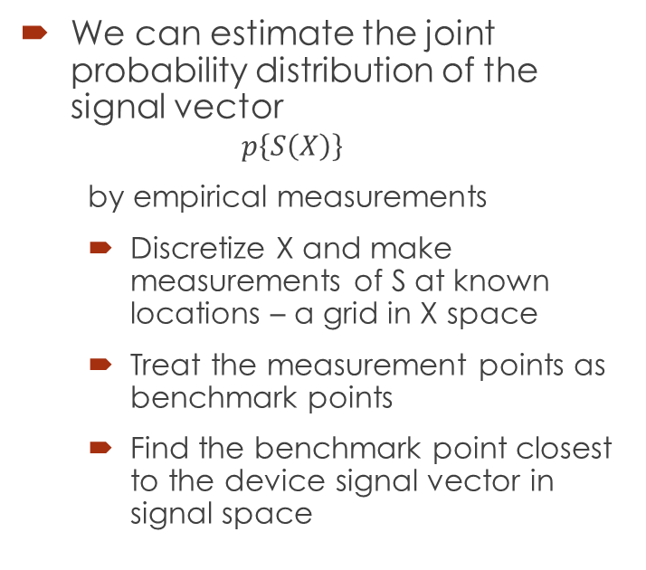
FingerPrinting
We can estimate the joint probability distribution of the signal vector
  $$p\left\{S\left(X\right)\right\}$$
  by empirical measurements
  Discretize X and make measurements of S at known locations – a grid in X space
  Treat the measurement points as benchmark points
  Find the benchmark point closest to the device signal vector in signal space
May refine the location by determining a few closest benchmark points and interpolating

Slide 12

Horus: A WLAN-Based Indoor Location Determination System
Moustafa Youssef
H
O
R
U
S
H
O
R
U
S

Slide 13
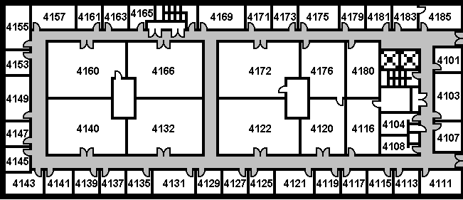
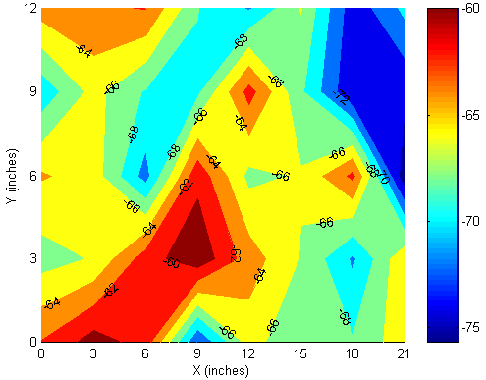
WLAN Location Determination (Cont’d)
Signal strength= f(distance)
Does not follow free space loss
Use lookup table ≡ Radio map
Radio Map: signal strength characteristics at selected locations

Slide 14
WLAN Location Determination (Cont’d)
(x_{i}, y_{i})
[-50, -60]
(x, y)
5
[-53, -56]
13
Offline phase
  Build radio map
  Radar system: average signal strength
Online phase
  Get user location
  Nearest location in signal strength space (Euclidian distance)
[-58, -68]

Slide 15
Horus Goals
High accuracy
  Wider range of applications
Energy efficiency
  Energy constrained devices
Scalability
  Number of supported users
  Coverage area

Slide 16
Sampling Process
Active scanning
  Send a probe request
  Receive a probe response

Slide 17
Signal Strength Characteristics
Temporal variations
  One access point
  Multiple access points
Spatial variations
  Large scale
  Small scale

Slide 18
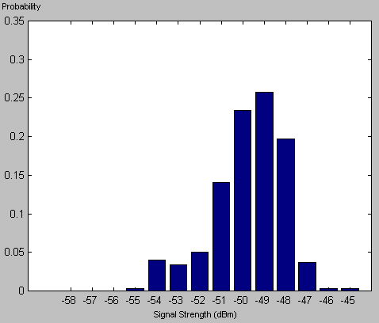
Temporal Variations

Slide 19
Temporal Variations

Slide 20
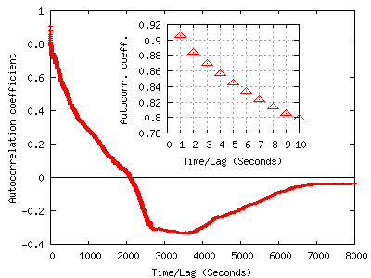
Temporal Variations:
Correlation

Slide 21
Spatial Variations: Large-Scale

Slide 22
Spatial Variations: Small-Scale

Slide 23
Testbeds
A.V. William’s
  4th floor, AVW
  224 feet by 85.1 feet
  UMD net (Cisco APs)
  21 APs (6 on avg.)
  172 locations
  5 feet apart
  Windows XP Prof.
FLA
  3rd floor, 8400 Baltimore Ave
  39 feet by 118 feet
  LinkSys/Cisco APs
  6 APs (4 on avg.)
  110 locations
  7 feet apart
  Linux (kernel 2.5.7)
Orinoco/Compaq cards

Slide 24
Horus Components
Basic algorithm [Percom03]
Correlation handler [InfoCom04]
Continuous space estimator [Under]
Locations clustering [Percom03]
Small-scale compensator [WCNC03]

Slide 25
Basic Algorithm:
Mathematical Formulation
x: Position vector
s: Signal strength vector
  One entry for each access point
s(x) is a stochastic process
P[s(x), t]: probability of receiving s at x at time t
s(x) is a stationary process
  P[s(x)] is the histogram of signal strength at x

Slide 26
Basic Algorithm:
Mathematical Formulation

Slide 27
Basic Algorithm:
Mathematical Formulation
Argmax_{x}[P(x/s)]
Using Bayesian inversion
  Argmax_{x}[P(s/x).P(x)/P(s)]
  Argmax_{x}[P(s/x).P(x)]
P(x): User history

Slide 28
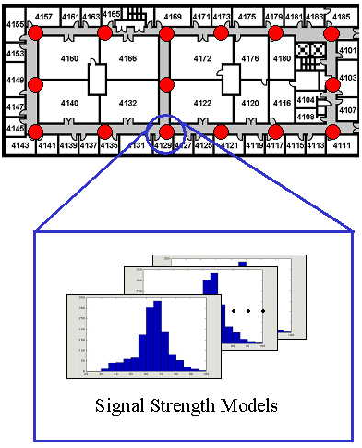
Basic Algorithm
Offline phase
  Radio map: signal strength histograms
Online phase
  Bayesian based inference

Slide 29
WLAN Location Determination (Cont’d)
-40 -60 -80
(x_{i}, y_{i})
(x, y)
P(-53/L1)=0.55
[-53]
P(-53/L2)=0.08
-40 -60 -80

Slide 30
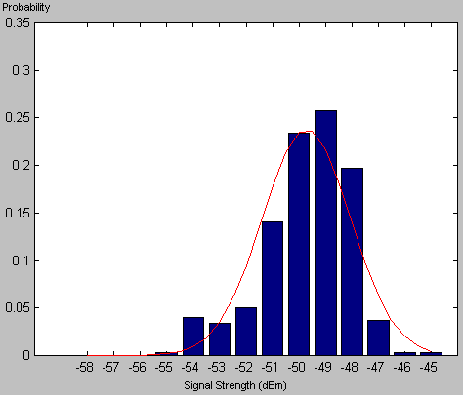
Basic Algorithm:
Signal Strength Distributions

Slide 31
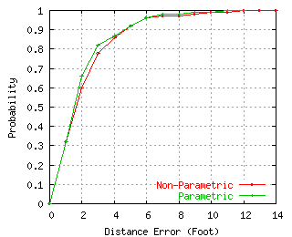
Basic Algorithm:
Results
Accuracy of 5 feet 90% of the time
Slight advantage of parametric over non-parametric method
  Smoothing of distribution shape

Slide 32
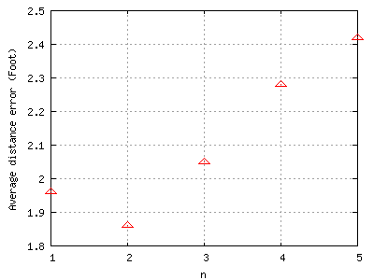
Correlation Handler
Need to average multiple samples to increase accuracy
Independence assumption is wrong

Slide 33
Correlation Handler:
Autoregressive Model
s(t+1)=α.s(t)+(1- α).v(t)
α: correlation degree
E[v(t)]=E[s(t)]
Var[v(t)]= (1+ α)/(1- α) Var[s(t)]

Slide 34
Correlation Handler: Averaging Process
s(t+1)= α.s(t)+(1- α).v(t)
s ~ N(0, m)
v ~ N(0, r)
A=1/n (s₁+s₂+...+s_{n})
E[A(t)]=E[s(t)]=0
Var[A(t)]= m²/n² { [(1- α ^{n})/(1- α)]² + n+ 1- α ² *(1- α ^{2(n-1)})/(1- α ²) }

Slide 35
Correlation Handler: Averaging

Slide 36
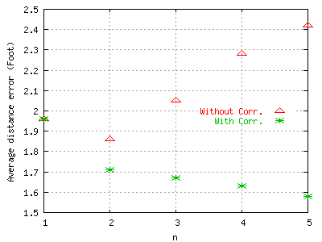
Correlation Handler:
Results
Independence assumption: performance degrades as n increases
Two factors affecting accuracy
  Increasing n
  Deviation from the actual distribution

Slide 37
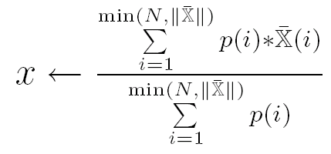
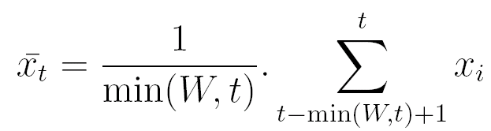
Continuous Space Estimator
Enhance the discrete radio map space estimator
Two techniques
  Center of mass of the top ranked locations
  Time averaging window

Slide 38
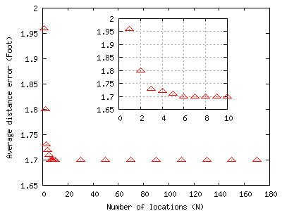
Center of Mass:
Results
N = 1 is the discrete-space estimator
Accuracy enhanced by more than 13%

Slide 39
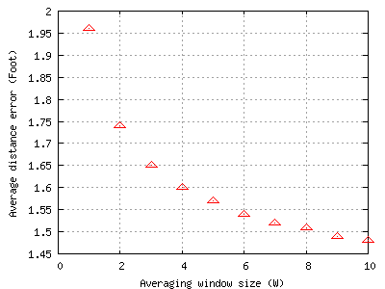
Time Averaging Window:
Results
N = 1 is the discrete-space estimator
Accuracy enhanced by more than 24%

Slide 40
Horus Components
Basic algorithm
Correlation handler
Continuous space estimator
Small-scale compensator
Locations clustering

Slide 41
Small-scale Compensator
Multi-path effect
Hard to capture by radio map (size/time)

Slide 42
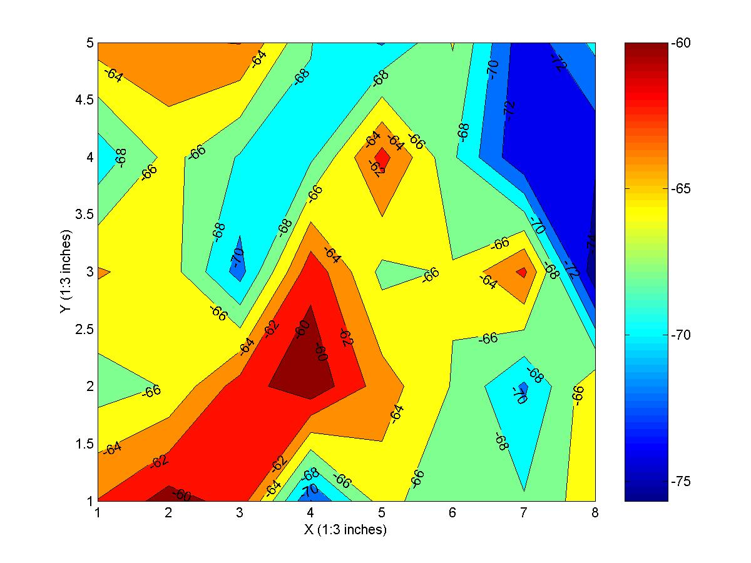
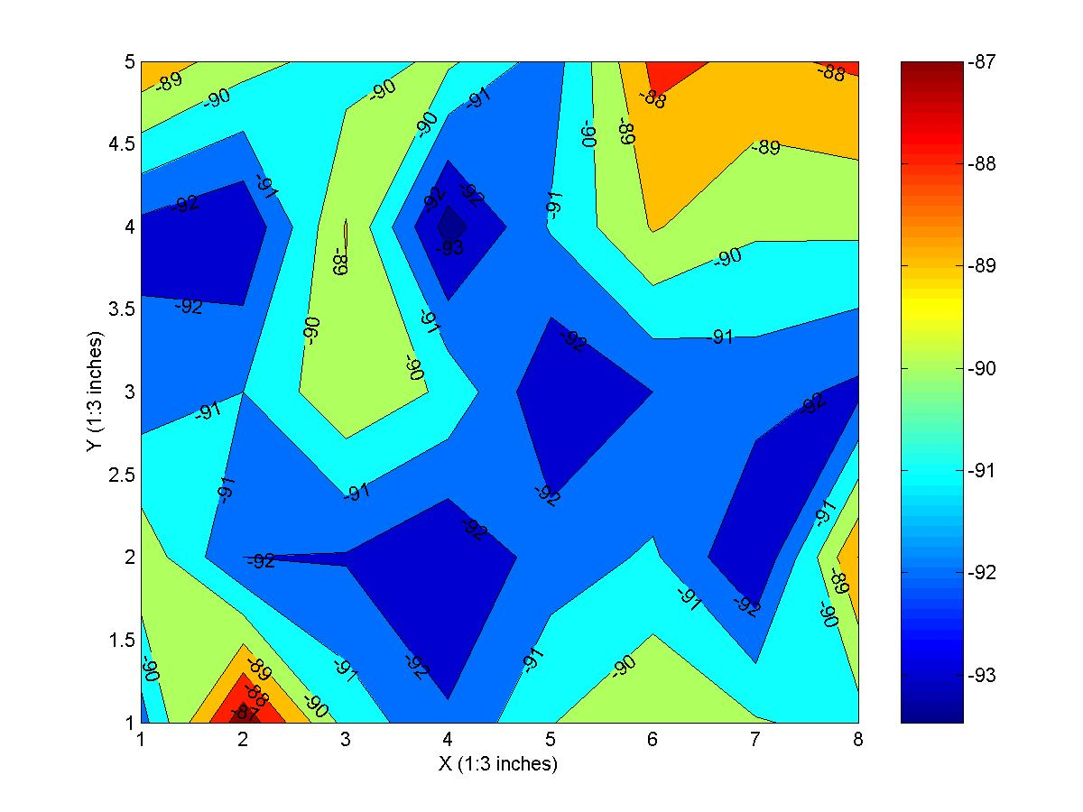
Small-scale Compensator:
Small-scale Variations
AP1
AP2
Variations up to 10 dBm in 3 inches
Variations proportional to average signal strength

Slide 43
Small-scale Compensator:
Perturbation Technique
Detect small-scale variations
  Using previous user location
Perturb signal strength vector
  (s₁, s₂, …, s_{n}) → (s₁±d₁, s₂±d₂, …, s_{n}±d_{n})
  Typically, n=3-4
d_{i} is chosen relative to the received signal strength

Slide 44
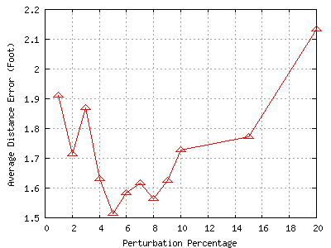
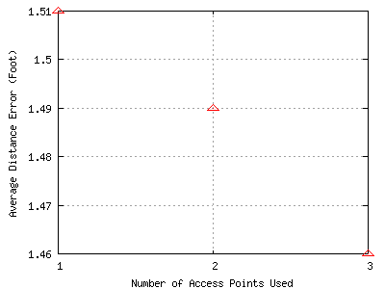
Small-scale Compensator:
Results
Perturbation technique is not sensitive to the number of APs perturbed
Better by more than 25%

Slide 45
Horus Components
Basic algorithm
Correlation handler
Continuous space estimator
Small-scale compensator
Locations clustering

Slide 46
Locations Clustering
Reduce computational requirements
Two techniques
  Explicit
  Implicit

Slide 47
Locations Clustering:
Explicit Clustering
Use access points that cover each location
Use the q strongest access points
S=[-60, -45, -80, -86, -70]
S=[-45, -60, -70, -80, -86]
q=3

Slide 48
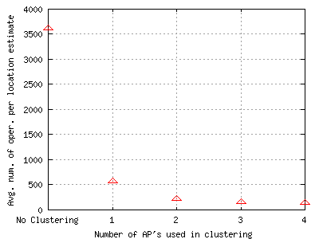
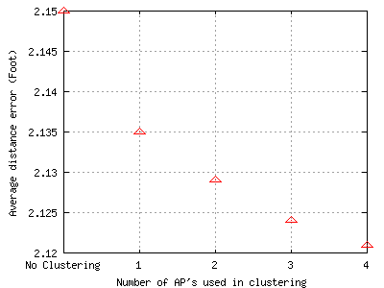
Locations Clustering:
Results- Explicit Clustering
An order of magnitude enhancement in avg. num. of oper. /location estimate
As q increases, accuracy slightly increases

Slide 49
Locations Clustering:
Implicit Clustering
Use the access points incrementally
Implicit multi-level clustering
S=[-60, -45, -80, -86, -70]
S=[-45, -60, -70, -80, -86]
S=(-45, -60, -70, -80, -86)

Slide 50
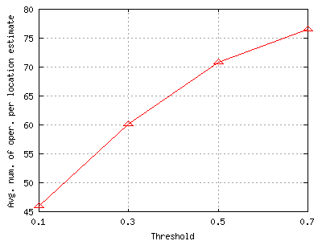
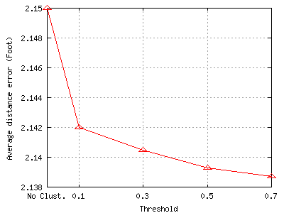
Locations Clustering:
Results- Implicit Clustering
Avg. num. of oper. /location estimate better than explicit clustering
Accuracy increases with Threshold

Slide 51
Horus Components

Slide 52
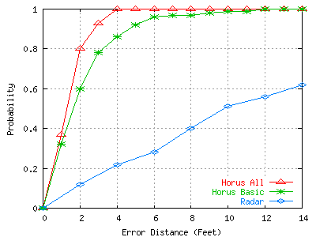
Horus-Radar Comparison

Slide 53
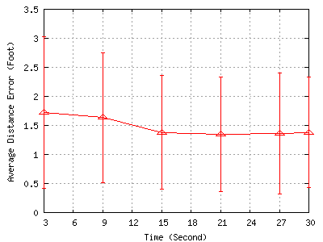
Training Time
15 seconds training time per location

Slide 54
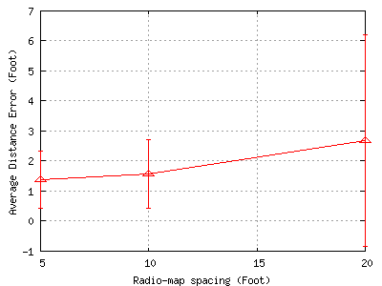
Radio map Spacing
Average distance error increase by as much as 100% (20 feet)
14 feet gives good accuracy

Slide 55
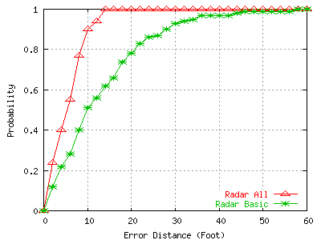
Radar with Horus Techniques
Average distance error enhanced by more than 58%
Worst case error decreased by more than 76%

Slide 56
Conclusions
The Horus system achieves its goals
High accuracy
  Through a probabilistic location determination technique
  Smoothing signal strength distributions by Gaussian approximation
  Using a continuous-space estimator
  Handling the high correlation between samples from the same access point
  The perturbation technique to handle small-scale variations
Low computational requirements
  Through the use of clustering techniques

Slide 57
Conclusions (Cont’d)
Scalability in terms of the coverage area
  Through the use of clustering techniques
Scalability in terms of the number of users
  Through the distributed implementation
Training time of 15 seconds per location is enough to construct the radio-map
Radio map spacing of 14 feet
Horus vs. Radar
  More accurate by more than 11 feet, on the average
  More than an order of magnitude savings in number of operations required per location estimate
Horus vs. Ekahau

Slide 58
Conclusions (Cont’d)
Modules can be applied to other WLAN location determination systems
  Correlation handling, continuous-space estimator, clustering, and small-scale compensator
Applied to Radar
  Average distance error enhanced by more than 58%
  Worst case error decreased by more than 76%
Techniques presented thesis are applicable to other RF-technologies
  802.11a, 802.11g, HiperLAN, and BlueTooth, …

Slide 59
Locus
Indoor location anywhere on College Park Campus
Based on Wi-Fi RSSI
~ 4500 Access Points
Floor accuracy >95%
Location Accurate to the room
Being integrated with M-Urgency

Slide 60
Flying Turtle
Locating indoors

Slide 61
Flying Squirrel – NRL Project
Goal
  Real-time discovery, analysis, and mapping of IEEE 802.11a/b/g/n wireless networks
  Use passive listeners
  Extensive analytics

Slide 62
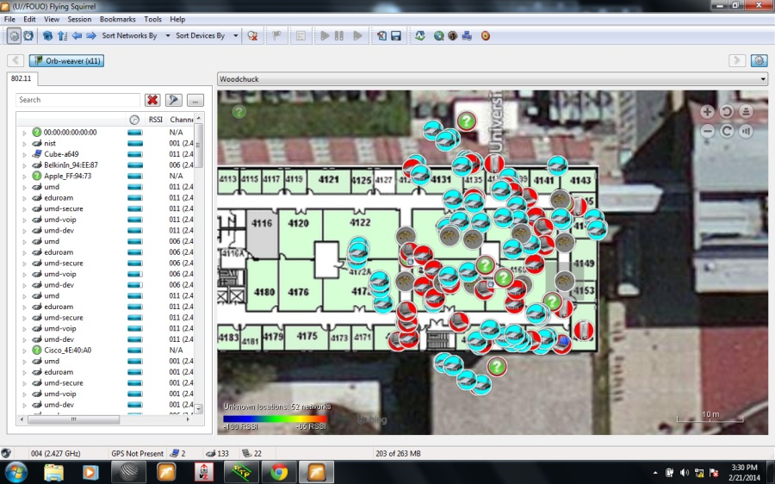
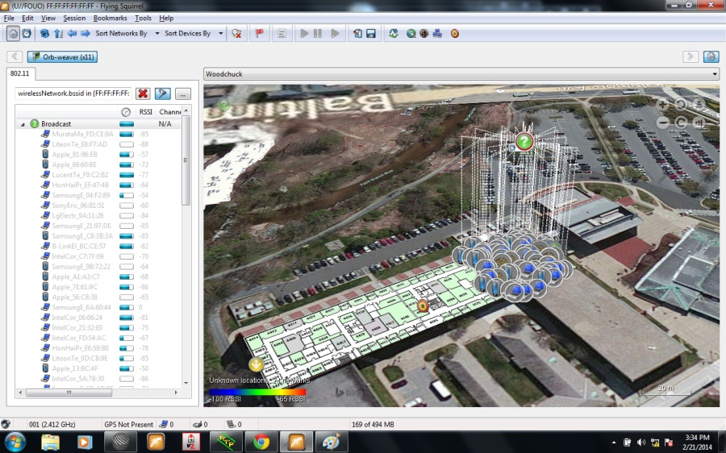
Flying Turtle
20 sensors on 4100 wing of AVW
- compose approx. 20 ft, 20 ft grid points.

Slide 63
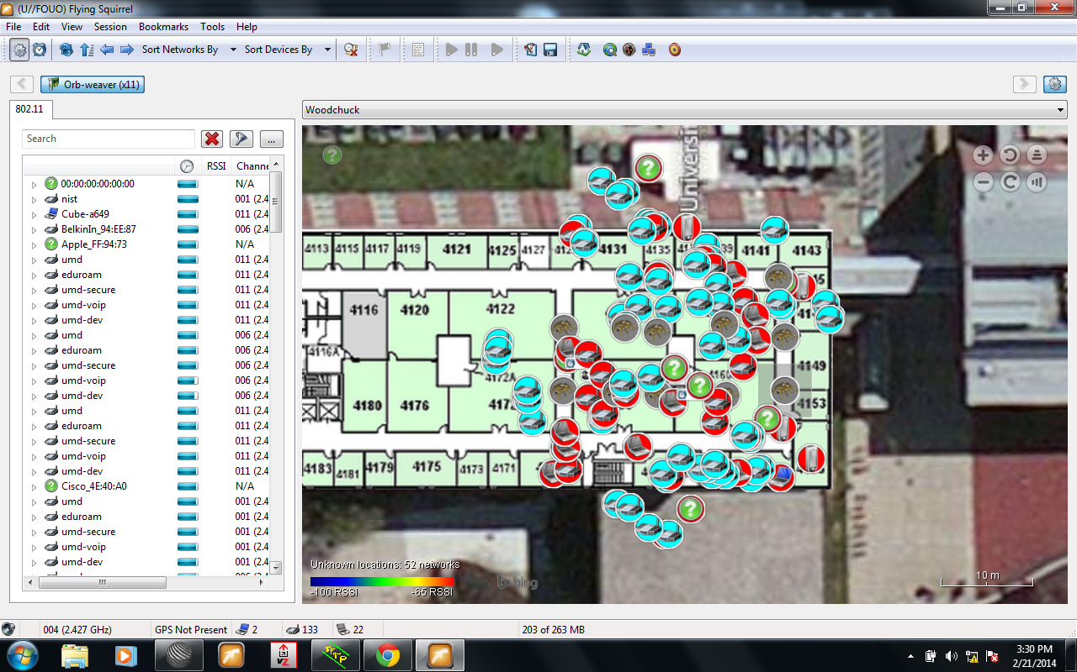
Initial Observations

Slide 64
Our Approach
Dynamic Fingerprinting/Radio Map
With passive listeners
  Can we provide accurate localization from measured signal strengths ?

Slide 65
Time Based Location
Ashok K. Agrawala
Director, MIND Lab
Professor, Computer Science
University of Maryland

Slide 66
Topics
Location Determination
    Horus and Locus
    PinPoint
Clock Synchronization
    With Absolute Real Time

Slide 67
GeoLocation
RSSI Based – Horus and Locus
Accurate Time Stamping
GeoLocation with accuracy in inches
Clock Synchronization
  Mapping Function Timing Protocol
  Synchronization with Absolute Time
Flying Turtle - testbed

Slide 68
PinPoint Technology - Basis
Use a clock model
Determine node to node distance by measuring time of flight of the signal

Slide 69
Clock Model
The clock at a node is assumed to have drift stable over short periods.
Hence clock time τ is related to the real time t by
where
  α and β remain constant for the measurement phase.
  β, the drift rate of the clock is no worse than 100 parts per million
  τ is measured with a nanosecond resolution

Slide 70
Measurements for node pair A and B
Let
  τa1, τb1: tx and rx ts of first A msg
  τb2, τa2: tx and rx ts of first B msg
  τa3, τb3: tx and rx ts of second A msg
  τa4, τb4: tx and rx ts of second B msg

Slide 71
Calculations for node pair A and B
Drift ratio
Propagation delay
Remote clock reading

Slide 72
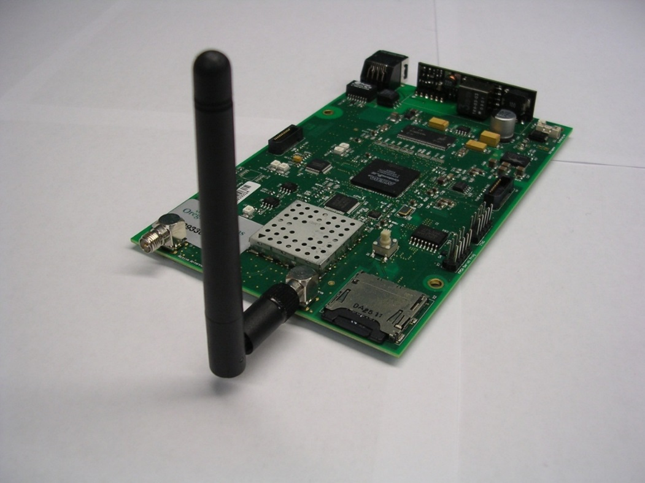
Accurate Time-stamping
Accuracy of distance measurement is directly related to the accuracy of timestamping
Collaboration with Austrian Academy of Sciences
  SMiLE 3 board

Slide 73
Block Diagram of SMiLE

Slide 74
SMiLE Details
Altera FPGA Cyclone III
Max 2830 WiFi chip
Sampling Rate = 44 MHz (22.75 ns Tick)
Discretization 256 levels (22.75/256 = 88.77 ps)

Slide 75
Measurement Results
Time Stamping
  Tick time 88.77 ps (~2.66 cm)
  Standard Deviation of Error – 0.97 ticks
  Stable
Clocks
  Have variable drifts ~ (0.119 to 0.364 ppm)

Slide 76
Clock Drift (Skew)

Slide 77
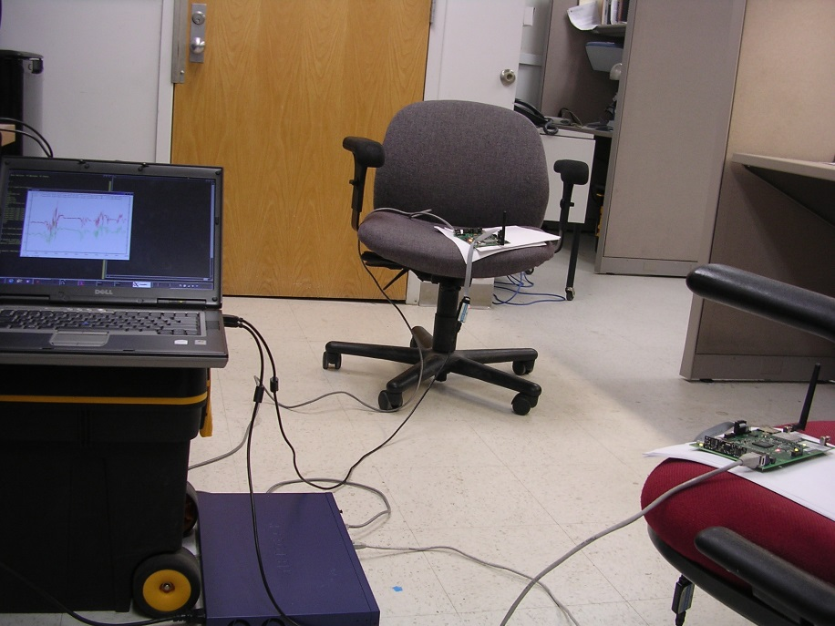
Distance Measurements
Configuration

Slide 78
Distance Measurements
Configuration
  Outdoors
Experiment
  Nodes take turn is sending
  messages
  10ms interval

Slide 79
Distance Statistics
stats | path | in ticks | in feet
mean | 12 | 1200.3790 | 104.8188
 | 13 | 1169.8708 | 102.1548
 | 14 | 1170.1178 | 102.1764
 | 15 | 1182.3626 | 103.2456
 | 23 | 1681.8644 | 146.8628
 | 34 | 1603.9611 | 140.0602
 | 45 | 1656.1120 | 144.6141
 | 52 | 1639.8012 | 143.1898
 | 24 | 2352.6710 | 205.4386
 | 35 | 2313.8754 | 202.0509
 | path | in ticks | in feet | in cms | in inches
std | 12 | 2.5491 | 0.2226 | 6.7845 | 2.6711
 | 13 | 2.4626 | 0.2150 | 6.5544 | 2.5805
 | 14 | 3.4353 | 0.3000 | 9.1433 | 3.5997
 | 15 | 4.0475 | 0.3534 | 10.7725 | 4.2412
 | 23 | 8.9180 | 0.7787 | 23.7358 | 9.3448
 | 34 | 15.0450 | 1.3138 | 40.0432 | 15.7651
 | 45 | 11.0574 | 0.9655 | 29.4299 | 11.5866
 | 52 | 12.2881 | 1.0730 | 32.7055 | 12.8762
 | 24 | 3.9620 | 0.3460 | 10.5451 | 4.1516
 | 35 | 25.5180 | 2.2283 | 67.9175 | 26.7392

Slide 80
Distance

Slide 81
Implication
ASIC Based Technique with accuracy in inches with sub second latencies
Indoor Location
  Multipath Effects need addressing

Slide 82
Clock Synchronization
Mapping Function Based
With Absolute Time

Slide 83
Mapping Function Based Synchronization
Normal approach
  Exchange signals
  Determine corrections
  Correct the local clock
Our Approach
  Use a free running local clock
  Exchange messages to determine a mapping function
  When time information is needed
    Read time from local clock
    Map it using a mapping function

Slide 84
Mapping Function
Two nodes, a and b
φ_{a}(t) = t_{a}
ψ_{a}(t_{a}) = t
  Example
φ_{ab}(t_{b}) = t_{a}
ψ_{ab}(t_{a}) = t_{b}

Slide 85
Approach
Linear model of clock works well over short periods of time
When exchanging messages, Time instants t_{a}(2) and t_{b}(2) are the same time instants in real time.
Calculate and use a piecewise linear mapping function

Slide 86
Synchronization tolerance
How far is the time at a node compared to the mapped time?

Slide 87
Synchronization Tolerance
3 nodes 4 ft apart
Average ~ 80 ps, STD ~ 60 ps

Slide 88
Synchronization Tolerance
Five Nodes – 123451 path

Slide 89
Synchronization with Absolute time
Note that
If we can measure d accurately we can determine β the drift rate with respect to real time

Slide 90
Two Approaches
Over the air
  The term d is a function of distance and the speed of light.
    We can keep nodes at fixed distance
    Speed of light through air changes as a function of temperature, pressure and humidity
    Monitoring these we can determine the speed of light with an accuracy of one part in 10⁹
    As these parameters change slowly we can have a stable reference during a mission.
Using a communications means with known delay
  Fiber with measured delay

