Slide 1

Computer Networks
CMSC 417 : Spring 2020
Topic: Intra- and Inter-AS routing (BGP)
(Textbook chapter 4)
Nirupam Roy
Tu-Th 2:00-3:15pm
CSI 1115

Slide 2
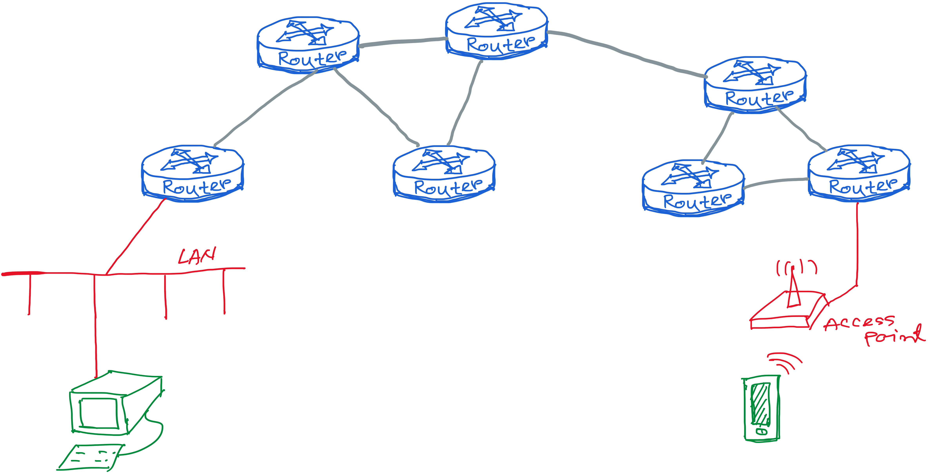
Our (improved) view of the Internet

Slide 3
Making routing scalable
our routing study thus far - idealized
all routers identical
network “flat”
… not true in practice
scale: with billions of destinations:
Can’t store all destinations in routing tables!
routing table exchange would swamp links!
administrative autonomy
internet = network of networks
each network admin may want to control routing in its own network

Slide 4
Autonomous Routing Domains
A collection of physical networks glued together
using IP, that have a unified administrative
routing policy.
Campus networks
Corporate networks
ISP Internal networks
…

Slide 5
Autonomous Systems (ASes)
An autonomous system is an autonomous routing domain
that has been assigned an Autonomous System Number (ASN).
… the administration of an AS appears to other ASes to
have a single coherent interior routing plan and presents a
consistent picture of what networks are reachable through it.
RFC 1930: Guidelines for creation, selection,
and registration of an Autonomous System

Slide 6
AS Numbers (ASNs)
ASNs are 16 bit values.
64512 through 65535 are “private”
Currently over 11,000 in use.
Genuity: 1
MIT: 3
Harvard: 11
UC San Diego: 7377
AT&T: 7018, 6341, 5074, …
UUNET: 701, 702, 284, 12199, …
Sprint: 1239, 1240, 6211, 6242, …
…
ASNs represent units of routing policy

Slide 7
Interdomain routing = routing between autonomous systems
UUNet
Sprint
134.244.0.0/16
AS 701
AS 1239
AT&T
Common Backbone
AS 7018
AT&T Research
Fidelity Investments
AS 6431
AS 11040
192.223.184.0/21
207.104.168.0/24

Slide 8
Internet approach to scalable routing
aggregate routers into regions known as “autonomous systems” (AS) (a.k.a. “domains”)
intra-AS routing
routing among hosts, routers in same AS (“network”)
all routers in AS must run same intra-domain protocol
routers in different AS can run different intra-domain routing protocol
gateway router: at “edge” of its own AS, has link(s) to router(s) in other AS’es
inter-AS routing
routing among AS’es
gateways perform inter-domain routing (as well as intra-domain routing)

Slide 9
Interconnected ASes
3c
3a
2c
3b
AS3
2a
1c
2b
AS2
1a
1b
1d
AS1
forwarding table configured by both intra- and inter-AS routing algorithm
  intra-AS routing determine entries for destinations within AS
  inter-AS & intra-AS determine entries for external destinations
Intra-AS
Routing
algorithm
Inter-AS
Routing
algorithm
Forwarding
table

Slide 10
Intra-AS Routing

Slide 11
Intra-AS Routing
also known as interior gateway protocols (IGP)
most common intra-AS routing protocols:
  RIP: Routing Information Protocol
  OSPF: Open Shortest Path First
  IGRP: Interior Gateway Routing Protocol (Cisco proprietary for decades, until 2016)

Slide 12
OSPF (Open Shortest Path First)
“open”: publicly available
uses link-state algorithm
  link state packet dissemination
  topology map at each node
  route computation using Dijkstra’s algorithm
router floods OSPF link-state advertisements to all other routers in entire AS
  carried in OSPF messages directly over IP (rather than TCP or UDP
  link state: for each attached link

Slide 13
OSPF “advanced” features
security: all OSPF messages authenticated (to prevent malicious intrusion)
multiple same-cost paths allowed (only one path in RIP)
for each link, multiple cost metrics for different ToS (e.g., satellite link cost set low for best effort ToS; high for real-time ToS)
integrated uni- and multi-cast support:
  Multicast OSPF (MOSPF) uses same topology data base as OSPF
hierarchical OSPF in large domains.

Slide 14
Hierarchical OSPF
boundary router
backbone router
backbone
area
border
routers
area 3
internal
routers
area 1
area 2

Slide 15
Hierarchical OSPF
two-level hierarchy: local area, backbone.
  link-state advertisements only in area
  each nodes has detailed area topology; only know direction (shortest path) to nets in other areas.
area border routers: “summarize” distances to nets in own area, advertise to other Area Border routers.
backbone routers: run OSPF routing limited to backbone.
boundary routers: connect to other AS’es.

Slide 16
Inter-AS tasks
suppose router in AS1 receives datagram destined outside of AS1:
  router should forward packet to gateway router, but which one?
AS1 must:
learn which dests are reachable through AS2, which through AS3
propagate this reachability info to all routers in AS1
job of inter-AS routing!
3c
3a
3b
AS3
2c
other
networks
1c
2a
other
networks
1a
2b
1b
AS2
AS1
1d

Slide 17
Inter-AS Routing

Slide 18
Internet inter-AS routing: BGP
BGP (Border Gateway Protocol): the de facto inter-domain routing protocol
  “glue that holds the Internet together”
BGP provides each AS a means to:
  eBGP: obtain subnet reachability information from neighboring ASes
  iBGP: propagate reachability information to all AS-internal routers.
  determine “good” routes to other networks based on reachability information and policy
allows subnet to advertise its existence to rest of Internet: “I am here”

Slide 19
eBGP, iBGP connections
2b
2a
2c
1b
3b
2d
1a
1c
3a
3c
AS 2
1d
3d
AS 1
eBGP connectivity
AS 3
iBGP connectivity
1c
gateway routers run both eBGP and iBGP protocols

Slide 20
BGP basics
BGP session: two BGP routers (“peers”) exchange BGP messages over semi-permanent TCP connection:
  advertising paths to different destination network prefixes (BGP is a “path vector” protocol)
when AS3 gateway router 3a advertises path AS3,X to AS2 gateway router 2c:
  AS3 promises to AS2 it will forward datagrams towards X
AS 3
3b
AS 1
1b
3a
3c
1a
1c
AS 2
2b
3d
X
1d
2a
2c
BGP advertisement:
AS3, X
2d

Slide 21
Path attributes and BGP routes
advertised prefix includes BGP attributes
  prefix + attributes = “route”
two important attributes:
  AS-PATH: list of ASes through which prefix advertisement has passed
  NEXT-HOP: indicates specific internal-AS router to next-hop AS
Policy-based routing:
  gateway receiving route advertisement uses import policy to accept/decline path (e.g., never route through AS Y).
  AS policy also determines whether to advertise path to other other neighboring ASes

Slide 22
BGP path advertisement
AS3
3b
AS1
1b
3a
3c
1a
1c
AS2
2b
3d
X
1d
AS3,X
AS2,AS3,X
2a
2c
2d
AS2 router 2c receives path advertisement AS3,X (via eBGP) from AS3 router 3a
Based on AS2 policy, AS2 router 2c accepts path AS3,X, propagates (via iBGP) to all AS2 routers
Based on AS2 policy, AS2 router 2a advertises (via eBGP) path AS2, AS3, X to AS1 router 1c

Slide 23
BGP path advertisement
AS3
3b
AS1
1b
AS3,X
3a
3c
1a
1c
AS2
2b
3d
X
1d
AS3,X
AS2,AS3,X
2a
2c
2d
gateway router may learn about multiple paths to destination:
AS1 gateway router 1c learns path AS2,AS3,X from 2a
AS1 gateway router 1c learns path AS3,X from 3a
Based on policy, AS1 gateway router 1c chooses path AS3,X, and advertises path within AS1 via iBGP

Slide 24
BGP messages
BGP messages exchanged between peers over TCP connection
BGP messages:
  OPEN: opens TCP connection to remote BGP peer and authenticates sending BGP peer
  UPDATE: advertises new path (or withdraws old)
  KEEPALIVE: keeps connection alive in absence of UPDATES; also ACKs OPEN request
  NOTIFICATION: reports errors in previous msg; also used to close connection

Slide 25
BGP, OSPF, forwarding table entries
Q: how does router set forwarding table entry to distant prefix?
AS3
3b
AS1
1b
AS3,X
1
AS3,X
3a
3c
1a
2
1c
local link interfaces
at 1a, 1d
AS2
2b
3d
X
2
1d
1
AS3,X
AS2,AS3,X
2a
2c
physical link
2d
dest
interface
recall: 1a, 1b, 1d learn about dest X via iBGP from 1c: “path to X goes through 1c”
…
…
…
…
X
1
1d: OSPF intra-domain routing: to get to 1c, forward over outgoing local interface 1

Slide 26
BGP, OSPF, forwarding table entries
Q: how does router set forwarding table entry to distant prefix?
AS3
3b
AS1
1b
1
3a
3c
1a
2
1c
AS2
2b
3d
X
1d
2a
2c
2d
dest
interface
recall: 1a, 1b, 1d learn about dest X via iBGP from 1c: “path to X goes through 1c”
…
…
…
…
X
2
1d: OSPF intra-domain routing: to get to 1c, forward over outgoing local interface 1
1a: OSPF intra-domain routing: to get to 1c, forward over outgoing local interface 2

Slide 27
BGP route selection
router may learn about more than one route to destination AS, selects route based on:
  local preference value attribute: policy decision
  shortest AS-PATH
  closest NEXT-HOP router: hot potato routing
  additional criteria

Slide 28
Hot Potato Routing
AS3
3b
AS1
1b
3a
3c
1a
1c
AS2
2b
3d
X
1d
112
152
AS3,X
AS1,AS3,X
2a
263
2c
201
OSPF link weights
2d
2d learns (via iBGP) it can route to X via 2a or 2c
hot potato routing: choose local gateway that has least intra-domain cost (e.g., 2d chooses 2a, even though more AS hops to X): don’t worry about inter-domain cost!

