Slide 1
Computer Networks
CMSC 417 : Spring 2020
Topic: Internetworking
(Textbook chapter 3)
Nirupam Roy
Tu-Th 2:00-3:15pm
CSI 1115

Slide 2
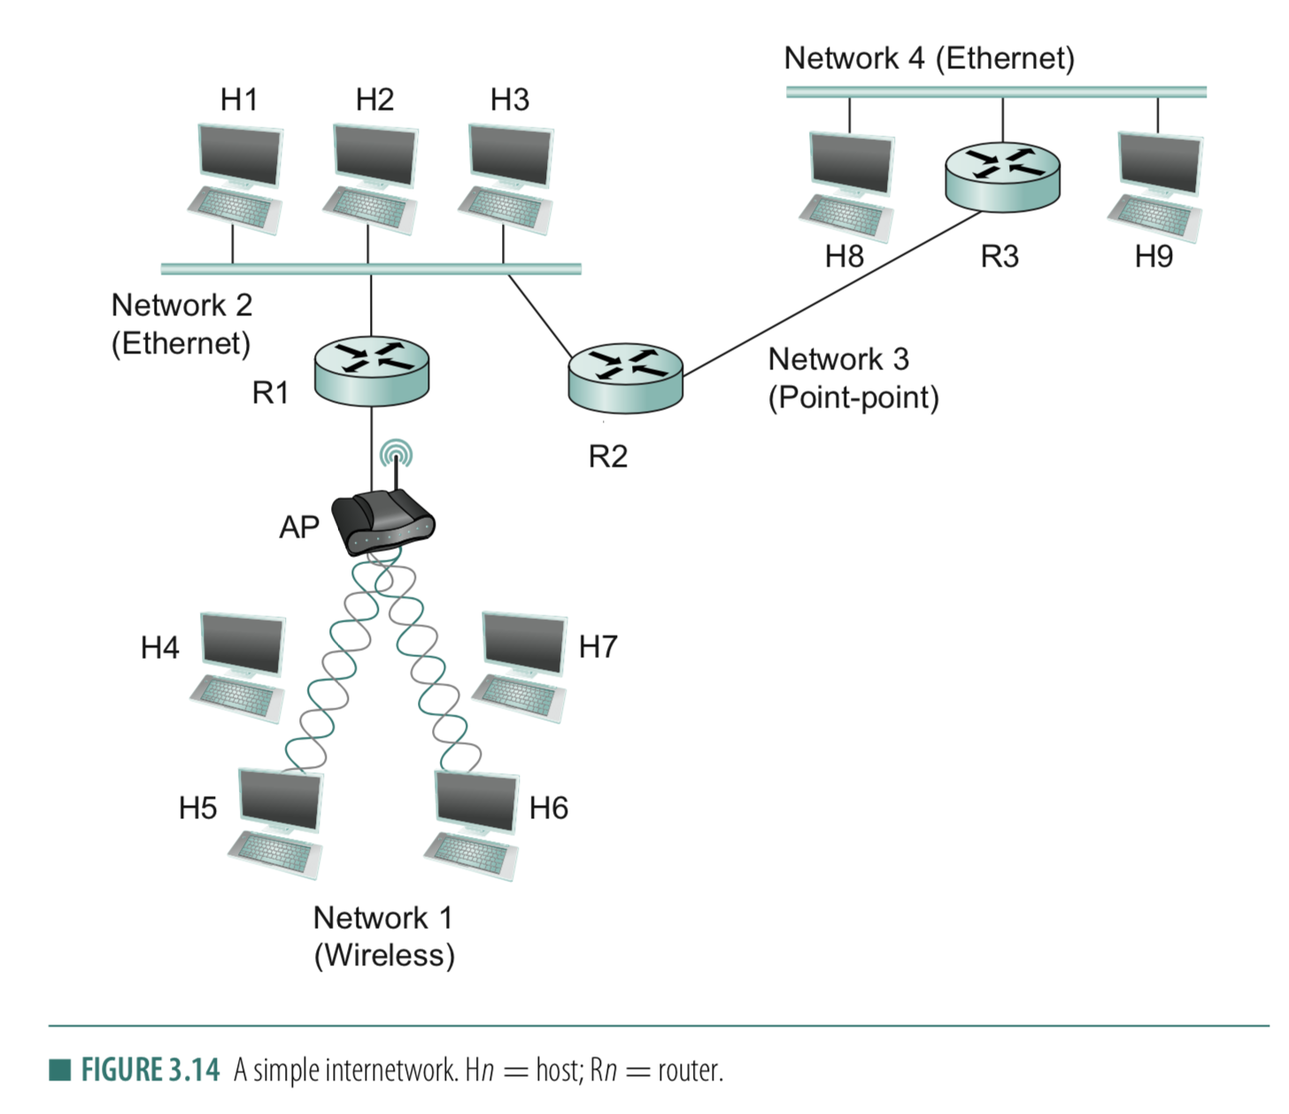
Connection between hosts
1. Addressing
– Unique identifier for global addressing
– Link name for neighbors
2. Forwarding
-- Switching packets between links
3. Routing
-- Determining paths between hosts

Slide 3
Connection between hosts
1. Addressing
– Unique identifier for global addressing
– Link name for neighbors
2. Forwarding
-- Switching packets between links
3. Routing
-- Determining paths between hosts

Slide 4
Routing protocols
Routing protocol goal: determine “good” paths (equivalently, routes), from sending hosts to receiving host, through network of routers
path: sequence of routers packets will traverse in going from given initial source host to given final destination host
“good”: least “cost”, “fastest”, “least congested”

Slide 5
Graph abstraction of the network
5
v
3
w
2
5
u
2
1
z
3
1
2
x
y
1
graph: G = (N,E)
N = set of routers = { u, v, w, x, y, z }
E = set of links ={ (u,v), (u,x), (v,x), (v,w), (x,w), (x,y), (w,y), (w,z), (y,z) }
aside: graph abstraction is useful in other network contexts, e.g.,
P2P, where N is set of peers and E is set of TCP connections

Slide 6
Graph abstraction: costs
5
c(x,x’) = cost of link (x,x’)
e.g., c(w,z) = 5
cost could always be 1, or
inversely related to bandwidth,
or related to congestion
v
3
w
2
5
u
2
1
z
3
1
2
x
y
1
cost of path (x₁, x₂, x₃,…, x_{p}) = c(x₁,x₂) + c(x₂,x₃) + … + c(x_{p-1},x_{p})
key question: what is the least-cost path between u and z ?
routing algorithm: algorithm that finds that least cost path

Slide 7
Routing
For a simple network, we can calculate all shortest paths and load them into some nonvolatile storage on each node.
Such a static approach has several shortcomings
It does not deal with node or link failures
It does not consider the addition of new nodes or links
It implies that edge costs cannot change
What is the solution?
Need a distributed and dynamic protocol
Two main classes of protocols
Distance Vector
Link State

Slide 8
Distance Vector Routing

Slide 9
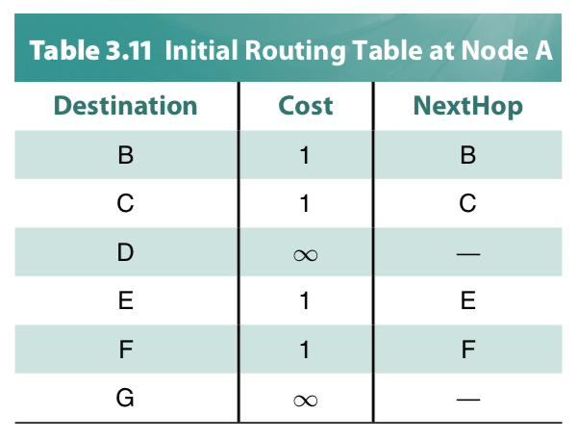
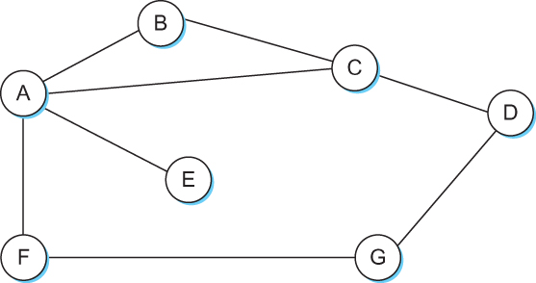
Distance Vector
Each node constructs a one dimensional array (a vector) containing the “distances” (costs) to all other nodes and distributes that vector to its immediate neighbors
Starting assumption is that each node knows the cost of the link to each of its directly connected neighbors

Slide 10
Distance Vector Routing: An example
B
D
19
4
A
11
13
15
7
5
C
E

Slide 11
Distance Vector Routing: An example
Routing table at Node A
Dest | Cost | N. Hop
B
D
19
4
A
11
13
15
7
5
C
E

Slide 12
Distance Vector Routing: An example
Routing table at Node A
Dest | Cost | N. Hop
A | 0 | A
B | 19 | B
C | 7 | C
D | ∞ | --
E | ∞ | --
B
D
19
4
A
11
13
15
7
5
C
E
Know thy neighbors !!
How?

Slide 13
Round: 0
Dest | Cost | N. Hop
A | 19 | A
B | 0 | B
C | 11 | C
D | 4 | D
E | ∞ | --
Dest | Cost | N. Hop
A | ∞ | --
B | 4 | B
C | 15 | C
D | 0 | D
E | 13 | E
Dest | Cost | N. Hop
A | 0 | A
B | 19 | B
C | 7 | C
D | ∞ | --
E | ∞ | --
B
D
19
4
A
11
13
15
7
5
C
E
Dest | Cost | N. Hop
A | 7 | A
B | 11 | B
C | 0 | C
D | 15 | D
E | 5 | E
Dest | Cost | N. Hop
A | ∞ | --
B | ∞ | --
C | 5 | C
D | 13 | D
E | 0 | E

Slide 14
Round: 0
Dest | Cost | N. Hop
A | 19 | A
B | 0 | B
C | 11 | C
D | 4 | D
E | ∞ | --
Dest | Cost | N. Hop
A | ∞ | --
B | 4 | B
C | 15 | C
D | 0 | D
E | 13 | E
Let your neighbors know what you know!!
Dest | Cost | N. Hop
A | 0 | A
B | 19 | B
C | 7 | C
D | ∞ | --
E | ∞ | --
B
D
19
4
A
11
13
15
7
5
C
E
Dest | Cost | N. Hop
A | 7 | A
B | 11 | B
C | 0 | C
D | 15 | D
E | 5 | E
Dest | Cost | N. Hop
A | ∞ | --
B | ∞ | --
C | 5 | C
D | 13 | D
E | 0 | E

Slide 15
Round: 1
Dest | Cost | N. Hop
A | 19 | A
B | 0 | B
C | 11 | C
D | 4 | D
E | ∞ | --
Dest | Cost | N. Hop
A | ∞ | --
B | 4 | B
C | 15 | C
D | 0 | D
E | 13 | E
Update your routing table, if required!!
Dest | Cost | N. Hop
A | 0 | A
B | 19 | B
C | 7 | C
D | ∞ | --
E | ∞ | --
B
D
19
4
A
11
13
15
7
5
C
E
Node A: Updates for B,D,E
Node B: Updates for A, E
Node C: No Updates
Node D: Updates for A
Node E: Updates for A, B
Dest | Cost | N. Hop
A | 7 | A
B | 11 | B
C | 0 | C
D | 15 | D
E | 5 | E
Dest | Cost | N. Hop
A | ∞ | --
B | ∞ | --
C | 5 | C
D | 13 | D
E | 0 | E

Slide 16
Round: 1
Dest | Cost | N. Hop
A | 18 | C
B | 0 | B
C | 11 | C
D | 4 | D
E | 16 | C
Dest | Cost | N. Hop
A | 22 | C
B | 4 | B
C | 15 | C
D | 0 | D
E | 13 | E
Dest | Cost | N. Hop
A | 0 | A
B | 18 | C
C | 7 | C
D | 22 | C
E | 12 | C
B
D
19
4
A
11
13
15
7
5
C
E
Node A: Updates for B,D,E
Node B: Updates for A, E
Node C: No Updates
Node D: Updates for A
Node E: Updates for A, B
Dest | Cost | N. Hop
A | 7 | A
B | 11 | B
C | 0 | C
D | 15 | D
E | 5 | E
Dest | Cost | N. Hop
A | 12 | C
B | 16 | C
C | 5 | C
D | 13 | D
E | 0 | E

Slide 17
Round: 1
Dest | Cost | N. Hop
A | 18 | C
B | 0 | B
C | 11 | C
D | 4 | D
E | 16 | C
Dest | Cost | N. Hop
A | 22 | C
B | 4 | B
C | 15 | C
D | 0 | D
E | 13 | E
Dest | Cost | N. Hop
A | 0 | A
B | 18 | C
C | 7 | C
D | 22 | C
E | 12 | C
B
D
19
4
A
11
13
15
7
5
C
E
Node A: Updates for B,D,E
Node B: Updates for A, E
Node C: No Updates
Node D: Updates for A
Node E: Updates for A, B
Dest | Cost | N. Hop
A | 7 | A
B | 11 | B
C | 0 | C
D | 15 | D
E | 5 | E
Dest | Cost | N. Hop
A | 12 | C
B | 16 | C
C | 5 | C
D | 13 | D
E | 0 | E

Slide 18
Round: 2
Dest | Cost | N. Hop
A | 18 | C
B | 0 | B
C | 11 | C
D | 4 | D
E | 16 | C
Dest | Cost | N. Hop
A | 22 | C
B | 4 | B
C | 15 | C
D | 0 | D
E | 13 | E
Dest | Cost | N. Hop
A | 0 | A
B | 18 | C
C | 7 | C
D | 22 | C
E | 12 | C
B
D
19
4
A
11
13
15
7
Convergence
C
5
E
Node A: No Updates
Node B: No Updates
Node C: No Updates
Node D: No Updates
Node E: No Updates
Dest | Cost | N. Hop
A | 7 | A
B | 11 | B
C | 0 | C
D | 15 | D
E | 5 | E
Dest | Cost | N. Hop
A | 12 | C
B | 16 | C
C | 5 | C
D | 13 | D
E | 0 | E

Slide 19
Distance vector algorithm
Bellman-Ford equation (dynamic programming)
let
d_{x}(y) := cost of least-cost path from x to y
then
d_{x}(y) = min {c(x,v) + d_{v}(y) }
v
cost from neighbor v to destination y
cost to neighbor v
min taken over all neighbors v of x

Slide 20
Bellman-Ford example
5
clearly, d_{v}(z) = 5, d_{x}(z) = 3, d_{w}(z) = 3
v
3
w
2
5
u
z
B-F equation says:
2
1
3
1
2
d_{u}(z) = min { c(u,v) + d_{v}(z),
c(u,x) + d_{x}(z),
c(u,w) + d_{w}(z) }
= min {2 + 5,
1 + 3,
5 + 3} = 4
x
y
1
node achieving minimum is next
hop in shortest path, used in forwarding table

Slide 21
Distance vector algorithm
D_{x}(y) = estimate of least cost from x to y
x maintains distance vector D_{x} = [D_{x}(y): y є N ]
node x:
knows cost to each neighbor v: c(x,v)
maintains its neighbors’ distance vectors. For each neighbor v, x maintains D_{v} = [D_{v}(y): y є N ]

Slide 22
Distance vector algorithm
key idea:
from time-to-time, each node sends its own distance vector estimate to neighbors
when x receives new DV estimate from neighbor, it updates its own DV using B-F equation:
D_{x}(y) ← min_{v}{c(x,v) + D_{v}(y)} for each node y ∊ N
under minor, natural conditions, the estimate D_{x}(y) converge to the actual least cost d_{x}(y)

Slide 23
Distance vector algorithm
iterative, asynchronous: each local iteration caused by:
local link cost change
DV update message from neighbor
distributed:
each node notifies neighbors only when its DV changes
neighbors then notify their neighbors if necessary
each node:
wait for (change in local link cost or msg from neighbor)
recompute estimates
if DV to any dest has changed, notify neighbors

Slide 24
Routing updates
Two circumstances when a node sends out routing advertisements:
Periodic update: Automatically after some time. Why?
2) Triggered update: Whenever an event makes a node to change its routing table (e.g., link fail or a new message from a neighbor).

Slide 25
Distance Vector Routing: Link failure

Slide 26
Round: 2
Dest | Cost | N. Hop
A | 18 | C
B | 0 | B
C | 11 | C
D | 4 | D
E | 16 | C
Dest | Cost | N. Hop
A | 22 | C
B | 4 | B
C | 15 | C
D | 0 | D
E | 13 | E
Dest | Cost | N. Hop
A | 0 | A
B | 18 | C
C | 7 | C
D | 22 | C
E | 12 | C
B
D
19
4
A
11
13
15
7
5
C
E
Node A: No Updates
Node B: No Updates
Node C: No Updates
Node D: No Updates
Node E: No Updates
Dest | Cost | N. Hop
A | 7 | A
B | 11 | B
C | 0 | C
D | 15 | D
E | 5 | E
Dest | Cost | N. Hop
A | 12 | C
B | 16 | C
C | 5 | C
D | 13 | D
E | 0 | E

Slide 27
Round: 3
Dest | Cost | N. Hop
A | ∞ | --
B | 0 | B
C | ∞ | --
D | 4 | D
E | ∞ | --
Dest | Cost | N. Hop
A | 22 | C
B | 4 | B
C | 15 | C
D | 0 | D
E | 13 | E
Dest | Cost | N. Hop
A | 0 | A
B | 18 | C
C | 7 | C
D | 22 | C
E | 12 | C
B
D
19
4
A
11
13
15
7
5
C
E
Node A: No Updates
Node B: No Updates
Node C: No Updates
Node D: No Updates
Node E: No Updates
Dest | Cost | N. Hop
A | 7 | A
B | ∞ | --
C | 0 | C
D | 15 | D
E | 5 | E
Dest | Cost | N. Hop
A | 12 | C
B | 16 | C
C | 5 | C
D | 13 | D
E | 0 | E

Slide 28
Round: 3
Dest | Cost | N. Hop
A | 19 | A
B | 0 | B
C | 19 | D
D | 4 | D
E | 17 | D
Dest | Cost | N. Hop
A | 22 | C
B | 4 | B
C | 15 | C
D | 0 | D
E | 13 | E
Dest | Cost | N. Hop
A | 0 | A
B | ∞ | C
C | 7 | C
D | 22 | C
E | 12 | C
Cost update
B
D
19
4
A
11
13
15
7
5
C
E
Node A: Updates for B
Node B: Updates for A,C,E
Node C: Updates for B
Node D: No Updates
Node E: Updates for B
Dest | Cost | N. Hop
A | 7 | A
B | 19 | D
C | 0 | C
D | 15 | D
E | 5 | E
Dest | Cost | N. Hop
A | 12 | C
B | 17 | D
C | 5 | C
D | 13 | D
E | 0 | E

Slide 29
Round: 4
Dest | Cost | N. Hop
A | 19 | A
B | 0 | B
C | 19 | D
D | 4 | D
E | 17 | D
Dest | Cost | N. Hop
A | 22 | C
B | 4 | B
C | 15 | C
D | 0 | D
E | 13 | E
Dest | Cost | N. Hop
A | 0 | A
B | ∞ | C
C | 7 | C
D | 22 | C
E | 12 | C
B
D
19
4
A
11
13
15
7
5
C
E
Node A: Updates for B
Node B: No Updates
Node C: No Updates
Node D: No Updates
Node E: No Updates
Dest | Cost | N. Hop
A | 7 | A
B | 19 | D
C | 0 | C
D | 15 | D
E | 5 | E
Dest | Cost | N. Hop
A | 12 | C
B | 17 | D
C | 5 | C
D | 13 | D
E | 0 | E

Slide 30
Round: 5
Dest | Cost | N. Hop
A | 19 | A
B | 0 | B
C | 19 | D
D | 4 | D
E | 17 | D
Dest | Cost | N. Hop
A | 22 | C
B | 4 | B
C | 15 | C
D | 0 | D
E | 13 | E
Dest | Cost | N. Hop
A | 0 | A
B | 19 | B
C | 7 | C
D | 22 | C
E | 12 | C
B
D
19
4
A
11
13
15
7
5
C
E
Node A: No Updates
Node B: No Updates
Node C: No Updates
Node D: No Updates
Node E: No Updates
Dest | Cost | N. Hop
A | 7 | A
B | 19 | D
C | 0 | C
D | 15 | D
E | 5 | E
Dest | Cost | N. Hop
A | 12 | C
B | 17 | D
C | 5 | C
D | 13 | D
E | 0 | E

Slide 31
Distance vector: link cost changes
link cost changes:
node detects local link cost change
updates routing info, recalculates distance vector
if DV changes, notify neighbors
1
y
4
1
x
z
50

Slide 32
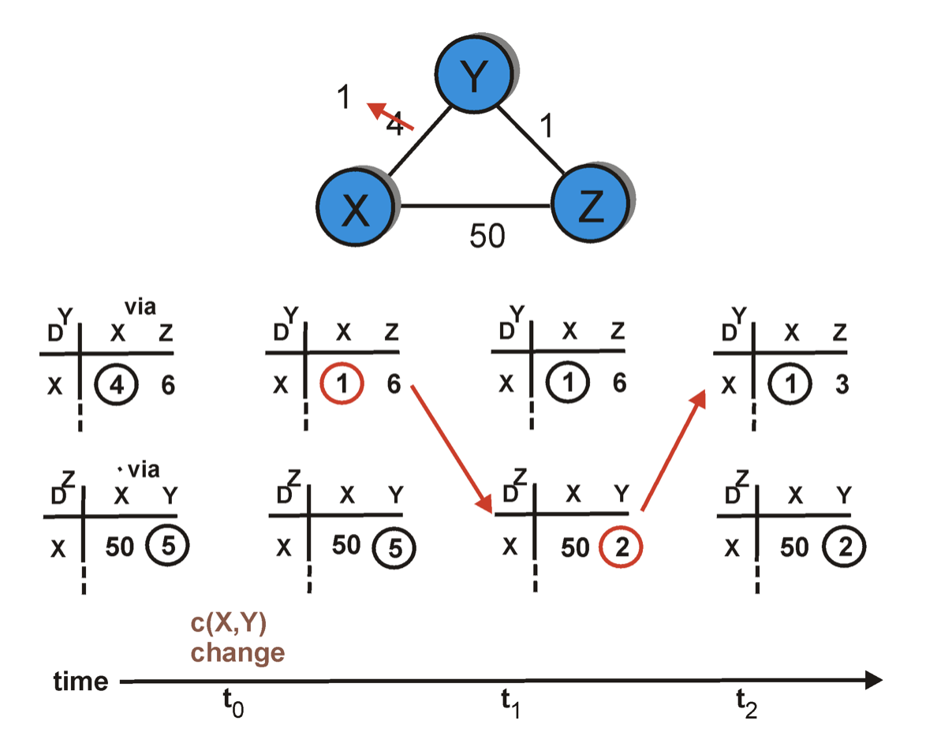
Distance vector: link cost decreases
Y’s routing table
Dest.
Z’s routing table
Dest.

Slide 33
Distance vector: link cost decreases
Dest.
Dest.

Slide 34
Distance vector: link cost changes
link cost changes:
node detects local link cost change
updates routing info, recalculates distance vector
if DV changes, notify neighbors
1
y
4
1
x
z
50
“good
news
travels
fast”
t₀ : y detects link-cost change, updates its DV, informs its neighbors.
t₁ : z receives update from y, updates its table, computes new least cost to x , sends its neighbors its DV.
t₂ : y receives z’s update, updates its distance table. y's least costs do not change, so y does not send a message to z.

Slide 35
Distance vector: link cost changes
link cost changes:
node detects local link cost change
bad news travels slow - “count to infinity” problem!
Many iterations before algorithm stabilizes
60
y
4
1
x
z
50

Slide 36
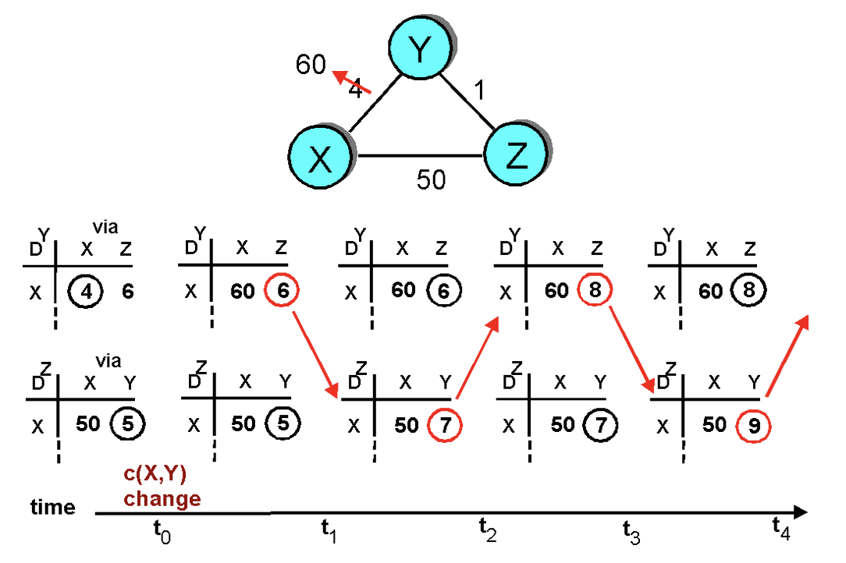
Distance vector: link cost increases
“Count to infinity” problem

