Slide 1

Computer Networks
CMSC 417 : Spring 2020
Topic: Internetworking: IP
(Textbook chapter 3)
Nirupam Roy
Tu-Th 2:00-3:15pm
CSI 1115

Slide 2
The Internet network layer
host, router network layer functions:
transport layer: TCP, UDP
routing protocols
path selection
RIP, OSPF, BGP
IP protocol
addressing conventions
datagram format
packet handling conventions
network
layer
forwarding
table
ICMP protocol
error reporting
router “signaling”
link layer
physical layer

Slide 3
















Network layer
Transport segment from sending to receiving host
On sending side encapsulates segments into datagrams
On receiving side, delivers segments to transport layer
Network layer protocols in every host, router
Router examines header fields in all IP datagrams passing through it
application
transport
network
data link
physical
network
data link
physical
network
data link
physical
network
data link
physical
network
data link
physical
network
data link
physical
network
data link
physical
network
data link
physical
network
data link
physical
network
data link
physical
application
transport
network
data link
physical
network
data link
physical
network
data link
physical

Slide 4
Two key network-layer functions
network-layer functions:
forwarding: move packets from router’s input to appropriate router output
routing: determine route taken by packets from source to destination
  routing algorithms
analogy: taking a trip
forwarding: process of getting through single interchange
routing: process of planning trip from source to destination

Slide 5
Network layer: data plane, control plane
Data plane
local, per-router function
determines how datagram arriving on router input port is forwarded to router output port
forwarding function
Control plane
network-wide logic
determines how datagram is routed among routers along end-end path from source host to destination host
two control-plane approaches:
  traditional routing algorithms: implemented in routers
  software-defined networking (SDN): implemented in (remote) servers
values in arriving
packet header
0111
1
3
2

Slide 6

Per-router control plane
Individual routing algorithm components in each and every router interact in the control plane
Routing
Algorithm
control
plane
data
plane
values in arriving
packet header
0111
1
3
2

Slide 7
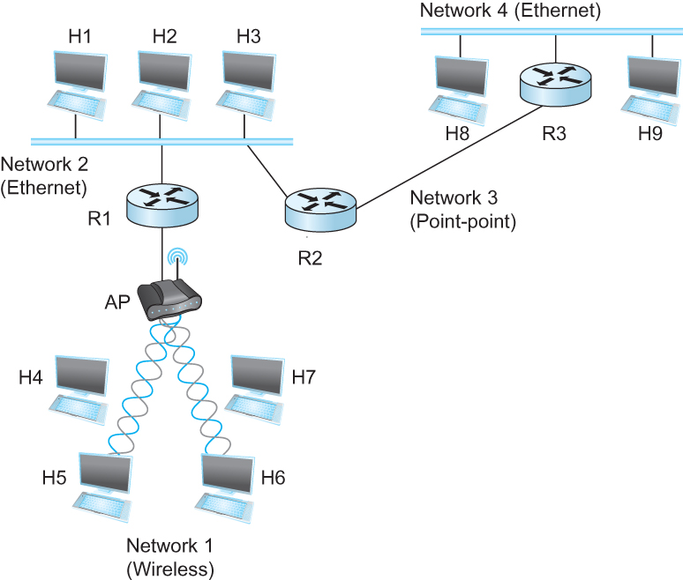
Internetworking
What is internetwork
  An arbitrary collection of networks interconnected to provide some sort of host-host to packet delivery service
  A simple internetwork where H represents hosts and R represents routers

Slide 8
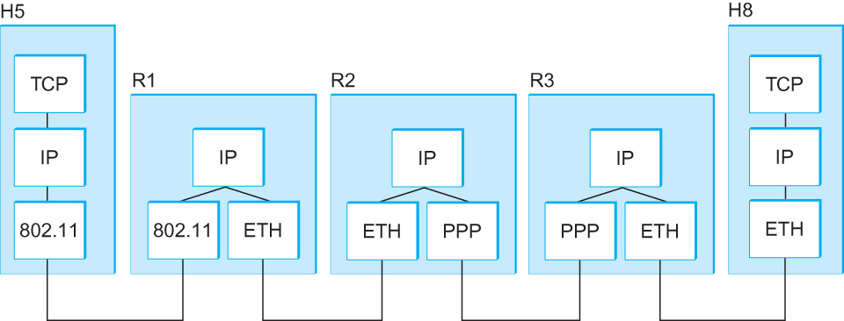
Internetworking
What is IP
  IP stands for Internet Protocol
  Key tool used today to build scalable, heterogeneous internetworks
  It runs on all the nodes in a collection of networks and defines the infrastructure that allows these nodes and networks to function as a single logical internetwork
  A simple internetwork showing the protocol layers

Slide 9
IP Service Model
Packet Delivery Model
  Connectionless model for data delivery
  Best-effort delivery (unreliable service)
    packets are lost
    packets are delivered out of order
    duplicate copies of a packet are delivered
    packets can be delayed for a long time
Global Addressing Scheme
  Provides a way to identify all hosts in the network

Slide 10
IP datagram format
IP protocol version
number
32 bits
total datagram
length (bytes)
header length
(bytes)
head.
len
type of
service
ver
length
for
fragmentation/
reassembly
“type” of data
flgs
fragment
offset
16-bit identifier
max number
remaining hops
(decremented at
each router)
time to
live
upper
layer
header
checksum
32 bit source IP address
upper layer protocol
to deliver payload to
32 bit destination IP address
options (if any)
e.g. timestamp,
record route
taken, specify
list of routers
to visit.
data
(variable length,
typically a TCP
or UDP segment)

Slide 11
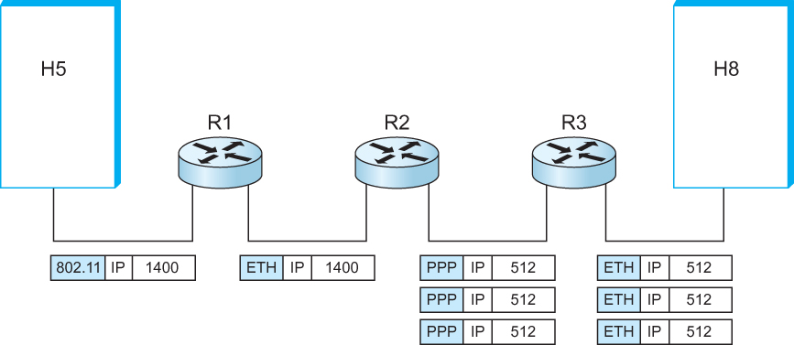
IP Fragmentation and Reassembly
  IP datagrams traversing the sequence of physical networks

Slide 12
IP Fragmentation and Reassembly
Each network has some MTU (Maximum Transmission Unit)
  Ethernet (1500 bytes), FDDI (4500 bytes)
Strategy
  Fragmentation occurs in a router when it receives a datagram that it wants to forward over a network which has (MTU < datagram)
  Reassembly is done at the receiving host
  All the fragments carry the same identifier in the Ident field
  Fragments are self-contained datagrams
  IP does not recover from missing fragments

Slide 13
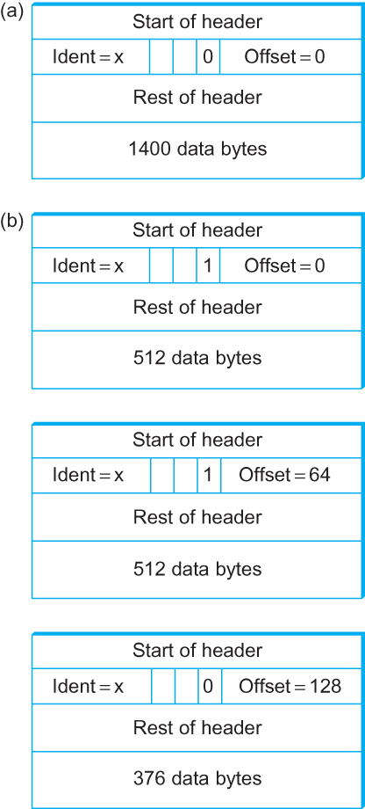
IP Fragmentation and Reassembly
Header fields used in IP fragmentation. (a) Unfragmented packet; (b) fragmented packets.

Slide 14
Network Addresses

Slide 15
IP Address (IPv4)
A unique 32-bit number
Identifies an interface (on a host, on a router, …)
Represented in dotted-quad notation
12
34
158
5
00001100
00100010
10011110
00000101
12:34:158:5

Slide 16
Grouping Related Hosts
The Internet is an “inter-network”
  Used to connect networks together, not hosts
  Need to address a network (i.e., group of hosts)
host
host
...
host
host
host
...
host
LAN 1
LAN 2
router
router
router
WAN
WAN
LAN = Local Area Network
WAN = Wide Area Network

Slide 17
Scalability Challenge
Suppose hosts had arbitrary addresses
  Then every router would need a lot of information
  …to know how to direct packets toward every host
1.2.3.4
5.6.7.8
2.4.6.8
1.2.3.5
5.6.7.9
2.4.6.9
host
host
...
host
host
host
...
host
LAN 1
LAN 2
router
router
router
WAN
WAN
1.2.3.4
1.2.3.5
forwarding table

Slide 18
Hierarchical Addressing in U.S. Mail
Addressing in the U.S. mail
  Zip code: 08540
  Building: 35 Olden Street
  Room in building: 306
  Name of occupant: Jennifer Rexford
Forwarding the U.S. mail
  Deliver to the post office in the zip code
  Assign to mailman covering the building
  Drop letter into mailbox for building/room
  Give letter to the appropriate person
???

Slide 19
Hierarchical Addressing: IP Prefixes
Network and host portions (left and right)
12
34
158
5
00001100
00100010
10011110
00000101
Network (24 bits)
Host (8 bits)

Slide 20
Easy to Add New Hosts
No need to update the routers
  E.g., adding a new host 5.6.7.213 on the right
  Doesn’t require adding a new forwarding-table entry
1.2.3.4
1.2.3.7
1.2.3.156
5.6.7.8
5.6.7.9
5.6.7.212
host
host
...
host
host
host
...
host
LAN 1
LAN 2
router
router
router
host
WAN
WAN
5.6.7.213
1.2.3.0/24
5.6.7.0/24
forwarding table

