Slide 1

Computer Networks
CMSC 417 : Spring 2020
Topic: Internetworking: IPv4 Address, Subnets, CIDR, DHCP protocol
(Textbook chapter 3)
Nirupam Roy
Tu-Th 2:00-3:15pm
CSI 1115

Slide 2
Class-full addressing

Slide 3
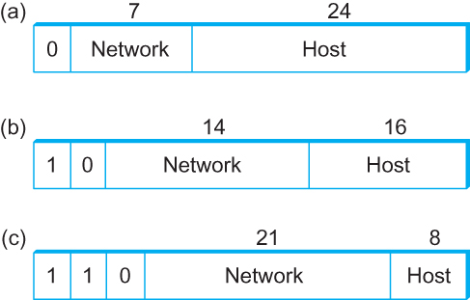
Global Addresses
Properties
  globally unique
  hierarchical: network + host
  4 Billion IP address, half are A type, ¼ is B type, and 1/8 is C type
Format
Dot notation
  10.3.2.4
  128.96.33.81
  192.12.69.77

Slide 4
Let’s assume we have 4-bit address (instead of 32 bit)
0000
0001
0010
0011
0100
0101
0110
0111
1000
1001
1010
1011
1100
1101
1110
1111
Class A (Half of all possible addresses)
Class B (1/4 of all possible addresses)
Class C (1/8 of all possible addresses)

Slide 5
Let’s assume we have 4-bit address (instead of 32 bit)
0000
0001
0010
0011
0100
0101
0110
0111
Class A (Half of all possible addresses)
Say, 1 bit for network part = 2 different networks
Say, 2 bits for host part = 4 hosts per network

Slide 6
Global Addresses
Properties
  globally unique
  hierarchical: network + host
  4 Billion IP address, half are A type, ¼ is B type, and 1/8 is C type
Format
Dot notation
  10.3.2.4
  128.96.33.81
  192.12.69.77

Slide 7
Classful Addressing
In the olden days, only fixed allocation sizes
  Class A: 0*
    Very large /8 blocks (e.g., MIT has 18.0.0.0/8)
    There can be 126 different class A networks (0 and 127 values are reserved) and (2²⁴-2) different hosts (2 values are reserved)
  Class B: 10*
    Large /16 blocks (e.g,. Princeton has 128.112.0.0/16)
  Class C: 110*
    Small /24 blocks (e.g., AT&T Labs has 192.20.225.0/24)
    2²¹ different networks possible, 254 hosts (255 is reserved for broadcast and 0 is reserved)
  Class D: 1110* for multicast groups
  Class E: 11110* reserved for future use
This is why folks use dotted-quad notation!

Slide 8
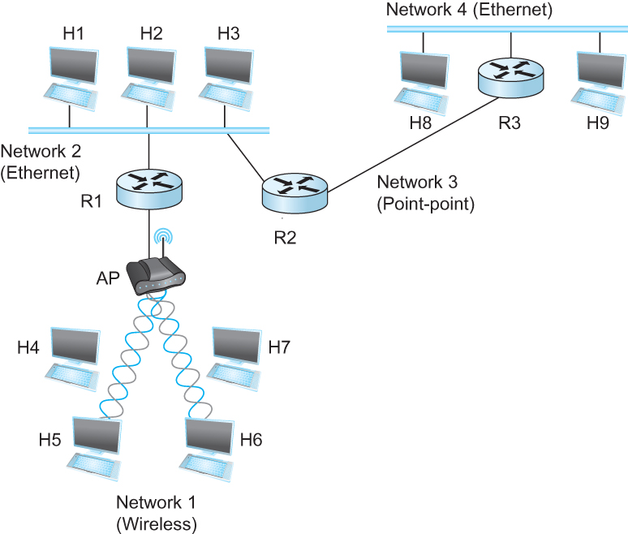
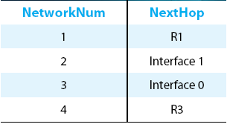
IP Datagram Forwarding
Strategy
  every datagram contains destination's address
  if directly connected to destination network, then forward to host
  if not directly connected to destination network, then forward to some router
  forwarding table maps network number into next hop
  each host has a default router
  each router maintains a forwarding table
Example (router R2)

Slide 9
IP Datagram Forwarding
Algorithm
if (NetworkNum of destination = NetworkNum of one of my interfaces) then
deliver packet to destination over that interface
else
if (NetworkNum of destination is in my forwarding table) then
deliver packet to NextHop router
else
deliver packet to default router
For a host with only one interface and only a default router in its forwarding table, this simplifies to
if (NetworkNum of destination = my NetworkNum)then
deliver packet to destination directly
else
deliver packet to default router

Slide 10
Obtaining a Block of Addresses
Internet Corporation for Assigned Names and Numbers (ICANN)
  Allocates large blocks to Regional Internet Registries
Regional Internet Registries (RIRs)
  E.g., ARIN (American Registry for Internet Numbers)
  Allocates to ISPs and large institutions
Internet Service Providers (ISPs)
  Allocate address blocks to their customers
  Who may, in turn, allocate to their customers…

Slide 11
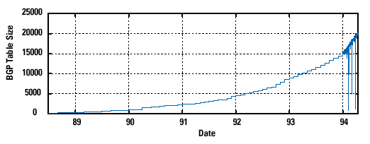
Pre-CIDR (1988-1994): Steep Growth
Growth faster than improvements in equipment capability

Slide 12
Subnetting

Slide 13
Problems with the classes of addresses
Wastage of addresses
Bigger tables to look up at routers

Slide 14
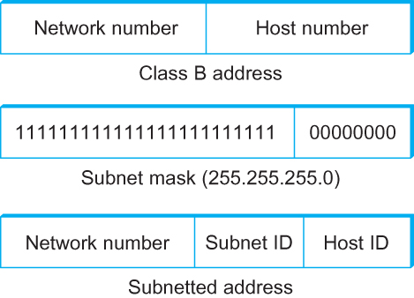
Subnetting
Add another level to address/routing hierarchy: subnet
Subnet masks define variable partition of host part of class A and B addresses
Subnets visible only within site

Slide 15
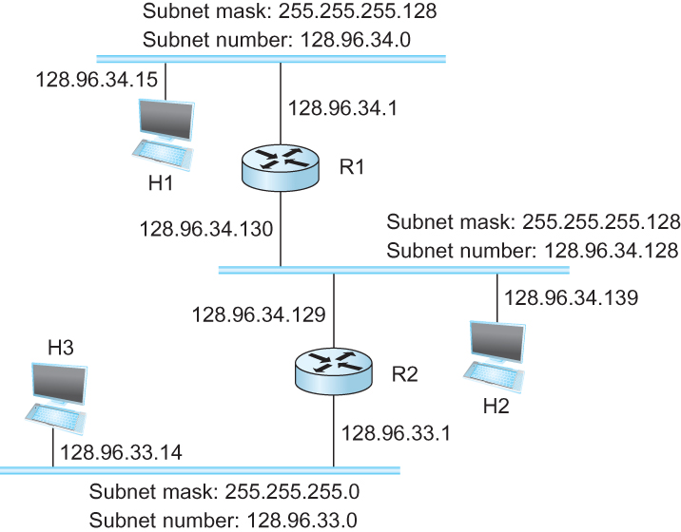
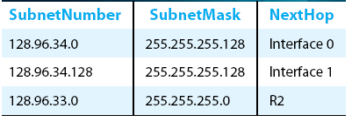
Subnetting
Forwarding Table at Router R1

Slide 16
Subnetting
Forwarding Table at Router R1
Forwarding Algorithm
D = destination IP address
for each entry < SubnetNum, SubnetMask, NextHop>
  D1 = SubnetMask & D
  if D1 = SubnetNum
    if NextHop is an interface
    deliver datagram directly to destination
    else
    deliver datagram to NextHop (a router)

Slide 17
Subnetting
Notes
Would use a default router if nothing matches
Not necessary for all ones in subnet mask to be contiguous
Can put multiple subnets on one physical network
Subnets not visible from the rest of the Internet

Slide 18
Class-less addressing: CIDR

Slide 19
IP addressing: CIDR
CIDR: Classless InterDomain Routing
  subnet portion of address of arbitrary length
  address format: a.b.c.d/x, where x is # bits in subnet portion of address
subnet
part
host
part
11001000 00010111 00010000 00000000
200.23.16.0/23
200.23.16.0–200.23.17.255

Slide 20
Classless Inter-Domain Routing (CIDR)
Use two 32-bit numbers to represent a network.
Network number = IP address + Mask
IP Address : 12.4.0.0 IP Mask: 255.254.0.0
Address
00001100
00000100
00000000
00000000
Mask
11111111
11111110
00000000
00000000
Network Prefix
for hosts
Written as 12.4.0.0/15

Slide 21
Hierarchical Address Allocation
Hierarchy is key to scalability
  Address allocated in contiguous chunks (prefixes)
  Today, the Internet has about 400,000 prefixes
12.0.0.0/16
12.1.0.0/16
:
:
:
12.3.0.0/24
12.2.0.0/16
12.3.1.0/24
12.3.0.0/16
:
:
:
:
:
12.0.0.0/8
12.3.254.0/24
12.253.0.0/19
12.253.32.0/19
:
:
12.254.0.0/16
12.253.160.0/19

Slide 22
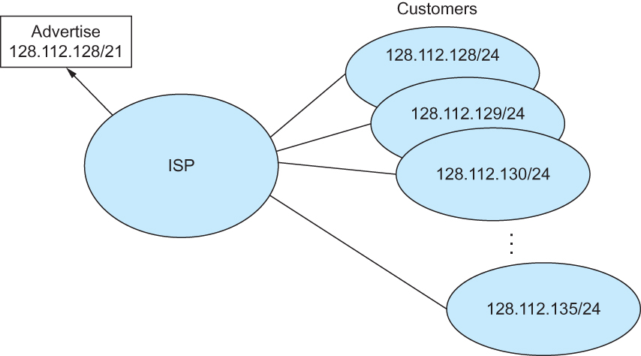
Classless Addressing
Route aggregation with CIDR

Slide 23
Separate Forwarding Entry Per Prefix
Prefix-based forwarding
  Map the destination address to matching prefix
  Forward to the outgoing interface
1.2.3.4
1.2.3.7
1.2.3.156
5.6.7.8
5.6.7.9
5.6.7.212
host
host
...
host
host
host
...
host
LAN 1
LAN
router
router
router
WAN
WAN
1.2.3.0/24
5.6.7.0/24
forwarding table

Slide 24
CIDR Makes Packet Forwarding Harder
Forwarding table may have many matches
  E.g., entries for 201.10.0.0/21 and 201.10.6.0/23
  The IP address 201.10.6.17 would match both!
201.10.0.0/21
Provider 1
Provider 2
201.10.0.0/22
201.10.4.0/24
201.10.5.0/24
201.10.6.0/23

Slide 25
Longest Prefix Match Forwarding
Destination-based forwarding
  Packet has a destination address
  Router identifies longest-matching prefix
  Cute algorithmic problem: very fast lookups
forwarding table
4.0.0.0/8
4.83.128.0/17
201.10.0.0/21
201.10.6.0/23
126.255.103.0/24
destination
201.10.6.17
outgoing link
Serial0/0.1

Slide 26
Pre-CIDR (1988-1994): Steep Growth
Growth faster than improvements in equipment capability

Slide 27
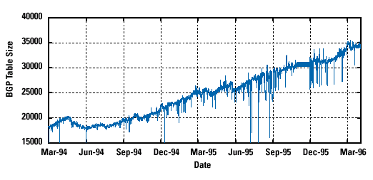
CIDR (1994-1996): Much Flatter
Efforts to aggregate

Slide 28
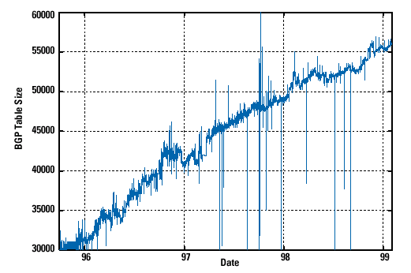
CIDR Growth (1996-1998): Roughly Linear
Good use of aggregation, and peer pressure!

Slide 29
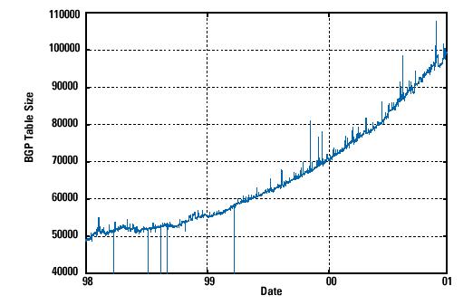
DotCom Boom (1998-2001): Steep Growth
Internet boom and increased multi-homing

Slide 30
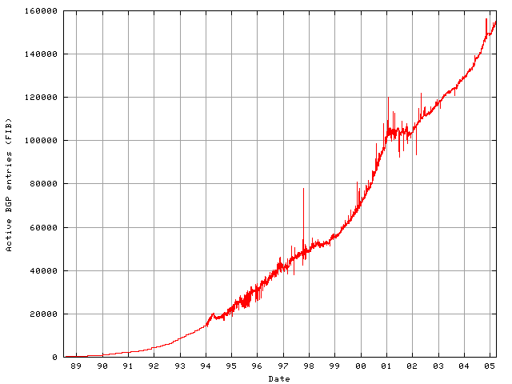
Long Term (1989-2005): Post-Boom
Today we are up to ~400,000 prefixes

Slide 31
Getting an IP address: DHCP

Slide 32
IP addresses: how to get one?
Q: How does a host get IP address?
hard-coded by system admin in a file
  Windows: control-panel->network->configuration->tcp/ip->properties
  UNIX: /etc/…
DHCP: Dynamic Host Configuration Protocol: dynamically get address from a server
  “plug-and-play”

Slide 33
DHCP: Dynamic Host Configuration Protocol
goal: allow host to dynamically obtain its IP address from network server when it joins network
  can renew its lease on address in use
  allows reuse of addresses (only hold address while connected/“on”)
  support for mobile users who want to join network (more shortly)

Slide 34
DHCP: Dynamic Host Configuration Protocol
DHCP overview:
  host broadcasts “DHCP discover” msg [optional]
  DHCP server responds with “DHCP offer” msg [optional]
  host requests IP address: “DHCP request” msg
  DHCP server sends address: “DHCP ack” msg

Slide 35



DHCP client-server scenario
DHCP
server
223.1.1.0/24
223.1.1.1
223.1.2.1
223.1.1.2
arriving DHCP
client needs
address in this
network
223.1.1.4
223.1.2.9
223.1.3.27
223.1.2.2
223.1.1.3
223.1.2.0/24
223.1.3.1
223.1.3.2
223.1.3.0/24

Slide 36
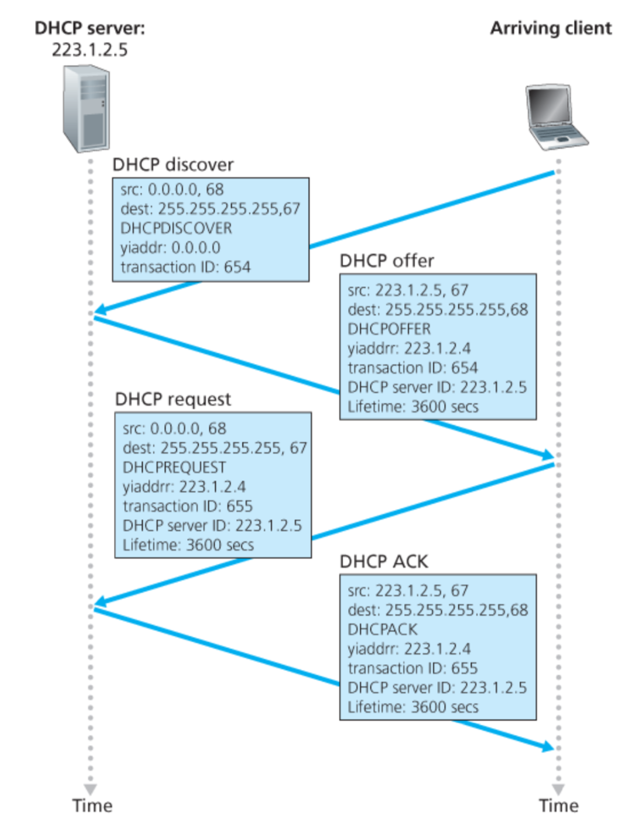
Broadcast: is there a DHCP server out there?
Broadcast: I’m a DHCP server! Here’s an IP address you can use
Broadcast: OK. I’ll take that IP address!
Broadcast: OK. You’ve got that IP address!

Slide 37
DHCP: more than IP addresses
DHCP can return more than just allocated IP address on subnet:
  address of first-hop router for client
  name and IP address of DNS sever
  network mask (indicating network versus host portion of address)

Slide 38
Dynamic Host Configuration Protocol (DHCP)
DHCP server is responsible for providing configuration information to hosts
There is at least one DHCP server for an administrative domain
DHCP server maintains a pool of available addresses

Slide 39
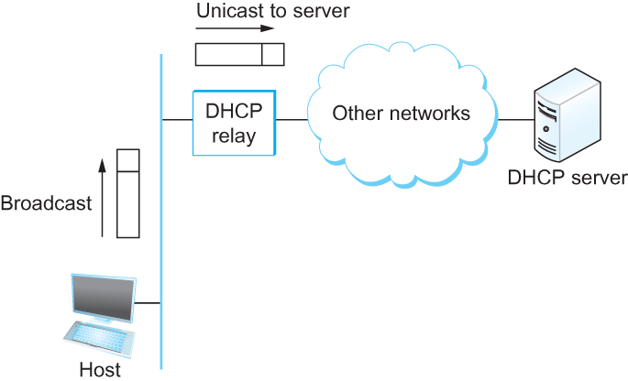
DHCP
Newly booted or attached host sends DHCPDISCOVER message to a special IP address (255.255.255.255)
DHCP relay agent unicasts the message to DHCP server and waits for the response

