Slide 1

Computer Networks
CMSC 417 : Spring 2020
Topic: Internetworking: ARP, ICMP, Tunnels
(Textbook chapter 3)
Nirupam Roy
Tu-Th 2:00-3:15pm
CSI 1115

Slide 2
Address Resolution Protocol (ARP)

Slide 3
MAC addresses and ARP
32-bit IP address:
  network-layer address for interface
  used for layer 3 (network layer) forwarding
MAC (or LAN or physical or Ethernet) address:
  function: used “locally” to get frame from one interface to another physically-connected interface (same network, in IP-addressing sense)
  48 bit MAC address (for most LANs) burned in NIC ROM, also sometimes software settable
  e.g.: 1A-2F-BB-76-09-AD
hexadecimal (base 16) notation
(each “numeral” represents 4 bits)

Slide 4

LAN addresses and ARP
each adapter on LAN has unique LAN address
1A-2F-BB-76-09-AD
LAN
(wired or
wireless)
adapter
71-65-F7-2B-08-53
58-23-D7-FA-20-B0
0C-C4-11-6F-E3-98

Slide 5
LAN addresses (more)
MAC address allocation administered by IEEE
manufacturer buys portion of MAC address space (to assure uniqueness)
analogy:
  MAC address: like Social Security Number
  IP address: like postal address
MAC flat address ➜ portability
  can move LAN card from one LAN to another
IP hierarchical address not portable
  address depends on IP subnet to which node is attached

Slide 6


ARP: address resolution protocol
Question: how to determine
interface’s MAC address, knowing its IP address?
ARP table: each IP node (host, router) on LAN has table
  IP/MAC address mappings for some LAN nodes:
< IP address; MAC address; TTL>
  TTL (Time To Live): time after which address mapping will be forgotten (typically 20 min)
137.196.7.78
1A-2F-BB-76-09-AD
137.196.7.23
137.196.7.14
LAN
71-65-F7-2B-08-53
58-23-D7-FA-20-B0
0C-C4-11-6F-E3-98
137.196.7.88

Slide 7
ARP protocol: same LAN
A wants to send datagram to B
  B’s MAC address not in A’s ARP table.
A broadcasts ARP query packet, containing B's IP address
  destination MAC address = FF-FF-FF-FF-FF-FF
  all nodes on LAN receive ARP query
B receives ARP packet, replies to A with its (B's) MAC address
  frame sent to A’s MAC address (unicast)
A caches (saves) IP-to-MAC address pair in its ARP table until information becomes old (times out)
  soft state: information that times out (goes away) unless refreshed
ARP is “plug-and-play”:
  nodes create their ARP tables without intervention from net administrator

Slide 8
Address Translation Protocol (ARP)
Map IP addresses into physical addresses
  destination host
  next hop router
Techniques
  encode physical address in host part of IP address
  table-based
ARP (Address Resolution Protocol)
  table of IP to physical address bindings
  broadcast request if IP address not in table
  target machine responds with its physical address
  table entries are discarded if not refreshed
  Query message include the physical address of the sending host. Why?

Slide 9
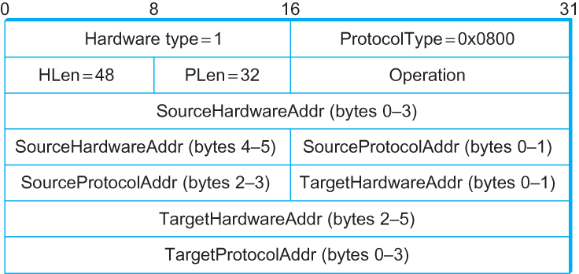
ARP Packet Format
  HardwareType: type of physical network (e.g., Ethernet)
  ProtocolType: type of higher layer protocol (e.g., IP)
  HLEN & PLEN: length of physical and protocol addresses
  Operation: request or response
  Source/Target Physical/Protocol addresses

Slide 10
Internet Control Message Protocol (ICMP)

Slide 11
Internet Control Message Protocol (ICMP)
Defines a collection of error messages that are sent back to the source host whenever a router or host is unable to process an IP datagram successfully
  Destination host unreachable due to link /node failure
  Reassembly process failed
  TTL had reached 0 (so datagrams don't cycle forever)
  IP header checksum failed
ICMP-Redirect
  From router to a source host
  With a better route information

Slide 12
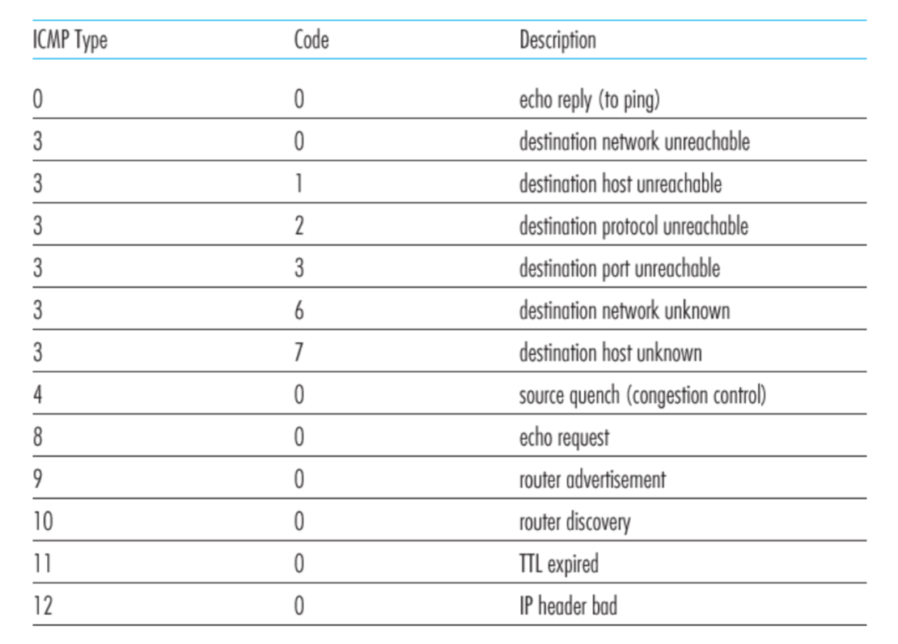
ICMP message types

Slide 13
Traceroute : An unintuitive application using ICMP

Slide 14
Traceroute : An unintuitive application

Slide 15
Virtual Networks and Tunnels

Slide 16
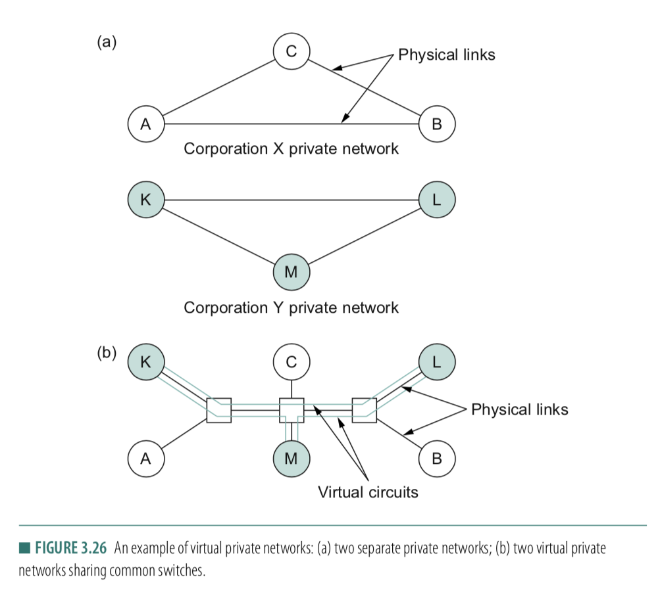

Slide 17
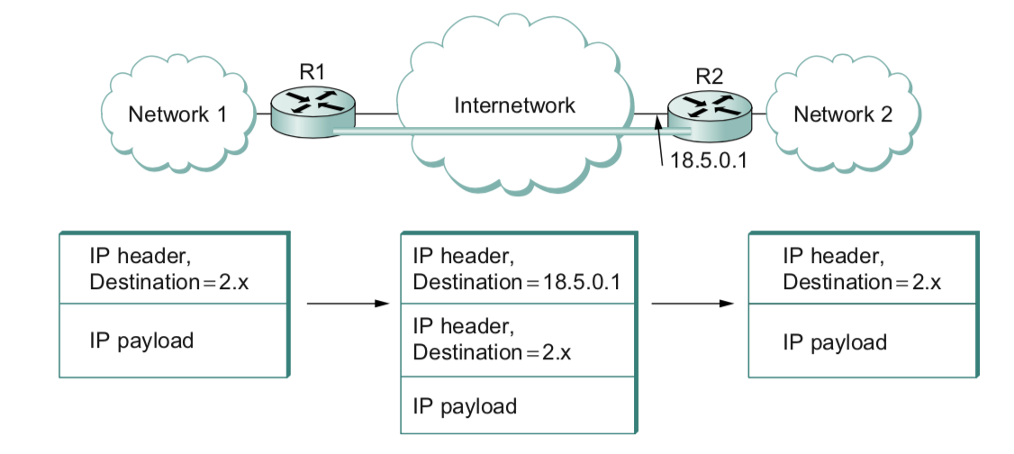

Slide 18
Why do we need virtual networks or tunnels?
1. Security
2. Special capabilities between routers (e.g., multicast)
3. Supporting heterogeneity
Disadvantages:
1. Increases packet length
a) Wastage of bandwidth
b) More processing
c) Fragmentation
2. Increases management cost

