Slide 1
Computer Networks
CMSC 417 : Spring 2022
Topic: Internetworking: ARP, ICMP, VPN
(Textbook chapter 3)
Nirupam Roy
Tu-Th 2:00-3:15pm
CSI 1115

Slide 2
Network address vs LAN address

Slide 3
Two perspectives of addresses:
(1)Network-to-network & (2)machine-to-machine
Destination
Router
Source

Slide 4
application
transport
network
link
physical
Router
Source

Slide 5
network
link
physical
application
transport
network
link
physical
Router
Source

Slide 6
network
link
physical
Router
Hierarchical address for addressing networks
(IP address)

Slide 7
network
link
physical
application
transport
network
link
physical
Router
Source

Slide 8
Flat address for addressing machines at the link-layer
(MAC address)
network
link
physical
application
transport
network
link
physical
Router
Source

Slide 9
Address Resolution Protocol (ARP)

Slide 10
MAC addresses and ARP
32-bit IP address:
network-layer address for interface
used for layer 3 (network layer) forwarding
MAC (or LAN or physical or Ethernet) address:
function: used “locally” to get frame from one interface to another physically-connected interface (same network, in IP-addressing sense)
48 bit MAC address (for most LANs) burned in NIC ROM, also sometimes software settable
e.g.: 1A-2F-BB-76-09-AD
hexadecimal (base 16) notation
(each “numeral” represents 4 bits)

Slide 11
MAC addresses and ARP
each adapter on LAN has unique LAN addr. or MAC addr.
1A-2F-BB-76-09-AD
LAN
(wired or
wireless)
adapter
71-65-F7-2B-08-53
58-23-D7-FA-20-B0
0C-C4-11-6F-E3-98

Slide 12
MAC addresses (more)
MAC address allocation administered by IEEE
manufacturer buys portion of MAC address space (to assure uniqueness)
analogy:
MAC address: like Social Security Number
IP address: like postal address
MAC flat address ➜ portability
can move LAN card from one LAN to another
IP hierarchical address not portable
address depends on IP subnet to which node is attached

Slide 13
ARP: address resolution protocol
Question: how to determine
interface’s MAC address, knowing its IP address?
ARP table: each IP node (host, router) on LAN has table
IP/MAC address mappings for some LAN nodes:
< IP address; MAC address; TTL>
TTL (Time To Live): time after which address mapping will be forgotten (typically 20 min)
137.196.7.78
1A-2F-BB-76-09-AD
137.196.7.23
137.196.7.14
LAN
71-65-F7-2B-08-53
58-23-D7-FA-20-B0
0C-C4-11-6F-E3-98
137.196.7.88

Slide 14
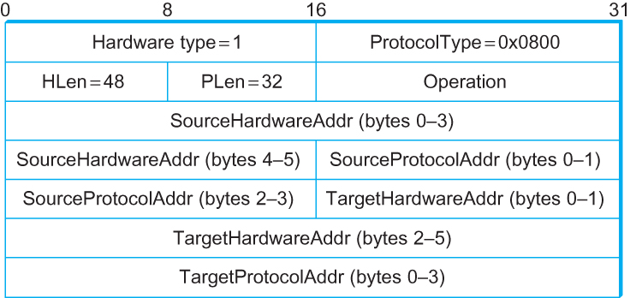
ARP Packet Format
HardwareType: type of physical network (e.g., Ethernet)
ProtocolType: type of higher layer protocol (e.g., IP)
HLEN & PLEN: length of physical and protocol addresses
Operation: request or response
Source/Target Physical/Protocol addresses

Slide 15
ARP protocol: same LAN
A wants to send datagram to B
B’s MAC address not in A’s ARP table.
A broadcasts ARP query packet, containing B's IP address
destination MAC address = FF-FF-FF-FF-FF-FF (Link layer broadcast address)
all nodes on LAN receive ARP query
B receives ARP packet, replies to A with its (B's) MAC address
frame sent to A’s MAC address (unicast)
A caches (saves) IP-to-MAC address pair in its ARP table until information becomes old (times out)
soft state: information that times out (goes away) unless refreshed
ARP is “plug-and-play”:
nodes create their ARP tables without intervention from net administrator

Slide 16
Address Translation Protocol (ARP)
Map IP addresses into physical addresses
destination host
next hop router
Techniques
encode physical address in host part of IP address
table-based
ARP (Address Resolution Protocol)
table of IP to physical address bindings
broadcast request if IP address not in table
target machine responds with its physical address
table entries are discarded if not refreshed
Query message include the physical address of the sending host. Why?

Slide 17
Internet Control Message Protocol (ICMP)

Slide 18
Internet Control Message Protocol (ICMP)
Defines a collection of error messages that are sent back to the source host whenever a router or host is unable to process an IP datagram successfully
Destination host unreachable due to link /node failure
Reassembly process failed
TTL had reached 0 (so datagrams don't cycle forever)
IP header checksum failed
ICMP-Redirect
From router to a source host
With a better route information

Slide 19
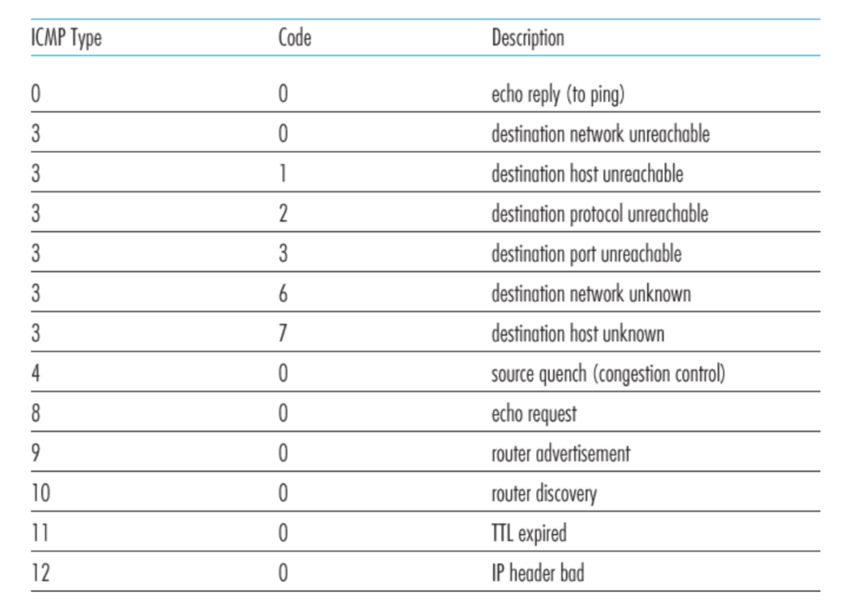
ICMP message types

Slide 20
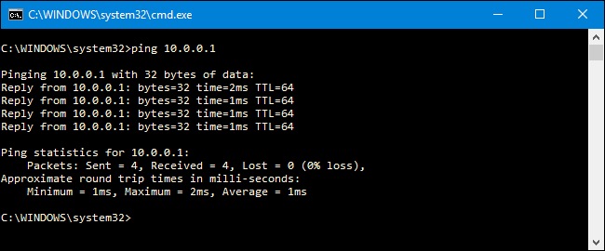
Ping example

Slide 21
Traceroute : An unintuitive application using ICMP

Slide 22
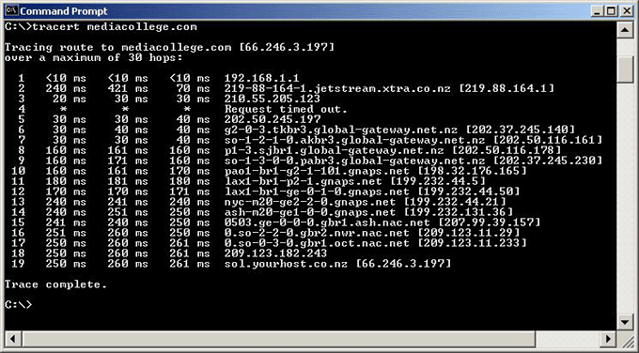
Traceroute example

Slide 23
Traceroute : An unintuitive application

Slide 24
Virtual Networks and Tunnels

Slide 25
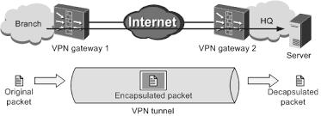

Slide 26
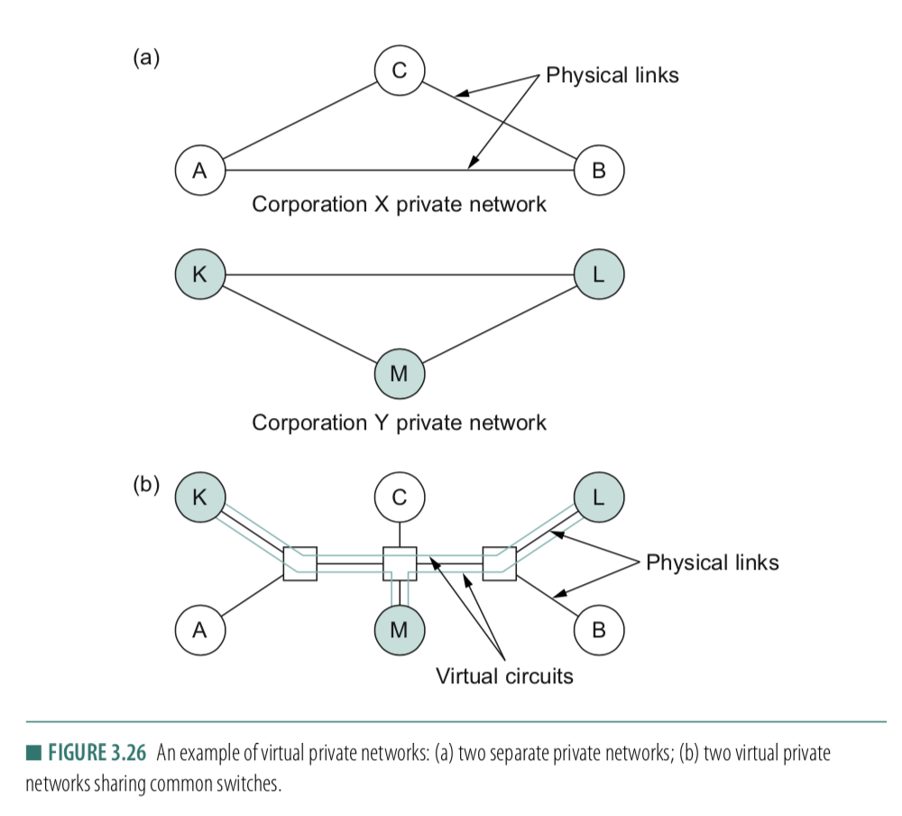

Slide 27
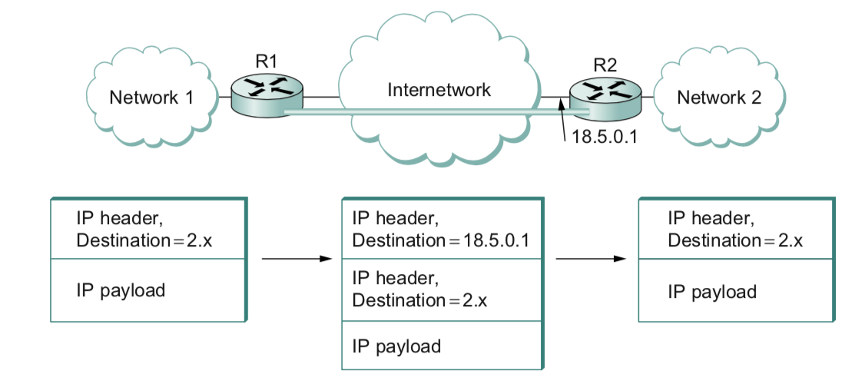

Slide 28
Why do we need virtual networks or tunnels?
1. Security
2. Special capabilities between routers (e.g., multicast)
3. Supporting heterogeneity
Disadvantages:
1. Increases packet length
a) Wastage of bandwidth
b) More processing
c) Fragmentation
2. Increases management cost

Slide 29
A note on the “subnet mask”

Slide 30
inet 10.104.216.101 ➔ 00001010.01101000.11011000.01100101
netmask ff:ff:f0:00 ➔ 11111111.11111111.11110000.00000000
broadcast 10.104.223.255 ➔
00001010.01101000.11011111.11111111

