Slide 1

Computer Networks
CMSC 417 : Spring 2020
Topic: Application Layer Protocols Part-2
(Textbook chapter 9)
Nirupam Roy
Tu-Th 2:00-3:15pm
CSI 1115

Slide 2
Trying out HTTP (client side) for yourself
1. Telnet to your favorite Web server:
telnet gaia.cs.umass.edu 80
opens TCP connection to port 80
(default HTTP server port)
at gaia.cs.umass. edu.
anything typed in will be sent
to port 80 at gaia.cs.umass.edu
2. type in a GET HTTP request:
GET /kurose_ross/interactive/index.php HTTP/1.1
Host: gaia.cs.umass.edu
by typing this in (hit carriage
return twice), you send
this minimal (but complete)
GET request to HTTP server
3. look at response message sent by HTTP server!
(or use Wireshark to look at captured HTTP request/response)

Slide 3
User-server state: cookies
Many Web sites use cookies
four components:
  1) Cookie header line of HTTP response message
  2) Cookie header line in next HTTP request message
  3) Cookie file kept on user’s host, managed by user’s browser
  4) Back-end database at Website
example:
Susan always access Internet from PC
visits specific e-commerce site for first time
when initial HTTP requests arrives at site, site creates:
  unique ID
  entry in backend database for ID

Slide 4

Cookies: keeping “state” (cont.)
client
server
ebay 8734
usual http request msg
Amazon server
creates ID
1678 for user
cookie file
usual http response
set-cookie: 1678
backend
database
create
entry
ebay 8734
amazon 1678
usual http request msg
cookie: 1678
cookie-
specific
action
access
usual http response msg
one week later:
access
ebay 8734
amazon 1678
usual http request msg
cookie: 1678
cookie-
specific
action
usual http response msg

Slide 5
Cookies (continued)
aside
what cookies can be used for:
authorization
shopping carts
recommendations
user session state (Web e-mail)
cookies and privacy:
cookies permit sites to learn a lot about you
you may supply name and e-mail to sites
how to keep “state”:
protocol endpoints: maintain state at sender/receiver over multiple transactions
cookies: http messages carry state
Notes:
tracking

Slide 6

Web caches (proxy server)
goal: satisfy client request without involving origin server
user sets browser: Web accesses via cache
browser sends all HTTP requests to cache
  object in cache: cache returns object
  else cache requests object from origin server, then returns object to client
proxy
server
HTTP request
HTTP request
client
origin
server
HTTP response
HTTP response
HTTP request
HTTP response
client
origin
server

Slide 7
More about Web caching
cache acts as both client and server
  server for original requesting client
  client to origin server
typically cache is installed by ISP (university, company, residential ISP)
why Web caching?
reduce response time for client request
reduce traffic on an institution’s access link
Internet dense with caches: enables “poor” content providers to effectively deliver content
Notes:
proxy

Slide 8
Outline
  Principles of network applications
  Web and HTTP
  Electronic Mail (SMTP, POP3, IMAP)
  DNS

Slide 9
Electronic mail
outgoing
message queue
user mailbox
Three major components:
user agents
mail servers
SMTP: Simple Mail Transfer Protocol
User Agent
a.k.a. “mail reader”
composing, editing, reading mail messages
e.g., Outlook, Thunderbird, iPhone mail client
outgoing, incoming messages stored on server
user
agent
mail
server
user
agent
SMTP
mail
server
user
agent
SMTP
SMTP
user
agent
mail
server
user
agent
user
agent

Slide 10
Electronic Mail: Mail Servers
outgoing
message queue
user mailbox
Mail Servers:
mailbox contains incoming messages for user
message queue of outgoing (to be sent) mail messages
SMTP protocol between mail servers to send email messages
  client: sending mail server
  “server”: receiving mail server
user
agent
mail
server
user
agent
SMTP
mail
server
user
agent
SMTP
SMTP
user
agent
mail
server
user
agent
user
agent

Slide 11
Electronic Mail: SMTP [RFC 2821]
uses TCP to reliably transfer email message from client to server, port 25
direct transfer: sending server to receiving server
three phases of transfer
  handshaking (greeting)
  transfer of messages
  closure
command/response interaction (like HTTP)
  commands: ASCII text
  response: status code and phrase
messages must be in 7-bit ASCII

Slide 12
Scenario: Alice sends message to Bob
1) Alice uses UA to compose message “to” bob@someschool.edu
2) Alice’s UA sends message to her mail server; message placed in message queue
3) client side of SMTP opens TCP connection with Bob’s mail server
4) SMTP client sends Alice’s message over the TCP connection
5) Bob’s mail server places the message in Bob’s mailbox
6) Bob invokes his user agent to read message
user
agent
mail
server
user
agent
1
mail
server
2
3
6
4
Alice’s mail server
5
Bob’s mail server

Slide 13
Sample SMTP interaction
S: 220 hamburger.edu
C: HELO crepes.fr
S: 250 Hello crepes.fr, pleased to meet you
C: MAIL FROM: <alice@crepes.fr>
S: 250 alice@crepes.fr... Sender ok
C: RCPT TO: <bob@hamburger.edu>
S: 250 bob@hamburger.edu ... Recipient ok
C: DATA
S: 354 Enter mail, end with "." on a line by itself
C: Do you like ketchup?
C: How about pickles?
C: .
S: 250 Message accepted for delivery
C: QUIT
S: 221 hamburger.edu closing connection
Notes:
Note: no authentication

Slide 14
SMTP: final words
SMTP uses persistent connections
SMTP requires message (header & body) to be in 7-bit ASCII
SMTP server uses CRLF.CRLF to determine end of message
comparison with HTTP:
HTTP: pull
SMTP: push
both have ASCII command/response interaction, status codes
HTTP: each object encapsulated in its own response message
SMTP: multiple objects sent in multipart message
Notes:
Question: what happens in an email with a single dot on a line?

Slide 15
Mail message format
SMTP: protocol for exchanging email messages
RFC 822: standard for text message format:
header lines, e.g.,
  To:
  From:
  Subject:
  different from SMTP MAIL FROM, RCPT TO: commands!
Body: the “message”
  ASCII characters only
header
blank
line
body

Slide 16
Mail access protocols
user
agent
mail access
protocol
user
agent
SMTP
SMTP
(e.g., POP,
IMAP)
Sender’s mail
server
Receiver’s mail
server
SMTP: delivery/storage to receiver’s server
mail access protocol: retrieval from server
  POP: Post Office Protocol [RFC 1939]: authorization, download
  IMAP: Internet Mail Access Protocol [RFC 1730]: more features, including manipulation of stored messages on server
  HTTP: gmail, Hotmail, Yahoo! Mail, etc.

Slide 17
Outline
  Principles of network applications
  Web and HTTP
  Electronic Mail (SMTP, POP3, IMAP)
  DNS

Slide 18
DNS: domain name system
people: many identifiers:
  SSN, name, passport #
Internet hosts, routers:
  IP address (32 bit) - used for addressing datagrams
  “name”, e.g., www.yahoo.com - used by humans
Q: how to map between IP address and name, and vice versa ?
Domain Name System:
distributed database implemented in hierarchy of many name servers
application-layer protocol: hosts, name servers communicate to resolve names (address/name translation)
  note: core Internet function, implemented as application-layer protocol
  complexity at network’s “edge”

Slide 19
DNS: services, structure
DNS services
hostname to IP address translation
host aliasing
  canonical, alias names
mail server aliasing
load distribution
  replicated Web servers: many IP addresses correspond to one name
why not centralize DNS?
single point of failure
traffic volume
distant centralized database
maintenance
A: doesn‘t scale!

Slide 20
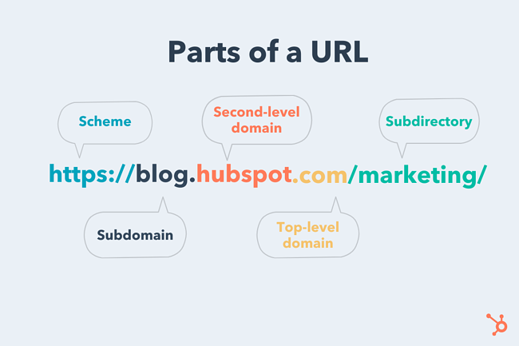
PC: https://blog.hubspot.com/marketing/parts-url

Slide 21
DNS: a distributed, hierarchical database
Root DNS Servers
…
…
com DNS servers
org DNS servers
edu DNS servers
yahoo.com
DNS servers
pbs.org
DNS servers
poly.edu
DNS servers
umass.edu
DNS servers
amazon.com
DNS servers
client wants IP for www.amazon.com; 1st approximation:
client queries root server to find com DNS server
client queries .com DNS server to get amazon.com DNS server
client queries amazon.com DNS server to get IP address for www.amazon.com

Slide 22
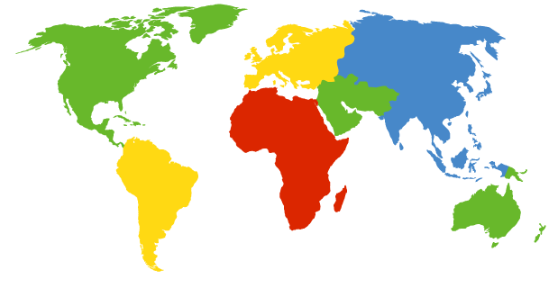
DNS: Root Name Servers
Contacted by local name server that cannot resolve name
Root name server:
  Contacts authoritative name server if name mapping not known
  Gets mapping
  Returns mapping to local name server
c. Cogent, Herndon, VA (5 other sites)
d. U Maryland College Park, MD
h. ARL Aberdeen, MD
j. Verisign, Dulles VA (69 other sites )
k. RIPE London (17 other sites)
i. Netnod, Stockholm (37 other sites)
e. NASA Mt View, CA
f. Internet Software C.
Palo Alto, CA (and 48 other sites)
m. WIDE Tokyo
(5 other sites)
13 logical root name “servers” worldwide
each “server” replicated many times
a. Verisign, Los Angeles CA
(5 other sites)
b. USC-ISI Marina del Rey, CA
l. ICANN Los Angeles, CA
(41 other sites)
g. US DoD Columbus, OH (5 other sites)

Slide 23
TLD, Authoritative DNS Servers
Top-level domain (TLD) servers:
  responsible for com, org, net, edu, aero, jobs, museums, and all top-level country domains, e.g.: uk, fr, ca, jp
  Network Solutions maintains servers for .com TLD
  Educause for .edu TLD
Authoritative DNS servers:
Organization’s own DNS server(s), providing authoritative hostname to IP mappings for organization’s named hosts
  can be maintained by organization or service provider

Slide 24
Local DNS name server
does not strictly belong to hierarchy
each ISP (residential ISP, company, university) has one
  also called “default name server”
when host makes DNS query, query is sent to its local DNS server
  has local cache of recent name-to-address translation pairs (but may be out of date!)
  acts as proxy, forwards query into hierarchy

Slide 25
DNS name resolution example
root DNS server
2
host at cs.stanford.edu wants IP address for cs.umd.edu
3
TLD DNS server
4
5
iterated query:
contacted server replies with name of server to contact
“I don’t know this name, but ask this server”
local DNS server
dns.stanford.edu
7
6
1
8
authoritative DNS server
dns.cs.umd.edu
requesting host
cs.stanford.edu
cs.umd.edu

Slide 26
DNS name
resolution example
root DNS server
2
3
recursive query:
puts burden of name resolution on contacted name server
heavy load at upper levels of hierarchy?
7
6
TLD DNS
server
local DNS server
dns.stanford.edu
5
4
1
8
authoritative DNS server
dns.cs.umd.edu
requesting host
cs.stanford.edu
cs.umd.edu

Slide 27
DNS: caching, updating records
once (any) name server learns mapping, it caches mapping
  cache entries timeout (disappear) after some time (TTL)
  TLD servers typically cached in local name servers
    thus root name servers not often visited
cached entries may be out-of-date (best effort name-to-address translation!)
  if name host changes IP address, may not be known Internet-wide until all TTLs expire
update/notify mechanisms proposed IETF standard
  RFC 2136

Slide 28
DNS records
DNS: distributed database storing resource records (RR)
RR format: (name, value, type, ttl)
type=A
  name is hostname
  value is IP address
type=CNAME
  name is alias name for some “canonical” (the real) name
  www.ibm.com is really
  servereast.backup2.ibm.com
  value is canonical name
type=NS
  name is domain (e.g., foo.com)
  value is hostname of authoritative name server for this domain
type=MX
  value is name of mail server associated with name

Slide 29
DNS protocol, messages
query and reply messages, both with same message format
2 bytes
2 bytes
message header
identification: 16 bit # for query, reply to query uses same #
flags:
  query or reply
  recursion desired
  recursion available
  reply is authoritative
identification
flags
# questions
# answer RRs
# authority RRs
# additional RRs
questions (variable # of questions)
answers (variable # of RRs)
authority (variable # of RRs)
additional info (variable # of RRs)

Slide 30
DNS protocol, messages
2 bytes
2 bytes
identification
flags
# questions
# answer RRs
# authority RRs
# additional RRs
name, type fields
for a query
questions (variable # of questions)
RRs in response
to query
answers (variable # of RRs)
records for
authoritative servers
authority (variable # of RRs)
additional “helpful”
info that may be used
additional info (variable # of RRs)
Notes:
Does DNS use TCP or UDP? Why?

Slide 31
Inserting records into DNS
example: new startup “Network Utopia”
register name networkuptopia.com at DNS registrar (e.g., Network Solutions)
  provide names, IP addresses of authoritative name server (primary and secondary)
  registrar inserts two RRs into .com TLD server:
  (networkutopia.com, dns1.networkutopia.com, NS)
  (dns1.networkutopia.com, 212.212.212.1, A)
create authoritative server type A record for www.networkuptopia.com; type NS record for networkutopia.com

