Slide 1

Computer Networks
CMSC 417 : Spring 2022
Topic: DNS (cont.) and Network Security
(Textbook chapter 8)
Nirupam Roy
Tu-Th 2:00-3:15pm
CSI 1115

Slide 2
DNS: a distributed, hierarchical database
Root DNS Servers
…
…
com DNS servers
org DNS servers
edu DNS servers
yahoo.com
DNS servers
pbs.org
DNS servers
poly.edu
DNS servers
umass.edu
DNS servers
amazon.com
DNS servers
client wants IP for www.amazon.com; 1st approximation:
client queries root server to find com DNS server
client queries .com DNS server to get amazon.com DNS server
client queries amazon.com DNS server to get IP address for www.amazon.com

Slide 3
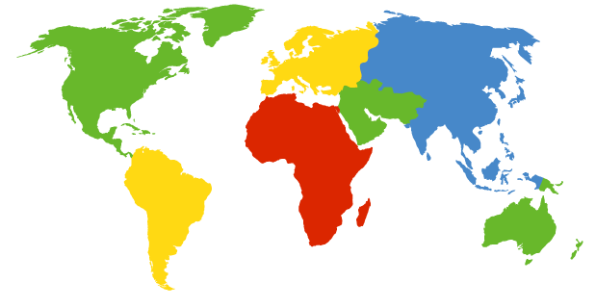
DNS: Root Name Servers
Contacted by local name server that cannot resolve name
Root name server:
  Contacts authoritative name server if name mapping not known
  Gets mapping
  Returns mapping to local name server
c. Cogent, Herndon, VA (5 other sites)
d. U Maryland College Park, MD
h. ARL Aberdeen, MD
j. Verisign, Dulles VA (69 other sites )
k. RIPE London (17 other sites)
i. Netnod, Stockholm (37 other sites)
e. NASA Mt View, CA
f. Internet Software C.
Palo Alto, CA (and 48 other sites)
m. WIDE Tokyo
(5 other sites)
13 logical root name “servers” worldwide
each “server” replicated many times
a. Verisign, Los Angeles CA
(5 other sites)
b. USC-ISI Marina del Rey, CA
l. ICANN Los Angeles, CA
(41 other sites)
g. US DoD Columbus, OH (5 other sites)

Slide 4
TLD, Authoritative DNS Servers
Top-level domain (TLD) servers:
  responsible for com, org, net, edu, aero, jobs, museums, and all top-level country domains, e.g.: uk, fr, ca, jp
  Network Solutions maintains servers for .com TLD
  Educause for .edu TLD
Authoritative DNS servers:
Organization’s own DNS server(s), providing authoritative hostname to IP mappings for organization’s named hosts
  can be maintained by organization or service provider

Slide 5
Local DNS name server
does not strictly belong to hierarchy
each ISP (residential ISP, company, university) has one
  also called “default name server”
when host makes DNS query, query is sent to its local DNS server
  has local cache of recent name-to-address translation pairs (but may be out of date!)
  acts as proxy, forwards query into hierarchy

Slide 6

DNS name resolution example
root DNS server
2
host at cs.stanford.edu wants IP address for cs.umd.edu
3
TLD DNS server
4
5
iterated query:
contacted server replies with name of server to contact
“I don’t know this name, but ask this server”
local DNS server
dns.stanford.edu
7
6
1
8
authoritative DNS server
dns.cs.umd.edu
requesting host
cs.stanford.edu
cs.umd.edu

Slide 7
DNS name
resolution example
root DNS server
2
3
recursive query:
puts burden of name resolution on contacted name server
heavy load at upper levels of hierarchy?
7
6
TLD DNS
server
local DNS server
dns.stanford.edu
5
4
1
8
authoritative DNS server
dns.cs.umd.edu
requesting host
cs.stanford.edu
cs.umd.edu

Slide 8
DNS: caching, updating records
once (any) name server learns mapping, it caches mapping
  cache entries timeout (disappear) after some time (TTL)
  TLD servers typically cached in local name servers
    thus root name servers not often visited
cached entries may be out-of-date (best effort name-to-address translation!)
  if name host changes IP address, may not be known Internet-wide until all TTLs expire
update/notify mechanisms proposed IETF standard
  RFC 2136

Slide 9
DNS records
DNS: distributed database storing resource records (RR)
RR format: (name, value, type, ttl)
type=A
  name is hostname
  value is IP address
type=CNAME
  name is alias name for some “canonical” (the real) name
  www.ibm.com is really
  servereast.backup2.ibm.com
  value is canonical name
type=NS
  name is domain (e.g., foo.com)
  value is hostname of authoritative name server for this domain
type=MX
  value is name of mail server associated with name

Slide 10
DNS protocol, messages
query and reply messages, both with same message format
2 bytes
2 bytes
message header
identification: 16 bit # for query, reply to query uses same #
flags:
  query or reply
  recursion desired
  recursion available
  reply is authoritative
identification
flags
# questions
# answer RRs
# authority RRs
# additional RRs
questions (variable # of questions)
answers (variable # of RRs)
authority (variable # of RRs)
additional info (variable # of RRs)

Slide 11
DNS protocol, messages
2 bytes
2 bytes
identification
flags
# questions
# answer RRs
# authority RRs
# additional RRs
name, type fields
for a query
questions (variable # of questions)
RRs in response
to query
answers (variable # of RRs)
records for
authoritative servers
authority (variable # of RRs)
additional “helpful”
info that may be used
additional info (variable # of RRs)
Notes:
Does DNS use TCP or UDP? Why?

Slide 12
Inserting records into DNS
example: new startup “Network Utopia”
register name networkuptopia.com at DNS registrar (e.g., Network Solutions)
  provide names, IP addresses of authoritative name server (primary and secondary)
  registrar inserts two RRs into .com TLD server:
  (networkutopia.com, dns1.networkutopia.com, NS)
  (dns1.networkutopia.com, 212.212.212.1, A)
create authoritative server type A record for www.networkuptopia.com; type NS record for networkutopia.com

Slide 13
Network Security

Slide 14
Chapter 8: Network Security
Chapter goals:
understand principles of network security:
  cryptography and its many uses beyond “confidentiality”
  authentication
  message integrity
security in practice:
  firewalls and intrusion detection systems
  security in application, transport, network, link layers

Slide 15
Outline
  What is Network Security?
  Principles of Cryptography
  Authentication, Message Integrity
  Securing TCP: SSL/TLS

Slide 16
What is network security?
confidentiality: only sender, intended receiver should “understand” message contents
  sender encrypts message
  receiver decrypts message
authentication: sender, receiver want to confirm identity of each other
message integrity: sender, receiver want to ensure message not altered (in transit, or afterwards) without detection
access and availability: services must be accessible and available to users

Slide 17



Friends and enemies: Alice, Bob, Trudy
well-known in network security world
Bob, Alice (lovers!) want to communicate “securely”
Trudy (intruder) may intercept, delete, add messages
Alice
Bob
channel
data, control messages
secure
sender
s
data
secure
receiver
data
Trudy

Slide 18
Who might Bob, Alice be?
… well, real-life Bobs and Alices!
Web browser/server for electronic transactions (e.g., on-line purchases)
on-line banking client/server
DNS servers
routers exchanging routing table updates
Many other examples!

Slide 19
There are attackers out there!
Q: What can an “attacker” do?
A: A lot!
  eavesdrop: intercept messages
  actively insert messages into connection
  impersonation: can fake (spoof) source address in packet (or any field in packet)
  hijacking: “take over” ongoing connection by removing sender or receiver, inserting himself in place
  denial of service: prevent service from being used by others (e.g., by overloading resources)

Slide 20
Outline
  What is Network Security?
  Principles of Cryptography
  Authentication, Message Integrity
  Securing TCP: SSL/TLS

Slide 21
The language of cryptography
Alice
Bob
Alice’s
encryption
key
Bob’s
decryption
key
K
K
A
B
plaintext
encryption
algorithm
ciphertext
decryption
algorithm
plaintext
m plaintext message
E(K_{A},m) ciphertext, encrypted with key K_{A}
m = D(K_{B},E(K_{A},m))

Slide 22
Symmetric key cryptography
Alice
Bob
K
K
S
S
plaintext
message, m
encryption
algorithm
ciphertext
decryption
algorithm
plaintext
E(K_{S},m)
m = D(K_{S},E(K_{S},m))
symmetric key crypto: Bob and Alice share same (symmetric) key: K
S

Slide 23
Symmetric key crypto: DES
DES: Data Encryption Standard
US encryption standard [NIST 1993]
56-bit symmetric key, 64-bit plaintext input
block cipher with cipher block chaining
how secure is DES?
  DES Challenge: 56-bit-key-encrypted phrase decrypted (brute force) in less than a day
  no known good analytic attack
making DES more secure:
  3DES: encrypt 3 times with 3 different keys

Slide 24
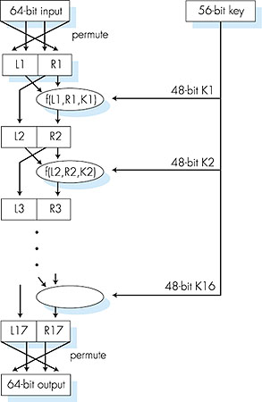
Symmetric key crypto: DES
DES operation
initial permutation
16 identical “rounds” of function application, each using different 48 bits of key
final permutation

Slide 25
AES: Advanced Encryption Standard
symmetric-key NIST standard, replaced DES (Nov 2001)
processes data in 128 bit blocks
128, 192, or 256 bit keys
brute force decryption (try each key) taking 1 sec on DES, takes 149 trillion years for AES

Slide 26
Public Key Cryptography
symmetric key crypto
requires sender, receiver know shared secret key
Q: how to agree on key in first place (particularly if never “met”)?
public key crypto
radically different approach [Diffie-Hellman76, RSA78]
sender, receiver do not share secret key
public encryption key known to all
private decryption key known only to receiver

Slide 27
Public key cryptography
+
Bob’s public
key
K
B
-
Bob’s private
key
K
B
Alice
Bob
plaintext
message, m
encryption
algorithm
ciphertext
decryption
algorithm
plaintext
message
E(K_{B}⁺,m)
m=D(K_{B}⁻,E(K_{B}⁺,m))

Slide 28
Public key encryption algorithms
requirements:
.
.
+
-
1
need K ( ) and K ( ) such that
B
B
D(K_{B}⁻,E(K_{B}⁺,m))=m
2
+
given public key K , it should be impossible* to compute private key K
B
-
B
RSA: Rivest, Shamir, Adleman algorithm

Slide 29
RSA: getting ready
message: just a bit pattern
bit pattern can be uniquely represented by an integer number
thus, encrypting a message is equivalent to encrypting a number
example:
m= 10010001 . This message is uniquely represented by the decimal number 145.
to encrypt m, we encrypt the corresponding number, which gives a new number (the ciphertext).

Slide 30
RSA: Creating public/private key pair
1. choose two large prime numbers p, q.
(e.g., 1024 bits each)
2. compute n = pq, z = (p-1)(q-1)
3. choose e (with e<n) that has no common factors
with z (e, z are “relatively prime”).
4. choose d such that ed-1 is exactly divisible by z.
(in other words: ed mod z = 1 ).
5. public key is (n,e). private key is (n,d).
+
-
K
K
B
B

Slide 31
RSA: encryption, decryption
0. given (n,e) and (n,d) as computed above
1. to encrypt message m (<n), compute
e
c = m mod n
2. to decrypt received bit pattern, c, compute
d
m = c mod n
magic
happens!
e
d
m = (m mod n)
mod n
c

Slide 32
RSA example:
Bob chooses p=5, q=7. Then n=35, z=24.
e=5 (so e, z relatively prime).
d=29 (so ed-1 exactly divisible by z).
encrypting 8-bit messages.
m
e
e
bit pattern
m
c = m mod n
encrypt:
0000l000
12
24832
17
d
d
c
c
m = c mod n
decrypt:
17
481968572106750915091411825223071697
12

Slide 33
Why does RSA work?
must show that c^{d} mod n = m
where c = m^{e} mod n
fact: for any x and y: x^{y} mod n = x^{(y mod z)} mod n
  where n= pq and z = (p-1)(q-1)
thus,
c^{d} mod n = (m^{e} mod n)^{d} mod n
= m^{ed} mod n
= m^{(ed mod z)} mod n
= m¹ mod n
= m

Slide 34
RSA: another important property
The following property will be very useful later:
-
+
+
-
K (K (m)) = m
=
K (K (m))
B
B
B
B
use public key first, followed by private key
use private key first, followed by public key
result is the same!

Slide 35
Why
-
+
+
-
K (K (m)) = m
=
K (K (m))
?
B
B
B
B
follows directly from modular arithmetic:
(m^{e} mod n)^{d} mod n = m^{ed} mod n
= m^{de} mod n
= (m^{d} mod n)^{e} mod n

Slide 36
Why is RSA secure?
suppose you know Bob’s public key (n,e). How hard is it to determine d?
essentially need to find factors of n without knowing the two factors p and q
  fact: factoring a big number is hard

Slide 37
RSA in practice: session keys
exponentiation in RSA is computationally intensive
DES is at least 100 times faster than RSA
use public key crypto to establish secure connection, then establish second key – symmetric session key – for encrypting data
session key, K_{S}
Bob and Alice use RSA to exchange a symmetric key K_{S}
once both have K_{S}, they use symmetric key cryptography

Slide 38
Outline
  What is Network Security?
  Principles of Cryptography
  Authentication, Message Integrity
  Securing TCP: SSL/TLS

Slide 39
Authentication
Goal: Bob wants Alice to “prove” her identity to him
Protocol ap1.0: Alice says “I am Alice”
“I am Alice”
Failure scenario??

Slide 40
Authentication
Goal: Bob wants Alice to “prove” her identity to him
Protocol ap1.0: Alice says “I am Alice”
in a network,
Bob can not “see” Alice, so Trudy simply declares
herself to be Alice
“I am Alice”

Slide 41
Authentication: another try
Protocol ap2.0: Alice says “I am Alice” in an IP packet
containing her source IP address
Alice’s
IP address
“I am Alice”
Failure scenario??

Slide 42
Authentication: another try
Protocol ap2.0: Alice says “I am Alice” in an IP packet
containing her source IP address
Trudy can create
a packet “spoofing”
Alice’s address
Alice’s
IP address
“I am Alice”

Slide 43
Authentication: another try
Protocol ap3.0: Alice says “I am Alice” and sends her
secret password to “prove” it.
Alice’s
IP addr
Alice’s
password
“I’m Alice”
Failure scenario??
Alice’s
IP addr
OK

Slide 44
Authentication: another try
Protocol ap3.0: Alice says “I am Alice” and sends her
secret password to “prove” it.
Alice’s
IP addr
Alice’s
password
“I’m Alice”
playback attack: Trudy records Alice’s packet
and later
plays it back to Bob
Alice’s
IP addr
OK
Alice’s
IP addr
Alice’s
password
“I’m Alice”

Slide 45
Authentication: yet another try
Protocol ap3.1: Alice says “I am Alice” and sends her
encrypted secret password to “prove” it.
Alice’s
IP addr
encrypted
password
“I’m Alice”
Failure scenario??
Alice’s
IP addr
OK

Slide 46
Authentication: yet another try
Protocol ap3.1: Alice says “I am Alice” and sends her
encrypted secret password to “prove” it.
Alice’s
IP addr
encrypted
password
“I’m Alice”
record
and
playback
still works!
Alice’s
IP addr
OK
Alice’s
IP addr
encrypted
password
“I’m Alice”

Slide 47
Authentication: yet another try
Goal: avoid playback attack
nonce: number (R) used only once-in-a-lifetime
ap4.0: to prove Alice “live”, Bob sends Alice nonce, R. Alice must return R, encrypted with shared secret key
“I am Alice”
R
K (R)
Alice is live, and only Alice knows key to encrypt nonce, so it must be Alice!
A-B
Failures, drawbacks?

Slide 48
Authentication: ap5.0
ap4.0 requires shared symmetric key
can we authenticate using public key techniques?
ap5.0: use nonce, public key cryptography
“I am Alice”
“send me your public key”
+
K
A
E(K_{A}⁺,R)
R

Slide 49
ap5.0: security hole
man (or woman) in the middle attack: Trudy poses as Alice (to Bob) and as Bob (to Alice)
I am Alice
I am Alice
Send me your public key
+
Send me your public key
K
T
+
K
E(K_{T}⁺,R)
A
E(K_{A}⁺,R)
R
R

Slide 50
ap5.0: security hole
man (or woman) in the middle attack: Trudy poses as Alice (to Bob) and as Bob (to Alice)
difficult to detect:
Bob receives everything that Alice sends, and vice versa. (e.g., so Bob, Alice can meet one week later and recall conversation!)
problem is that Trudy receives all messages as well!

Slide 51
Digital signatures
cryptographic technique analogous to hand-written signatures:
sender (Bob) digitally signs document, establishing he is document owner/creator.
verifiable, nonforgeable: recipient (Alice) can prove to someone that Bob, and no one else (including Alice), must have signed document

Slide 52
Digital signatures
simple digital signature for message m:
Bob signs m by signing with his private key K_{B}, creating signed message, K_{B}(m)
-
-
Bob’s message, m
-
Bob’s private
key
K
m,S(K_{B}⁻,m)
B
Dear Alice
Oh, how I have missed you. I think of you all the time! …(blah blah blah)
Bob
Bob’s message, m, signed with his private key
Public key
signature
algorithm

Slide 53
Digital signatures
suppose Alice receives msg m, with signature: m, S(K_{B}⁻,m)
Alice verifies m signed by Bob by using Bob’s public key K_{B}⁺ to verify V(K_{B}⁺,S(K_{B}⁻,m),m) = True
Alice thus verifies that:
  Bob signed m
  no one else signed m
  Bob signed m and not m‘
non-repudiation:
  Alice can take m, and signature K_{B}(m) to court and prove that Bob signed m
-

Slide 54
Outline
  What is Network Security?
  Principles of Cryptography
  Authentication, Message Integrity
  Securing TCP: SSL/TLS

Slide 55
SSL/TLS: Transport Layer Security
widely deployed security protocol
  supported by almost all browsers, web servers
  https
  billions $/year over TLS
mechanisms: [Woo 1994], implementation: Netscape
Current version: TLS1.2
  TLS1.3 (aka TLS2 aka TLS4 aka TLS7 on the horizon)
provides
  confidentiality
  integrity
  authentication
original goals:
  Web e-commerce transactions
  encryption (especially credit-card numbers)
  Web-server authentication
  optional client authentication
  minimum hassle in doing business with new merchant
available to all TCP applications
  secure socket interface

Slide 56
TLS and TCP/IP
Application
Application
TLS
TCP
TCP
IP
IP
normal application
application with TLS
TLS provides application programming interface (API) to applications
C and Java TLS libraries/classes readily available

Slide 57
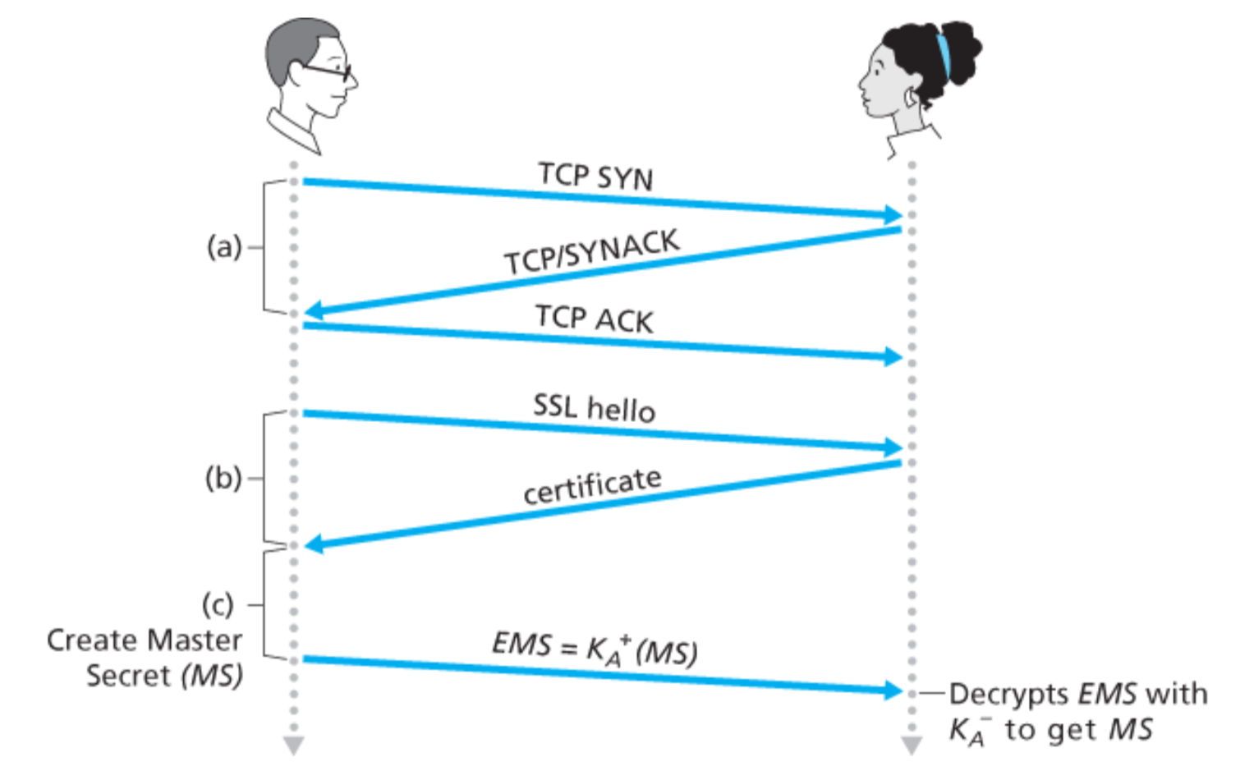
SSL Handshake overview

Slide 58
Outline
  What is Network Security?
  Principles of Cryptography
  Authentication, Message Integrity
  Securing TCP: SSL/TLS

Slide 59
Network Security (summary)
basic techniques…...
  cryptography (symmetric and public)
  message integrity
  end-point authentication
…. used in many different security scenarios
  secure email
  secure transport (SSL)
operational security: firewalls and IDS

