Slide 1

Computer Networks
CMSC 417 : Spring 2020
Topic: Internetworking
(Textbook chapter 3)
Nirupam Roy
Tu-Th 2:00-3:15pm
CSI 1115

Slide 2
One topic continued from the last lecture (overview of networks)

Slide 3
Chapter 1: Roadmap
  What is the Internet?
  Network edge
  Network core
  Delay, Loss, Throughput in networks
  Protocol layers, service models

Slide 4
Protocol “Layers”
Networks are complex,
with many “pieces”:
  hosts
  routers
  links of various media
  applications
  protocols
  hardware, software
Question:
is there any hope of organizing structure of network?
…. or at least our discussion of networks?

Slide 5
Layering of airline functionality
ticket (purchase)
baggage (check)
gates (load)
runway (takeoff)
airplane routing
ticket (complain)
baggage (claim
gates (unload)
runway (land)
airplane routing
ticket
baggage
gate
takeoff/landing
airplane routing
airplane routing
airplane routing
departure
airport
intermediate air-traffic
control centers
arrival
airport
layers: each layer implements a service
  via its own internal-layer actions
  relying on services provided by layer below

Slide 6
Why layering?
dealing with complex systems:
explicit structure allows identification, relationship of complex system’s pieces
  layered reference model for discussion
modularization eases maintenance, updating of system
  change of implementation of layer’s service transparent to rest of system
  e.g., change in gate procedure doesn’t affect rest of system
layering considered harmful?

Slide 7
Internet protocol stack
application: supporting network applications
  FTP, SMTP, HTTP
transport: process-process data transfer
  TCP, UDP
network: routing of packets from source to destination
  IP, routing protocols
link: data transfer between neighboring network elements
  Ethernet, 802.11 (WiFi), PPP
physical: bits “on the wire”
application
transport
network
link
physical

Slide 8

Encapsulation
source
message
M
application
transport
network
link
physical
segment
H_{t}
M
H_{t}
datagram
H_{n}
H_{n}
H_{t}
M
frame
H_{l}
H_{n}
H_{t}
M
link
physical
switch
destination
H_{n}
H_{t}
M
network
link
physical
M
application
transport
network
link
physical
H_{l}
H_{n}
H_{t}
M
H_{n}
H_{t}
M
H_{t}
M
H_{n}
H_{t}
M
H_{l}
H_{n}
H_{t}
M
router

Slide 9
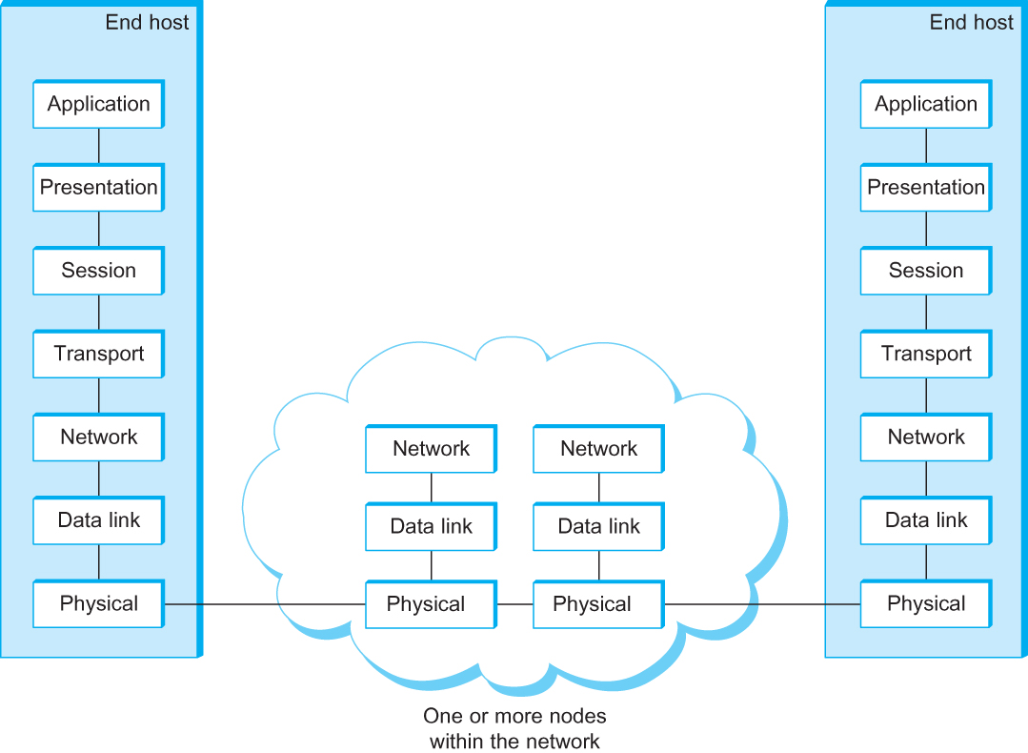
OSI Architecture
The OSI 7-layer Model
OSI – Open Systems Interconnection

Slide 10
Description of Layers
Physical Layer
  Handles the transmission of raw bits over a communication link
Data Link Layer
  Collects a stream of bits into a larger aggregate called a frame
  Network adaptor along with device driver in OS implement the protocol in this layer
  Frames are actually delivered to hosts
Network Layer
  Handles routing among nodes within a packet-switched network
  Unit of data exchanged between nodes in this layer is called a packet
  The lower three layers are implemented on all network nodes

Slide 11
Description of Layers
Transport Layer
  Implements a process-to-process channel
  Unit of data exchanges in this layer is called a message
Session Layer
  Provides a name space that is used to tie together the potentially different transport streams that are part of a single application.
Presentation Layer
  Concerned about the format of data exchanged between peers (data formats, data encryption)
Application Layer
  Standardize common type of exchanges
  The transport layer and the higher layers typically run only on end-hosts and not on the intermediate switches and routers

Slide 12
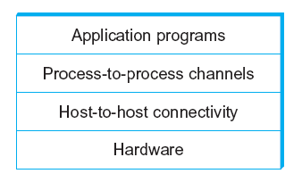
Network Architecture
Example of a layered network system

Slide 13
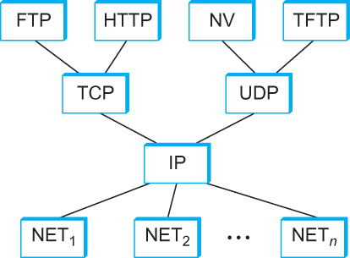
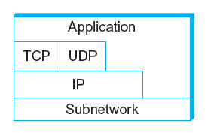
Internet Architecture
Alternative view of the Internet architecture. The “Network” layer shown here is sometimes referred to as the “sub-network” or “link” layer.
Internet Protocol Graph

Slide 14
This course: Top-Down or Bottom-up?
3
2
1
4

Slide 15
Internetworking

Slide 16
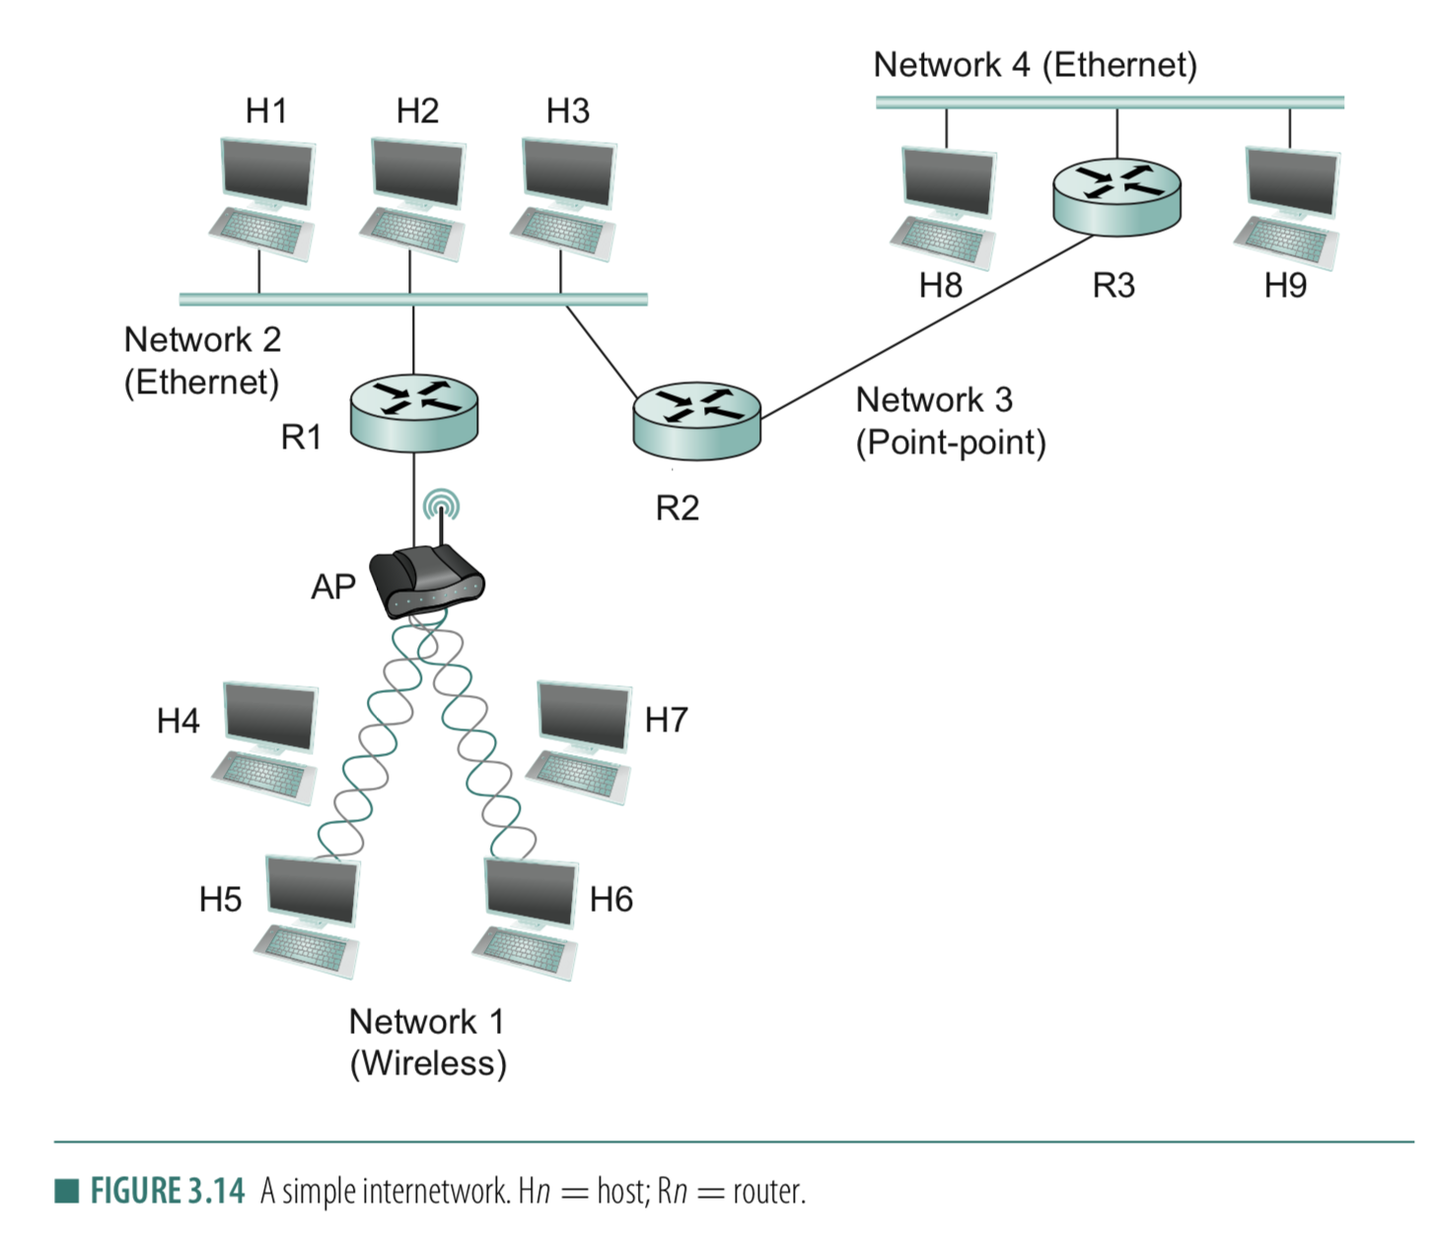
Connection between hosts
1. Addressing
– Unique identifier for global addressing
– Link name for neighbors
2. Forwarding
-- Switching packets between links
3. Routing
-- Determining paths between hosts

Slide 17
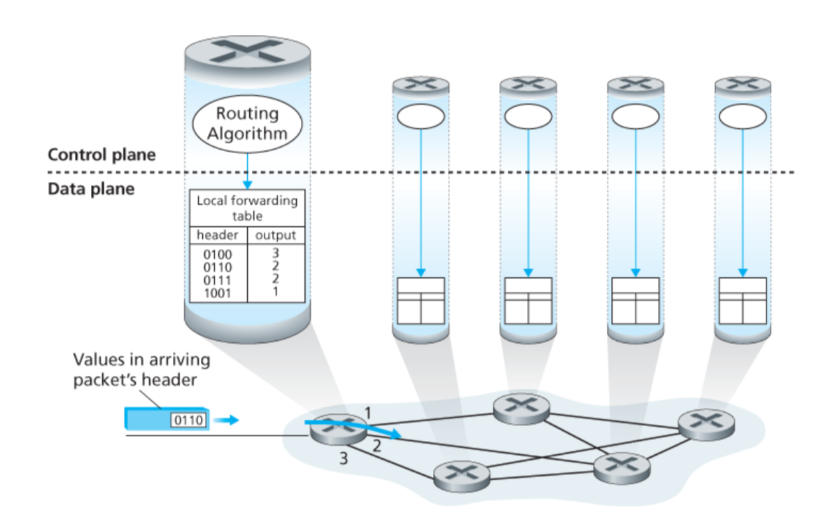
Connection between hosts

Slide 18
Connection between hosts
1. Addressing
– Unique identifier for global addressing
– Link name for neighbors
2. Forwarding
-- Switching packets between links
3. Routing
-- Determining paths between hosts

Slide 19
Routing protocols
Routing protocol goal: determine “good” paths (equivalently, routes), from sending hosts to receiving host, through network of routers
path: sequence of routers packets will traverse in going from given initial source host to given final destination host
“good”: least “cost”, “fastest”, “least congested”

Slide 20
Graph abstraction of the network
5
v
3
w
2
5
u
2
1
z
3
1
2
x
y
1
graph: G = (N,E)
N = set of routers = { u, v, w, x, y, z }
E = set of links ={ (u,v), (u,x), (v,x), (v,w), (x,w), (x,y), (w,y), (w,z), (y,z) }
aside: graph abstraction is useful in other network contexts, e.g.,
P2P, where N is set of peers and E is set of TCP connections

Slide 21
Graph abstraction: costs
5
c(x,x’) = cost of link (x,x’)
e.g., c(w,z) = 5
cost could always be 1, or
inversely related to bandwidth,
or related to congestion
v
3
w
2
5
u
2
1
z
3
1
2
x
y
1
cost of path (x₁, x₂, x₃,…, x_{p}) = c(x₁,x₂) + c(x₂,x₃) + … + c(x_{p-1},x_{p})
key question: what is the least-cost path between u and z ?
routing algorithm: algorithm that finds that least cost path

Slide 22
Routing
  For a simple network, we can calculate all shortest paths and load them into some nonvolatile storage on each node.
  Such a static approach has several shortcomings
    It does not deal with node or link failures
    It does not consider the addition of new nodes or links
    It implies that edge costs cannot change
  What is the solution?
    Need a distributed and dynamic protocol
    Two main classes of protocols
      Distance Vector
      Link State

Slide 23
Distance Vector Routing

Slide 24
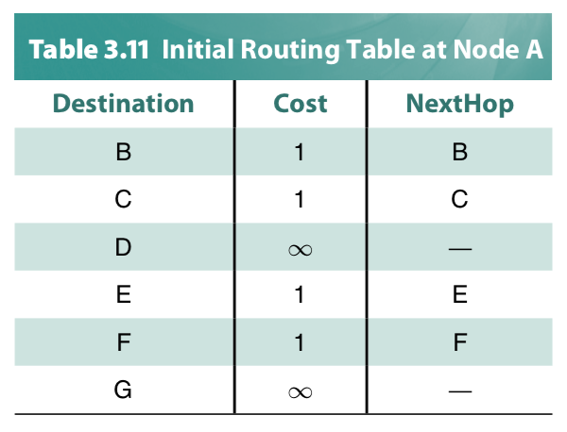
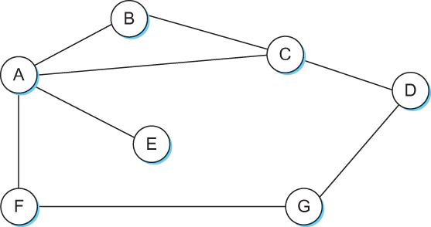
Distance Vector
Each node constructs a one dimensional array (a vector) containing the “distances” (costs) to all other nodes and distributes that vector to its immediate neighbors
Starting assumption is that each node knows the cost of the link to each of its directly connected neighbors

Slide 25
Distance Vector Routing: An example
B
D
19
4
A
11
13
15
7
5
C
E

Slide 26
Distance Vector Routing: An example
Routing table at Node A
Dest | Cost | N. Hop
B
D
19
4
A
11
13
15
7
5
C
E

Slide 27
Distance Vector Routing: An example
Routing table at Node A
Dest | Cost | N. Hop
A | 0 | A
B | 19 | B
C | 7 | C
D | ∞ | --
E | ∞ | --
B
D
19
4
A
11
13
15
7
5
C
E
Know thy neighbors !!
How?

Slide 28
Round: 0
Dest | Cost | N. Hop
A | 19 | A
B | 0 | B
C | 11 | C
D | 4 | D
E | ∞ | --
Dest | Cost | N. Hop
A | ∞ | --
B | 4 | B
C | 15 | C
D | 0 | D
E | 13 | E
Dest | Cost | N. Hop
A | 0 | A
B | 19 | B
C | 7 | C
D | ∞ | --
E | ∞ | --
B
D
19
4
A
11
13
15
7
5
C
E
Dest | Cost | N. Hop
A | 7 | A
B | 11 | B
C | 0 | C
D | 15 | D
E | 5 | E
Dest | Cost | N. Hop
A | ∞ | --
B | ∞ | --
C | 5 | C
D | 13 | D
E | 0 | E

Slide 29
Round: 0
Dest | Cost | N. Hop
A | 19 | A
B | 0 | B
C | 11 | C
D | 4 | D
E | ∞ | --
Dest | Cost | N. Hop
A | ∞ | --
B | 4 | B
C | 15 | C
D | 0 | D
E | 13 | E
Let your neighbors know what you know!!
Dest | Cost | N. Hop
A | 0 | A
B | 19 | B
C | 7 | C
D | ∞ | --
E | ∞ | --
B
D
19
4
A
11
13
15
7
5
C
E
Dest | Cost | N. Hop
A | 7 | A
B | 11 | B
C | 0 | C
D | 15 | D
E | 5 | E
Dest | Cost | N. Hop
A | ∞ | --
B | ∞ | --
C | 5 | C
D | 13 | D
E | 0 | E

Slide 30
Round: 1
Dest | Cost | N. Hop
A | 19 | A
B | 0 | B
C | 11 | C
D | 4 | D
E | ∞ | --
Dest | Cost | N. Hop
A | ∞ | --
B | 4 | B
C | 15 | C
D | 0 | D
E | 13 | E
Update your routing table, if required!!
Dest | Cost | N. Hop
A | 0 | A
B | 19 | B
C | 7 | C
D | ∞ | --
E | ∞ | --
B
D
19
4
A
11
13
15
7
5
C
E
Node A: Updates for B,D,E
Node B: Updates for A, E
Node C: No Updates
Node D: Updates for A
Node E: Updates for A, B
Dest | Cost | N. Hop
A | 7 | A
B | 11 | B
C | 0 | C
D | 15 | D
E | 5 | E
Dest | Cost | N. Hop
A | ∞ | --
B | ∞ | --
C | 5 | C
D | 13 | D
E | 0 | E

Slide 31
Round: 1
Dest | Cost | N. Hop
A | 0 | A
B | 19 | B
C | 7 | C
D | ∞ | --
E | ∞ | --
B
D
19
4
A
11
13
15
7
5
C
E
Node A: Updates for B,D,E
Node B: Updates for A, E
Node C: No Updates
Node D: Updates for A
Node E: Updates for A, B
Dest | Cost | N. Hop
A | 7 | A
B | 11 | B
C | 0 | C
D | 15 | D
E | 5 | E

Slide 32
Round: 1
Dest | Cost | N. Hop
A | 0 | A
B | 18 | C
C | 7 | C
D | ∞ | --
E | ∞ | --
B
D
19
4
A
11
13
15
7
5
C
E
Node A: Updates for B,D,E
Node B: Updates for A, E
Node C: No Updates
Node D: Updates for A
Node E: Updates for A, B
Dest | Cost | N. Hop
A | 7 | A
B | 11 | B
C | 0 | C
D | 15 | D
E | 5 | E

Slide 33
Round: 1
Dest | Cost | N. Hop
A | 0 | A
B | 18 | C
C | 7 | C
D | ∞ | --
E | ∞ | --
B
D
19
4
A
11
13
15
7
5
C
E
Node A: Updates for B,D,E
Node B: Updates for A, E
Node C: No Updates
Node D: Updates for A
Node E: Updates for A, B
Dest | Cost | N. Hop
A | 7 | A
B | 11 | B
C | 0 | C
D | 15 | D
E | 5 | E

Slide 34
Round: 1
Dest | Cost | N. Hop
A | 0 | A
B | 18 | C
C | 7 | C
D | 22 | C
E | ∞ | --
B
D
19
4
A
11
13
15
7
5
C
E
Node A: Updates for B,D,E
Node B: Updates for A, E
Node C: No Updates
Node D: Updates for A
Node E: Updates for A, B
Dest | Cost | N. Hop
A | 7 | A
B | 11 | B
C | 0 | C
D | 15 | D
E | 5 | E

Slide 35
Round: 1
Dest | Cost | N. Hop
A | 18 | C
B | 0 | B
C | 11 | C
D | 4 | D
E | 16 | C
Dest | Cost | N. Hop
A | 22 | C
B | 4 | B
C | 15 | C
D | 0 | D
E | 13 | E
Dest | Cost | N. Hop
A | 0 | A
B | 18 | C
C | 7 | C
D | 22 | C
E | 12 | C
B
D
19
4
A
11
13
15
7
5
C
E
Node A: Updates for B,D,E
Node B: Updates for A, E
Node C: No Updates
Node D: Updates for A
Node E: Updates for A, B
Dest | Cost | N. Hop
A | 7 | A
B | 11 | B
C | 0 | C
D | 15 | D
E | 5 | E
Dest | Cost | N. Hop
A | 12 | C
B | 16 | C
C | 5 | C
D | 13 | D
E | 0 | E

Slide 36
Round: 1
Dest | Cost | N. Hop
A | 18 | C
B | 0 | B
C | 11 | C
D | 4 | D
E | 16 | C
Dest | Cost | N. Hop
A | 22 | C
B | 4 | B
C | 15 | C
D | 0 | D
E | 13 | E
When will a node send routing updates to its neighbors?
Dest | Cost | N. Hop
A | 0 | A
B | 18 | C
C | 7 | C
D | 22 | C
E | 12 | C
B
D
19
4
A
11
13
15
7
5
C
E
Node A: Updates for B,D,E
Node B: Updates for A, E
Node C: No Updates
Node D: Updates for A
Node E: Updates for A, B
Dest | Cost | N. Hop
A | 7 | A
B | 11 | B
C | 0 | C
D | 15 | D
E | 5 | E
Dest | Cost | N. Hop
A | 12 | C
B | 16 | C
C | 5 | C
D | 13 | D
E | 0 | E

Slide 37
Routing updates
Two circumstances when a node sends out routing advertisements:
Periodic update: Automatically after some time. Why?
2) Triggered update: Whenever an event makes a node to change its routing table (e.g., link fail or a new message from a neighbor).

Slide 38
Round: 2
Dest | Cost | N. Hop
A | 18 | C
B | 0 | B
C | 11 | C
D | 4 | D
E | 16 | C
Dest | Cost | N. Hop
A | 22 | C
B | 4 | B
C | 15 | C
D | 0 | D
E | 13 | E
Dest | Cost | N. Hop
A | 0 | A
B | 18 | C
C | 7 | C
D | 22 | C
E | 12 | C
B
D
19
4
A
11
13
15
7
Convergence
C
5
E
Node A: No Updates
Node B: No Updates
Node C: No Updates
Node D: No Updates
Node E: No Updates
Dest | Cost | N. Hop
A | 7 | A
B | 11 | B
C | 0 | C
D | 15 | D
E | 5 | E
Dest | Cost | N. Hop
A | 12 | C
B | 16 | C
C | 5 | C
D | 13 | D
E | 0 | E

Slide 39
Distance vector algorithm
Bellman-Ford equation (dynamic programming)
let
d_{x}(y) := cost of least-cost path from x to y
then
d_{x}(y) = min {c(x,v) + d_{v}(y) }
v
cost from neighbor v to destination y
cost to neighbor v
min taken over all neighbors v of x

Slide 40
Bellman-Ford example
5
clearly, d_{v}(z) = 5, d_{x}(z) = 3, d_{w}(z) = 3
v
3
w
2
5
u
z
B-F equation says:
2
1
3
1
2
d_{u}(z) = min { c(u,v) + d_{v}(z),
c(u,x) + d_{x}(z),
c(u,w) + d_{w}(z) }
= min {2 + 5,
1 + 3,
5 + 3} = 4
x
y
1
node achieving minimum is next
hop in shortest path, used in forwarding table

Slide 41
Distance vector algorithm
D_{x}(y) = estimate of least cost from x to y
  x maintains distance vector D_{x} = [D_{x}(y): y є N ]
node x:
  knows cost to each neighbor v: c(x,v)
  maintains its neighbors’ distance vectors. For each neighbor v, x maintains
  D_{v} = [D_{v}(y): y є N ]

Slide 42
Distance vector algorithm
key idea:
from time-to-time, each node sends its own distance vector estimate to neighbors
when x receives new DV estimate from neighbor, it updates its own DV using B-F equation:
D_{x}(y) ← min_{v}{c(x,v) + D_{v}(y)} for each node y ∊ N
under minor, natural conditions, the estimate D_{x}(y) converge to the actual least cost d_{x}(y)

Slide 43
Distance vector algorithm
iterative, asynchronous: each local iteration caused by:
local link cost change
DV update message from neighbor
distributed:
each node notifies neighbors only when its DV changes
  neighbors then notify their neighbors if necessary
each node:
wait for (change in local link cost or msg from neighbor)
recompute estimates
if DV to any dest has changed, notify neighbors

