Slide 1
Computer Networks
CMSC 417 : Spring 2022
Topic: Internetworking
(Textbook chapter 3)
Nirupam Roy
Tu-Th 2:00-3:15pm
CSI 1115

Slide 2
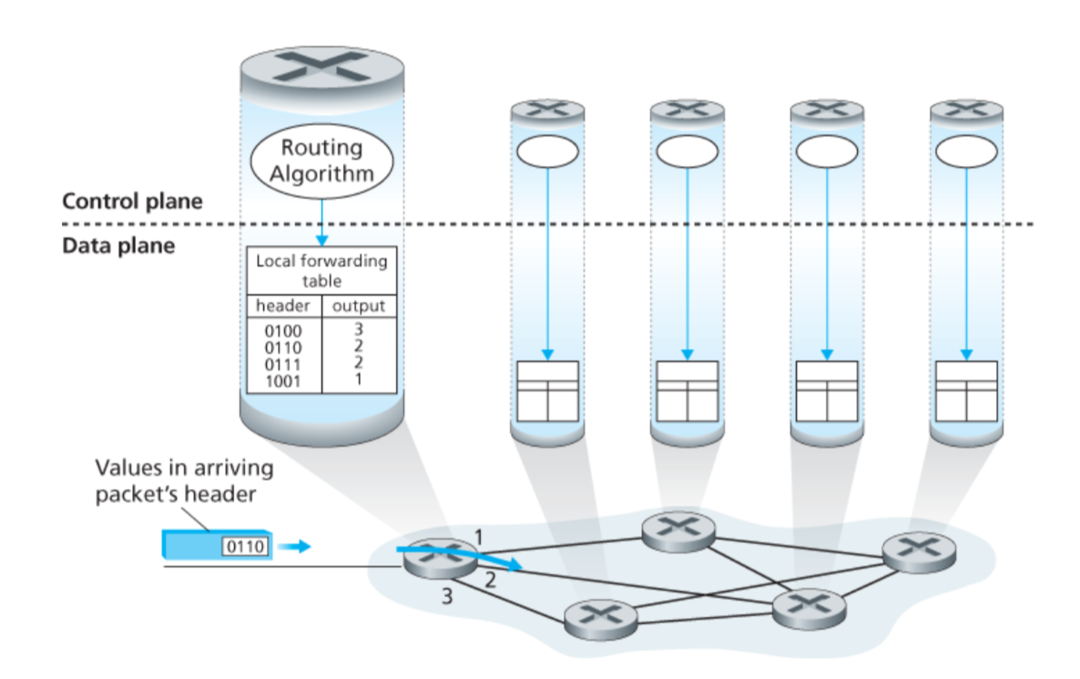
Connection between hosts

Slide 3
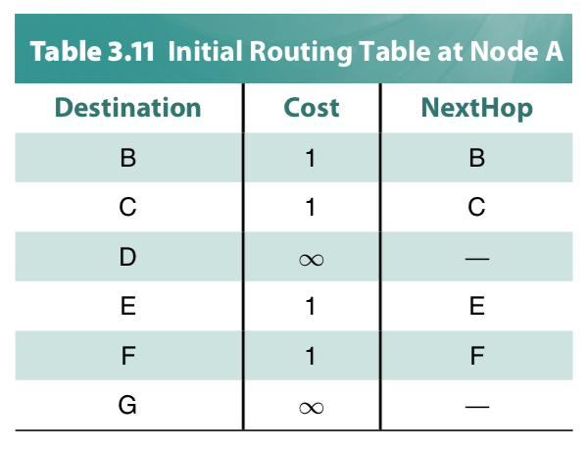
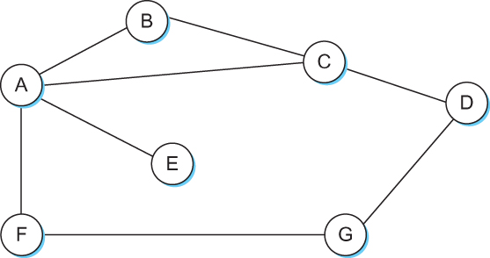
Distance Vector
Each node constructs a one dimensional array (a vector) containing the “distances” (costs) to all other nodes and distributes that vector to its immediate neighbors
Starting assumption is that each node knows the cost of the link to each of its directly connected neighbors

Slide 4
Distance vector algorithm
iterative, asynchronous: each local iteration caused by:
local link cost change
DV update message from neighbor
distributed:
each node notifies neighbors only when its DV changes
neighbors then notify their neighbors if necessary
each node:
wait for (change in local link cost or msg from neighbor)
recompute estimates
if DV to any dest has changed, notify neighbors

Slide 5
Routing updates
Two circumstances when a node sends out routing advertisements:
Periodic update: Automatically after some time. Why?
2) Triggered update: Whenever an event makes a node to change its routing table (e.g., link fail or a new message from a neighbor).

Slide 6
Distance Vector Routing: Link failure

Slide 7
Round: 2
Dest | Cost | N. Hop
A | 18 | C
B | 0 | B
C | 11 | C
D | 4 | D
E | 16 | C
Dest | Cost | N. Hop
A | 22 | C
B | 4 | B
C | 15 | C
D | 0 | D
E | 13 | E
Dest | Cost | N. Hop
A | 0 | A
B | 18 | C
C | 7 | C
D | 22 | C
E | 12 | C
B
D
19
4
A
11
13
15
7
5
C
E
Node A: No Updates
Node B: No Updates
Node C: No Updates
Node D: No Updates
Node E: No Updates
Dest | Cost | N. Hop
A | 7 | A
B | 11 | B
C | 0 | C
D | 15 | D
E | 5 | E
Dest | Cost | N. Hop
A | 12 | C
B | 16 | C
C | 5 | C
D | 13 | D
E | 0 | E

Slide 8
Round: 3
Dest | Cost | N. Hop
A | ∞ | --
B | 0 | B
C | ∞ | --
D | 4 | D
E | ∞ | --
Dest | Cost | N. Hop
A | 22 | C
B | 4 | B
C | 15 | C
D | 0 | D
E | 13 | E
Dest | Cost | N. Hop
A | 0 | A
B | 18 | C
C | 7 | C
D | 22 | C
E | 12 | C
B
D
19
4
A
11
13
15
7
5
C
E
Node A: No Updates
Node B: No Updates
Node C: No Updates
Node D: No Updates
Node E: No Updates
Dest | Cost | N. Hop
A | 7 | A
B | ∞ | --
C | 0 | C
D | 15 | D
E | 5 | E
Dest | Cost | N. Hop
A | 12 | C
B | 16 | C
C | 5 | C
D | 13 | D
E | 0 | E

Slide 9
Round: 3
Dest | Cost | N. Hop
A | 19 | A
B | 0 | B
C | 19 | D
D | 4 | D
E | 17 | D
Dest | Cost | N. Hop
A | 22 | C
B | 4 | B
C | 15 | C
D | 0 | D
E | 13 | E
Dest | Cost | N. Hop
A | 0 | A
B | ∞ | C
C | 7 | C
D | 22 | C
E | 12 | C
Cost update
B
D
19
4
A
11
13
15
7
5
C
E
Node A: Updates for B
Node B: Updates for A,C,E
Node C: Updates for B
Node D: No Updates
Node E: Updates for B
Dest | Cost | N. Hop
A | 7 | A
B | 19 | D
C | 0 | C
D | 15 | D
E | 5 | E
Dest | Cost | N. Hop
A | 12 | C
B | 17 | D
C | 5 | C
D | 13 | D
E | 0 | E

Slide 10
Round: 4
Dest | Cost | N. Hop
A | 19 | A
B | 0 | B
C | 19 | D
D | 4 | D
E | 17 | D
Dest | Cost | N. Hop
A | 22 | C
B | 4 | B
C | 15 | C
D | 0 | D
E | 13 | E
Dest | Cost | N. Hop
A | 0 | A
B | ∞ | C
C | 7 | C
D | 22 | C
E | 12 | C
B
D
19
4
A
11
13
15
7
5
C
E
Node A: Updates for B
Node B: No Updates
Node C: No Updates
Node D: No Updates
Node E: No Updates
Dest | Cost | N. Hop
A | 7 | A
B | 19 | D
C | 0 | C
D | 15 | D
E | 5 | E
Dest | Cost | N. Hop
A | 12 | C
B | 17 | D
C | 5 | C
D | 13 | D
E | 0 | E

Slide 11
Round: 5
Dest | Cost | N. Hop
A | 19 | A
B | 0 | B
C | 19 | D
D | 4 | D
E | 17 | D
Dest | Cost | N. Hop
A | 22 | C
B | 4 | B
C | 15 | C
D | 0 | D
E | 13 | E
Dest | Cost | N. Hop
A | 0 | A
B | 19 | B
C | 7 | C
D | 22 | C
E | 12 | C
B
D
19
4
A
11
13
15
7
5
C
E
Node A: No Updates
Node B: No Updates
Node C: No Updates
Node D: No Updates
Node E: No Updates
Dest | Cost | N. Hop
A | 7 | A
B | 19 | D
C | 0 | C
D | 15 | D
E | 5 | E
Dest | Cost | N. Hop
A | 12 | C
B | 17 | D
C | 5 | C
D | 13 | D
E | 0 | E

Slide 12
Distance vector: link cost changes
link cost changes:
node detects local link cost change
updates routing info, recalculates distance vector
if DV changes, notify neighbors
1
y
4
1
x
z
50

Slide 13
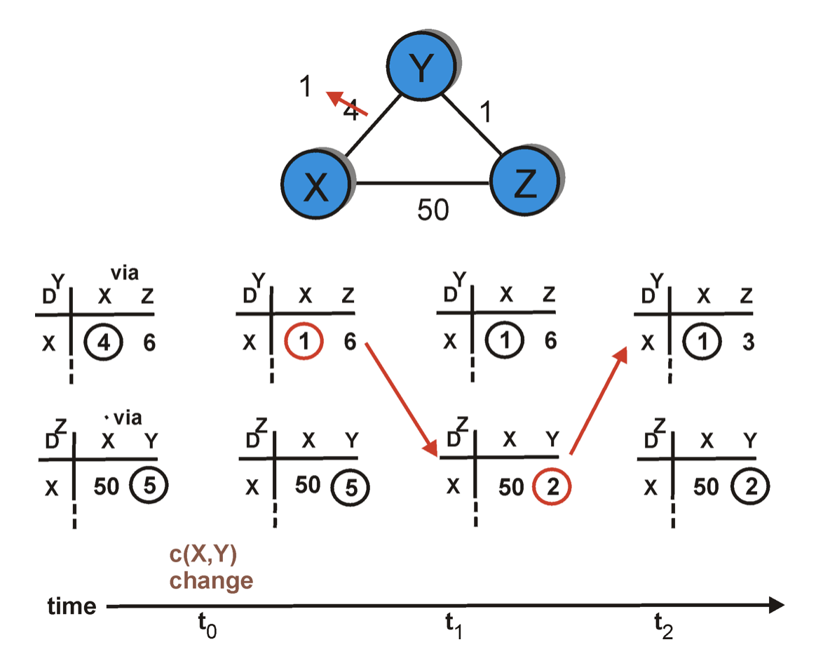
Distance vector: link cost decreases
node Y
Dest.
Dest.
node Z

Slide 14
Distance vector: link cost decreases
node Y
Dest.
Dest.
node Z

Slide 15
Distance vector: link cost decreases
node Y
Dest.
Dest.
node Z

Slide 16
Distance vector: link cost decreases
node Y
Dest.
Dest.
node Z

Slide 17
Distance vector: link cost decreases
node Y
Dest.
Dest.
node Z

Slide 18
Distance vector: link cost decreases
Dest.
Dest.

Slide 19
Distance vector: link cost changes
link cost changes:
node detects local link cost change
updates routing info, recalculates distance vector
if DV changes, notify neighbors
1
y
4
1
x
z
50
“good
news
travels
fast”
t₀ : y detects link-cost change, updates its DV, informs its neighbors.
t₁ : z receives update from y, updates its table, computes new least cost to x , sends its neighbors its DV.
t₂ : y receives z’s update, updates its distance table. y's least costs do not change, so y does not send a message to z.

Slide 20
Distance vector: link cost changes
link cost changes:
node detects local link cost change
bad news travels slow - “count to infinity” problem!
Many iterations before algorithm stabilizes
60
y
4
1
x
z
50

Slide 21
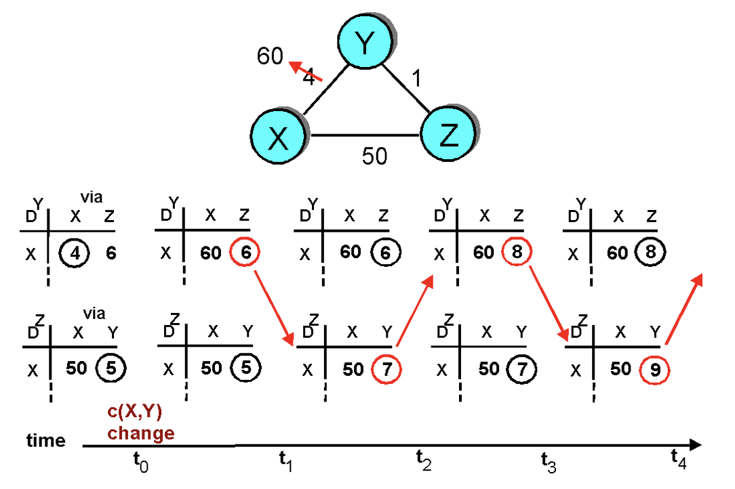
Distance vector: link cost increases
“Count to infinity” problem

Slide 22
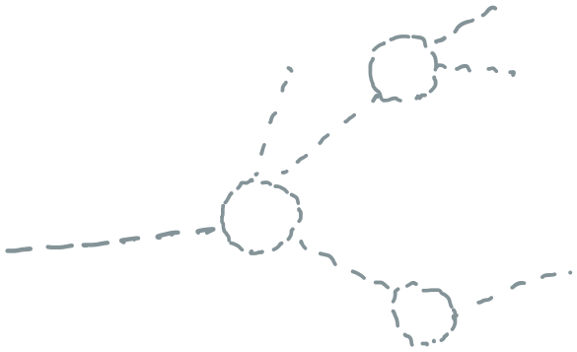
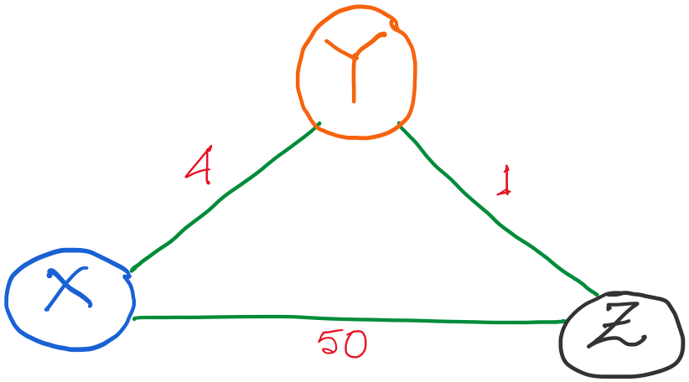
Distance vector routing: Example
Routing table entries:

Slide 23
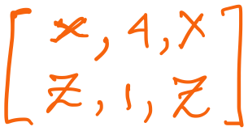
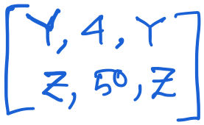
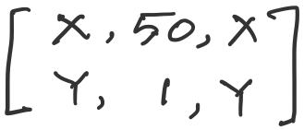
Distance vector routing: Revisited
Routing table entries:

Slide 24
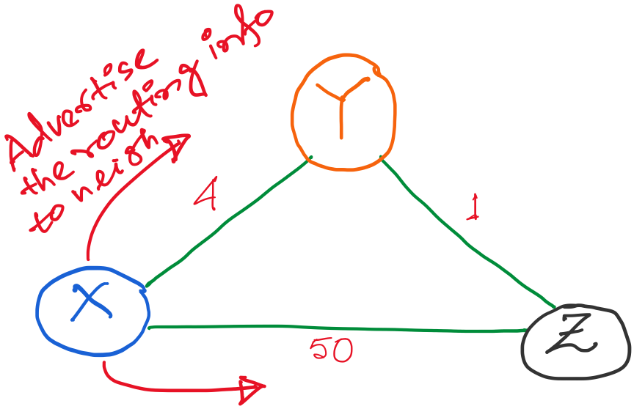
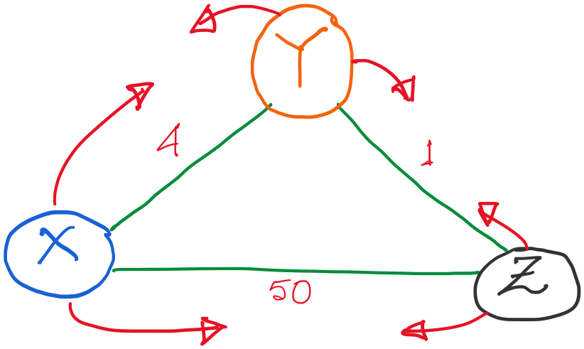

Slide 25
Alternate route to Z,
with lower cost (1+4)
So, update.
Alternate route to Y,
But higher cost (1+50)
No update.

Slide 26
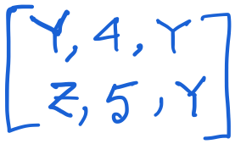
X’s updated table.

Slide 27
X’s updated table.
Alternate route to X,
with lower cost (4+1)
So, update.

Slide 28
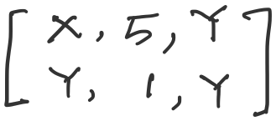
X’s updated table.

Slide 29
Tables are updated.
Advertisement messages will trigger as routing table is updates.

Slide 30
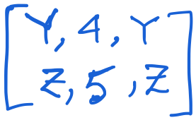
Let’s take a look at the node Y only.
An (false) alternate route to X,
with higher cost (5+1)
So, (fortunately) no update.

Slide 31
No update at any node. The routing algorithm converges.

Slide 32
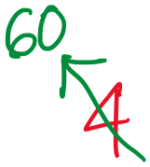
Distance vector: link cost increases

Slide 33
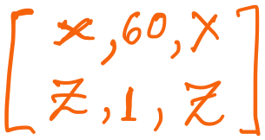
Distance vector: link cost increases
Y updates its table.

Slide 34
Distance vector: link cost increases
Y updates its table.
But imagine if Z advertises its old information to Y. (e.g., periodic update)

Slide 35
Distance vector: link cost increases
An (false) alternate route to X,
with lower cost (5+1)
So, (unfortunately) it will update.
But imagine if Z advertises its old information to Y, before reading Y’s message. (e.g., periodic update)

Slide 36
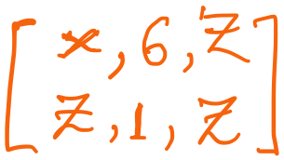
Distance vector: link cost increases
Y updates its table.

Slide 37
Distance vector: link cost increases
Y updates its table.
Sharing distance vector info

Slide 38
Distance vector: link cost increases
Y updates its table.
7
Z updates its table.

Slide 39
Distance vector: link cost increases
“Count to infinity” problem

Slide 40
Count-to-infinity Problem
Use some relatively small number as an approximation of infinity
For example, the maximum number of hops to get across a certain network is never going to be more than 16

Slide 41
Count-to-infinity Problem
Use some relatively small number as an approximation of infinity
For example, the maximum number of hops to get across a certain network is never going to be more than 16
Maximum possible hops

Slide 42
Count-to-infinity Problem
Use some relatively small number as an approximation of infinity
For example, the maximum number of hops to get across a certain network is never going to be more than 16
Maximum possible hops
“Thus, when considering even the most distant Facebook user in the Siberian tundra or the Peruvian rainforest, a friend of your friend probably knows a friend of their friend,” -- Facebook

Slide 43
Count-to-infinity Problem
Use some relatively small number as an approximation of infinity
For example, the maximum number of hops to get across a certain network is never going to be more than 16
One technique to improve the time to stabilize routing is called
split horizon
When a node sends a routing update to its neighbors, it does not send those routes it learned from each neighbor back to that neighbor
For example, if B has the route (E, 2, A) in its table, then it knows it must have learned this route from A, and so whenever B sends a routing update to A, it does not include the route (E, 2) in that update

Slide 44
Count-to-infinity Problem
In a stronger version of split horizon, called split horizon with poison reverse
B actually sends that back route to A, but it puts negative information in the route to ensure that A will not eventually use B to get to E
For example, B sends the route (E, ∞) to A

Slide 45
Distance vector: Poisoned reverse
Does poison reverse solve the general count-to-infinity problem?
It does not. It may be possible that loops involving three or more nodes (rather than simply two immediately neighboring nodes, as we shown in last example) will not be detected by the poison reverse technique.

Slide 46
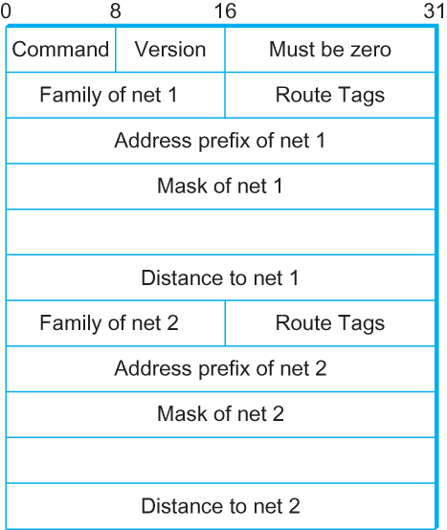
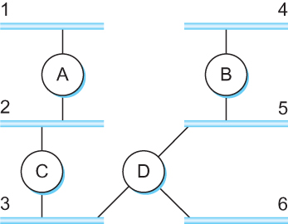
DV Implementation: Routing Information Protocol (RIP)
Example Network
running RIP RIPv2 Packet Format

Slide 47
Link State Routing

Slide 48
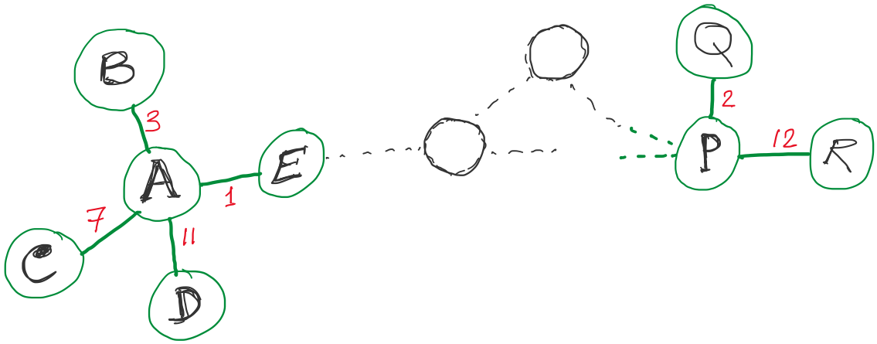
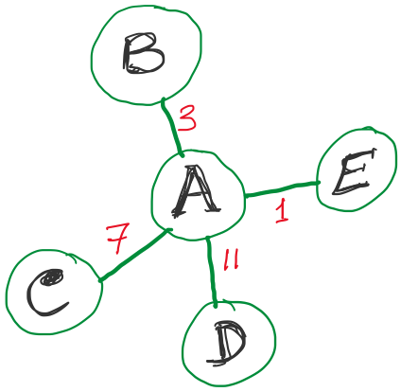
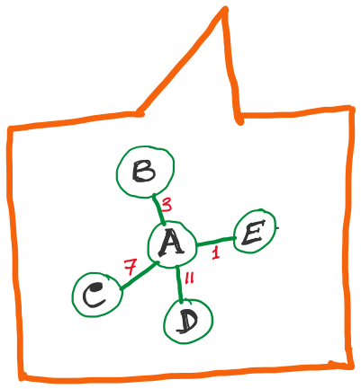
Link State Routing
Strategy:
Send to all nodes (not just neighbors) information about neighbors (not connection to all nodes).
All nodes will know the link-state information of all other nodes

Slide 49
Link State Routing
Strategy:
Send to all nodes (not just neighbors) information about neighbors (not connection to all nodes).
Link State Packet (LSP):
The ID of the node that created the LSP
(2) Costs of links to each directly connected neighbor
(3) A sequence number (SEQNO)
[To distinguish a newer LSP from the old ones]
[Smaller number == older LSP]
(4) A Time-To-Live (TTL) for this packet
[To make sure old information is eventually removed
from the network]

