Slide 1

Computer Networks
CMSC 417 : Spring 2022
Topic: Internetworking: IP
(Textbook chapter 3)
Nirupam Roy
Tu-Th 2:00-3:15pm
CSI 1115

Slide 2
Internet Protocol

Slide 3
The Internet network layer
host, router network layer functions:
transport layer: TCP, UDP
routing protocols
path selection
RIP, OSPF, BGP
IP protocol
addressing conventions
datagram format
packet handling conventions
network
layer
forwarding
table
ICMP protocol
error reporting
router “signaling”
link layer
physical layer

Slide 4
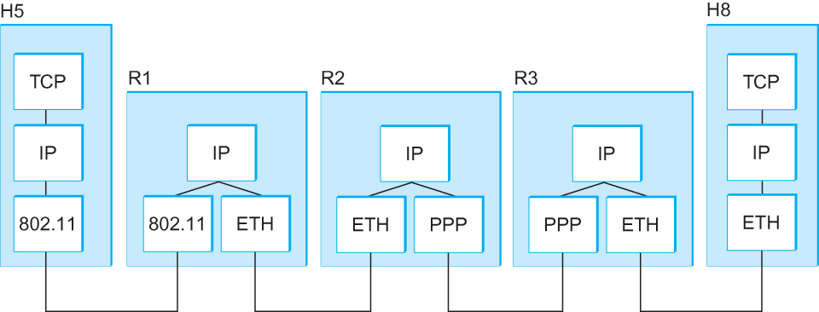
Internetworking
What is IP
  IP stands for Internet Protocol
  Key tool used today to build scalable, heterogeneous internetworks
  It runs on all the nodes in a collection of networks and defines the infrastructure that allows these nodes and networks to function as a single logical internetwork
  A simple internetwork showing the protocol layers

Slide 5
IP Service Model
Packet Delivery Model
  Connectionless model for data delivery
  Best-effort delivery (unreliable service)
    packets are lost
    packets are delivered out of order
    duplicate copies of a packet are delivered
    packets can be delayed for a long time
Global Addressing Scheme
  Provides a way to identify all hosts in the network

Slide 6
IP datagram format
IP protocol version
number
32 bits
total datagram
length (bytes)
header length
(bytes)
head.
len
type of
service
ver
length
for
fragmentation/
reassembly
“type” of data
flgs
fragment
offset
16-bit identifier
max number
remaining hops
(decremented at
each router)
time to
live
upper
layer
header
checksum
32 bit source IP address
upper layer protocol
to deliver payload to
32 bit destination IP address
options (if any)
e.g. timestamp,
record route
taken, specify
list of routers
to visit.
data
(variable length,
typically a TCP
or UDP segment)

Slide 7
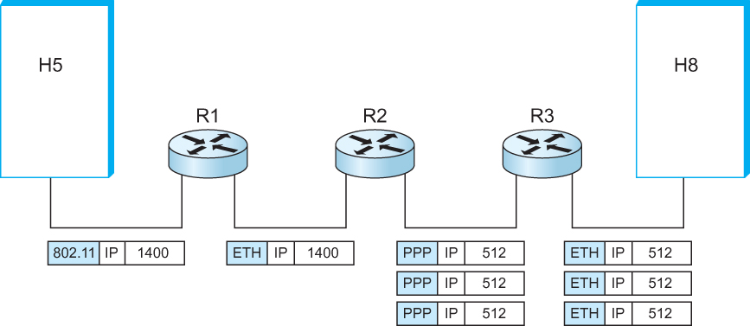
IP Fragmentation and Reassembly
  IP datagrams traversing the sequence of physical networks

Slide 8
IP Fragmentation and Reassembly
Each network has some MTU (Maximum Transmission Unit)
  Ethernet (1500 bytes), FDDI (4500 bytes)
Strategy
  Fragmentation occurs in a router when it receives a datagram that it wants to forward over a network which has (MTU < datagram)
  Reassembly is done at the receiving host
  All the fragments carry the same identifier in the Ident field
  Fragments are self-contained datagrams
  IP does not recover from missing fragments

Slide 9
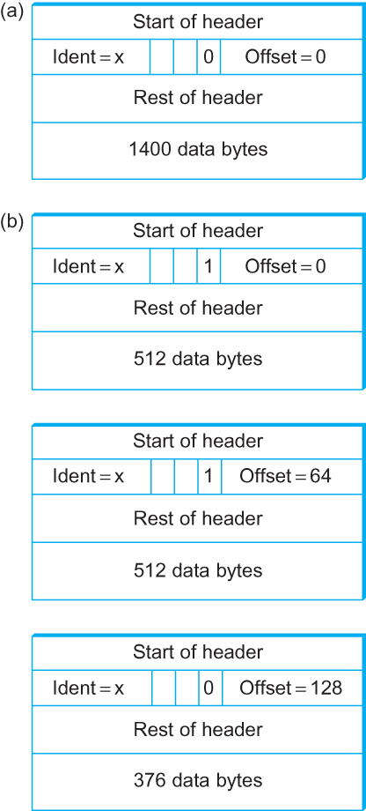
IP Fragmentation and Reassembly
Header fields used in IP fragmentation. (a) Unfragmented packet; (b) fragmented packets.

Slide 10
Network Addresses

Slide 11
IP Address (IPv4)
A unique 32-bit number
Identifies an interface (on a host, on a router, …)
Represented in dotted-quad notation
12
34
158
5
00001100
00100010
10011110
00000101
12:34:158:5

Slide 12
Grouping Related Hosts
The Internet is an “inter-network”
  Used to connect networks together, not hosts
  Need to address a network (i.e., group of hosts)
host
host
...
host
host
host
...
host
LAN 1
LAN 2
router
router
router
WAN
WAN
LAN = Local Area Network
WAN = Wide Area Network

Slide 13
Scalability Challenge
Suppose hosts had arbitrary addresses
  Then every router would need a lot of information
  …to know how to direct packets toward every host
1.2.3.4
5.6.7.8
2.4.6.8
1.2.3.5
5.6.7.9
2.4.6.9
host
host
...
host
host
host
...
host
LAN 1
LAN 2
router
router
router
WAN
WAN
1.2.3.4
1.2.3.5
forwarding table

Slide 14
Hierarchical Addressing in U.S. Mail
Addressing in the U.S. mail
  Zip code: 08540
  Building: 35 Olden Street
  Room in building: 306
  Name of occupant: Jennifer Rexford
Forwarding the U.S. mail
  Deliver to the post office in the zip code
  Assign to mailman covering the building
  Drop letter into mailbox for building/room
  Give letter to the appropriate person
???

Slide 15
Hierarchical Addressing: IP Prefixes
Network and host portions (left and right)
12
34
158
5
00001100
00100010
10011110
00000101
Network (24 bits)
Host (8 bits)

Slide 16
Easy to Add New Hosts
No need to update the routers
  E.g., adding a new host 5.6.7.213 on the right
  Doesn’t require adding a new forwarding-table entry
1.2.3.4
1.2.3.7
1.2.3.156
5.6.7.8
5.6.7.9
5.6.7.212
host
host
...
host
host
host
...
host
LAN 1
LAN 2
router
router
router
host
WAN
WAN
5.6.7.213
1.2.3.0/24
5.6.7.0/24
forwarding table

Slide 17
Class-full addressing

Slide 18
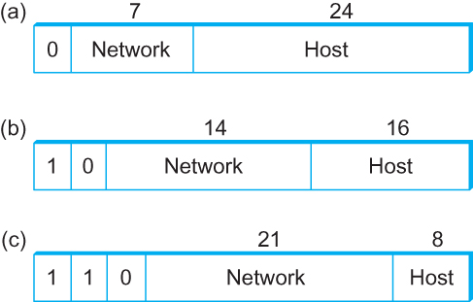
Global Addresses
Properties
  globally unique
  hierarchical: network + host
  4 Billion IP address, half are A type, ¼ is B type, and 1/8 is C type
Format
Dot notation
  10.3.2.4
  128.96.33.81
  192.12.69.77

Slide 19
Let’s assume we have 4-bit address (instead of 32 bit)
0000
0001
0010
0011
0100
0101
0110
0111
1000
1001
1010
1011
1100
1101
1110
1111
Class A (Half of all possible addresses)
Class B (1/4 of all possible addresses)
Class C (1/8 of all possible addresses)

Slide 20
Let’s assume we have 4-bit address (instead of 32 bit)
0000
0001
0010
0011
0100
0101
0110
0111
Class A (Half of all possible addresses)
Say, 1 bit for network part = 2 different networks
Say, 2 bits for host part = 4 hosts per network

Slide 21
Global Addresses
Properties
  globally unique
  hierarchical: network + host
  4 Billion IP address, half are A type, ¼ is B type, and 1/8 is C type
Format
Dot notation
  10.3.2.4
  128.96.33.81
  192.12.69.77

Slide 22
Classful Addressing
In the olden days, only fixed allocation sizes
  Class A: 0*
    Very large /8 blocks (e.g., MIT has 18.0.0.0/8)
    There can be 126 different class A networks (0 and 127 values are reserved) and (2²⁴-2) different hosts (2 values are reserved)
  Class B: 10*
    Large /16 blocks (e.g,. Princeton has 128.112.0.0/16)
  Class C: 110*
    Small /24 blocks (e.g., AT&T Labs has 192.20.225.0/24)
    2²¹ different networks possible, 254 hosts (255 is reserved for broadcast and 0 is reserved)
  Class D: 1110* for multicast groups
  Class E: 11110* reserved for future use
This is why folks use dotted-quad notation!

Slide 23
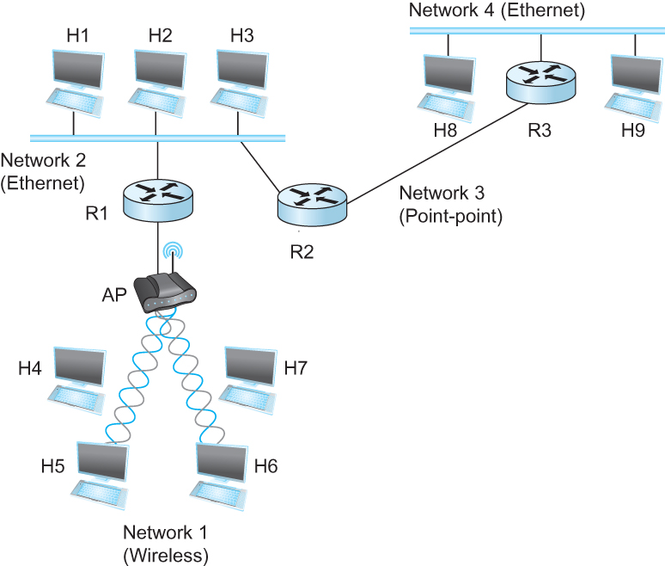
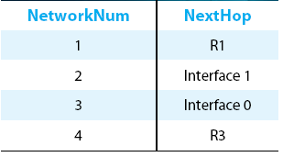
IP Datagram Forwarding
Strategy
  every datagram contains destination's address
  if directly connected to destination network, then forward to host
  if not directly connected to destination network, then forward to some router
  forwarding table maps network number into next hop
  each host has a default router
  each router maintains a forwarding table
Example (router R2)

Slide 24
IP Datagram Forwarding
Algorithm
if (NetworkNum of destination = NetworkNum of one of my interfaces) then
deliver packet to destination over that interface
else
if (NetworkNum of destination is in my forwarding table) then
deliver packet to NextHop router
else
deliver packet to default router
For a host with only one interface and only a default router in its forwarding table, this simplifies to
if (NetworkNum of destination = my NetworkNum)then
deliver packet to destination directly
else
deliver packet to default router

