Slide 1
Computer Networks
CMSC 417 : Spring 2022
Topic: Internetworking: Subnets, CIDR
(Textbook chapter 3)
Nirupam Roy
Tu-Th 2:00-3:15pm
CSI 1115

Slide 2
IP fragment and reassembly
(fragment offset)

Slide 3
IP datagram format
IP protocol version
number
32 bits
total datagram
length (bytes)
header length
(bytes)
head.
len
type of
service
ver
length
for
fragmentation/
reassembly
“type” of data
flgs
fragment
offset
16-bit identifier
max number
remaining hops
(decremented at
each router)
time to
live
upper
layer
header
checksum
32 bit source IP address
upper layer protocol
to deliver payload to
32 bit destination IP address
options (if any)
e.g. timestamp,
record route
taken, specify
list of routers
to visit.
data
(variable length,
typically a TCP
or UDP segment)

Slide 4
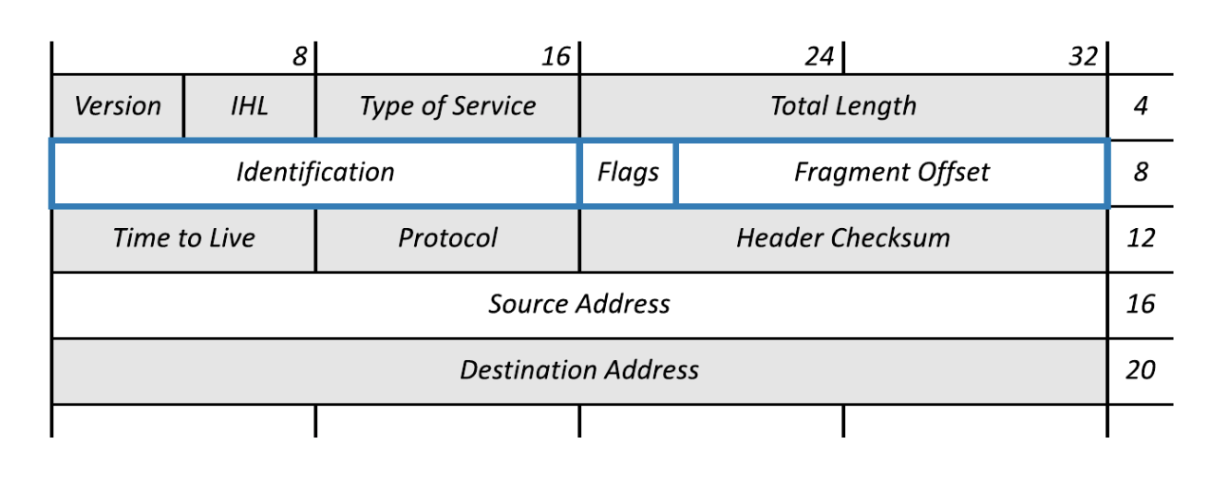
IP datagram format
3 bits
13 bits

Slide 5
IP Fragmentation and Reassembly
Each network has some MTU (Maximum Transmission Unit)
Ethernet (1500 bytes), FDDI (4500 bytes)
Strategy
Fragmentation occurs in a router when it receives a datagram that it wants to forward over a network which has (MTU < datagram)
Reassembly is done at the receiving host
All the fragments carry the same identifier in the Ident field
Fragments are self-contained datagrams
IP does not recover from missing fragments

Slide 6
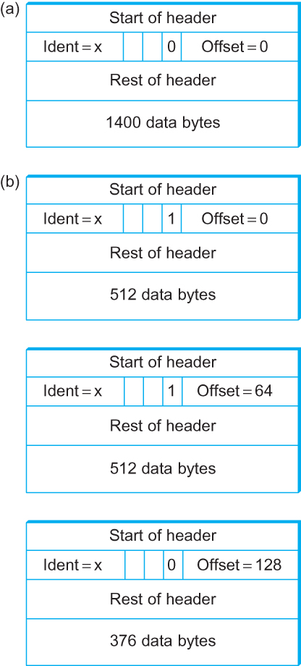
IP Fragmentation and Reassembly
Header fields used in IP fragmentation. (a) Unfragmented packet; (b) fragmented packets.

Slide 7
IP Fragmentation and Reassembly
Header fields used in IP fragmentation. (a) Unfragmented packet; (b) fragmented packets.
In terms of “8 byte blocks (i.e., octawords)”

Slide 8
IP Fragmentation and Reassembly
The offset value must be the number of 8 byte blocks of data, which means the data in the prior fragment must be a multiple of 8 bytes. The last fragment can carry data that isn’t a multiple of 8 bytes.
Header fields used in IP fragmentation. (a) Unfragmented packet; (b) fragmented packets.
In terms of “8 byte blocks (i.e., octawords)”

Slide 9
Network Addresses

Slide 10
IP Address (IPv4)
A unique 32-bit number
Identifies an interface (on a host, on a router, …)
Represented in dotted-quad notation
12
34
158
5
00001100
00100010
10011110
00000101
12:34:158:5

Slide 11
Hierarchical Addressing: IP Prefixes
Network and host portions (left and right)
12
34
158
5
00001100
00100010
10011110
00000101
Network (24 bits)
Host (8 bits)

Slide 12
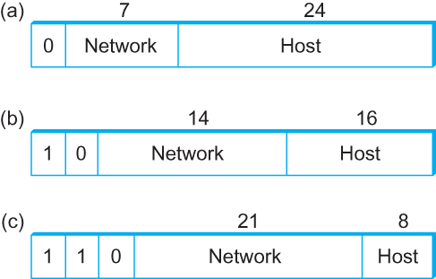
Global Addresses
Properties
globally unique
hierarchical: network + host
4 Billion IP address, half are A type, ¼ is B type, and 1/8 is C type
Format
Dot notation
10.3.2.4
128.96.33.81
192.12.69.77

Slide 13
IP Datagram Forwarding
Algorithm
if (NetworkNum of destination = NetworkNum of one of my interfaces) then
deliver packet to destination over that interface
else
if (NetworkNum of destination is in my forwarding table) then
deliver packet to NextHop router
else
deliver packet to default router
For a host with only one interface and only a default router in its forwarding table, this simplifies to
if (NetworkNum of destination = my NetworkNum)then
deliver packet to destination directly
else
deliver packet to default router

Slide 14
Obtaining a Block of Addresses
Internet Corporation for Assigned Names and Numbers (ICANN)
Allocates large blocks to Regional Internet Registries
Regional Internet Registries (RIRs)
E.g., ARIN (American Registry for Internet Numbers)
Allocates to ISPs and large institutions
Internet Service Providers (ISPs)
Allocate address blocks to their customers
Who may, in turn, allocate to their customers…

Slide 15
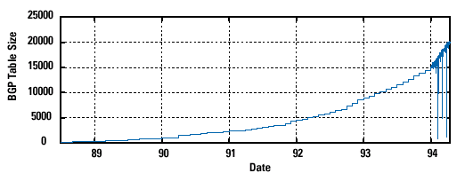
Pre-CIDR (1988-1994): Steep Growth
Growth faster than improvements in equipment capability

Slide 16
Subnetting

Slide 17
Problems with the classes of addresses
Wastage of addresses
Bigger tables to look up at routers

Slide 18
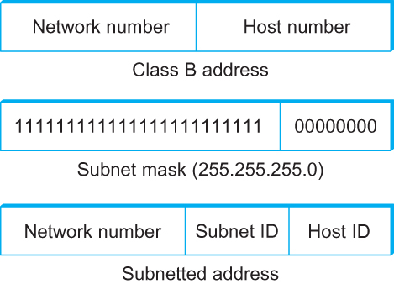
Subnetting
Add another level to address/routing hierarchy: subnet
Subnet masks define variable partition of host part of class A and B addresses
Subnets visible only within site

Slide 19
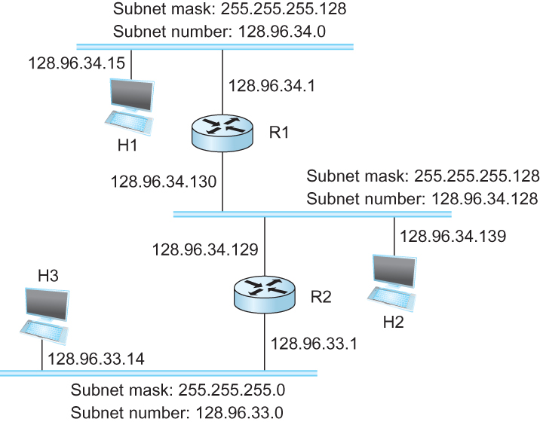
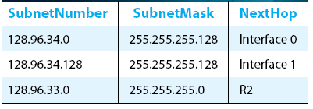
Subnetting
Forwarding Table at Router R1

Slide 20
Subnetting
Forwarding Table at Router R1
Forwarding Algorithm
D = destination IP address
for each entry < SubnetNum, SubnetMask, NextHop>
D1 = SubnetMask & D
if D1 = SubnetNum
if NextHop is an interface
deliver datagram directly to destination
else
deliver datagram to NextHop (a router)

Slide 21
Subnetting
Notes
Would use a default router if nothing matches
Not necessary for all ones in subnet mask to be contiguous
Can put multiple subnets on one physical network
Subnets not visible from the rest of the Internet

Slide 22
Class-less addressing: CIDR

Slide 23
IP addressing: CIDR
CIDR: Classless InterDomain Routing
subnet portion of address of arbitrary length
address format: a.b.c.d/x, where x is # bits in subnet portion of address
subnet
part
host
part
11001000 00010111 00010000 00000000
200.23.16.0/23
200.23.16.0–200.23.17.255

Slide 24
Classless Inter-Domain Routing (CIDR)
Use two 32-bit numbers to represent a network.
Network number = IP address + Mask
IP Address : 12.4.0.0 IP Mask: 255.254.0.0
Address
00001100
00000100
00000000
00000000
Mask
11111111
11111110
00000000
00000000
Network Prefix
for hosts
Written as 12.4.0.0/15

Slide 25
Hierarchical Address Allocation
Hierarchy is key to scalability
Address allocated in contiguous chunks (prefixes)
Today, the Internet has about 400,000 prefixes
12.0.0.0/16
12.1.0.0/16
:
:
:
12.3.0.0/24
12.2.0.0/16
12.3.1.0/24
12.3.0.0/16
:
:
:
:
:
12.0.0.0/8
12.3.254.0/24
12.253.0.0/19
12.253.32.0/19
:
:
12.254.0.0/16
12.253.160.0/19

Slide 26
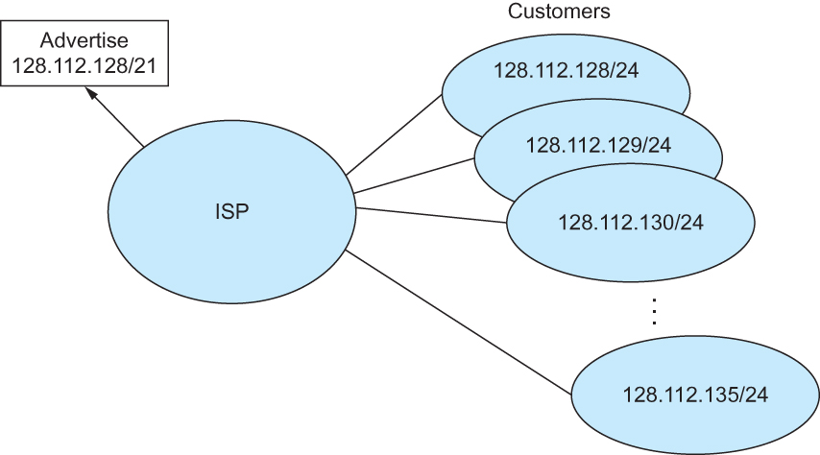
Classless Addressing
Route aggregation with CIDR

Slide 27
Separate Forwarding Entry Per Prefix
Prefix-based forwarding
Map the destination address to matching prefix
Forward to the outgoing interface
1.2.3.4
1.2.3.7
1.2.3.156
5.6.7.8
5.6.7.9
5.6.7.212
host
host
...
host
host
host
...
host
LAN 1
LAN
router
router
router
WAN
WAN
1.2.3.0/24
5.6.7.0/24
forwarding table

Slide 28
CIDR Makes Packet Forwarding Harder
Forwarding table may have many matches
E.g., entries for 201.10.0.0/21 and 201.10.6.0/23
The IP address 201.10.6.17 would match both!
201.10.0.0/21
Provider 1
Provider 2
201.10.0.0/22
201.10.4.0/24
201.10.5.0/24
201.10.6.0/23

Slide 29
Longest Prefix Match Forwarding
Destination-based forwarding
Packet has a destination address
Router identifies longest-matching prefix
Cute algorithmic problem: very fast lookups
forwarding table
4.0.0.0/8
4.83.128.0/17
201.10.0.0/21
201.10.6.0/23
126.255.103.0/24
destination
201.10.6.17
outgoing link
Serial0/0.1

Slide 30
Pre-CIDR (1988-1994): Steep Growth
Growth faster than improvements in equipment capability

Slide 31
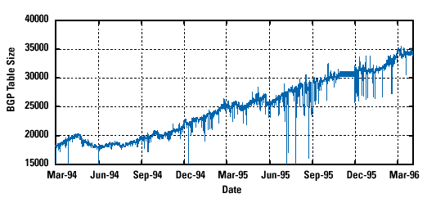
CIDR (1994-1996): Much Flatter
Efforts to aggregate

Slide 32
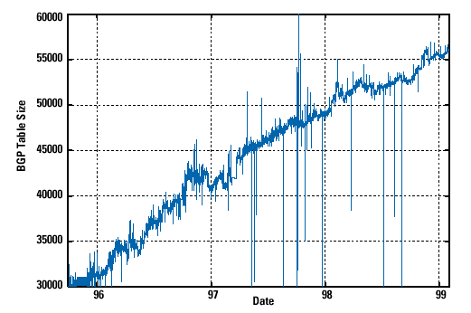
CIDR Growth (1996-1998): Roughly Linear
Good use of aggregation, and peer pressure!

Slide 33
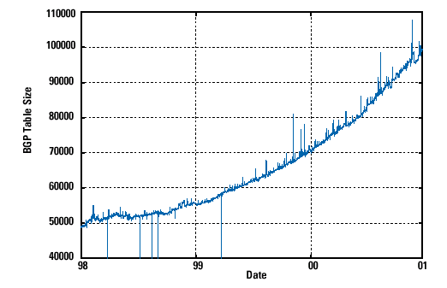
DotCom Boom (1998-2001): Steep Growth
Internet boom and increased multi-homing

Slide 34
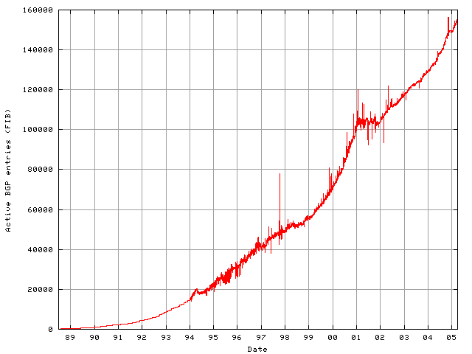
Long Term (1989-2005): Post-Boom
Today we are up to ~400,000 prefixes

Slide 35
Subnets and CIDR
Subnets “toy” example

Slide 36
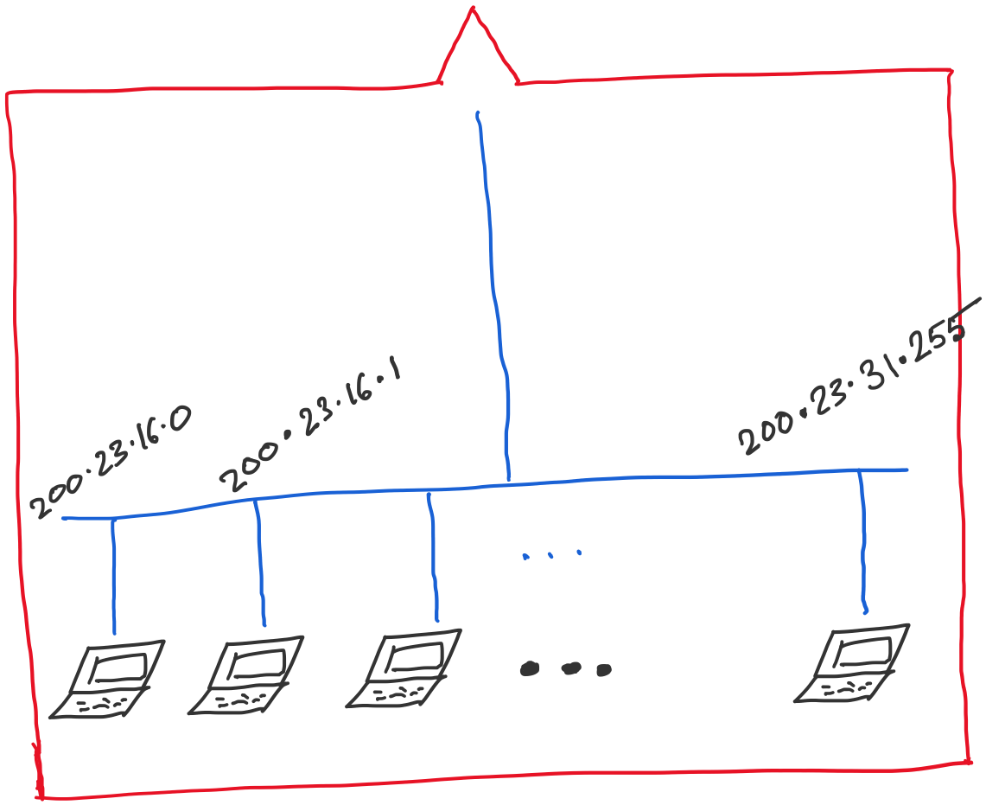
Address space assigned to you:

Slide 37
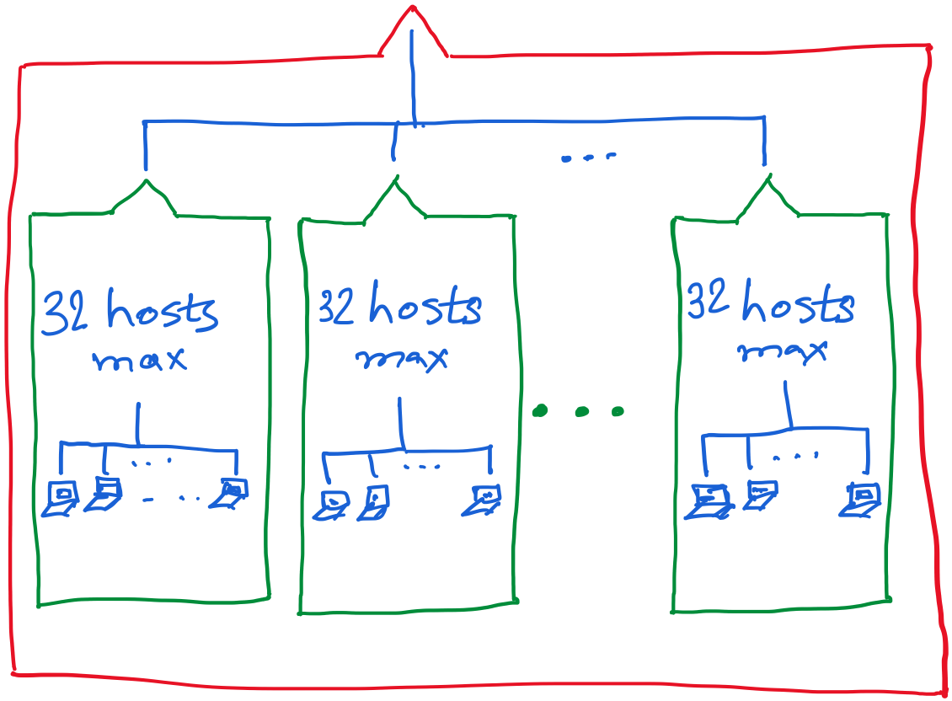

Slide 40
Getting an IP address: DHCP

Slide 41
IP addresses: how to get one?
Q: How does a host get IP address?
hard-coded by system admin in a file
Windows: control-panel->network->configuration->tcp/ip->properties
UNIX: /etc/…
DHCP: Dynamic Host Configuration Protocol: dynamically get address from a server
“plug-and-play”

Slide 42
DHCP: Dynamic Host Configuration Protocol
goal: allow host to dynamically obtain its IP address from network server when it joins network
can renew its lease on address in use
allows reuse of addresses (only hold address while connected/“on”)
support for mobile users who want to join network

Slide 43
DHCP: Dynamic Host Configuration Protocol
DHCP overview:
host broadcasts “DHCP discover” msg [optional]
DHCP server responds with “DHCP offer” msg
host requests IP address: “DHCP request” msg
DHCP server sends address: “DHCP ack” msg

Slide 44
DHCP client-server scenario
DHCP
server
223.1.1.0/24
223.1.1.1
223.1.2.1
223.1.1.2
arriving DHCP
client needs
address in this
network
223.1.1.4
223.1.2.9
223.1.3.27
223.1.2.2
223.1.1.3
223.1.2.0/24
223.1.3.1
223.1.3.2
223.1.3.0/24

Slide 45
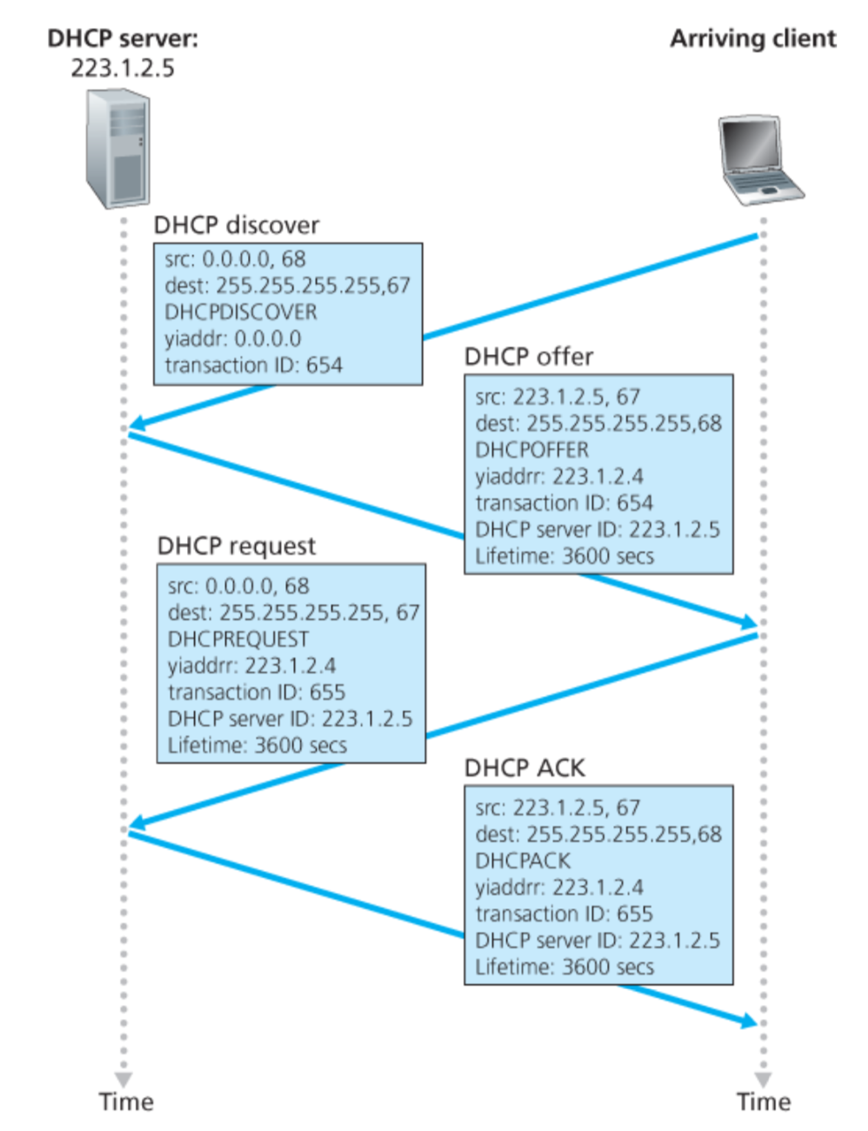
Broadcast: is there a DHCP server out there?
Broadcast: I’m a DHCP server! Here’s an IP address you can use
Broadcast: OK. I’ll take that IP address!
Broadcast: OK. You’ve got that IP address!

Slide 46
DHCP: more than IP addresses
DHCP can return more than just allocated IP address on subnet:
address of first-hop router for client
name and IP address of DNS sever
network mask (indicating network versus host portion of address)

Slide 47
Dynamic Host Configuration Protocol (DHCP)
DHCP server is responsible for providing configuration information to hosts
DHCP server maintains a pool of available addresses
There is at least one DHCP server for an administrative domain (a server or a relay agent per subnet)

Slide 48
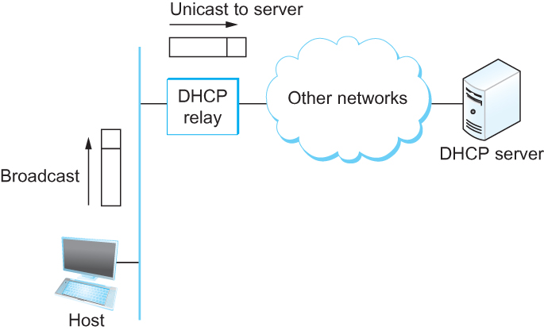
DHCP
Newly booted or attached host sends DHCPDISCOVER message to a special IP address (255.255.255.255)
DHCP relay agent unicasts the message to DHCP server and waits for the response

Slide 49
Check our IP addresses
(ifconfig/ipconfig)

Slide 50
Private Address Space

Slide 51
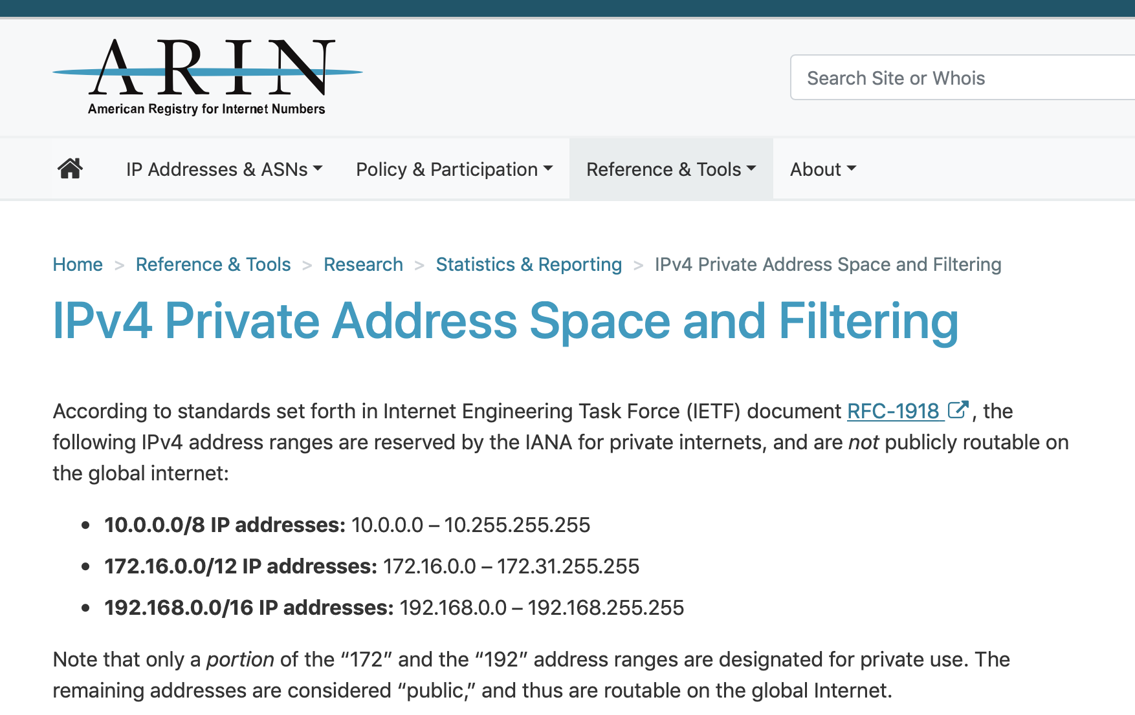

Slide 52
NAT: network address translation
rest of
Internet
local network
(e.g., home network)
10.0.0/24
10.0.0.1
10.0.0.4
10.0.0.2
138.76.29.7
10.0.0.3
all datagrams leaving local
network have same single source NAT IP address: 138.76.29.7,different source port numbers
datagrams with source or
destination in this network
have 10.0.0/24 address for
source, destination (as usual)

Slide 53
NAT: network address translation
NAT translation table
WAN side addr LAN side addr
2: NAT router
changes datagram
source addr from
10.0.0.1, 3345 to
138.76.29.7, 5001,
updates table
1: host 10.0.0.1
sends datagram to
128.119.40.186, 80
138.76.29.7, 5001 10.0.0.1, 3345
…… ……
S: 10.0.0.1, 3345
D: 128.119.40.186, 80
10.0.0.1
1
2
S: 138.76.29.7, 5001
D: 128.119.40.186, 80
10.0.0.4
10.0.0.2
138.76.29.7
S: 128.119.40.186, 80
D: 10.0.0.1, 3345
4
S: 128.119.40.186, 80
D: 138.76.29.7, 5001
3
10.0.0.3
4: NAT router
changes datagram
dest addr from
138.76.29.7, 5001 to 10.0.0.1, 3345
3: reply arrives
dest. address:
138.76.29.7, 5001

Slide 54
NAT: network address translation
motivation: local network uses just one IP address as far as outside world is concerned:
range of addresses not needed from ISP: just one IP address for all devices
can change addresses of devices in local network without notifying outside world
can change ISP without changing addresses of devices in local network
devices inside local net not explicitly addressable, visible by outside world (a security plus)

Slide 55
NAT: network address translation
implementation: NAT router must:
outgoing datagrams: replace (source IP address, port #) of every outgoing datagram to (NAT IP address, new port #)
. . . remote clients/servers will respond using (NAT IP address, new port #) as destination addr
remember (in NAT translation table) every (source IP address, port #) to (NAT IP address, new port #) translation pair
incoming datagrams: replace (NAT IP address, new port #) in dest fields of every incoming datagram with corresponding (source IP address, port #) stored in NAT table

Slide 56
NAT: network address translation
16-bit port-number field:
60,000 simultaneous connections with a single LAN-side address!
NAT challenges:
violates end-to-end argument
NAT possibility must be taken into account by app designers, e.g., P2P applications
NAT traversal: what if client wants to connect to server behind NAT?

