Slide 1

Computer Networks
CMSC 417 : Spring 2022
Topic: Internetworking: Subnets, CIDR
(Textbook chapter 3)
Nirupam Roy
Tu-Th 2:00-3:15pm
CSI 1115

Slide 2

Does this network require IP address (network layer address) for message exchange?

Slide 3
Does this network require IP address (network layer address) for message exchange?

Slide 4

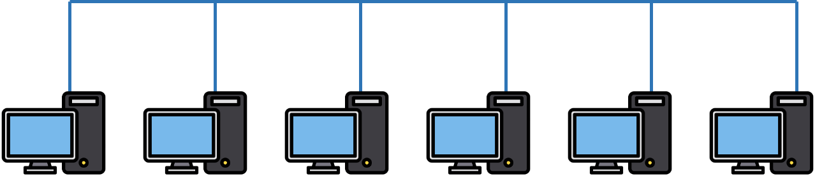
Destination
Does this network require IP address (network layer address) for message exchange?
Source

Slide 5

Destination
Router
Source

Slide 6
Destination
Router
Routers will use routing algorithms to create and maintain forwarding tables.
Source

Slide 7
Destination
forwarding table
<addr1, n.hop1>
<addr2, n.hop2>
<addr3, n.hop3>
Router
Routers will use routing algorithms to create and maintain forwarding tables.
Source

Slide 8
forwarding table
<addr1, n.hop1>
<addr2, n.hop2>
<addr3, n.hop3>
Router
Router requires the address of the network
IP-Addr1
IP-Addr2
IP-Addr3
IP-Addr4
IP-Addr5
IP-Addr6

Slide 9
forwarding table
<addr1, n.hop1>
<addr2, n.hop2>
<addr3, n.hop3>
Router
Rather the address of the interface.
IP-Addr1
IP-Addr2
IP-Addr3
IP-Addr4
IP-Addr5
IP-Addr6

Slide 10
11011111.00000001.00000001.XXXXXXX
Router
223.1.1.7
223.1.1.X
223.1.1.1
223.1.1.2
223.1.1.3
223.1.1.4
223.1.1.5
223.1.1.6

Slide 11
24 leading bits = Network number
11011111.00000001.00000001.XXXXXXX
Router
223.1.1.7
223.1.1.X
223.1.1.1
223.1.1.2
223.1.1.3
223.1.1.4
223.1.1.5
223.1.1.6

Slide 12
forwarding table
<223.1.1.0, Interface_number>
Router
223.1.1.7
223.1.1.X
223.1.1.1
223.1.1.2
223.1.1.3
223.1.1.4
223.1.1.5
223.1.1.6

Slide 13
forwarding table
Dest addr: 223.1.1.3
<223.1.1.0, Interface_number>
Router
223.1.1.7
223.1.1.X
223.1.1.1
223.1.1.2
223.1.1.3
223.1.1.4
223.1.1.5
223.1.1.6

Slide 14
forwarding table
Dest addr: 223.1.1.3
<223.1.1.0, Interface_number>
Router
223.1.1.7
Dest addr: 223.1.1.3
11011111.00000001.00000001.00000011
Bitwise &
Mask: 255.255.255.0
11111111. 11111111. 11111111.00000000
= 11011111.00000001.00000001.00000000
223.1.1.0

Slide 15
The ISP provided the network address space: 223.1.1.X
ISP
Router
223.1.1.1
223.1.1.2
223.1.1.3
223.1.1.4
223.1.1.5
223.1.1.6

Slide 16
The ISP provided the network address space: 223.1.1.X
ISP
223.1.2.X
Router
223.1.3.X
223.1.1.1
223.1.1.2
223.1.1.3
223.1.1.4
223.1.1.5
223.1.1.6

Slide 17
The ISP provided the network address space: 223.1.1.X
Router
Two separate networks are needed. How can we assign addresses to these “sub” networks?

Slide 18
The ISP provided the network address space: 223.1.1.X
Router
223.1.2.X
223.1.1.X

Slide 19
The ISP provided the network address space: 223.1.1.X
Router
Use subnetting
223.1.2.X
223.1.1.X

Slide 20
The ISP provided the network address space: 223.1.1.X
11011111.00000001.00000001.XXXXXXX
Router
Use part of the host bits to identify separate subnets.
223.1.1.X

Slide 21
The ISP provided the network address space: 223.1.1.X
11011111.00000001.00000001.XXXXXXX
Router
Use part of the host bits to identify separate subnets.
11011111.00000001.00000001.0XXXXXX
11011111.00000001.00000001.1XXXXXX
Subnet mask = 11111111. 11111111. 11111111.10000000

Slide 22
Obtaining a Block of Addresses
Internet Corporation for Assigned Names and Numbers (ICANN)
  Allocates large blocks to Regional Internet Registries
Regional Internet Registries (RIRs)
  E.g., ARIN (American Registry for Internet Numbers)
  Allocates to ISPs and large institutions
Internet Service Providers (ISPs)
  Allocate address blocks to their customers
  Who may, in turn, allocate to their customers…

Slide 23
A reverse problem
(Supernettting/CIDR)

Slide 24
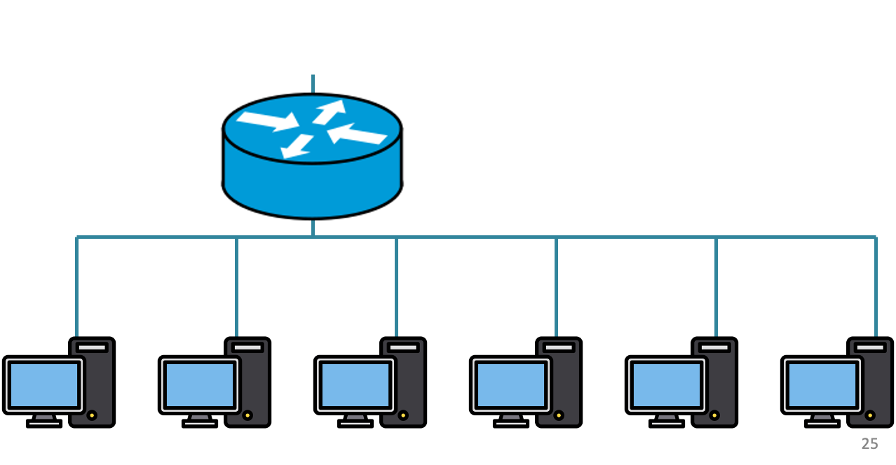
200.20.2.X
200.20.3.X
200.20.1.X

Slide 25
200.20.2.0/24
200.20.3.0/24
200.20.1.0/24

Slide 26
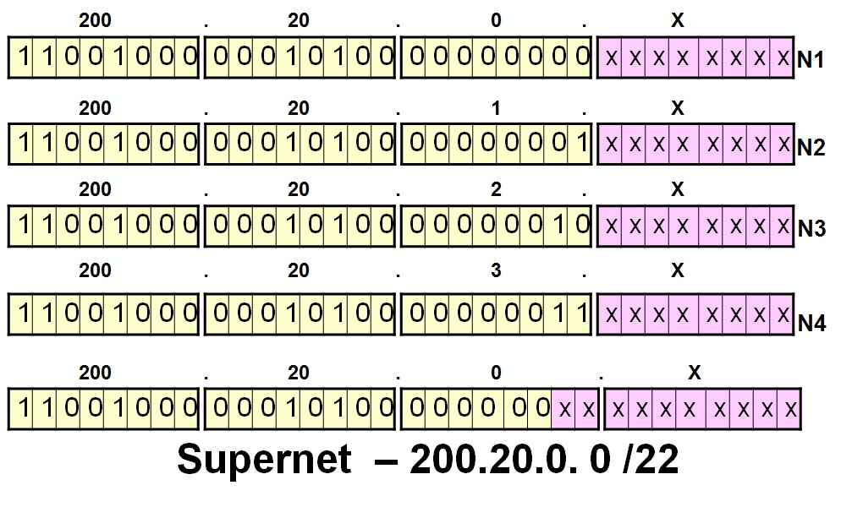
200.20.2.0/24
200.20.3.0/24
200.20.1.0/24

Slide 27
Route aggregation
200.20.2.0/24
200.20.3.0/24
200.20.1.0/24

Slide 28
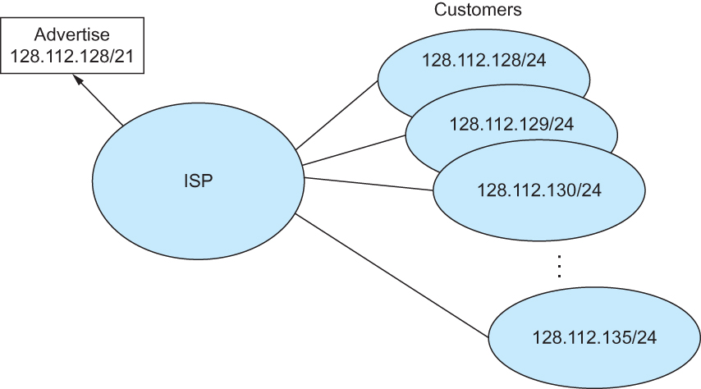
Classless Addressing
Route aggregation with CIDR

Slide 29
IP addressing: CIDR
CIDR: Classless InterDomain Routing
  subnet portion of address of arbitrary length
  address format: a.b.c.d/x, where x is # bits in subnet portion of address
subnet
part
host
part
11001000 00010111 00010000 00000000
200.23.16.0/23
200.23.16.0–200.23.17.255

Slide 30
IP addressing: CIDR
CIDR: Classless InterDomain Routing
  subnet portion of address of arbitrary length
  address format: a.b.c.d/x, where x is # bits in subnet portion of address
forwarding table
4.0.0.0/8
4.83.128.0/17
201.10.0.0/21
201.10.6.0/23
126.255.103.0/24

Slide 31
Classless Inter-Domain Routing (CIDR)
Use two 32-bit numbers to represent a network.
Network number = IP address + Mask
IP Address : 12.4.0.0 IP Mask: 255.254.0.0
Address
00001100
00000100
00000000
00000000
Mask
11111111
11111110
00000000
00000000
Network Prefix
for hosts
Written as 12.4.0.0/15

Slide 32
Hierarchical Address Allocation
Hierarchy is key to scalability
  Address allocated in contiguous chunks (prefixes)
  Today, the Internet has about 400,000 prefixes
12.0.0.0/16
12.1.0.0/16
:
:
:
12.3.0.0/24
12.2.0.0/16
12.3.1.0/24
12.3.0.0/16
:
:
:
:
:
12.0.0.0/8
12.3.254.0/24
12.253.0.0/19
12.253.32.0/19
:
:
12.254.0.0/16
12.253.160.0/19

Slide 33
Separate Forwarding Entry Per Prefix
Prefix-based forwarding
  Map the destination address to matching prefix
  Forward to the outgoing interface
1.2.3.4
1.2.3.7
1.2.3.156
5.6.7.8
5.6.7.9
5.6.7.212
host
host
...
host
host
host
...
host
LAN 1
LAN
router
router
router
WAN
WAN
1.2.3.0/24
5.6.7.0/24
forwarding table

Slide 34
CIDR Makes Packet Forwarding Harder
Forwarding table may have many matches
  E.g., entries for 201.10.0.0/21 and 201.10.6.0/23
  The IP address 201.10.6.17 would match both!
201.10.0.0/21
Provider 1
Provider 2
201.10.0.0/22
201.10.4.0/24
201.10.5.0/24
201.10.6.0/23

Slide 35
Longest Prefix Match Forwarding
Destination-based forwarding
  Packet has a destination address
  Router identifies longest-matching prefix
  Cute algorithmic problem: very fast lookups
forwarding table
4.0.0.0/8
4.83.128.0/17
201.10.0.0/21
201.10.6.0/23
126.255.103.0/24
destination
201.10.6.17
outgoing link
Serial0/0.1

Slide 36
Subnets “toy” example

Slide 37


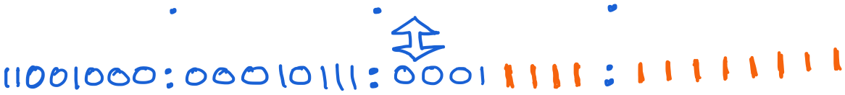
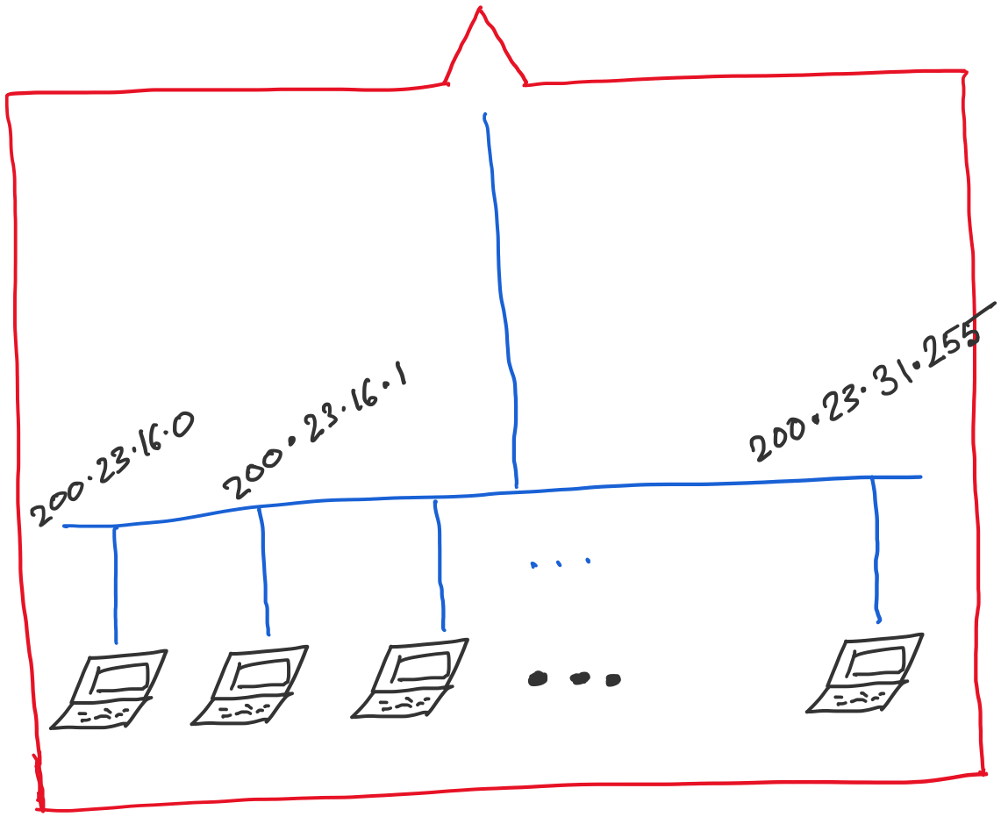
Address space assigned to you:

Slide 38
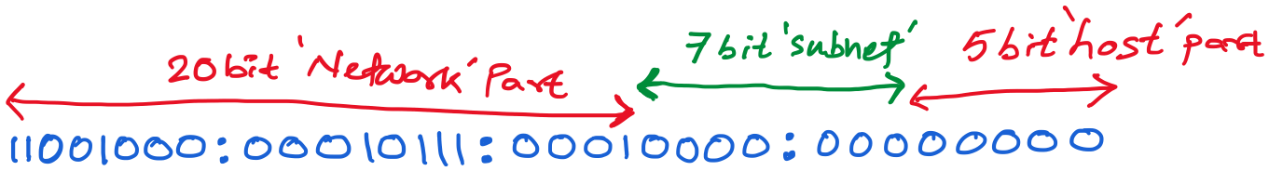
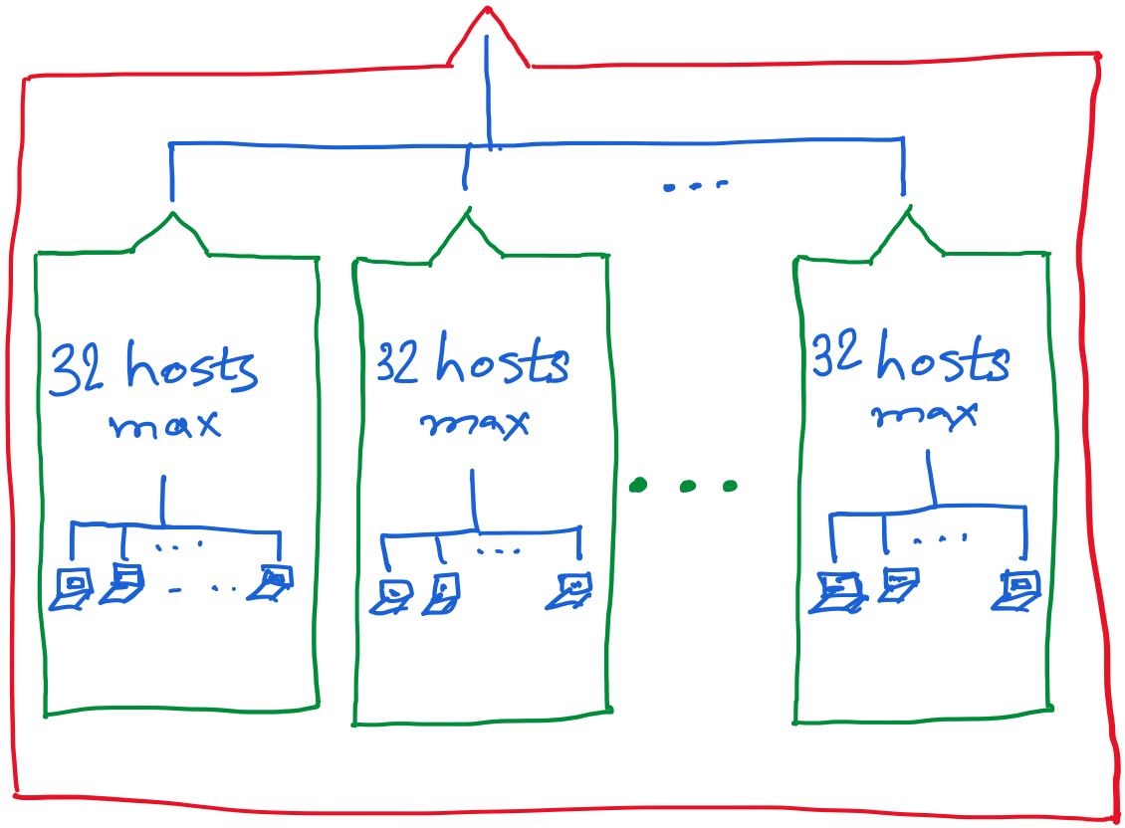

Slide 39
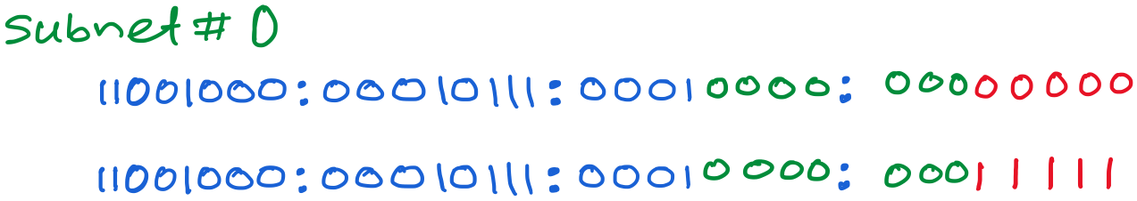
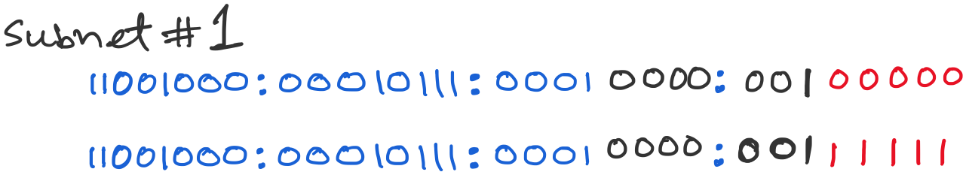
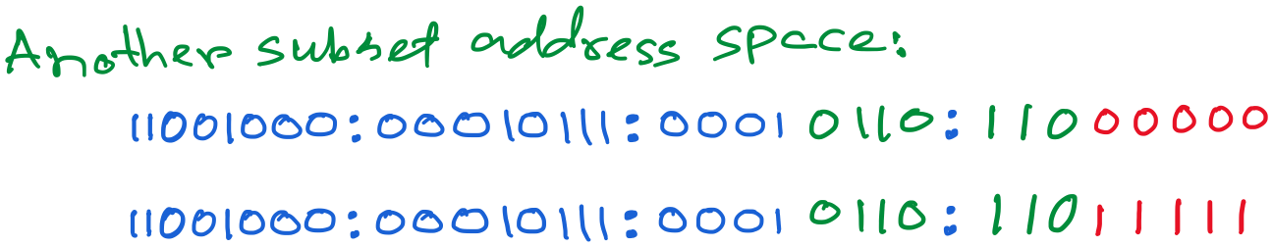

Slide 40
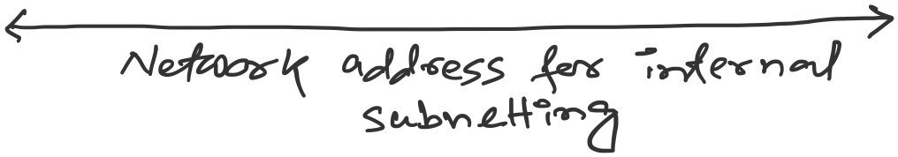

Slide 41
Getting an IP address: DHCP

Slide 42
IP addresses: how to get one?
Q: How does a host get IP address?
hard-coded by system admin in a file
  Windows: control-panel->network->configuration->tcp/ip->properties
  UNIX: /etc/…
DHCP: Dynamic Host Configuration Protocol: dynamically get address from a server
  “plug-and-play”

Slide 43
DHCP: Dynamic Host Configuration Protocol
goal: allow host to dynamically obtain its IP address from network server when it joins network
  can renew its lease on address in use
  allows reuse of addresses (only hold address while connected/“on”)
  support for mobile users who want to join network

Slide 44
DHCP: Dynamic Host Configuration Protocol
DHCP overview:
  host broadcasts “DHCP discover” msg
  DHCP server responds with “DHCP offer” msg
  host requests IP address: “DHCP request” msg
  DHCP server sends address: “DHCP ack” msg

Slide 45



DHCP client-server scenario
DHCP
server
223.1.1.0/24
223.1.1.1
223.1.2.1
223.1.1.2
arriving DHCP
client needs
address in this
network
223.1.1.4
223.1.2.9
223.1.3.27
223.1.2.2
223.1.1.3
223.1.2.0/24
223.1.3.1
223.1.3.2
223.1.3.0/24

Slide 46
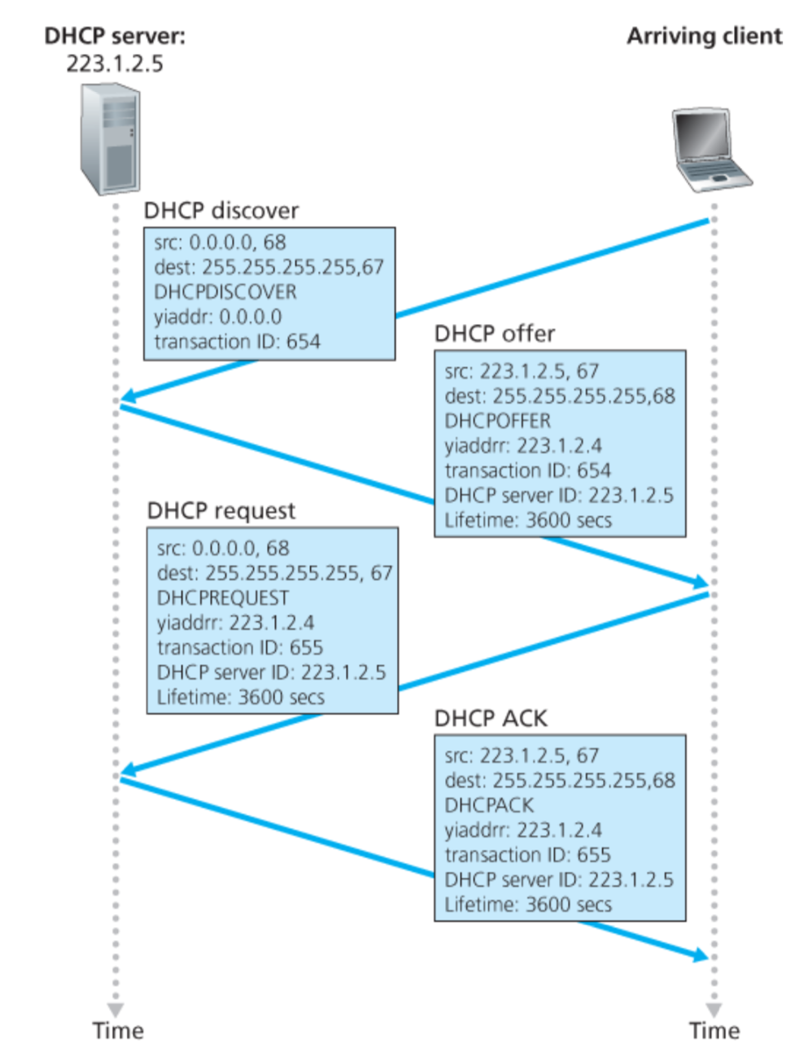
Broadcast: is there a DHCP server out there?
Broadcast: I’m a DHCP server! Here’s an IP address you can use
Broadcast: OK. I’ll take that IP address!
Broadcast: OK. You’ve got that IP address!

Slide 47
DHCP: more than IP addresses
DHCP can return more than just allocated IP address on subnet:
  address of first-hop router for client
  name and IP address of DNS sever
  network mask (indicating network versus host portion of address)

Slide 48
Dynamic Host Configuration Protocol (DHCP)
DHCP server is responsible for providing configuration information to hosts
DHCP server maintains a pool of available addresses
There is at least one DHCP server for an administrative domain (a server or a relay agent per subnet)

Slide 49
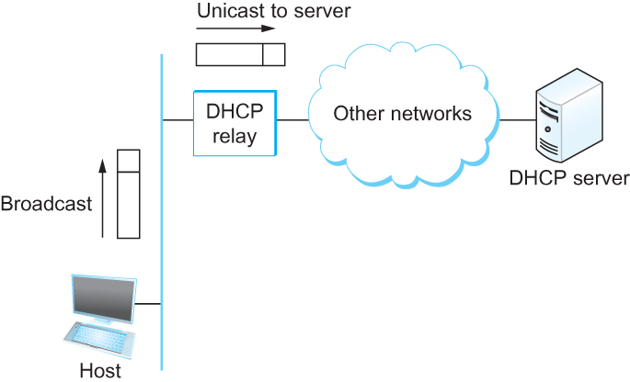
DHCP
Newly booted or attached host sends DHCPDISCOVER message to a special IP address (255.255.255.255)
DHCP relay agent unicasts the message to DHCP server and waits for the response

Slide 50
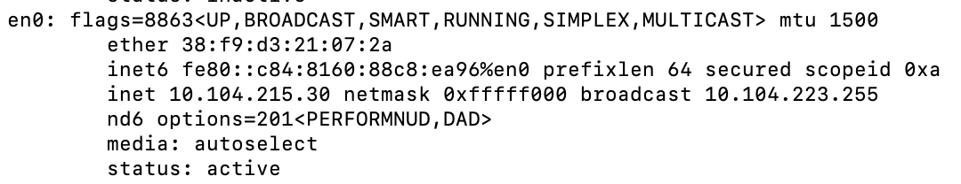
Check our IP addresses
(ifconfig/ipconfig)

Slide 51
Private Address Space

Slide 52
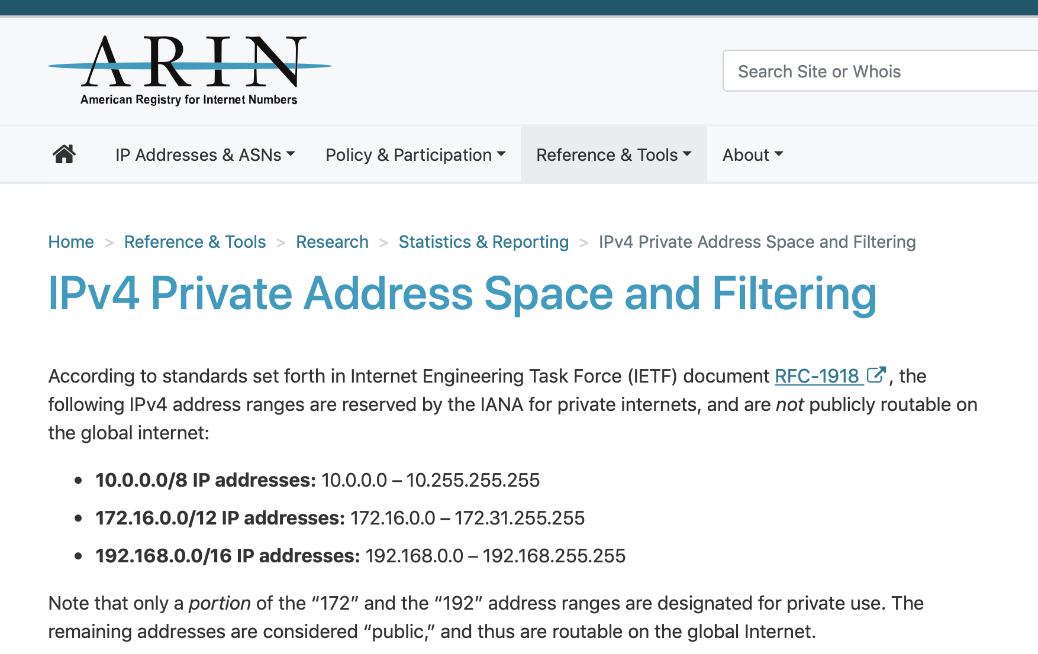

Slide 53
NAT: network address translation
rest of
Internet
local network
(e.g., home network)
10.0.0/24
10.0.0.1
10.0.0.4
10.0.0.2
138.76.29.7
10.0.0.3
all datagrams leaving local
network have same single source NAT IP address: 138.76.29.7,different source port numbers
datagrams with source or
destination in this network
have 10.0.0/24 address for
source, destination (as usual)

Slide 54
NAT: network address translation
NAT translation table
WAN side addr LAN side addr
2: NAT router
changes datagram
source addr from
10.0.0.1, 3345 to
138.76.29.7, 5001,
updates table
1: host 10.0.0.1
sends datagram to
128.119.40.186, 80
138.76.29.7, 5001 10.0.0.1, 3345
…… ……
S: 10.0.0.1, 3345
D: 128.119.40.186, 80
10.0.0.1
1
2
S: 138.76.29.7, 5001
D: 128.119.40.186, 80
10.0.0.4
10.0.0.2
138.76.29.7
S: 128.119.40.186, 80
D: 10.0.0.1, 3345
4
S: 128.119.40.186, 80
D: 138.76.29.7, 5001
3
10.0.0.3
4: NAT router
changes datagram
dest addr from
138.76.29.7, 5001 to 10.0.0.1, 3345
3: reply arrives
dest. address:
138.76.29.7, 5001

Slide 55
NAT: network address translation
motivation: local network uses just one IP address as far as outside world is concerned:
  range of addresses not needed from ISP: just one IP address for all devices
  can change addresses of devices in local network without notifying outside world
  can change ISP without changing addresses of devices in local network
  devices inside local net not explicitly addressable, visible by outside world (a security plus)

Slide 56
NAT: network address translation
implementation: NAT router must:
  outgoing datagrams: replace (source IP address, port #) of every outgoing datagram to (NAT IP address, new port #)
    . . . remote clients/servers will respond using (NAT IP address, new port #) as destination addr
  remember (in NAT translation table) every (source IP address, port #) to (NAT IP address, new port #) translation pair
  incoming datagrams: replace (NAT IP address, new port #) in dest fields of every incoming datagram with corresponding (source IP address, port #) stored in NAT table

Slide 57
NAT: network address translation
16-bit port-number field:
  60,000 simultaneous connections with a single LAN-side address!
NAT challenges:
  violates end-to-end argument
    NAT possibility must be taken into account by app designers, e.g., P2P applications
  NAT traversal: what if client wants to connect to server behind NAT?

