Slide 1
CSMC 818G
Information-Centric Design of
Context-Aware Systems
Prof. Ashok K Agrawala
© 2022 Ashok Agrawala

Slide 2
Class
Tuesdays and Thursdays
  11:00 to 12:15
Location
  CSIC 2107
  Zoom – umd.zoom.us/my/agrawala
University Requirements
  Participate in person unless there are medical reasons
Exams- Midterm and Final – required for it to be a part of PhD course requirements.

Slide 3
Participants
CMSC 818G
  16 registered
Cui, Shaobo
Das, Ritwika
Harrity, Michael D
Hurley, Kyle James
Ingold, William George Lawrence
Liu, Geng
Luo, Alan Fei
Madan, Sanna
Neskovic, Marko
Shahid, Irtaza
Shon, Yoon Kyung
Song, Hyemi
Tan, Jason
Varma, Kamala
Yerramreddy, Sai Srinivasa Rao
Zamiri Zeraati, Farnaz

Slide 4
Workload
Class Presentation and Write-up
  Will assign a topic for each class and each student must pick a topic, present, and prepare a 4–5-page summary write up to be distributed to the class before presentation
Class participation and discussions
Project
Midterm
Final

Slide 5
Methodology
Lectures
  Focused presentation on a topic
    Slides posted on the web
    Write up to be distributed before presentation.
      Annotate by adding your notes to catch the major points that may come up in discussions after the presentation.

Slide 6
Grading
Based on
  Class participation
  Weekly activities
  Papers/Presentations/ Projects
  Exams

Slide 7
Interactions
In Class
Through “Piazza”
Papers
Web postings
Individualized
…

Slide 8
Class Presentations
Signup – Available shortly
Augment the reading list by adding 2-5 recent papers
Make slides available for posting on the web
A write up on the topic
  Presenter
  Others

Slide 9
When reading a paper
  Standard paper questions:
    What is the claim of the paper?
    What is the key idea of the paper?
    What are the strengths and weaknesses of the paper?
  Information-Centric questions:
    What is the purpose of the ‘information’ they are capturing?
    What ‘information’ are they capturing?
    How are they capturing the ‘information’?
    How are they storing the ‘information’?
    What ‘contextual information’ are they capturing?
    Is the ‘information’ being captured sufficient or useful for the purpose?
    What additional ‘information’ could or should be captured?

Slide 10
Project
Build a Context-aware Personal Assistant
  Group project

Slide 11
What is this Course About
Improving the quality of life using information technology

Slide 12
Topics to be Covered
Information Dynamics
Context and Context Aware Computing
Location –Determination and Use
Activity Recognition
Context Modeling and Reasoning
Learning from Context
Context-Aware Systems and Middleware
Proactive Computing
Other issues – Security, Privacy,…

Slide 13
Quality of Life
What does it mean to you?

Slide 14
Perspective
Individual
  Family
  Social Groups
  Friends Circle
  …
Organization
  International - UN
  Corporation
  Government
  Non-profit

Slide 15
Some Basic Notions
Information
  Fundamental Nature
  Implications
Interrelationships
Context
Models
Limitations of Physical representations of information

Slide 16
Technological aspects
Processing
Storage
Human Interaction
Communications
Inputs
  Sensors
Outputs
  Actuations
  Commands
  Messages

Slide 17
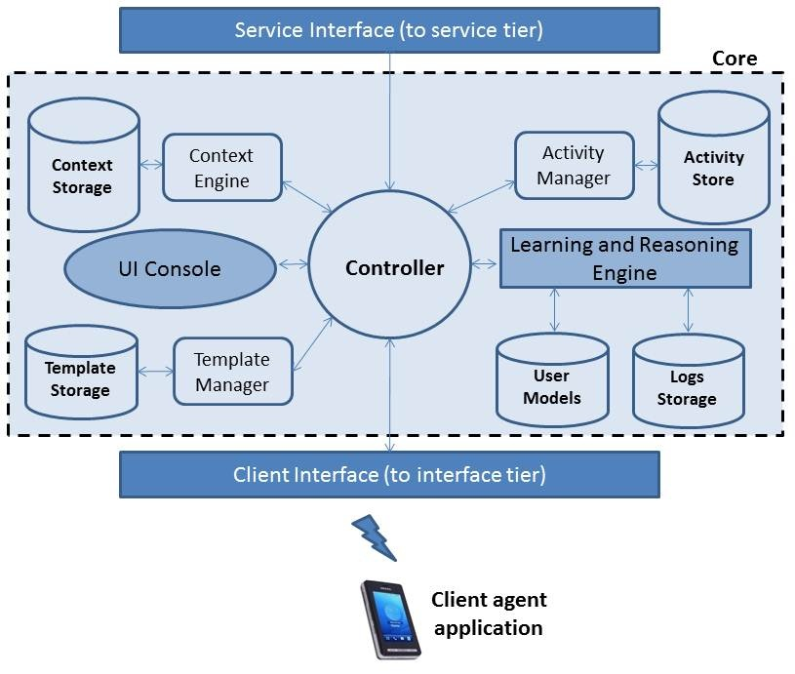
Rover

