Slide 1
CSMC 412
Operating Systems
Prof. Ashok K Agrawala
Memory Management

Slide 2
Memory Management
Background
Swapping
Contiguous Memory Allocation
Segmentation
Paging
Structure of the Page Table

Slide 3
CPU and Memory
Basic architecture of a computer system requires the CPU and the main memory
All programs and data accessed by the CPU during the execution of instructions is either in the registers or in the main memory
For the discussion here we are going to ignore the presence of Cache Memory which many CPUs have today and whose presence is managed by the hardware transparently
For executing an instruction
Instruction has to be fetched from the memory
Operand(s) have to be fetched from the memory – if so required
Results may have to be stored in memory – if so required
CPU may make multiple memory accesses for each instruction

Slide 4
Background
Program must be brought (from disk) into memory and placed within a process for it to be run
Main memory and registers are only storage CPU can access directly
Memory unit only sees a stream of addresses + read requests, or address + data and write requests
Register access in one CPU clock (or less)
Main memory can take many cycles, causing a stall
Cache sits between main memory and CPU registers
Protection of memory required to ensure correct operation

Slide 5
View of the memory
An array of cells
Each cell can store several bits (cell width)
8- Byte
16 – Half Word
32 – Word
..
Cells are organized as a linear array with each cell having a unique address
A memory cell is accessed by the CPU by presenting the address of the cell to the memory controller

Slide 6


Address Space
Address Space
$$2^{n}−1$$
The address of a cell consists of say n bits. This gives 2^{n} unique addresses, from 0 to (2^{n} -1)
We can view this address space in any logical organization we desire, treating any number of contiguous cells as a block.
When the number of such cells in a block is a power of 2 then the address can be decomposed easily into the group number and the cell within the group
n bit address
n-1
k
0
$$2^{k}−1$$
0

Slide 7
Mapping of Address Spaces
We can map any address space, “A” into any other address space “B” as long as we can get a unique address for one given address for the other.
Map one address to the other
Address spaces do not have to be of the same size. (Size defined by the number of bits required to specify a unique address.
Usually, the cell sizes are same but if they are not, a mapping there is required also.
One organized with cell size of one byte while the other with cell size of a word – 4 bytes
How to map???

Slide 8
Mapping of address spaces
A | B
How to map ( Going from “A” to “B”)
Lookup table
Organized by cells
Each address in A has an entry for the address in B
Use A as an index in the array which has the corresponding address B
n bit address
B
B
Block Number
Displacement
A
n-1
k
0
Block Number
Displacement
m-1
k
0
m bit address

Slide 9
Desirable Features
Very large address space
Ability to execute partially loaded programs
Dynamic Relocatability
Sharing
Protection
Achieving these features require a variety of hardware and software support

Slide 10
Binding and Multiple Mappings
Address Space B
Binding
Associating an address to a location in an address space
Mapping
Translating one address to another address
Each address is defined in an address space
Mapping one address space to another address space
Mapping is never done on Byte by Byte
A contagious portion is mapped on to a contagious portion
Address Space A

Slide 11
Address Binding
Programs on disk, ready to be brought into memory to execute form an input queue
Without support, must be loaded into address 0000
Inconvenient to have first user process physical address always at 0000
How can it not be?
Further, addresses represented in different ways at different stages of a program’s life
Source code addresses usually symbolic
Compiled code addresses bind to relocatable addresses
i.e. “14 bytes from beginning of this module”
Linker or loader will bind relocatable addresses to absolute addresses
i.e. 74014
Each binding maps one address space to another

Slide 12
Binding of Instructions and Data to Memory
Address binding of instructions and data to memory addresses can happen at three different stages
Compile time: If memory location known a priori, absolute code can be generated; must recompile code if starting location changes
Load time: Must generate relocatable code if memory location is not known at compile time
Execution time: Binding delayed until run time if the process can be moved during its execution from one memory segment to another
Need hardware support for address maps (e.g., base and limit registers)

Slide 13
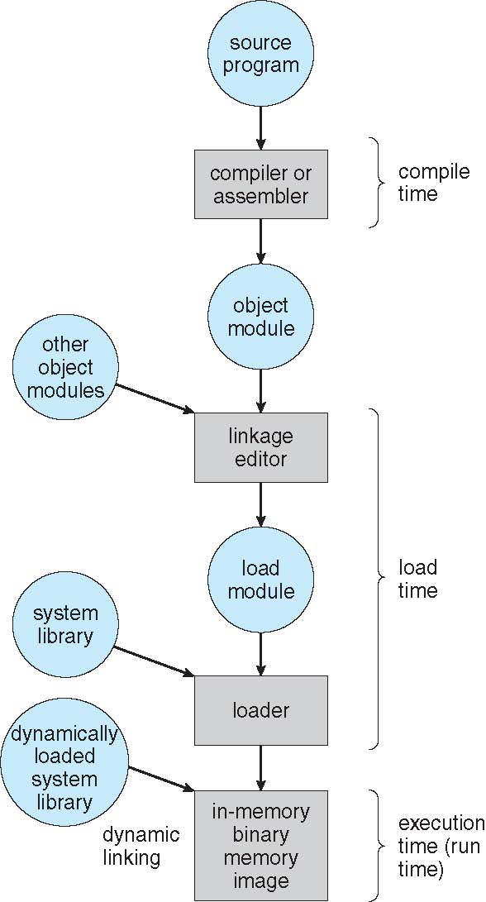
Multistep Processing of a User Program

Slide 14
Dynamic Linking
Static linking – system libraries and program code combined by the loader into the binary program image
Dynamic linking –linking postponed until execution time
Small piece of code, stub, used to locate the appropriate memory-resident library routine
Stub replaces itself with the address of the routine, and executes the routine
Operating system checks if routine is in processes’ memory address space
If not in address space, add to address space
Dynamic linking is particularly useful for libraries
System also known as shared libraries

Slide 15
Dynamic Loading
Routine is not loaded until it is called
Better memory-space utilization; unused routine is never loaded
Useful when large amounts of code are needed to handle infrequently occurring cases
No special support from the operating system is required implemented through program design

Slide 16
Overlays
Keep in memory only those instructions and data that are needed at any given time
Needed when process is larger than amount of memory allocated to it
Implemented by user, no special support needed from operating system, programming design of overlay structure is complex

Slide 17
Logical vs. Physical Address Space
The concept of a logical address space that is bound to a separate physical address space is central to proper memory management
Logical address – generated by the CPU; also referred to as virtual address
Physical address – address seen by the memory unit
Logical and physical addresses are the same in compile-time and load-time address-binding schemes; logical (virtual) and physical addresses differ in execution-time address-binding scheme
Logical address space is the set of all logical addresses that can be generated by a program
Physical address space is the set of all physical addresses that can be generated by a program

Slide 18
Memory-Management Unit (MMU)
Hardware device that at run time maps virtual to physical address
Many methods possible
To start, consider simple scheme where the value in the relocation register is added to every address generated by a user process at the time it is sent to memory
Base register now called relocation register
MS-DOS on Intel 80x86 used 4 relocation registers
The user program deals with logical addresses; it never sees the real physical addresses
Execution-time binding occurs when reference is made to location in memory
Logical address bound to physical addresses

Slide 19
Swapping
A process can be swapped temporarily out of memory to a backing store, and then brought back into memory for continued execution
Total physical memory space of processes can exceed physical memory
Backing store – fast disk large enough to accommodate copies of all memory images for all users; must provide direct access to these memory images
Roll out, roll in – swapping variant used for priority-based scheduling algorithms; lower-priority process is swapped out so higher-priority process can be loaded and executed
Major part of swap time is transfer time; total transfer time is directly proportional to the amount of memory swapped
System maintains a ready queue of ready-to-run processes which have memory images on disk

Slide 20
Swapping (Cont.)
Does the swapped out process need to swap back in to same physical addresses?
Depends on address binding method
Plus consider pending I/O to / from process memory space
Modified versions of swapping are found on many systems (i.e., UNIX, Linux, and Windows)
Swapping normally disabled
Started if more than threshold amount of memory allocated
Disabled again once memory demand reduced below threshold

Slide 21
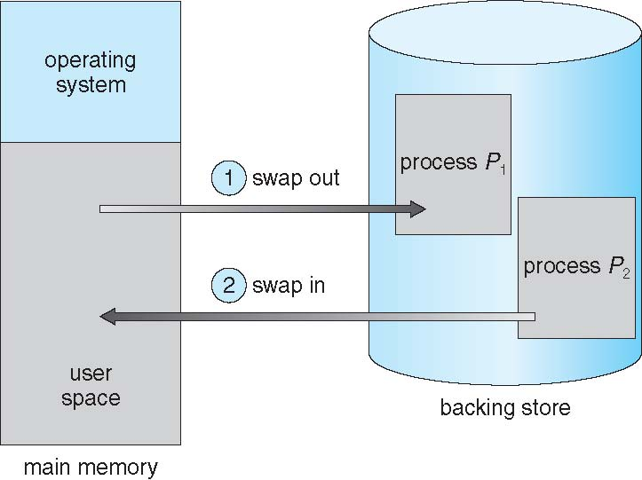
Schematic View of Swapping

Slide 22
Context Switch Time including Swapping
If next processes to be run on the CPU is not in memory, need to swap out a process and swap in target process
Context switch time can then be very high
100MB process swapping to hard disk with transfer rate of 50MB/sec
Swap out time of 2000 ms
Plus swap in of same sized process
Total context switch swapping component time of 4000ms (4 seconds)
Can reduce if reduce size of memory swapped – by knowing how much memory really being used
System calls to inform OS of memory use via request_memory() and release_memory()

Slide 23
Context Switch Time and Swapping (Cont.)
Other constraints as well on swapping
Pending I/O – can’t swap out as I/O would occur to wrong process
Or always transfer I/O to kernel space, then to I/O device
Known as double buffering, adds overhead
Standard swapping not used in modern operating systems
But modified version common
Swap only when free memory extremely low

Slide 24
Contiguous Allocation
Main memory must support both OS and user processes
Limited resource, must allocate efficiently
Contiguous allocation is one early method
Main memory usually into two partitions:
Resident operating system, usually held in low memory with interrupt vector
User processes then held in high memory
Each process contained in single contiguous section of memory

Slide 25
Contiguous Allocation (Cont.)
Relocation registers used to protect user processes from each other, and from changing operating-system code and data
Base register contains value of smallest physical address
Limit register contains range of logical addresses – each logical address must be less than the limit register
MMU maps logical address dynamically
Can then allow actions such as kernel code being transient and kernel changing size

Slide 26
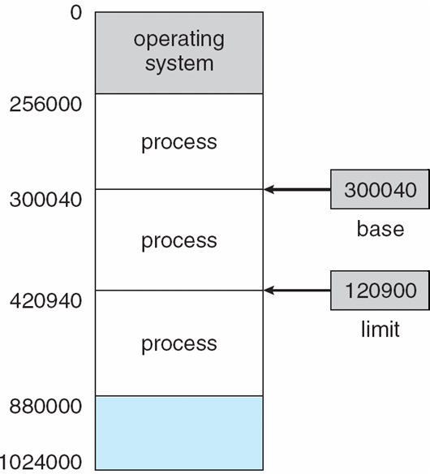
Base and Limit Registers
A pair of base and limit registers define the logical address space
CPU must check every memory access generated in user mode to be sure it is between base and limit for that user

Slide 27
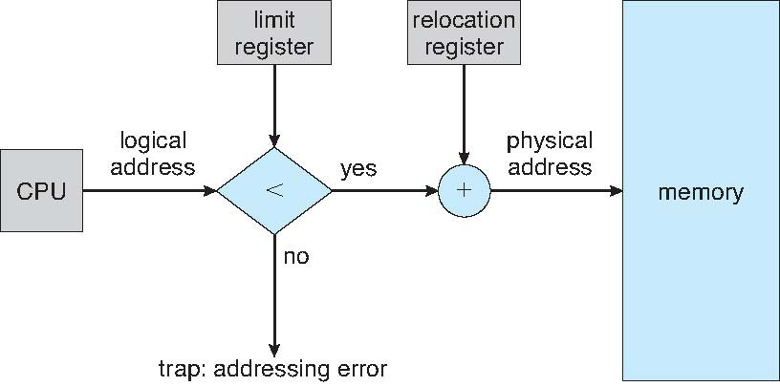
Hardware Support for Relocation and Limit Registers

Slide 28
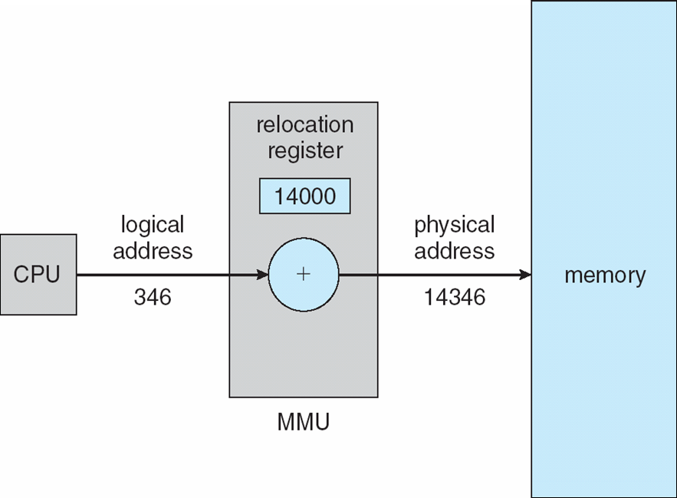
Dynamic relocation using a relocation register
Routine is not loaded until it is called
Better memory-space utilization; unused routine is never loaded
All routines kept on disk in relocatable load format
Useful when large amounts of code are needed to handle infrequently occurring cases
No special support from the operating system is required
Implemented through program design
OS can help by providing libraries to implement dynamic loading

Slide 29
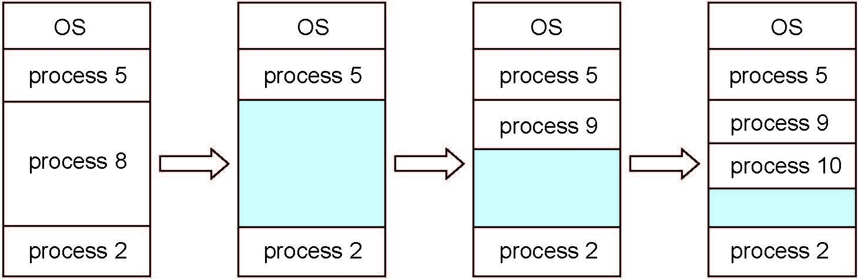
Multiple-partition allocation
Degree of multiprogramming limited by number of partitions
Variable-partition sizes for efficiency (sized to a given process’ needs)
Hole – block of available memory; holes of various size are scattered throughout memory
When a process arrives, it is allocated memory from a hole large enough to accommodate it
Process exiting frees its partition, adjacent free partitions combined
Operating system maintains information about: a) allocated partitions b) free partitions (hole)

Slide 30
Dynamic Storage-Allocation Problem
How to satisfy a request of size n from a list of free holes?
First-fit: Allocate the first hole that is big enough
Best-fit: Allocate the smallest hole that is big enough; must search entire list, unless ordered by size
Produces the smallest leftover hole
Worst-fit: Allocate the largest hole; must also search entire list
Produces the largest leftover hole
First-fit and best-fit better than worst-fit in terms of speed and storage utilization

Slide 31
Fragmentation
External Fragmentation – total memory space exists to satisfy a request, but it is not contiguous
Internal Fragmentation – allocated memory may be slightly larger than requested memory; this size difference is memory internal to a partition, but not being used
First fit analysis reveals that given N blocks allocated, 0.5 N blocks lost to fragmentation
1/3 may be unusable -> 50-percent rule

Slide 32
Fragmentation (Cont.)
Reduce external fragmentation by compaction
Shuffle memory contents to place all free memory together in one large block
Compaction is possible only if relocation is dynamic, and is done at execution time
I/O problem
Latch job in memory while it is involved in I/O
Do I/O only into OS buffers
Now consider that backing store has same fragmentation problems

Slide 33
Memory Management Schemes from I
The logical address space of a process must be resident in the physical memory when this process is executing
Desirable Features:
Very large address space
Ability to execute partially loaded programs
Dynamic Relocatability
Sharing
Protection

Slide 34
Programmers View
0
Each Module starts with address 0
When linking/loading start from 0 again but only one module can be at location 0. Others have to be relocated.
What if each module was treated independently.
A
B
C
D
0
A
B
C
D

Slide 35
Logical Address Space
Single linear address space
Address is (d) where d is a number between 0 and 2^{k} – 1, when address uses k bits.
Segmented
Logical address space consists of a collection of segments where each segment is an independent linear address space
Address now consists of (s,d) where s is the segment identifier and d an address in the linear address space of the segment
0
A
B
C
D
0
A
B
C
D

Slide 36
Segmentation
Memory-management scheme that supports user view of memory
A program is a collection of segments
A segment is a logical unit such as:
main program
procedure
function
method
object
local variables, global variables
common block
stack
symbol table
arrays

Slide 37
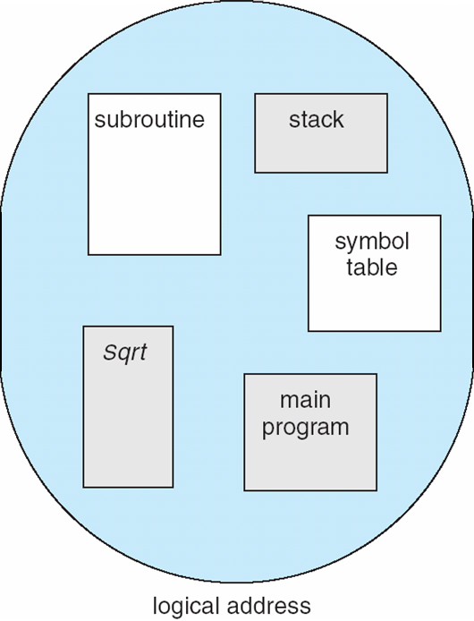
User’s View of a Program

Slide 38
Logical View of Segmentation
1
1
4
2
3
4
2
3
user space
physical memory space

Slide 39
Segmentation Architecture
Logical address consists of a two tuple:
<segment-number, offset>,
Segment table – maps two-dimensional physical addresses; each table entry has:
base – contains the starting physical address where the segments reside in memory
limit – specifies the length of the segment
Segment-table base register (STBR) points to the segment table’s location in memory
Segment-table length register (STLR) indicates number of segments used by a program;
segment number s is legal if s < STLR

Slide 40
Segmentation Architecture (Cont.)
Protection
With each entry in segment table associate:
validation bit = 0 ⇒ illegal segment
read/write/execute privileges
Protection bits associated with segments; code sharing occurs at segment level
Since segments vary in length, memory allocation is a dynamic storage-allocation problem
A segmentation example is shown in the following diagram

Slide 41
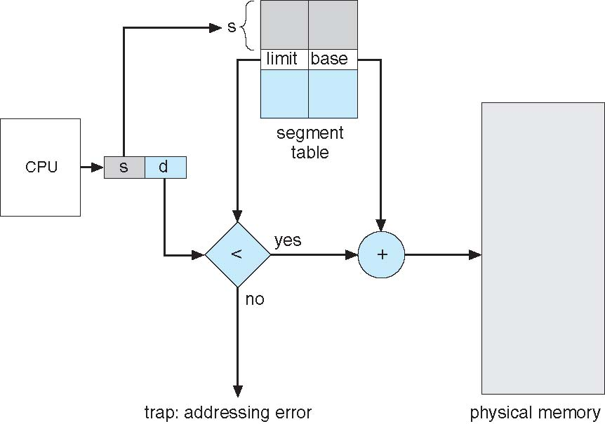
Segmentation Hardware

Slide 42
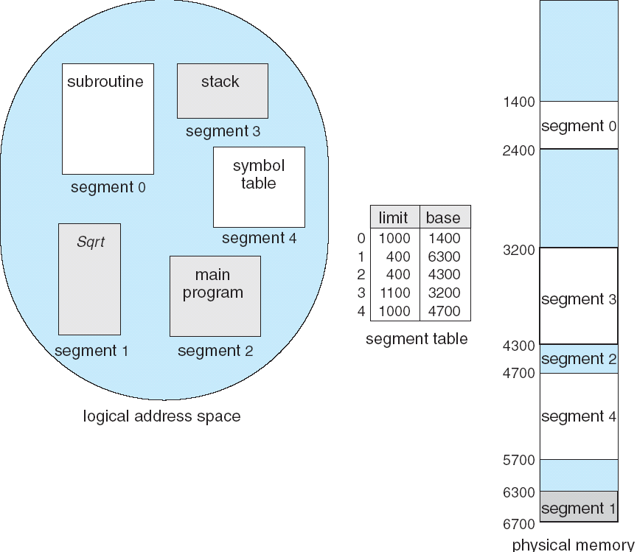
Example of Segmentation

Slide 43
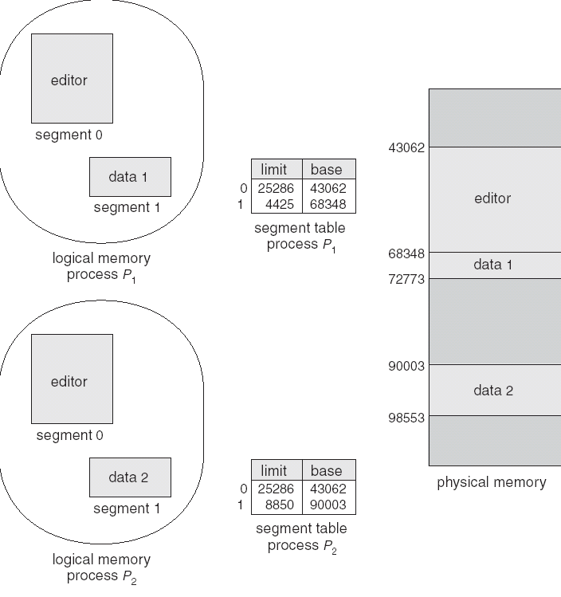
Sharing of Segments

Slide 44
Paging
Used to map a linear, contiguous Logical Address Space on to (linear) Physical Address Space
View physical memory consisting of fixed-sized blocks called frames
Size is power of 2, between 512 bytes and 16 Mbytes
View logical memory consisting of blocks of same size called pages
To run a program of size N pages, need to find N free frames and load program
Set up a page table to translate logical to physical addresses

Slide 45
Address Space
Address Space
$$2^{n}−1$$
The address of a cell consists of say n bits. This gives 2^{n} unique addresses, from 0 to (2^{n} -1)
We can view this address space in any logical organization we desire, treating any number of contiguous cells as a block.
When the number of such cells in a block is a power of 2 then the address can be decomposed easily into the group number and the cell within the group
n bit address
n-1
k
0
$$2^{k}−1$$
0

Slide 46
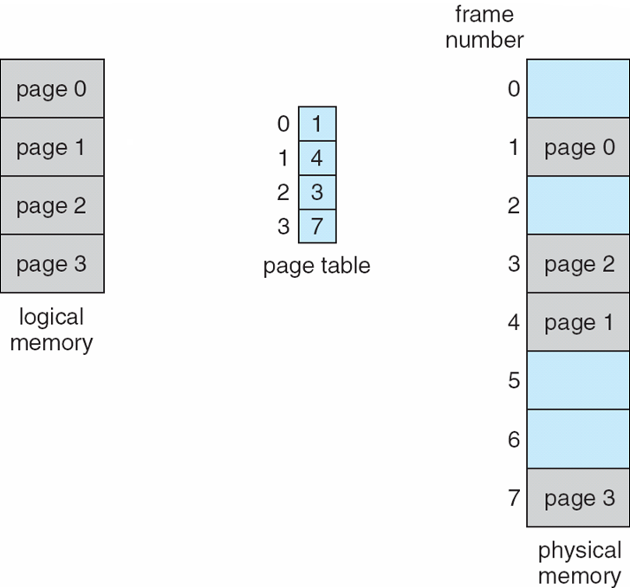
Paging Model of Logical and Physical Memory

Slide 47
Address Translation Scheme
Address generated by CPU is divided into:
Page number (p) – used as an index into a page table which contains base address of each page in physical memory
Page offset (d) – combined with base address to define the physical memory address that is sent to the memory unit
For given logical address space 2^{m} and page size 2^{n}

Slide 48
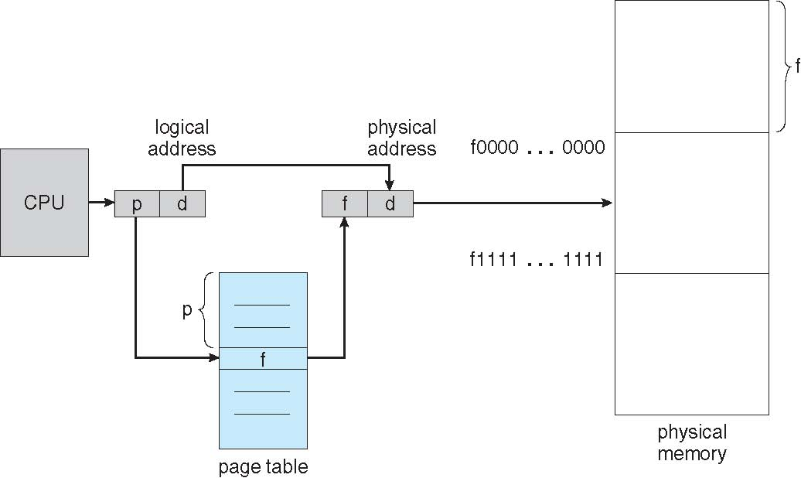
Paging Hardware

Slide 49
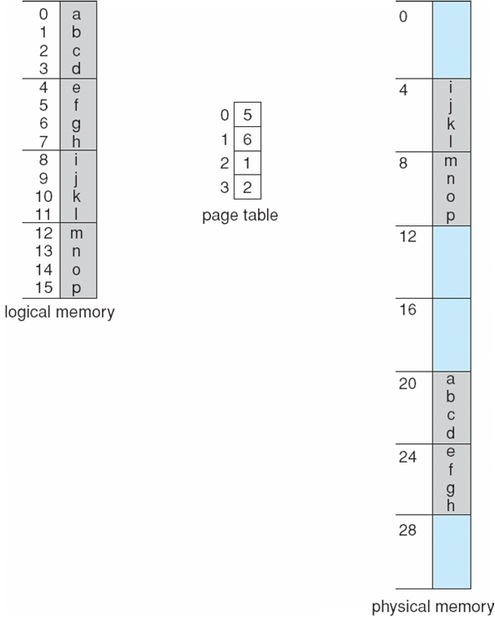
Paging Example
n=2 and m=4 32-byte memory and 4-byte pages

Slide 50
Paging (Cont.)
Calculating internal fragmentation
Page size = 2,048 bytes
Process size = 72,766 bytes
35 pages + 1,086 bytes
Internal fragmentation of 2,048 - 1,086 = 962 bytes
Worst case fragmentation = 1 frame – 1 byte
On average fragmentation = 1 / 2 frame size
So small frame sizes desirable?
But each page table entry takes memory to track
Page sizes growing over time
Solaris supports two page sizes – 8 KB and 4 MB
Process view and physical memory now very different
By implementation process can only access its own memory

Slide 51
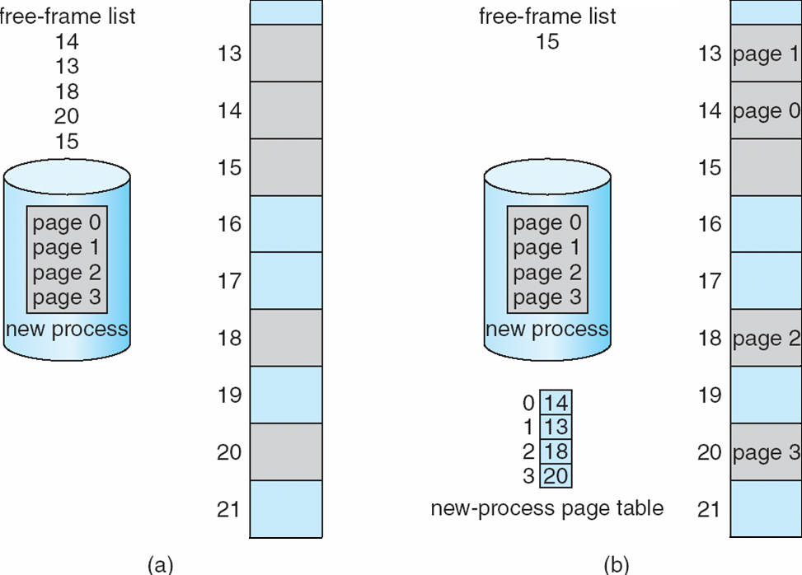
Free Frames
Before allocation
After allocation

Slide 52
Implementation of Page Table
Page table is kept in main memory
Page-table base register (PTBR) points to the page table
Page-table length register (PTLR) indicates size of the page table
In this scheme every data/instruction access requires two memory accesses
One for the page table and one for the data / instruction
The two memory access problem can be helped some by the use of a special fast-lookup hardware cache called associative memory or translation look-aside buffers (TLBs)

Slide 53
Translation Lookaside Buffer
Keep a list of translations
Provide means for fast look up
Page #
Frame #
Page #
Frame #
Page #
Frame #
Page #
Frame #
Page #
Frame #
Page #
Frame #
Page #
Frame #
Page #
Frame #
Page #
Frame #

Slide 54
Implementation of Page Table (Cont.)
Some TLBs store address-space identifiers (ASIDs) in each TLB entry – uniquely identifies each process to provide address-space protection for that process
Otherwise need to flush at every context switch
TLBs typically small (64 to 1,024 entries)
On a TLB miss, value is loaded into the TLB for faster access next time
Replacement policies must be considered
Some entries can be wired down for permanent fast access

Slide 55
Associative Memory
Associative memory – parallel search
Address translation (p, d)
If p is in associative register, get frame # out
Otherwise get frame # from page table in memory

Slide 56
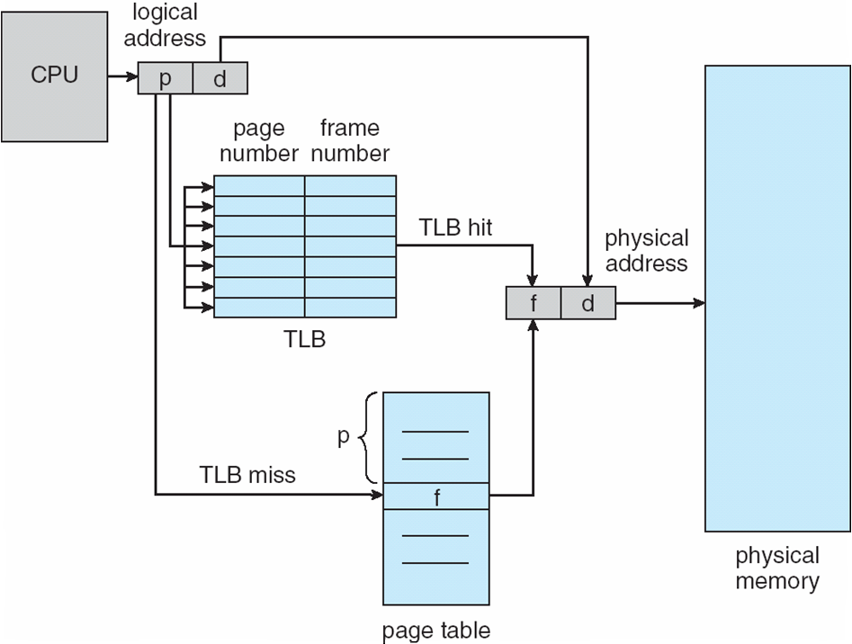
Paging Hardware With TLB

Slide 57
Effective Access Time
Associative Lookup = ε time unit
Can be < 10% of memory access time
Hit ratio = α
Hit ratio – percentage of times that a page number is found in the associative registers; ratio related to number of associative registers
Consider α = 80%, ε = 20ns for TLB search, 100ns for memory access
The time for accessing TLB is often ignored as it is overlapped with memory access.
Effective Access Time (EAT)
Consider α = 80%, ε = 20ns for TLB search, 100ns for memory access
EAT = 0.80 x 100 + 0.20 x 200 = 120ns
Consider more realistic hit ratio -> α = 99%, ε = 20ns for TLB search, 100ns for memory access
EAT = 0.99 x 100 + 0.01 x 200 = 101ns

Slide 58
Memory Protection
Memory protection implemented by associating protection bit with each frame to indicate if read-only or read-write access is allowed
Can also add more bits to indicate page execute-only, and so on
Valid-invalid bit attached to each entry in the page table:
“valid” indicates that the associated page is in the process’ logical address space, and is thus a legal page
“invalid” indicates that the page is not in the process’ logical address space
Or use page-table length register (PTLR)
Any violations result in a trap to the kernel

Slide 59
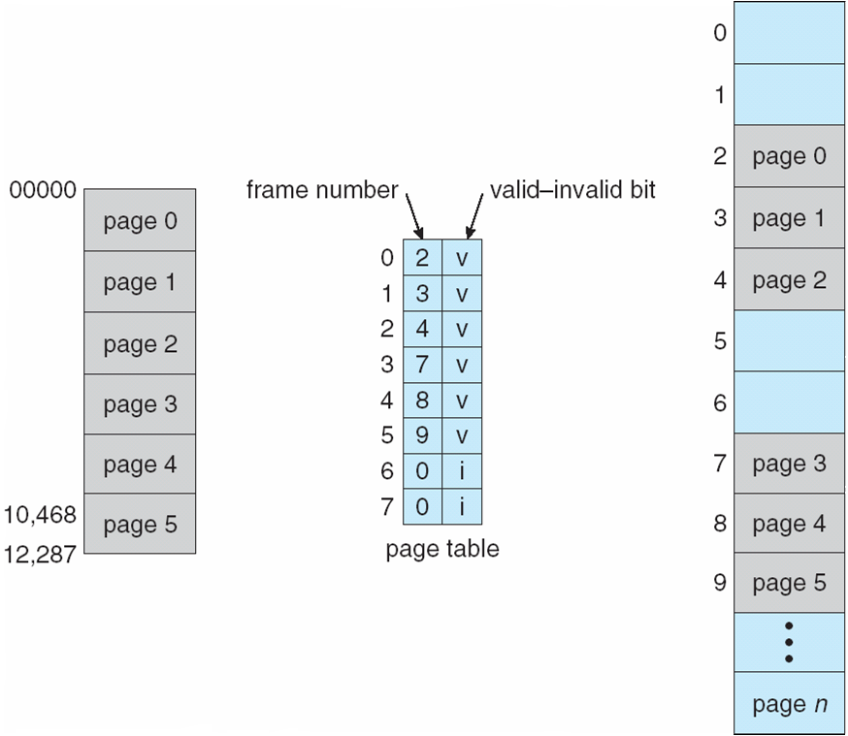
Valid (v) or Invalid (i) Bit In A Page Table

Slide 60
Memory Management Schemes
Segmentation
Paging
Address Translation Mechanisms
Desirable Features:
Very large address space
Ability to execute partially loaded programs
Dynamic Relocatability
Sharing
Protection

Slide 61
Shared Pages
Shared code
One copy of read-only (reentrant) code shared among processes (i.e., text editors, compilers, window systems)
Similar to multiple threads sharing the same process space
Also useful for interprocess communication if sharing of read-write pages is allowed
Private code and data
Each process keeps a separate copy of the code and data
The pages for the private code and data can appear anywhere in the logical address space

Slide 62
Shared Code
0
Editor
2000
0
4000
1000
5000
5100
7000
1100
5100
5100
1100
2000

Slide 63
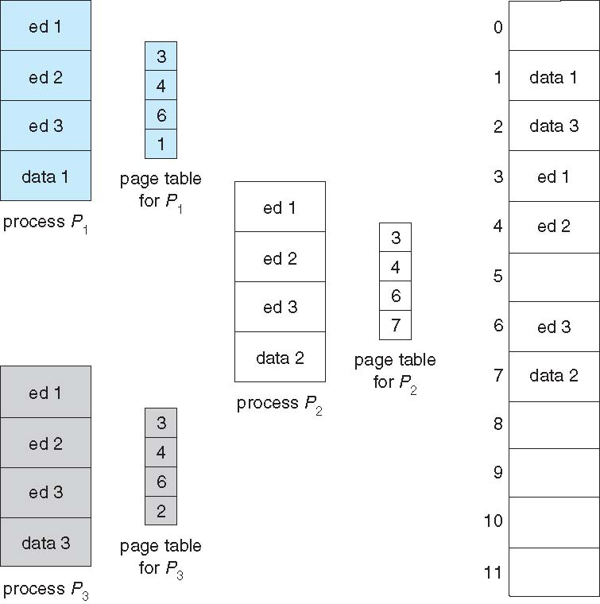
Shared Pages Example

Slide 64
Structure of the Page Table
Memory structures for paging can get huge using straight-forward methods
Consider a 32-bit logical address space as on modern computers
Page size of 4 KB (2¹²)
Page table would have 1 million entries (2³² / 2¹²)
If each entry is 4 bytes -> 4 MB of physical address space / memory for page table alone
That amount of memory used to cost a lot
Don’t want to allocate that contiguously in main memory
Hierarchical Paging
Hashed Page Tables
Inverted Page Tables

Slide 65
Hierarchical Page Tables
Break up the logical address space into multiple page tables
A simple technique is a two-level page table
We then page the page table

Slide 66
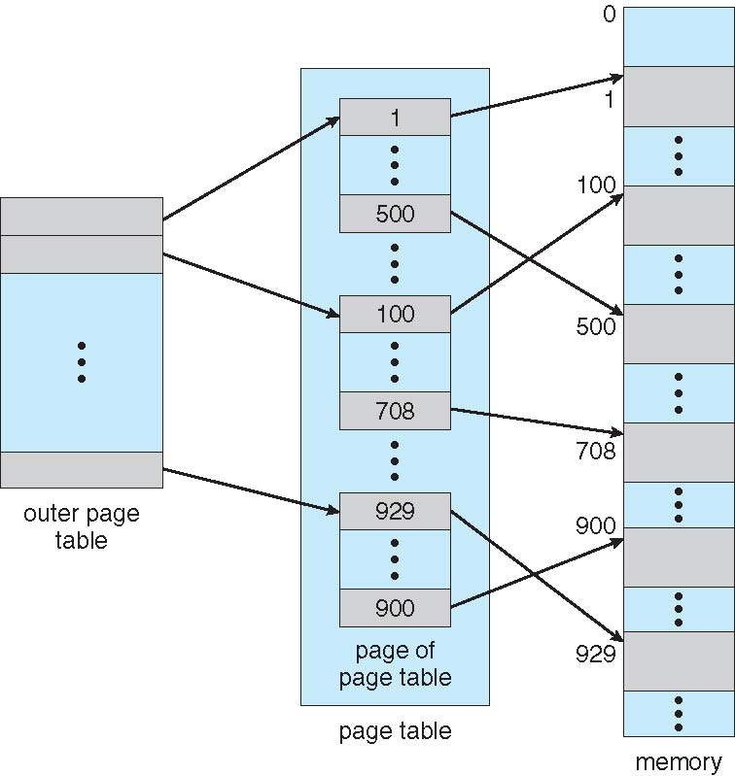
Two-Level Page-Table Scheme

Slide 67
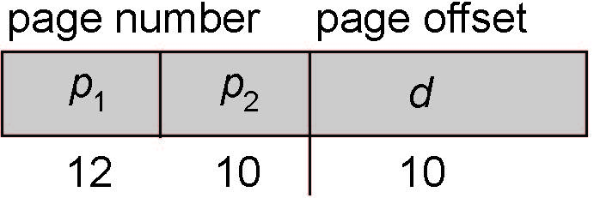
Two-Level Paging Example
A logical address (on 32-bit machine with 1K page size) is divided into:
a page number consisting of 22 bits
a page offset consisting of 10 bits
Since the page table is paged, the page number is further divided into:
a 12-bit page number
a 10-bit page offset
Thus, a logical address is as follows:
where p₁ is an index into the outer page table, and p₂ is the displacement within the page of the inner page table
Known as forward-mapped page table

Slide 68
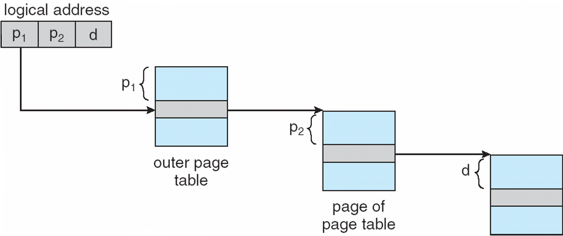
Address-Translation Scheme

Slide 69
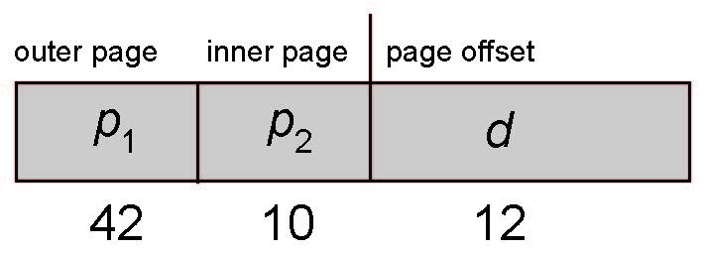
64-bit Logical Address Space
Even two-level paging scheme not sufficient
If page size is 4 KB (2¹²)
Then page table has 2⁵² entries
If two level scheme, inner page tables could be 2¹⁰ 4-byte entries
Address would look like
Outer page table has 2⁴² entries or 2⁴⁴ bytes
One solution is to add a 2nd outer page table
But in the following example the 2nd outer page table is still 2³⁴ bytes in size
And possibly 4 memory access to get to one physical memory location

Slide 70
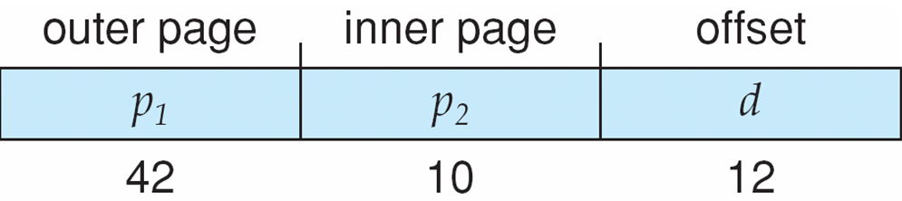
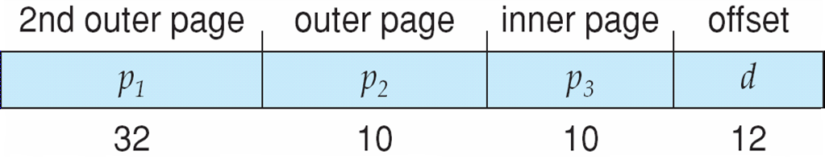
Three-level Paging Scheme

Slide 71
Hashed Page Tables
Common in address spaces > 32 bits
The virtual page number is hashed into a page table
This page table contains a chain of elements hashing to the same location
Each element contains (1) the virtual page number (2) the value of the mapped page frame (3) a pointer to the next element
Virtual page numbers are compared in this chain searching for a match
If a match is found, the corresponding physical frame is extracted
Variation for 64-bit addresses is clustered page tables
Similar to hashed but each entry refers to several pages (such as 16) rather than 1
Especially useful for sparse address spaces (where memory references are non-contiguous and scattered)

Slide 72
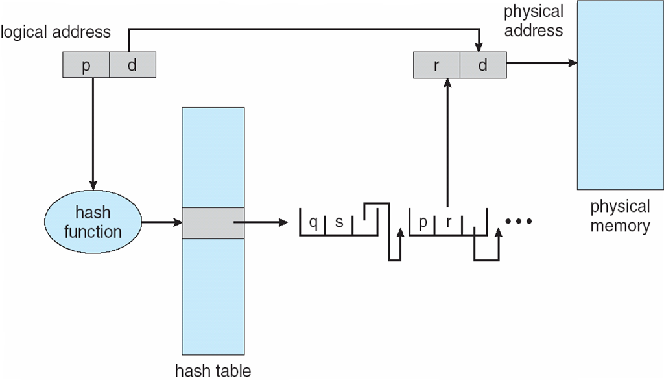
Hashed Page Table

Slide 73
Inverted Page Table
Rather than each process having a page table and keeping track of all possible logical pages, track all physical pages
One entry for each real page of memory
Entry consists of the virtual address of the page stored in that real memory location, with information about the process that owns that page
Decreases memory needed to store each page table, but increases time needed to search the table when a page reference occurs
Use hash table to limit the search to one — or at most a few — page-table entries
TLB can accelerate access
But how to implement shared memory?
One mapping of a virtual address to the shared physical address

Slide 74
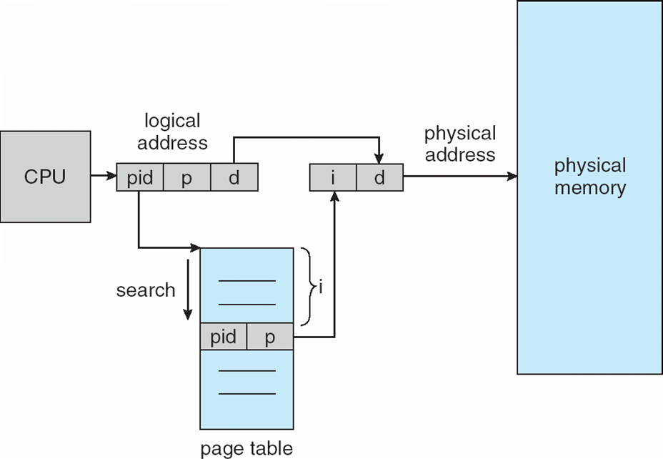
Inverted Page Table Architecture

Slide 75
Example: The Intel 32 and 64-bit Architectures
Dominant industry chips
Pentium CPUs are 32-bit and called IA-32 architecture
Current Intel CPUs are 64-bit and called IA-64 architecture
Many variations in the chips, cover the main ideas here

Slide 76
Example: The Intel IA-32 Architecture
Supports both segmentation and segmentation with paging
Each segment can be 4 GB
Up to 16 K segments per process
Divided into two partitions
First partition of up to 8 K segments are private to process (kept in local descriptor table (LDT))
Second partition of up to 8K segments shared among all processes (kept in global descriptor table (GDT))

Slide 77

Example: The Intel IA-32 Architecture (Cont.)
CPU generates logical address
Selector given to segmentation unit
Which produces linear addresses
Linear address given to paging unit
Which generates physical address in main memory
Paging units form equivalent of MMU
Pages sizes can be 4 KB or 4 MB

Slide 78
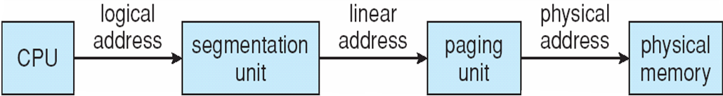
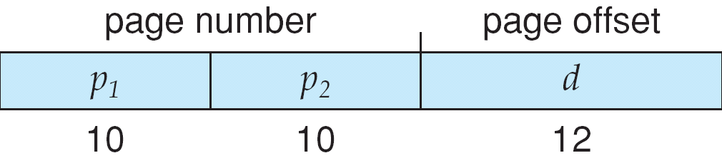
Logical to Physical Address Translation in IA-32

Slide 79
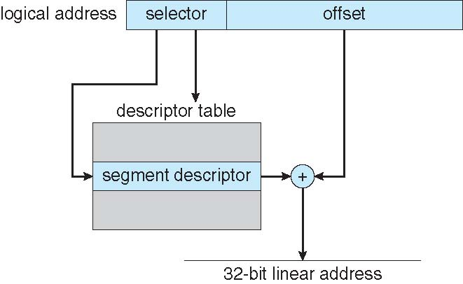
Intel IA-32 Segmentation

Slide 80
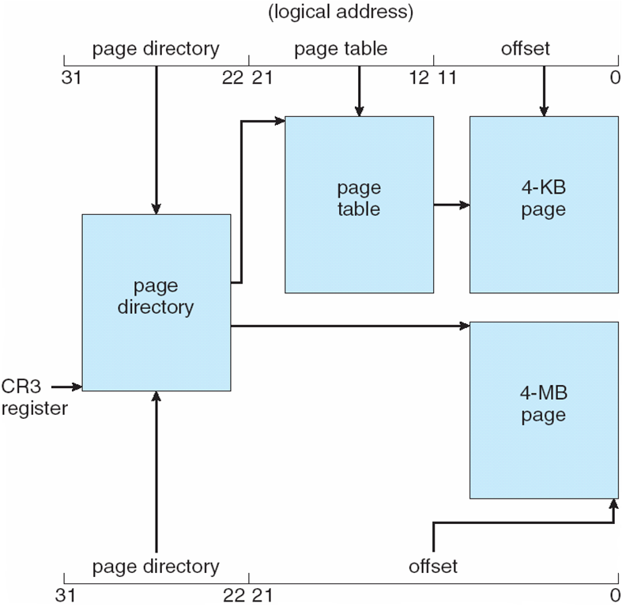
Intel IA-32 Paging Architecture

Slide 81
Intel IA-32 Page Address Extensions
32-bit address limits led Intel to create page address extension (PAE), allowing 32-bit apps access to more than 4GB of memory space
Paging went to a 3-level scheme
Top two bits refer to a page directory pointer table
Page-directory and page-table entries moved to 64-bits in size
Net effect is increasing address space to 36 bits – 64GB of physical memory

Slide 82
Intel x86-64
Current generation Intel x86 architecture
64 bits is ginormous (> 16 exabytes)
In practice only implement 48 bit addressing
Page sizes of 4 KB, 2 MB, 1 GB
Four levels of paging hierarchy
Can also use PAE so virtual addresses are 48 bits and physical addresses are 52 bits

Slide 83

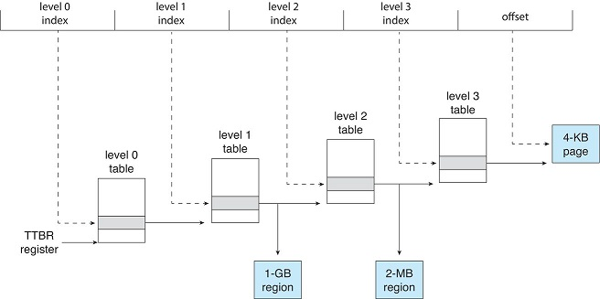
ARM Architecture
ARM 4-KB translation granule.
ARM four-level hierarchical paging.

