Slide 1
CSMC 412
Operating Systems
Prof. Ashok K Agrawala
Set 14

Slide 2
Background
Code needs to be in memory to execute, but entire program rarely used
  Error code, unusual routines, large data structures
Entire program code not needed at the same time
Consider ability to execute partially-loaded program
  Program no longer constrained by limits of physical memory
  Each program takes less memory while running -> more programs run at the same time
    Increased CPU utilization and throughput with no increase in response time or turnaround time
  Less I/O needed to load or swap programs into memory -> each user program runs faster

Slide 3
Background (Cont.)
Virtual memory – separation of user logical memory from physical memory
  Only a part of the program needs to be in memory for execution
  Logical address space can be much larger than physical address space
  Allows address spaces to be shared by several processes
  Allows for more efficient process creation
  More programs running concurrently
  Less I/O needed to load or swap processes

Slide 4
Background (Cont.)
Virtual address space – logical view of how process is stored in memory
  Usually start at address 0, contiguous addresses until end of space
  Meanwhile, physical memory organized in page frames
  MMU must map logical to physical
Virtual memory can be implemented via:
  Demand paging
  Demand segmentation

Slide 5
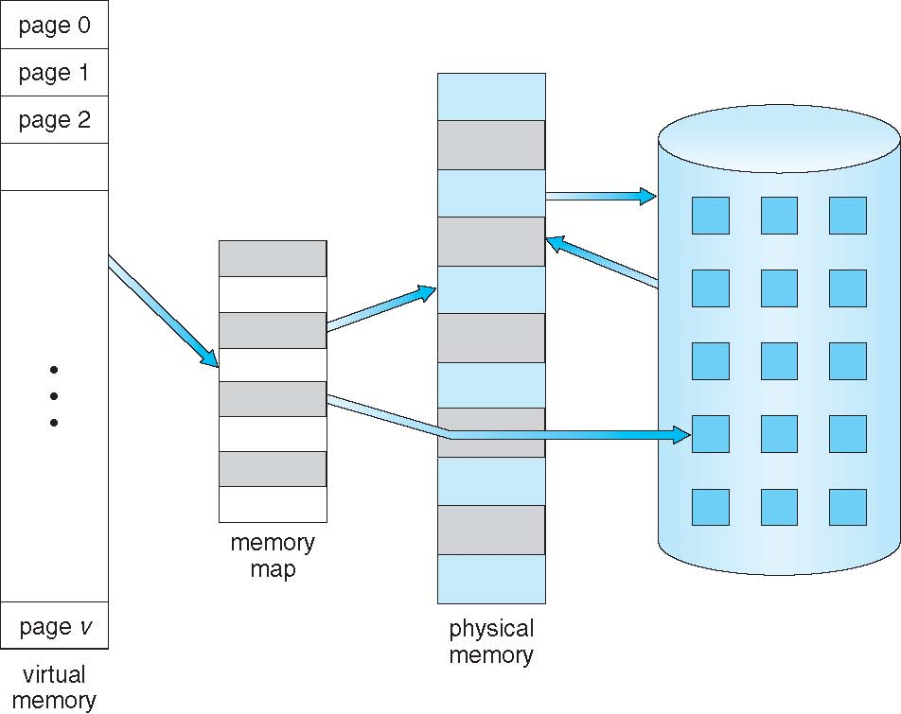
Virtual Memory That is Larger Than Physical Memory

Slide 6
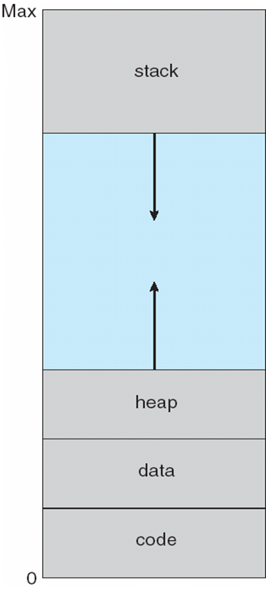
Virtual-address Space
Usually design logical address space for stack to start at Max logical address and grow “down” while heap grows “up”
  Maximizes address space use
  Unused address space between the two is hole
    No physical memory needed until heap or stack grows to a given new page
Enables sparse address spaces with holes left for growth, dynamically linked libraries, etc.
System libraries shared via mapping into virtual address space
Shared memory by mapping pages read-write into virtual address space
Pages can be shared during fork(), speeding process creation

Slide 7
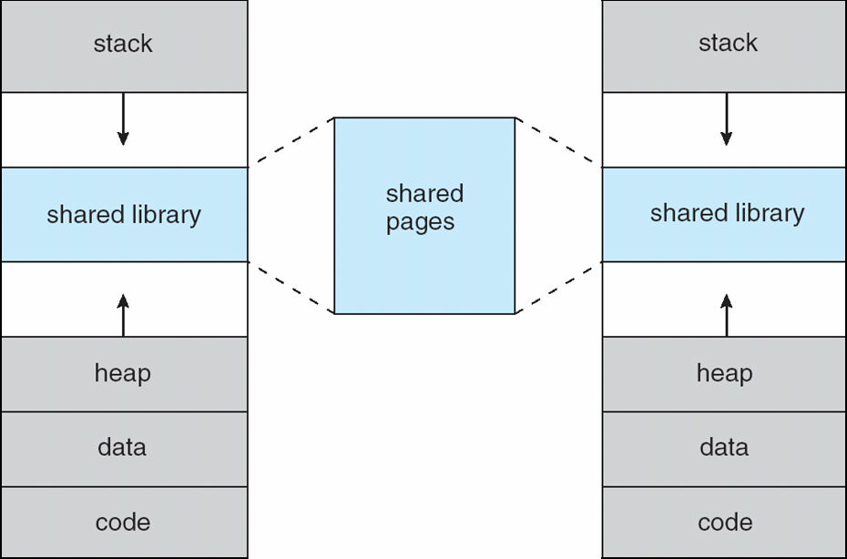
Shared Library Using Virtual Memory

Slide 8
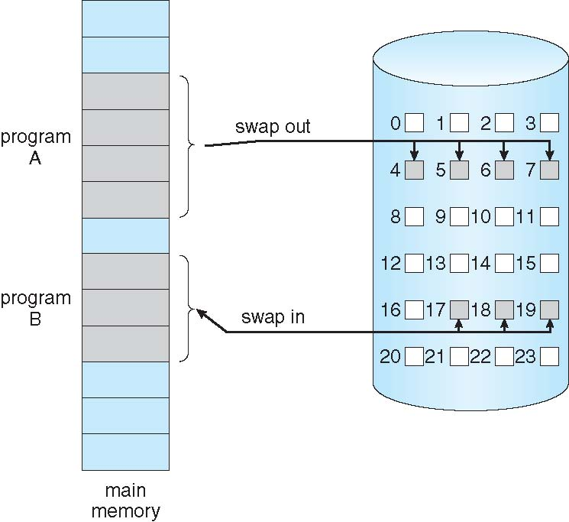
Swapping Using Paging
Could bring entire process into memory at load time
Like paging system with swapping
No external fragmentation

Slide 9
Demand Paging
Bring a page into memory only when it is needed
  Less I/O needed, no unnecessary I/O
  Less memory needed
  Faster response
  More users
Page is needed ⇒ reference to it
  invalid reference ⇒ abort
  not-in-memory ⇒ bring to memory
Lazy swapper – never swaps a page into memory unless page will be needed
  Swapper that deals with pages is usually called a pager

Slide 10
Basic Concepts
With swapping, pager guesses which pages will be used before swapping out again
Instead, pager brings in only needed pages into memory
How to determine that set of pages?
  Need new MMU functionality to implement demand paging
If pages needed are already memory resident
  No difference from non-demand-paging
If page needed and not memory resident
  Need to detect and load the page into memory from storage
    Without changing program behavior
    Without programmer needing to change code

Slide 11
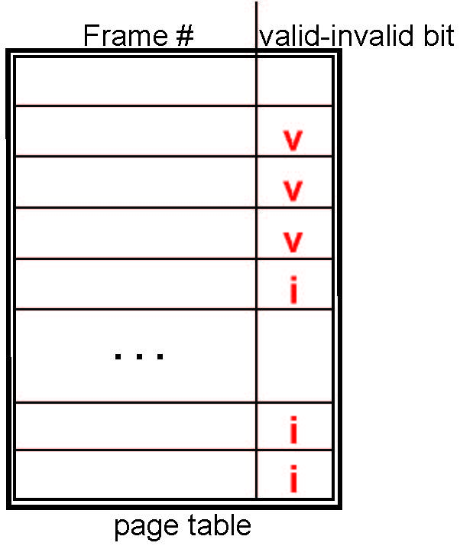
Valid-Invalid Bit
With each page table entry, a valid–invalid bit is associated
(v ⇒ in-memory – memory resident, i ⇒ not-in-memory)
Initially valid–invalid bit is set to i on all entries
Example of a page table snapshot:
During MMU address translation, if valid–invalid bit in page table entry is i ⇒ page fault

Slide 12
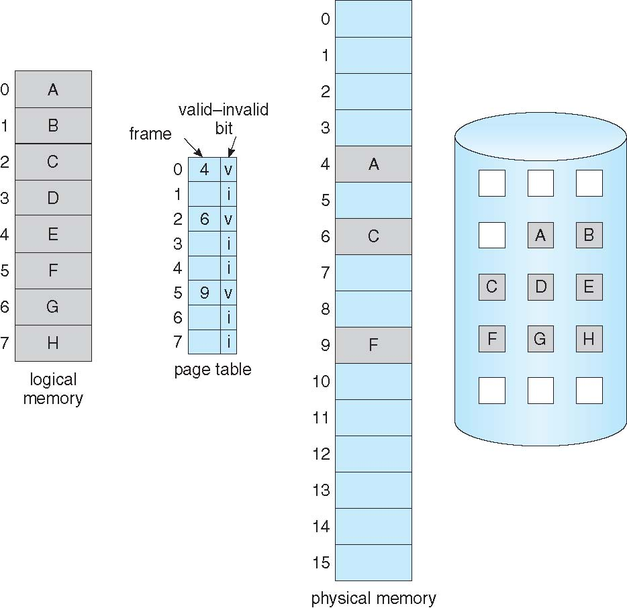
Page Table When Some Pages Are Not in Main Memory

Slide 13
Page Fault
If there is a reference to a page, first reference to that page will trap to operating system:
page fault
Operating system looks at another table to decide:
  Invalid reference ⇒ abort
  Just not in memory
Find free frame
Swap page into frame via scheduled disk operation
Reset tables to indicate page now in memory
Set validation bit = v
Restart the instruction that caused the page fault

Slide 14
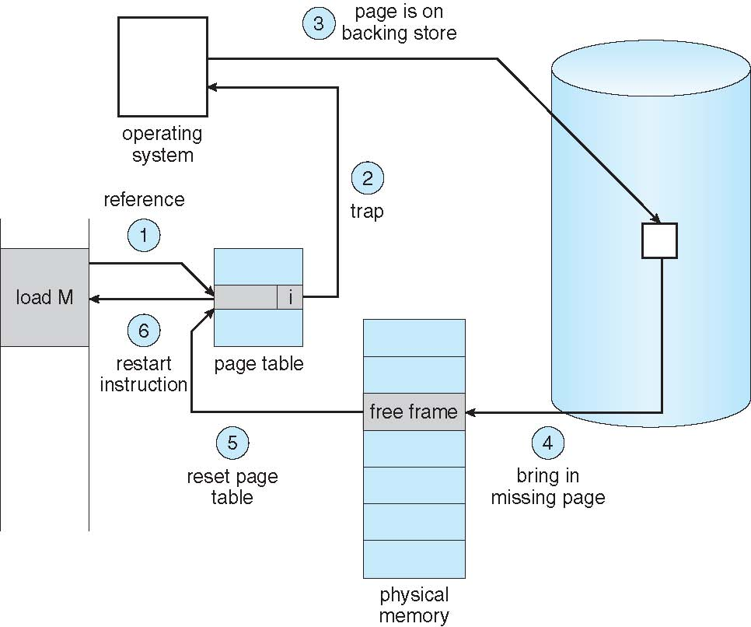
Steps in Handling a Page Fault

Slide 15
Aspects of Demand Paging
Extreme case – start process with no pages in memory
  OS sets instruction pointer to first instruction of process, non-memory-resident -> page fault
  And for every other process pages on first access
  Pure demand paging
A given instruction could access multiple pages -> multiple page faults
  Consider fetch and decode of instruction which adds 2 numbers from memory and stores result back to memory
  Pain decreased because of locality of reference
Hardware support needed for demand paging
  Page table with valid / invalid bit
  Secondary memory (swap device with swap space)
  Instruction restart

Slide 16
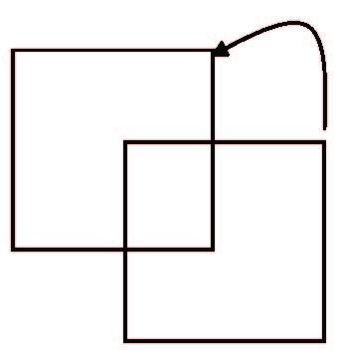
Instruction Restart
Must be able to restart the instruction that caused the page fault
  Save enough state
Consider an instruction that could access several different locations
  block move
  auto increment/decrement location
  Restart the whole operation?
    What if source and destination overlap?

Slide 17
Performance of Demand Paging
Stages in Demand Paging (worse case)
Trap to the operating system
Save the user registers and process state
Determine that the interrupt was a page fault
Check that the page reference was legal and determine the location of the page on the disk
Issue a read from the disk to a free frame:
  Wait in a queue for this device until the read request is serviced
  Wait for the device seek and/or latency time
  Begin the transfer of the page to a free frame
While waiting, allocate the CPU to some other user
Receive an interrupt from the disk I/O subsystem (I/O completed)
Save the registers and process state for the other user
Determine that the interrupt was from the disk
Move the page information
Correct the page table and other tables to show page is now in memory
Wait for the CPU to be allocated to this process again
Restore the user registers, process state, and new page table, and then resume the interrupted instruction

Slide 18
Performance of Demand Paging (Cont.)
Three major activities
  Service the interrupt – careful coding means just several hundred instructions needed
  Read the page – lots of time
  Restart the process – again just a small amount of time
Page Fault Rate 0 ≤ p ≤ 1
  if p = 0 no page faults
  if p = 1, every reference is a fault
Effective Access Time (EAT)
EAT = (1 – p) x memory access
+ p (page fault overhead
+ swap page out
+ swap page in )
Page Fault Service Time

Slide 19
Demand Paging Example
Memory access time = 200 nanoseconds
Average page-fault service time = 8 milliseconds
EAT = (1 – p) x 200 + p (8 milliseconds)
= (1 – p) x 200 + p x 8,000,000
= 200 + p x 7,999,800
If one access out of 1,000 causes a page fault, then
EAT = 8.2 microseconds.
This is a slowdown by a factor of 40!!
If want performance degradation < 10 percent
  220 > 200 + 7,999,800 x p
  20 > 7,999,800 x p
  p < .0000025
  < one page fault in every 400,000 memory accesses

Slide 20
Demand Paging Optimizations
Dedicate Swap Space in memory or Disk
  Swap space I/O faster than file system I/O even if on the same device
    Swap space allocated in larger chunks; less management needed than file system
  Copy entire process image to swap space at process load time
    Then page in and out of swap space
    Used in older BSD Unix
Demand page in from program binary on disk, but discard rather than paging out when freeing frame
  Used in Solaris and current BSD
  Still need to write to swap space
    Pages not associated with a file (like stack and heap) – anonymous memory
    Pages modified in memory but not yet written back to the file system
Mobile systems
  Typically, don’t support swapping
  Instead, demand page from file system and reclaim read-only pages (such as code)

Slide 21
Copy-on-Write
Copy-on-Write (COW) allows both parent and child processes to initially share the same pages in memory
  If either process modifies a shared page, only then is the page copied
COW allows more efficient process creation as only modified pages are copied
In general, free pages are allocated from a pool of zero-fill-on-demand pages
  Pool should always have free frames for fast demand page execution
    Don’t want to have to free a frame as well as other processing on page fault
  Why zero-out a page before allocating it?
vfork() variation on fork() system call has parent suspend and child using copy-on-write address space of parent
  Designed to have child call exec()
  Very efficient

Slide 22
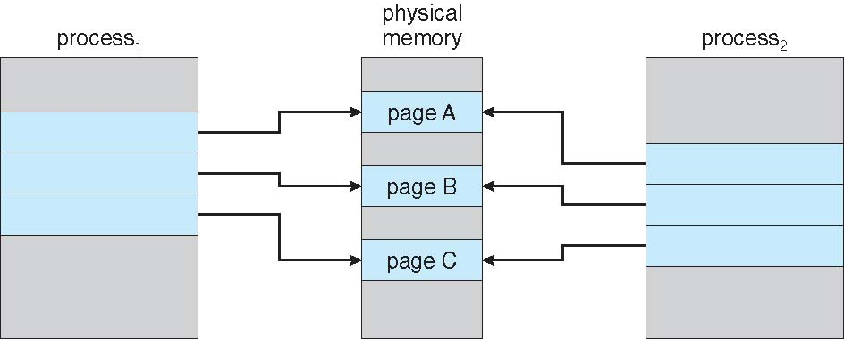
Before Process 1 Modifies Page C

Slide 23
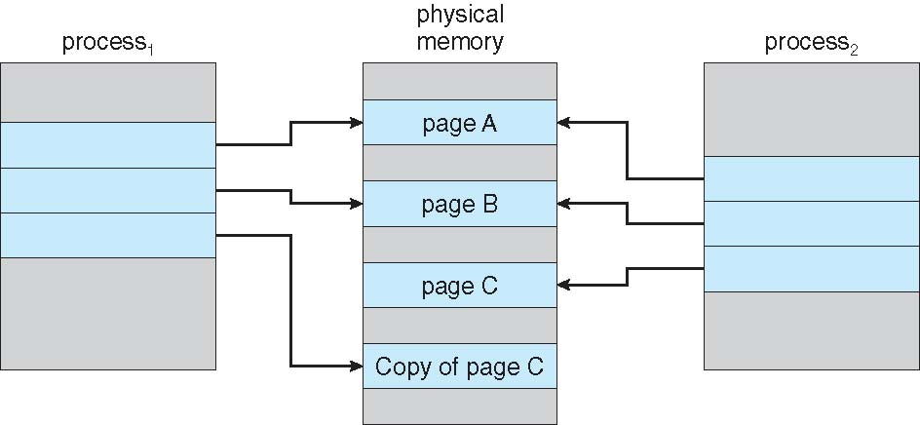
After Process 1 Modifies Page C

Slide 24
What Happens if There is no Free Frame?
Used up by process pages
Also, in demand from the kernel, I/O buffers, etc
How much to allocate to each?
Page replacement – find some page in memory, but not really in use, page it out
  Algorithm – terminate? swap out? replace the page?
  Performance – want an algorithm which will result in minimum number of page faults
Same page may be brought into memory several times

Slide 25
Page Replacement
Use modify (dirty) bit to reduce overhead of page transfers – only modified pages are written to disk
Page replacement completes separation between logical memory and physical memory – large virtual memory can be provided on a smaller physical memory

Slide 26
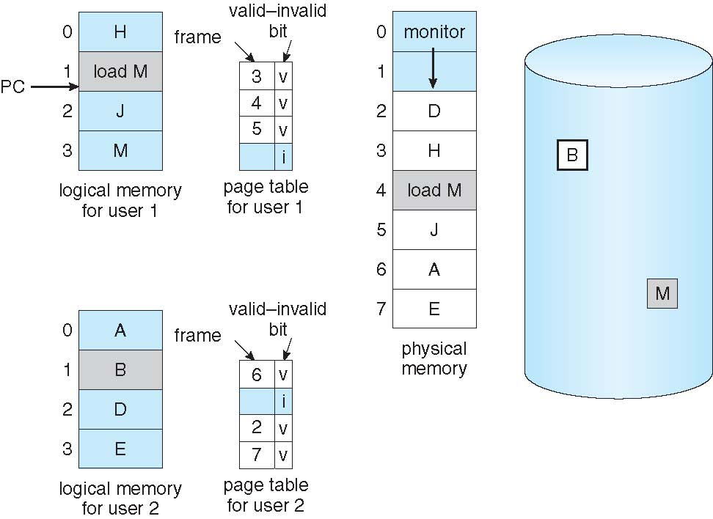
Need For Page Replacement

Slide 27
Basic Page Replacement
Find the location of the desired page on disk
Find a free frame:
- If there is a free frame, use it
- If there is no free frame,
    use a page replacement algorithm to select a victim frame
    - Write victim frame to disk if dirty
Bring the desired page into the (newly) free frame; update the page and frame tables
Continue the process by restarting the instruction that caused the trap
Note now potentially 2 page transfers for page fault – increasing EAT

Slide 28
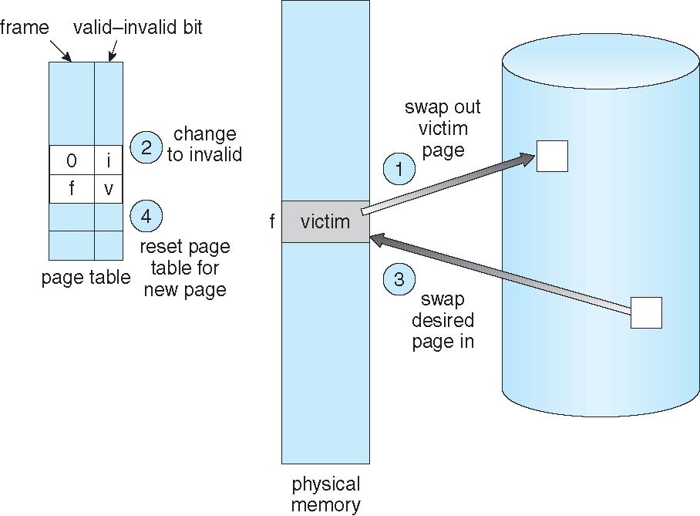
Page Replacement

Slide 29
Page and Frame Replacement Algorithms
Frame-allocation algorithm determines
  How many frames to give each process
  Which frames to replace
Page-replacement algorithm
  Want lowest page-fault rate on both first access and re-access
Evaluate algorithm by running it on a string of memory references (reference string) and computing the number of page faults on that string
  String is just page numbers, not full addresses
  Repeated access to the same page does not cause a page fault
  Results depend on number of frames available
In all our examples, the reference string of referenced page numbers is
7,0,1,2,0,3,0,4,2,3,0,3,0,3,2,1,2,0,1,7,0,1

Slide 30
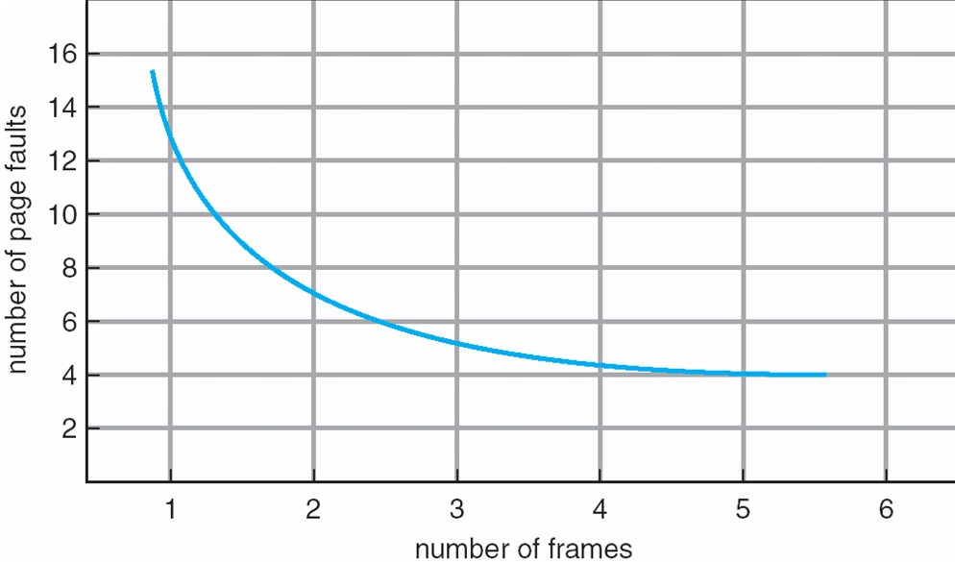
Graph of Page Faults Versus The Number of Frames

Slide 31
First-In-First-Out (FIFO) Algorithm
Reference string: 7,0,1,2,0,3,0,4,2,3,0,3,0,3,2,1,2,0,1,7,0,1
3 frames (3 pages can be in memory at a time per process)
Refrence string |  | 7 | 0 | 1 | 2 | 0 | 3 | 0 | 4 | 2 | 3 | 0 | 3 | 0 | 3 | 2 | 1 | 2 | 0 | 1 | 7 | 0 | 1
Page Frames
0 |  | 7 | 7 | 7 | 2 | 2 | 2 | 2 | 4 | 4 | 4 | 0 | 0 | 0 | 0 | 0 | 0 | 0 | 0 | 0 | 7 | 7 | 7
1 |  |  | 0 | 0 | 0 | 0 | 3 | 3 | 3 | 2 | 2 | 2 | 2 | 2 | 2 | 2 | 1 | 1 | 1 | 1 | 1 | 0 | 0
2 |  |  |  | 1 | 1 | 1 | 1 | 0 | 0 | 0 | 3 | 3 | 3 | 3 | 3 | 3 | 3 | 2 | 2 | 2 | 2 | 2 | 1
 |  | * | * | * | * |  | * | * | * | * | * | * |  |  |  |  | * | * |  |  | * | * | *
15 page-faults
Refrence string |  | 7 | 0 | 1 | 2 | 0 | 3 | 0 | 4 | 2 | 3 | 0 | 3 | 0 | 3 | 2 | 1 | 2 | 0 | 1 | 7 | 0 | 1
Page Frames
0 |  | 7 | 0 | 1 | 2 | 2 | 3 | 3 | 4 | 4 | 4 | 0 | 0 | 0 | 0 | 0 | 1 | 2 | 2 | 2 | 7 | 7 | 7
1 |  |  | 7 | 0 | 1 | 1 | 2 | 2 | 3 | 3 | 3 | 4 | 4 | 4 | 4 | 4 | 0 | 1 | 1 | 1 | 2 | 2 | 2
2 |  |  |  | 7 | 0 | 0 | 1 | 1 | 2 | 2 | 2 | 3 | 3 | 3 | 3 | 3 | 4 | 0 | 0 | 0 | 1 | 1 | 1
3 |  |  |  |  | 7 | 7 | 0 | 0 | 1 | 1 | 1 | 2 | 2 | 2 | 2 | 2 | 3 | 4 | 4 | 4 | 0 | 0 | 0
 |  | * | * | * | * |  | * |  | * |  |  | * |  |  |  |  | * | * |  |  | *
10 page-faults

Slide 32
First-In-First-Out (FIFO) Algorithm
Ref string |  | 1 | 2 | 3 | 4 | 1 | 2 | 5 | 1 | 2 | 3 | 4 | 5
Page Frames
 |  | 1 | 2 | 3 | 4 | 1 | 2 | 5 | 5 | 5 | 3 | 4 | 4
 |  |  | 1 | 2 | 3 | 4 | 1 | 2 | 2 | 2 | 5 | 3 | 3
 |  |  |  | 1 | 2 | 3 | 4 | 1 | 1 | 1 | 2 | 5 | 5
Page Fault | 9 | * | * | * | * | * | * | * |  |  | * | *
Page Frames
 |  | 1 | 2 | 3 | 4 | 4 | 4 | 5 | 1 | 2 | 3 | 4 | 5
 |  |  | 1 | 2 | 3 | 3 | 3 | 4 | 5 | 1 | 2 | 3 | 4
 |  |  |  | 1 | 2 | 2 | 2 | 3 | 4 | 5 | 1 | 2 | 3
 |  |  |  |  | 1 | 1 | 1 | 2 | 3 | 4 | 5 | 1 | 2
Page Fault | 10 | * | * | * | * |  |  | * | * | * | * | * | *
  CanAdding more frames can cause more page faults!
    Belady’s Anomaly
How to track ages of pages?
  Just use a FIFO queue

Slide 33
FIFO Illustrating Belady’s Anomaly

Slide 34
Optimal Algorithm
Replace page that will not be used for longest period of time
  9 is optimal for the example when using 3 Page Frames
How do you know this?
  Can’t read the future
Used for measuring how well your algorithm performs
Ref Str |  | 7 | 0 | 1 | 2 | 0 | 3 | 4 | 2 | 3 | 0 | 3 | 0 | 3 | 2 | 1 | 2 | 0 | 1 | 7 | 0 | 1
PageFrame
0 |  | 7 | 7 | 7 | 2 | 2 | 2 | 2 | 2 | 2 | 2 | 2 | 2 | 2 | 2 | 2 | 2 | 2 | 2 | 7 | 7 | 7
1 |  |  | 0 | 0 | 0 | 0 | 0 | 4 | 4 | 4 | 0 | 0 | 0 | 0 | 0 | 0 | 0 | 0 | 0 | 0 | 0 | 0
2 |  |  |  | 1 | 1 | 1 | 3 | 3 | 3 | 3 | 3 | 3 | 3 | 3 | 3 | 1 | 1 | 1 | 1 | 1 | 1 | 1
 | 9 | * | * | * | * |  | * | * |  |  | * |  |  |  |  | * |  |  |  | *

Slide 35
Optimal Algorithm
Ref Str |  | 7 | 0 | 1 | 2 | 0 | 3 | 4 | 2 | 3 | 0 | 3 | 0 | 3 | 2 | 1 | 2 | 0 | 1 | 7 | 0 | 1
PageFrame
0 |  | 7 | 7 | 7 | 2 | 2 | 2 | 2 | 2 | 2 | 2 | 2 | 2 | 2 | 2 | 2 | 2 | 2 | 2 | 7 | 7 | 7
1 |  |  | 0 | 0 | 0 | 0 | 0 | 4 | 4 | 4 | 0 | 0 | 0 | 0 | 0 | 0 | 0 | 0 | 0 | 0 | 0 | 0
2 |  |  |  | 1 | 1 | 1 | 3 | 3 | 3 | 3 | 3 | 3 | 3 | 3 | 3 | 1 | 1 | 1 | 1 | 1 | 1 | 1
 | 9 | * | * | * | * |  | * | * |  |  | * |  |  |  |  | * |  |  |  | *
3 Page Frames
Ref Str |  | 7 | 0 | 1 | 2 | 0 | 3 | 4 | 2 | 3 | 0 | 3 | 0 | 3 | 2 | 1 | 2 | 0 | 1 | 7 | 0 | 1
PageFrame
0 |  | 7 | 7 | 7 | 7 | 7 | 3 | 3 | 3 | 3 | 3 | 3 | 3 | 3 | 3 | 3 | 3 | 3 | 3 | 7 | 7 | 7
1 |  |  | 0 | 0 | 0 | 0 | 0 | 0 | 0 | 0 | 0 | 0 | 0 | 0 | 0 | 0 | 0 | 0 | 0 | 0 | 0 | 0
2 |  |  |  | 1 | 1 | 1 | 1 | 4 | 4 | 4 | 4 | 4 | 4 | 4 | 4 | 1 | 1 | 1 | 1 | 1 | 1 | 1
3 |  |  |  |  | 2 | 2 | 2 | 2 | 2 | 2 | 2 | 2 | 2 | 2 | 2 | 2 | 2 | 2 | 2 | 2 | 2 | 2
 | 8 | * | * | * | * |  | * | * |  |  |  |  |  |  |  | * |  |  |  | *
4 Page Frames

Slide 36
Least Recently Used (LRU) Algorithm
Use past knowledge rather than future
Replace page that has not been used in the most amount of time
Associate time of last use with each page
11 faults – better than FIFO but worse than OPT
Generally good algorithm and frequently used
But how to implement?
Ref Str |  | 7 | 0 | 1 | 2 | 0 | 3 | 4 | 2 | 3 | 0 | 3 | 0 | 3 | 2 | 1 | 2 | 0 | 1 | 7 | 0 | 1
PageFrame
 |  | 7 | 0 | 1 | 2 | 0 | 3 | 4 | 2 | 3 | 0 | 3 | 0 | 3 | 2 | 1 | 2 | 0 | 1 | 7 | 0 | 1
 |  |  | 7 | 0 | 1 | 2 | 0 | 3 | 4 | 2 | 3 | 0 | 3 | 0 | 3 | 2 | 1 | 2 | 0 | 1 | 7 | 0
 |  |  |  | 7 | 0 | 1 | 2 | 0 | 3 | 4 | 2 | 2 | 2 | 2 | 0 | 3 | 3 | 1 | 2 | 0 | 1 | 7
 | 11 | * | * | * | * |  | * | * | * |  | * |  |  |  |  | * |  | * |  | *

Slide 37
Least Recently Used (LRU) Algorithm
Ref Str |  | 7 | 0 | 1 | 2 | 0 | 3 | 4 | 2 | 3 | 0 | 3 | 0 | 3 | 2 | 1 | 2 | 0 | 1 | 7 | 0 | 1
PageFrame
 |  | 7 | 0 | 1 | 2 | 0 | 3 | 4 | 2 | 3 | 0 | 3 | 0 | 3 | 2 | 1 | 2 | 0 | 1 | 7 | 0 | 1
 |  |  | 7 | 0 | 1 | 2 | 0 | 3 | 4 | 2 | 3 | 0 | 3 | 0 | 3 | 2 | 1 | 2 | 0 | 1 | 7 | 0
 |  |  |  | 7 | 0 | 1 | 2 | 0 | 3 | 4 | 2 | 2 | 2 | 2 | 0 | 3 | 3 | 1 | 2 | 0 | 1 | 7
 | 11 | * | * | * | * |  | * | * | * |  | * |  |  |  |  | * |  | * |  | *
3 Page Frames
Ref Str |  | 7 | 0 | 1 | 2 | 0 | 3 | 4 | 2 | 3 | 0 | 3 | 0 | 3 | 2 | 1 | 2 | 0 | 1 | 7 | 0 | 1
PageFrame
0 |  | 7 | 0 | 1 | 2 | 0 | 3 | 4 | 2 | 3 | 0 | 3 | 0 | 3 | 2 | 1 | 2 | 0 | 1 | 7 | 0 | 1
1 |  |  | 7 | 0 | 1 | 2 | 0 | 3 | 4 | 2 | 3 | 0 | 3 | 0 | 3 | 2 | 1 | 2 | 0 | 1 | 7 | 0
2 |  |  |  | 7 | 0 | 1 | 2 | 0 | 3 | 4 | 2 | 2 | 2 | 2 | 0 | 3 | 3 | 1 | 2 | 0 | 1 | 7
3 |  |  |  |  | 7 | 7 | 1 | 2 | 0 | 0 | 4 | 4 | 4 | 4 | 4 | 0 | 0 | 3 | 3 | 2 | 2 | 2
 | 8 | * | * | * | * |  | * | * |  |  |  |  |  |  |  | * |  |  |  | *
4 Page Frames

Slide 38
LRU Algorithm (Cont.)
Counter implementation
  Every page entry has a counter; every time page is referenced through this entry, copy the clock into the counter
  When a page needs to be changed, look at the counters to find smallest value
    Search through table needed
Stack implementation
  Keep a stack of page numbers in a double link form:
  Page referenced:
    move it to the top
    requires 6 pointers to be changed
  But each update more expensive
  No search for replacement
LRU and OPT are cases of stack algorithms that don’t have Belady’s Anomaly

Slide 39
Use Of A Stack to Record Most Recent Page References

Slide 40
LRU Approximation Algorithms
LRU needs special hardware and still slow
Reference bit
  With each page associate a bit, initially = 0
  When page is referenced bit set to 1
  Replace any with reference bit = 0 (if one exists)
    We do not know the order, however
Second-chance algorithm
  Generally FIFO, plus hardware-provided reference bit
  Clock replacement
  If page to be replaced has
    Reference bit = 0 -> replace it
    reference bit = 1 then:
      set reference bit 0, leave page in memory
      replace next page, subject to same rules

Slide 41
Second-Chance (clock) Page-Replacement Algorithm

Slide 42
Enhanced Second-Chance Algorithm
Improve algorithm by using reference bit and modify bit (if available) in concert
Take ordered pair (reference, modify)
(0, 0) neither recently used not modified – best page to replace
(0, 1) not recently used but modified – not quite as good, must write out before replacement
(1, 0) recently used but clean – probably will be used again soon
(1, 1) recently used and modified – probably will be used again soon and need to write out before replacement
When page replacement called for, use the clock scheme but use the four classes replace page in lowest non-empty class
  Might need to search circular queue several times

Slide 43
Counting Algorithms
Keep a counter of the number of references that have been made to each page
  Not common
Lease Frequently Used (LFU) Algorithm: replaces page with smallest count
Most Frequently Used (MFU) Algorithm: based on the argument that the page with the smallest count was probably just brought in and has yet to be used

Slide 44
Page-Buffering Algorithms
Keep a pool of free frames, always
  Then frame available when needed, not found at fault time
  Read page into free frame and select victim to evict and add to free pool
  When convenient, evict victim
Possibly, keep list of modified pages
  When backing store otherwise idle, write pages there and set to non-dirty
Possibly, keep free frame contents intact and note what is in them
  If referenced again before reused, no need to load contents again from disk
  Generally useful to reduce penalty if wrong victim frame selected

Slide 45
Applications and Page Replacement
All of these algorithms have OS guessing about future page access
Some applications have better knowledge – e.g., databases
Memory intensive applications can cause double buffering
  OS keeps copy of page in memory as I/O buffer
  Application keeps page in memory for its own work
Operating system can give direct access to the disk, getting out of the way of the applications
  Raw disk mode
Bypasses buffering, locking, etc.

Slide 46
Allocation of Frames
Each process needs minimum number of frames
Example: IBM 370 – 6 pages to handle SS MOVE instruction:
  instruction is 6 bytes, might span 2 pages
  2 pages to handle from
  2 pages to handle to
Maximum of course is total frames in the system
Two major allocation schemes
  fixed allocation
  priority allocation
Many variations

Slide 47
Fixed Allocation
Equal allocation – For example, if there are 100 frames (after allocating frames for the OS) and 5 processes, give each process 20 frames
  Keep some as free frame buffer pool
Proportional allocation – Allocate according to the size of process
  Dynamic as degree of multiprogramming, process sizes change

Slide 48
Priority Allocation
Use a proportional allocation scheme using priorities rather than size
If process P_{i} generates a page fault,
  select for replacement one of its frames
  select for replacement a frame from a process with lower priority number

Slide 49
Global vs. Local Allocation
Global replacement – process selects a replacement frame from the set of all frames; one process can take a frame from another
  But then process execution time can vary greatly
  But greater throughput so more common
Local replacement – each process selects from only its own set of allocated frames
  More consistent per-process performance
  But possibly underutilized memory

Slide 50
Non-Uniform Memory Access
So far, all memory accessed equally (Same access time)
Many systems are NUMA – speed of access to memory varies
  Consider system boards containing CPUs and memory, interconnected over a system bus
Optimal performance comes from allocating memory “close to” the CPU on which the thread is scheduled
  And modifying the scheduler to schedule the thread on the same system board when possible
  Solved by Solaris by creating lgroups
    Structure to track CPU / Memory low latency groups
    Used my schedule and pager
    When possible, schedule all threads of a process and allocate all memory for that process within the lgroup

Slide 51
Virtual Memory
Paging
  Demand paging
  Page Replacement Algorithms
    FIFO, Optimal, LRU
    Stack Algorithms
  Implementations
    Approximations
  Strategies
    Global vs. local

Slide 52
Thrashing
If a process does not have “enough” pages, the page-fault rate is very high
  Page fault to get page
  Replace existing frame
  But quickly need replaced frame back
  This leads to:
    Low CPU utilization
    Operating system thinking that it needs to increase the degree of multiprogramming
    Another process added to the system
Thrashing ≡ a process is busy swapping pages in and out

Slide 53
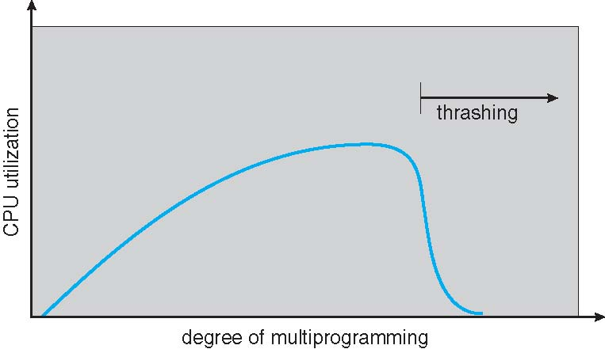
Thrashing (Cont.)

Slide 54
Demand Paging and Thrashing
Why does demand paging work?
Locality model
  Process migrates from one locality to another
  Localities may overlap
Why does thrashing occur?
Σ size of locality > total memory size
  Limit effects by using local or priority page replacement

Slide 55
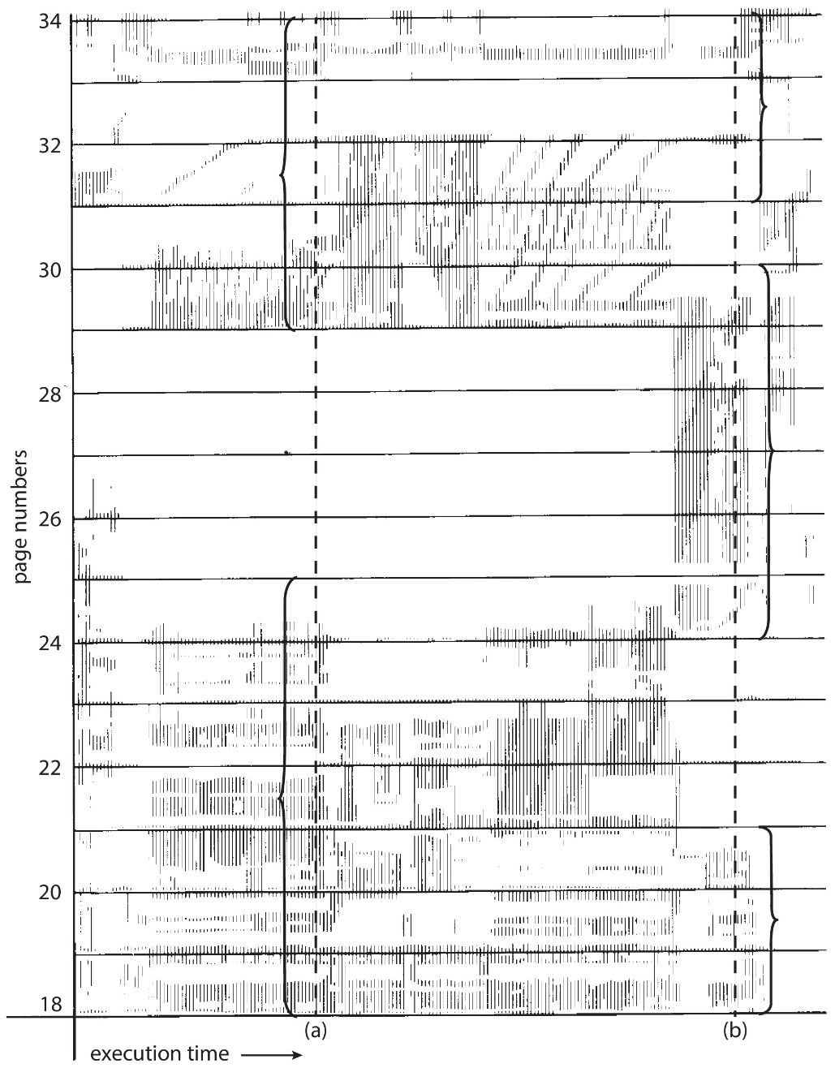
Locality In A Memory-Reference
Pattern
Working set at time a
{18, 19, 20, 21, 22, 23, 24, 29, 30, 33}
Working set at time b
{18, 19, 20, 24, 25, 26, 27, 28, 29, 31, 32, 33}

Slide 56
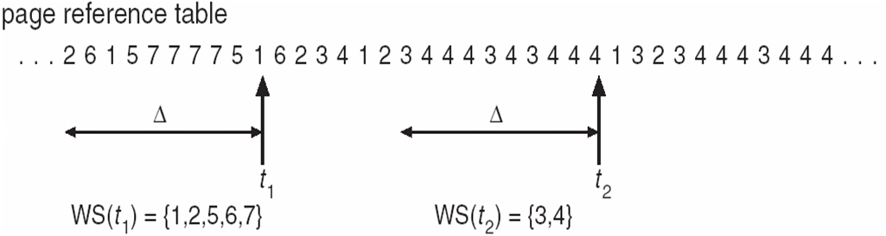
Working-Set Model
Δ ≡ working-set window ≡ a fixed number of page references
Example: 10,000 instructions
WSS_{i} (working set of Process P_{i}) =
total number of pages referenced in the most recent Δ (varies in time)
  if Δ too small will not encompass entire locality
  if Δ too large will encompass several localities
  if Δ = ∞ ⇒ will encompass entire program
D = Σ WSS_{i} ≡ total demand frames
  Approximation of locality
if D > m ⇒ Thrashing
Policy if D > m, then suspend or swap out one of the processes

Slide 57
Keeping Track of the Working Set
Approximate with interval timer + a reference bit
Example: Δ = 10,000
  Timer interrupts after every 5000 time units
  Keep in memory 2 bits for each page
  Whenever a timer interrupts
    Copy reference bits to memory
    Set all reference bits to 0
  If one of the bits for a page (in memory or reference bit) is 1
    ⇒ page in working set
Why is this not completely accurate?
Improvement = 10 bits and interrupt every 1000 time units

Slide 58
Page-Fault Frequency
More direct approach than WSS
Establish “acceptable” page-fault frequency (PFF) rate and use local replacement policy
  If actual rate too low, process loses frame
  If actual rate too high, process gains frame

Slide 59
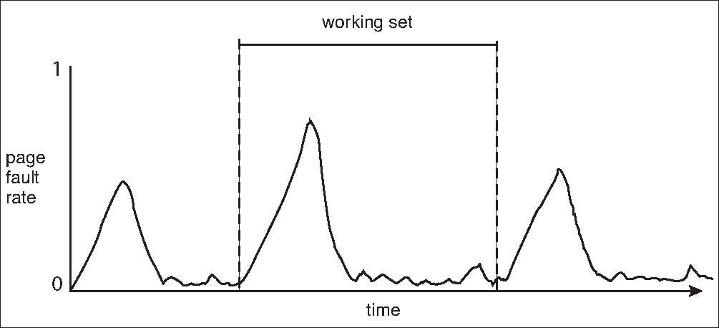
Working Sets and Page Fault Rates
Direct relationship between working set of a process and its page-fault rate
Working set changes over time
Peaks and valleys over time

Slide 60
Memory-Mapped Files
Memory-mapped file I/O allows file I/O to be treated as routine memory access by mapping a disk block to a page in memory
A file is initially read using demand paging
  A page-sized portion of the file is read from the file system into a physical page
  Subsequent reads/writes to/from the file are treated as ordinary memory accesses
Simplifies and speeds file access by driving file I/O through memory rather than read() and write() system calls
Also allows several processes to map the same file allowing the pages in memory to be shared
But when does written data make it to disk?
  Periodically and / or at file close() time
  For example, when the pager scans for dirty pages

Slide 61
Allocating Kernel Memory
Treated differently from user memory
Often allocated from a free-memory pool
  Kernel requests memory for structures of varying sizes
  Some kernel memory needs to be contiguous
    I.e., for device I/O

Slide 62
Buddy System
Allocates memory from fixed-size segment consisting of physically-contiguous pages
Memory allocated using power-of-2 allocator
  Satisfies requests in units sized as power of 2
  Request rounded up to next highest power of 2
  When smaller allocation needed than is available, current chunk split into two buddies of next-lower power of 2
    Continue until appropriately sized chunk available
For example, assume 256KB chunk available, kernel requests 21KB
  Split into A_{L} _{and} A_{R} of 128KB each
    One further divided into B_{L} and B_{R} of 64KB
      One further into C_{L} and C_{R} of 32KB each – one used to satisfy request
Advantage – quickly coalesce unused chunks into larger chunk
Disadvantage - fragmentation

Slide 63
Buddy System Allocator

Slide 64
Slab Allocator
Alternate strategy
Slab is one or more physically contiguous pages
Cache consists of one or more slabs
  (this is not the hardware memory cache of the cpu)
Single cache for each unique kernel data structure
  Each cache filled with objects – instantiations of the data structure
  For example – Cache representing semaphores stores instances of semaphore objects
When cache created, filled with objects marked as free
When structures stored, objects marked as used
If slab is full of used objects, next object allocated from empty slab
  If no empty slabs, new slab allocated
Benefits include no fragmentation, fast memory request satisfaction

Slide 65
Slab Allocation

Slide 66
Slab Allocator in Linux
For example, process descriptor is of type struct task_struct
Approx 1.7KB of memory
New task -> allocate new struct from cache
  Will use existing free struct task_struct
Slab can be in three possible states
  Full – all used
  Empty – all free
  Partial – mix of free and used
Upon request, slab allocator
  Uses free struct in partial slab
  If none, takes one from empty slab
  If no empty slab, create new empty

Slide 67
Slab Allocator in Linux (Cont.)
Slab started in Solaris, now wide-spread for both kernel mode and user memory in various OSes
Linux 2.2 had SLAB, now has both SLOB and SLUB allocators
  SLOB for systems with limited memory
    Simple List of Blocks – maintains 3 list objects for small, medium, large objects
  SLUB is performance-optimized SLAB removes per-CPU queues, metadata stored in page structure

Slide 68
Other Considerations -- Prepaging
Prepaging
  To reduce the large number of page faults that occurs at process startup
  Prepage all or some of the pages a process will need, before they are referenced
  But if prepaged pages are unused, I/O and memory was wasted
  Assume s pages are prepaged and α fraction of the pages is used
    Is cost of saved pages faults > or < than the cost of prepaging
    unnecessary pages?

Slide 69
Other Issues – Page Size
Sometimes OS designers have a choice
  Especially if running on custom-built CPU
Page size selection must take into consideration:
  Fragmentation
  Page table size
  Resolution
  I/O overhead
  Number of page faults
  Locality
  TLB size and effectiveness
Always power of 2, usually in the range 2¹² (4,096 bytes) to 2²² (4,194,304 bytes)
On average, growing over time

Slide 70
Other Issues – TLB Reach
TLB Reach - The amount of memory accessible from the TLB
TLB Reach = (TLB Size) X (Page Size)
Ideally, the working set of each process is stored in the TLB
  Otherwise, there is a high degree of page faults
Increase the Page Size
  This may lead to an increase in fragmentation as not all applications require a large page size
Provide Multiple Page Sizes
  This allows applications that require larger page sizes the opportunity to use them without an increase in fragmentation

Slide 71
Other Issues – Program Structure
Program structure
  int[128,128] data;
  Each row is stored in one page
  Program 1
for (j = 0; j <128; j++)
for (i = 0; i < 128; i++)
data[i,j] = 0;
  128 x 128 = 16,384 page faults
  Program 2
  for (i = 0; i < 128; i++)
  for (j = 0; j < 128; j++)
  data[i,j] = 0;
  128 page faults

Slide 72
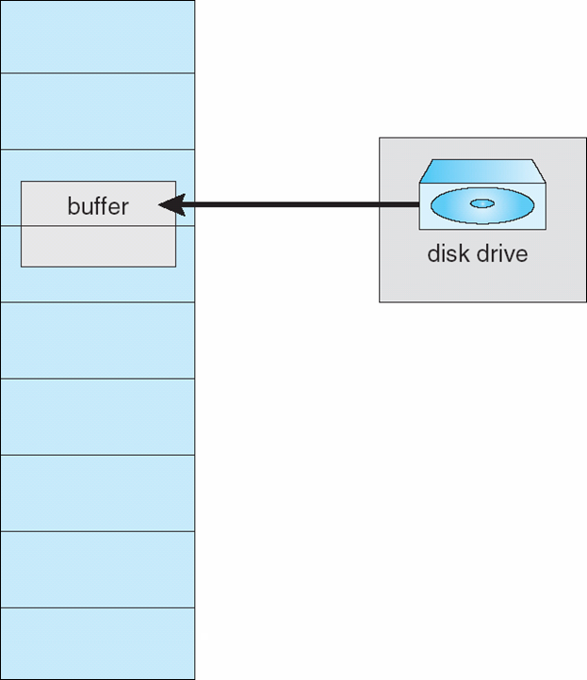
Other Issues – I/O interlock
I/O Interlock – Pages must sometimes be locked into memory
Consider I/O - Pages that are used for copying a file from a device must be locked from being selected for eviction by a page replacement algorithm
Pinning of pages to lock into memory

Slide 73
Operating System Examples
4 BSD UNIX
Linux
Windows
Solaris

Slide 74
4 BSD UNIX
Global replacement policy
  Using second chance algorithm
Implemented by pageout daemon
  Also uses a swapper process
  Both execute in kernel mode with their own process structure and kernel stack
There is a core map table (cmap) with one entry for each page frame
Executing process has its page table in the memory

Slide 75
4 BSD UNIX- Page Replacement Algorithm
Clock Algorithm implemented by pageout daemon
  A software clock hand sweeps all entries in cmap
    If the frame is unused, advance the clock hand to the next entry.
    If I/O is active on the page, leave it as it is.
    If the reference bit is set, reset it.
    If the reference bit is reset (because the page have not been referenced since last time the bit was reset), release the page by entering it into free list.
      If the page was modified, it must first be written to the paging disk.

Slide 76
4 BSD UNIX- Clock Algorithm with two Clock Hands
If a large main memory is used, the clock algorithm with one hand does not work very well because the time to scan all page frames is too large.
On some systems an algorithm with two clock hands is used.
The first clock hand is used to reset the reference bit, and the second clock hand releases pages with the referenced bit still reset. (they have not been referenced in the time span between the scan of the first and second clock hands)

Slide 77
4 BSD UNIX
Page Replacement Algorithm for two Clock Hands
The goal for the pageout daemon is to assure that there are a sufficient number of free frames available at all times in a free frame list.
The pageout daemon is awakened every 250 ms by a timeout to check that there is at least lotsfree (system parameter) free page frames. If this is the case the pageout daemon goes back to sleep.
If the number of free frames is below lotsfree, the clock hand sweeps a number of steps. How many steps depends on the number of pages needed to reach lotsfree free frames.
There is a maximum number of steps the pageout daemon is allowed to sweep at one occasion. This is adjusted so that the pageout daemon should not use more than 10% of the CPU time.

Slide 78
4 BSD UNIX - Swapping
If it is discovered that the paging system is overloaded, the swapper process is started to swap out some processes entirely (including page table and u-block). The reason for using swapping is to try to avoid that the system enters a thrashing condition.
The swapper process is started only if the following conditions are fulfilled:
1. Load average is high (many processes in the ready queue).
2. The number of free page frames is below a low value minfree.
3. The average number of free frames is less than desfree.
  (lotsfree > desfree > minfree).

Slide 79
4 BSD UNIX - Swapping
Swapout:
If some process has been idle more than 20 seconds, swap it out.
Else select the one among the four biggest processes that has been in main memory the longest time.
The algorithm is repeated until a sufficient number of frames is available or no more candidate processes for swapping can be found.
Swapin
With a few seconds interval, the swapper process checks if some swapped out process can be swapped in again. Only the page table and the u-block is brought in by the swapper process. The pages are not fetched until they generate a page fault.

Slide 80
Linux
Kernel memory – slab allocation
Rest – uses demand paging
  Global page replacement policy
    LRU approximation clock algorithm
  Maintains two lists
    Active List – pages considered to be in use
    Inactive List – pages that have not recently been referenced and are eligible to be reclaimed

Slide 81
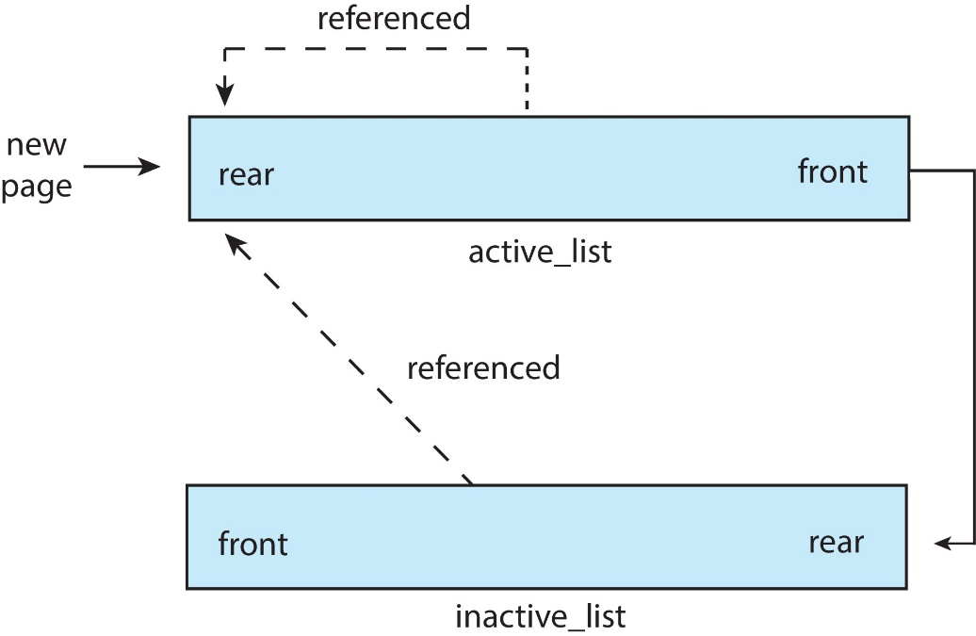
Linux
Accessed bit
  Set when first allocated
    Added to the rear of the active_list
  When referenced access bit set and moved to the rear of the Active_list
Periodically access bits for pages in the active_list are reset
Pages from the front of the Active_list may move to the rear of the Inactive_list
If a page on inactive_list is referenced it is moved to active_list
Free page List
  Paging daemon – kswapd
  Awakens and if the size of Free page list below a threshold
    Reclaims the pages from the front of Inactive_list

Slide 82
Windows
32 bit architecture
  Virtual address space 2 GB – can be extended to 3 GB
  Physical memory – up to 4 GB
64 bit architecture
  128 TB Virtual address space
  Up to 24 TB physical memory (server version supports 128 TB )

Slide 83
Windows
Uses demand paging with clustering. Clustering brings in pages surrounding the faulting page
Processes are assigned working set minimum and working set maximum
Working set minimum is the minimum number of pages the process is guaranteed to have in memory
A process may be assigned as many pages as possible up to its working set maximum
When the amount of free memory in the system falls below a threshold, automatic working set trimming is performed to restore the amount of free memory
Working set trimming removes pages from processes that have pages in excess of their working set minimum

Slide 84
Solaris
Assigns page from the list of free pages
Maintains a list of free pages to assign faulting processes
Lotsfree – threshold parameter (amount of free memory) to begin paging
Desfree – threshold parameter to increasing paging
Minfree – threshold parameter to being swapping
Paging is performed by pageout process
Pageout scans pages using modified clock algorithm
Scanrate is the rate at which pages are scanned. This ranges from slowscan to fastscan
Pageout is called more frequently depending upon the amount of free memory available
Priority paging gives priority to process code pages

Slide 85
Solaris 2 Page Scanner

