Slide 1
CSMC 412
Operating Systems
Prof. Ashok K Agrawala
Set 17

Slide 2
File-System Interface
File Concept
Access Methods
Disk and Directory Structure
File-System Mounting
File Sharing
Protection

Slide 3
Objectives
To explain the function of file systems
To describe the interfaces to file systems
To discuss file-system design tradeoffs, including access methods, file sharing, file locking, and directory structures
To explore file-system protection

Slide 4
File Concept
Contiguous logical address space
Records
Types:
Data
numeric
character
binary
Program
Contents defined by file’s creator
Many types
Consider text file, source file, executable file

Slide 5
File Attributes
Name – only information kept in human-readable form
Identifier – unique tag (number) identifies file within file system
Type – needed for systems that support different types
Location – pointer to file location on device
Size – current file size
Protection – controls who can do reading, writing, executing
Time, date, and user identification – data for protection, security, and usage monitoring
Information about files are kept in the directory structure, which is maintained on the disk
Many variations, including extended file attributes such as file checksum
Information kept in the directory structure

Slide 6
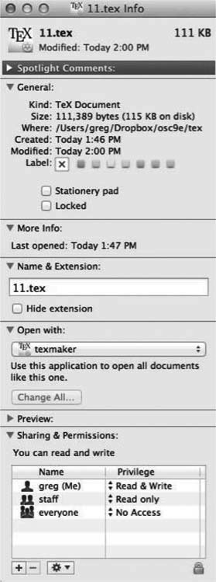
File info Window on Mac OS X

Slide 7
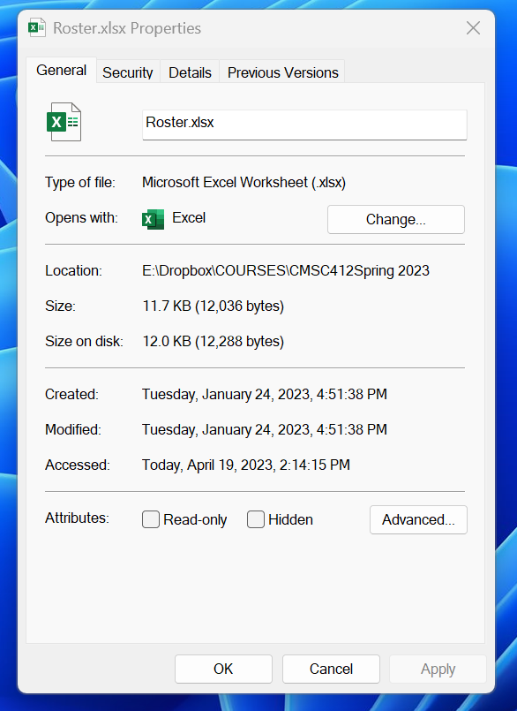
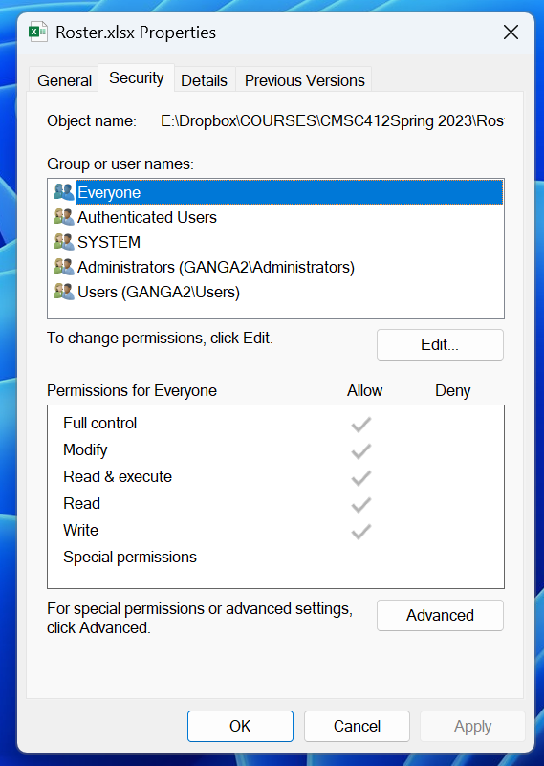
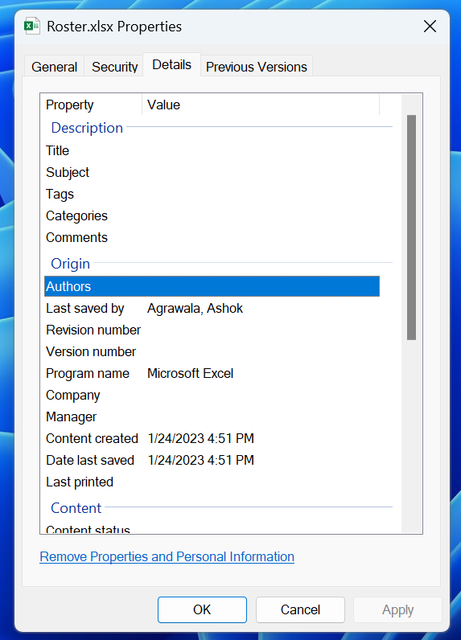
File information in Windows

Slide 8
File Operations
File is an abstract data type
Create
Write – at write pointer location
Read – at read pointer location
Reposition within file - seek
Delete
Truncate
Open(F_{i}) – search the directory structure on disk for entry F_{i}, and move the content of entry to memory
Close (F_{i}) – move the content of entry F_{i} in memory to directory structure on disk

Slide 9
Open Files
Several pieces of data are needed to manage open files:
Open-file table: tracks open files
File pointer: pointer to last read/write location, per process that has the file open
File-open count: counter of number of times a file is open – to allow removal of data from open-file table when last processes closes it
Disk location of the file: cache of data access information
Access rights: per-process access mode information

Slide 10
Open File Locking
Provided by some operating systems and file systems
Similar to reader-writer locks
Shared lock similar to reader lock – several processes can acquire concurrently
Exclusive lock similar to writer lock
Mediates access to a file
Mandatory or advisory:
Mandatory – access is denied depending on locks held and requested
Advisory – processes can find status of locks and decide what to do

Slide 11
File Locking Example – Java API
import java.io.*;
import java.nio.channels.*;
public class LockingExample {
public static final boolean EXCLUSIVE = false;
public static final boolean SHARED = true;
public static void main(String arsg[]) throws IOException {
FileLock sharedLock = null;
FileLock exclusiveLock = null;
try {
RandomAccessFile raf = new RandomAccessFile("file.txt", "rw");
// get the channel for the file
FileChannel ch = raf.getChannel();
// this locks the first half of the file - exclusive
exclusiveLock = ch.lock(0, raf.length()/2, EXCLUSIVE);
/** Now modify the data . . . */
// release the lock
exclusiveLock.release();

Slide 12
File Locking Example – Java API (Cont.)
// this locks the second half of the file - shared
sharedLock = ch.lock(raf.length()/2+1, raf.length(), SHARED);
/** Now read the data . . . */
// release the lock
sharedLock.release();
} catch (java.io.IOException ioe) {
System.err.println(ioe);
}finally {
if (exclusiveLock != null)
exclusiveLock.release();
if (sharedLock != null)
sharedLock.release();
}
}
}

Slide 13
File Name
File Name | Contents
README | Project overview
MANIFEST | List of project files with brief explanations
INSTALL | Installation instructions
Copying | Licensing information
TODO | Wish list for future extensions
NEWS | Documentation on user-visible changes
Changes | Code change summary
configure | Platform configuration script
Makefile | Build specification
Makefile.SH | Shell script producing the above
config.h | Platform configuration definitions
config_h.SH | Shell script producing the above
patchlevel.h | Defines the project release version
name used to uniquely identify a computer file stored in a file system.
Name may include:
Host
Device
Path/Directory/Folder
File – base name
Type/Extension
Version
Common names:

Slide 14
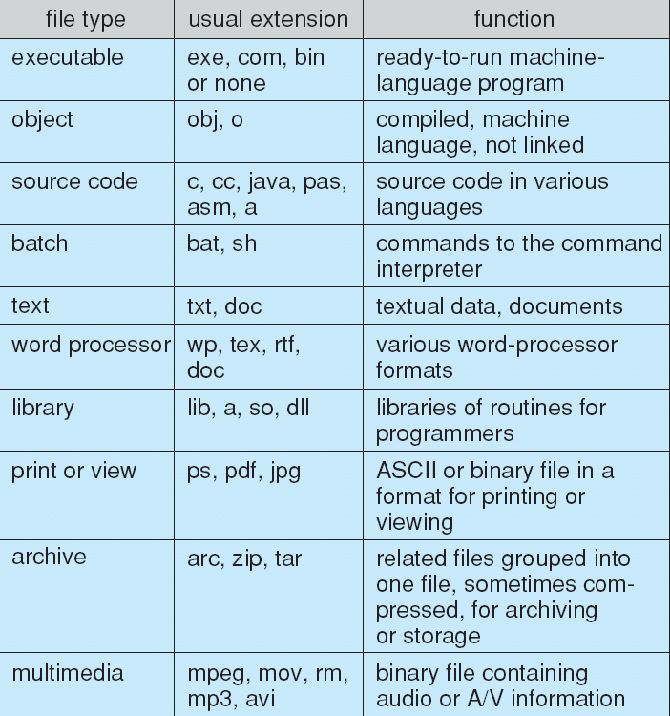
File Types – Name, Extension

Slide 15
File Structure
None - sequence of words, bytes
Simple record structure
Lines
Fixed length
Variable length
Complex Structures
Formatted document
Relocatable load file
Can simulate last two with first method by inserting appropriate control characters
Who decides:
Operating system
Program

Slide 16
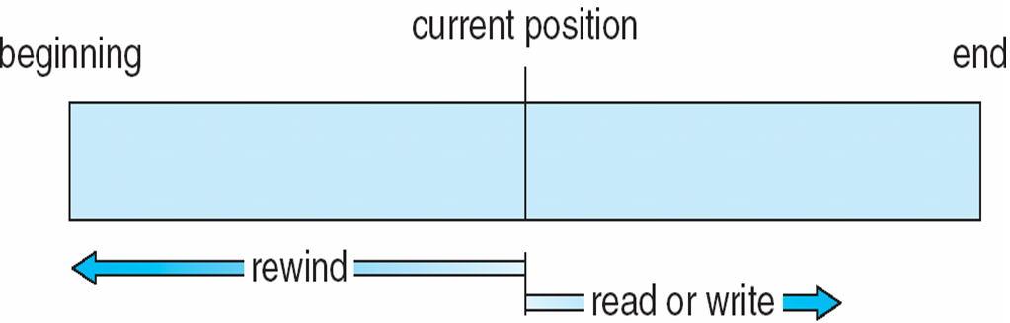
Sequential-access File

Slide 17
Access Methods
Sequential Access
read next
write next
reset
no read after last write
(rewrite)
Direct Access – file is fixed length logical records
read n
write n
position to n
read next
write next
rewrite n
n = relative block number
Relative block numbers allow OS to decide where file should be placed

Slide 18
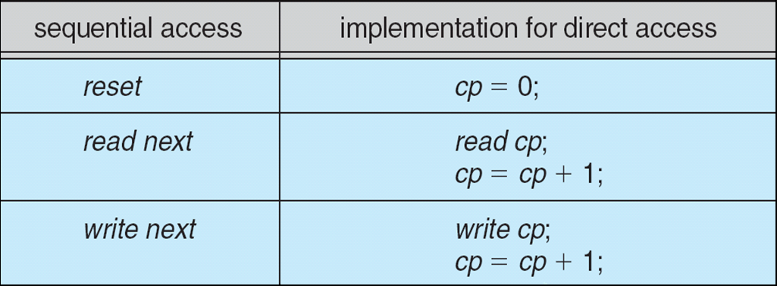
Simulation of Sequential Access on Direct-access File

Slide 19
Other Access Methods
Can be built on top of base methods
General involve creation of an index for the file
Keep index in memory for fast determination of location of data to be operated on (consider UPC code plus record of data about that item)
If too large, index (in memory) of the index (on disk)
IBM indexed sequential-access method (ISAM)
Small master index, points to disk blocks of secondary index
File kept sorted on a defined key
All done by the OS
VMS operating system provides index and relative files as another example (see next slide)

Slide 20
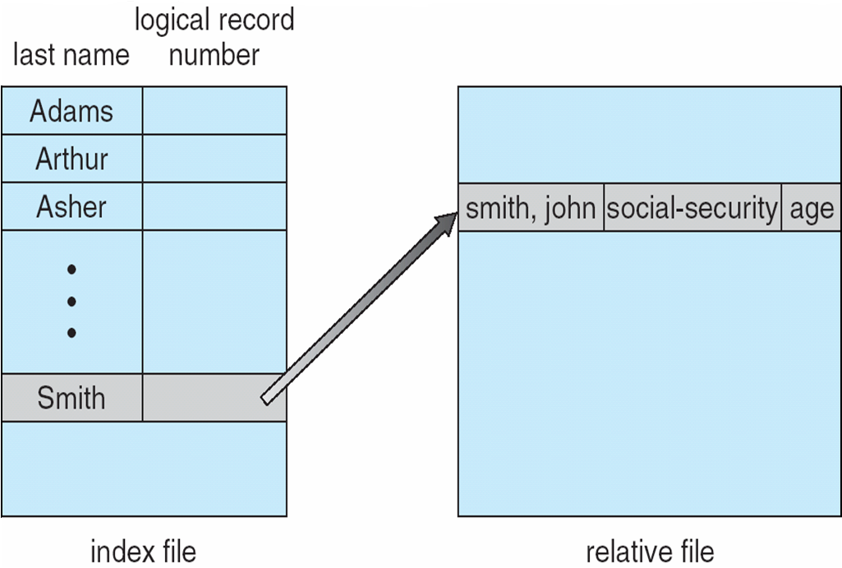
Example of Index and Relative Files

Slide 21
Directory Structure
A collection of nodes containing information about all files
Directory
Files
F 1
F 2
F 3
F 4
F n
Both the directory structure and the files reside on disk

Slide 22
Disk Structure
Disk can be subdivided into partitions
Disks or partitions can be RAID protected against failure
Disk or partition can be used raw – without a file system, or formatted with a file system
Partitions also known as minidisks, slices
Entity containing file system known as a volume
Each volume containing file system also tracks that file system’s info in device directory or volume table of contents
As well as general-purpose file systems there are many special-purpose file systems, frequently all within the same operating system or computer

Slide 23
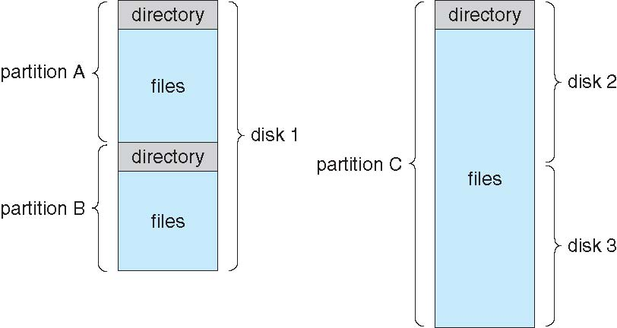
A Typical File-system Organization

Slide 24
Types of File Systems
We mostly talk of general-purpose file systems
But systems frequently have may file systems, some general- and some special- purpose
Consider Solaris has
tmpfs – memory-based volatile FS for fast, temporary I/O
objfs – interface into kernel memory to get kernel symbols for debugging
ctfs – contract file system for managing daemons
lofs – loopback file system allows one FS to be accessed in place of another
procfs – kernel interface to process structures
ufs, zfs – general purpose file systems

Slide 25
Operations Performed on Directory
Search for a file
Create a file
Delete a file
List a directory
Rename a file
Traverse the file system

Slide 26
Directory Organization
The directory is organized logically to obtain
Efficiency – locating a file quickly
Naming – convenient to users
Two users can have same name for different files
The same file can have several different names
Grouping – logical grouping of files by properties, (e.g., all Java programs, all games, …)

Slide 27
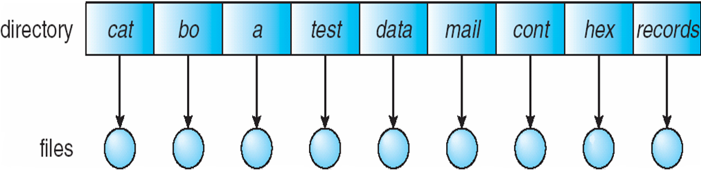
Single-Level Directory
A single directory for all users
Naming problem
Grouping problem

Slide 28
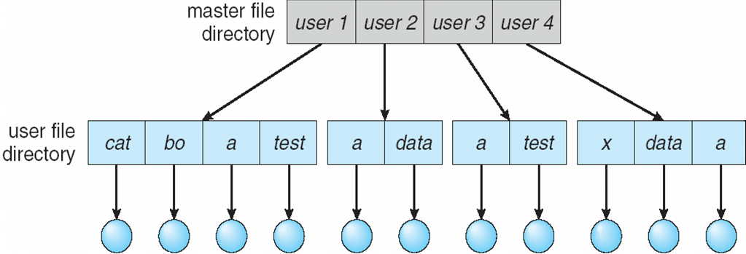
Two-Level Directory
Separate directory for each user
Path name
Can have the same file name for different user
Efficient searching
No grouping capability

Slide 29
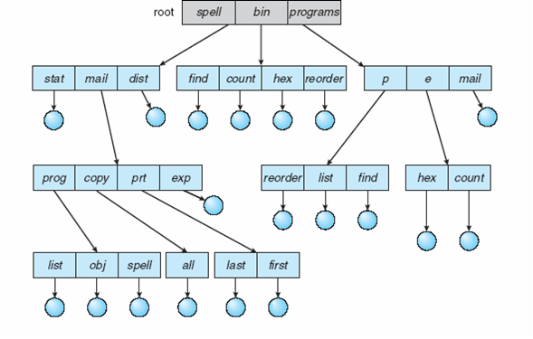
Tree-Structured Directories

Slide 30
Tree-Structured Directories (Cont.)
Efficient searching
Grouping Capability
Current directory (working directory)
cd /spell/mail/prog
type list

Slide 31
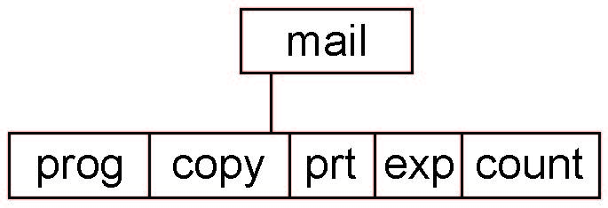
Tree-Structured Directories (Cont)
Absolute or relative path name
Creating a new file is done in current directory
Delete a file
rm <file-name>
Creating a new subdirectory is done in current directory
mkdir <dir-name>
Example: if in current directory /mail
mkdir count
Deleting “mail” ⇒ deleting the entire subtree rooted by “mail”

Slide 32
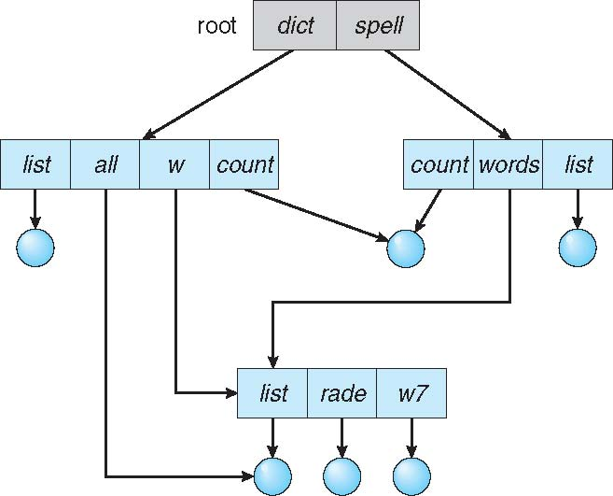
Acyclic-Graph Directories
Have shared subdirectories and files

Slide 33
Acyclic-Graph Directories (Cont.)
Two different names (aliasing)
If dict deletes list ⇒ dangling pointer
Solutions:
Backpointers, so we can delete all pointers Variable size records a problem
Backpointers using a daisy chain organization
Entry-hold-count solution
New directory entry type
Link – another name (pointer) to an existing file
Resolve the link – follow pointer to locate the file

Slide 34
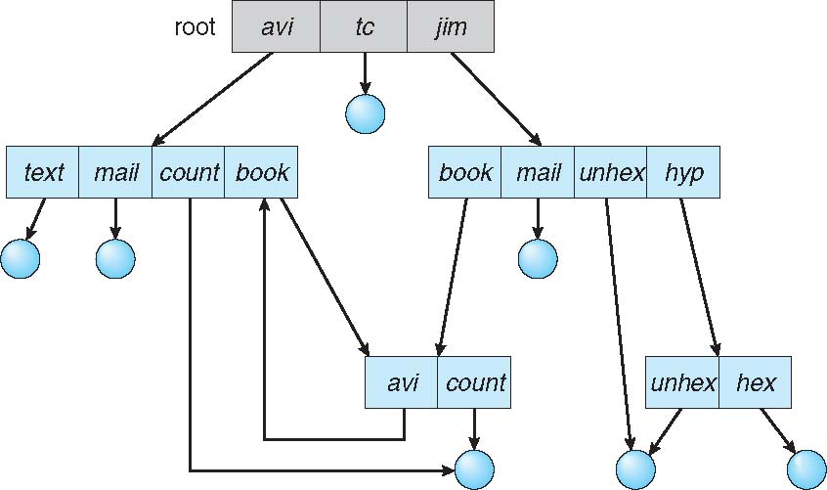
General Graph Directory

Slide 35
General Graph Directory (Cont.)
How do we guarantee no cycles?
Allow only links to file not subdirectories
Garbage collection
Every time a new link is added use a cycle detection algorithm to determine whether it is OK

Slide 36
File System Mounting
A file system must be mounted before it can be accessed
A unmounted file system is mounted at a mount point

Slide 37
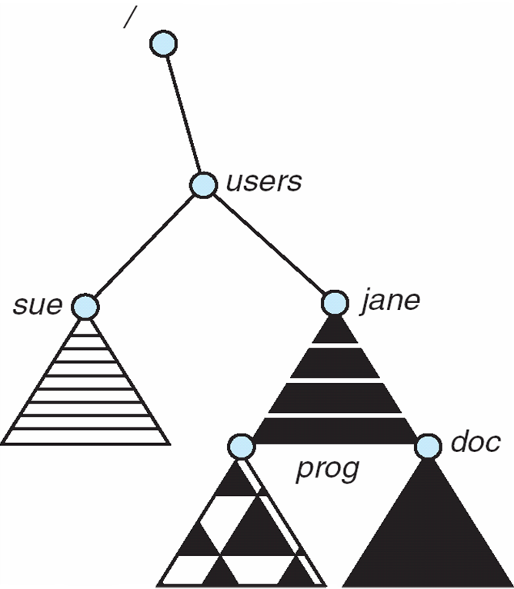
Mount Point

Slide 38
File Sharing
Sharing of files on multi-user systems is desirable
Sharing may be done through a protection scheme
On distributed systems, files may be shared across a network
Network File System (NFS) is a common distributed file-sharing method
If multi-user system
User IDs identify users, allowing permissions and protections to be per-user Group IDs allow users to be in groups, permitting group access rights
Owner of a file / directory
Group of a file / directory

Slide 39
File Sharing – Remote File Systems
Uses networking to allow file system access between systems
Manually via programs like FTP
Automatically, seamlessly using distributed file systems
Semi automatically via the world wide web
Client-server model allows clients to mount remote file systems from servers
Server can serve multiple clients
Client and user-on-client identification is insecure or complicated
NFS is standard UNIX client-server file sharing protocol
CIFS is standard Windows protocol
Standard operating system file calls are translated into remote calls
Distributed Information Systems (distributed naming services) such as LDAP, DNS, NIS, Active Directory implement unified access to information needed for remote computing

Slide 40
File Sharing – Failure Modes
All file systems have failure modes
For example, corruption of directory structures or other non-user data, called metadata
Remote file systems add new failure modes, due to network failure, server failure
Recovery from failure can involve state information about status of each remote request
Stateless protocols such as NFS v3 include all information in each request, allowing easy recovery but less security

Slide 41
File Sharing – Consistency Semantics
Specify how multiple users are to access a shared file simultaneously
Similar to process synchronization algorithms
Tend to be less complex due to disk I/O and network latency (for remote file systems
Andrew File System (AFS) implemented complex remote file sharing semantics
Unix file system (UFS) implements:
Writes to an open file visible immediately to other users of the same open file
Sharing file pointer to allow multiple users to read and write concurrently
AFS has session semantics
Writes only visible to sessions starting after the file is closed

Slide 42
Protection
File owner/creator should be able to control:
what can be done
by whom
Types of access
Read
Write
Execute
Append
Delete
List

Slide 43
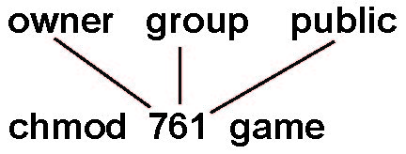
Access Lists and Groups
Mode of access: read, write, execute
Three classes of users on Unix / Linux
RWX
a) owner access 7 ⇒ 1 1 1 RWX
b) group access 6 ⇒ 1 1 0
RWX
c) public access 1 ⇒ 0 0 1
Ask manager to create a group (unique name), say G, and add some users to the group.
For a particular file (say game) or subdirectory, define an appropriate access.
Attach a group to a file chgrp G game

Slide 44
Windows 11 Access-Control List Management

Slide 45
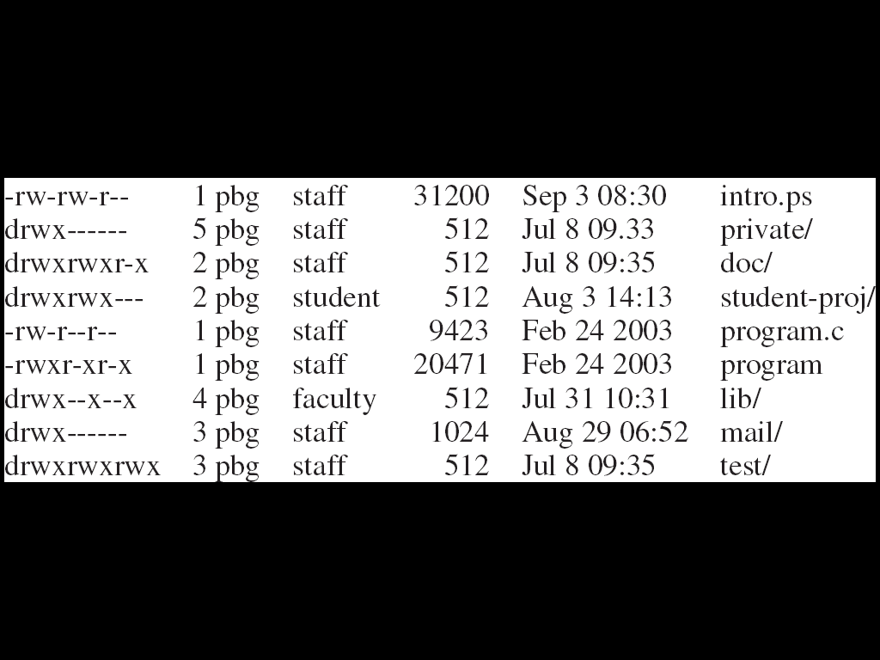
A Sample UNIX Directory Listing

