Slide 1
CSMC 412
Operating Systems
Prof. Ashok K Agrawala
Protection

Slide 2
Chapter 17: Protection
Goals of Protection
Principles of Protection
Protection Rings
Domain of Protection
Access Matrix
Implementation of Access Matrix
Revocation of Access Rights
Role-based Access Control
Mandatory Access Control (MAC)
Capability-Based Systems
Other Protection Implementation Methods
Language-based Protection

Slide 3
Objectives
Discuss the goals and principles of protection in a modern computer system
Explain how protection domains combined with an access matrix are used to specify the resources a process may access
Examine capability and language-based protection systems
Describe how protection mechanisms can mitigate system attacks

Slide 4
Goals of Protection
In one protection model, computer consists of a collection of objects, hardware or software
Each object has a unique name and can be accessed through a well-defined set of operations
Protection problem - ensure that each object is accessed correctly and only by those processes that are allowed to do so

Slide 5
Principles of Protection
Guiding principle – principle of least privilege
  Programs, users and systems should be given just enough privileges to perform their tasks
  Properly set permissions can limit damage if entity has a bug, gets abused
  Can be static (during life of system, during life of process)
  Or dynamic (changed by process as needed) – domain switching, privilege escalation
  Compartmentalization a derivative concept regarding access to data
    Process of protecting each individual system component through the use of specific permissions and access restrictions

Slide 6
Principles of Protection (Cont.)
Must consider “grain” aspect
  Rough-grained privilege management easier, simpler, but least privilege now done in large chunks
    For example, traditional Unix processes either have abilities of the associated user, or of root
  Fine-grained management more complex, more overhead, but more protective
    File ACL lists, RBAC
Domain can be user, process, procedure
Audit trail – recording all protection-orientated activities, important to understanding what happened, why, and catching things that shouldn’t
No single principle is a panacea for security vulnerabilities – need defense in depth

Slide 7
Protection Rings
Components ordered by amount of privilege and protected from each other
  For example, the kernel is in one ring and user applications in another
  This privilege separation requires hardware support
  Gates used to transfer between levels, for example the syscall Intel instruction
  Also traps and interrupts
  Hypervisors introduced the need for yet another ring
  ARMv7 processors added TrustZone(TZ) ring to protect crypto functions with access via new Secure Monitor Call (SMC) instruction
    Protecting NFC secure element and crypto keys from even the kernel

Slide 8
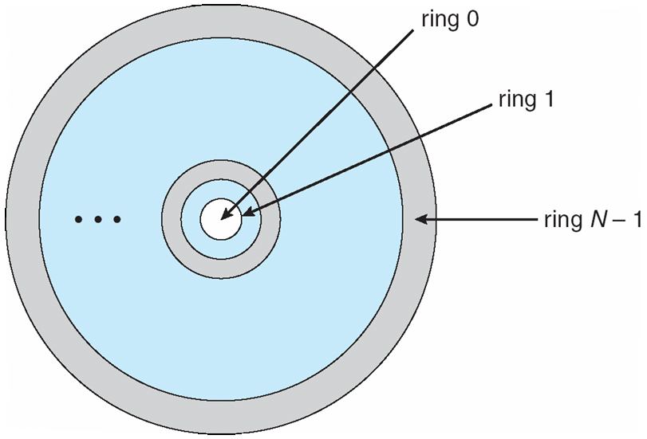
Protection Rings (MULTICS)
Let D_{i} and D_{j} be any two domain rings
If j < I ⇒ D_{i} ⊆ D_{j}

Slide 9
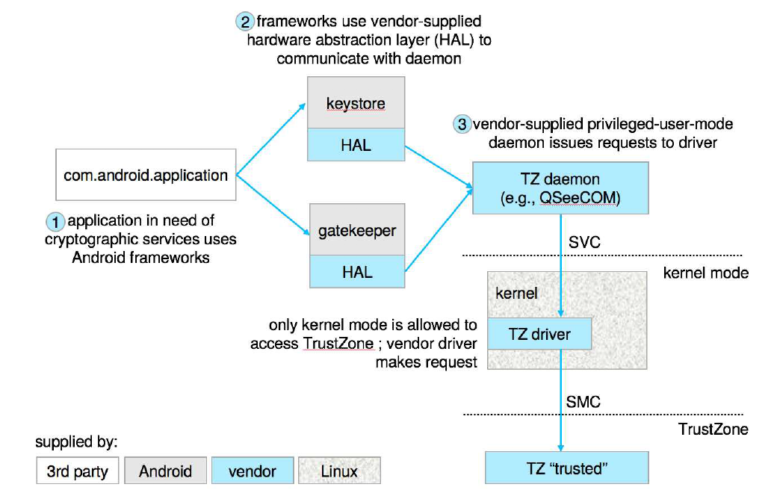
Android use of TrustZone

Slide 10
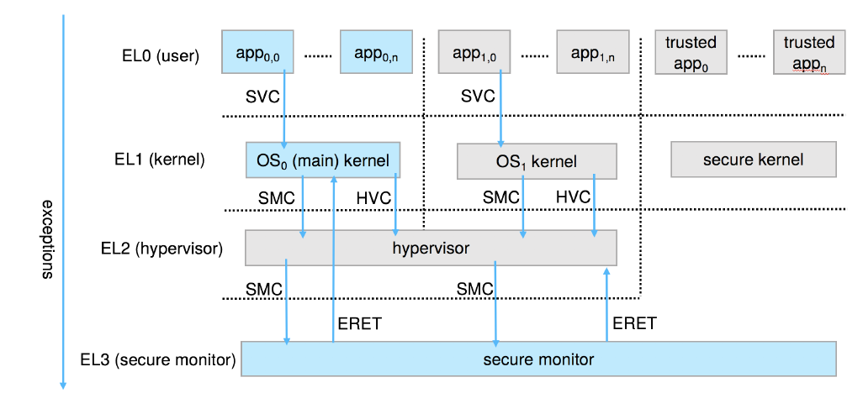
ARM CPU Architecture

Slide 11
Domain of Protection
Rings of protection separate functions into domains and order them hierarchically
Computer can be treated as processes and objects
  Hardware objects (such as devices) and software objects (such as files, programs, semaphores
Process for example should only have access to objects it currently requires to complete its task – the need-to-know principle
Implementation can be via process operating in a protection domain
  Specifies resources process may access
  Each domain specifies set of objects and types of operations on them
  Ability to execute an operation on an object is an access right
    <object-name, rights-set>
  Domains may share access rights
  Associations can be static or dynamic
  If dynamic, processes can domain switch

Slide 12
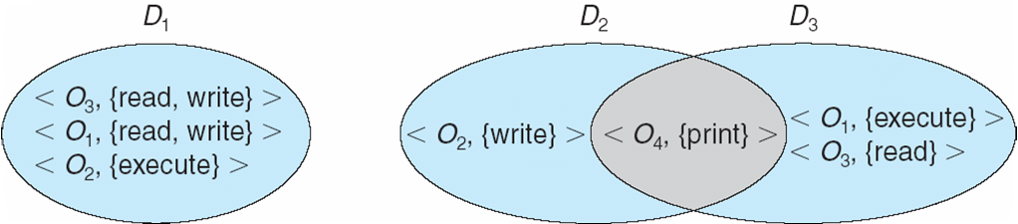
Domain Structure
Access-right = <object-name, rights-set>
where rights-set is a subset of all valid operations that can be performed on the object
Domain = set of access-rights

Slide 13
Domain Implementation (UNIX)
Domain = user-id
Domain switch accomplished via file system
    Each file has associated with it a domain bit (setuid bit)
    When file is executed and setuid = on, then user-id is set to owner of the file being executed
    When execution completes user-id is reset
Domain switch accomplished via passwords
  su command temporarily switches to another user’s domain when other domain’s password provided
Domain switching via commands
  sudo command prefix executes specified command in another domain (if original domain has privilege or password given)

Slide 14
Domain Implementation (Android App IDs)
In Android, distinct user IDs are provided on a per-application basis
When an application is installed, the installd daemon assigns it a distinct user ID (UID) and group ID (GID), along with a private data directory (/data/data/<appname>) whose ownership is granted to this UID/GID combination alone.
Applications on the device enjoy the same level of protection provided by UNIX systems to separate users
A quick and simple way to provide isolation, security, and privacy.
The mechanism is extended by modifying the kernel to allow certain operations (such as networking sockets) only to members of a particular GID (for example, AID INET, 3003)
A further enhancement by Android is to define certain UIDs as “isolated,” prevents them from initiating RPC requests to any but a bare minimum of services

Slide 15
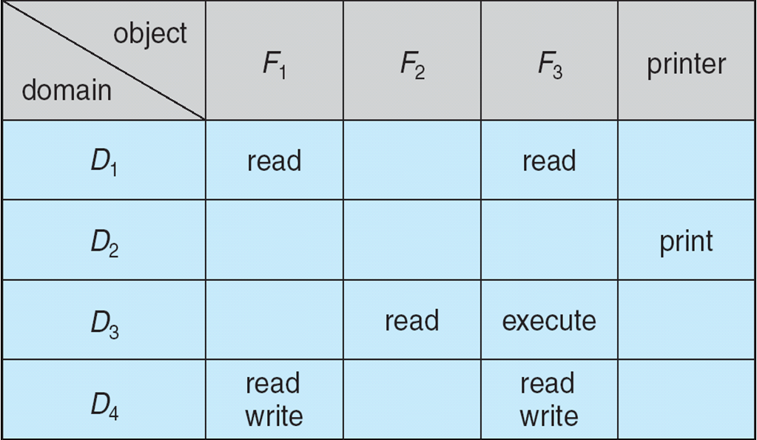
Access Matrix
View protection as a matrix (access matrix)
Rows represent domains
Columns represent objects
Access(i, j) is the set of operations that a process executing in Domain_{i} can invoke on Object_{j}

Slide 16
Use of Access Matrix
If a process in Domain D_{i} tries to do “op” on object O_{j}, then “op” must be in the access matrix
User who creates object can define access column for that object
Can be expanded to dynamic protection
  Operations to add, delete access rights
  Special access rights:
    owner of O_{i}
    copy op from O_{i} to O_{j} (denoted by “*”)
    control – D_{i} can modify D_{j} access rights
    transfer – switch from domain D_{i} to D_{j}
  Copy and Owner applicable to an object
  Control applicable to domain object

Slide 17
Use of Access Matrix (Cont.)
Access matrix design separates mechanism from policy
  Mechanism
    Operating system provides access-matrix + rules
    If ensures that the matrix is only manipulated by authorized agents and that rules are strictly enforced
  Policy
    User dictates policy
    Who can access what object and in what mode
But doesn’t solve the general confinement problem

Slide 18
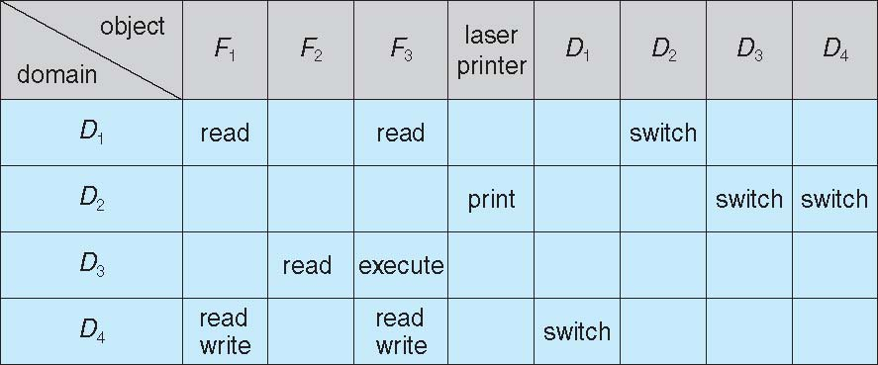
Access Matrix of Figure A with Domains as Objects

Slide 19
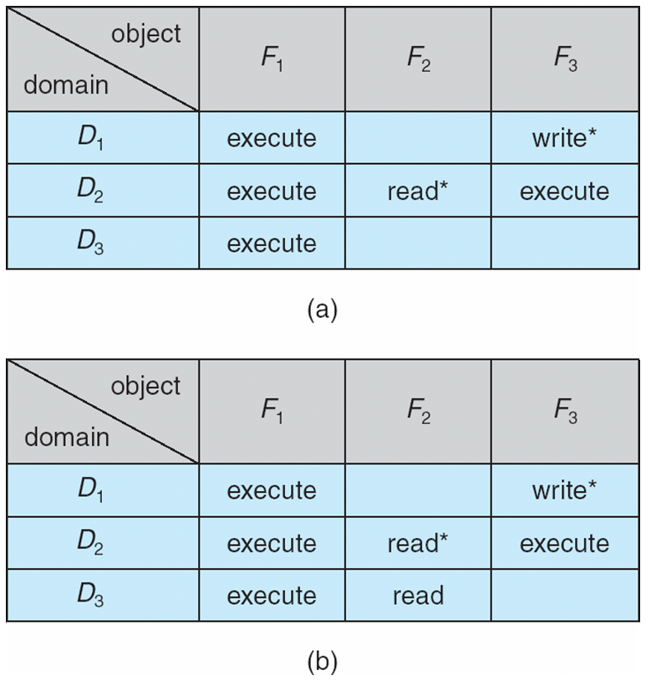
Access Matrix with Copy Rights

Slide 20
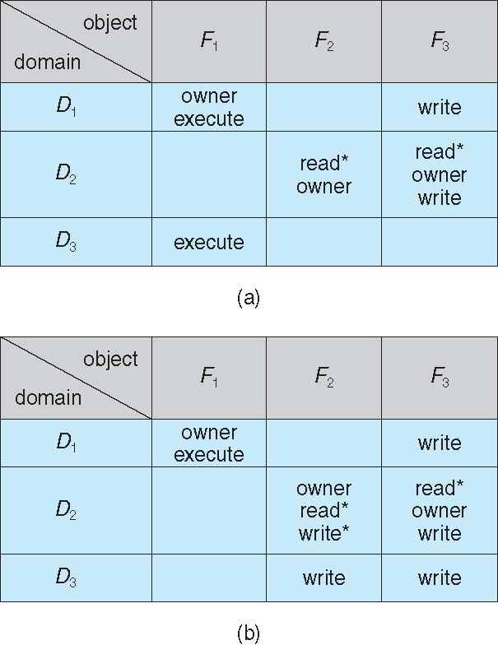
Access Matrix With Owner Rights

Slide 21
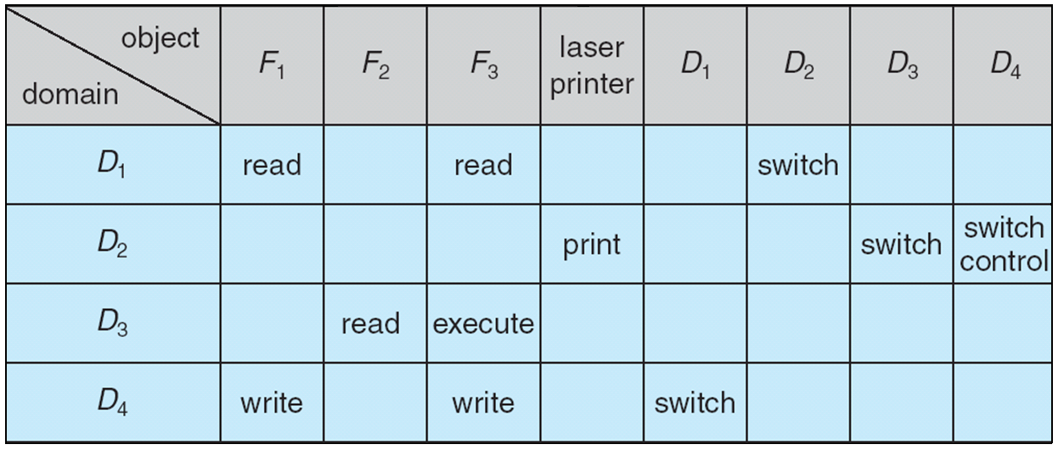
Modified Access Matrix of Figure B

Slide 22
Implementation of Access Matrix
Generally, a sparse matrix
Option 1 – Global table
  Store ordered triples <domain, object, rights-set> in table
  A requested operation M on object O_{j} within domain D_{i} -> search table for < D_{i}, O_{j}, R_{k} >
    with M ∈ R_{k}
  But table could be large -> won’t fit in main memory
  Difficult to group objects (consider an object that all domains can read)

Slide 23
Implementation of Access Matrix (Cont.)
Option 2 – Access lists for objects
  Each column implemented as an access list for one object
  Resulting per-object list consists of ordered pairs <domain, rights-set> defining all domains with non-empty set of access rights for the object
  Easily extended to contain default set -> If M ∈ default set, also allow access

Slide 24
Implementation of Access Matrix (Cont.)
Each column = Access-control list for one object
Defines who can perform what operation
Domain 1 = Read, Write
Domain 2 = Read
Domain 3 = Read
Each Row = Capability List (like a key)
For each domain, what operations allowed on what objects
      Object F1 – Read
      Object F4 – Read, Write, Execute
      Object F5 – Read, Write, Delete, Copy

Slide 25
Implementation of Access Matrix (Cont.)
Option 3 – Capability list for domains
  Instead of object-based, list is domain based
  Capability list for domain is list of objects together with operations allows on them
  Object represented by its name or address, called a capability
  Execute operation M on object O_{j}, process requests operation and specifies capability as parameter
    Possession of capability means access is allowed
  Capability list associated with domain but never directly accessible by domain
    Rather, protected object, maintained by OS and accessed indirectly
    Like a “secure pointer”
    Idea can be extended up to applications

Slide 26
Implementation of Access Matrix (Cont.)
Option 4 – Lock-key
  Compromise between access lists and capability lists
  Each object has list of unique bit patterns, called locks
  Each domain as list of unique bit patterns called keys
  Process in a domain can only access object if domain has key that matches one of the locks

Slide 27
Comparison of Implementations
Many trade-offs to consider
  Global table is simple, but can be large
  Access lists correspond to needs of users
    Determining set of access rights for domain non-localized so difficult
    Every access to an object must be checked
      Many objects and access rights -> slow
  Capability lists useful for localizing information for a given process
    But revocation capabilities can be inefficient
  Lock-key effective and flexible, keys can be passed freely from domain to domain, easy revocation

Slide 28
Comparison of Implementations (Cont.)
Most systems use combination of access lists and capabilities
  First access to an object -> access list searched
    If allowed, capability created and attached to process
      Additional accesses need not be checked
    After last access, capability destroyed
    Consider file system with ACLs per file

Slide 29
Revocation of Access Rights
Various options to remove the access right of a domain to an object
  Immediate vs. delayed
  Selective vs. general
  Partial vs. total
  Temporary vs. permanent
Access List – Delete access rights from access list
  Simple – search access list and remove entry
  Immediate, general or selective, total or partial, permanent or temporary

Slide 30
Revocation of Access Rights (Cont.)
Capability List – Scheme required to locate capability in the system before capability can be revoked
  Reacquisition – periodic delete, with require and denial if revoked
  Back-pointers – set of pointers from each object to all capabilities of that object (Multics)
  Indirection – capability points to global table entry which points to object – delete entry from global table, not selective (CAL)
  Keys – unique bits associated with capability, generated when capability created
    Master key associated with object, key matches master key for access
    Revocation – create new master key
    Policy decision of who can create and modify keys – object owner or others?

Slide 31
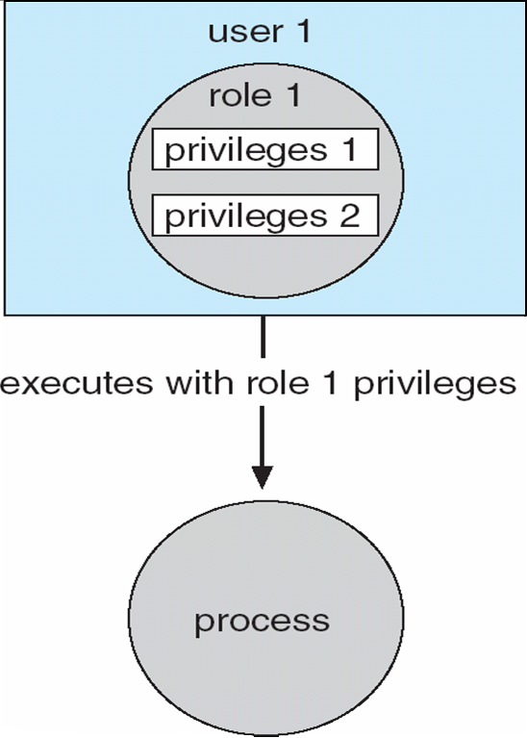
Role-based Access Control
Protection can be applied to non-file resources
Oracle Solaris 10 provides role-based access control (RBAC) to implement least privilege
  Privilege is right to execute system call or use an option within a system call
  Can be assigned to processes
  Users assigned roles granting access to privileges and programs
    Enable role via password to gain its privileges
  Similar to access matrix

Slide 32
Mandatory Access Control (MAC)
Operating systems traditionally had discretionary access control (DAC) to limit access to files and other objects (for example UNIX file permissions and Windows access control lists (ACLs))
  Discretionary is a weakness – users / admins need to do something to increase protection
Stronger form is mandatory access control, which even root user can’t circumvent
  Makes resources inaccessible except to their intended owners
  Modern systems implement both MAC and DAC, with MAC usually a more secure, optional configuration (Trusted Solaris, TrustedBSD (used in macOS), SELinux), Windows Vista MAC)
At its heart, labels assigned to objects and subjects (including processes)
  When a subject requests access to an object, policy checked to determine whether or not a given label-holding subject is allowed to perform the action on the object

Slide 33
Capability-Based Systems
Hydra and CAP were first capability-based systems
Now included in Linux, Android and others, based on POSIX.1e (that never became a standard)
  Essentially slices up root powers into distinct areas, each represented by a bitmap bit
  Fine grain control over privileged operations can be achieved by setting or masking the bitmap
  Three sets of bitmaps – permitted, effective, and inheritable
    Can apply per process or per thread
    Once revoked, cannot be reacquired
    Process or thread starts with all privs, voluntarily decreases set during execution
    Essentially a direct implementation of the principle of least privilege
An improvement over root having all privileges but inflexible (adding new privilege difficult, etc)

Slide 34
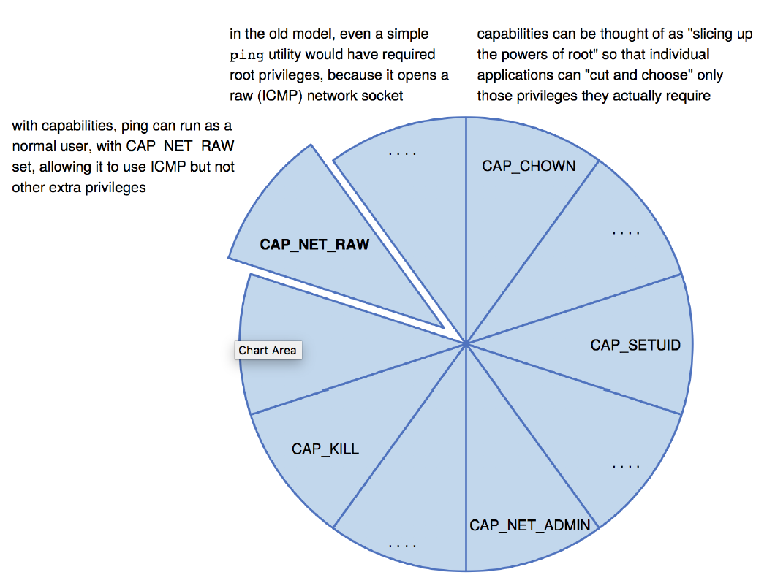
Capabilities in POSIX.1e

Slide 35
Other Protection Improvement Methods
System integrity protection (SIP)
  Introduced by Apple in macOS 10.11
  Restricts access to system files and resources, even by root
  Uses extended file attribs to mark a binary to restrict changes, disable debugging and scrutinizing
  Also, only code-signed kernel extensions allowed and configurably only code-signed apps
System-call filtering
  Like a firewall, for system calls
  Can also be deeper –inspecting all system call arguments
  Linux implements via SECCOMP-BPF (Berkeley packet filtering)

Slide 36
Other Protection Improvement Methods (cont.)
Sandboxing
  Running process in limited environment
  Impose set of irremovable restrictions early in startup of process (before main())
  Process then unable to access any resources beyond its allowed set
  Java and .net implement at a virtual machine level
  Other systems use MAC to implement
  Apple was an early adopter, from macOS 10.5’s “seatbelt” feature
    Dynamic profiles written in the Scheme language, managing system calls even at the argument level
    Apple now does SIP, a system-wide platform profile

Slide 37
Other Protection Improvement Methods (cont.)
Code signing allows a system to trust a program or script by using crypto hash to have the developer sign the executable
  So code as it was compiled by the author
  If the code is changed, signature invalid and (some) systems disable execution
  Can also be used to disable old programs by the operating system vendor (such as Apple) cosigning apps, and then invaliding those signatures so the code will no longer run

Slide 38
Language-Based Protection
Specification of protection in a programming language allows the high-level description of policies for the allocation and use of resources
Language implementation can provide software for protection enforcement when automatic hardware-supported checking is unavailable
Interpret protection specifications to generate calls on whatever protection system is provided by the hardware and the operating system

Slide 39
Protection in Java 2
Protection is handled by the Java Virtual Machine (JVM)
A class is assigned a protection domain when it is loaded by the JVM
The protection domain indicates what operations the class can (and cannot) perform
If a library method is invoked that performs a privileged operation, the stack is inspected to ensure the operation can be performed by the library
Generally, Java’s load-time and run-time checks enforce type safety
Classes effectively encapsulate and protect data and methods from other classes

Slide 40
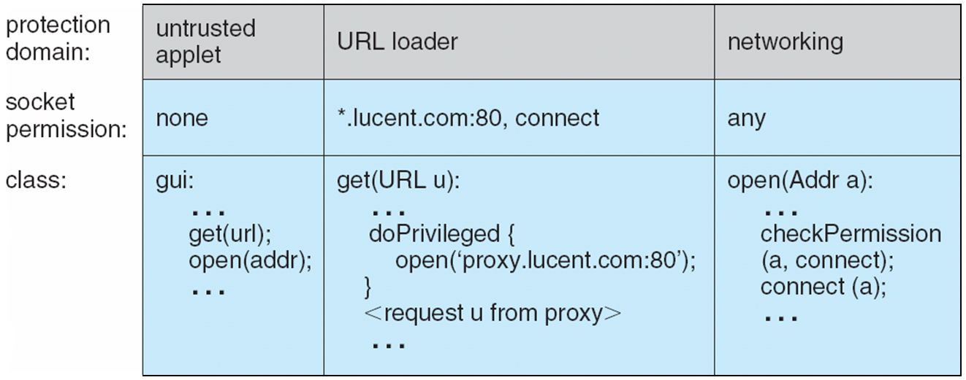
Stack Inspection

