Slide 1

Computer Networks
CMSC 417 : Spring 2023
Topic: Internetworking: ARP, ICMP, VPN
(Textbook chapter 3)
Nirupam Roy
Tu-Th 2:00-3:15pm
CSI 2117

Slide 2
Internet Control Message Protocol (ICMP)

Slide 3
Internet Control Message Protocol (ICMP)
Defines a collection of error messages that are sent back to the source host whenever a router or host is unable to process an IP datagram successfully
  Destination host unreachable due to link /node failure
  Reassembly process failed
  TTL had reached 0 (so datagrams don't cycle forever)
  IP header checksum failed
ICMP-Redirect
  From router to a source host
  With a better route information

Slide 4
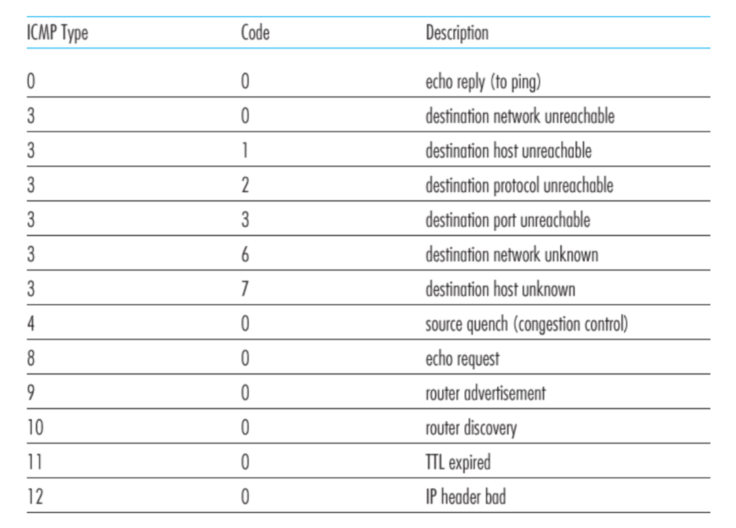
ICMP message types

Slide 5
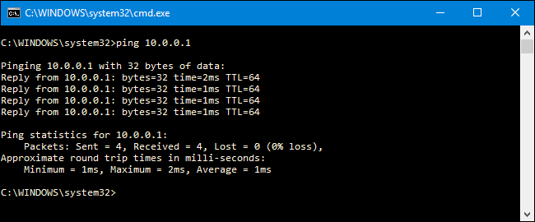
Ping example

Slide 6
Traceroute : An unintuitive application using ICMP

Slide 7
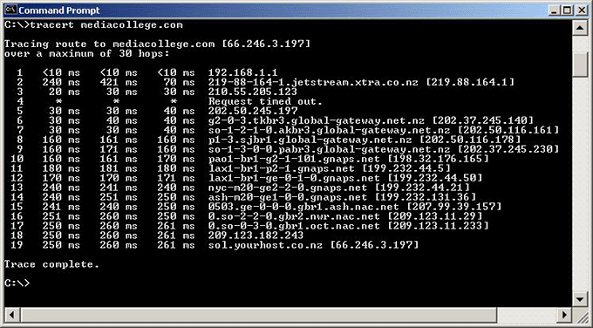
Traceroute example

Slide 8
Traceroute : An unintuitive application

Slide 9
Virtual Networks and Tunnels

Slide 10

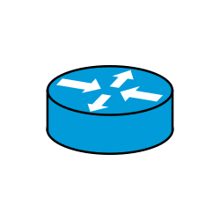

Untrusted/Shared network
Gateway A
Gateway B
IP Header
Data
Trusted network (Site A)
Trusted network (Site B)

Slide 11
Untrusted/Shared network
Gateway A
Gateway B
Virtual Tunnel
IP Header
Data
Trusted network (Site A)
Trusted network (Site B)

Slide 12
New IP Header Source: Gateway-A Dest: Gateway-A
Encapsulation
IP Header
Data
Untrusted/Shared network
Gateway A
Gateway B
Virtual Tunnel
IP Header
Data
Trusted network (Site A)
Trusted network (Site B)

Slide 13
New IP Header Source: Gateway-A Dest: Gateway-A
Decapsulation
New IP Header Source: Gateway-A Dest: Gateway-A
IP Header
Data
IP Header
Data
Untrusted/Shared network
Gateway A
Gateway B
Virtual Tunnel
IP Header
Data
Trusted network (Site A)
Trusted network (Site B)

Slide 14
Untrusted/Shared network
Gateway A
Gateway B
Virtual Tunnel
IP Header
Data
IP Header
Data
Trusted network (Site A)
Trusted network (Site B)

Slide 15

New IP Header Source: Gateway-A Dest: Gateway-A
New IP Header Source: Gateway-A Dest: Gateway-A
Encryption/Decryption
IP Header
Data
IP Header
Data
Untrusted/Shared network
Gateway A
Gateway B
Virtual Tunnel
IP Header
Data
Trusted network (Site A)
Trusted network (Site B)

Slide 16
Untrusted/Shared network
Gateway A
Gateway B
Virtual Tunnel
Virtual Private Network
(VPN)
Trusted network (Site A)
Trusted network (Site B)

Slide 17
Why do we need virtual networks or tunnels?
1. Security
2. Special capabilities between routers (e.g., multicast)
3. Supporting heterogeneity

Slide 18
Why do we need virtual networks or tunnels?
1. Security
2. Special capabilities between routers (e.g., multicast)
3. Supporting heterogeneity
Disadvantages:
1. Increases packet length
a) Wastage of bandwidth
b) More processing
c) Fragmentation
2. Increases management cost

Slide 19
IPv6
1) Address and packet format
2) Unicast, Multicast, Anycast addressing
3) IPV4 and IPV6 coexistence

Slide 20
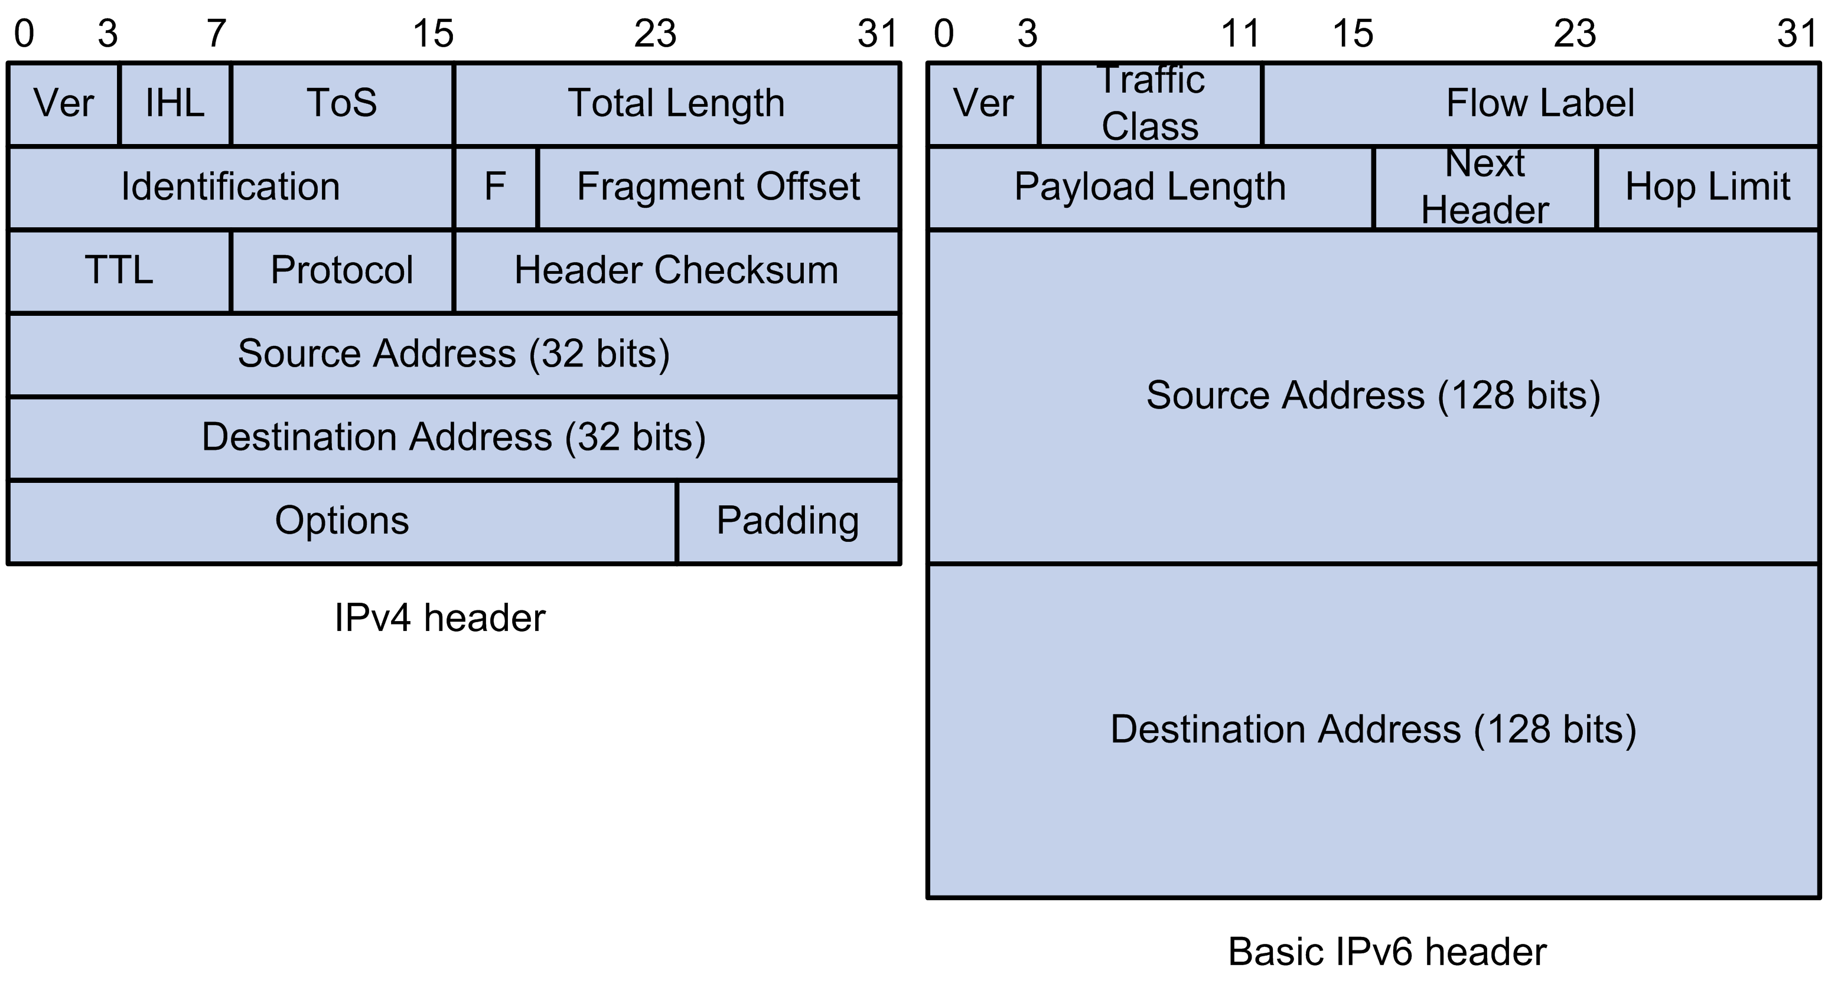
IPv6: Address and packet format
Pic courtesy: https://techhub.hpe.com

Slide 21
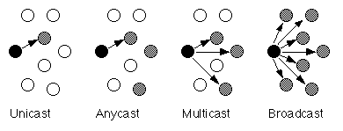
IPv6: Unicast, Multicast, Anycast addressing

Slide 22
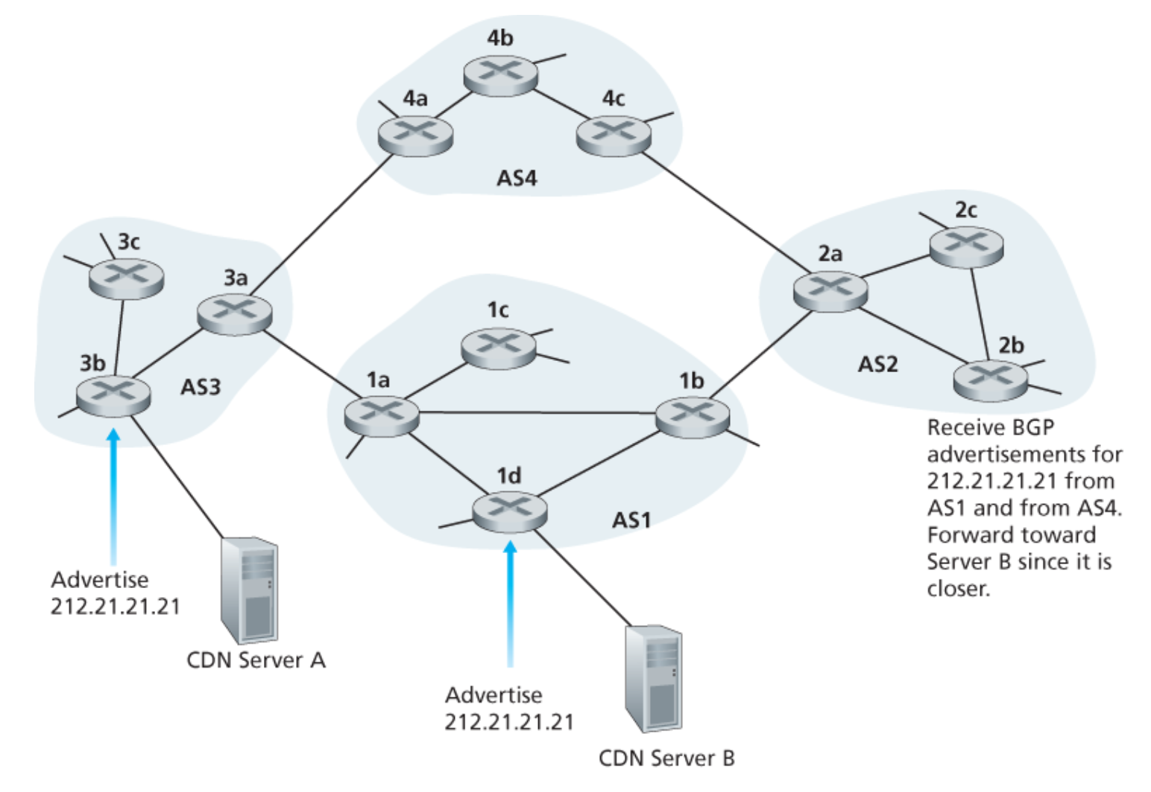
IPv6: Unicast, Multicast, Anycast addressing
IP: Anycast example

Slide 23
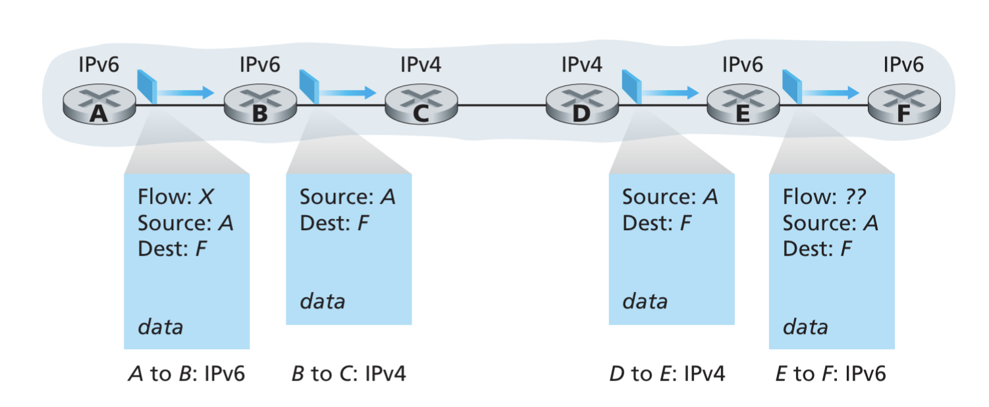
IPv4 and IPv6 Co-existence

Slide 24
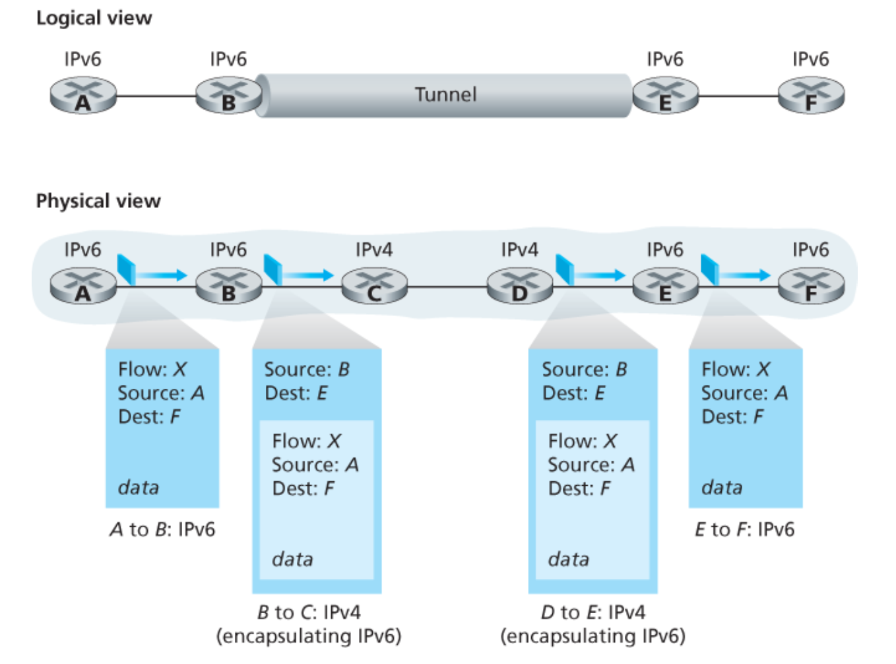
IPv4 and IPv6 Co-existence

Slide 25
Computer Networks
CMSC 417 : Spring 2023
Topic: Transport Layer Protocols (UDP, TCP)
(Textbook chapter 5)
Nirupam Roy
Tu-Th 2:00-3:15pm
CSI 2117

Slide 26
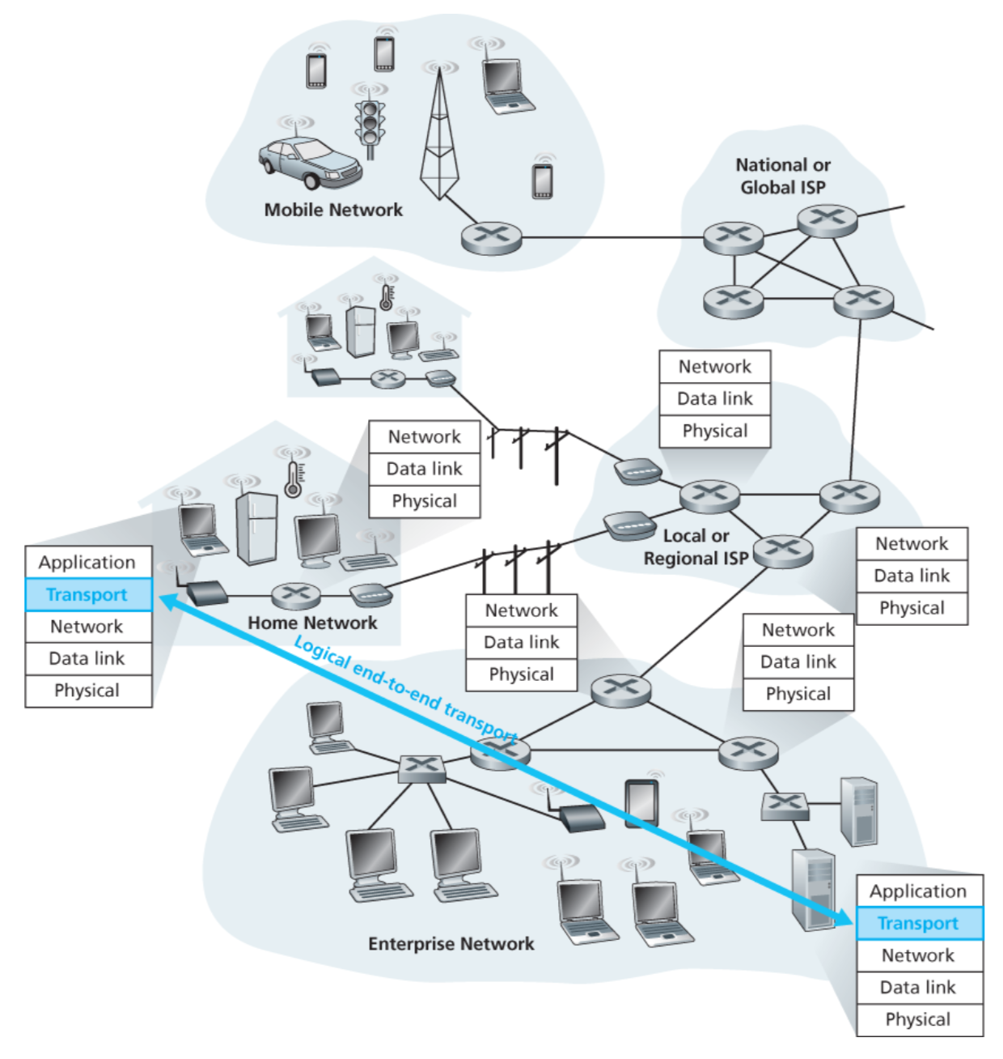

Slide 27
Transport layer: Two perspective
(1) Abstraction of clients. (machines/networks/processes)
(2) Abstraction of services.

Slide 28
(1) Abstraction of clients

Slide 29
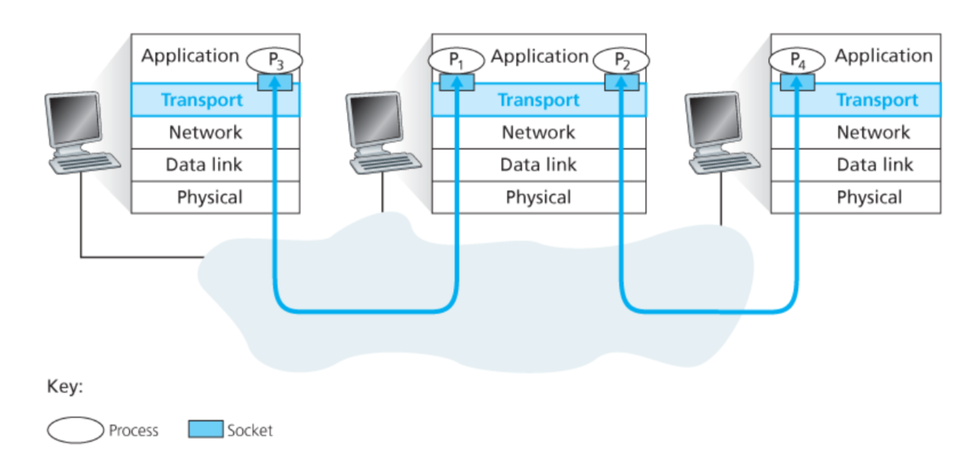
Connection between processes

Slide 30
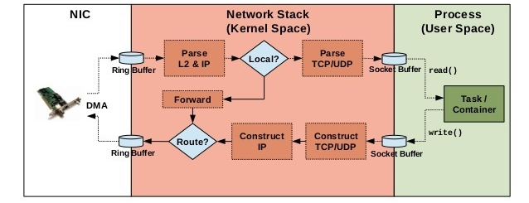
Implementation of networking algorithms

Slide 31
Transport Protocols
Logical communication between processes
  Sender divides a message into segments
  Receiver reassembles segments into message
Transport services
  (De)multiplexing packets
  Detecting corrupted data
  Optionally: reliable delivery, flow control, …

Slide 32
Two Basic Transport Features
Demultiplexing: port numbers
Error detection: checksums
Server host 128.2.194.242
Service request for
128.2.194.242:80
(i.e., the Web server)
Client host
Web server
(port 80)
Client
OS
Echo server
(port 7)
IP
payload
detect corruption

Slide 33
Multiplexing/demultiplexing
Demultiplexing at rcv host:
Multiplexing at send host:
delivering received segments
to correct socket
gathering data from multiple
sockets, enveloping data with
header (later used for
demultiplexing)
= socket
= process
application
application
application
P4
P3
P1
P2
P1
transport
transport
transport
network
network
network
link
link
link
physical
physical
physical
host 1
host 2
host 3

Slide 34
How demultiplexing works
host receives IP datagrams
  each datagram has source IP address, destination IP address
  each datagram carries 1 transport-layer segment
  each segment has source, destination port number
host uses IP addresses & port numbers to direct segment to appropriate socket
32 bits
source port #
dest port #
other header fields
application
data
(message)
Analogous to airport shuttles
Shuttles MUX passengers and take them
to downtown -- DeMUX at different locations
TCP/UDP segment format

Slide 35
Connection-less mux/demux:
- User Datagram Protocol (UDP)
Connection-oriented mux/demux:
- Transmission Control Protocol (TCP)

Slide 36
Connectionless demultiplexing
When host receives UDP segment:
  checks destination port number in segment
  directs UDP segment to socket with that port number
IP datagrams with different source IP addresses and/or source port numbers directed to same socket
Create sockets with port numbers:
DatagramSocket mySocket1 = new DatagramSocket(99111);
DatagramSocket mySocket2 = new DatagramSocket(99222);
UDP socket identified by two-tuple:
(dest IP address, dest port number)

Slide 37
Connectionless demux (cont)
DatagramSocket serverSocket = new DatagramSocket(6428);
P2
P1
P3
P1
SP: 6428
SP: 6428
DP: 9157
DP: 5775
SP: 9157
SP: 5775
client
IP: A
DP: 6428
server
IP: C
DP: 6428
Client
IP:B
SP provides “return address”

Slide 38
Connection-oriented demux
TCP socket identified by 4-tuple:
  source IP address
  source port number
  dest IP address
  dest port number
recv host uses all four values to direct segment to appropriate socket
Server host may support many simultaneous TCP sockets:
  each socket identified by its own 4-tuple
Web servers have different sockets for each connecting client
  non-persistent HTTP will have different socket for each request

Slide 39
Connection-oriented demux (cont)
= socket
= process
P1
P4
P5
P6
P2
P1
P3
SP: 5775
DP: 80
S-IP: B
D-IP:C
SP: 9157
SP: 9157
client
IP: A
DP: 80
server
IP: C
DP: 80
Client
IP:B
S-IP: A
S-IP: B
D-IP:C
D-IP:C

Slide 40
Connection-oriented demux: Threaded Web Server
= socket
= process
P1
P4
P2
P1
P3
SP: 5775
DP: 80
S-IP: B
D-IP:C
SP: 9157
SP: 9157
client
IP: A
DP: 80
server
IP: C
DP: 80
Client
IP:B
S-IP: A
S-IP: B
D-IP:C
D-IP:C

Slide 41
(2) Abstraction of services

Slide 42
IP Protocol Stack: Key Abstractions
Application
Applications
Transport
Reliable streams
Messages
Network
Best-effort global packet delivery
Best-effort local packet delivery
Link
Transport layer is where we “pay the piper”
  Provide applications with good abstractions
  Without support or feedback from the network

Slide 43
End-to-end Protocols
Common properties that a transport protocol can be expected to provide
  Guarantees message delivery
  Delivers messages in the same order they were sent
  Delivers at most one copy of each message
  Supports arbitrarily large messages
  Supports synchronization between the sender and the receiver
  Allows the receiver to apply flow control to the sender
  Supports multiple application processes on each host

Slide 44
End-to-end Protocols
Typical limitations of the network on which transport protocol will operate
  Drop messages/Packet loss
  Reorder messages/Out of order delivery
  Deliver duplicate copies of a given message
  Limit messages to some finite size
  Deliver messages after an arbitrarily long delay

Slide 45
End-to-end Protocols
Challenge for Transport Protocols
  Develop algorithms that turn the less-than-desirable properties of the underlying network into the high level of service required by application programs

Slide 46
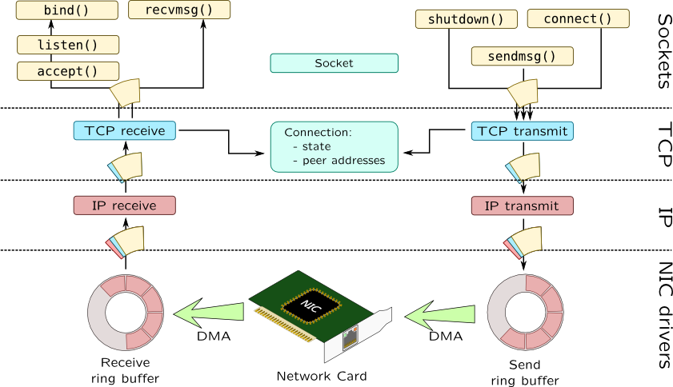

Slide 47
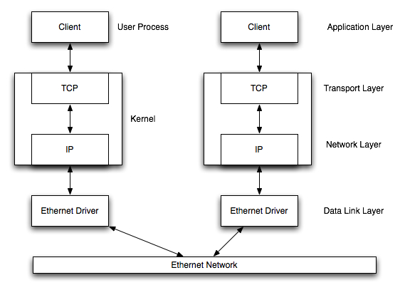

Slide 48
UDP: User Datagram Protocol [RFC 768]
“no frills,” “bare bones” Internet transport protocol
“best effort” service, UDP segments may be:
  lost
  delivered out of order to app
connectionless:
  no handshaking between UDP sender, receiver
  each UDP segment handled independently of others
Why is there a UDP?
no connection establishment (which can add delay)
simple: no connection state at sender, receiver
small segment header
no congestion control: UDP can blast away as fast as desired

Slide 49
UDP: more
often used for streaming multimedia apps
  loss tolerant
  rate sensitive
other UDP uses
  DNS
  SNMP
reliable transfer over UDP: add reliability at application layer
  application-specific error recovery!
32 bits
Length, in
bytes of UDP
segment,
including
header
source port #
dest port #
length
checksum
Application
data
(message)
UDP segment format

Slide 50
UDP checksum
Goal: detect “errors” (e.g., flipped bits) in transmitted segment
Sender:
treat segment contents as sequence of 16-bit integers
checksum: addition (1’s complement sum) of segment contents
sender puts checksum value into UDP checksum field
Receiver:
compute checksum of received segment
check if computed checksum equals checksum field value:
  NO - error detected
  YES - no error detected. But maybe errors nonetheless? More later ….

Slide 51
User Datagram Protocol (UDP)
Datagram messaging service
  Demultiplexing: port numbers
  Detecting corruption: checksum
Lightweight communication between processes
  Send and receive messages
  Avoid overhead of ordered, reliable delivery
SRC port
DST port
checksum
length
DATA

Slide 52
Recall encapsulation

Slide 53
Advantages of UDP
Fine-grain control
  UDP sends as soon as the application writes
No connection set-up delay
  UDP sends without establishing a connection
No connection state
  No buffers, parameters, sequence #s, etc.
Small header overhead
  UDP header is only eight-bytes long

Slide 54
Popular Applications That Use UDP
Multimedia streaming
  Retransmitting packets is not always worthwhile
  E.g., phone calls, video conferencing, gaming, IPTV
Simple query-response protocols
  Overhead of connection establishment is overkill
  E.g., Domain Name System (DNS), DHCP, etc.
“Address for www.cnn.com?”
“12.3.4.15”

Slide 55
What are the features of a ‘best effort’ network?
Packet loss
Out of order delivery
Multiple copies
Delay variations
A non-zero probability of packet delivery

Slide 56
What are the expectations from a reliable packet delivery system?
Guaranteed delivery
Ordered delivery
At-most one copy of the message
(any or all of the above)

