Slide 1

Computer Networks
CMSC 417 : Spring 2023
Topic: Link layer: WiFi, Cellular
(Textbook chapter 2)
Nirupam Roy
Tu-Th 2:00-3:15pm
CSI 2117

Slide 2
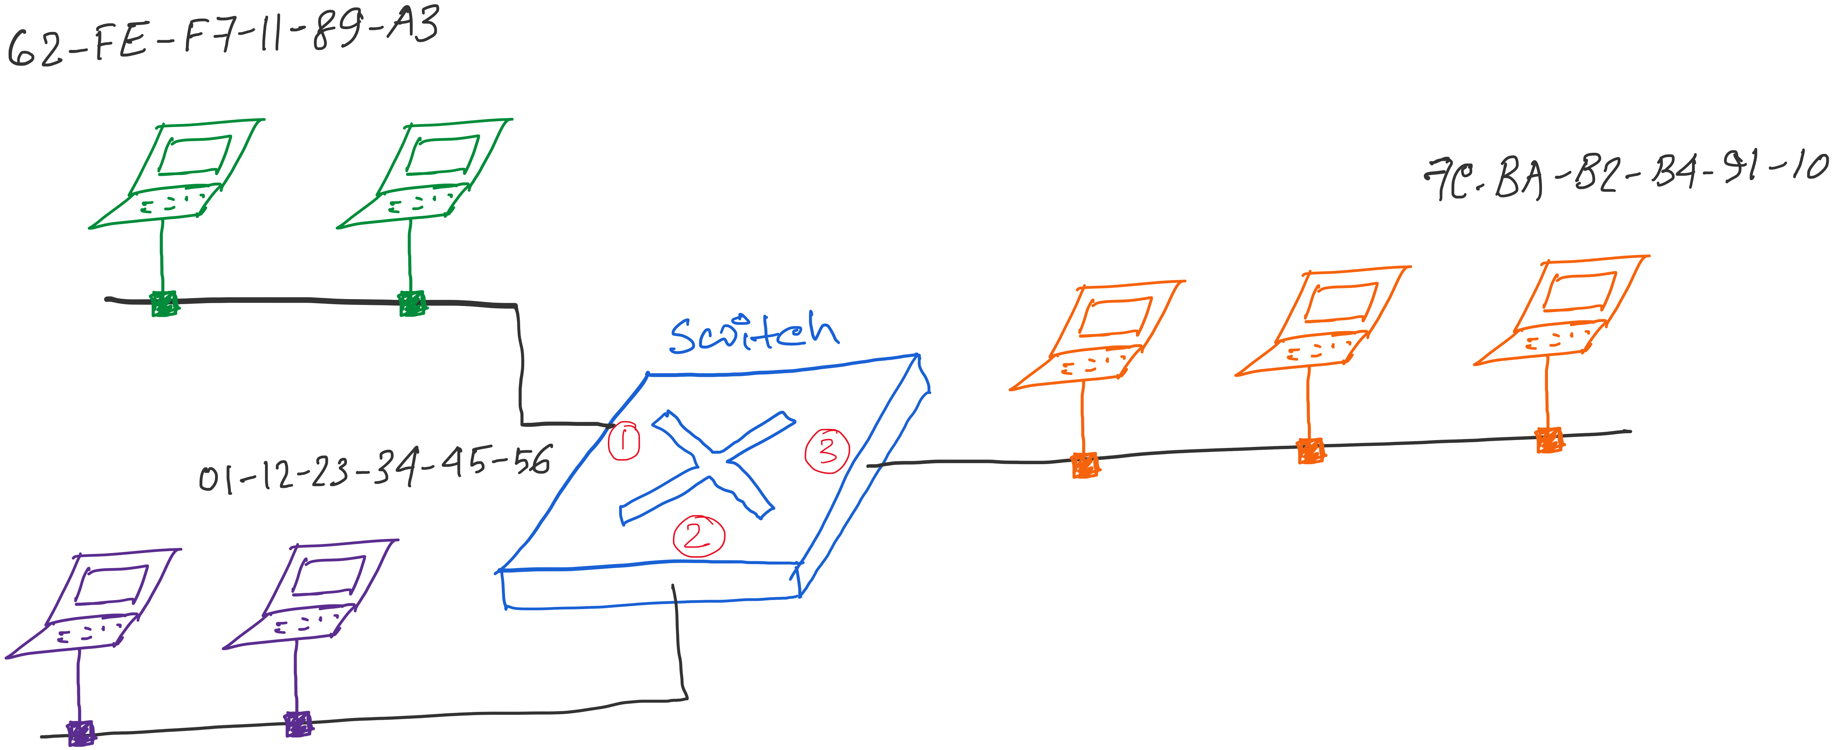
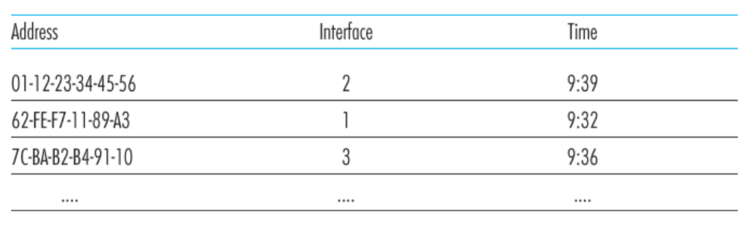
Traffic Isolation: Example
Switch table

Slide 3
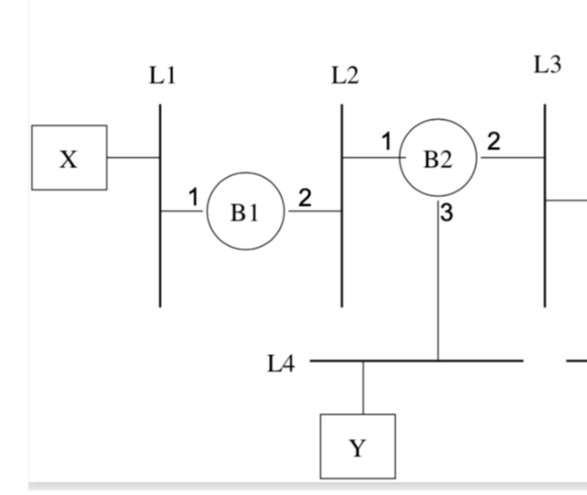
Problems related to learning-bridges/switches

Slide 4
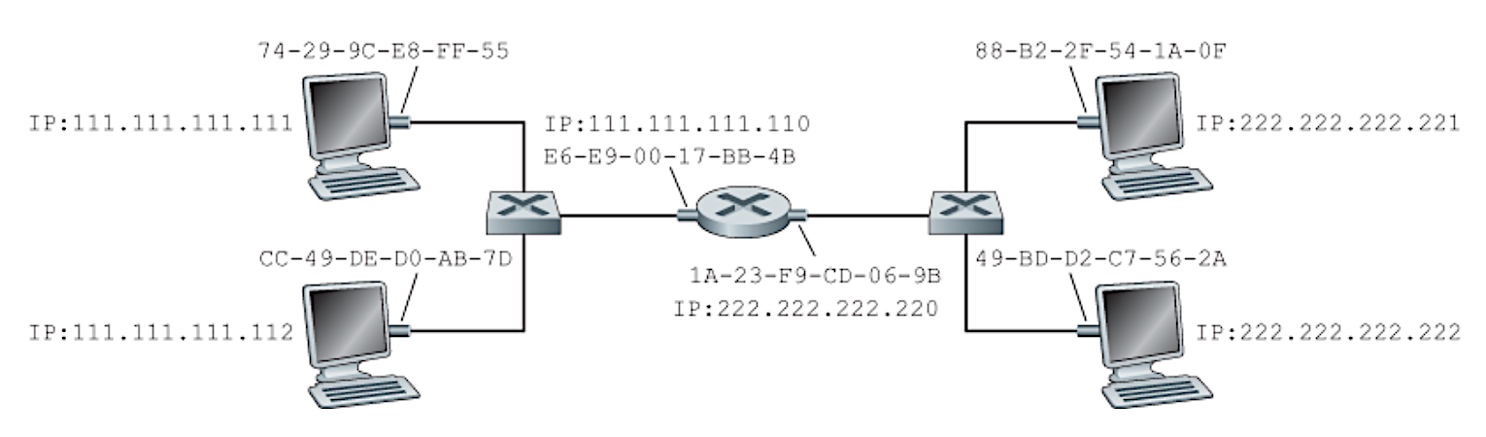
Problems related to learning-bridges/switches
and routers
Notes:
Figure: Computer Networking - A Top Down Approach, 7th edition, Figure 6.19

Slide 5
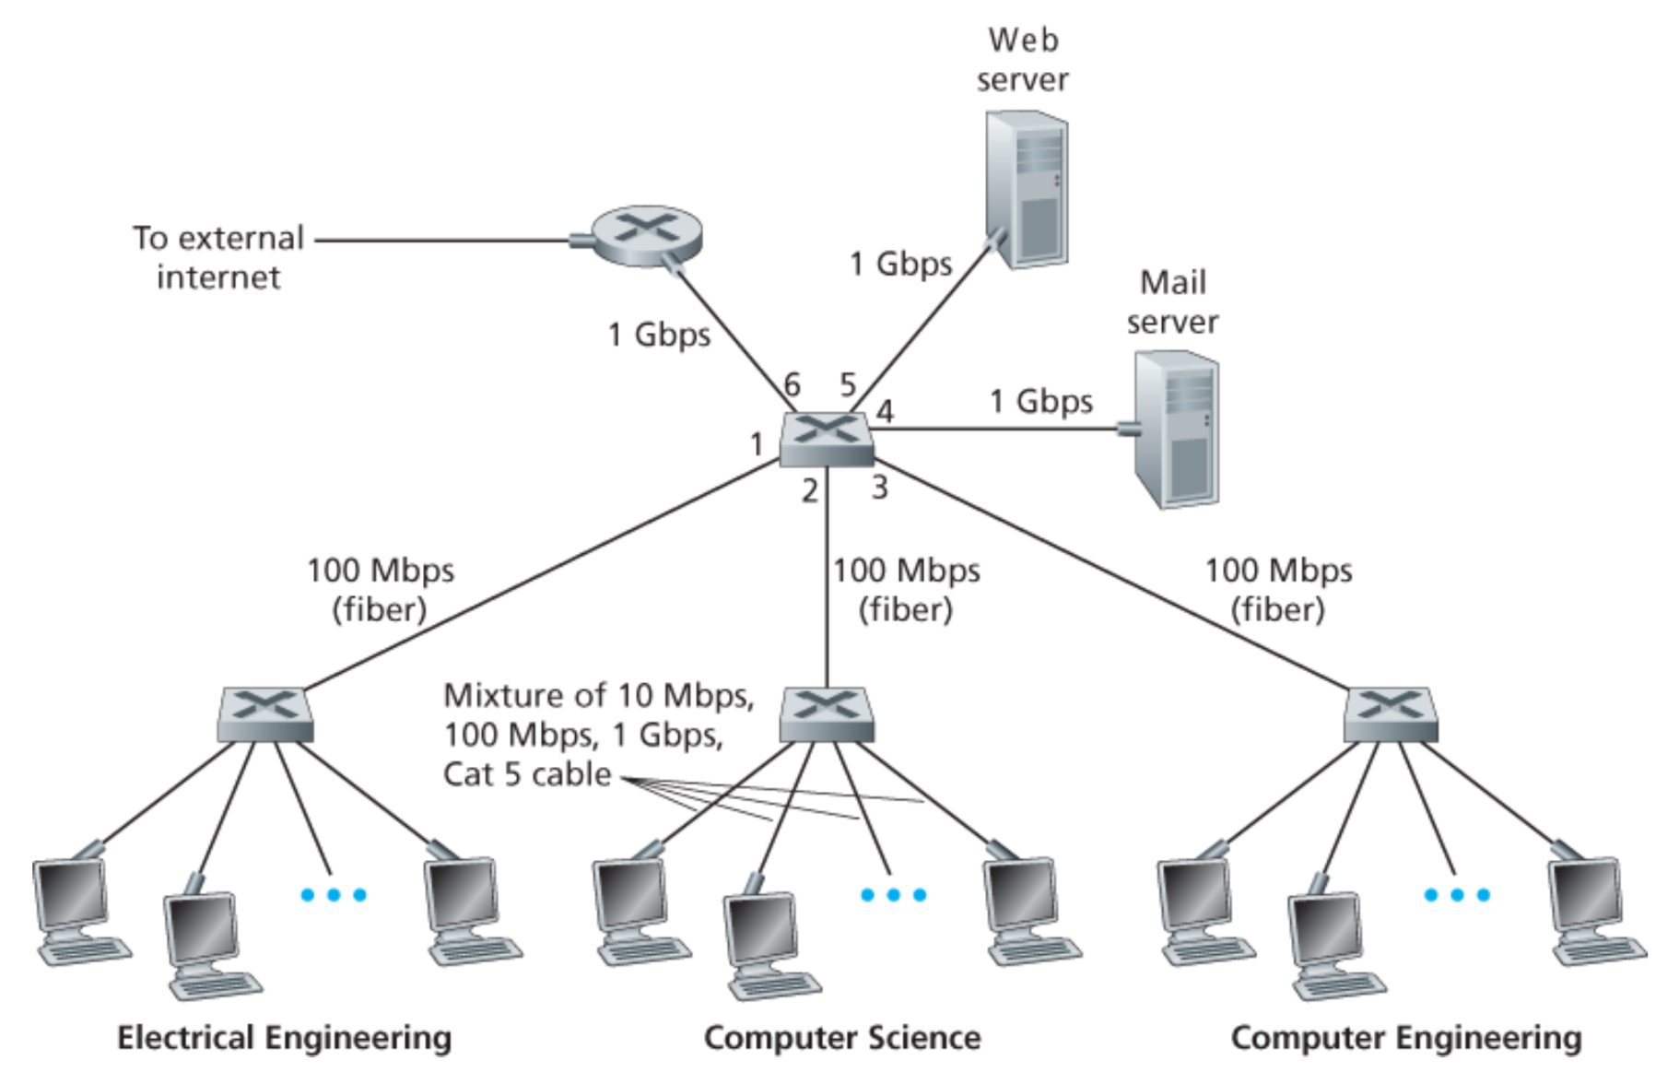

Slide 6
Summary: Multiple Layers
Different devices switch different things
  Network layer: packets (routers)
  Link layer: frames (bridges and switches)
  Physical layer: electrical signals (repeaters and hubs)
Application
Transport
Frame
header
Packet
header
TCP
header
User
data
Router
Bridge, switch
Repeater, hub

Slide 7

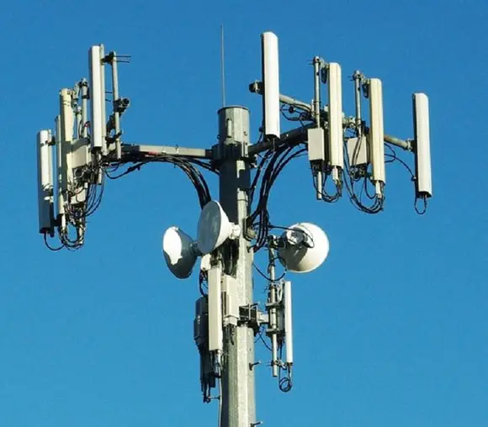
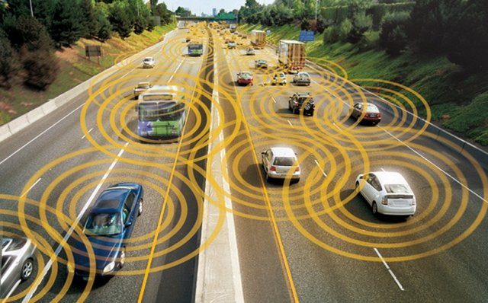
Wireless Networks

Slide 8
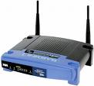

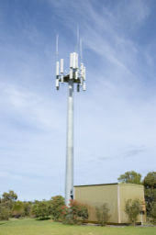

Widespread Deployment
Worldwide cellular subscribers
  1993: 34 million
  2005: more than 2 billion
  2009: more than 4 billion
  > landline subscribers
Wireless local area networks
  Wireless adapters built into laptops, tablets, & phones
  More than 220,000 known WiFi locations in 134 countries
  Probably many, many more (e.g., home networks, corporate networks, …)

Slide 9
Wireless Links

Slide 10
Wireless Properties
Interference / bit errors
  More sources of corruption compared to wired
Multipath propagation
  Signal does not travel in a straight line
Broadcast medium
  All traffic to everyone
Power trade-offs
  Important for power constrained devices

Slide 11
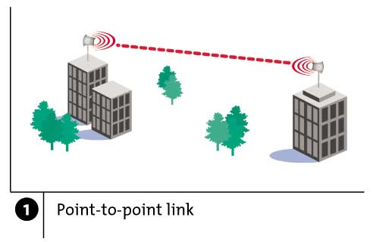
Wireless Links: High Bit Error Rate
Decreasing signal strength
  Disperses as it travels greater distance
  Attenuates as it passes through matter

Slide 12
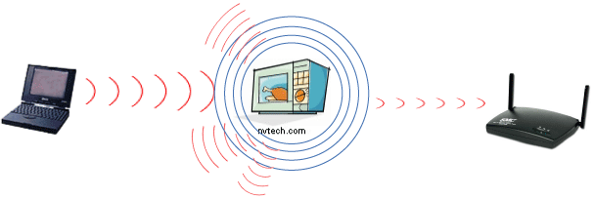
Wireless Links: High Bit Error Rate
Interference from other sources
  Radio sources in same frequency band
  E.g., 2.4 GHz wireless phone interferes with 802.11b wireless LAN
  Electromagnetic noise (e.g., microwave oven)

Slide 13
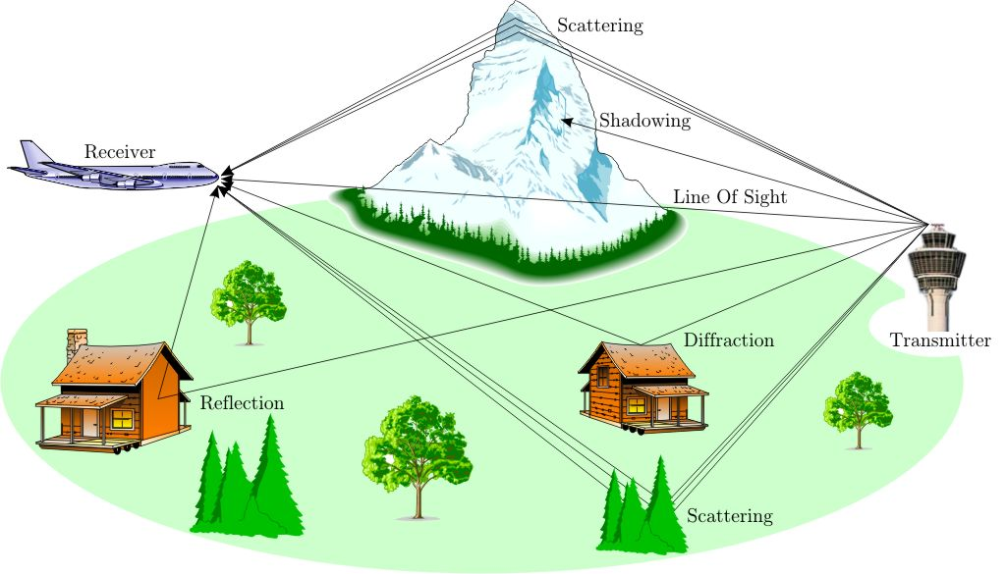
Wireless Links: High Bit Error Rate
Multi-path propagation
  Electromagnetic waves reflect off objects
  Taking many paths of different lengths
  Causing blurring of signal at the receiver
receiver
transmitter

Slide 14
Dealing With Bit Errors
Wireless vs. wired links
  Wired: most loss is due to congestion
  Wireless: higher, time-varying bit-error rate
Dealing with high bit-error rates
  Sender could increase transmission power
    Requires more energy (bad for battery-powered hosts)
    Creates more interference with other senders
  Stronger error detection and recovery
    More powerful error detection/correction codes
    Link-layer retransmission of corrupted frames

Slide 15
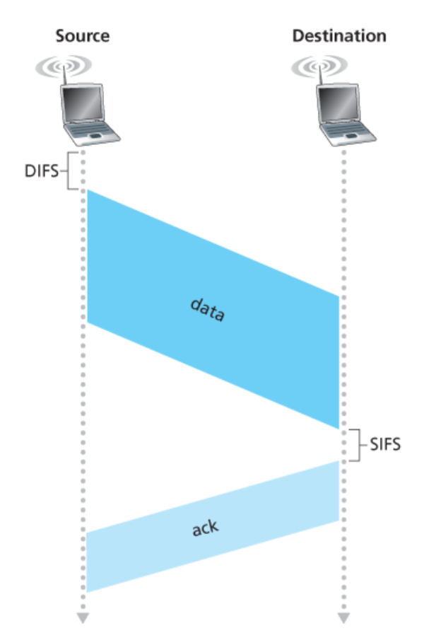
Link layer ACK

Slide 16
Wireless Links: Broadcast Limitations
Wired broadcast links
  E.g., Ethernet bridging, in wired LANs
  All nodes receive transmissions from all other nodes
Wireless broadcast: hidden terminal problem
C
A and B hear each other
B and C hear each other
But, A and C do not
So, A and C are unaware of their interference at B
B
A

Slide 17
Wireless Links: Broadcast Limitations
Wired broadcast links
  E.g., Ethernet bridging, in wired LANs
  All nodes receive transmissions from all other nodes
Wireless broadcast: fading over distance
A
B
C
A and B hear each other
B and C hear each other
But, A and C do not
So, A and C are unaware of their interference at B
A’s signal
strength
C’s signal
strength
space

Slide 18
Example Wireless Link Technologies
Data networks
  802.15.1 (Bluetooth): 2.1 Mbps – 10 m
  802.11b (WiFi): 5-11 Mbps – 100 m
  802.11a and g (WiFi): 54 Mbps – 100 m
  802.11n (WiFi): 200 Mbps – 100 m
  802.16 (WiMax): 70 Mbps – 10 km
Cellular networks, outdoors
  2G: 56 Kbps
  3G: 384 Kbps
  3G enhanced (“4G”): 4 Mbps
  LTE
  5G

Slide 19
Example Wireless Link Technologies
Data networks
  802.15.1 (Bluetooth): 2.1 Mbps – 10 m
  802.11b (WiFi): 5-11 Mbps – 100 m
  802.11a and g (WiFi): 54 Mbps – 100 m
  802.11n (WiFi): 200 Mbps – 100 m
  802.16 (WiMax): 70 Mbps – 10 km
Cellular networks, outdoors
  2G: 56 Kbps
  3G: 384 Kbps
  3G enhanced (“4G”): 4 Mbps
  LTE
  5G

Slide 20
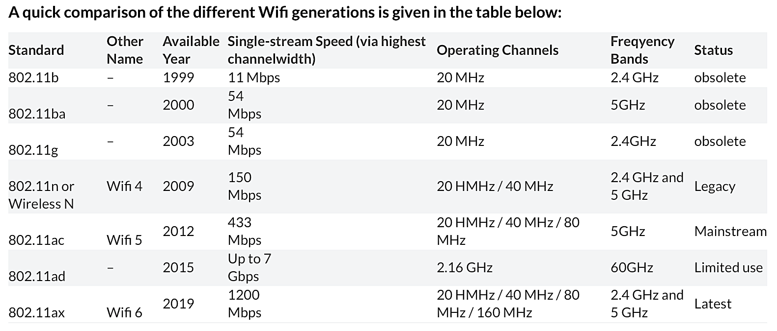
WiFi: IEEE 802.11 Wireless LANs

Slide 21
WiFi: IEEE 802.11 Wireless LANs
LAN Architecture
MAC protocol
Frame structure
Advanced features

Slide 22
WiFi: IEEE 802.11 Wireless LANs
LAN Architecture
MAC protocol
Frame structure
Advanced features

Slide 23
Wireless Network: Wireless Link
Wireless link
Typically used to connect mobile(s) to base station
Also used as backbone link
Multiple access protocol coordinates link access
network
infrastructure

Slide 24
Wireless Network: Wireless Hosts
Wireless host
Laptop, smartphone
Run applications
May be stationary (non-mobile) or mobile
network
infrastructure

Slide 25
Wireless Network: Base Station
Base station
Typically connected to wired network
Relay responsible for sending packets between wired network and wireless host(s) in its “area”
E.g., cell towers, 802.11 access points
network
infrastructure

Slide 26
Wireless Network: Infrastructure
Network infrastructure
Larger network with which a wireless host wants to communicate
Typically a wired network
Provides traditional network services
May not always exist
network
infrastructure

Slide 27
Infrastructure Mode (APs)
Infrastructure mode
Base station connects mobiles into wired network
Network provides services (addressing, routing, DNS)
Handoff: mobile changes base station providing connection to wired network
network
infrastructure

Slide 28
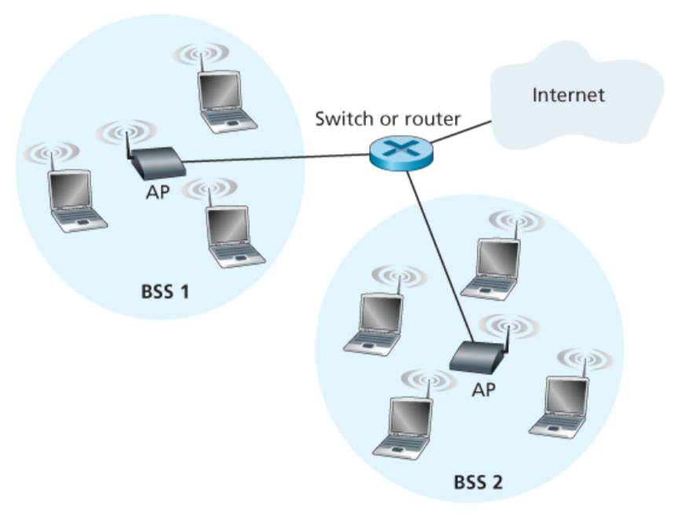
802.11 LAN Architecture
Access Point (AP)
  Base station that communicates with the wireless hosts
Basic Service Set (BSS)
  Coverage of one AP
  AP acts as the master
  Identified by a “network name” known as an SSID
SSID: Service Set Identifier
(1) Infrastructure wireless LAN

Slide 29
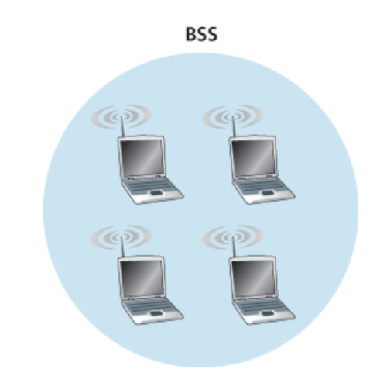
802.11 LAN Architecture
(2) Ad hoc wireless LAN

Slide 30
Channels and Association
network
infrastructure

Slide 31
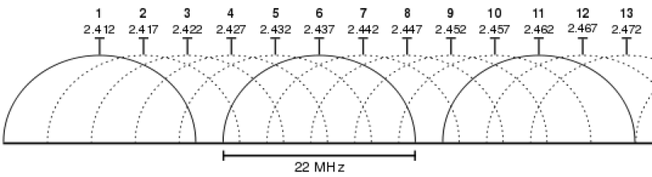
Channels and Association
Multiple channels at different frequencies
  Network administrator chooses frequency for AP
  Interference if channel is same as neighboring AP
Beacon frames from APs
Associate request from host
Association response from AP

Slide 32
Channels and Association
Multiple channels at different frequencies
  Network administrator chooses frequency for AP
  Interference if channel is same as neighboring AP
Access points send periodic beacon frames
  Containing AP’s name (SSID) and MAC address
  Host scans channels, listening for beacon frames
  Host selects an access point to associate with
Beacon frames from APs
Associate request from host
Association response from AP

Slide 33
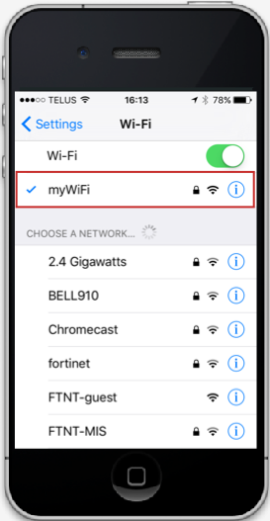
Channels and Association
Multiple channels at different frequencies
  Network administrator chooses frequency for AP
  Interference if channel is same as neighboring AP
Access points send periodic beacon frames
  Containing AP’s name (SSID) and MAC address
  Host scans channels, listening for beacon frames
  Host selects an access point to associate with
Beacon frames from APs
Associate request from host
Association response from AP

Slide 34
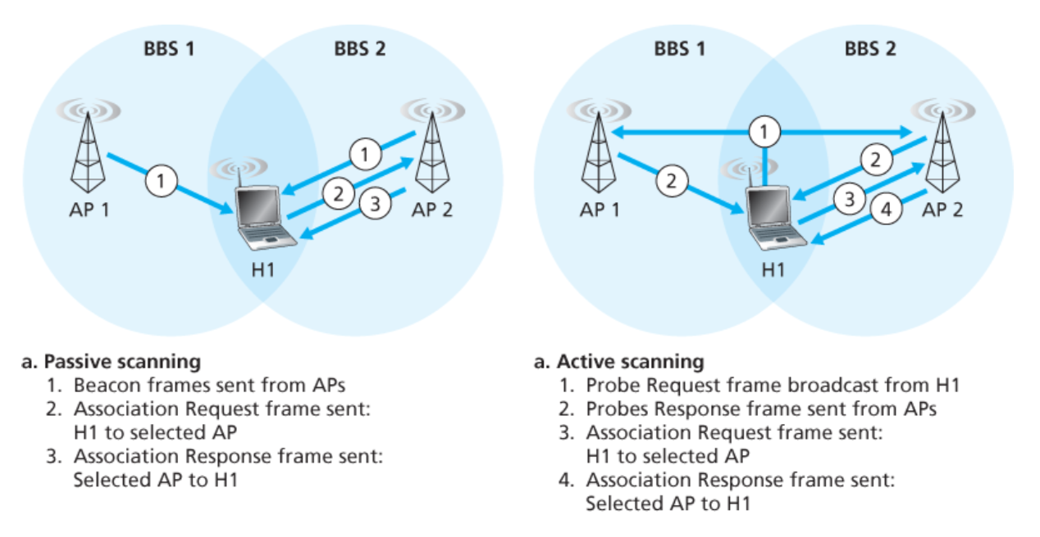
Scanning: Passive and active
Notes:
First : Association with the AP.
Then: DHCP discovery to join to the subnet.

Slide 35
Mobility Within the Same Subnet
H1 remains in same IP subnet
  IP address of the host can remain same
  Ongoing data transfers can continue uninterrupted
H1 recognizes the need to change
  H1 detects a weakening signal
  Starts scanning for stronger one
Changes APs with same SSID
  H1 disassociates from one
  And associates with other
Switch learns new location
  Self-learning mechanism
router
switch
BBS 1
AP 1
AP 2
H1
BBS 2
Notes:
The hack: AP2 sends a broadcast frame with H1s address as source, right after H1’s association with AP2. This will let the switch learn the current location (port association) of H1.

Slide 36
WiFi: IEEE 802.11 Wireless LANs
LAN Architecture
MAC protocol
Frame structure
Advanced features

Slide 37
CSMA: Carrier Sense, Multiple Access
Multiple access: channel is shared medium
  Station: wireless host or access point
  Multiple stations may want to transmit at same time
Carrier sense: sense channel before sending
  Station doesn’t send when channel is busy
  To prevent collisions with ongoing transfers
  But, detecting ongoing transfers isn’t always possible
A
B
C
C
A’s signal
strength
C’s signal
strength
B
A
space

Slide 38
CSMA/CA: Collision Avoidance (CA), Not Collision Detection (CD)
Collision detection in wired Ethernet
  Station listens while transmitting
  Detects collision with other transmission
  Aborts transmission and tries sending again

Slide 39
CSMA/CA: Collision Avoidance (CA), Not Collision Detection (CD)
Collision detection in wired Ethernet
  Station listens while transmitting
  Detects collision with other transmission
  Aborts transmission and tries sending again
Problem #1: cannot detect all collisions
  Hidden terminal problem
  Fading

Slide 40
CA: Collision Avoidance, Not Detection
Collision detection in wired Ethernet
  Station listens while transmitting
  Detects collision with other transmission
  Aborts transmission and tries sending again
Problem #1: cannot detect all collisions
  Hidden terminal problem
  Fading
Problem #2: Can not listen while sending
  Strength of received signal is much smaller
  Expensive to build hardware that detects collisions
So, 802.11 does collision avoidance, not detection

Slide 41
Hidden Terminal Problem
A
B
C
A and C can’t see each other, both send to B
Occurs since 802.11 relies on physical carrier sensing, which is susceptible to hidden terminal problem

Slide 42
Virtual carrier sensing
First exchange control frames before transmitting data
  Sender issues “Request to Send” (RTS), incl. length of data
  Receiver responds with “Clear to Send” (CTS)
If sender sees CTS, transmits data (of specified length)
If other node sees CTS, will idle for specified period
If other node sees RTS but not CTS, free to send

Slide 43
Hidden Terminal Problem
A
B
C
A and C can’t see each other, both send to B
RTS/CTS can help
  Both A and C would send RTS that B would see first
  B only responds with one CTS (say, echo’ing A’s RTS)
  C detects that CTS doesn’t match and won’t send

Slide 44
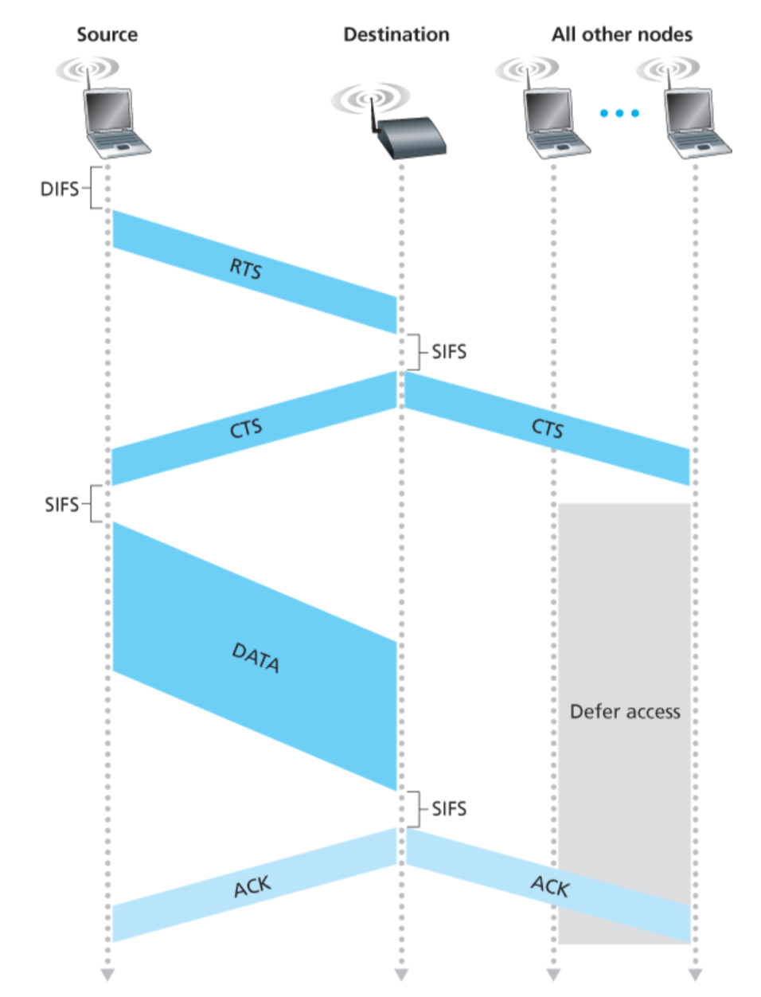
Virtual carrier sensing (RTS-CTS)
A
B
C
D

Slide 45
Virtual carrier sensing (RTS-CTS)

Slide 46
Exposed Terminal Problem
A
B
C
D
B sending to A, C wants to send to D
As C receives B’s packets, carrier sense would prevent it from sending to D, even though wouldn’t interfere
RTS/CTS can help
  C hears RTS from B, but not CTS from A
  C knows it’s transmission will not interfere with A
  C is safe to transmit to D

Slide 47
Impact on Higher-Layer Protocols
Wireless and mobility change path properties
  Wireless: higher packet loss, not from congestion
  Mobility: transient disruptions, and changes in RTT
Logically, impact should be minimal …
  Best-effort service model remains unchanged
  TCP and UDP can (and do) run over wireless, mobile
But, performance definitely is affected
  TCP treats packet loss as a sign of congestion
  TCP tries to estimate the RTT to drive retransmissions
  TCP does not perform well under out-of-order packets
Internet not designed with these issues in mind

Slide 48
WiFi: IEEE 802.11 Wireless LANs
LAN Architecture
MAC protocol
Frame structure
Advanced features

Slide 49
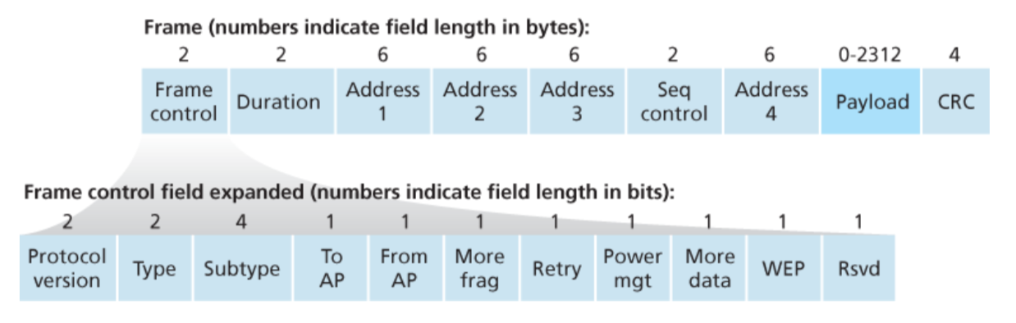
WiFi: IEEE 802.11 Frame
Notes:
Address 4 is used for Ad-hoc mode.

Slide 50
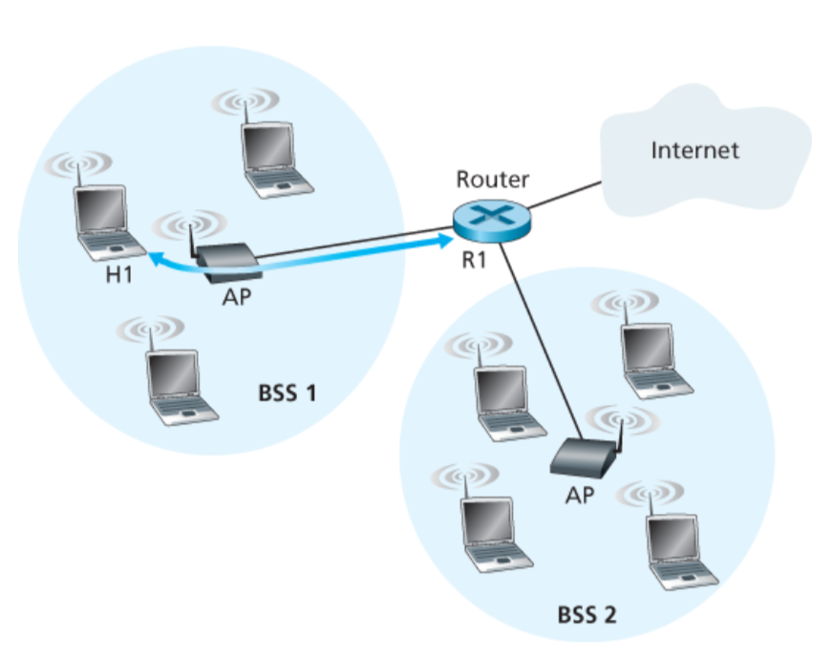
802.11 Frame: The secret of Address-3

Slide 51
802.11 Frame: The secret of Address-3
Case 1: Router R1 send data to host H1

Slide 52
802.11 Frame: The secret of Address-3
Case 1: Router R1 send data to host H1
(1) R1 knows H1’s IP addr, runs ARP to get the MAC addr.

Slide 53
802.11 Frame: The secret of Address-3
(2) R1 encapsulates the data in Ethernet frame.
Source addr: R1’s MAC addr
Dest. addr: H1’s MAC addr
Case 1: Router R1 send data to host H1

Slide 54
802.11 Frame: The secret of Address-3
Case 1: Router R1 send data to host H1
(3) AP converts the Ethernet (802.3) frame to WiFi frame (802.11).
Addr 1: H1’s MAC addr
Addr 2: AP’s MAC addr
Addr 3: R1’s MAC addr

Slide 55
802.11 Frame: The secret of Address-3
Case 1: Router R1 send data to host H1
(4) H1 can determine that the frame has come from R1 by checking Addr-3 field.

Slide 56
802.11 Frame: The secret of Address-3
Case 2: Host H1 responds by sending packet to Router R1

Slide 57
802.11 Frame: The secret of Address-3
Case 2: Host H1 responds by sending packet to Router R1
H1 creates a WiFi frame.
Addr 1: AP’s MAC addr
Addr 2: H1’s MAC addr
Addr 3: R1’s MAC addr

Slide 58
802.11 Frame: The secret of Address-3
Case 2: Host H1 responds by sending packet to Router R1
(2) AP can determine that the frame should be forwarded to R1 by checking Addr-3 field.

Slide 59
802.11 Frame: The secret of Address-3
Case 2: Host H1 responds by sending packet to Router R1
(3) AP converts the WiFi (802.11) frame to Ethernet frame (802.3).
Source addr : H1’s MAC addr
Dest. addr : R1’s MAC addr

Slide 60
WiFi: IEEE 802.11 Wireless LANs
LAN Architecture
MAC protocol
Frame structure
Advanced features

Slide 61
WiFi: Advanced features
1) Rate adaptation
2) Power management

Slide 62




Award # 2125526

Slide 63
Notes:
Separate systems: donor’s system is not accessible by guest
Speed – donor’s speed should not be affected by the donation

Slide 64
Bluetooth: 802.15.1
“personal-area-networks”

Slide 66
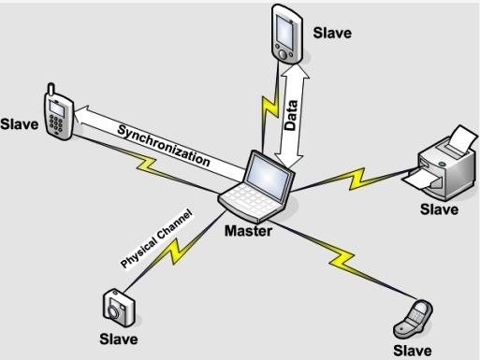
Bluetooth piconets
1 master, up to 7 “slave” devices; 225 “parked” devices
Operates on unlicensed wireless spectrum
  How to prevent interference?

Slide 67
PHY: Spread Spectrum – Frequency Hopping
Nodes rapidly jump between frequencies
Sender and receiver coordinated in jumps
  How coordinate? Pseudorandom number generator, with shared input known to sender/receiver
If randomly collide with other transmitted, only for short period before jump again
Bluetooth
  79 frequencies, on each frequency for 625 microseconds
  Each channel also uses TDMA, with each frame taking 1/3/5 consecutive slots.
  Only master can start in odd slot, slave only in response
Notes:
Question: why bluetooth use this approach of TDMA, rather than CSMA?

Slide 68
PHY: Spread Spectrum – Frequency Hopping

Slide 69
Ad-Hoc Networks
Ad hoc mode
No base stations
Nodes can only transmit to other nodes within link coverage
Nodes self-organize and route among themselves
Can create multi-hop wireless networks, instead of a wired backend

Slide 70
Infrastructure vs. Ad Hoc
Infrastructure mode
  Wireless hosts are associated with a base station
  Traditional services provided by the connected network
  E.g., address assignment, routing, and DNS resolution
Ad hoc networks
  Wireless hosts have no infrastructure to connect to
  Hosts themselves must provide network services
Similar in spirit to the difference between
  Client-server communication
  Peer-to-peer communication

Slide 71
Delay Tolerant Networking
Nodes can both route and store
  Next hop is available, forward
  Otherwise, store packets
Useful for data collection with no time limit
  e.g., sensors in the field
Analogous to email
  Hold onto packets until another hop can take it from you
  Eventually reach its destination

Slide 72
The Upside to Interference
Some systems leverage interference
If packets collide once, likely will again
  Can use both collisions to construct original packets
  Reduce effective error rate significantly
If two hosts send to each other thru an AP, and they collide, AP can broadcast collision to both
  Both know what they sent, can “subtract” that from collision to get the other
  Improves throughput of system!

Slide 73
Conclusions
Wireless
  Already a major way people connect to the Internet
  Gradually becoming more than just an access network
Mobility
  Today’s users tolerate disruptions as they move
  … and applications try to hide the effects
  Tomorrow’s users expect seamless mobility
Challenges the design of network protocols
  Wireless breaks the abstraction of a link, and the assumption that packet loss implies congestion
  Mobility breaks association of address and location
  Higher-layer protocols don’t perform as well

Slide 74
802.11 LAN
802.15 PAN

Slide 75
Wide-Area Wireless Network:
WiMAX
(Worldwide Interoperability for Microwave Access)

Slide 76
802.16 Metropolitan Area Network (MAN)

Slide 77
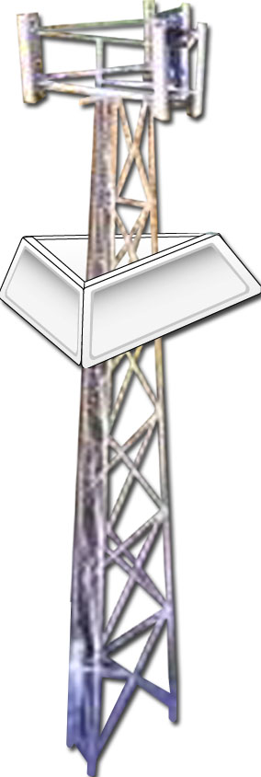

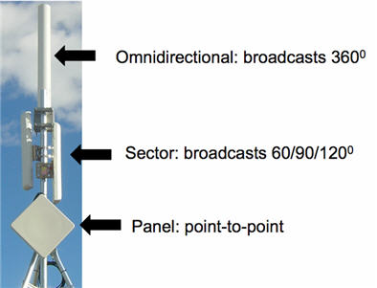
802.16: WiMAX
point-to-point
like 802.11: base station model
  transmissions to/from base station by hosts with omnidirectional antenna
  base station-to-base station backhaul with point-to-point antenna
unlike 802.11:
  range ~ 6 miles (“city rather than coffee shop”)
  ~14 Mbps
point-to-multipoint

Slide 78
802.16: WiMAX: downlink, uplink scheduling
transmission frame
  down-link subframe: base station to node
  uplink subframe: node to base station
…
…
pream.
DL-
MAP
UL-
MAP
DL
burst 1
DL
burst 2
DL
burst n
Initial
maint.
request
conn.
SS #1
SS #2
SS #k
…
…
downlink subframe
uplink subframe
base station tells nodes who will get to receive (DL map)
and who will get to send (UL map), and when
WiMAX standard provide mechanism for scheduling, but not scheduling algorithm

Slide 79
Cellular Networks

Slide 80

Components of cellular network architecture
MSC
connects cells to wired tel. net.
manages call setup
handles mobility
cell
covers geographical region
base station (BS) analogous to 802.11 AP
mobile users attach to network through BS
air-interface: physical and link layer protocol between mobile and BS
Mobile
Switching
Center
Public telephone
network
Mobile
Switching
Center
wired network

Slide 81
Cellular networks: the first hop
Two techniques for sharing mobile-to-BS radio spectrum
combined FDMA/TDMA: divide spectrum in frequency channels, divide each channel into time slots
CDMA: code division multiple access
time slots
frequency
bands

Slide 82
Picture1: https://www.brandsynario.com/the-evolution-of-gs-generation-networks/
Notes:
Picture from: https://www.brandsynario.com/the-evolution-of-gs-generation-networks/

Slide 83
Picture1: https://www.brandsynario.com/the-evolution-of-gs-generation-networks/
Picture2: http://kaaale.blogspot.com/2019/02/the-evolution-of-cellular-mobile.html
Notes:
Picture from: https://www.brandsynario.com/the-evolution-of-gs-generation-networks/

Slide 84
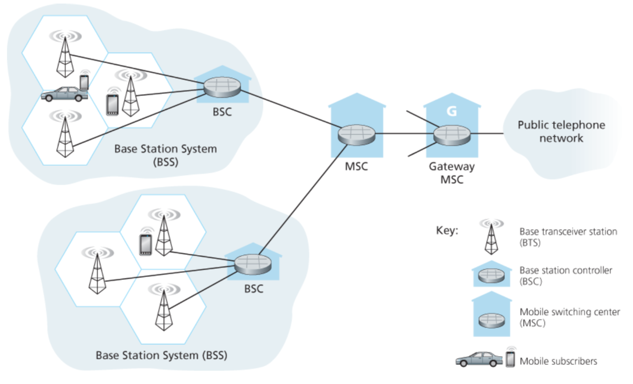
2G (voice) network architecture

Slide 85
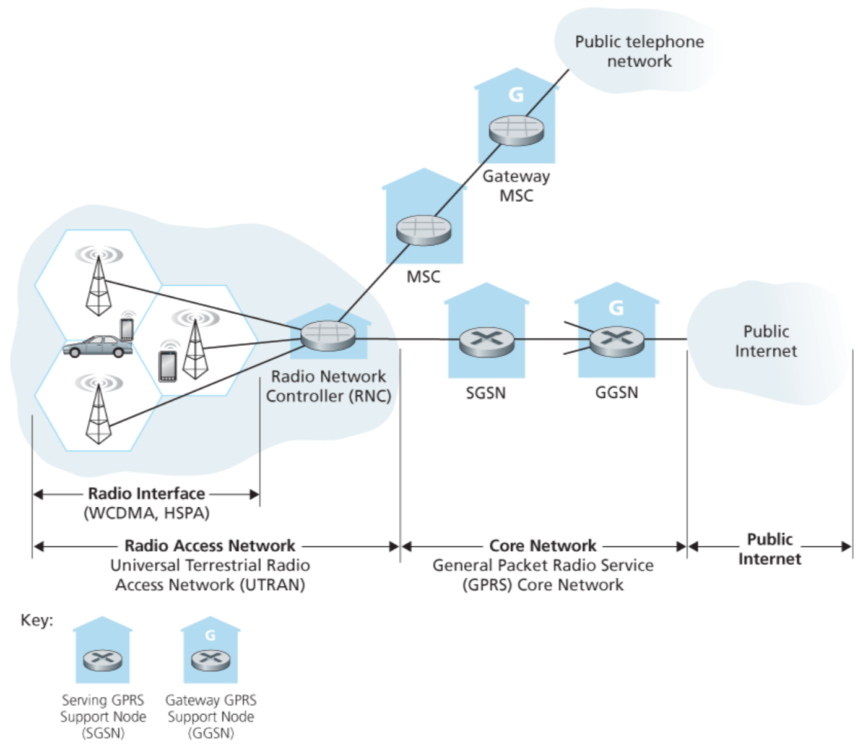
3G (voice+data) network architecture
Key insight: new cellular data
network operates in parallel
(except at edge) with existing
cellular voice network
voice network unchanged in core
data network operates in parallel

Slide 86
3G (voice+data) network architecture

Slide 87
3G versus 4G LTE network architecture
MSC
G
Public
telephone
network
3G
radio
network
controller
Gateway
MSC
G
Public
Internet
SGSN
GGSN
4G-LTE
HSS
MME
G
G
Public
Internet
S-GW
P-GW
radio access network
Universal Terrestrial Radio
Access Network (UTRAN)
Evolved Packet Core
(EPC)

Slide 88
4G: differences from 3G
all IP core: IP packets tunneled (through core IP network) from base station to gateway
no separation between voice and data – all traffic carried over IP core to gateway
Mobility
Management
Entity (MME)
Home Subscriber
Server(HSS)
(like HLR+VLR)
Serving
Gateway
(S-GW)
Packet data
network
Gateway
(P-GW)
UE
(user element)
eNodeB
(base station)
HSS
MME
control
G
G
Public
Internet
data
S-GW
P-GW
radio access network
Universal Terrestrial Radio
Access Network (UTRAN)
Evolved Packet Core
(EPC)

Slide 89
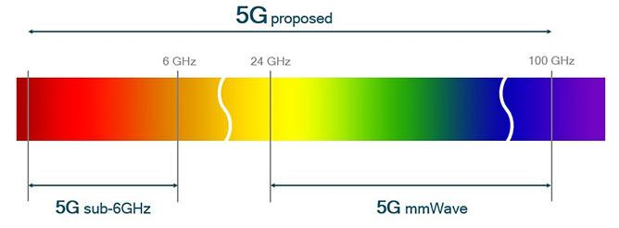
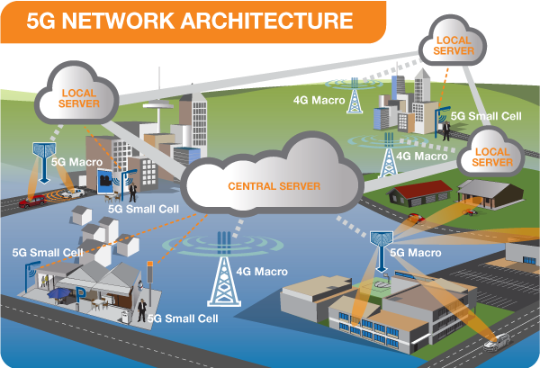
5G cellular networks

Slide 90
Mobility in Wireless Networks

Slide 91
What is mobility?
spectrum of mobility, from the network perspective:
no mobility
high mobility
mobile wireless user,
using same access
point
mobile user, connecting/ disconnecting from network using DHCP.
mobile user, passing through multiple access point while maintaining ongoing connections (like cell phone)

Slide 92




Mobility: vocabulary
home network: permanent “home” of mobile
(e.g., 128.119.40/24)
home agent: entity that will perform mobility functions on behalf of mobile, when mobile is remote
wide area network
permanent address: address in home network, can always be used to reach mobile
e.g., 128.119.40.186

Slide 93
Mobility: more vocabulary
permanent address: remains constant (e.g., 128.119.40.186)
visited network: network in which mobile currently resides (e.g., 79.129.13/24)
care-of-address: address in visited network.
(e.g., 79,129.13.2)
wide area network
foreign agent: entity in visited network that performs mobility functions on behalf of mobile.
correspondent: wants to communicate with mobile

Slide 94
Mobility: approaches
let routing handle it: routers advertise permanent address of mobile-nodes-in-residence via usual routing table exchange.
  routing tables indicate where each mobile located
  no changes to end-systems
let end-systems handle it:
  indirect routing: communication from correspondent to mobile goes through home agent, then forwarded to remote
  direct routing: correspondent gets foreign address of mobile, sends directly to mobile

Slide 95
Mobility: approaches
let routing handle it: routers advertise permanent address of mobile-nodes-in-residence via usual routing table exchange.
  routing tables indicate where each mobile located
  no changes to end-systems
let end-systems handle it:
  indirect routing: communication from correspondent to mobile goes through home agent, then forwarded to remote
  direct routing: correspondent gets foreign address of mobile, sends directly to mobile
not
scalable
to millions of
mobiles

Slide 96
Mobility: registration
visited network
home network
1
2
wide area network
mobile contacts foreign agent on entering visited network
foreign agent contacts home agent home: “this mobile is resident in my network”
end result:
foreign agent knows about mobile
home agent knows location of mobile

Slide 97

Mobility via indirect routing
foreign agent receives packets, forwards to mobile
home agent intercepts packets, forwards to foreign agent
visited
network
home
network
3
wide area network
2
1
correspondent addresses packets using home address of mobile

Slide 98
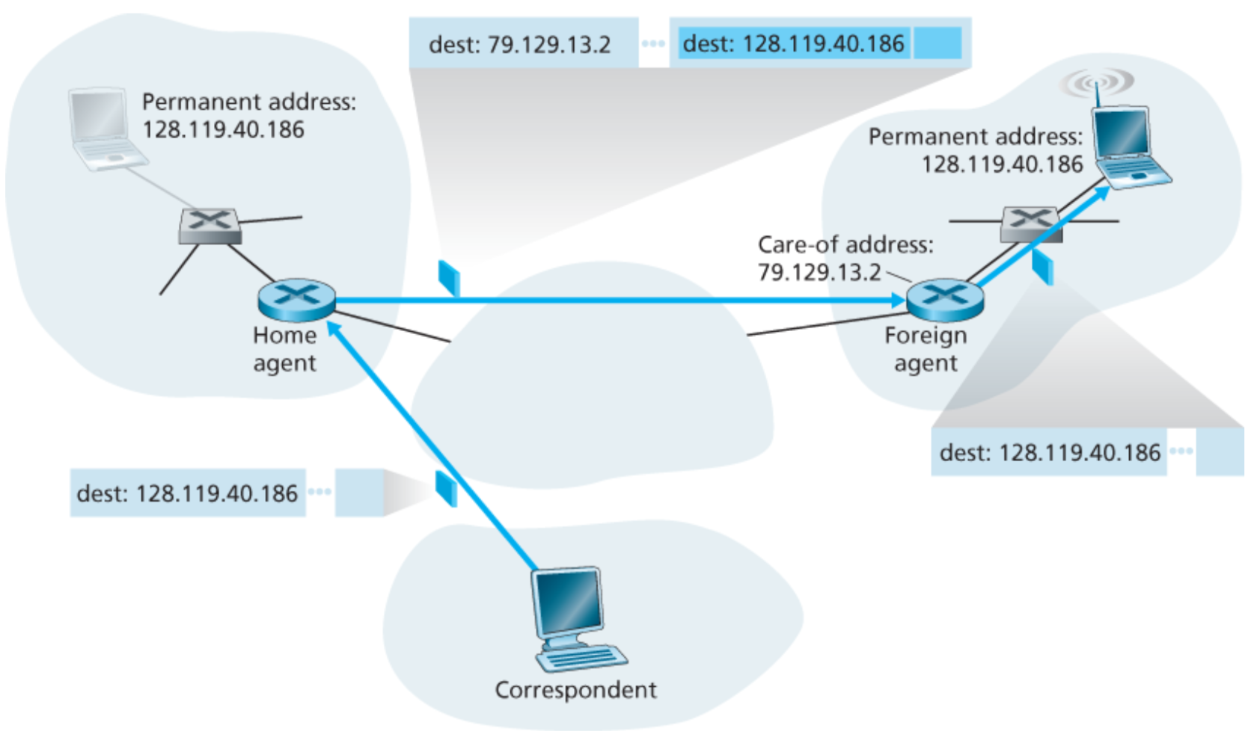
Packet encapsulation

Slide 99
Mobility via indirect routing
foreign agent receives packets, forwards to mobile
home agent intercepts packets, forwards to foreign agent
visited
network
home
network
3
wide area network
2
1
correspondent addresses packets using home address of mobile
4
mobile replies directly to correspondent

Slide 100



Indirect Routing: comments
mobile uses two addresses:
  permanent address: used by correspondent (hence mobile location is transparent to correspondent)
  care-of-address: used by home agent to forward datagrams to mobile
foreign agent functions may be done by mobile itself
triangle routing: correspondent-home-network-mobile
  inefficient when
  correspondent, mobile
  are in same network

Slide 101


Mobility via direct routing
foreign agent receives packets, forwards to mobile
correspondent forwards to foreign agent
visited
network
home
network
3
1
2
4
correspondent requests, receives foreign address of mobile
mobile replies directly to correspondent

Slide 102
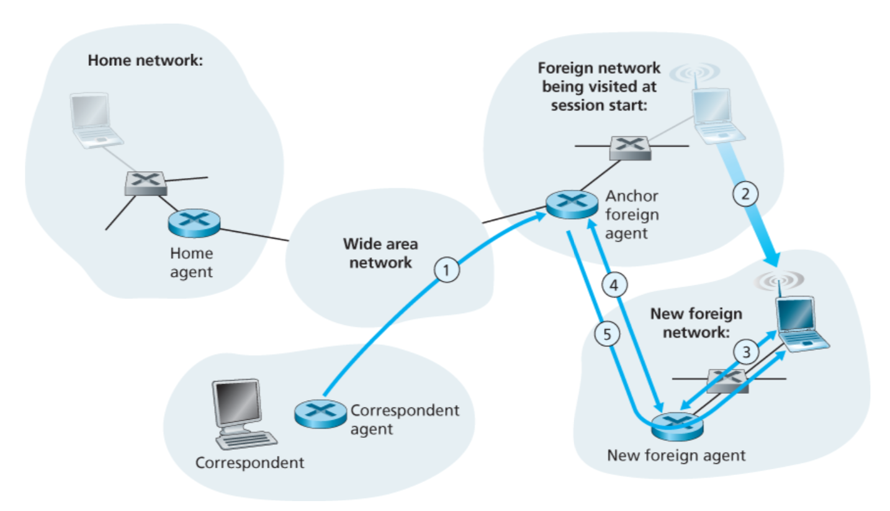
Mobility through multiple foreign networks

Slide 103
WiFi: IEEE 802.11 Wireless LANs
LAN Architecture
MAC protocol
Frame structure
Advanced features

Slide 104
WiFi: IEEE 802.11 Frame

Slide 105
802.11 Frame: The secret of Address-3

Slide 106
802.11 Frame: The secret of Address-3
Case 1: Router R1 send data to host H1

Slide 107
802.11 Frame: The secret of Address-3
Case 1: Router R1 send data to host H1
(1) R1 knows H1’s IP addr, runs ARP to get the MAC addr.

Slide 108
802.11 Frame: The secret of Address-3
(2) R1 encapsulates the data in Ethernet frame.
Source addr: R1’s MAC addr
Dest. addr: H1’s MAC addr
Case 1: Router R1 send data to host H1

