Slide 1

Computer Networks
CMSC 417 : Spring 2023
Topic: Overview of networks – Part 2
(Textbook chapter 1)
Nirupam Roy
Tu-Th 2:00-3:15pm
CSI 2117

Slide 2
Programming assignments & Project
Tentative assignment topics:
  0: TCP client/server
  1: UDP client/server
  2: Distance Vector routing
  3: Chat server
  4: Chord P2P lookup protocol
  Final: bittorrent client
Languages:
  C/C++. We may allow a few other depending on the assignment. Will update on this soon.
Working together:
  Assignments 0-4 are individual; can discuss together, but code implemented individually
  Final project must be in groups of 4

Slide 3
Programming assignments & Project
Tentative assignment topics:
  0: TCP client/server
  1: UDP client/server
  2: Distance Vector routing
  3: Chat server
  4: Chord P2P lookup protocol
  Final: bittorrent client
Languages:
  0,1: must be done in C/C++
  2,3,4,final: will have options (C/C++, Python, Java, Ruby, Rust)
Working together:
  Assignments 0-3 are individual; can discuss together, but code implemented individually
  Assignments 4 can be done in a group of 2
  Final project must be in groups of 4

Slide 4



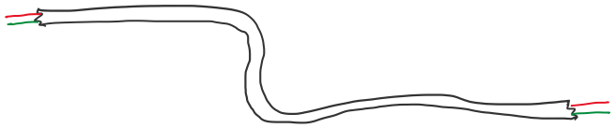

Network interface controller
(NIC)

Slide 5
Point-to-point connection

Slide 7
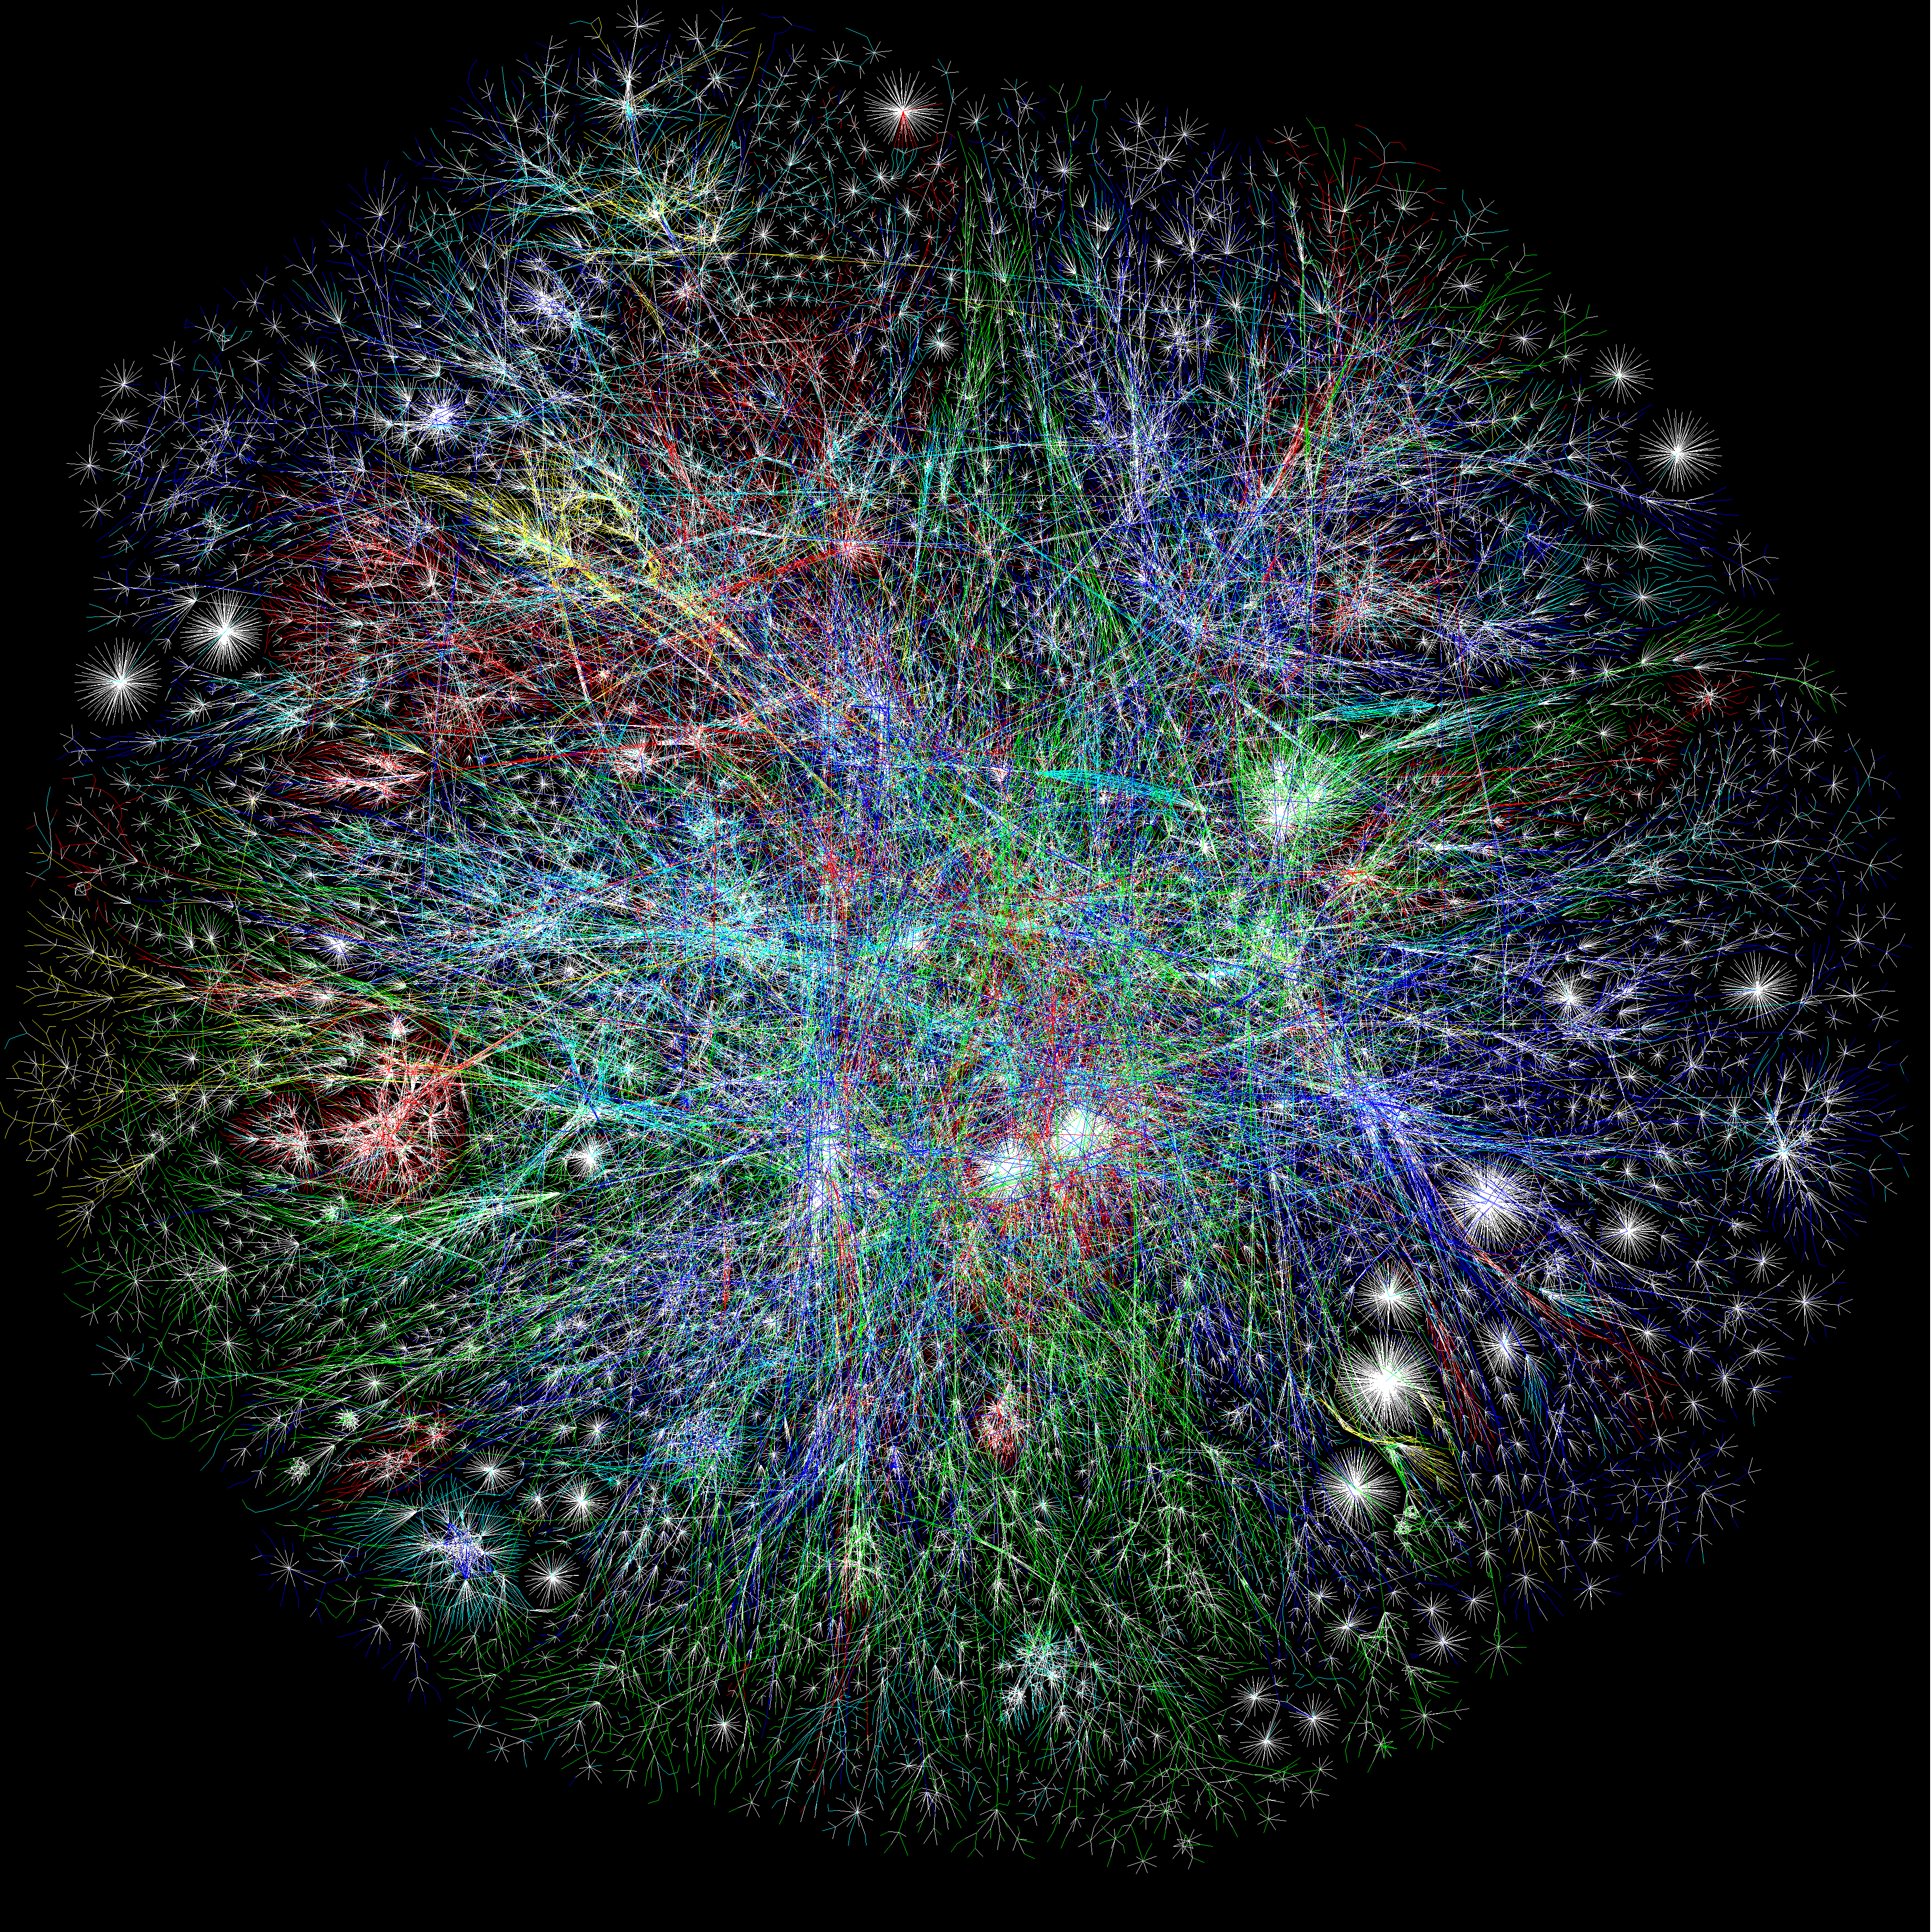
MOOCs
Online Content
Search Engines
Notes:
So building networks is hard
But unfortunately, computer networks are becoming increasingly critical to our daily lives
You know all the standard uses of computers…
Social networking
Gaming
But there’s a lot you may not thinki about
Financial sector – trillions of dollars –
Critical infrastructures – power grid, water delibvery systems – now all managed and operated with IP networks
911 communication services
…
Remote medicine
Brakes of your car
Power grid and critical infrastructure
Financial and trading networks – move billions of dollars per day over computer netowrks
Computer networks are no longer just for fun and games
People’s lives every day depend on the availability and functioning of computer netowrks
Makign it very important that we build them well, and protect them from adversaries,

Slide 8
All pair Point-to-point connection

Slide 9
Is this scalable?
All pair Point-to-point connection

Slide 10
Shared channel
Multiple access

Slide 11
Shared channel
How to direct the flow of data at these points?
Multiple access

Slide 12
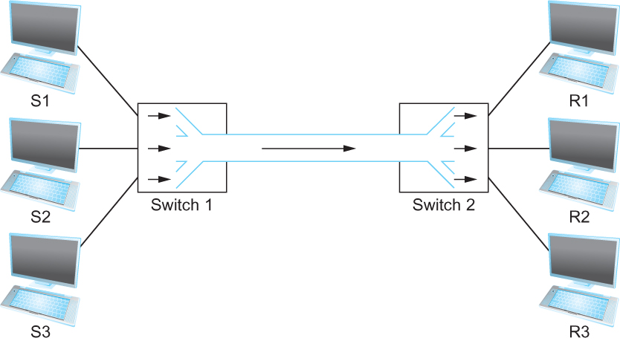
Multiplexing multiple logical flows over a single physical link
Switching

Slide 13

Circuit Switching
end-end resources allocated to, reserved for “call” between source & destination:
in diagram, each link has four circuits.
  call gets 2nd circuit in top link and 1st circuit in right link.
dedicated resources: no sharing
  circuit-like (guaranteed) performance
commonly used in traditional telephone networks

Slide 14
Circuit Switching

Slide 15
Circuit Switching: FDM versus TDM
Example:
FDM
4 users
frequency
time
TDM
frequency
time
Notes:
Two simple multiple access control techniques.
Each mobile’s share of the bandwidth is divided into portions for the uplink and the downlink. Also, possibly, out of band signaling.
As we will see, used in AMPS, GSM, IS-54/136

Slide 16
Circuit Switching
end-end resources allocated to, reserved for “call” between source & destination:
in diagram, each link has four circuits.
  call gets 2nd circuit in top link and 1st circuit in right link.
dedicated resources: no sharing
  circuit-like (guaranteed) performance
commonly used in traditional telephone networks
Circuit segment idle if there is not enough data

Slide 17
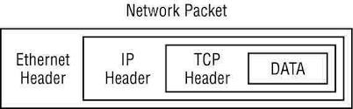

Packet Switching

Slide 18
Packet Switching
R = 100 Mb/s
C
A
D
R = 1.5 Mb/s
B
E
queue of packets
waiting for output link

Slide 19
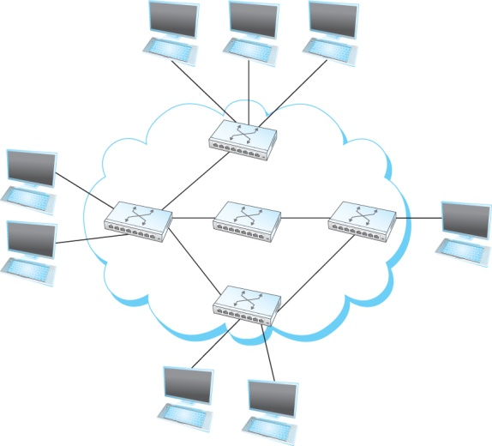
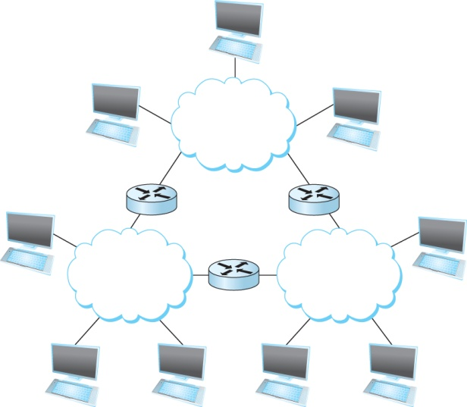
Switch vs Router
Switches
Routers

Slide 20
Chapter 1: Roadmap
  What is the Internet?
  Network edge
  Network core
  Delay, Loss, Throughput in networks
  Protocol layers, service models
  History

Slide 21

What’s the Internet?
Notes:
Associate press: an Internet vs the Internet

Slide 22
Chapter 1: Roadmap
  What is the Internet?
  Network edge
  Network core
  Delay, Loss, Throughput in networks
  Protocol layers, service models
  History

Slide 23
Network Edge
Notes:
So building networks is hard
But unfortunately, computer networks are becoming increasingly critical to our daily lives
You know all the standard uses of computers…
Social networking
Gaming
But there’s a lot you may not thinki about
Financial sector – trillions of dollars –
Critical infrastructures – power grid, water delibvery systems – now all managed and operated with IP networks
911 communication services
…
Remote medicine
Brakes of your car
Power grid and critical infrastructure
Financial and trading networks – move billions of dollars per day over computer netowrks
Computer networks are no longer just for fun and games
People’s lives every day depend on the availability and functioning of computer netowrks
Makign it very important that we build them well, and protect them from adversaries,

Slide 24
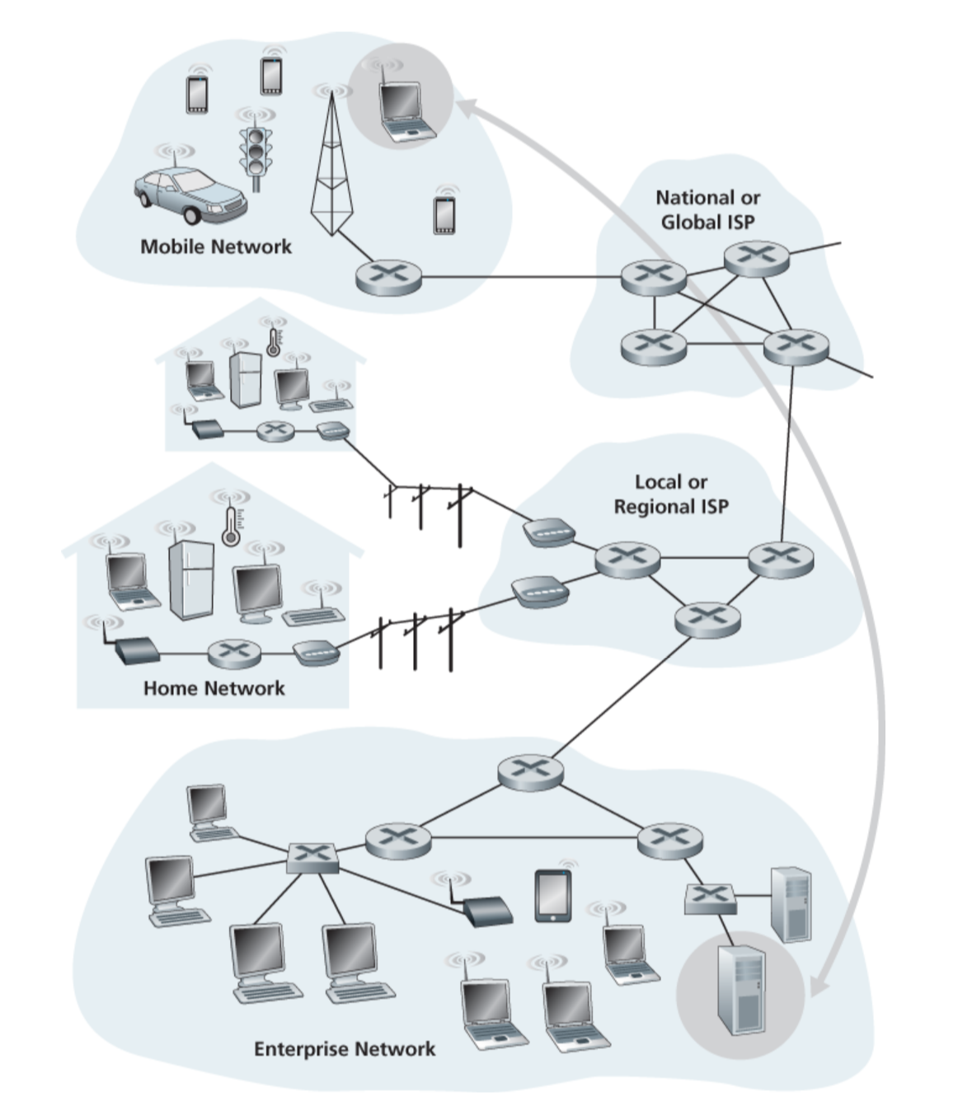
Network Edge

Slide 25
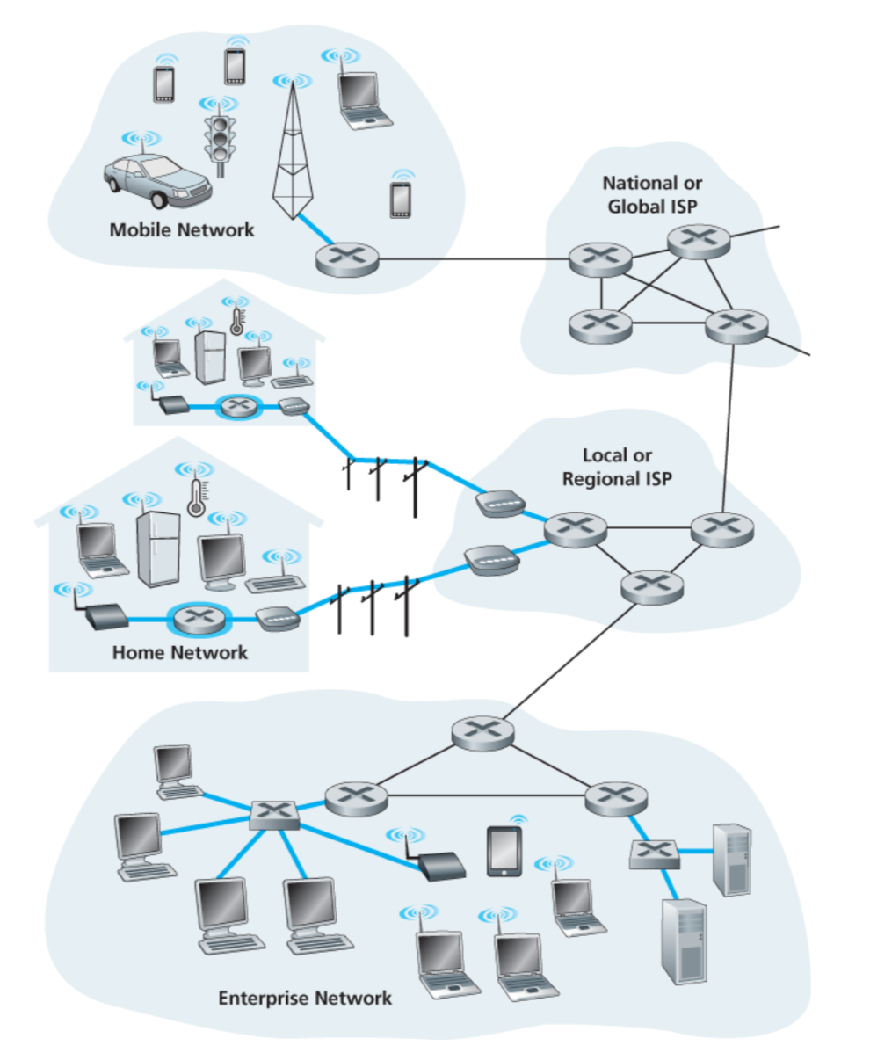
A closer look at network structure:
Network edge:
  hosts: clients and servers
  servers often in data centers
  access networks, physical media: wired, wireless communication links

Slide 26








Access Network: Home Network
wireless
devices
to/from headend or central office
often combined
in single box
cable or DSL modem
(DSL=Digital Subscriber Line)
wireless access
point (54 Mbps)
router, firewall
wired Ethernet (1 Gbps)

Slide 27
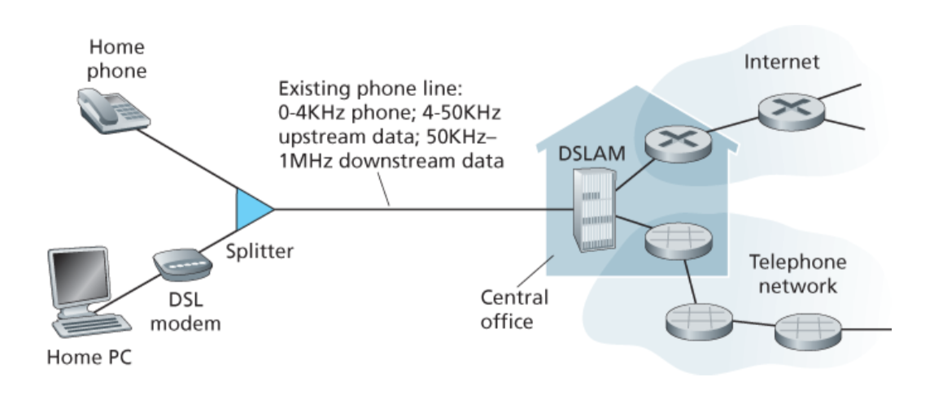
Access Network: Home Network

Slide 28









Enterprise Access Networks (Ethernet)
institutional link to
ISP (Internet)
institutional router
Ethernet
switch
institutional mail,
web servers
Typically used in companies, universities, etc.
  10 Mbps, 100Mbps, 1Gbps, 10Gbps transmission rates
  Today, end systems typically connect into Ethernet switch

Slide 29









Wireless Access Networks
Shared wireless access network connects end system to router
  via base station aka “access point”
Wide-area wireless access
  provided by telco (cellular) operator, 10’s km
  between 1 and 10 Mbps
  3G, 4G: LTE
Wireless LANs:
  within building (100 ft.)
  802.11b/g/n (WiFi): 11, 54, 450 Mbps transmission rate
to Internet
to Internet

Slide 30
Chapter 1: Roadmap
  What is the Internet?
  Network edge
  Network core
  Delay, Loss, Throughput in networks
  Protocol layers, service models
  History

Slide 31
Network Core
MOOCs
Online Content
Search Engines
Notes:
So building networks is hard
But unfortunately, computer networks are becoming increasingly critical to our daily lives
You know all the standard uses of computers…
Social networking
Gaming
But there’s a lot you may not thinki about
Financial sector – trillions of dollars –
Critical infrastructures – power grid, water delibvery systems – now all managed and operated with IP networks
911 communication services
…
Remote medicine
Brakes of your car
Power grid and critical infrastructure
Financial and trading networks – move billions of dollars per day over computer netowrks
Computer networks are no longer just for fun and games
People’s lives every day depend on the availability and functioning of computer netowrks
Makign it very important that we build them well, and protect them from adversaries,

Slide 32









The Network Core
Mesh of interconnected routers
Packet-switching: hosts break application-layer messages into packets
  forward packets from one router to the next, across links on path from source to destination
  each packet transmitted at full link capacity

Slide 33
Two key network-core functions
routing: determines source-destination route taken by packets
  routing algorithms
forwarding: move packets from router’s input to appropriate router output
routing algorithm
local forwarding table
header value
output link
0100
0101
0111
1001
3
2
2
1
1
3
2
0111
destination address in arriving
packet’s header

Slide 34



Packet-switching: Store-and-Forward
L bits
per packet
source
3
2
1
R bps
R bps
destination
takes L/R seconds to transmit (push out) L-bit packet into link at R bps
store and forward: entire packet must arrive at router before it can be transmitted on next link
one-hop numerical example:
L = 7.5 Mbits
R = 1.5 Mbps
one-hop transmission delay = 5 sec
end-end delay = 2L/R (assuming zero propagation delay)
more on delay shortly …

Slide 35
Internet Structure: Network of Networks
End systems connect to Internet via access ISPs (Internet Service Providers)
  residential, company and university ISPs
Access ISPs in turn must be interconnected.
  so that any two hosts can send packets to each other
Resulting network of networks is very complex
  evolution was driven by economics and national policies
Let’s take a stepwise approach to describe current Internet structure

Slide 36
Internet Structure: Network of Networks
Question: given millions of access ISPs, how to connect them together?
…
…
access
net
access
net
access
net
access
net
access
net
access
net
access
net
…
…
access
net
access
net
access
net
access
net
access
net
access
net
…
access
net
access
net
…
access
net

Slide 37
Internet Structure: Network of Networks
Option: connect each access ISP to every other access ISP?
…
…
access
net
access
net
access
net
access
net
access
net
…
…
access
net
access
net
…
connecting each access ISP to each other directly doesn’t scale: O(N²) connections.
…
…
access
net
access
net
…
access
net
access
net
access
net
…
access
net
…
access
net
access
net
…
access
net

Slide 38
Internet Structure: Network of Networks
Option: connect each access ISP to one global transit ISP?
Customer and provider ISPs have economic agreement.
…
…
access
net
access
net
access
net
access
net
access
net
access
net
access
net
…
…
global
ISP
access
net
access
net
access
net
access
net
access
net
access
net
…
access
net
access
net
…
access
net

Slide 39
Internet Structure: Network of Networks
But if one global ISP is viable business, there will be competitors ….
…
…
access
net
access
net
access
net
access
net
access
net
access
net
ISP A
access
net
…
…
access
net
ISP B
access
net
ISP C
access
net
access
net
access
net
access
net
…
access
net
access
net
…
access
net

Slide 40
Internet Structure: Network of Networks
But if one global ISP is viable business, there will be competitors …. which must be interconnected
Internet exchange point
…
…
access
net
access
net
access
net
access
net
access
net
IXP
access
net
access
net
ISP A
…
…
access
net
IXP
ISP B
access
net
ISP C
access
net
access
net
peering link
access
net
access
net
…
access
net
access
net
…
access
net

Slide 41
Internet Structure: Network of Networks
… and regional networks may arise to connect access nets to ISPs
…
…
access
net
access
net
access
net
access
net
access
net
IXP
access
net
access
net
ISP A
…
…
access
net
IXP
ISP B
access
net
ISP C
access
net
access
net
access
net
regional net
access
net
…
access
net
access
net
…
access
net

Slide 42
Internet Structure: Network of Networks
… and content provider networks (e.g., Google, Microsoft, Akamai) may run their own network, to bring services, content close to end users
…
…
access
net
access
net
access
net
access
net
access
net
IXP
access
net
access
net
ISP A
…
…
Content provider/distribution network
access
net
IXP
ISP B
access
net
ISP C
access
net
access
net
access
net
regional net
access
net
…
access
net
access
net
…
access
net

Slide 43
Internet Structure: Network of Networks
Tier 1 ISP
Tier 1 ISP
Google
IXP
IXP
IXP
Regional ISP
Regional ISP
access
ISP
access
ISP
access
ISP
access
ISP
access
ISP
access
ISP
access
ISP
access
ISP
at center: small # of well-connected large networks
  “tier-1” commercial ISPs (e.g., Level 3, Sprint, AT&T, NTT), national & international coverage
  content provider/distribution network (e.g., Google, Akamai): private network that connects it data centers to Internet, often bypassing tier-1, regional ISPs

Slide 44
Chapter 1: Roadmap
  What is the Internet?
  Network edge
  Network core
  Delay, Loss, Throughput in networks
  Protocol layers, service models
  History

Slide 45
How do loss and delay occur?
packets queue in router buffers
packet arrival rate to link (temporarily) exceeds output link capacity
packets queue, wait for turn
packet being transmitted (delay)
A
B
packets queueing (delay)
free (available) buffers: arriving packets
dropped (loss) if no free buffers

Slide 46
Four sources of packet delay
transmission
A
propagation
B
nodal
processing
queueing
d_{nodal} = d_{proc} + d_{queue} + d_{trans} + d_{prop}
d_{proc}: nodal processing
check bit errors
determine output link
typically < msec
d_{queue}: queueing delay
time waiting at output link for transmission
depends on congestion level of router

Slide 47
Four sources of packet delay
transmission
A
propagation
B
nodal
processing
queueing
d_{nodal} = d_{proc} + d_{queue} + d_{trans} + d_{prop}
d_{trans}: transmission delay:
L: packet length (bits)
R: link bandwidth (bps)
d_{trans} = L/R
d_{prop}: propagation delay:
d: length of physical link
v: propagation speed
d_{prop} = d/v
d_{trans} and d_{prop}
very different
Notes:
47

Slide 48
Packet Loss
queue (aka buffer) preceding link in buffer has finite capacity
packet arriving to full queue dropped (aka lost)
lost packet may be retransmitted by previous node, by source end system, or not at all
buffer
(waiting area)
A
packet being transmitted
B
packet arriving to
full buffer is lost

Slide 49
Throughput
throughput: rate (bits/time unit) at which bits transferred between sender/receiver
  instantaneous: rate at given point in time
  average: rate over longer period of time
server, with
file of F bits
to send to client
link capacity
R_{s} bits/sec
link capacity
R_{c} bits/sec
server sends bits
(fluid) into pipe
pipe that can carry
fluid at rate
R_{s} bits/sec)
pipe that can carry
fluid at rate
R_{c} bits/sec)

Slide 50
Throughput
R_{s} < R_{c} What is average end-end throughput?
R_{s} bits/sec
R_{c} bits/sec
R_{s} > R_{c} What is average end-end throughput?
R_{s} bits/sec
R_{c} bits/sec
bottleneck link
link on end-end path that constrains end-end throughput

Slide 51
Throughput: Internet scenario
per-connection end-end throughput: min(R_{c},R_{s},R/10)
in practice: R_{c} or R_{s} is often bottleneck
R_{s}
R_{s}
R_{s}
R
R_{c}
R_{c}
R_{c}
10 connections (fairly) share backbone bottleneck link R bits/sec

Slide 52
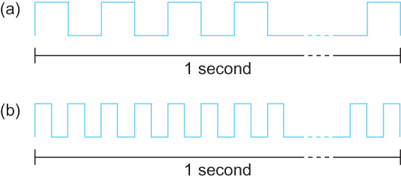
Bandwidth
Bits transmitted at a particular bandwidth can be regarded as having some width:
(a) bits transmitted at 1Mbps (each bit 1 μs wide);
(b) bits transmitted at 2Mbps (each bit 0.5 μs wide).

Slide 53
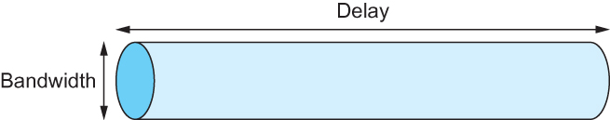
Delay X Bandwidth
We think the channel between a pair of processes as a hollow pipe
Latency (delay) length of the pipe and bandwidth the width of the pipe
Delay of 50 ms and bandwidth of 45 Mbps
50 x 10⁻³ seconds x 45 x 10⁶ bits/second
2.25 x 10⁶ bits = 280 KB data.
Network as a pipe

Slide 54
Delay X Bandwidth
Relative importance of bandwidth and latency depends on application
  For large file transfer, bandwidth is critical
  For small messages (HTTP, NFS, etc.), latency is critical
  Variance in latency (jitter) can also affect some applications (e.g., audio/video conferencing)

Slide 55
Delay X Bandwidth
  How many bits the sender must transmit before the first bit arrives at the receiver if the sender keeps the pipe full
  Takes another one-way latency to receive a response from the receiver
  If the sender does not fill the pipe—send a whole delay × bandwidth product’s worth of data before it stops to wait for a signal—the sender will not fully utilize the network

Slide 56
Delay X Bandwidth
Infinite bandwidth
  RTT dominates
  Throughput = TransferSize / TransferTime
  TransferTime = RTT + 1/Bandwidth x TransferSize
Its all relative
  1-MB file to 1-Gbps link looks like a 1-KB packet to 1-Mbps link

Slide 57
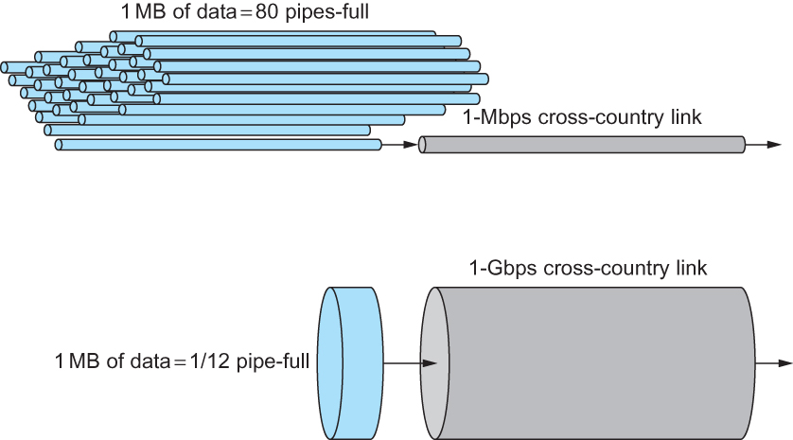
Relationship between bandwidth and latency
A 1-MB file would fill the 1-Mbps link 80 times,
but only fill the 1-Gbps link 1/12 of one time

Slide 58
Chapter 1: Roadmap
  What is the Internet?
  Network edge
  Network core
  Delay, Loss, Throughput in networks
  Protocol layers, service models

Slide 59
Protocol “Layers”
Networks are complex,
with many “pieces”:
  hosts
  routers
  links of various media
  applications
  protocols
  hardware, software
Question:
is there any hope of organizing structure of network?
…. or at least our discussion of networks?

Slide 60
Protocol “Layers”
Networks are complex,
with many “pieces”:
  hosts
  routers
  links of various media
  applications
  protocols
  hardware, software
Question:
is there any hope of organizing structure of network?
…. or at least our discussion of networks?

Slide 61
Organization of air travel
ticket (purchase)
baggage (check)
gates (load)
runway takeoff
airplane routing
ticket (complain)
baggage (claim)
gates (unload)
runway landing
airplane routing
airplane routing
a series of steps

Slide 62
Layering of airline functionality
ticket (purchase)
baggage (check)
gates (load)
runway (takeoff)
airplane routing
ticket (complain)
baggage (claim
gates (unload)
runway (land)
airplane routing
ticket
baggage
gate
takeoff/landing
airplane routing
airplane routing
airplane routing
departure
airport
intermediate air-traffic
control centers
arrival
airport
layers: each layer implements a service
  via its own internal-layer actions
  relying on services provided by layer below

Slide 63
Internet protocol stack
application: supporting network applications
  FTP, SMTP, HTTP
transport: process-process data transfer
  TCP, UDP
network: routing of packets from source to destination
  IP, routing protocols
link: data transfer between neighboring network elements
  Ethernet, 802.11 (WiFi), PPP
physical: bits “on the wire”
application
transport
network
link
physical

Slide 64
Why layering?
dealing with complex systems:
explicit structure allows identification, relationship of complex system’s pieces
  layered reference model for discussion
modularization eases maintenance, updating of system
  change of implementation of layer’s service transparent to rest of system
  e.g., change in gate procedure doesn’t affect rest of system
layering considered harmful?

Slide 65
Encapsulation
source
message
M
application
transport
network
link
physical
segment
H_{t}
M
H_{t}
datagram
H_{n}
H_{n}
H_{t}
M
frame
H_{l}
H_{n}
H_{t}
M
link
physical
switch
destination
H_{n}
H_{t}
M
network
link
physical
M
application
transport
network
link
physical
H_{l}
H_{n}
H_{t}
M
H_{n}
H_{t}
M
H_{t}
M
H_{n}
H_{t}
M
H_{l}
H_{n}
H_{t}
M
router

Slide 66
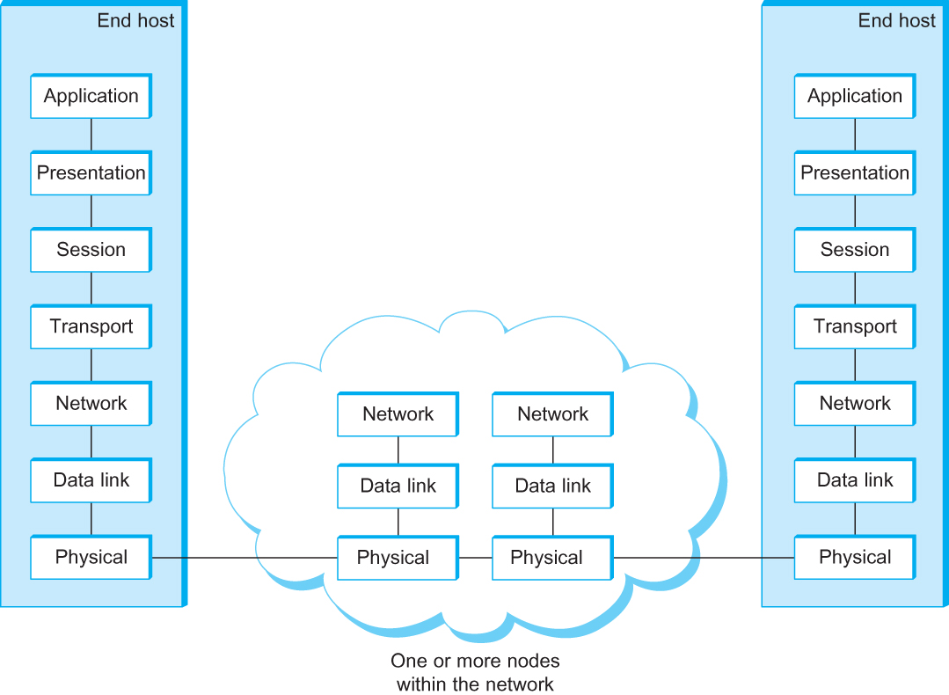
OSI Architecture
The OSI 7-layer Model
OSI – Open Systems Interconnection

Slide 67
Description of Layers
Physical Layer
  Handles the transmission of raw bits over a communication link
Data Link Layer
  Collects a stream of bits into a larger aggregate called a frame
  Network adaptor along with device driver in OS implement the protocol in this layer
  Frames are actually delivered to hosts
Network Layer
  Handles routing among nodes within a packet-switched network
  Unit of data exchanged between nodes in this layer is called a packet
  The lower three layers are implemented on all network nodes

Slide 68
Description of Layers
Transport Layer
  Implements a process-to-process channel
  Unit of data exchanges in this layer is called a message
Session Layer
  Provides a name space that is used to tie together the potentially different transport streams that are part of a single application
Presentation Layer
  Concerned about the format of data exchanged between peers
Application Layer
  Standardize common type of exchanges
  The transport layer and the higher layers typically run only on end-hosts and not on the intermediate switches and routers

Slide 69
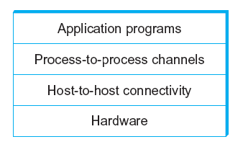
Network Architecture
Example of a layered network system

Slide 70
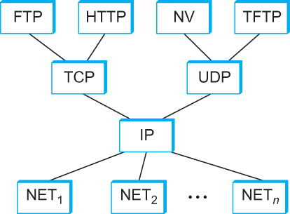
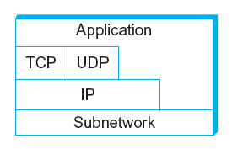
Internet Architecture
Alternative view of the Internet architecture. The “Network” layer shown here is sometimes referred to as the “sub-network” or “link” layer.
Internet Protocol Graph

Slide 71
This course: Top-Down or Bottom-up?
3
2
1
4

