Slide 1
Computer Networks
CMSC 417 : Spring 2023
Topic: Internetworking
(Textbook chapter 3)
Nirupam Roy
Tu-Th 2:00-3:15pm
CSI 2117

Slide 2
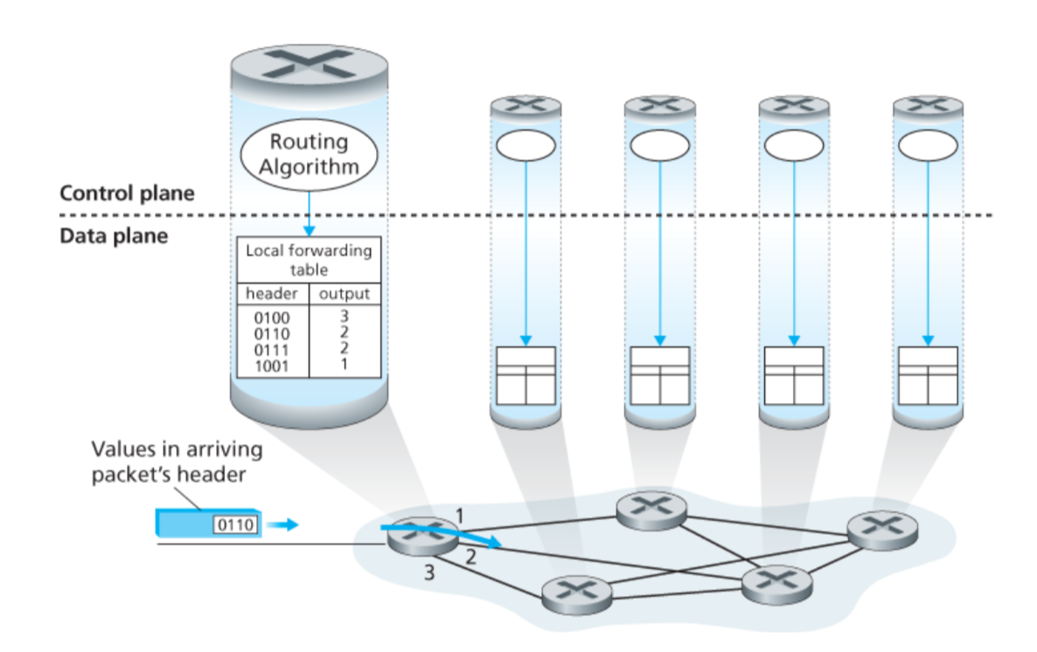
Connection between hosts

Slide 3
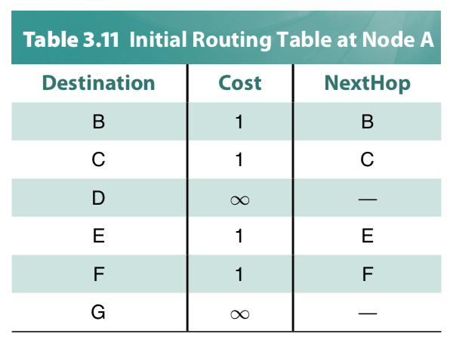
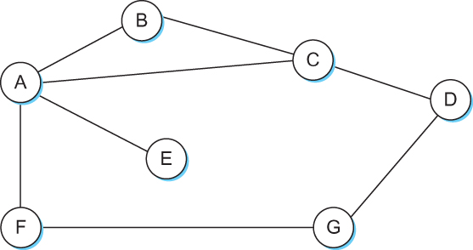
Distance Vector
Each node constructs a one dimensional array (a vector) containing the “distances” (costs) to all other nodes and distributes that vector to its immediate neighbors
Starting assumption is that each node knows the cost of the link to each of its directly connected neighbors

Slide 4
Distance vector algorithm
iterative, asynchronous: each local iteration caused by:
local link cost change
DV update message from neighbor
distributed:
each node notifies neighbors only when its DV changes
neighbors then notify their neighbors if necessary
each node:
wait for (change in local link cost or msg from neighbor)
recompute estimates
if DV to any dest has changed, notify neighbors

Slide 5
Routing updates
Two circumstances when a node sends out routing advertisements:
Periodic: Automatically after some time.
2) Triggered: Whenever an event makes a node to change its routing table (e.g., link fail or a new message from a neighbor).

Slide 6
Distance Vector Routing: Link failure

Slide 7
Round: 2
Dest | Cost | N. Hop
A | 18 | C
B | 0 | B
C | 11 | C
D | 4 | D
E | 16 | C
Dest | Cost | N. Hop
A | 22 | C
B | 4 | B
C | 15 | C
D | 0 | D
E | 13 | E
Dest | Cost | N. Hop
A | 0 | A
B | 18 | C
C | 7 | C
D | 22 | C
E | 12 | C
B
D
19
4
A
11
13
15
7
5
C
E
Node A: No Updates
Node B: No Updates
Node C: No Updates
Node D: No Updates
Node E: No Updates
Dest | Cost | N. Hop
A | 7 | A
B | 11 | B
C | 0 | C
D | 15 | D
E | 5 | E
Dest | Cost | N. Hop
A | 12 | C
B | 16 | C
C | 5 | C
D | 13 | D
E | 0 | E

Slide 8
Round: 3
Dest | Cost | N. Hop
A | ∞ | --
B | 0 | B
C | ∞ | --
D | 4 | D
E | ∞ | --
Dest | Cost | N. Hop
A | 22 | C
B | 4 | B
C | 15 | C
D | 0 | D
E | 13 | E
Dest | Cost | N. Hop
A | 0 | A
B | 18 | C
C | 7 | C
D | 22 | C
E | 12 | C
B
D
19
4
A
11
13
15
7
5
C
E
Node A: No Updates
Node B: No Updates
Node C: No Updates
Node D: No Updates
Node E: No Updates
Dest | Cost | N. Hop
A | 7 | A
B | ∞ | --
C | 0 | C
D | 15 | D
E | 5 | E
Dest | Cost | N. Hop
A | 12 | C
B | 16 | C
C | 5 | C
D | 13 | D
E | 0 | E

Slide 9
Round: 3
Dest | Cost | N. Hop
A | 19 | A
B | 0 | B
C | 19 | D
D | 4 | D
E | 17 | D
Dest | Cost | N. Hop
A | 22 | C
B | 4 | B
C | 15 | C
D | 0 | D
E | 13 | E
Dest | Cost | N. Hop
A | 0 | A
B | ∞ | C
C | 7 | C
D | 22 | C
E | 12 | C
Cost update
B
D
19
4
A
11
13
15
7
5
C
E
Node A: Updates for B
Node B: Updates for A,C,E
Node C: Updates for B
Node D: No Updates
Node E: Updates for B
Dest | Cost | N. Hop
A | 7 | A
B | 19 | D
C | 0 | C
D | 15 | D
E | 5 | E
Dest | Cost | N. Hop
A | 12 | C
B | 17 | D
C | 5 | C
D | 13 | D
E | 0 | E

Slide 10
Round: 4
Dest | Cost | N. Hop
A | 19 | A
B | 0 | B
C | 19 | D
D | 4 | D
E | 17 | D
Dest | Cost | N. Hop
A | 22 | C
B | 4 | B
C | 15 | C
D | 0 | D
E | 13 | E
Dest | Cost | N. Hop
A | 0 | A
B | ∞ | C
C | 7 | C
D | 22 | C
E | 12 | C
B
D
19
4
A
11
13
15
7
5
C
E
Node A: Updates for B
Node B: No Updates
Node C: No Updates
Node D: No Updates
Node E: No Updates
Dest | Cost | N. Hop
A | 7 | A
B | 19 | D
C | 0 | C
D | 15 | D
E | 5 | E
Dest | Cost | N. Hop
A | 12 | C
B | 17 | D
C | 5 | C
D | 13 | D
E | 0 | E

Slide 11
Round: 5
Dest | Cost | N. Hop
A | 19 | A
B | 0 | B
C | 19 | D
D | 4 | D
E | 17 | D
Dest | Cost | N. Hop
A | 22 | C
B | 4 | B
C | 15 | C
D | 0 | D
E | 13 | E
Dest | Cost | N. Hop
A | 0 | A
B | 19 | B
C | 7 | C
D | 22 | C
E | 12 | C
B
D
19
4
A
11
13
15
7
5
C
E
Node A: No Updates
Node B: No Updates
Node C: No Updates
Node D: No Updates
Node E: No Updates
Dest | Cost | N. Hop
A | 7 | A
B | 19 | D
C | 0 | C
D | 15 | D
E | 5 | E
Dest | Cost | N. Hop
A | 12 | C
B | 17 | D
C | 5 | C
D | 13 | D
E | 0 | E

Slide 12
Distance vector: link cost changes
link cost changes:
node detects local link cost change
updates routing info, recalculates distance vector
if DV changes, notify neighbors
1
y
4
1
x
z
50

Slide 13
Distance vector: link cost “decreases”
Bellman-Ford algo.
considered the route
through Z (cost=51).
Dest | Cost | Hop
X | 4 | X
Y | 0 | Y
Z | 1 | Z
Dest | Cost | Hop
X | 1 | X
Y | 0 | Y
Z | 1 | Z
Dest | Cost | Hop
X | 1 | X
Y | 0 | Y
Z | 1 | Z
Dest | Cost | Hop
X | 1 | X
Y | 0 | Y
Z | 1 | Z
node Y
Dest | Cost | Hop
X | 5 | Y
Y | 1 | Y
Z | 0 | Z
Dest | Cost | Hop
X | 5 | Y
Y | 1 | Y
Z | 0 | Z
Dest | Cost | Hop
X | 2 | Y
Y | 1 | Y
Z | 0 | Z
Dest | Cost | Hop
X | 2 | Y
Y | 1 | Y
Z | 0 | Z
node Z
T1
T2
T3
T4
Cost change

Slide 14
Distance vector: link cost “increases”
Bellman-Ford algo.
considers two routes from the
saved advertisements.
<X, 60, X> -- direct link
<X, 5, Z> + d_{Z}(X) – Cost 6 link via Z
60
Dest | Cost | Hop
X | 4 | X
Y | 0 | Y
Z | 1 | Z
Dest | Cost | Hop
X | 6 | Z
Y | 0 | Y
Z | 1 | Z
Dest | Cost | Hop
X | 6 | Z
Y | 0 | Y
Z | 1 | Z
Dest | Cost | Hop
X | 8 | X
Y | 0 | Y
Z | 1 | Z
node Y
Dest | Cost | Hop
X | 5 | Y
Y | 1 | Y
Z | 0 | Z
Dest | Cost | Hop
X | 5 | Y
Y | 1 | Y
Z | 0 | Z
Dest | Cost | Hop
X | 7 | Y
Y | 1 | Y
Z | 0 | Z
Dest | Cost | Hop
X | 7 | Y
Y | 1 | Y
Z | 0 | Z
node Z
T1
T2
T3
T4
Cost change

Slide 15
Distance vector: link cost “increases”
Bellman-Ford algo.
considers two routes from the
saved advertisements.
<X, 60, X> -- direct link
<X, 5, Z> + d_{Z}(X) – Cost 6 link via Z
60
When will this looped update stop (converge)?
Dest | Cost | Hop
X | 4 | X
Y | 0 | Y
Z | 1 | Z
Dest | Cost | Hop
X | 6 | Z
Y | 0 | Y
Z | 1 | Z
Dest | Cost | Hop
X | 6 | Z
Y | 0 | Y
Z | 1 | Z
Dest | Cost | Hop
X | 8 | X
Y | 0 | Y
Z | 1 | Z
node Y
Dest | Cost | Hop
X | 5 | Y
Y | 1 | Y
Z | 0 | Z
Dest | Cost | Hop
X | 5 | Y
Y | 1 | Y
Z | 0 | Z
Dest | Cost | Hop
X | 7 | Y
Y | 1 | Y
Z | 0 | Z
Dest | Cost | Hop
X | 7 | Y
Y | 1 | Y
Z | 0 | Z
node Z
T1
T2
T3
T4
Cost change

Slide 16
Distance vector: link cost “increases”
Bellman-Ford algo.
considers two routes from the
saved advertisements.
<X, 60, X> -- direct link
<X, 5, Z> + d_{Z}(X) – Cost 6 link via Z
60
“Count-to-infinity” problem
Dest | Cost | Hop
X | 4 | X
Y | 0 | Y
Z | 1 | Z
Dest | Cost | Hop
X | 6 | Z
Y | 0 | Y
Z | 1 | Z
Dest | Cost | Hop
X | 6 | Z
Y | 0 | Y
Z | 1 | Z
Dest | Cost | Hop
X | 8 | X
Y | 0 | Y
Z | 1 | Z
node Y
Dest | Cost | Hop
X | 5 | Y
Y | 1 | Y
Z | 0 | Z
Dest | Cost | Hop
X | 5 | Y
Y | 1 | Y
Z | 0 | Z
Dest | Cost | Hop
X | 7 | Y
Y | 1 | Y
Z | 0 | Z
Dest | Cost | Hop
X | 7 | Y
Y | 1 | Y
Z | 0 | Z
node Z
T1
T2
T3
T4
Cost change

Slide 17
Distance vector: link cost decreases
node Y
Dest.
Dest.
node Z

Slide 18
Distance vector: link cost decreases
node Y
Dest.
Dest.
node Z

Slide 19
Distance vector: link cost decreases
node Y
Dest.
Dest.
node Z

Slide 20
Distance vector: link cost decreases
node Y
Dest.
Dest.
node Z

Slide 21
Distance vector: link cost decreases
node Y
Dest.
Dest.
node Z

Slide 22
Distance vector: link cost decreases
Dest.
Dest.

Slide 23
Distance vector: link cost changes
link cost changes:
node detects local link cost change
updates routing info, recalculates distance vector
if DV changes, notify neighbors
1
y
4
1
x
z
50
“good
news
travels
fast”
t₀ : y detects link-cost change, updates its DV, informs its neighbors.
t₁ : z receives update from y, updates its table, computes new least cost to x , sends its neighbors its DV.
t₂ : y receives z’s update, updates its distance table. y's least costs do not change, so y does not send a message to z.

Slide 24
Distance vector: link cost changes
link cost changes:
node detects local link cost change
bad news travels slow - “count to infinity” problem!
Many iterations before algorithm stabilizes
60
y
4
1
x
z
50

Slide 25
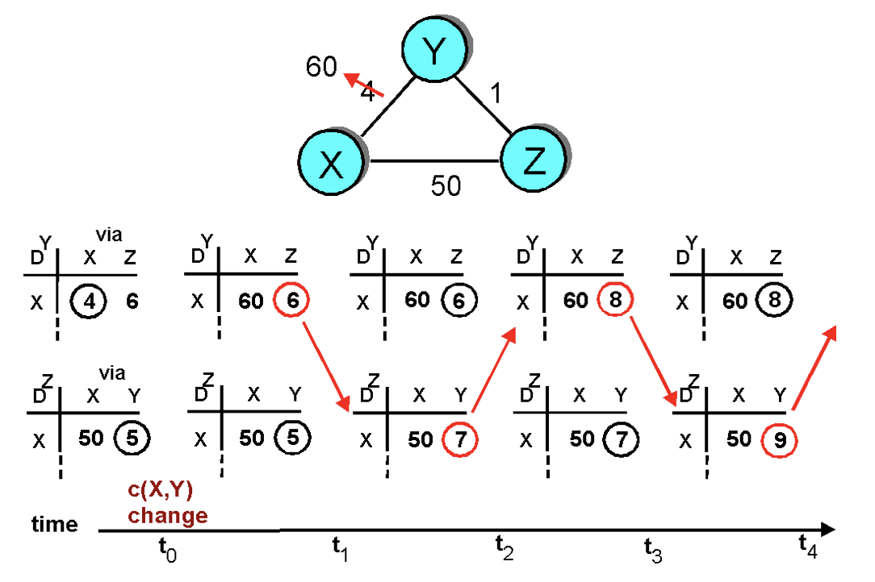
Distance vector: link cost increases
“Count to infinity” problem

Slide 26
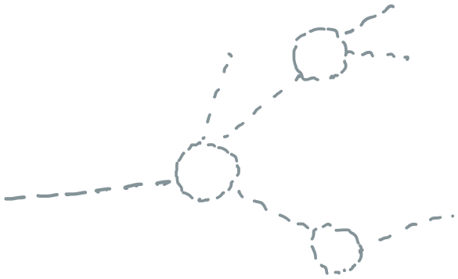
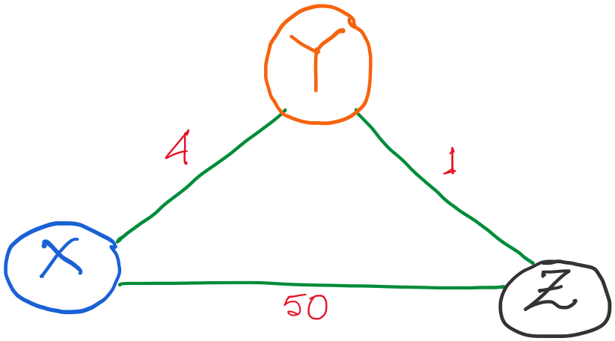
Distance vector routing: Example
Routing table entries:

Slide 27
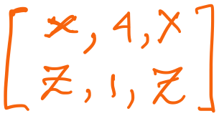
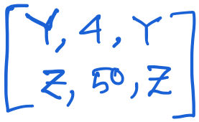
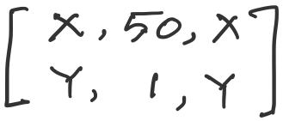
Distance vector routing: Revisited
Routing table entries:

Slide 28
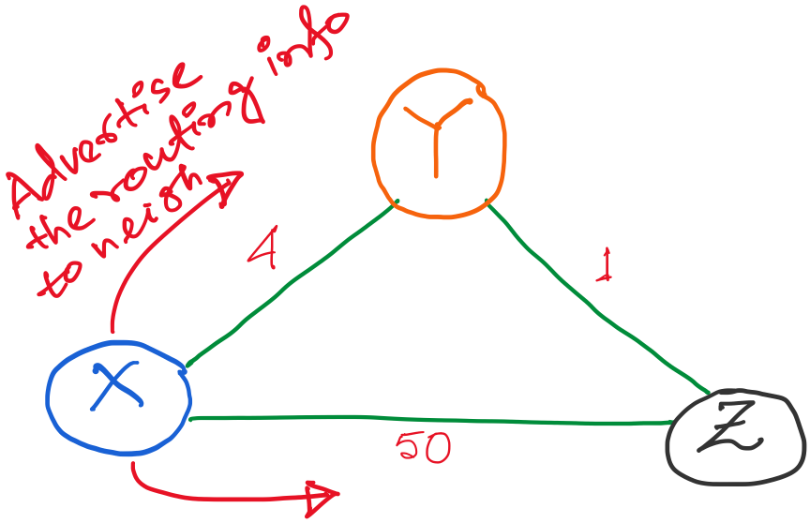
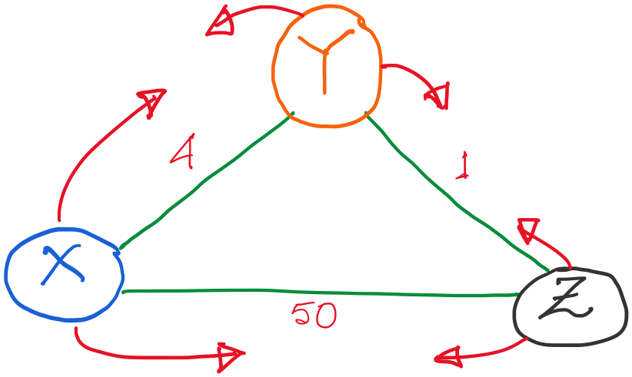

Slide 29
Alternate route to Z,
with lower cost (1+4)
So, update.
Alternate route to Y,
But higher cost (1+50)
No update.

Slide 30
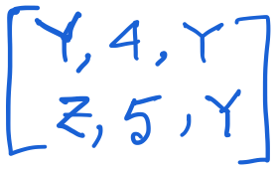
X’s updated table.

Slide 31
X’s updated table.
Alternate route to X,
with lower cost (4+1)
So, update.

Slide 32
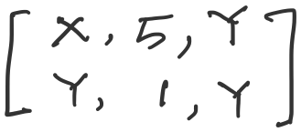
X’s updated table.

Slide 33
Tables are updated.
Advertisement messages will trigger as routing table is updates.

Slide 34
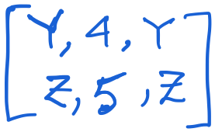
Let’s take a look at the node Y only.
An (false) alternate route to X,
with higher cost (5+1)
So, (fortunately) no update.

Slide 35
No update at any node. The routing algorithm converges.

Slide 36
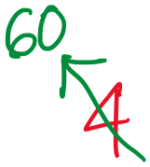
Distance vector: link cost increases

Slide 37
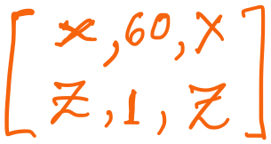
Distance vector: link cost increases
Y updates its table.

Slide 38
Distance vector: link cost increases
Y updates its table.
But imagine if Z advertises its old information to Y. (e.g., periodic update)

Slide 39
Distance vector: link cost increases
An (false) alternate route to X,
with lower cost (5+1)
So, (unfortunately) it will update.
But imagine if Z advertises its old information to Y, before reading Y’s message. (e.g., periodic update)

Slide 40
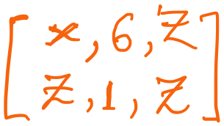
Distance vector: link cost increases
Y updates its table.

Slide 41
Distance vector: link cost increases
Y updates its table.
Sharing distance vector info

Slide 42
Distance vector: link cost increases
Y updates its table.
7
Z updates its table.

Slide 43
Distance vector: link cost increases
“Count to infinity” problem

Slide 44
Count-to-infinity Problem
Use some relatively small number as an approximation of infinity
For example, the maximum number of hops to get across a certain network is never going to be more than 16

Slide 45
Count-to-infinity Problem
Use some relatively small number as an approximation of infinity
For example, the maximum number of hops to get across a certain network is never going to be more than 16
Maximum possible hops

Slide 46
Count-to-infinity Problem
Use some relatively small number as an approximation of infinity
For example, the maximum number of hops to get across a certain network is never going to be more than 16
Maximum possible hops
“Thus, when considering even the most distant Facebook user in the Siberian tundra or the Peruvian rainforest, a friend of your friend probably knows a friend of their friend,” -- Facebook

Slide 47
Count-to-infinity Problem
Use some relatively small number as an approximation of infinity
For example, the maximum number of hops to get across a certain network is never going to be more than 16
One technique to improve the time to stabilize routing is called
split horizon
When a node sends a routing update to its neighbors, it does not send those routes it learned from each neighbor back to that neighbor
For example, if B has the route (E, 2, A) in its table, then it knows it must have learned this route from A, and so whenever B sends a routing update to A, it does not include the route (E, 2) in that update

Slide 48
Count-to-infinity Problem
In a stronger version of split horizon, called split horizon with poison reverse
B actually sends that back route to A, but it puts negative information in the route to ensure that A will not eventually use B to get to E
For example, B sends the route (E, ∞) to A

Slide 49
Distance vector: Poisoned reverse
Does poison reverse solve the general count-to-infinity problem?
It does not. It may be possible that loops involving three or more nodes (rather than simply two immediately neighboring nodes, as we shown in last example) will not be detected by the poison reverse technique.

Slide 50
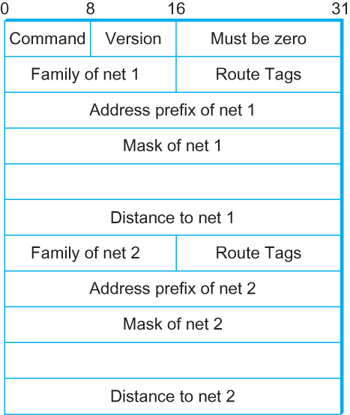
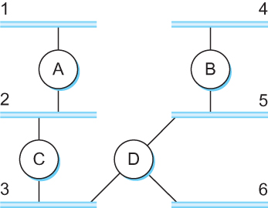
DV Implementation: Routing Information Protocol (RIP)
Example Network
running RIP RIPv2 Packet Format

Slide 51
Link State Routing

Slide 52
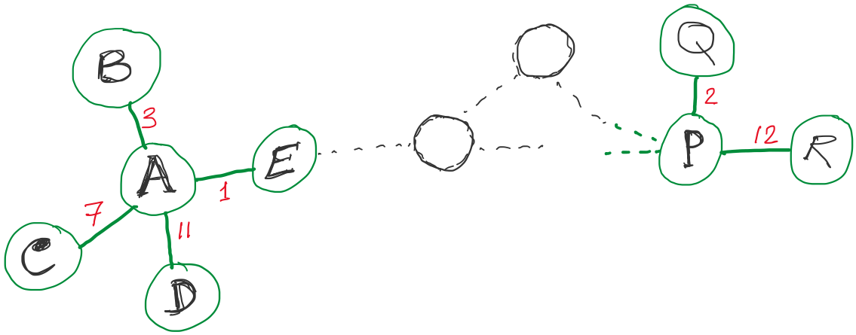
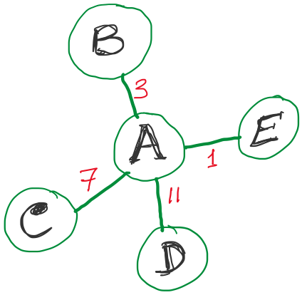
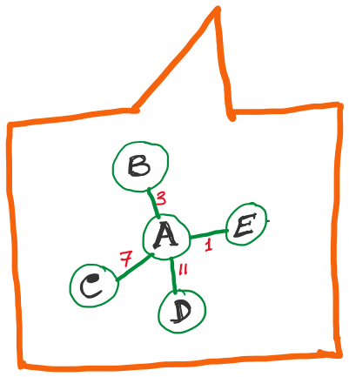
Link State Routing
Strategy:
Send to all nodes (not just neighbors) information about neighbors (not connection to all nodes).
All nodes will know the link-state information of all other nodes

Slide 53
Link State Routing
Strategy:
Send to all nodes (not just neighbors) information about neighbors (not connection to all nodes).
Link State Packet (LSP):
The ID of the node that created the LSP
(2) Costs of links to each directly connected neighbor
(3) A sequence number (SEQNO)
[To distinguish a newer LSP from the old ones]
[Smaller number == older LSP]
(4) A Time-To-Live (TTL) for this packet
[To make sure old information is eventually removed
from the network]

Slide 54
Link State Routing
(1) Reliable flooding
[Makes sure all nodes in the network get a copy of LSP from all other nodes]
(2) Route calculation
(Dijkstra’s shortest path algorithm)
[Calculates the shortest path from each node to all other nodes and the corresponding next-hop]

Slide 55
Link State Routing: Reliable flooding
Store most recent LSP from each node
Forward LSP to all nodes but one that sent it
Generate new LSP periodically; increment SEQNO
Start SEQNO at 0 when reboot
Decrement TTL before flooding it to neighbors.
Also age the stored LSP (decrement TTL)
Discard when TTL=0.
Goals:
Flood in minimum time
Minimize total routing traffic

Slide 56
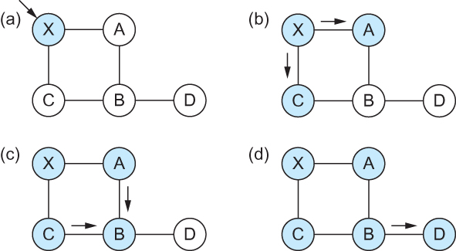
Link State
Gets two identical copies of LSP.
Accepts the one arrived first
Reliable Flooding
Flooding of link-state packets. (a) LSP arrives at node X; (b) X floods LSP to A and C; (c) A and C flood LSP to B (but not X); (d) flooding is complete

Slide 57
Consider this network:
B
D
19
4
A
11
13
15
7
5
C
E
After flooding every node will have the following information:
Each node has complete knowledge of the network topology
B
B
D
19
A
11
15
B
D
4
7
C
C
5
E
13
Apply shortest path algorithm to find routes
E
D
B
D
19
4
13
A
C
5
E

Slide 58
Shortest Path Routing
Dijkstra’s Algorithm - Assume non-negative link weights
N: set of nodes in the graph
l((i, j): the non-negative cost associated with the edge between nodes i, j ∈N and l(i, j) = ∝ if no edge connects i and j
Let s ∈N be the starting node which executes the algorithm to find shortest paths to all other nodes in N
Two variables used by the algorithm
M: set of nodes incorporated so far by the algorithm
C(n) : the cost of the path from s to each node n
The algorithm
M = {s}
For each n in N – {s}
C(n) = l(s, n)
while ( N ≠ M)
M = M ∪ {w} such that C(w) is the minimum
for all w in (N-M)
For each n in (N-M)
C(n) = MIN (C(n), C(w) + l(w, n))

Slide 59
Shortest Path Routing
In practice, each switch computes its routing table directly from the LSP’s it has collected using a realization of Dijkstra’s algorithm called the forward search algorithm
Specifically each switch maintains two lists, known as Tentative and Confirmed
Each of these lists contains a set of entries of the form (Destination, Cost, NextHop)

Slide 60
Consider this network:
B
D
19
4
A
11
13
15
7
5
C
E
After flooding every node will have the following information:
B
B
D
19
A
11
15
B
D
4
7
C
C
5
E
13
E
D
B
D
19
4
13
A
C
5
E

Slide 61
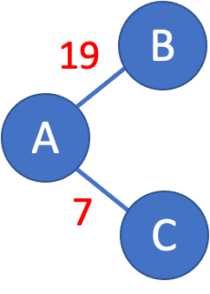
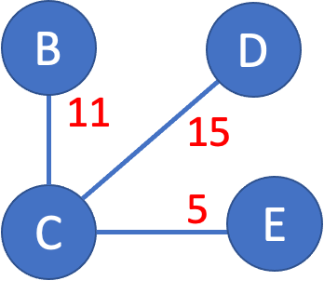
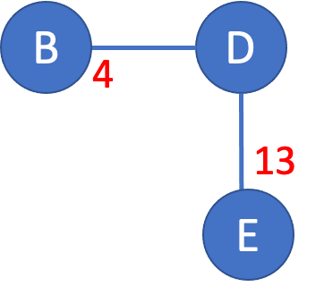
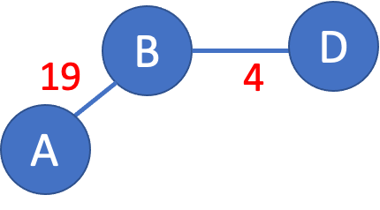
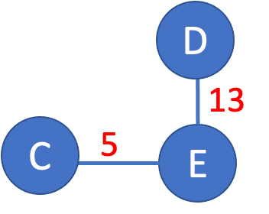
>

Slide 62
>
19
B
A
7
C

Slide 63
>
19
B
A
7
C

Slide 64
>
19
B
Unvisited nodes
A
Confirmed nodes
7
C
Tentative nodes

Slide 65
>
19
B
A
7
C

Slide 66
>
19
B
A
7
C

Slide 67
>
B
B
D
19
A
11
15
7
C
C
5
E
7

Slide 68
>
B
B
D
19
A
11
15
Update costs
7
C
C
5
E
7

Slide 69
>
B
B
D
19
A
18
22
Update costs
7
C
C
12
E
7

Slide 70
>
D
B
B
D
A
18
22
18
Update costs
22
7
C
12
E
C
12
E
7

Slide 71
>
D
B
A
18
22
7
C
12
E

Slide 72
>
D
D
B
13
A
18
22
C
5
E
7
C
12
E

Slide 73
>
D
D
B
X
13
18
22
25
A
C
5
E
7
C
12
E
No update.

Slide 74
>
18
D
B
D
B
19
4
A
18
22
A
X
7
C
12
E
No update.

Slide 75
>
18
D
B
D
B
19
4
A
18
22
22
A
X
7
C
12
E
No update.

Slide 76
>
18
D
B
D
B
19
4
A
18
22
22
A
X
7
C
12
E
No update.

Slide 77
>
D
X
B
B
D
4
A
18
22
12
E
13
7
C
E
X
No update.

Slide 78
>
D
X
B
B
D
4
A
18
22
12
E
13
7
C
E
X
No update.

Slide 79
Consider this network:
B
D
19
4
A
11
13
15
7
5
C
E
D
B
A
18
22
7
C
12
E

Slide 80
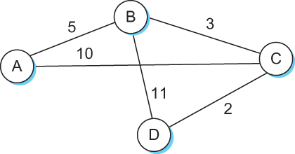
Shortest Path Routing

Slide 81
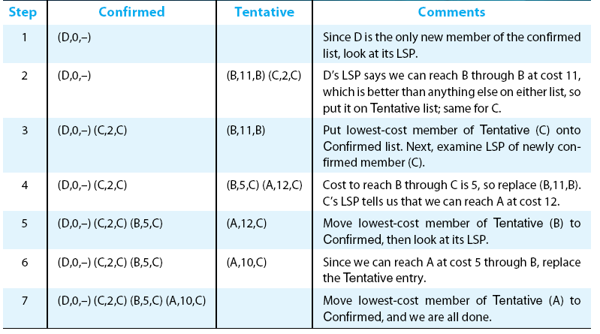
Shortest Path Routing

Slide 82
Shortest Path Routing
Dijkstra’s Algorithm
M = {s}
For each n in N – {s}
C(n) = l(s, n)
while ( N ≠ M)
M = M ∪ {w} such that C(w) is the minimum
for all w in (N-M)
For each n in (N-M)
C(n) = MIN (C(n), C(w) + l(w, n))
Confirmed list
Newly added member to the confirmed list
Tentative list

Slide 83
Shortest Path Routing
The algorithm
Initialize the Confirmed list with an entry for myself; this entry has a cost of 0
For the node just added to the Confirmed list in the previous step, call it node Next, select its LSP
For each neighbor (Neighbor) of Next, calculate the cost (Cost) to reach this Neighbor as the sum of the cost from myself to Next and from Next to Neighbor
If Neighbor is currently on neither the Confirmed nor the Tentative list, then add (Neighbor, Cost, Nexthop) to the Tentative list, where Nexthop is the direction I go to reach Next
If Neighbor is currently on the Tentative list, and the Cost is less than the currently listed cost for the Neighbor, then replace the current entry with (Neighbor, Cost, Nexthop) where Nexthop is the direction I go to reach Next
If the Tentative list is empty, stop. Otherwise, pick the entry from the Tentative list with the lowest cost, move it to the Confirmed list, and return to Step 2.

Slide 84
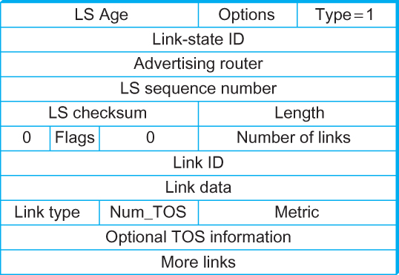
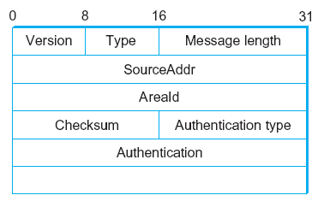
Open Shortest Path First (OSPF)
OSPF Header Format OSPF Link State Advertisement

Slide 85
Comparison of LS and DV algorithms
message complexity
LS: with n nodes, E links, O(nE) msgs sent
DV: exchange between neighbors only
convergence time varies
speed of convergence
LS: O(n²) algorithm requires O(nE) msgs
may have oscillations
DV: convergence time varies
may be routing loops
count-to-infinity problem
robustness: what happens if router malfunctions?
LS:
node can advertise incorrect link cost
each node computes only its own table
DV:
DV node can advertise incorrect path cost
each node’s table used by others
error propagate thru network

Slide 86
Comparison of LS and DV algorithms
message complexity
LS: with n nodes, E links, O(nE) msgs sent
DV: exchange between neighbors only
convergence time varies
speed of convergence
LS: O(n²) algorithm requires O(nE) msgs
may have oscillations
DV: convergence time varies
may be routing loops
count-to-infinity problem
robustness: what happens if router malfunctions?
LS:
node can advertise incorrect link cost
each node computes only its own table
DV:
DV node can advertise incorrect path cost
each node’s table used by others
error propagate thru network

