Slide 1

Computer Networks
CMSC 417 : Spring 2023
Topic: Internetworking
(Textbook chapter 3)
Nirupam Roy
Tu-Th 2:00-3:15pm
CSI 2117

Slide 2
Link State Routing

Slide 3
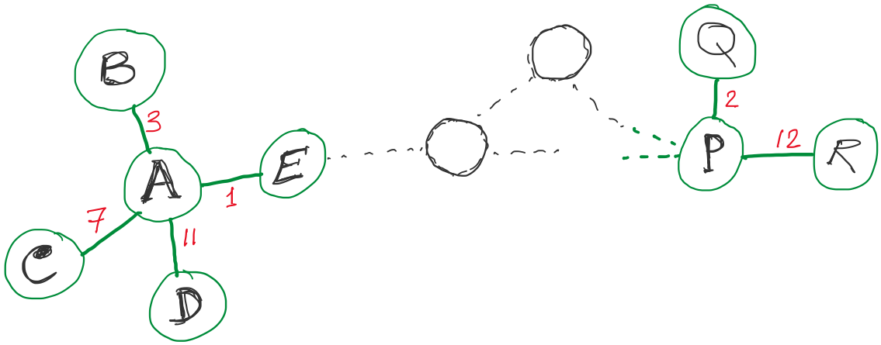
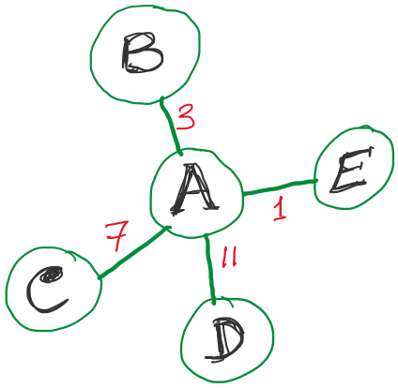
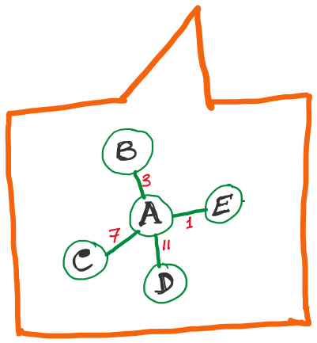
Link State Routing
Strategy:
Send to all nodes (not just neighbors) information about neighbors (not connection to all nodes).
All nodes will know the link-state information of all other nodes

Slide 4
Link State Routing
Strategy:
Send to all nodes (not just neighbors) information about neighbors (not connection to all nodes).
Link State Packet (LSP):
  The ID of the node that created the LSP
  (2) Costs of links to each directly connected neighbor
  (3) A sequence number (SEQNO)
  [To distinguish a newer LSP from the old ones]
  [Smaller number == older LSP]
  (4) A Time-To-Live (TTL) for this packet
  [To make sure old information is eventually removed
  from the network]
What is the unit of the “Time-to-Live”?

Slide 5
Link State Routing
(1) Reliable flooding
[Makes sure all nodes in the network get a copy of LSP from all other nodes]
(2) Route calculation
(Dijkstra’s shortest path algorithm)
[Calculates the shortest path from each node to all other nodes and the corresponding next-hop]

Slide 6
Link State Routing: Reliable flooding
  Store most recent LSP from each node
  Forward LSP to all nodes but one that sent it
  Generate new LSP periodically; increment SEQNO
  Start SEQNO at 0 when reboot
  Decrement TTL before flooding it to neighbors.
  Also age the stored LSP (decrement TTL)
  Discard when TTL=0.
Goals:
Flood in minimum time
Minimize total routing traffic

Slide 7
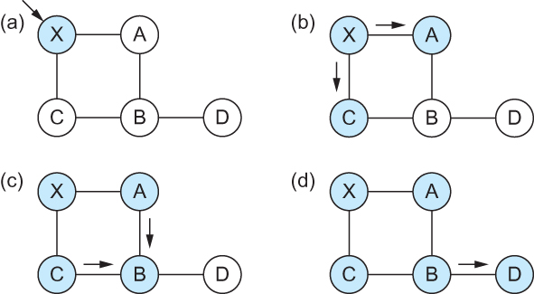
Link State
Gets two identical copies of LSP.
Accepts the one arrived first
Reliable Flooding
Flooding of link-state packets. (a) LSP arrives at node X; (b) X floods LSP to A and C; (c) A and C flood LSP to B (but not X); (d) flooding is complete

Slide 8
Consider this network:
B
D
19
4
A
11
13
15
7
5
C
E
After flooding every node will have the following information:
Each node has complete knowledge of the network topology
B
B
D
19
A
11
15
B
D
4
7
C
C
5
E
13
Apply shortest path algorithm to find routes
E
D
B
D
19
4
13
A
C
5
E

Slide 9
Shortest Path Routing
Dijkstra’s Algorithm - Assume non-negative link weights
  N: set of nodes in the graph
  l((i, j): the non-negative cost associated with the edge between nodes i, j ∈N and l(i, j) = ∝ if no edge connects i and j
  Let s ∈N be the starting node which executes the algorithm to find shortest paths to all other nodes in N
  Two variables used by the algorithm
    M: set of nodes incorporated so far by the algorithm
    C(n) : the cost of the path from s to each node n
    The algorithm
      M = {s}
      For each n in N – {s}
        C(n) = l(s, n)
      while ( N ≠ M)
        M = M ∪ {w} such that C(w) is the minimum
        for all w in (N-M)
        For each n in (N-M)
        C(n) = MIN (C(n), C(w) + l(w, n))

Slide 10
Shortest Path Routing
In practice, each switch computes its routing table directly from the LSP’s it has collected using a realization of Dijkstra’s algorithm called the forward search algorithm
Specifically each switch maintains two lists, known as Tentative and Confirmed
Each of these lists contains a set of entries of the form (Destination, Cost, NextHop)

Slide 11
Consider this network:
B
D
19
4
A
11
13
15
7
5
C
E
After flooding every node will have the following information:
B
B
D
19
A
11
15
B
D
4
7
C
C
5
E
13
E
D
B
D
19
4
13
A
C
5
E

Slide 12
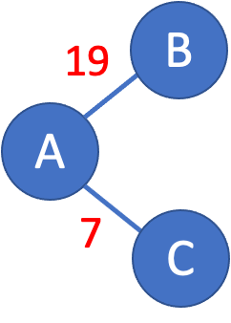
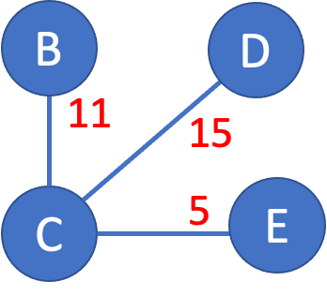
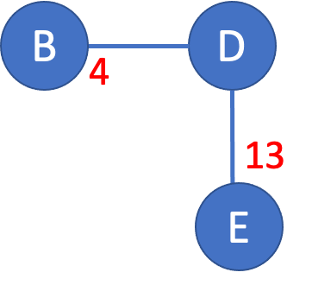
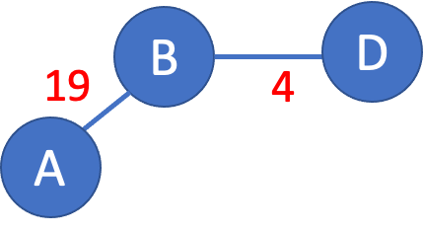
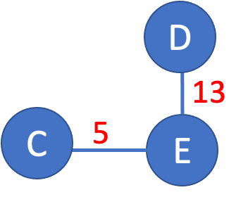
>

Slide 13
>
19
B
A
7
C

Slide 14
>
19
B
A
7
C

Slide 15
>
19
B
Unvisited nodes
A
Confirmed nodes
7
C
Tentative nodes

Slide 16
>
19
B
A
7
C

Slide 17
>
19
B
A
7
C

Slide 18
>
B
B
D
19
A
11
15
7
C
C
5
E
7

Slide 19
>
B
B
D
19
A
11
15
Update costs
7
C
C
5
E
7

Slide 20
>
B
B
D
19
A
18
22
Update costs
7
C
C
12
E
7

Slide 21
>
D
B
B
D
A
18
22
18
Update costs
22
7
C
12
E
C
12
E
7

Slide 22
>
D
B
A
18
22
7
C
12
E

Slide 23
>
D
D
B
13
A
18
22
C
5
E
7
C
12
E

Slide 24
>
D
D
B
X
13
18
22
25
A
C
5
E
7
C
12
E
No update.

Slide 25
>
18
D
B
D
B
19
4
A
18
22
A
X
7
C
12
E
No update.

Slide 26
>
18
D
B
D
B
19
4
A
18
22
22
A
X
7
C
12
E
No update.

Slide 27
>
18
D
B
D
B
19
4
A
18
22
22
A
X
7
C
12
E
No update.

Slide 28
>
D
X
B
B
D
4
A
18
22
12
E
13
7
C
E
X
No update.

Slide 29
>
D
X
B
B
D
4
A
18
22
12
E
13
7
C
E
X
No update.

Slide 30
Consider this network:
B
D
19
4
A
11
13
15
7
5
C
E
D
B
A
18
22
7
C
12
E

Slide 31
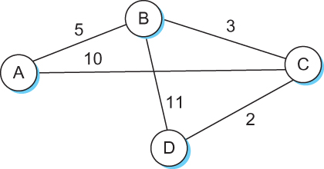
Shortest Path Routing

Slide 32
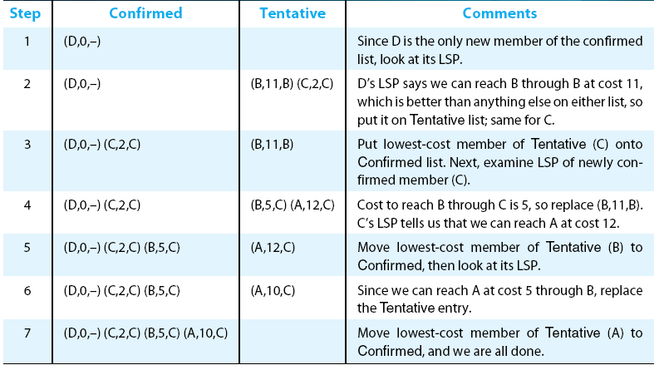
Shortest Path Routing

Slide 33
Shortest Path Routing
Dijkstra’s Algorithm
M = {s}
      For each n in N – {s}
        C(n) = l(s, n)
      while ( N ≠ M)
        M = M ∪ {w} such that C(w) is the minimum
        for all w in (N-M)
        For each n in (N-M)
        C(n) = MIN (C(n), C(w) + l(w, n))
Confirmed list
Newly added member to the confirmed list
Tentative list

Slide 34
Shortest Path Routing
The algorithm
  Initialize the Confirmed list with an entry for myself; this entry has a cost of 0
  For the node just added to the Confirmed list in the previous step, call it node Next, select its LSP
  For each neighbor (Neighbor) of Next, calculate the cost (Cost) to reach this Neighbor as the sum of the cost from myself to Next and from Next to Neighbor
    If Neighbor is currently on neither the Confirmed nor the Tentative list, then add (Neighbor, Cost, Nexthop) to the Tentative list, where Nexthop is the direction I go to reach Next
    If Neighbor is currently on the Tentative list, and the Cost is less than the currently listed cost for the Neighbor, then replace the current entry with (Neighbor, Cost, Nexthop) where Nexthop is the direction I go to reach Next
  If the Tentative list is empty, stop. Otherwise, pick the entry from the Tentative list with the lowest cost, move it to the Confirmed list, and return to Step 2.

Slide 35
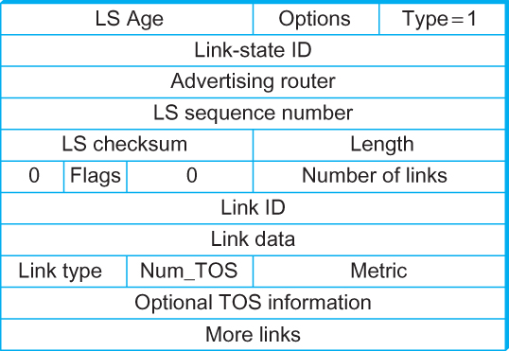
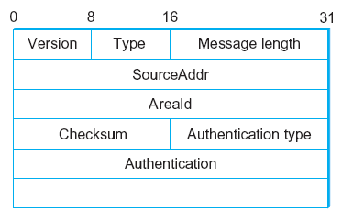
Open Shortest Path First (OSPF)
  OSPF Header Format OSPF Link State Advertisement

Slide 36
Comparison of LS and DV algorithms
message complexity
LS: with n nodes, E links, O(nE) msgs sent
DV: exchange between neighbors only
  convergence time varies
speed of convergence
LS: O(n²) algorithm requires O(nE) msgs
  may have oscillations
DV: convergence time varies
  may be routing loops
  count-to-infinity problem
robustness: what happens if router malfunctions?
LS:
  node can advertise incorrect link cost
  each node computes only its own table
DV:
  DV node can advertise incorrect path cost
  each node’s table used by others
    error propagate thru network

Slide 37
Comparison of LS and DV algorithms
message complexity
LS: with n nodes, E links, O(nE) msgs sent
DV: exchange between neighbors only
  convergence time varies
speed of convergence
LS: O(n²) algorithm requires O(nE) msgs
  may have oscillations
DV: convergence time varies
  may be routing loops
  count-to-infinity problem
robustness: what happens if router malfunctions?
LS:
  node can advertise incorrect link cost
  each node computes only its own table
DV:
  DV node can advertise incorrect path cost
  each node’s table used by others
    error propagate thru network

Slide 38
Internet Protocol

Slide 39
The Internet network layer
host, router network layer functions:
transport layer: TCP, UDP
routing protocols
path selection
RIP, OSPF, BGP
IP protocol
addressing conventions
datagram format
packet handling conventions
network
layer
forwarding
table
ICMP protocol
error reporting
router “signaling”
link layer
physical layer

Slide 40
















Network layer
Transport segment from sending to receiving host
On sending side encapsulates segments into datagrams
On receiving side, delivers segments to transport layer
Network layer protocols in every host, router
Router examines header fields in all IP datagrams passing through it
application
transport
network
data link
physical
network
data link
physical
network
data link
physical
network
data link
physical
network
data link
physical
network
data link
physical
network
data link
physical
network
data link
physical
network
data link
physical
network
data link
physical
application
transport
network
data link
physical
network
data link
physical
network
data link
physical

Slide 41
Two key network-layer functions
network-layer functions:
forwarding: move packets from router’s input to appropriate router output
routing: determine route taken by packets from source to destination
  routing algorithms
analogy: taking a trip
forwarding: process of getting through single interchange
routing: process of planning trip from source to destination

Slide 42
Network layer: data plane, control plane
Data plane
local, per-router function
determines how datagram arriving on router input port is forwarded to router output port
forwarding function
Control plane
network-wide logic
determines how datagram is routed among routers along end-end path from source host to destination host
two control-plane approaches:
  traditional routing algorithms: implemented in routers
  software-defined networking (SDN): implemented in (remote) servers
values in arriving
packet header
0111
1
3
2

Slide 43

Per-router control plane
Individual routing algorithm components in each and every router interact in the control plane
Routing
Algorithm
control
plane
data
plane
values in arriving
packet header
0111
1
3
2

Slide 44
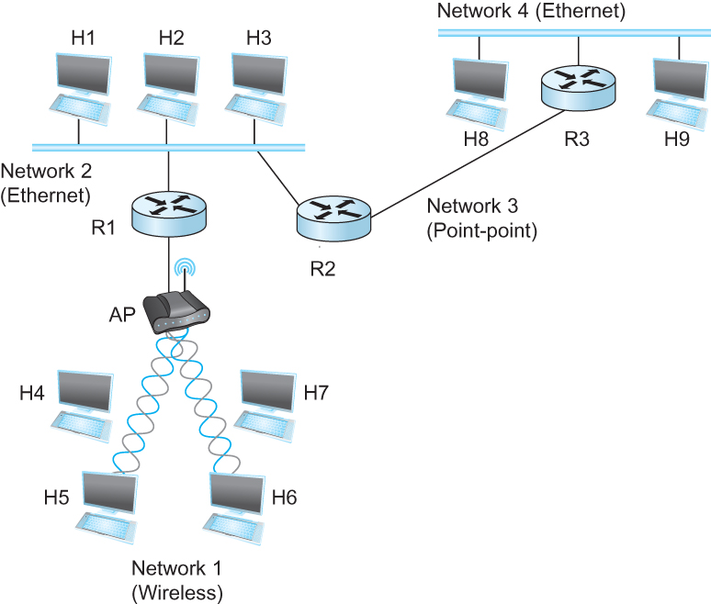
Internetworking
What is internetwork
  An arbitrary collection of networks interconnected to provide some sort of host-host to packet delivery service
  A simple internetwork where H represents hosts and R represents routers

Slide 45
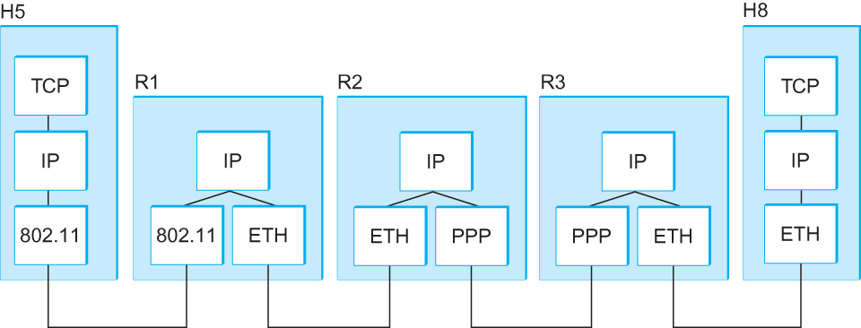
Internetworking
What is IP
  IP stands for Internet Protocol
  Key tool used today to build scalable, heterogeneous internetworks
  It runs on all the nodes in a collection of networks and defines the infrastructure that allows these nodes and networks to function as a single logical internetwork
  A simple internetwork showing the protocol layers

Slide 46
IP Service Model
Packet Delivery Model
  Connectionless model for data delivery
  Best-effort delivery (unreliable service)
    packets are lost
    packets are delivered out of order
    duplicate copies of a packet are delivered
    packets can be delayed for a long time
Global Addressing Scheme
  Provides a way to identify all hosts in the network

Slide 47
IP datagram format
IP protocol version
number
32 bits
total datagram
length (bytes)
header length
(bytes)
head.
len
type of
service
ver
length
for
fragmentation/
reassembly
“type” of data
flgs
fragment
offset
16-bit identifier
max number
remaining hops
(decremented at
each router)
time to
live
upper
layer
header
checksum
32 bit source IP address
upper layer protocol
to deliver payload to
32 bit destination IP address
options (if any)
e.g. timestamp,
record route
taken, specify
list of routers
to visit.
data
(variable length,
typically a TCP
or UDP segment)

Slide 48
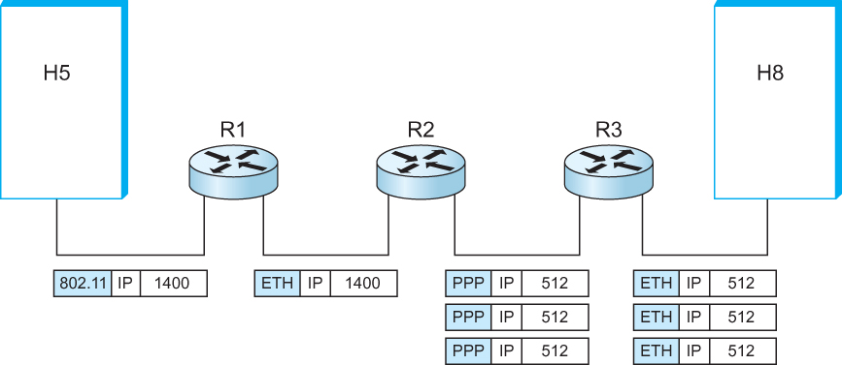
IP Fragmentation and Reassembly
  IP datagrams traversing the sequence of physical networks

Slide 49
IP Fragmentation and Reassembly
Each network has some MTU (Maximum Transmission Unit)
  Ethernet (1500 bytes), FDDI (4500 bytes)
Strategy
  Fragmentation occurs in a router when it receives a datagram that it wants to forward over a network which has (MTU < datagram)
  Reassembly is done at the receiving host
  All the fragments carry the same identifier in the Ident field
  Fragments are self-contained datagrams
  IP does not recover from missing fragments

Slide 50
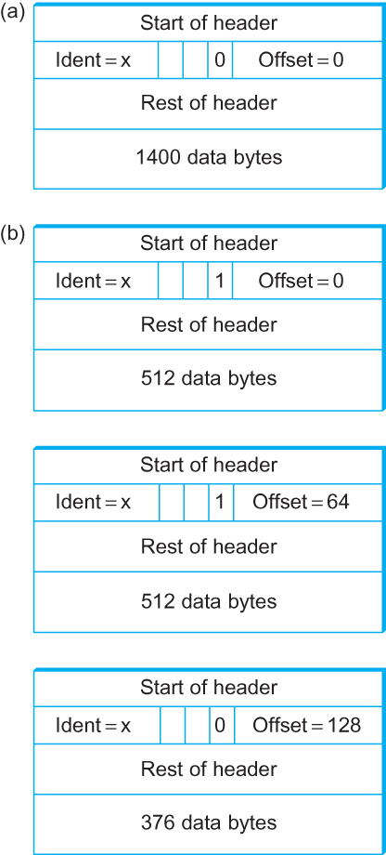
IP Fragmentation and Reassembly
Header fields used in IP fragmentation. (a) Unfragmented packet; (b) fragmented packets.

Slide 51
Network Addresses

Slide 52
IP Address (IPv4)
A unique 32-bit number
Identifies an interface (on a host, on a router, …)
Represented in dotted-quad notation
12
34
158
5
00001100
00100010
10011110
00000101
12:34:158:5

Slide 53
Grouping Related Hosts
The Internet is an “inter-network”
  Used to connect networks together, not hosts
  Need to address a network (i.e., group of hosts)
host
host
...
host
host
host
...
host
LAN 1
LAN 2
router
router
router
WAN
WAN
LAN = Local Area Network
WAN = Wide Area Network

Slide 54
Scalability Challenge
Suppose hosts had arbitrary addresses
  Then every router would need a lot of information
  …to know how to direct packets toward every host
1.2.3.4
5.6.7.8
2.4.6.8
1.2.3.5
5.6.7.9
2.4.6.9
host
host
...
host
host
host
...
host
LAN 1
LAN 2
router
router
router
WAN
WAN
1.2.3.4
1.2.3.5
forwarding table

Slide 55
Hierarchical Addressing in U.S. Mail
Addressing in the U.S. mail
  Zip code: 08540
  Building: 35 Olden Street
  Room in building: 306
  Name of occupant: Jennifer Rexford
Forwarding the U.S. mail
  Deliver to the post office in the zip code
  Assign to mailman covering the building
  Drop letter into mailbox for building/room
  Give letter to the appropriate person
???

Slide 56
Hierarchical Addressing: IP Prefixes
Network and host portions (left and right)
12
34
158
5
00001100
00100010
10011110
00000101
Network (24 bits)
Host (8 bits)

Slide 57
Easy to Add New Hosts
No need to update the routers
  E.g., adding a new host 5.6.7.213 on the right
  Doesn’t require adding a new forwarding-table entry
1.2.3.4
1.2.3.7
1.2.3.156
5.6.7.8
5.6.7.9
5.6.7.212
host
host
...
host
host
host
...
host
LAN 1
LAN 2
router
router
router
host
WAN
WAN
5.6.7.213
1.2.3.0/24
5.6.7.0/24
forwarding table

Slide 58
Class-full addressing

Slide 59
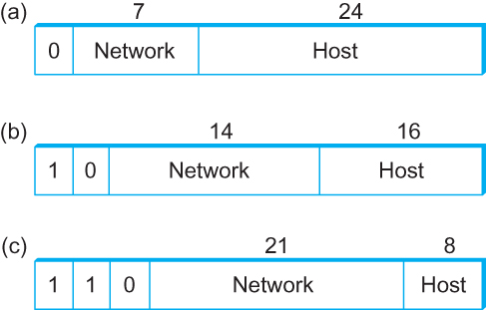
Global Addresses
Properties
  globally unique
  hierarchical: network + host
  4 Billion IP address, half are A type, ¼ is B type, and 1/8 is C type
Format
Dot notation
  10.3.2.4
  128.96.33.81
  192.12.69.77

Slide 60
Let’s assume we have 4-bit address (instead of 32 bit)
0000
0001
0010
0011
0100
0101
0110
0111
1000
1001
1010
1011
1100
1101
1110
1111
Class A (Half of all possible addresses)
Class B (1/4 of all possible addresses)
Class C (1/8 of all possible addresses)

Slide 61
Let’s assume we have 4-bit address (instead of 32 bit)
0000
0001
0010
0011
0100
0101
0110
0111
Class A (Half of all possible addresses)
Say, 1 bit for network part = 2 different networks
Say, 2 bits for host part = 4 hosts per network

Slide 62
Global Addresses
Properties
  globally unique
  hierarchical: network + host
  4 Billion IP address, half are A type, ¼ is B type, and 1/8 is C type
Format
Dot notation
  10.3.2.4
  128.96.33.81
  192.12.69.77

Slide 63
Classful Addressing
In the olden days, only fixed allocation sizes
  Class A: 0*
    Very large /8 blocks (e.g., MIT has 18.0.0.0/8)
    There can be 126 different class A networks (0 and 127 values are reserved) and (2²⁴-2) different hosts (2 values are reserved)
  Class B: 10*
    Large /16 blocks (e.g,. Princeton has 128.112.0.0/16)
  Class C: 110*
    Small /24 blocks (e.g., AT&T Labs has 192.20.225.0/24)
    2²¹ different networks possible, 254 hosts (255 is reserved for broadcast and 0 is reserved)
  Class D: 1110* for multicast groups
  Class E: 11110* reserved for future use
This is why folks use dotted-quad notation!

Slide 64
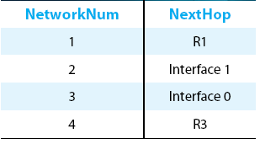
IP Datagram Forwarding
Strategy
  every datagram contains destination's address
  if directly connected to destination network, then forward to host
  if not directly connected to destination network, then forward to some router
  forwarding table maps network number into next hop
  each host has a default router
  each router maintains a forwarding table
Example (router R2)

Slide 65
IP Datagram Forwarding
Algorithm
if (NetworkNum of destination = NetworkNum of one of my interfaces) then
deliver packet to destination over that interface
else
if (NetworkNum of destination is in my forwarding table) then
deliver packet to NextHop router
else
deliver packet to default router
For a host with only one interface and only a default router in its forwarding table, this simplifies to
if (NetworkNum of destination = my NetworkNum)then
deliver packet to destination directly
else
deliver packet to default router

Slide 66
IP fragment and reassembly
(fragment offset)

Slide 67
IP datagram format
IP protocol version
number
32 bits
total datagram
length (bytes)
header length
(bytes)
head.
len
type of
service
ver
length
for
fragmentation/
reassembly
“type” of data
flgs
fragment
offset
16-bit identifier
max number
remaining hops
(decremented at
each router)
time to
live
upper
layer
header
checksum
32 bit source IP address
upper layer protocol
to deliver payload to
32 bit destination IP address
options (if any)
e.g. timestamp,
record route
taken, specify
list of routers
to visit.
data
(variable length,
typically a TCP
or UDP segment)

Slide 68
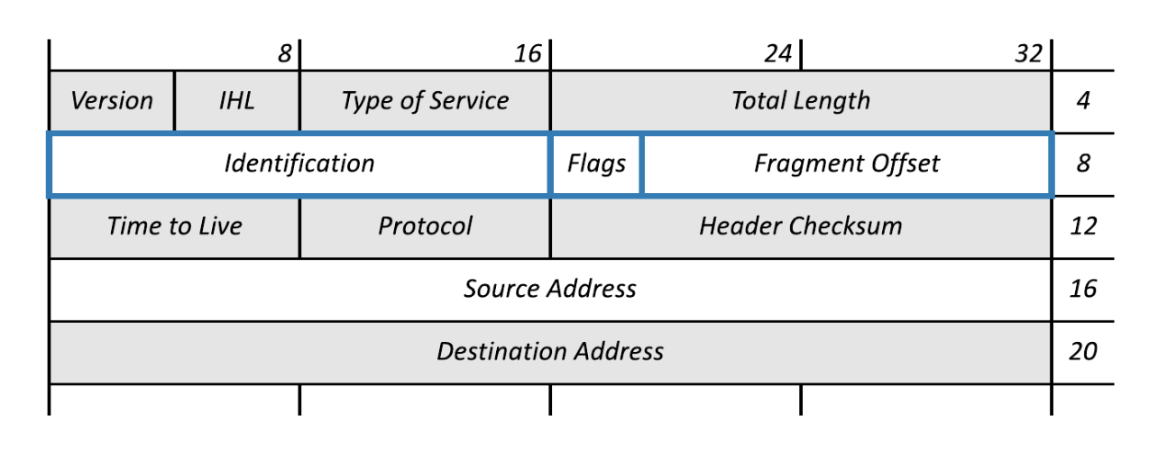
IP datagram format
3 bits
13 bits

Slide 69
IP Fragmentation and Reassembly
Each network has some MTU (Maximum Transmission Unit)
  Ethernet (1500 bytes), FDDI (4500 bytes)
Strategy
  Fragmentation occurs in a router when it receives a datagram that it wants to forward over a network which has (MTU < datagram)
  Reassembly is done at the receiving host
  All the fragments carry the same identifier in the Ident field
  Fragments are self-contained datagrams
  IP does not recover from missing fragments

Slide 70
IP Fragmentation and Reassembly
Header fields used in IP fragmentation. (a) Unfragmented packet; (b) fragmented packets.

Slide 71
IP Fragmentation and Reassembly
Header fields used in IP fragmentation. (a) Unfragmented packet; (b) fragmented packets.
In terms of “8 byte blocks (i.e., octawords)”

Slide 72
IP Fragmentation and Reassembly
The offset value must be the number of 8 byte blocks of data, which means the data in the prior fragment must be a multiple of 8 bytes. The last fragment can carry data that isn’t a multiple of 8 bytes.
Header fields used in IP fragmentation. (a) Unfragmented packet; (b) fragmented packets.
In terms of “8 byte blocks (i.e., octawords)”

Slide 73
Network Addresses

Slide 74
IP Address (IPv4)
A unique 32-bit number
Identifies an interface (on a host, on a router, …)
Represented in dotted-quad notation
12
34
158
5
00001100
00100010
10011110
00000101
12:34:158:5

Slide 75
Hierarchical Addressing: IP Prefixes
Network and host portions (left and right)
12
34
158
5
00001100
00100010
10011110
00000101
Network (24 bits)
Host (8 bits)

Slide 76
Global Addresses
Properties
  globally unique
  hierarchical: network + host
  4 Billion IP address, half are A type, ¼ is B type, and 1/8 is C type
Format
Dot notation
  10.3.2.4
  128.96.33.81
  192.12.69.77

Slide 77
IP Datagram Forwarding
Algorithm
if (NetworkNum of destination = NetworkNum of one of my interfaces) then
deliver packet to destination over that interface
else
if (NetworkNum of destination is in my forwarding table) then
deliver packet to NextHop router
else
deliver packet to default router
For a host with only one interface and only a default router in its forwarding table, this simplifies to
if (NetworkNum of destination = my NetworkNum)then
deliver packet to destination directly
else
deliver packet to default router

Slide 78
Obtaining a Block of Addresses
Internet Corporation for Assigned Names and Numbers (ICANN)
  Allocates large blocks to Regional Internet Registries
Regional Internet Registries (RIRs)
  E.g., ARIN (American Registry for Internet Numbers)
  Allocates to ISPs and large institutions
Internet Service Providers (ISPs)
  Allocate address blocks to their customers
  Who may, in turn, allocate to their customers…

Slide 79
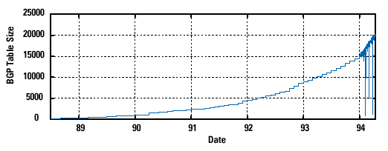
Pre-CIDR (1988-1994): Steep Growth
Growth faster than improvements in equipment capability

Slide 80
Subnetting

Slide 81
Problems with the classes of addresses
Wastage of addresses
Bigger tables to look up at routers

Slide 82
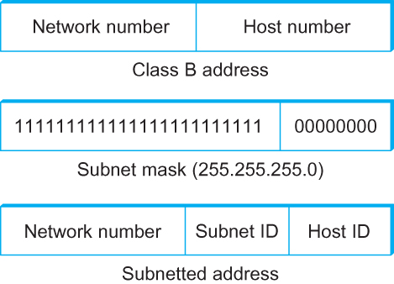
Subnetting
Add another level to address/routing hierarchy: subnet
Subnet masks define variable partition of host part of class A and B addresses
Subnets visible only within site

Slide 83
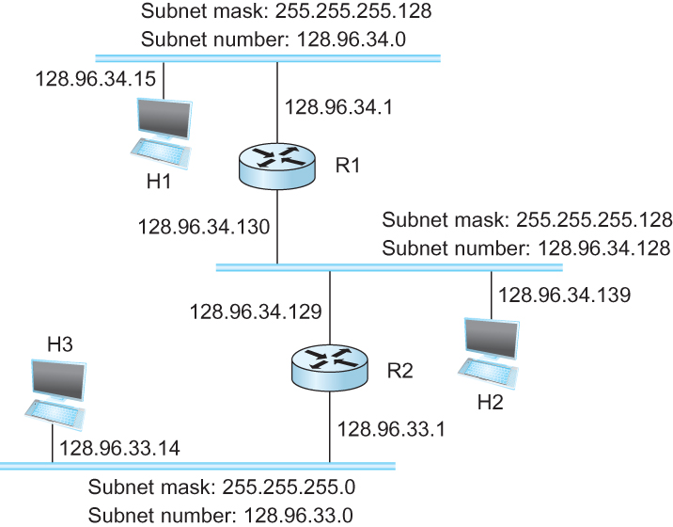
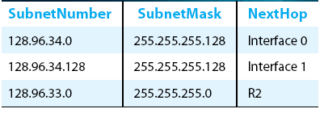
Subnetting
Forwarding Table at Router R1

Slide 84
Subnetting
Forwarding Table at Router R1
Forwarding Algorithm
D = destination IP address
for each entry < SubnetNum, SubnetMask, NextHop>
  D1 = SubnetMask & D
  if D1 = SubnetNum
    if NextHop is an interface
    deliver datagram directly to destination
    else
    deliver datagram to NextHop (a router)

Slide 85
Subnetting
Notes
Would use a default router if nothing matches
Not necessary for all ones in subnet mask to be contiguous
Can put multiple subnets on one physical network
Subnets not visible from the rest of the Internet

Slide 86
Class-less addressing: CIDR

Slide 87
IP addressing: CIDR
CIDR: Classless InterDomain Routing
  subnet portion of address of arbitrary length
  address format: a.b.c.d/x, where x is # bits in subnet portion of address
subnet
part
host
part
11001000 00010111 00010000 00000000
200.23.16.0/23
200.23.16.0–200.23.17.255

Slide 88
Classless Inter-Domain Routing (CIDR)
Use two 32-bit numbers to represent a network.
Network number = IP address + Mask
IP Address : 12.4.0.0 IP Mask: 255.254.0.0
Address
00001100
00000100
00000000
00000000
Mask
11111111
11111110
00000000
00000000
Network Prefix
for hosts
Written as 12.4.0.0/15

Slide 89
Hierarchical Address Allocation
Hierarchy is key to scalability
  Address allocated in contiguous chunks (prefixes)
  Today, the Internet has about 400,000 prefixes
12.0.0.0/16
12.1.0.0/16
:
:
:
12.3.0.0/24
12.2.0.0/16
12.3.1.0/24
12.3.0.0/16
:
:
:
:
:
12.0.0.0/8
12.3.254.0/24
12.253.0.0/19
12.253.32.0/19
:
:
12.254.0.0/16
12.253.160.0/19

Slide 90
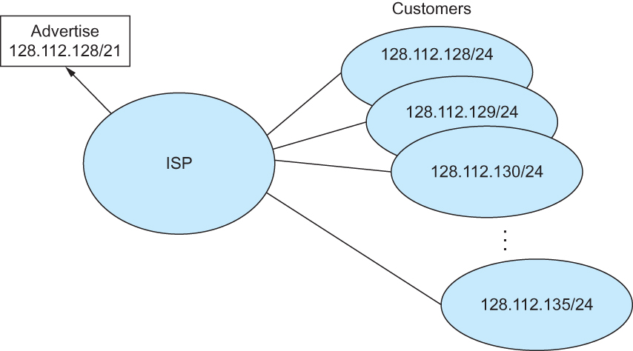
Classless Addressing
Route aggregation with CIDR

Slide 91
Separate Forwarding Entry Per Prefix
Prefix-based forwarding
  Map the destination address to matching prefix
  Forward to the outgoing interface
1.2.3.4
1.2.3.7
1.2.3.156
5.6.7.8
5.6.7.9
5.6.7.212
host
host
...
host
host
host
...
host
LAN 1
LAN
router
router
router
WAN
WAN
1.2.3.0/24
5.6.7.0/24
forwarding table

Slide 92
CIDR Makes Packet Forwarding Harder
Forwarding table may have many matches
  E.g., entries for 201.10.0.0/21 and 201.10.6.0/23
  The IP address 201.10.6.17 would match both!
201.10.0.0/21
Provider 1
Provider 2
201.10.0.0/22
201.10.4.0/24
201.10.5.0/24
201.10.6.0/23

Slide 93
Longest Prefix Match Forwarding
Destination-based forwarding
  Packet has a destination address
  Router identifies longest-matching prefix
  Cute algorithmic problem: very fast lookups
forwarding table
4.0.0.0/8
4.83.128.0/17
201.10.0.0/21
201.10.6.0/23
126.255.103.0/24
destination
201.10.6.17
outgoing link
Serial0/0.1

Slide 94
Pre-CIDR (1988-1994): Steep Growth
Growth faster than improvements in equipment capability

Slide 95
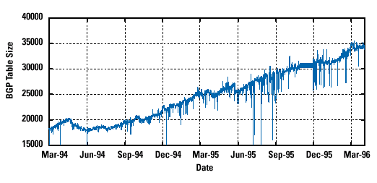
CIDR (1994-1996): Much Flatter
Efforts to aggregate

Slide 96
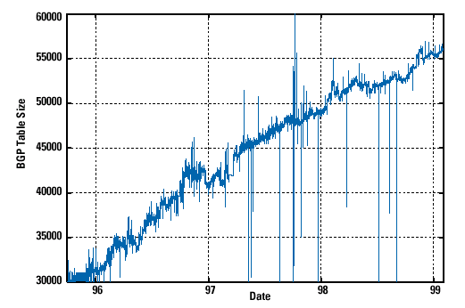
CIDR Growth (1996-1998): Roughly Linear
Good use of aggregation, and peer pressure!

Slide 97
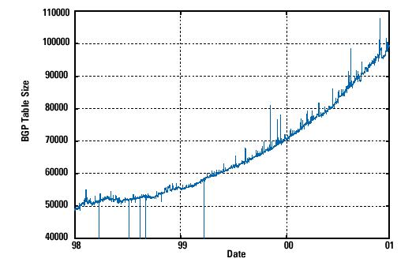
DotCom Boom (1998-2001): Steep Growth
Internet boom and increased multi-homing

Slide 98
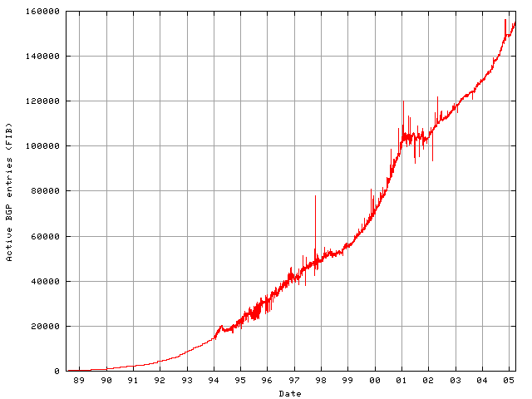
Long Term (1989-2005): Post-Boom
Today we are up to ~400,000 prefixes

Slide 99
Subnets and CIDR
Subnets “toy” example

Slide 100


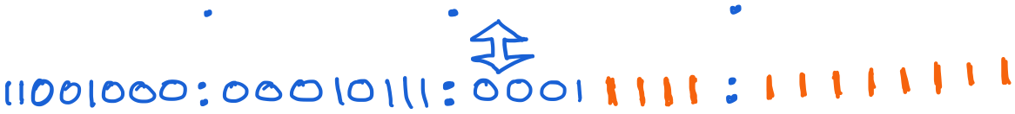
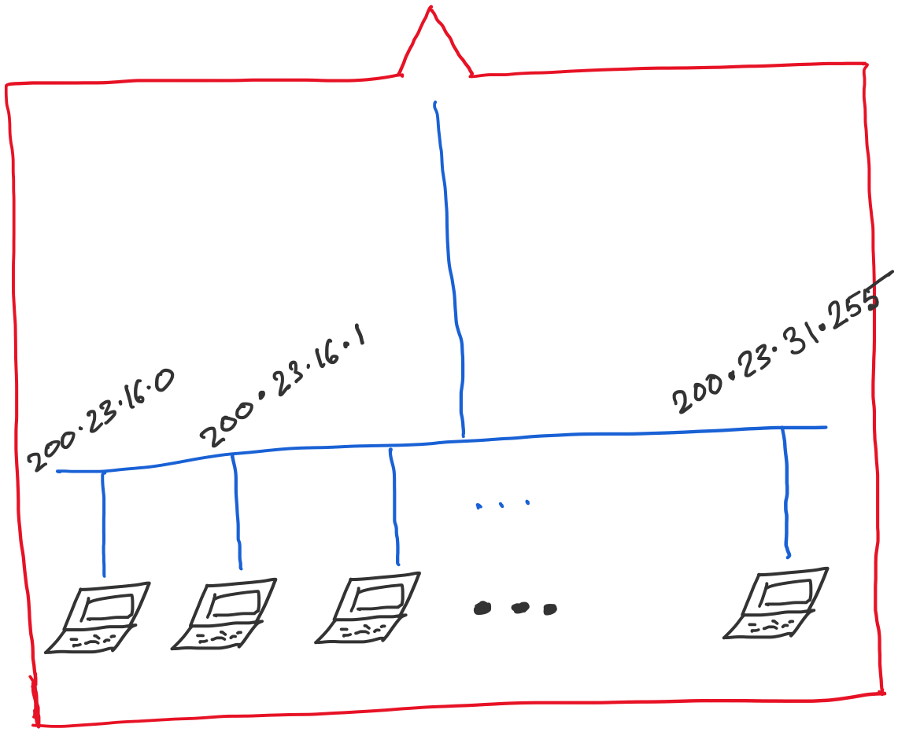
Address space assigned to you:

Slide 101
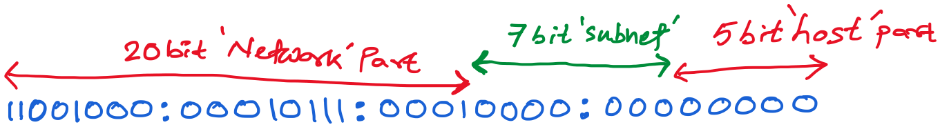
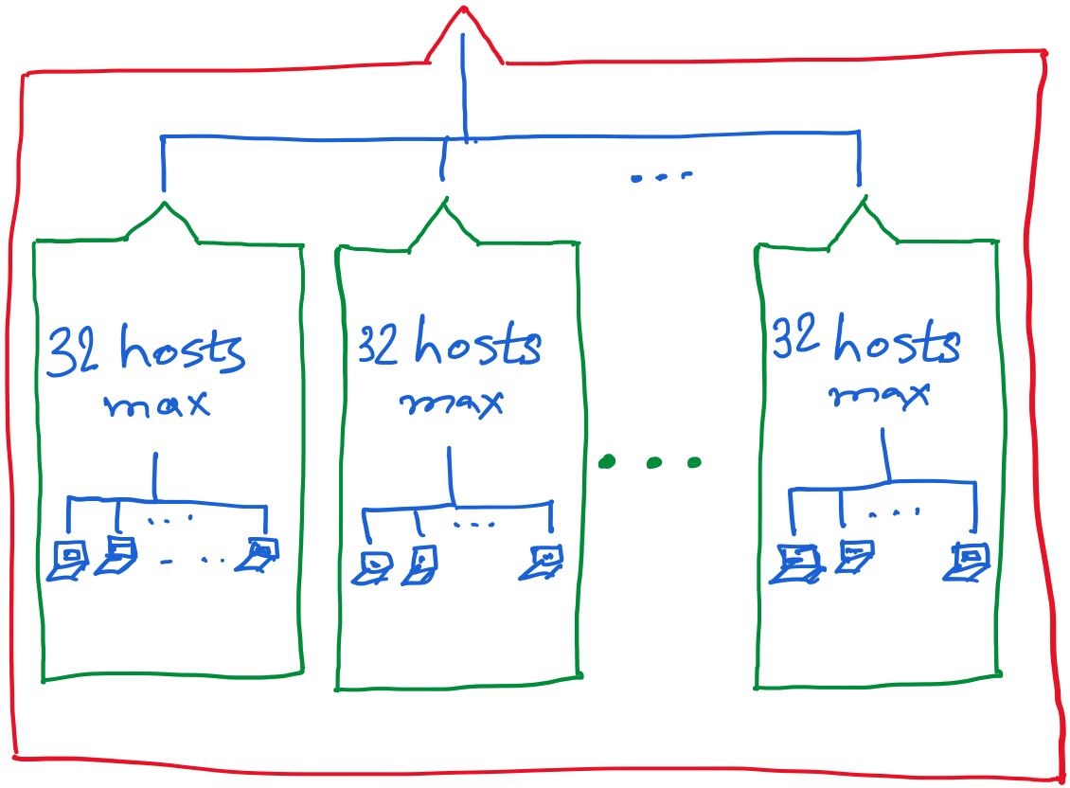

Slide 102
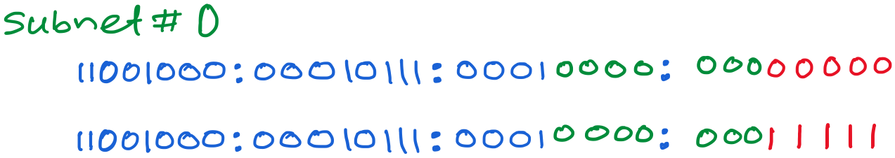
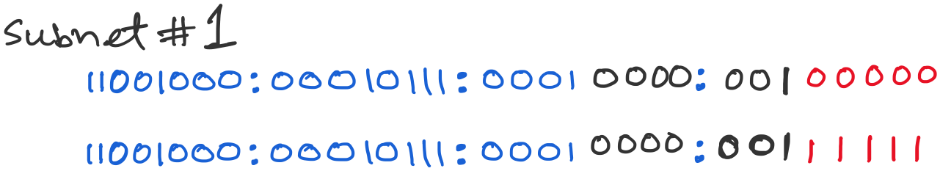
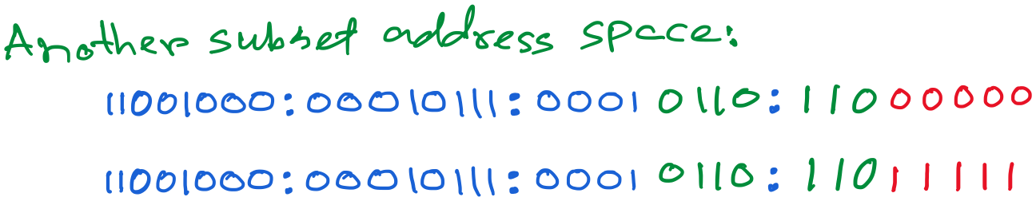

Slide 103
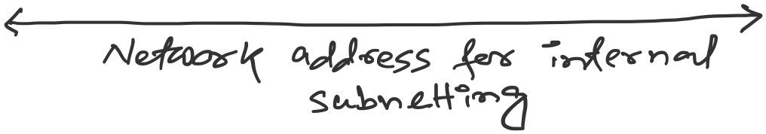

Slide 104
Getting an IP address: DHCP

Slide 105
IP addresses: how to get one?
Q: How does a host get IP address?
hard-coded by system admin in a file
  Windows: control-panel->network->configuration->tcp/ip->properties
  UNIX: /etc/…
DHCP: Dynamic Host Configuration Protocol: dynamically get address from a server
  “plug-and-play”

Slide 106
DHCP: Dynamic Host Configuration Protocol
goal: allow host to dynamically obtain its IP address from network server when it joins network
  can renew its lease on address in use
  allows reuse of addresses (only hold address while connected/“on”)
  support for mobile users who want to join network

Slide 107
DHCP: Dynamic Host Configuration Protocol
DHCP overview:
  host broadcasts “DHCP discover” msg [optional]
  DHCP server responds with “DHCP offer” msg
  host requests IP address: “DHCP request” msg
  DHCP server sends address: “DHCP ack” msg

Slide 108



DHCP client-server scenario
DHCP
server
223.1.1.0/24
223.1.1.1
223.1.2.1
223.1.1.2
arriving DHCP
client needs
address in this
network
223.1.1.4
223.1.2.9
223.1.3.27
223.1.2.2
223.1.1.3
223.1.2.0/24
223.1.3.1
223.1.3.2
223.1.3.0/24

Slide 109
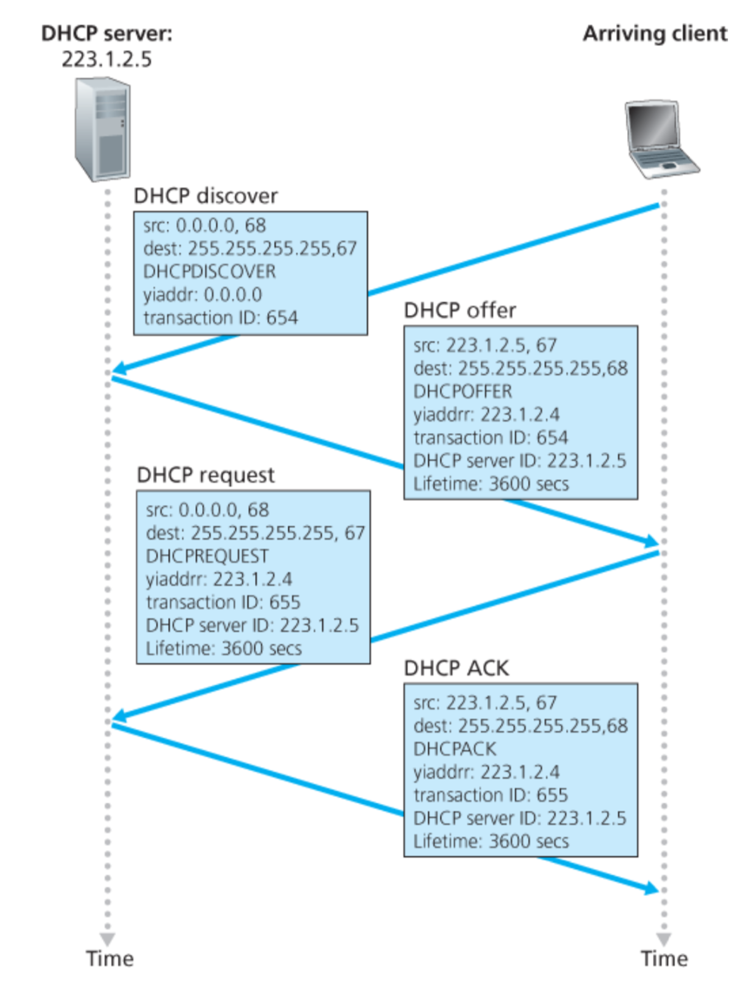
Broadcast: is there a DHCP server out there?
Broadcast: I’m a DHCP server! Here’s an IP address you can use
Broadcast: OK. I’ll take that IP address!
Broadcast: OK. You’ve got that IP address!

Slide 110
DHCP: more than IP addresses
DHCP can return more than just allocated IP address on subnet:
  address of first-hop router for client
  name and IP address of DNS sever
  network mask (indicating network versus host portion of address)

Slide 111
Dynamic Host Configuration Protocol (DHCP)
DHCP server is responsible for providing configuration information to hosts
DHCP server maintains a pool of available addresses
There is at least one DHCP server for an administrative domain (a server or a relay agent per subnet)

Slide 112
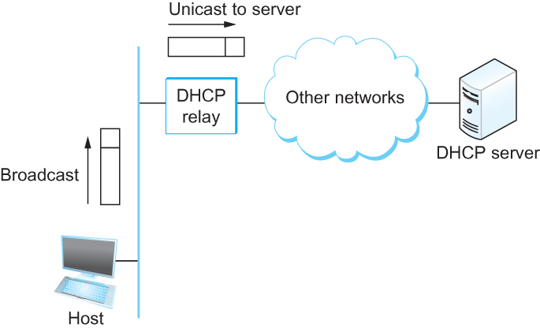
DHCP
Newly booted or attached host sends DHCPDISCOVER message to a special IP address (255.255.255.255)
DHCP relay agent unicasts the message to DHCP server and waits for the response

