Slide 1

Computer Networks
CMSC 417 : Spring 2023
Topic: Internetworking : IP
(Textbook chapter 3)
Nirupam Roy
Tu-Th 2:00-3:15pm
CSI 2117

Slide 2

Example: IP Fragmentation
Fragments
Dgram Len<=532
Dgram Len<=532
Datagram Len=1500
Dgram Len<=532
MTU=1500
MTU=532
R2
Header field/<info> | Value
P. Identifier | XYZ
More Frag. bit | 0
Frag. offset | 0
Header Len. | 20 (bytes)
<Data Len.> | 1400
Packer Length | 1420
Fields | Val.
P. Id | XYZ
MF bit | 1
F. off. | 0
H. Len. | 20
<D Len.> | 512
Pkt Len | 532
Fields | Val.
P. Id | XYZ
MF bit | 1
F. off. | 64
H. Len. | 20
<D Len.> | 512
Pkt Len | 532
Fields | Val.
P. Id | XYZ
MF bit | 0
F. off. | 128
H. Len. | 20
<D Len.> | 376
Pkt Len | 396
Frag. Pkt #1
Frag. Pkt #2
Frag. Pkt #3
Original Packet

Slide 3
Example: IP Reassembly
Fields | Val.
P. Id | XYZ
MF bit | 1
F. off. | 0
H. Len. | 20
<D Len.> | 512
Pkt Len | 532
Fields | Val.
P. Id | XYZ
MF bit | 1
F. off. | 64
H. Len. | 20
<D Len.> | 512
Pkt Len | 532
Fields | Val.
P. Id | XYZ
MF bit | 0
F. off. | 128
H. Len. | 20
<D Len.> | 376
Pkt Len | 396
Header buffer
Data from fgmt 1
Data from fgmt 2
Data from fgmt 3
Data buffer

Slide 4
Example: IP Reassembly
Header from
fgmt 1
(will be updated later)
Fields | Val.
P. Id | XYZ
MF bit | 1
F. off. | 0
H. Len. | 20
<D Len.> | 512
Pkt Len | 532
Fields | Val.
P. Id | XYZ
MF bit | 1
F. off. | 64
H. Len. | 20
<D Len.> | 512
Pkt Len | 532
Fields | Val.
P. Id | XYZ
MF bit | 0
F. off. | 128
H. Len. | 20
<D Len.> | 376
Pkt Len | 396
Header buffer
Data from fgmt 1
Data from fgmt 2
Data from fgmt 3
Data buffer

Slide 5
Example: IP Reassembly
Header from
fgmt 1
(will be updated later)
Fields | Val.
P. Id | XYZ
MF bit | 1
F. off. | 0
H. Len. | 20
<D Len.> | 512
Pkt Len | 532
Fields | Val.
P. Id | XYZ
MF bit | 1
F. off. | 64
H. Len. | 20
<D Len.> | 512
Pkt Len | 532
Fields | Val.
P. Id | XYZ
MF bit | 0
F. off. | 128
H. Len. | 20
<D Len.> | 376
Pkt Len | 396
Header buffer
0
Data from fgmt 1
Data from fgmt 1
Data from fgmt 2
Data from fgmt 3
64
Data from fgmt 2
128
Data from fgmt 3
What if assembly is not possible?
Data buffer

Slide 6
Example: IP Reassembly
32 bits
ver
head.
len
type of
service
length
Header from
fgmt 1
(will be updated later)
Fields | Val.
P. Id | XYZ
MF bit | 1
F. off. | 0
H. Len. | 20
<D Len.> | 512
Pkt Len | 532
Fields | Val.
P. Id | XYZ
MF bit | 1
F. off. | 64
H. Len. | 20
<D Len.> | 512
Pkt Len | 532
Fields | Val.
P. Id | XYZ
MF bit | 0
F. off. | 128
H. Len. | 20
<D Len.> | 376
Pkt Len | 396
flgs
fragment
offset
16-bit identifier
time to
live
upper
layer
header
checksum
32 bit source IP address
Header buffer
32 bit destination IP address
options (if any)
Data from fgmt 1
Data from fgmt 2
Data from fgmt 3
data
(variable length,
typically a TCP
or UDP segment)
Which header fields will be updated
during reassembly?
Data buffer

Slide 7
Network Addresses

Slide 8
IP Address (IPv4)
A unique 32-bit number
Identifies an interface (on a host, on a router, …)
Represented in dotted-quad notation
12
34
158
5
00001100
00100010
10011110
00000101
12:34:158:5

Slide 9
Grouping Related Hosts
The Internet is an “inter-network”
  Used to connect networks together, not hosts
  Need to address a network (i.e., group of hosts)
host
host
...
host
host
host
...
host
LAN 1
LAN 2
router
router
router
WAN
WAN
LAN = Local Area Network
WAN = Wide Area Network

Slide 10
Scalability Challenge
Suppose hosts had arbitrary addresses
  Then every router would need a lot of information
  …to know how to direct packets toward every host
1.2.3.4
5.6.7.8
2.4.6.8
1.2.3.5
5.6.7.9
2.4.6.9
host
host
...
host
host
host
...
host
LAN 1
LAN 2
router
router
router
WAN
WAN
1.2.3.4
1.2.3.5
forwarding table

Slide 11
Hierarchical Addressing in U.S. Mail
Addressing in the U.S. mail
  Zip code: 08540
  Building: 35 Olden Street
  Room in building: 306
  Name of occupant: Jennifer Rexford
Forwarding the U.S. mail
  Deliver to the post office in the zip code
  Assign to mailman covering the building
  Drop letter into mailbox for building/room
  Give letter to the appropriate person
???

Slide 12
Hierarchical Addressing: IP Prefixes
Network and host portions (left and right)
12
34
158
5
00001100
00100010
10011110
00000101
Network (24 bits)
Host (8 bits)
(N bits)
(32-N bits)

Slide 13
Easy to Add New Hosts
No need to update the routers
  E.g., adding a new host 5.6.7.213 on the right
  Doesn’t require adding a new forwarding-table entry
1.2.3.4
1.2.3.7
1.2.3.156
5.6.7.8
5.6.7.9
5.6.7.212
host
host
...
host
host
host
...
host
LAN 1
LAN 2
router
router
router
host
WAN
WAN
5.6.7.213
1.2.3.0/24
5.6.7.0/24
forwarding table

Slide 14
Hierarchical Addressing: IP Prefixes
Network and host portions (left and right)
12
34
158
5
00001100
00100010
10011110
00000101
Network (24 bits)
Host (8 bits)
(N bits)
(32-N bits)
N = ?

Slide 15
“Classes” of networks
The sizes of networks can be different
1.2.3.4
1.2.3.7
1.2.3.156
5.6.7.8
5.6.7.9
host
host
...
host
host
host
LAN 1
LAN 2
router
router
router
WAN
WAN
Large networks (many hosts)
Fewer such networks exist
Small networks (fewer hosts)
Many such networks exist
1.2.3.0/24
5.6.7.0/24
forwarding table

Slide 16
Class-full addressing

Slide 17
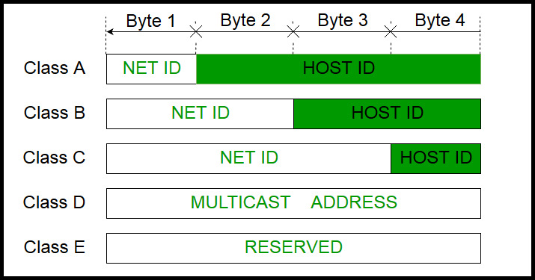
How can you tell network class from the IP address?
Picture courtesy: https://www.geeksforgeeks.org/introduction-of-classful-ip-addressing/

Slide 18
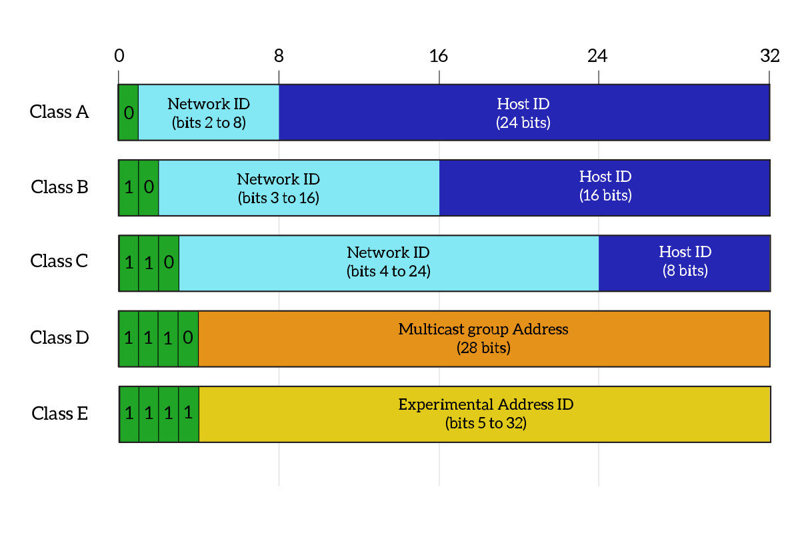
What percentage of addresses and allocated to each class?
Picture courtesy: https://www.ictshore.com/free-ccna-course/network-layer-ipv4-addressing/attachment/1013-05-classful_addressing/

Slide 19
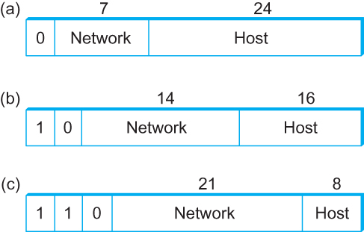
Global Addresses
Properties
  globally unique
  hierarchical: network + host
  4 Billion IP address, half are A type, ¼ is B type, and 1/8 is C type
Format
Dot notation
  10.3.2.4
  128.96.33.81
  192.12.69.77

Slide 20
Let’s assume we have 4-bit address (instead of 32 bit)
0000
0001
0010
0011
0100
0101
0110
0111
1000
1001
1010
1011
1100
1101
1110
1111
Class A (Half of all possible addresses)
Class B (1/4 of all possible addresses)
Class C (1/8 of all possible addresses)

Slide 21
Let’s assume we have 4-bit address (instead of 32 bit)
0000
0001
0010
0011
0100
0101
0110
0111
Class A (Half of all possible addresses)
Say, 1 bit for network part = 2 different networks
Say, 2 bits for host part = 4 hosts per network

Slide 22
Global Addresses
Properties
  globally unique
  hierarchical: network + host
  4 Billion IP address, half are A type, ¼ is B type, and 1/8 is C type
Format
Dot notation
  10.3.2.4
  128.96.33.81
  192.12.69.77

Slide 23
Classful Addressing
In the olden days, only fixed allocation sizes
  Class A: 0*
    Very large /8 blocks (e.g., MIT has 18.0.0.0/8)
    There can be 126 different class A networks (0 and 127 values are reserved) and (2²⁴-2) different hosts (2 values are reserved)
  Class B: 10*
    Large /16 blocks (e.g,. Princeton has 128.112.0.0/16)
  Class C: 110*
    Small /24 blocks (e.g., AT&T Labs has 192.20.225.0/24)
    2²¹ different networks possible, 254 hosts (255 is reserved for broadcast and 0 is reserved)
  Class D: 1110* for multicast groups
  Class E: 11110* reserved for future use
This is why folks use dotted-quad notation!

Slide 24
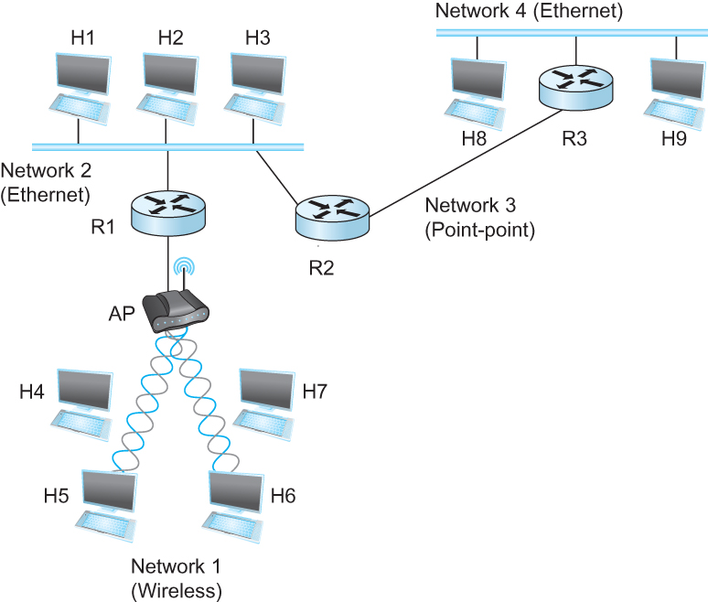
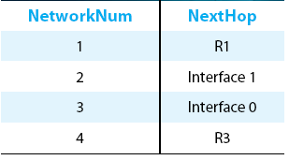
IP Datagram Forwarding
Strategy
  every datagram contains destination's address
  if directly connected to destination network, then forward to host
  if not directly connected to destination network, then forward to some router
  forwarding table maps network number into next hop
  each host has a default router
  each router maintains a forwarding table
Example (router R2)

Slide 25
IP Datagram Forwarding
Algorithm
if (NetworkNum of destination = NetworkNum of one of my interfaces) then
deliver packet to destination over that interface
else
if (NetworkNum of destination is in my forwarding table) then
deliver packet to NextHop router
else
deliver packet to default router
First: find the NetworkNum. How?

Slide 26
IP Datagram Forwarding
Algorithm
if (NetworkNum of destination = NetworkNum of one of my interfaces) then
deliver packet to destination over that interface
else
if (NetworkNum of destination is in my forwarding table) then
deliver packet to NextHop router
else
deliver packet to default router
For a host with only one interface and only a default router in its forwarding table, this simplifies to
if (NetworkNum of destination = my NetworkNum)then
deliver packet to destination directly
else
deliver packet to default router

Slide 27
Obtaining a Block of Addresses
Internet Corporation for Assigned Names and Numbers (ICANN)
  Allocates large blocks to Regional Internet Registries
Regional Internet Registries (RIRs)
  E.g., ARIN (American Registry for Internet Numbers)
  Allocates to ISPs and large institutions
Internet Service Providers (ISPs)
  Allocate address blocks to their customers
  Who may, in turn, allocate to their customers…

Slide 28
Obtaining a Block of Addresses
Your organization: XYZ
Maximum # of hosts is estimated to be 10 millions.
What class of IP address will you request for?
Maximum # of hosts is estimated to be 64K ?
Maximum # of hosts is estimated to be 250?
Maximum # of hosts is estimated to be 100?
Maximum # of hosts is estimated to be 20?
Maximum # of hosts is estimated to be 300?
Maximum # of hosts is estimated to be 66K?

Slide 29
Problems with the classes of addresses
Wastage of addresses
Bigger tables to look up at routers

Slide 30
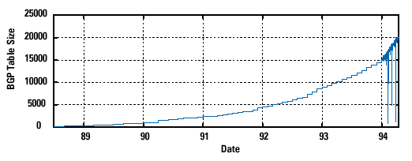
Pre-CIDR (1988-1994): Steep Growth
Growth faster than improvements in equipment capability

Slide 31
Subnetting

Slide 32


The ISP provided the network address space: 223.1.1.X
ISP
Router
223.1.1.1
223.1.1.2
223.1.1.3
223.1.1.4
223.1.1.5
223.1.1.6

Slide 33
The ISP provided the network address space: 223.1.1.X
ISP
223.1.2.X
Router
223.1.3.X
223.1.1.1
223.1.1.2
223.1.1.3
223.1.1.4
223.1.1.5
223.1.1.6

Slide 34
The ISP provided the network address space: 223.1.1.X
Router
Two separate networks are needed. How can we assign addresses to these “sub” networks?

Slide 35
The ISP provided the network address space: 223.1.1.X
Router

Slide 36
The ISP provided the network address space: 223.1.1.X
Router
Use subnetting

Slide 37
The ISP provided the network address space: 223.1.1.X
11011111.00000001.00000001.XXXXXXX
Router
Use part of the host bits to identify separate subnets.

Slide 38
The ISP provided the network address space: 223.1.1.X
11011111.00000001.00000001.XXXXXXX
Router
Use part of the host bits to identify separate subnets.
11011111.00000001.00000001.0XXXXXX
11011111.00000001.00000001.1XXXXXX
Subnet mask = 11111111. 11111111. 11111111.10000000

Slide 39
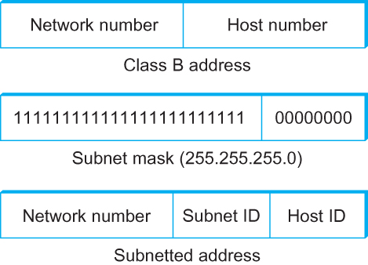
Subnetting
Add another level to address/routing hierarchy: subnet
Subnet masks define variable partition of host part of class A and B addresses
Subnets visible only within site
“Bitwise and”

Slide 40
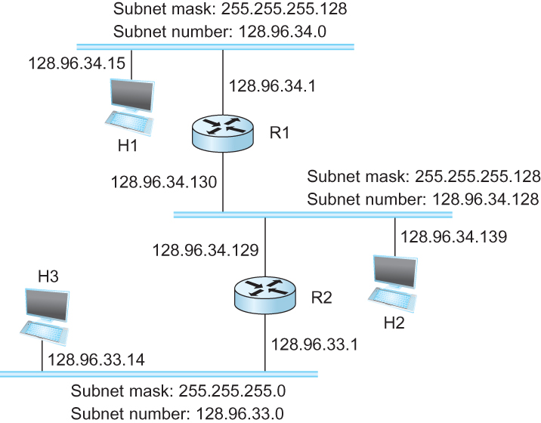
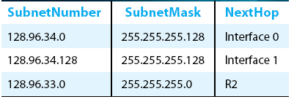
Subnetting
Forwarding Table at Router R1

Slide 41
Subnetting
Forwarding Table at Router R1
Forwarding Algorithm
D = destination IP address
for each entry < SubnetNum, SubnetMask, NextHop>
  D1 = SubnetMask & D
  if D1 = SubnetNum
    if NextHop is an interface
    deliver datagram directly to destination
    else
    deliver datagram to NextHop (a router)

Slide 42
Subnetting
Notes
Would use a default router if nothing matches
Not necessary for all ones in subnet mask to be contiguous
Can put multiple subnets on one physical network
Subnets not visible from the rest of the Internet

Slide 43
Subnets “toy” example

Slide 44


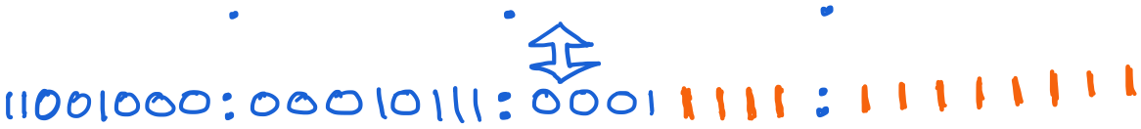
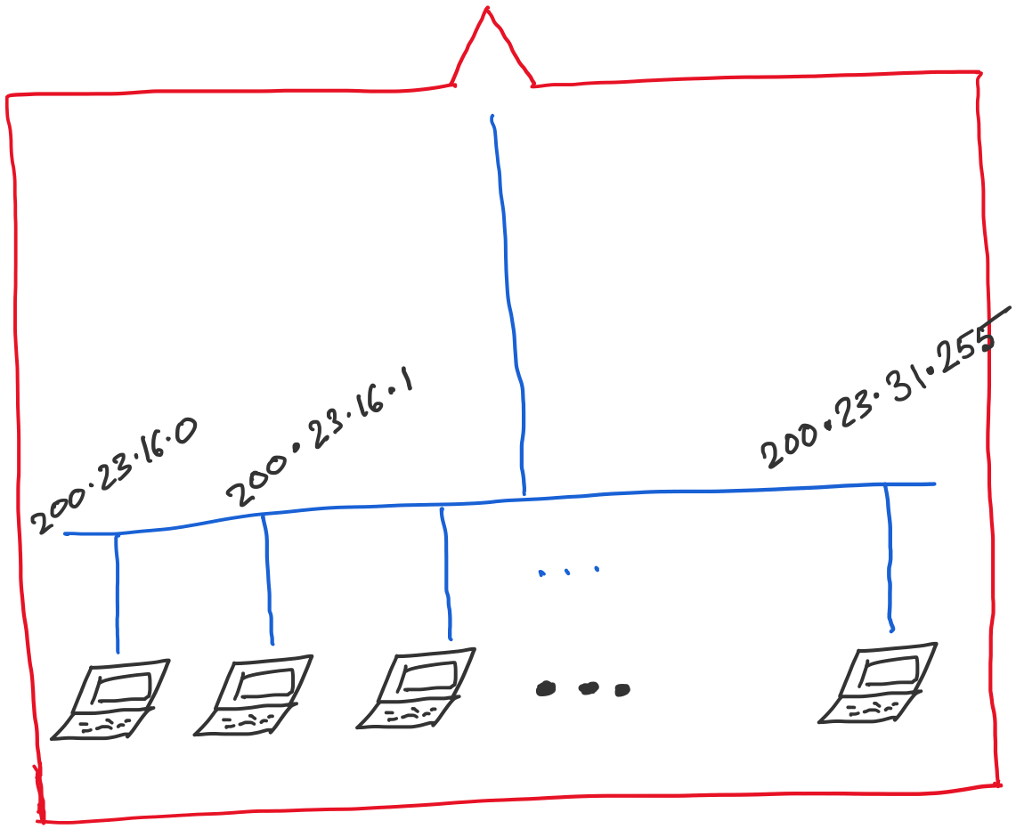
Address space assigned to you:

Slide 45
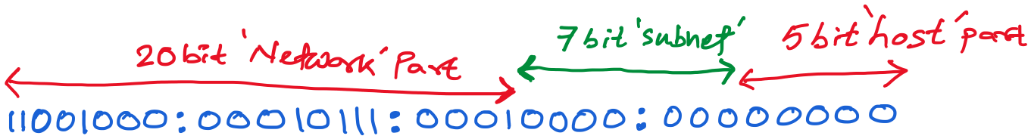
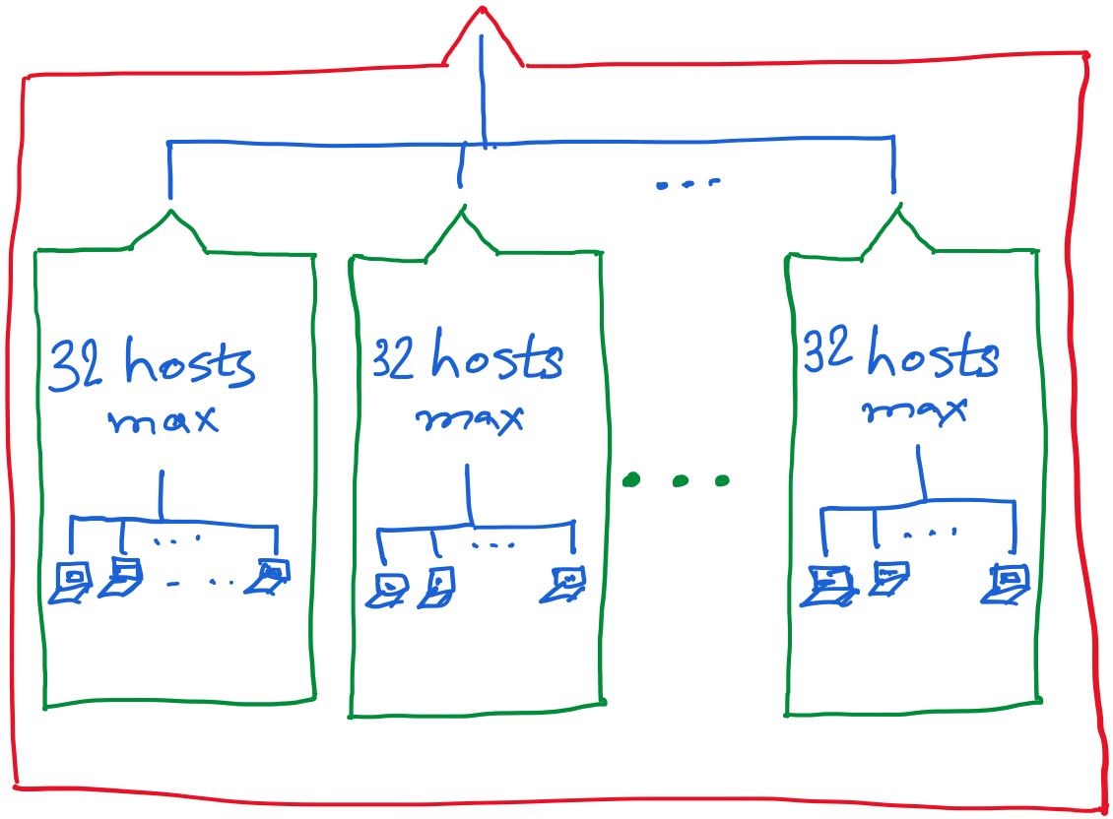

Slide 46
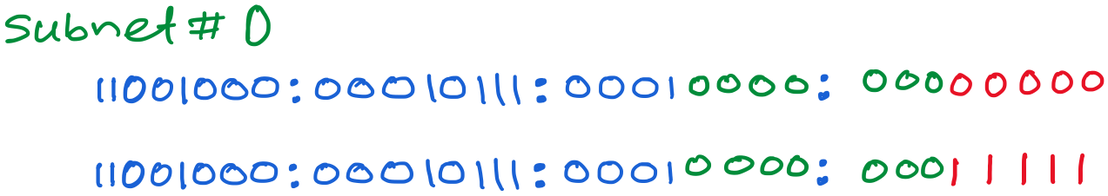
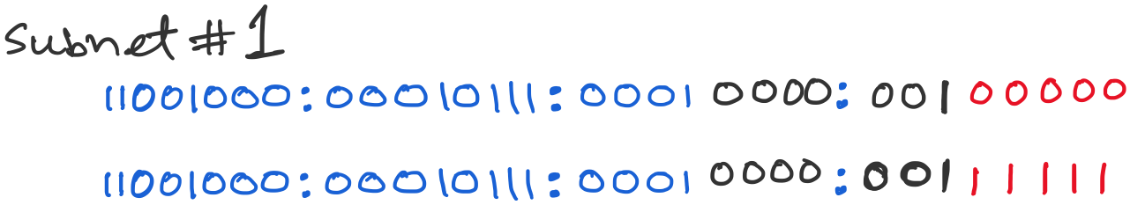
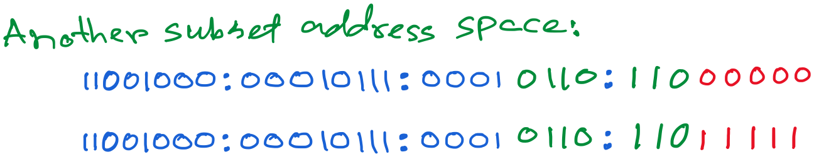

Slide 47
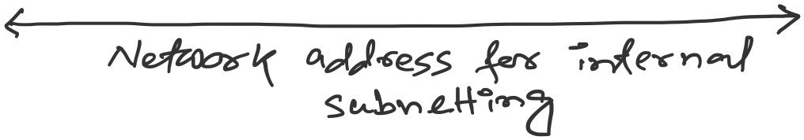

Slide 48
Class-less addressing: CIDR

Slide 49
IP addressing: CIDR
CIDR: Classless InterDomain Routing
  subnet portion of address of arbitrary length
  address format: a.b.c.d/x, where x is # bits in subnet portion of address
subnet
part
host
part
11001000 00010111 00010000 00000000
200.23.16.0/23
200.23.16.0–200.23.17.255

Slide 50
Classless Inter-Domain Routing (CIDR)
Use two 32-bit numbers to represent a network.
Network number = IP address + Mask
IP Address : 12.4.0.0 IP Mask: 255.254.0.0
Address
00001100
00000100
00000000
00000000
Mask
11111111
11111110
00000000
00000000
Network Prefix
for hosts
Written as 12.4.0.0/15

Slide 51
Hierarchical Address Allocation
Hierarchy is key to scalability
  Address allocated in contiguous chunks (prefixes)
  Today, the Internet has about 400,000 prefixes
12.0.0.0/16
12.1.0.0/16
:
:
:
12.3.0.0/24
12.2.0.0/16
12.3.1.0/24
12.3.0.0/16
:
:
:
:
:
12.0.0.0/8
12.3.254.0/24
12.253.0.0/19
12.253.32.0/19
:
:
12.254.0.0/16
12.253.160.0/19

Slide 52
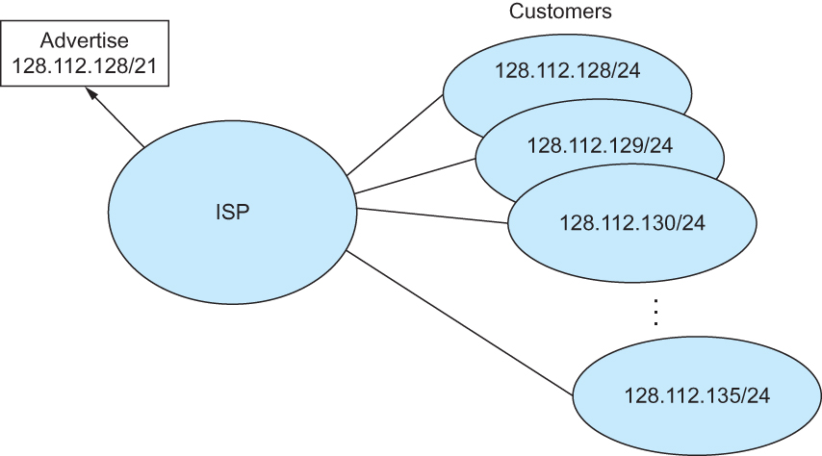
Classless Addressing
Route aggregation with CIDR

Slide 53
Separate Forwarding Entry Per Prefix
Prefix-based forwarding
  Map the destination address to matching prefix
  Forward to the outgoing interface
1.2.3.4
1.2.3.7
1.2.3.156
5.6.7.8
5.6.7.9
5.6.7.212
host
host
...
host
host
host
...
host
LAN 1
LAN
router
router
router
WAN
WAN
1.2.3.0/24
5.6.7.0/24
forwarding table

Slide 54
CIDR Makes Packet Forwarding Harder
Forwarding table may have many matches
  E.g., entries for 201.10.0.0/21 and 201.10.6.0/23
  The IP address 201.10.6.17 would match both!
201.10.0.0/21
Provider 1
Provider 2
201.10.0.0/22
201.10.4.0/24
201.10.5.0/24
201.10.6.0/23

Slide 55
Longest Prefix Match Forwarding
Destination-based forwarding
  Packet has a destination address
  Router identifies longest-matching prefix
  Cute algorithmic problem: very fast lookups
forwarding table
4.0.0.0/8
4.83.128.0/17
201.10.0.0/21
201.10.6.0/23
126.255.103.0/24
destination
201.10.6.17
outgoing link
Serial0/0.1

Slide 56
Pre-CIDR (1988-1994): Steep Growth
Growth faster than improvements in equipment capability

Slide 57
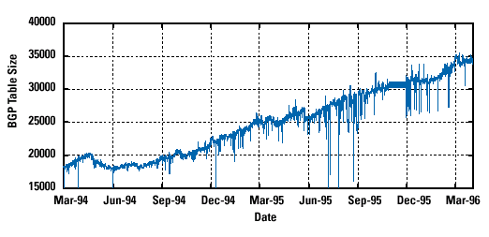
CIDR (1994-1996): Much Flatter
Efforts to aggregate

Slide 58
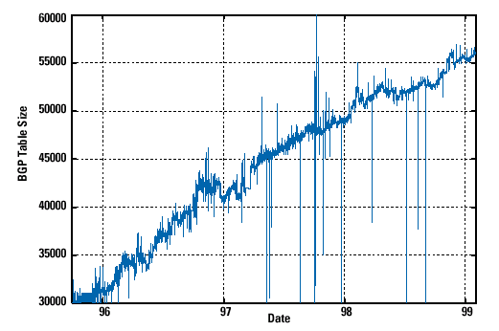
CIDR Growth (1996-1998): Roughly Linear
Good use of aggregation, and peer pressure!

Slide 59
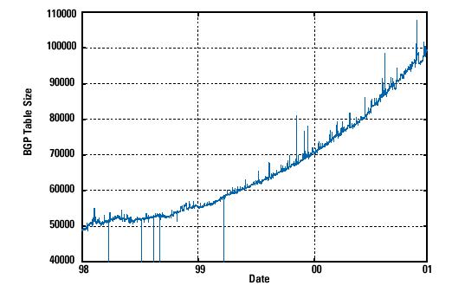
DotCom Boom (1998-2001): Steep Growth
Internet boom and increased multi-homing

Slide 60
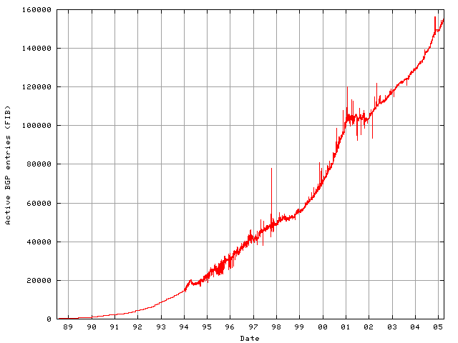
Long Term (1989-2005): Post-Boom
Today we are up to ~400,000 prefixes

Slide 61
Getting an IP address: DHCP

Slide 62
IP addresses: how to get one?
Q: How does a host get IP address?
hard-coded by system admin in a file
  Windows: control-panel->network->configuration->tcp/ip->properties
  UNIX: /etc/…
DHCP: Dynamic Host Configuration Protocol: dynamically get address from a server
  “plug-and-play”

Slide 63
DHCP: Dynamic Host Configuration Protocol
goal: allow host to dynamically obtain its IP address from network server when it joins network
  can renew its lease on address in use
  allows reuse of addresses (only hold address while connected/“on”)
  support for mobile users who want to join network

Slide 64
DHCP: Dynamic Host Configuration Protocol
DHCP overview:
  host broadcasts “DHCP discover” msg [optional]
  DHCP server responds with “DHCP offer” msg
  host requests IP address: “DHCP request” msg
  DHCP server sends address: “DHCP ack” msg

Slide 65



DHCP client-server scenario
DHCP
server
223.1.1.0/24
223.1.1.1
223.1.2.1
223.1.1.2
arriving DHCP
client needs
address in this
network
223.1.1.4
223.1.2.9
223.1.3.27
223.1.2.2
223.1.1.3
223.1.2.0/24
223.1.3.1
223.1.3.2
223.1.3.0/24

Slide 66
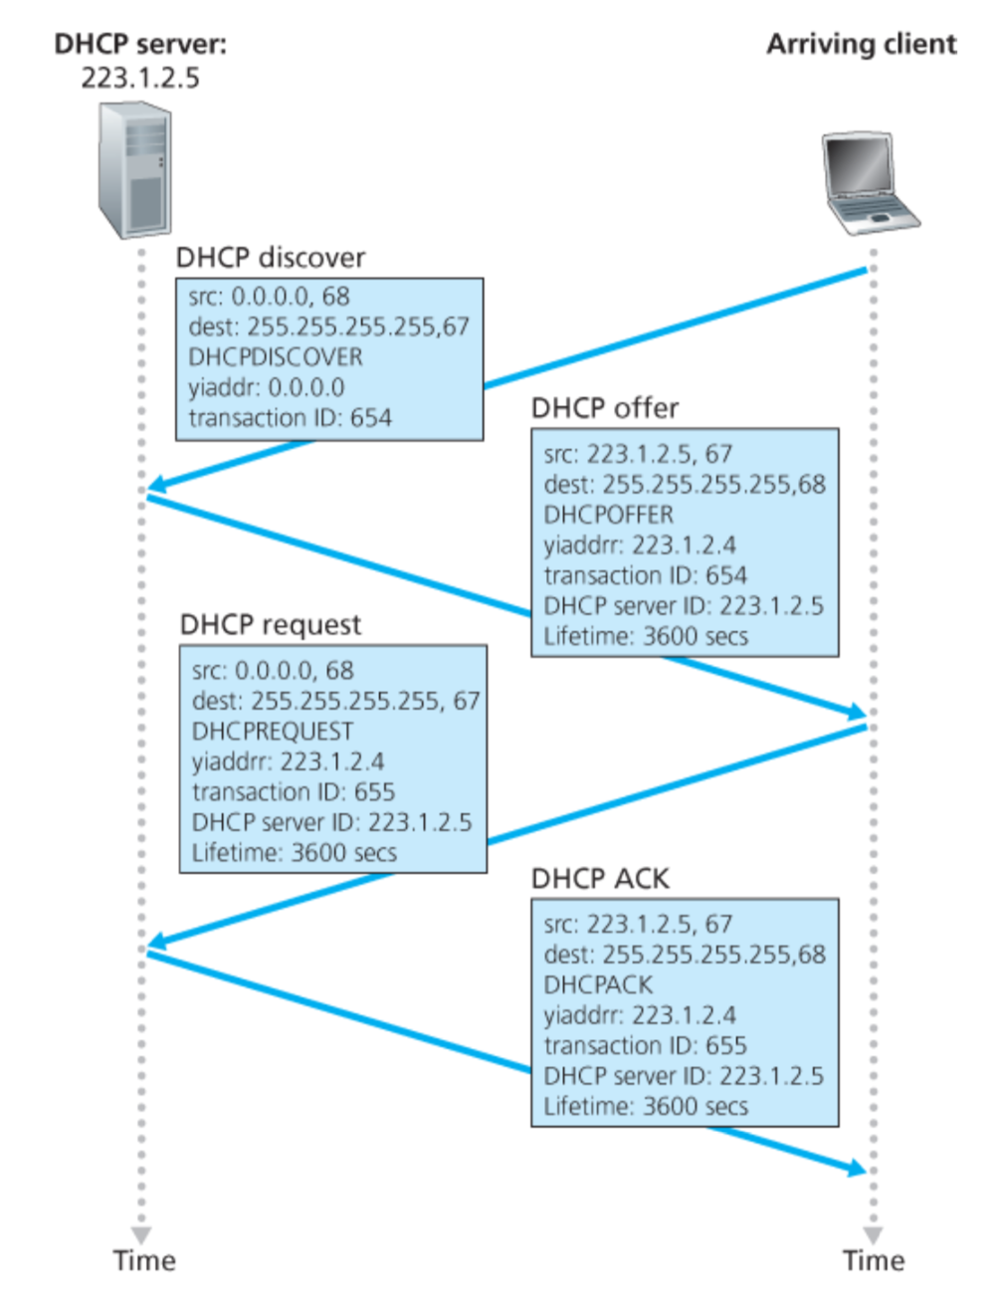
Broadcast: is there a DHCP server out there?
Broadcast: I’m a DHCP server! Here’s an IP address you can use
Broadcast: OK. I’ll take that IP address!
Broadcast: OK. You’ve got that IP address!

Slide 67
DHCP: more than IP addresses
DHCP can return more than just allocated IP address on subnet:
  address of first-hop router for client
  name and IP address of DNS sever
  network mask (indicating network versus host portion of address)

Slide 68
Dynamic Host Configuration Protocol (DHCP)
DHCP server is responsible for providing configuration information to hosts
DHCP server maintains a pool of available addresses
There is at least one DHCP server for an administrative domain (a server or a relay agent per subnet)

Slide 69
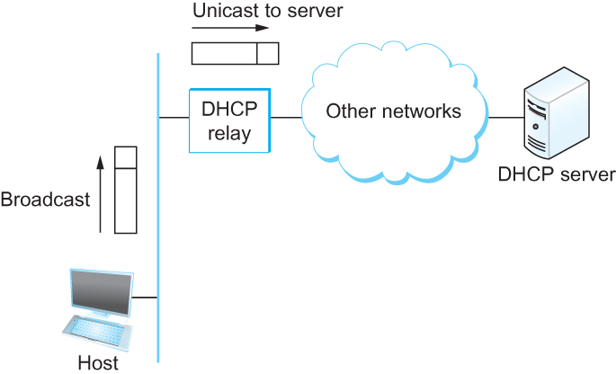
DHCP
Newly booted or attached host sends DHCPDISCOVER message to a special IP address (255.255.255.255)
DHCP relay agent unicasts the message to DHCP server and waits for the response

