Slide 1
Computer Networks
CMSC 417 : Spring 2022
Topic: Internetworking: CIDR, DHCP
(Textbook chapter 3)
Nirupam Roy
Tu-Th 2:00-3:15pm
CSI 1115

Slide 2
Class-less Interdomain Routing (CIDR)
Generalizes the ideas of subnetting

Slide 3
Lessons learned from subnetting
Forwarding tab.
Forwarding tab.
223.1.1.0
223.1.1.0
223.1.2.0
223.1.2.0
223.1.1.0
223.1.3.0
223.1.3.0
ISP
223.1.2.0
223.1.3.0

Slide 4
Lessons learned from subnetting
Forwarding tab.
Forwarding tab.
223.1.1.0
223.1.1.0
223.1.2.0
223.1.2.0
223.1.1.128
223.1.1.0
223.1.3.0
223.1.3.0
223.1.1.192
ISP
223.1.2.0
223.1.3.0

Slide 5
Lessons learned from subnetting
Forwarding tab.
Forwarding tab.
223.1.1.0
223.1.1.0
223.1.2.0
223.1.2.0
223.1.1.128
223.1.1.0
223.1.3.0
223.1.3.0
223.1.1.192
ISP
Lesson 1:
Address classes are not needed. Mask can define the number of bits for network part.
Lesson 2:
Network hierarchies can be hidden from the outside world.
Network addresses can be aggregated/summarized/combined
223.1.2.0
223.1.3.0

Slide 6
CIDR: Classless address

Slide 7
IP addressing: CIDR
CIDR: Classless InterDomain Routing
Network portion of address of arbitrary length
address format: a.b.c.d/x, where x is # bits in subnet portion of address
subnet
part
host
part
11001000 00010111 00010000 00000000
200.23.16.0/23
200.23.16.0–200.23.17.255
This X bit network part is often called Prefix or Network-prefix

Slide 8
IP addressing: CIDR
CIDR: Classless InterDomain Routing
subnet portion of address of arbitrary length
address format: a.b.c.d/x, where x is # bits in subnet portion of address
forwarding table
4.0.0.0/8
4.83.128.0/17
201.10.0.0/21
201.10.6.0/23
126.255.103.0/24

Slide 9
CIDR: Super-netting/ Route aggregation

Slide 10
Lessons learned from subnetting
Forwarding tab.
Forwarding tab.
223.1.1.0/24
223.1.1.0/24
223.1.2.0/24
223.1.2.0/24
223.1.1.0
223.1.3.0/24
223.1.3.0/24
ISP
223.1.0.0/16
223.1.2.0
223.1.3.0

Slide 11
Lessons learned from subnetting
Forwarding tab.
Forwarding tab.
223.1.1.0/24
223.1.0.0/16
223.1.2.0/24
223.1.1.0
223.1.3.0/24
ISP
223.1.0.0/16
223.1.2.0
223.1.3.0

Slide 12
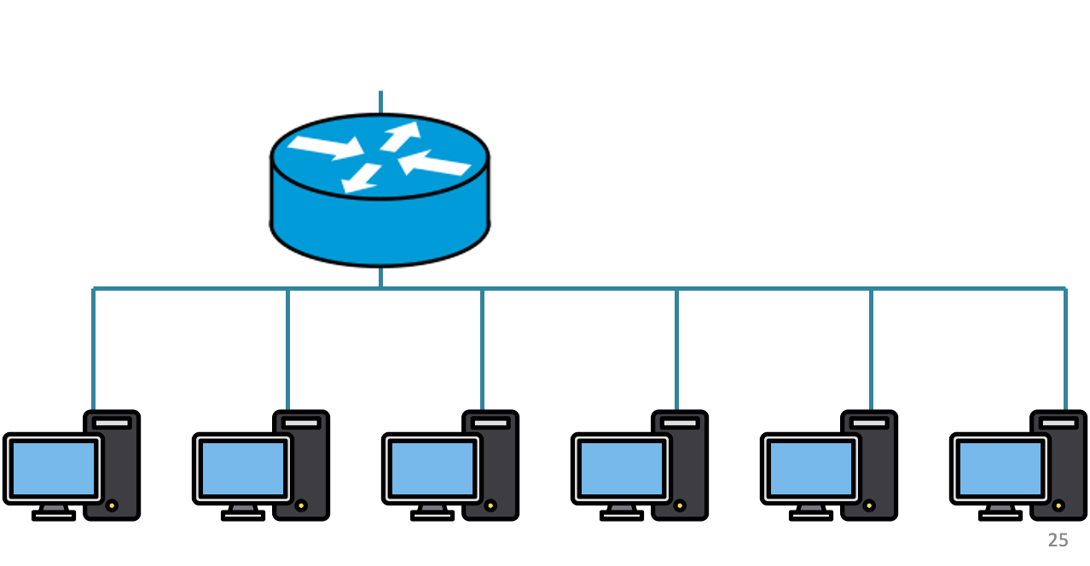
200.20.2.0/24
200.20.3.0/24
200.20.1.0/24

Slide 13
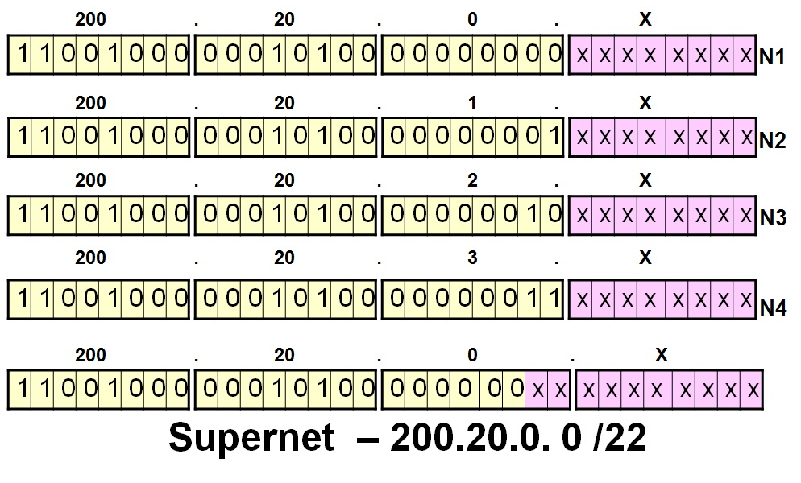
200.20.2.0/24
200.20.3.0/24
200.20.1.0/24

Slide 14
Route aggregation
200.20.2.0/24
200.20.3.0/24
200.20.1.0/24

Slide 15
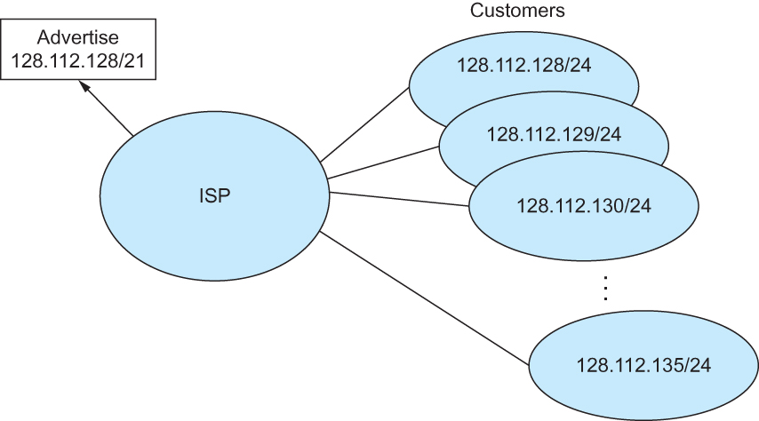
Route aggregation with CIDR

Slide 16
Classless Inter-Domain Routing (CIDR)
Use two 32-bit numbers to represent a network.
Network number = IP address + Mask
IP Address : 12.4.0.0 IP Mask: 255.254.0.0
Address
00001100
00000100
00000000
00000000
Mask
11111111
11111110
00000000
00000000
Network Prefix
for hosts
Written as 12.4.0.0/15

Slide 17
Hierarchical Address Allocation
Hierarchy is key to scalability
Address allocated in contiguous chunks (prefixes)
Today, the Internet has about 400,000 prefixes
12.0.0.0/16
12.1.0.0/16
:
:
:
12.3.0.0/24
12.2.0.0/16
12.3.1.0/24
12.3.0.0/16
:
:
:
:
:
12.0.0.0/8
12.3.254.0/24
12.253.0.0/19
12.253.32.0/19
:
:
12.254.0.0/16
12.253.160.0/19

Slide 18
Separate Forwarding Entry Per Prefix
Prefix-based forwarding
Map the destination address to matching prefix
Forward to the outgoing interface
1.2.3.4
1.2.3.7
1.2.3.156
5.6.7.8
5.6.7.9
5.6.7.212
host
host
...
host
host
host
...
host
LAN 1
LAN
router
router
router
WAN
WAN
1.2.3.0/24
5.6.7.0/24
forwarding table

Slide 19
CIDR Makes Packet Forwarding Harder
201.10.0.0/21
Provider 1
201.10.0.0/22
201.10.4.0/24
201.10.5.0/24
201.10.6.0/23

Slide 20
CIDR Makes Packet Forwarding Harder
201.10.0.0/21
Provider 1
Provider 2
Multi-homing
201.10.0.0/22
201.10.4.0/24
201.10.5.0/24
201.10.6.0/23

Slide 21
CIDR Makes Packet Forwarding Harder
Forwarding tab.
201.10.0.0/21
Provider 1
Provider 2
Multi-homing
201.10.0.0/22
201.10.4.0/24
201.10.5.0/24
201.10.6.0/23

Slide 22
CIDR Makes Packet Forwarding Harder
Forwarding tab.
201.10.0.0/21
201.10.6.0/23
201.10.0.0/21
Provider 1
Provider 2
Multi-homing
201.10.0.0/22
201.10.4.0/24
201.10.5.0/24
201.10.6.0/23

Slide 23
CIDR Makes Packet Forwarding Harder
Forwarding table
201.10.0.0/21
11001001.00001010.00000000.00000000/21
201.10.6.0/23
11001001.00001010.00000110.00000000/23
A packet with dest. Addr.: 201.10.6.17
11001001.00001010.00000110.00010001

Slide 24
CIDR Makes Packet Forwarding Harder
Forwarding table may have many matches
E.g., entries for 201.10.0.0/21 and 201.10.6.0/23
The IP address 201.10.6.17 would match both!
201.10.0.0/21
Provider 1
Provider 2
201.10.0.0/22
201.10.4.0/24
201.10.5.0/24
201.10.6.0/23

Slide 25
Longest Prefix Match Forwarding
Destination-based forwarding
Packet has a destination address
Router identifies longest-matching prefix
Cute algorithmic problem: very fast lookups
forwarding table
4.0.0.0/8
4.83.128.0/17
201.10.0.0/21
201.10.6.0/23
126.255.103.0/24
destination
201.10.6.17
outgoing link

Slide 26
Getting an IP address: DHCP Protocol

Slide 27
IP addresses: how to get one?
Q: How does a host get IP address?
hard-coded by system admin in a file
Windows: control-panel->network->configuration->tcp/ip->properties
UNIX: /etc/…
DHCP: Dynamic Host Configuration Protocol: dynamically get address from a server
“plug-and-play”

Slide 28
DHCP: Dynamic Host Configuration Protocol
goal: allow host to dynamically obtain its IP address from network server when it joins network
can renew its lease on address in use
allows reuse of addresses (only hold address while connected/“on”)
support for mobile users who want to join network

Slide 29
DHCP: Dynamic Host Configuration Protocol
DHCP overview:
host broadcasts “DHCP discover” msg
DHCP server responds with “DHCP offer” msg
host requests IP address: “DHCP request” msg
DHCP server sends address: “DHCP ack” msg

Slide 30
DHCP client-server scenario
DHCP
server
223.1.1.0/24
223.1.1.1
223.1.2.1
223.1.1.2
arriving DHCP
client needs
address in this
network
223.1.1.4
223.1.2.9
223.1.3.27
223.1.2.2
223.1.1.3
223.1.2.0/24
223.1.3.1
223.1.3.2
223.1.3.0/24

Slide 31
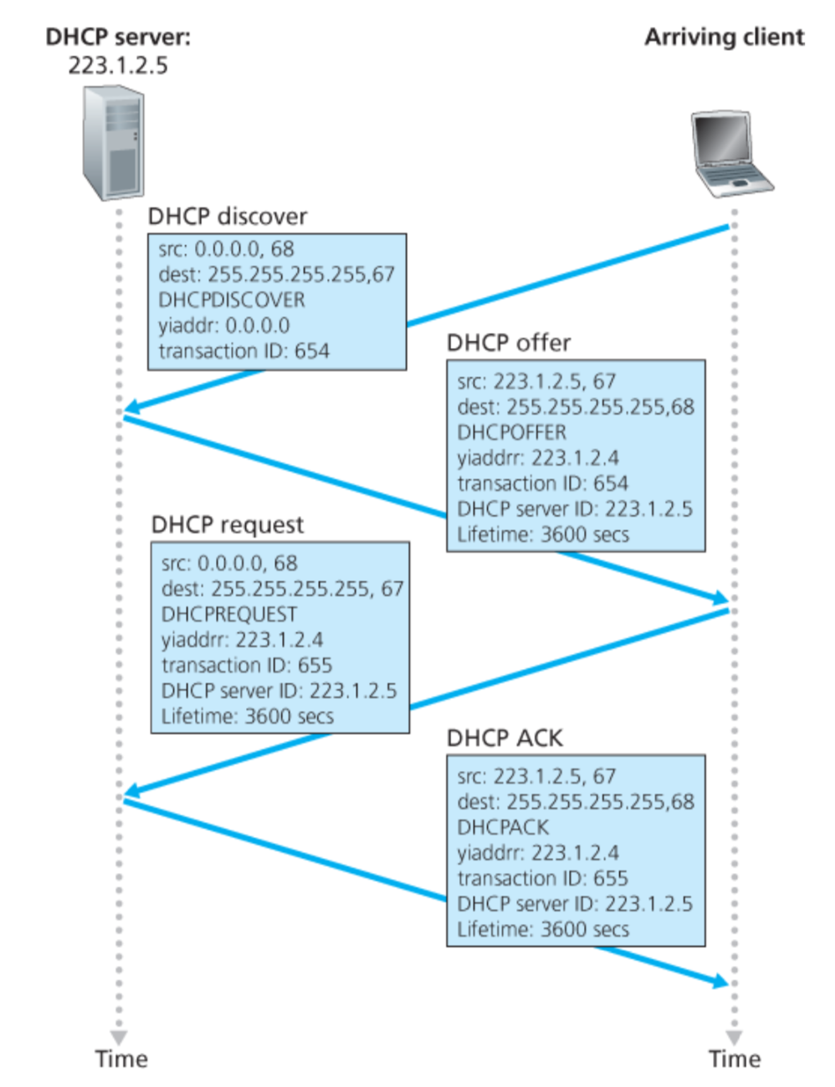
Broadcast: is there a DHCP server out there?

Slide 32
A note on the “broadcast address”

Slide 33
inet 10.104.216.101 ➔ 00001010.01101000.11011000.01100101
netmask ff:ff:f0:00 ➔ 11111111.11111111.11110000.00000000
broadcast 10.104.223.255 ➔
00001010.01101000.11011111.11111111

Slide 34
Broadcast: is there a DHCP server out there?
Broadcast: I’m a DHCP server! Here’s an IP address you can use
Broadcast: OK. I’ll take that IP address!
Broadcast: OK. You’ve got that IP address!

Slide 35
Broadcast: is there a DHCP server out there?
Broadcast: I’m a DHCP server! Here’s an IP address you can use
Broadcast: OK. I’ll take that IP address!
Broadcast: OK. You’ve got that IP address!

Slide 36
Broadcast: is there a DHCP server out there?
Broadcast: I’m a DHCP server! Here’s an IP address you can use
Broadcast: OK. I’ll take that IP address!
Broadcast: OK. You’ve got that IP address!

Slide 37
Broadcast: is there a DHCP server out there?
Broadcast: I’m a DHCP server! Here’s an IP address you can use
Broadcast: OK. I’ll take that IP address!
Broadcast: OK. You’ve got that IP address!

Slide 38
Broadcast: is there a DHCP server out there?
Broadcast: I’m a DHCP server! Here’s an IP address you can use
Broadcast: OK. I’ll take that IP address!
Broadcast: OK. You’ve got that IP address!

Slide 39
Broadcast: is there a DHCP server out there?
Broadcast: I’m a DHCP server! Here’s an IP address you can use
Broadcast: OK. I’ll take that IP address!
Broadcast: OK. You’ve got that IP address!

Slide 40
Broadcast: is there a DHCP server out there?
Broadcast: I’m a DHCP server! Here’s an IP address you can use
Broadcast: OK. I’ll take that IP address!
Broadcast: OK. You’ve got that IP address!

Slide 41
Broadcast: is there a DHCP server out there?
Broadcast: I’m a DHCP server! Here’s an IP address you can use
Broadcast: OK. I’ll take that IP address!
Broadcast: OK. You’ve got that IP address!

Slide 42
Broadcast: is there a DHCP server out there?
Broadcast: I’m a DHCP server! Here’s an IP address you can use
Broadcast: OK. I’ll take that IP address!
Broadcast: OK. You’ve got that IP address!

Slide 43
Broadcast: is there a DHCP server out there?
Broadcast: I’m a DHCP server! Here’s an IP address you can use
Broadcast: OK. I’ll take that IP address!
Broadcast: OK. You’ve got that IP address!

Slide 44
Broadcast: is there a DHCP server out there?
Broadcast: I’m a DHCP server! Here’s an IP address you can use
Broadcast: OK. I’ll take that IP address!
Broadcast: OK. You’ve got that IP address!

Slide 45
Broadcast: is there a DHCP server out there?
Broadcast: I’m a DHCP server! Here’s an IP address you can use
Broadcast: OK. I’ll take that IP address!
Broadcast: OK. You’ve got that IP address!

Slide 46
Broadcast: is there a DHCP server out there?
Broadcast: I’m a DHCP server! Here’s an IP address you can use
Broadcast: OK. I’ll take that IP address!
Broadcast: OK. You’ve got that IP address!

Slide 47
Broadcast: is there a DHCP server out there?
Broadcast: I’m a DHCP server! Here’s an IP address you can use
Broadcast: OK. I’ll take that IP address!
Broadcast: OK. You’ve got that IP address!

Slide 48
Broadcast: is there a DHCP server out there?
Broadcast: I’m a DHCP server! Here’s an IP address you can use
Broadcast: OK. I’ll take that IP address!
Broadcast: OK. You’ve got that IP address!

Slide 49
DHCP: more than IP addresses
DHCP can return more than just allocated IP address on subnet:
address of first-hop router for client
name and IP address of DNS sever
network mask (indicating network versus host portion of address)

Slide 50
Dynamic Host Configuration Protocol (DHCP)
DHCP server is responsible for providing configuration information to hosts
DHCP server maintains a pool of available addresses
There is at least one DHCP server for an administrative domain (a server or a relay agent per subnet)

Slide 51
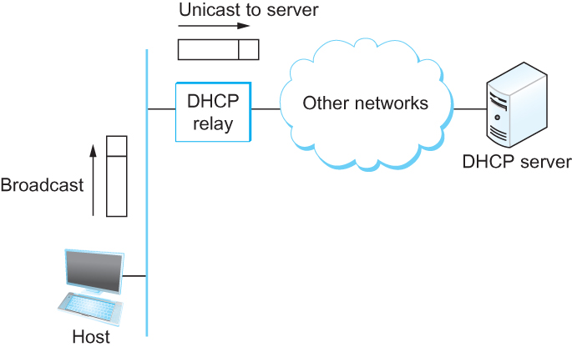
DHCP relay
Newly booted or attached host sends DHCPDISCOVER message to a special IP address (255.255.255.255)
DHCP relay agent unicasts the message to DHCP server and waits for the response

Slide 52
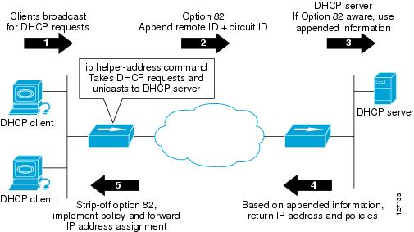
DHCP relay

Slide 53
Check our IP addresses
(ifconfig/ipconfig)

Slide 54
Private Address Space

Slide 55
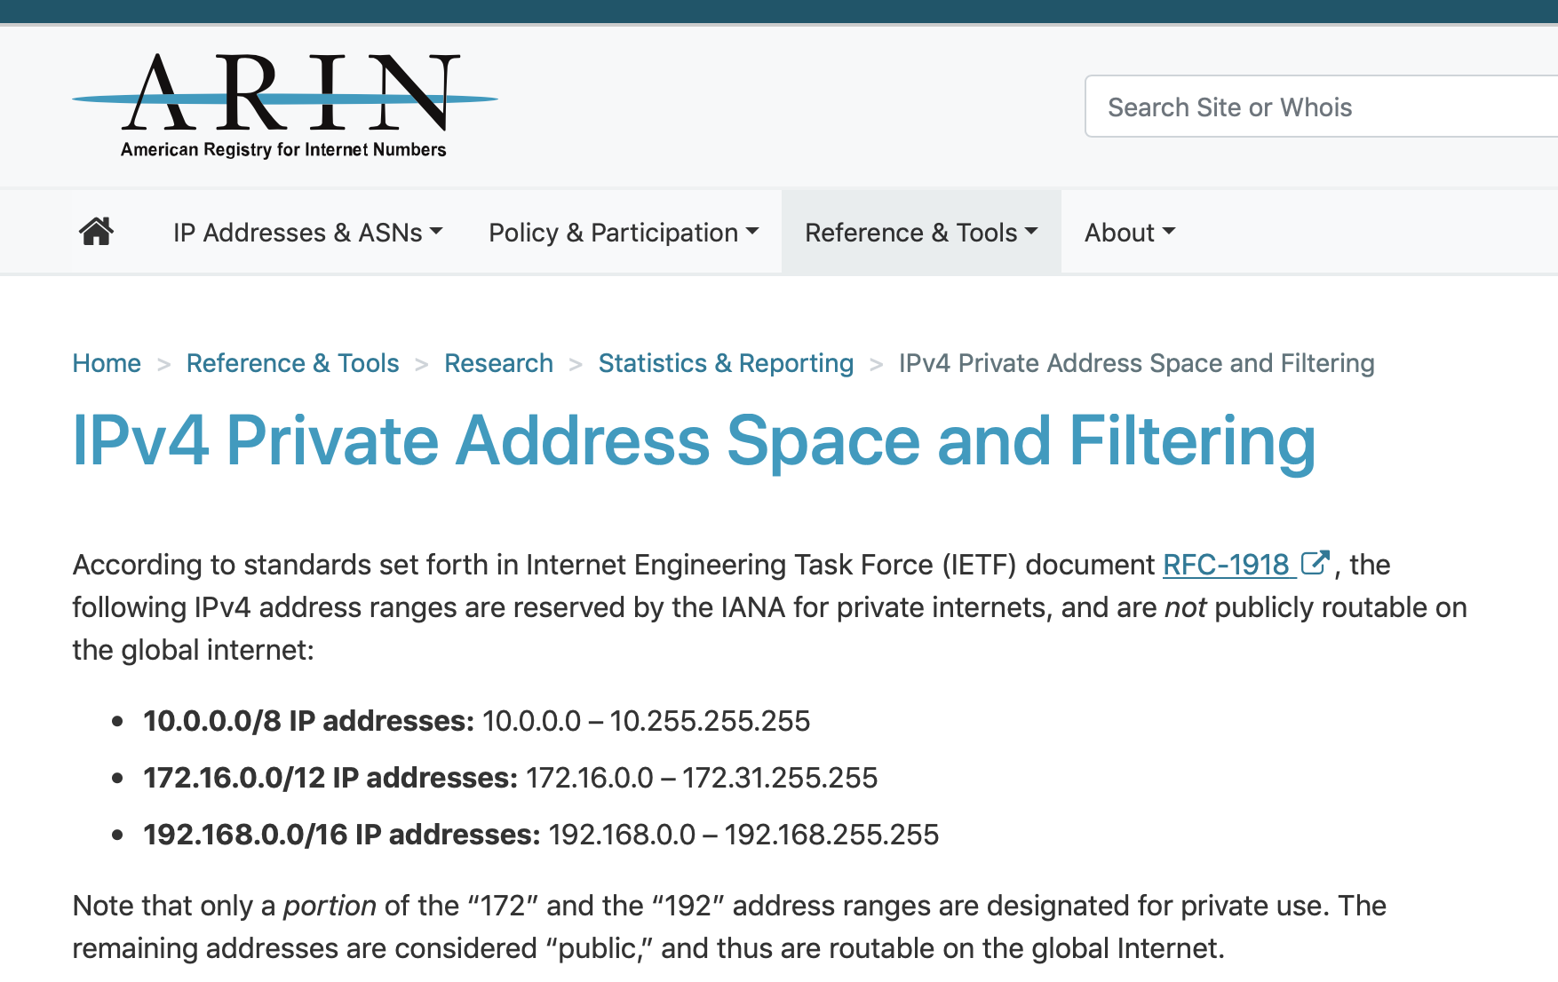

Slide 56
NAT: network address translation
rest of
Internet
local network
(e.g., home network)
10.0.0/24
10.0.0.1
10.0.0.4
10.0.0.2
138.76.29.7
10.0.0.3
all datagrams leaving local
network have same single source NAT IP address: 138.76.29.7,different source port numbers
datagrams with source or
destination in this network
have 10.0.0/24 address for
source, destination (as usual)

Slide 57
NAT: network address translation
NAT translation table
WAN side addr LAN side addr
2: NAT router
changes datagram
source addr from
10.0.0.1, 3345 to
138.76.29.7, 5001,
updates table
1: host 10.0.0.1
sends datagram to
128.119.40.186, 80
138.76.29.7, 5001 10.0.0.1, 3345
…… ……
S: 10.0.0.1, 3345
D: 128.119.40.186, 80
10.0.0.1
1
2
S: 138.76.29.7, 5001
D: 128.119.40.186, 80
10.0.0.4
10.0.0.2
138.76.29.7
S: 128.119.40.186, 80
D: 10.0.0.1, 3345
4
S: 128.119.40.186, 80
D: 138.76.29.7, 5001
3
10.0.0.3
4: NAT router
changes datagram
dest addr from
138.76.29.7, 5001 to 10.0.0.1, 3345
3: reply arrives
dest. address:
138.76.29.7, 5001

Slide 58
NAT: network address translation
motivation: local network uses just one IP address as far as outside world is concerned:
range of addresses not needed from ISP: just one IP address for all devices
can change addresses of devices in local network without notifying outside world
can change ISP without changing addresses of devices in local network
devices inside local net not explicitly addressable, visible by outside world (a security plus)

Slide 59
NAT: network address translation
implementation: NAT router must:
outgoing datagrams: replace (source IP address, port #) of every outgoing datagram to (NAT IP address, new port #)
. . . remote clients/servers will respond using (NAT IP address, new port #) as destination addr
remember (in NAT translation table) every (source IP address, port #) to (NAT IP address, new port #) translation pair
incoming datagrams: replace (NAT IP address, new port #) in dest fields of every incoming datagram with corresponding (source IP address, port #) stored in NAT table

Slide 60
NAT: network address translation
16-bit port-number field:
60,000 simultaneous connections with a single LAN-side address!
NAT challenges:
violates end-to-end argument
NAT possibility must be taken into account by app designers, e.g., P2P applications
NAT traversal: what if client wants to connect to server behind NAT?

