Slide 1
Computer Networks
CMSC 417 : Spring 2023
Topic: Internetworking: NAT, ARP, ICMP, VPN
(Textbook chapter 3)
Nirupam Roy
Tu-Th 2:00-3:15pm
CSI 2117

Slide 2
Check your IP addresses
(ifconfig/ipconfig)

Slide 3
Private Address Space & NAT

Slide 4
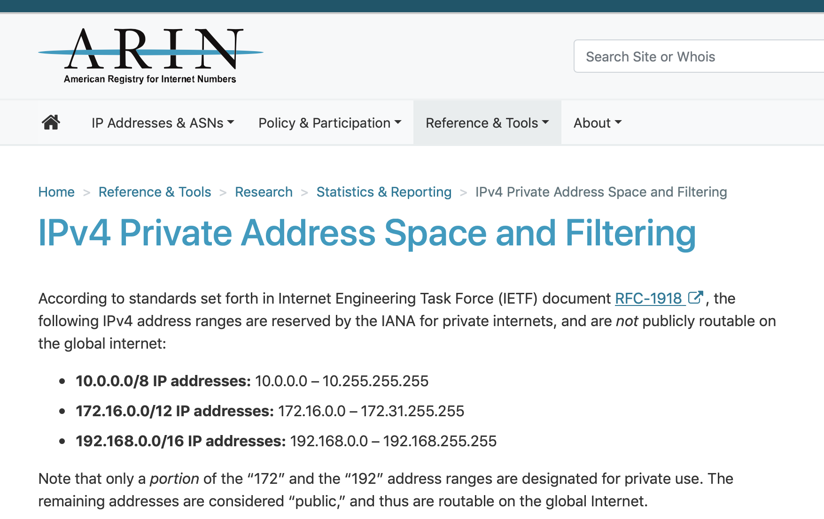

Slide 5
NAT: network address translation
rest of
Internet
local network
(e.g., home network)
10.0.0.0/24
10.0.0.1
10.0.0.4
10.0.0.2
138.76.29.7
10.0.0.3
all datagrams leaving local
network have same single source NAT IP address: 138.76.29.7,different source port numbers
datagrams with source or
destination in this network
have 10.0.0.0/24 address for
source, destination (as usual)

Slide 6
NAT: network address translation
NAT translation table
WAN side addr LAN side addr
2: NAT router
changes datagram
source addr from
10.0.0.1, 3345 to
138.76.29.7, 5001,
updates table
1: host 10.0.0.1
sends datagram to
128.119.40.186, 80
138.76.29.7, 5001 10.0.0.1, 3345
…… ……
S: 10.0.0.1, 3345
D: 128.119.40.186, 80
10.0.0.1
1
2
S: 138.76.29.7, 5001
D: 128.119.40.186, 80
10.0.0.4
10.0.0.2
138.76.29.7
S: 128.119.40.186, 80
D: 10.0.0.1, 3345
4
S: 128.119.40.186, 80
D: 138.76.29.7, 5001
3
10.0.0.3
4: NAT router
changes datagram
dest addr from
138.76.29.7, 5001 to 10.0.0.1, 3345
3: reply arrives
dest. address:
138.76.29.7, 5001

Slide 7
NAT: network address translation
motivation: local network uses just one IP address as far as outside world is concerned:
range of addresses not needed from ISP: just one IP address for all devices
can change addresses of devices in local network without notifying outside world
can change ISP without changing addresses of devices in local network
devices inside local net not explicitly addressable, visible by outside world (a security plus)

Slide 8
NAT: network address translation
implementation: NAT router must:
outgoing datagrams: replace (source IP address, port #) of every outgoing datagram to (NAT IP address, new port #)
. . . remote clients/servers will respond using (NAT IP address, new port #) as destination addr
remember (in NAT translation table) every (source IP address, port #) to (NAT IP address, new port #) translation pair
incoming datagrams: replace (NAT IP address, new port #) in dest fields of every incoming datagram with corresponding (source IP address, port #) stored in NAT table

Slide 9
NAT: network address translation
implementation: NAT router must:
outgoing datagrams: replace (source IP address, port #) of every outgoing datagram to (NAT IP address, new port #)
. . . remote clients/servers will respond using (NAT IP address, new port #) as destination addr
remember (in NAT translation table) every (source IP address, port #) to (NAT IP address, new port #) translation pair
incoming datagrams: replace (NAT IP address, new port #) in dest fields of every incoming datagram with corresponding (source IP address, port #) stored in NAT table

Slide 10
NAT: network address translation
16-bit port-number field:
Over 60,000 simultaneous connections with a single LAN-side address!
NAT challenges:
violates end-to-end argument
NAT possibility must be taken into account by app designers, e.g., P2P applications
NAT traversal: what if client wants to connect to server behind NAT?

Slide 11
Network address vs LAN address

Slide 12
Two perspectives of addresses:
(1)Network-to-network & (2)machine-to-machine
Destination
Router
Source

Slide 13
application
transport
network
link
physical
Router
Source

Slide 14
network
link
physical
application
transport
network
link
physical
Router
Source

Slide 15
network
link
physical
Router
Hierarchical address for addressing networks
(IP address)

Slide 16
network
link
physical
application
transport
network
link
physical
Router
Source

Slide 17
Flat address for addressing machines at the link-layer
(MAC address)
network
link
physical
application
transport
network
link
physical
Router
Source

Slide 18
Address Resolution Protocol (ARP)

Slide 19
MAC addresses and ARP
32-bit IP address:
network-layer address for interface
used for layer 3 (network layer) forwarding
MAC (or LAN or physical or Ethernet) address:
function: used “locally” to get frame from one interface to another physically-connected interface (same network, in IP-addressing sense)
48 bit MAC address (for most LANs) burned in NIC ROM, also sometimes software settable
e.g.: 1A-2F-BB-76-09-AD
hexadecimal (base 16) notation
(each “numeral” represents 4 bits)

Slide 20
MAC addresses and ARP
each adapter on LAN has unique LAN addr. or MAC addr.
1A-2F-BB-76-09-AD
LAN
(wired or
wireless)
adapter
71-65-F7-2B-08-53
58-23-D7-FA-20-B0
0C-C4-11-6F-E3-98

Slide 21
MAC addresses (more)
MAC address allocation administered by IEEE
manufacturer buys portion of MAC address space (to assure uniqueness)
analogy:
MAC address: like Social Security Number
IP address: like postal address
MAC flat address ➜ portability
can move LAN card from one LAN to another
IP hierarchical address not portable
address depends on IP subnet to which node is attached

Slide 22
ARP: address resolution protocol
Question: how to determine
interface’s MAC address, knowing its IP address?
ARP table: each IP node (host, router) on LAN has table
IP/MAC address mappings for some LAN nodes:
< IP address; MAC address; TTL>
TTL (Time To Live): time after which address mapping will be forgotten (typically 20 min)
137.196.7.78
1A-2F-BB-76-09-AD
137.196.7.23
137.196.7.14
LAN
71-65-F7-2B-08-53
58-23-D7-FA-20-B0
0C-C4-11-6F-E3-98
137.196.7.88

Slide 23
ARP protocol: same LAN
A wants to send datagram to B
B’s MAC address not in A’s ARP table.
A broadcasts ARP query packet, containing B's IP address
destination MAC address = FF-FF-FF-FF-FF-FF
all nodes on LAN receive ARP query
B receives ARP packet, replies to A with its (B's) MAC address
frame sent to A’s MAC address (unicast)
A caches (saves) IP-to-MAC address pair in its ARP table until information becomes old (times out)
soft state: information that times out (goes away) unless refreshed
ARP is “plug-and-play”:
nodes create their ARP tables without intervention from net administrator

Slide 24
Address Translation Protocol (ARP)
Map IP addresses into physical addresses
destination host
next hop router
Techniques
encode physical address in host part of IP address
table-based
ARP (Address Resolution Protocol)
table of IP to physical address bindings
broadcast request if IP address not in table
target machine responds with its physical address
table entries are discarded if not refreshed
Query message include the physical address of the sending host. Why?

Slide 25
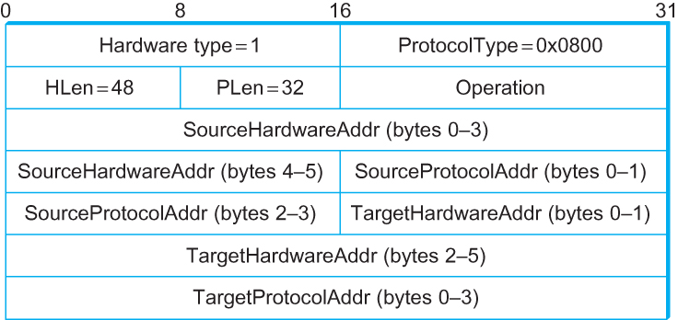
ARP Packet Format
HardwareType: type of physical network (e.g., Ethernet)
ProtocolType: type of higher layer protocol (e.g., IP)
HLEN & PLEN: length of physical and protocol addresses
Operation: request or response
Source/Target Physical/Protocol addresses

Slide 26
Internet Control Message Protocol (ICMP)

Slide 27
Internet Control Message Protocol (ICMP)
Defines a collection of error messages that are sent back to the source host whenever a router or host is unable to process an IP datagram successfully
Destination host unreachable due to link /node failure
Reassembly process failed
TTL had reached 0 (so datagrams don't cycle forever)
IP header checksum failed
ICMP-Redirect
From router to a source host
With a better route information

Slide 28
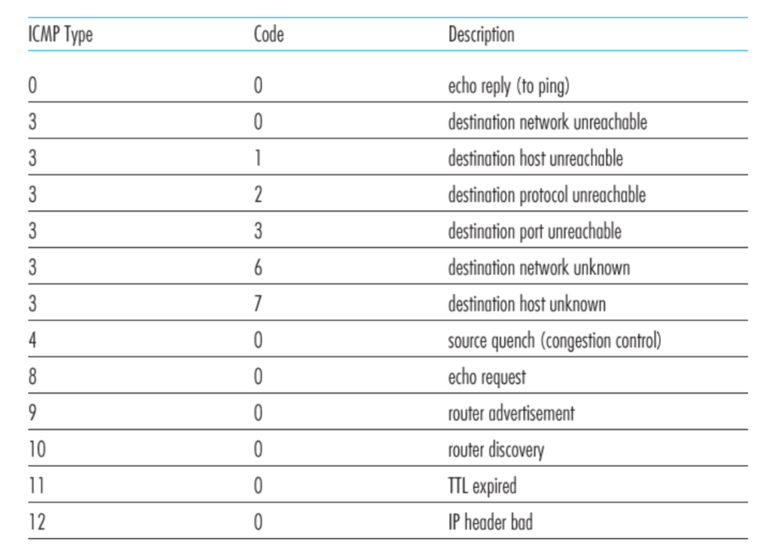
ICMP message types

Slide 29
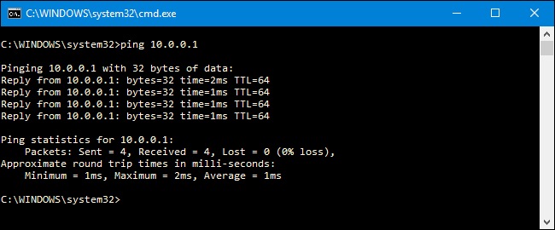
Ping example

Slide 30
Traceroute : An unintuitive application using ICMP

Slide 31
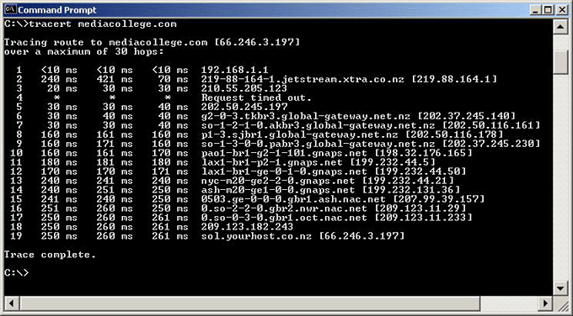
Traceroute example

Slide 32
Traceroute : An unintuitive application

Slide 33
Virtual Networks and Tunnels

Slide 34
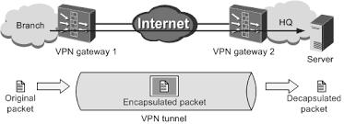

Slide 35
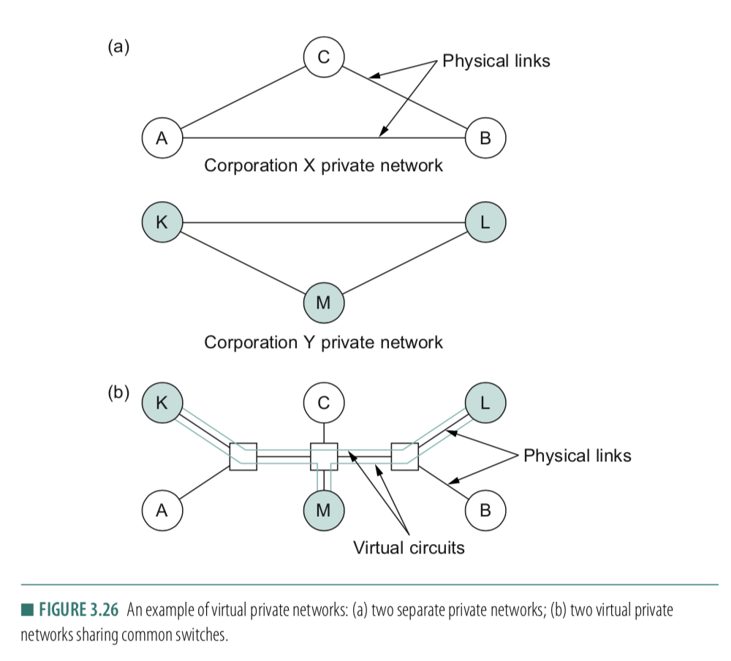

Slide 36
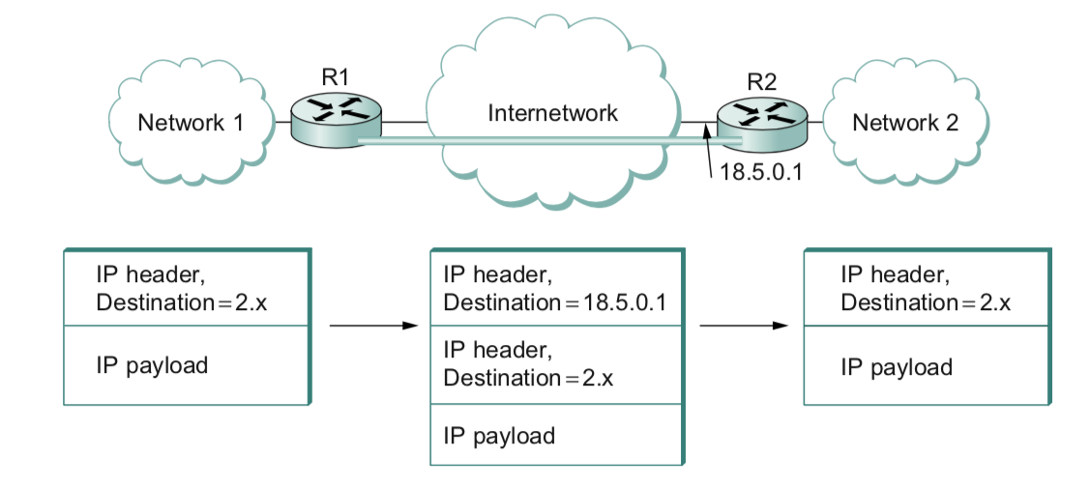

Slide 37
Why do we need virtual networks or tunnels?
1. Security
2. Special capabilities between routers (e.g., multicast)
3. Supporting heterogeneity
Disadvantages:
1. Increases packet length
a) Wastage of bandwidth
b) More processing
c) Fragmentation
2. Increases management cost

