Slide 1

Computer Networks
CMSC 417 : Spring 2023
Topic: Internetworking: DHCP, NAT, ARP, ICMP
(Textbook chapter 3)
Nirupam Roy
Tu-Th 2:00-3:15pm
CSI 2117
Feb 29th, 2024

Slide 2
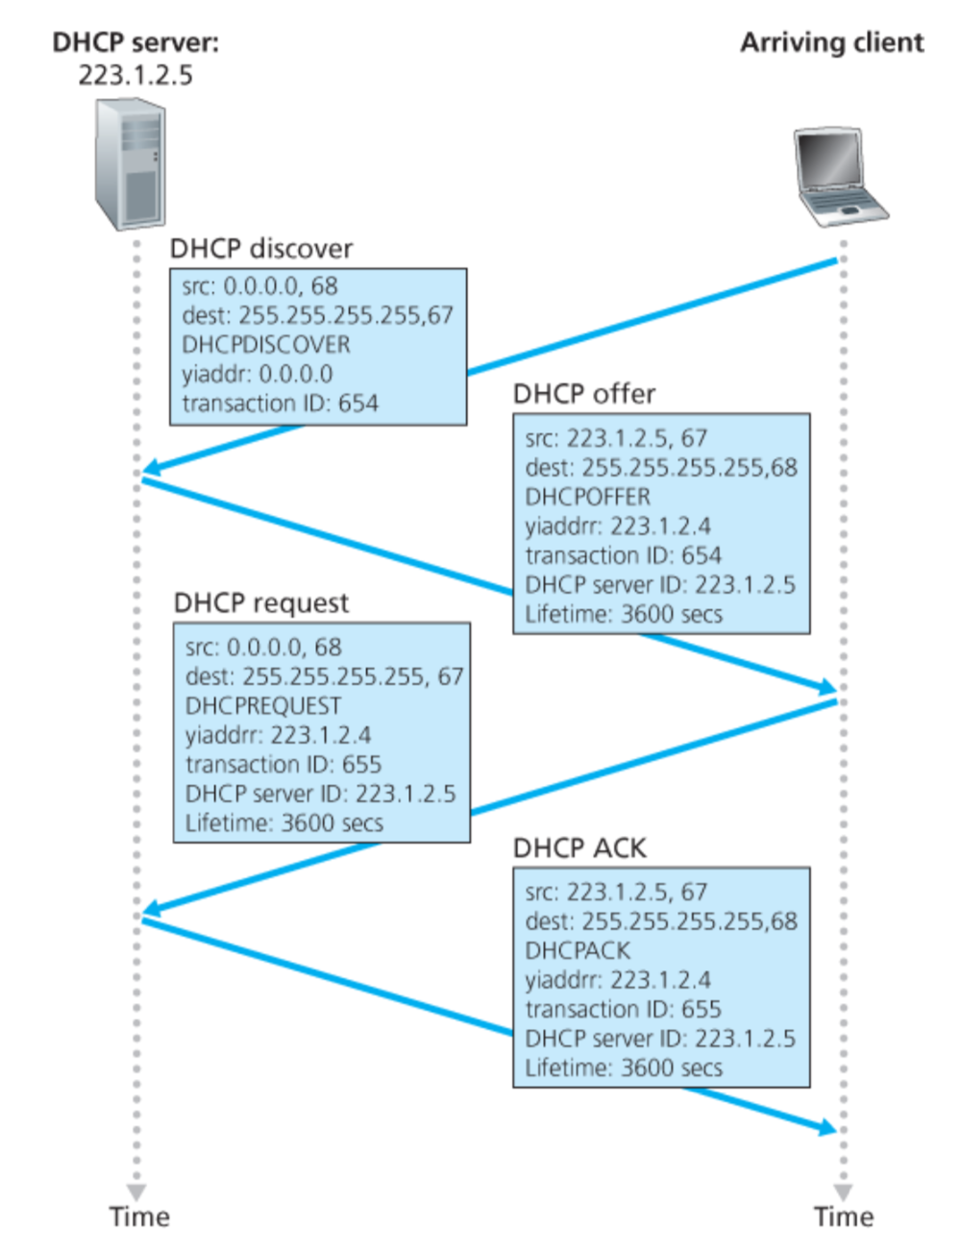
Broadcast: is there a DHCP server out there?
Broadcast: I’m a DHCP server! Here’s an IP address you can use
Broadcast: OK. I’ll take that IP address!
Broadcast: OK. You’ve got that IP address!

Slide 3
Broadcast: is there a DHCP server out there?
Broadcast: I’m a DHCP server! Here’s an IP address you can use
Broadcast: OK. I’ll take that IP address!
Broadcast: OK. You’ve got that IP address!
Discussion Point 1: The transaction ID (xid). RFC 2131
Discussion Point 2: Broadcast address. (Limited/Directed broadcast)

Slide 4
DHCP: more than IP addresses
DHCP can return more than just allocated IP address on subnet:
  address of first-hop router for client
  name and IP address of DNS sever
  network mask (indicating network versus host portion of address)

Slide 5
Dynamic Host Configuration Protocol (DHCP)
DHCP server is responsible for providing configuration information to hosts
DHCP server maintains a pool of available addresses
There is at least one DHCP server for an administrative domain (a server or a relay agent per subnet)

Slide 6
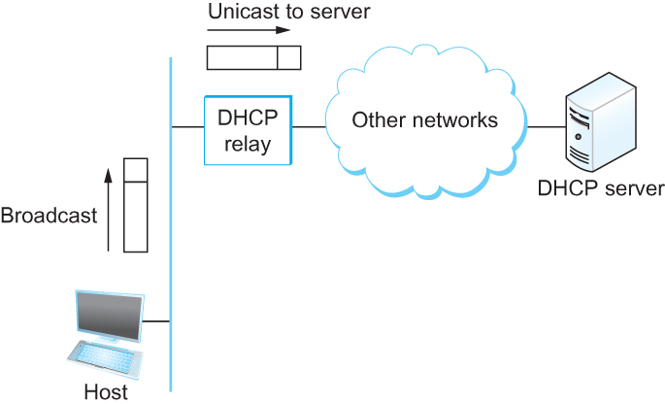
DHCP relay
Newly booted or attached host sends DHCPDISCOVER message to a special IP address (255.255.255.255)
DHCP relay agent unicasts the message to DHCP server and waits for the response

Slide 7
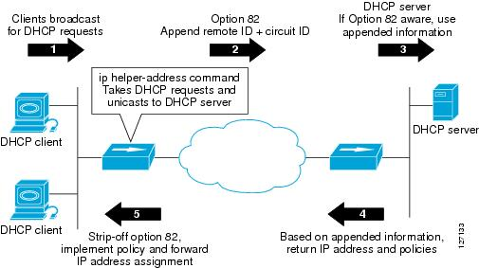
DHCP relay

Slide 8
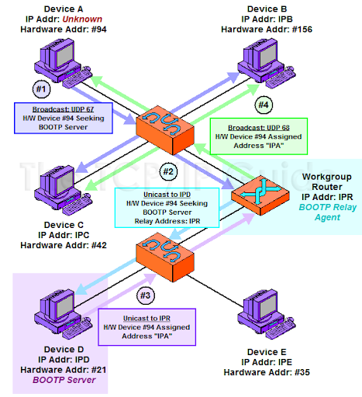
PC: http://www.tcpipguide.com/free/t_BOOTPRelayAgentsForwardingAgents-3.htm

Slide 9
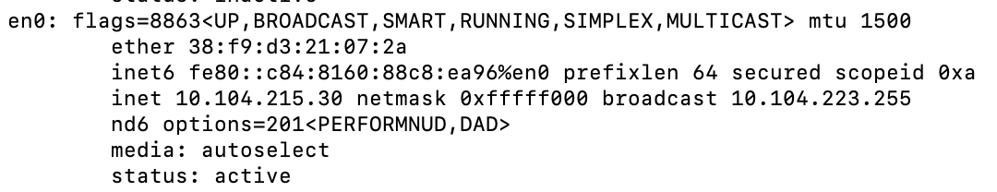
Check your IP addresses
(ifconfig/ipconfig)

Slide 10
Check your IP addresses
(ifconfig/ipconfig)

Slide 11
Private Address Space
&
NAT

Slide 12
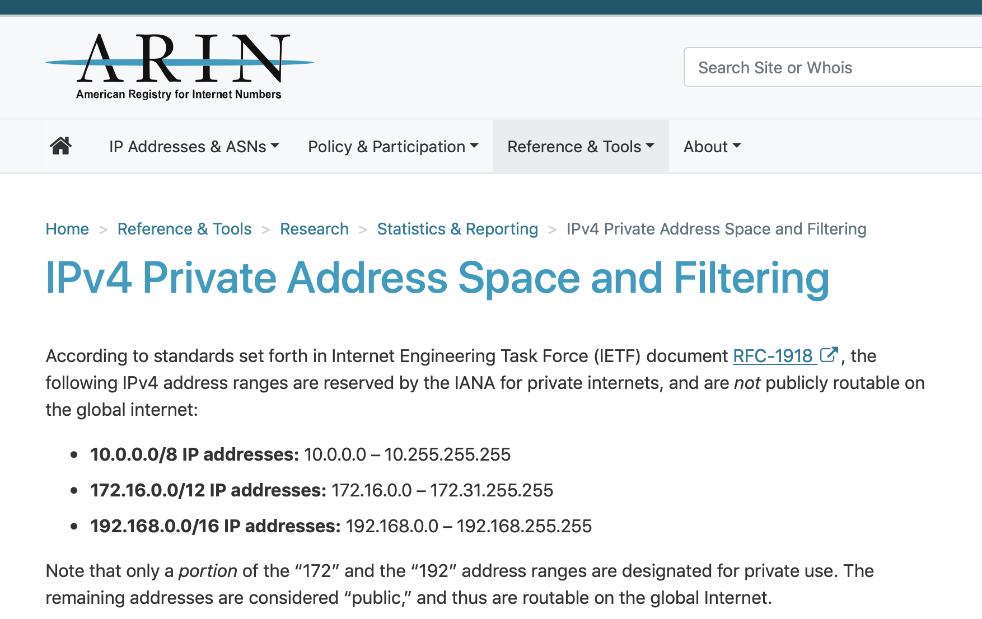

Slide 13

NAT: network address translation
rest of
Internet
local network
(e.g., home network)
10.0.0.0/24
10.0.0.1
10.0.0.4
10.0.0.2
138.76.29.7
10.0.0.3
all datagrams leaving local
network have same single source NAT IP address: 138.76.29.7,different source port numbers
datagrams with source or
destination in this network
have 10.0.0.0/24 address for
source, destination (as usual)

Slide 14
NAT: network address translation
NAT translation table
WAN side addr LAN side addr
2: NAT router
changes datagram
source addr from
10.0.0.1, 3345 to
138.76.29.7, 5001,
updates table
1: host 10.0.0.1
sends datagram to
128.119.40.186, 80
138.76.29.7, 5001 10.0.0.1, 3345
…… ……
S: 10.0.0.1, 3345
D: 128.119.40.186, 80
10.0.0.1
1
2
S: 138.76.29.7, 5001
D: 128.119.40.186, 80
10.0.0.4
10.0.0.2
138.76.29.7
S: 128.119.40.186, 80
D: 10.0.0.1, 3345
4
S: 128.119.40.186, 80
D: 138.76.29.7, 5001
3
10.0.0.3
4: NAT router
changes datagram
dest addr from
138.76.29.7, 5001 to 10.0.0.1, 3345
3: reply arrives
dest. address:
138.76.29.7, 5001

Slide 15
NAT: network address translation
motivation: local network uses just one IP address as far as outside world is concerned:
  range of addresses not needed from ISP: just one IP address for all devices
  can change addresses of devices in local network without notifying outside world
  can change ISP without changing addresses of devices in local network
  devices inside local net not explicitly addressable, visible by outside world (a security plus)

Slide 16
NAT: network address translation
implementation: NAT router must:
  outgoing datagrams: replace (source IP address, port #) of every outgoing datagram to (NAT IP address, new port #)
    . . . remote clients/servers will respond using (NAT IP address, new port #) as destination addr
  remember (in NAT translation table) every (source IP address, port #) to (NAT IP address, new port #) translation pair
  incoming datagrams: replace (NAT IP address, new port #) in dest fields of every incoming datagram with corresponding (source IP address, port #) stored in NAT table

Slide 17
NAT: network address translation
implementation: NAT router must:
  outgoing datagrams: replace (source IP address, port #) of every outgoing datagram to (NAT IP address, new port #)
    . . . remote clients/servers will respond using (NAT IP address, new port #) as destination addr
  remember (in NAT translation table) every (source IP address, port #) to (NAT IP address, new port #) translation pair
  incoming datagrams: replace (NAT IP address, new port #) in dest fields of every incoming datagram with corresponding (source IP address, port #) stored in NAT table

Slide 18
NAT: network address translation
16-bit port-number field:
  Over 60,000 simultaneous connections with a single LAN-side address!
NAT challenges:
  violates end-to-end argument
    NAT possibility must be taken into account by app designers, e.g., P2P applications
  NAT traversal: what if client wants to connect to server behind NAT?

Slide 19
Network-specific address
(IP address) vs
LAN-specific address
(HW address)

Slide 20


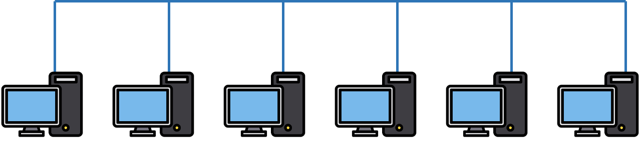

Two perspectives of addresses:
(1)Network-to-network & (2)machine-to-machine
Destination
Router
Source

Slide 21
application
transport
network
link
physical
Router
Source

Slide 22
network
link
physical
application
transport
network
link
physical
Router
Source

Slide 23
network
link
physical
Router
Hierarchical address for addressing networks
(IP address)

Slide 24
network
link
physical
application
transport
network
link
physical
Router
Source

Slide 25
Flat address for addressing machines at the link-layer
(MAC address)
network
link
physical
application
transport
network
link
physical
Router
Source

Slide 26
Address Resolution Protocol (ARP)

Slide 27
MAC addresses and ARP
32-bit IP address:
  network-layer address for interface
  used for layer 3 (network layer) forwarding
MAC (or LAN or physical or Ethernet) address:
  function: used “locally” to get frame from one interface to another physically-connected interface (same network, in IP-addressing sense)
  48 bit MAC address (for most LANs) burned in NIC ROM, also sometimes software settable
  e.g.: 1A-2F-BB-76-09-AD
hexadecimal (base 16) notation
(each “numeral” represents 4 bits)

Slide 28
MAC addresses and ARP
each adapter on LAN has unique LAN addr. or MAC addr.
1A-2F-BB-76-09-AD
LAN
(wired or
wireless)
adapter
71-65-F7-2B-08-53
58-23-D7-FA-20-B0
0C-C4-11-6F-E3-98

Slide 29
MAC addresses (more)
MAC address allocation administered by IEEE
manufacturer buys portion of MAC address space (to assure uniqueness)
analogy:
  MAC address: like Social Security Number
  IP address: like postal address
MAC flat address ➜ portability
  can move LAN card from one LAN to another
IP hierarchical address not portable
  address depends on IP subnet to which node is attached

Slide 30


ARP: address resolution protocol
Question: how to determine
interface’s MAC address, knowing its IP address?
ARP table: each IP node (host, router) on LAN has table
  IP/MAC address mappings for some LAN nodes:
< IP address; MAC address; TTL>
  TTL (Time To Live): time after which address mapping will be forgotten (typically 20 min)
137.196.7.78
1A-2F-BB-76-09-AD
137.196.7.23
137.196.7.14
LAN
71-65-F7-2B-08-53
58-23-D7-FA-20-B0
0C-C4-11-6F-E3-98
137.196.7.88

Slide 31
ARP protocol: same LAN
A wants to send datagram to B
  B’s MAC address not in A’s ARP table.
A broadcasts ARP query packet, containing B's IP address
  destination MAC address = FF-FF-FF-FF-FF-FF
  all nodes on LAN receive ARP query
B receives ARP packet, replies to A with its (B's) MAC address
  frame sent to A’s MAC address (unicast)
A caches (saves) IP-to-MAC address pair in its ARP table until information becomes old (times out)
  soft state: information that times out (goes away) unless refreshed
ARP is “plug-and-play”:
  nodes create their ARP tables without intervention from net administrator

Slide 32
Address Translation Protocol (ARP)
Map IP addresses into physical addresses
  destination host
  next hop router
Techniques
  encode physical address in host part of IP address
  table-based
ARP (Address Resolution Protocol)
  table of IP to physical address bindings
  broadcast request if IP address not in table
  target machine responds with its physical address
  table entries are discarded if not refreshed
  Query message include the physical address of the sending host. Why?

Slide 33
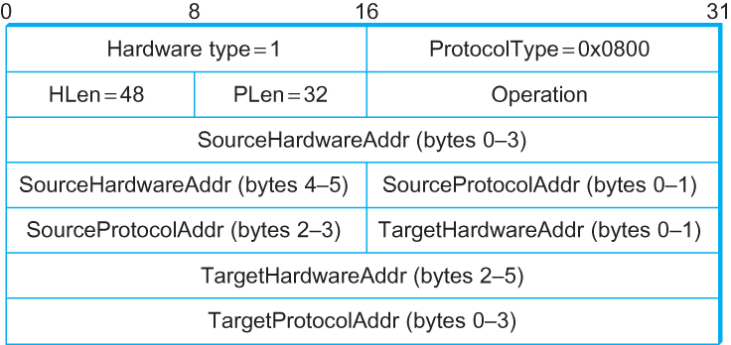
ARP Packet Format
  HardwareType: type of physical network (e.g., Ethernet)
  ProtocolType: type of higher layer protocol (e.g., IP)
  HLEN & PLEN: length of physical and protocol addresses
  Operation: request or response
  Source/Target Physical/Protocol addresses

Slide 34
Thank you!

Slide 37
Internet Control Message Protocol (ICMP)

Slide 38
Internet Control Message Protocol (ICMP)
Defines a collection of error messages that are sent back to the source host whenever a router or host is unable to process an IP datagram successfully
  Destination host unreachable due to link /node failure
  Reassembly process failed
  TTL had reached 0 (so datagrams don't cycle forever)
  IP header checksum failed
ICMP-Redirect
  From router to a source host
  With a better route information

Slide 39
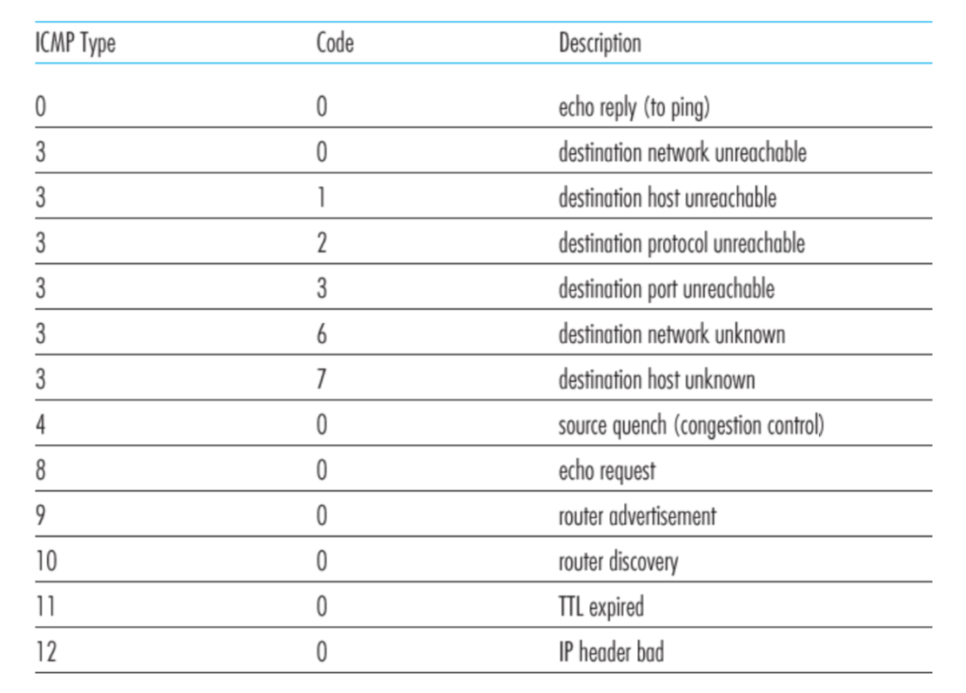
ICMP message types

Slide 40
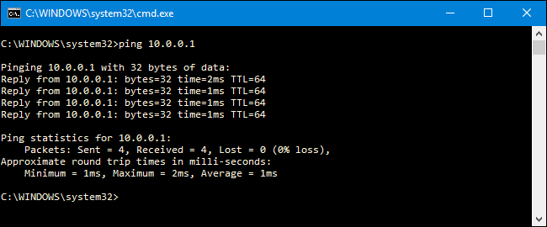
Ping example

Slide 41
Traceroute : An unintuitive application using ICMP

Slide 42
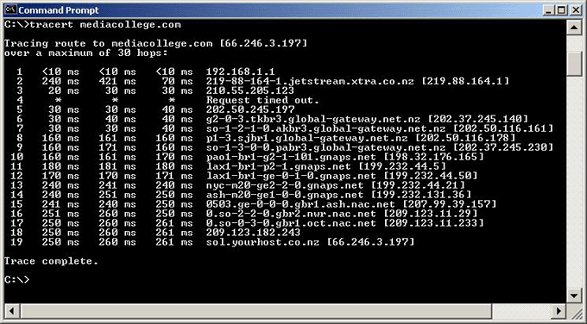
Traceroute example

Slide 43
Traceroute : An unintuitive application

Slide 44
Virtual Networks and Tunnels

Slide 45


Untrusted/Shared network
Gateway A
Gateway B
IP Header
Data
Trusted network (Site A)
Trusted network (Site B)

Slide 46
Untrusted/Shared network
Gateway A
Gateway B
Virtual Tunnel
IP Header
Data
Trusted network (Site A)
Trusted network (Site B)

Slide 47
New IP Header Source: Gateway-A Dest: Gateway-B
Encapsulation
IP Header
Data
Untrusted/Shared network
Gateway A
Gateway B
Virtual Tunnel
IP Header
Data
Trusted network (Site A)
Trusted network (Site B)

Slide 48
New IP Header Source: Gateway-A Dest: Gateway-B
Decapsulation
New IP Header Source: Gateway-A Dest: Gateway-B
IP Header
Data
IP Header
Data
Untrusted/Shared network
Gateway A
Gateway B
Virtual Tunnel
IP Header
Data
Trusted network (Site A)
Trusted network (Site B)

Slide 49
Untrusted/Shared network
Gateway A
Gateway B
Virtual Tunnel
IP Header
Data
IP Header
Data
Trusted network (Site A)
Trusted network (Site B)

Slide 50

New IP Header Source: Gateway-A Dest: Gateway-A
New IP Header Source: Gateway-A Dest: Gateway-A
Encryption/Decryption
IP Header
Data
IP Header
Data
Untrusted/Shared network
Gateway A
Gateway B
Virtual Tunnel
IP Header
Data
Trusted network (Site A)
Trusted network (Site B)

Slide 51
Untrusted/Shared network
Gateway A
Gateway B
Virtual Tunnel
Virtual Private Network
(VPN)
Trusted network (Site A)
Trusted network (Site B)

Slide 52
Why do we need virtual networks or tunnels?
1. Security
2. Special capabilities between routers (e.g., multicast)
3. Supporting heterogeneity

Slide 53
Why do we need virtual networks or tunnels?
1. Security
2. Special capabilities between routers (e.g., multicast)
3. Supporting heterogeneity
Disadvantages:
1. Increases packet length
a) Wastage of bandwidth
b) More processing
c) Fragmentation
2. Increases management cost

Slide 54
IPv6
1) Address and packet format
2) Unicast, Multicast, Anycast addressing
3) IPV4 and IPV6 coexistence

Slide 55
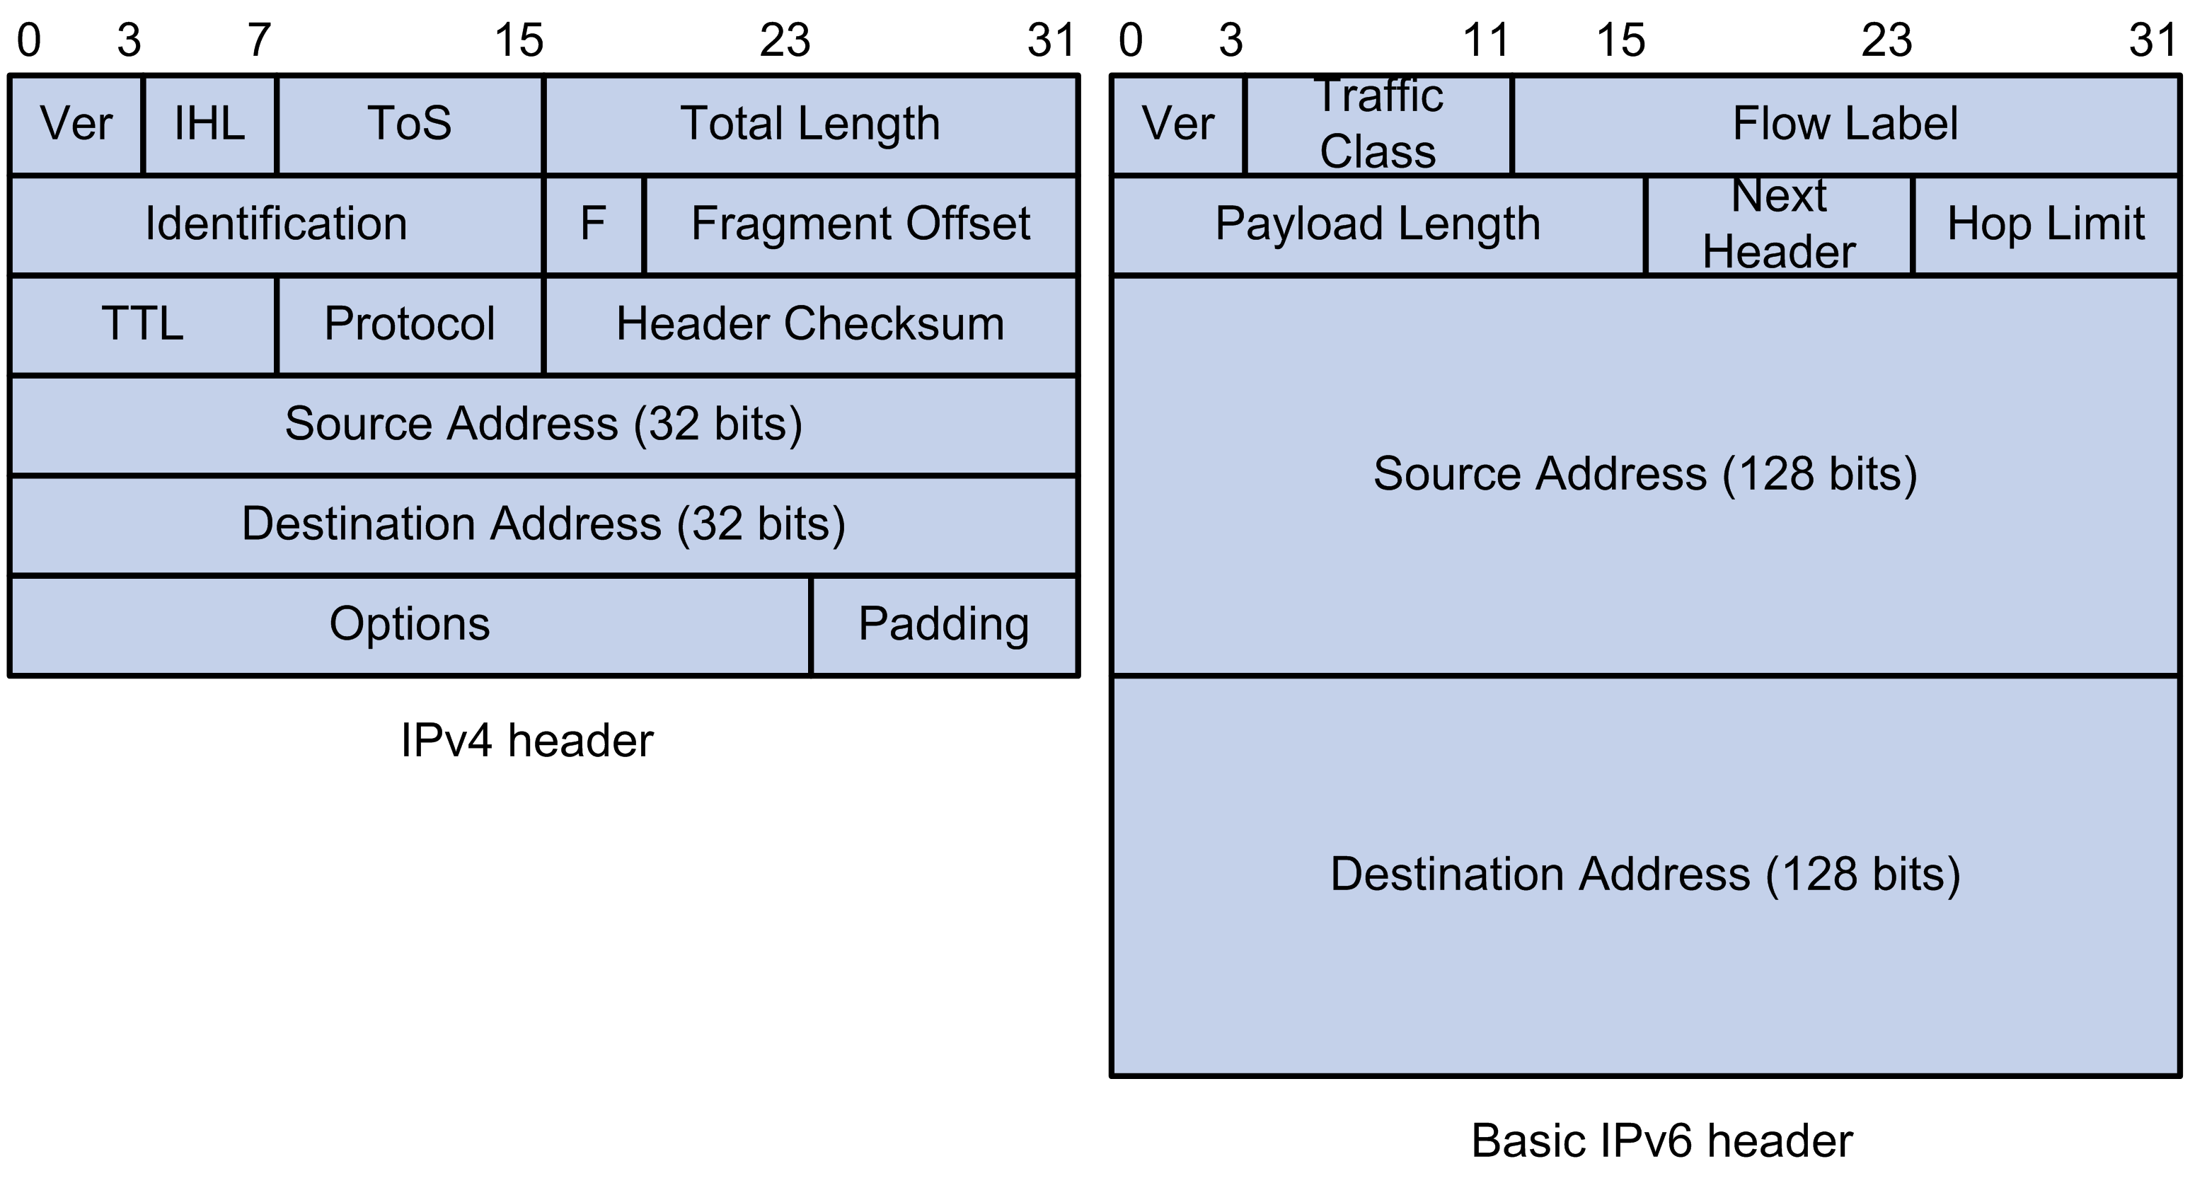
IPv6: Address and packet format
Pic courtesy: https://techhub.hpe.com

Slide 56
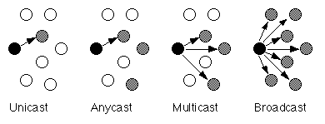
IPv6: Unicast, Multicast, Anycast addressing

Slide 57
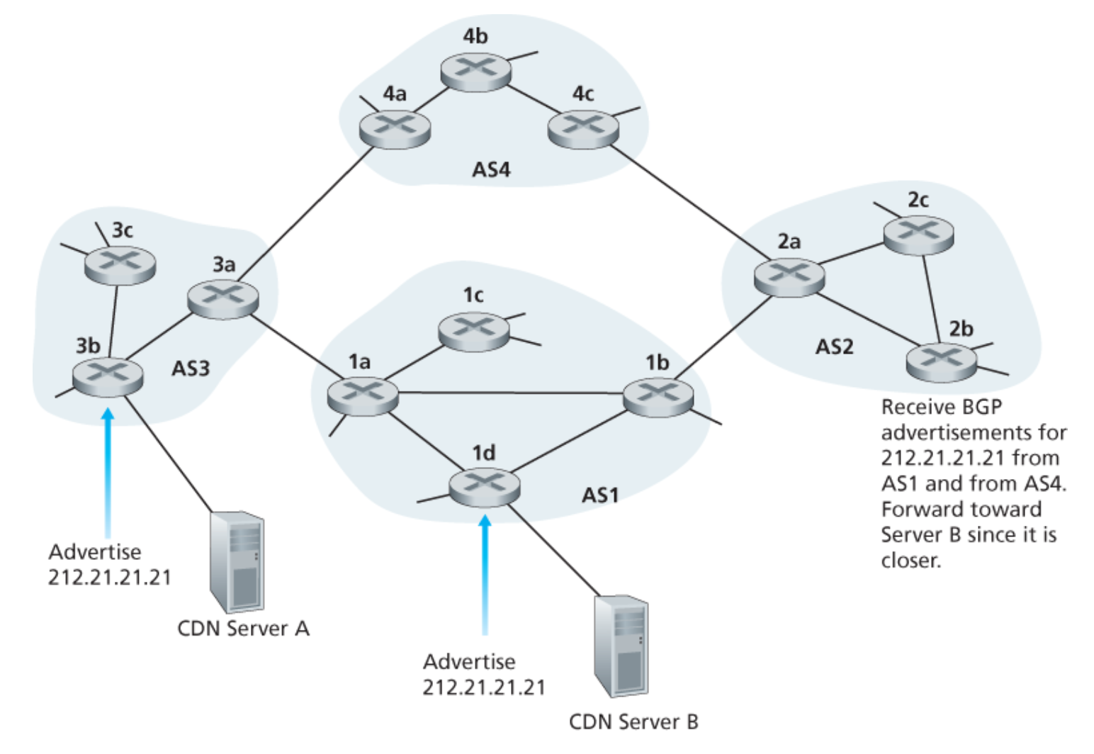
IPv6: Unicast, Multicast, Anycast addressing
IP: Anycast example

Slide 58
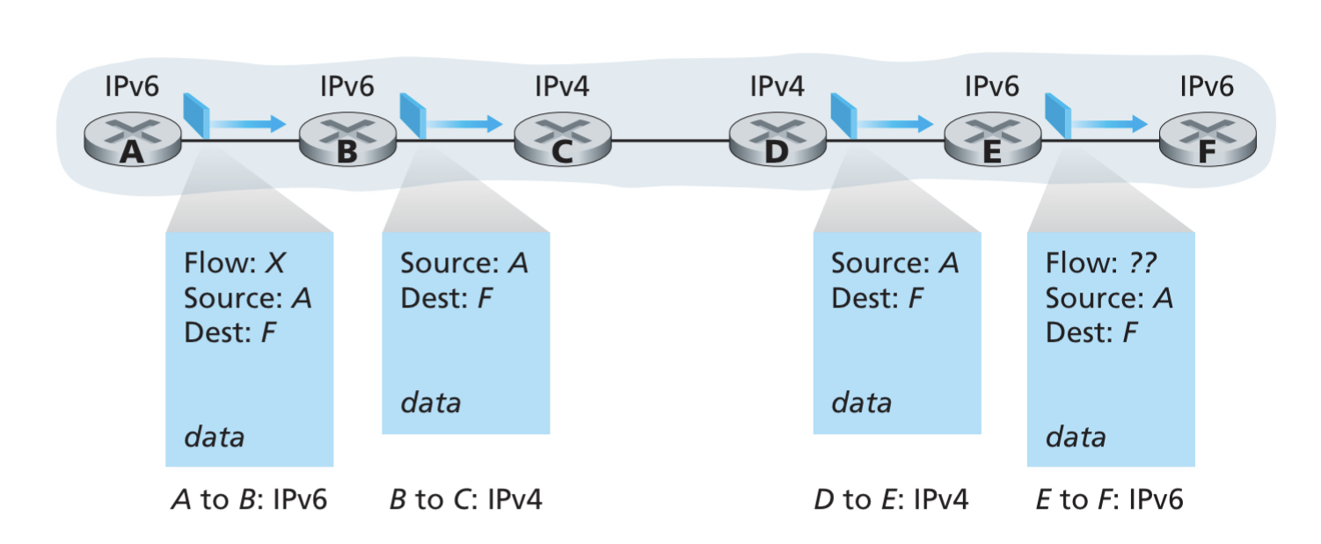
IPv4 and IPv6 Co-existence

Slide 59
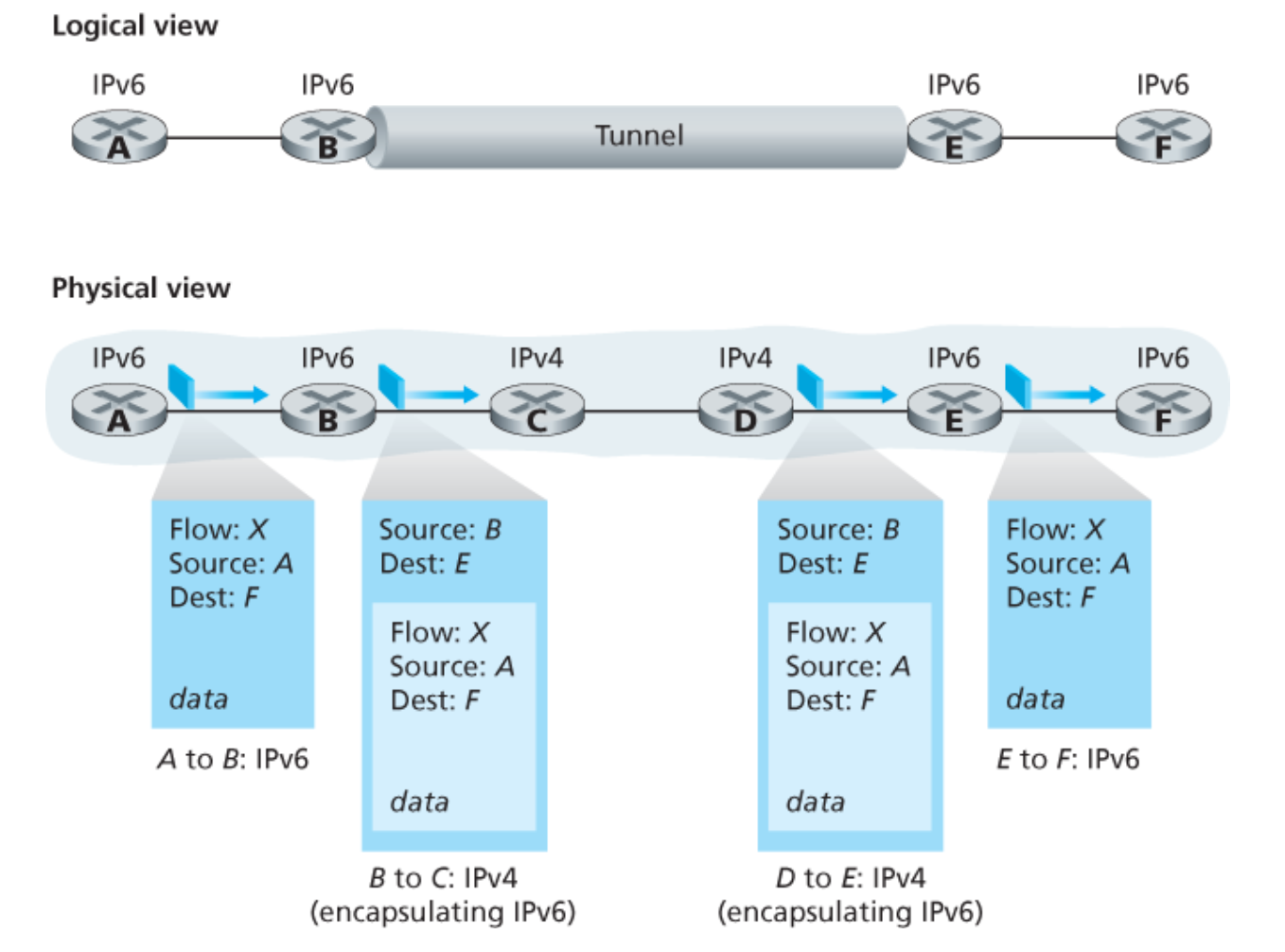
IPv4 and IPv6 Co-existence

Slide 60
Computer Networks
CMSC 417 : Spring 2023
Topic: Transport Layer Protocols (UDP, TCP)
(Textbook chapter 5)
Nirupam Roy
Tu-Th 2:00-3:15pm
CSI 2117

Slide 61
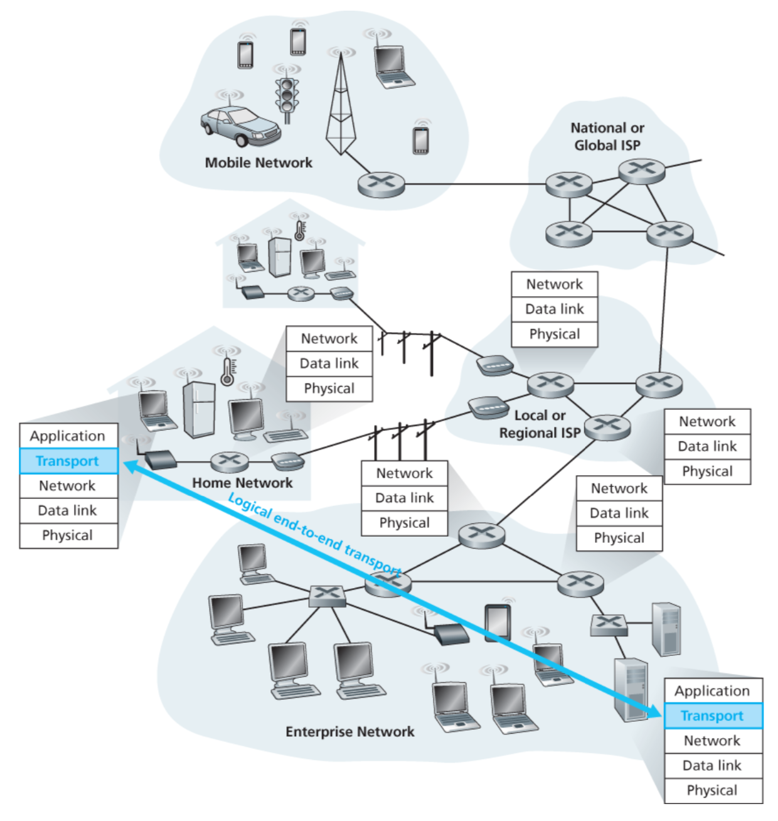

Slide 62
Transport layer: Two perspective
(1) Abstraction of clients. (machines/networks/processes)
(2) Abstraction of services.

