Slide 1

Computer Networks
CMSC 417 : Spring 2024
Topic: Link layer: WiFi, Mobility, BGP
(Textbook chapter 2, 4)
Nirupam Roy
Tu-Th 2:00-3:15pm
CSI 2117
April 25th, 2024

Slide 2
WiFi: IEEE 802.11 Wireless LANs
LAN Architecture
MAC protocol
Frame structure
Advanced features

Slide 3
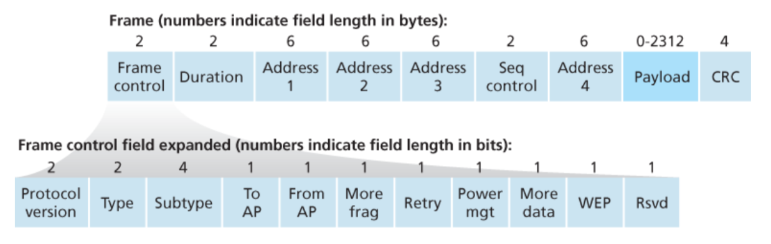
WiFi: IEEE 802.11 Frame
Notes:
Address 4 is used for Ad-hoc mode.

Slide 4
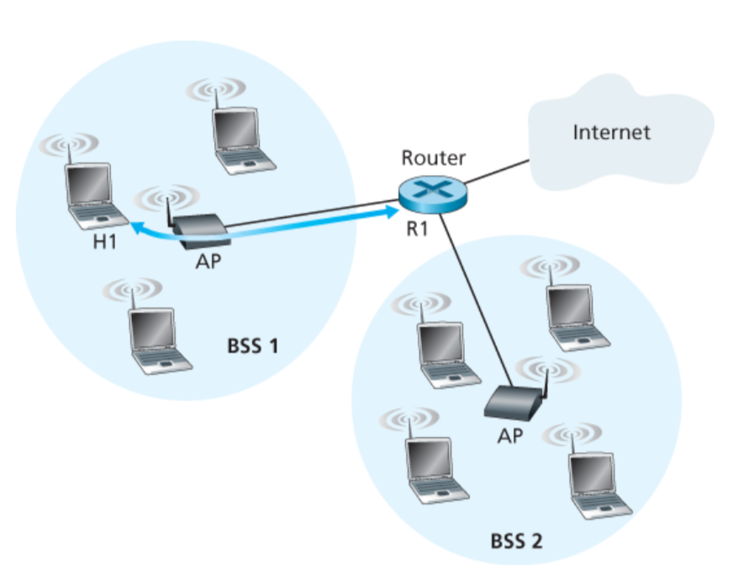
802.11 Frame: The secret of Address-3

Slide 5
802.11 Frame: The secret of Address-3

Slide 6
802.11 Frame: The secret of Address-3
Case 1: Router R1 send data to host H1

Slide 7
802.11 Frame: The secret of Address-3
Case 1: Router R1 send data to host H1
(1) R1 knows H1’s IP addr, runs ARP to get the MAC addr.

Slide 8
802.11 Frame: The secret of Address-3
(2) R1 encapsulates the data in Ethernet frame.
Source addr: R1’s MAC addr
Dest. addr: H1’s MAC addr
Case 1: Router R1 send data to host H1

Slide 9
802.11 Frame: The secret of Address-3
Case 1: Router R1 send data to host H1
(3) AP converts the Ethernet (802.3) frame to WiFi frame (802.11).
Addr 1: H1’s MAC addr
Addr 2: AP’s MAC addr
Addr 3: R1’s MAC addr

Slide 10
802.11 Frame: The secret of Address-3
Case 1: Router R1 send data to host H1
(4) H1 can determine that the frame has come from R1 by checking Addr-3 field.

Slide 11
802.11 Frame: The secret of Address-3
Case 2: Host H1 responds by sending packet to Router R1

Slide 12
802.11 Frame: The secret of Address-3
Case 2: Host H1 responds by sending packet to Router R1
H1 creates a WiFi frame.
Addr 1: AP’s MAC addr
Addr 2: H1’s MAC addr
Addr 3: R1’s MAC addr

Slide 13
802.11 Frame: The secret of Address-3
Case 2: Host H1 responds by sending packet to Router R1
(2) AP can determine that the frame should be forwarded to R1 by checking Addr-3 field.

Slide 14
802.11 Frame: The secret of Address-3
Case 2: Host H1 responds by sending packet to Router R1
(3) AP converts the WiFi (802.11) frame to Ethernet frame (802.3).
Source addr : H1’s MAC addr
Dest. addr : R1’s MAC addr

Slide 15
WiFi: IEEE 802.11 Wireless LANs
LAN Architecture
MAC protocol
Frame structure
Advanced features

Slide 16
WiFi: Advanced features
1) Rate adaptation
2) Power management

Slide 17




Award # 2125526

Slide 18
Notes:
Separate systems: donor’s system is not accessible by guest
Speed – donor’s speed should not be affected by the donation

Slide 19
Cellular Networks

Slide 20


Components of cellular network architecture
MSC
connects cells to wired tel. net.
manages call setup
handles mobility
cell
covers geographical region
base station (BS) analogous to 802.11 AP
mobile users attach to network through BS
air-interface: physical and link layer protocol between mobile and BS
Mobile
Switching
Center
Public telephone
network
Mobile
Switching
Center
wired network

Slide 21
Cellular networks: the first hop
Two techniques for sharing mobile-to-BS radio spectrum
combined FDMA/TDMA: divide spectrum in frequency channels, divide each channel into time slots
CDMA: code division multiple access
time slots
frequency
bands

Slide 22
Picture1: https://www.brandsynario.com/the-evolution-of-gs-generation-networks/
Notes:
Picture from: https://www.brandsynario.com/the-evolution-of-gs-generation-networks/

Slide 23
Picture1: https://www.brandsynario.com/the-evolution-of-gs-generation-networks/
Picture2: http://kaaale.blogspot.com/2019/02/the-evolution-of-cellular-mobile.html
Notes:
Picture from: https://www.brandsynario.com/the-evolution-of-gs-generation-networks/

Slide 24
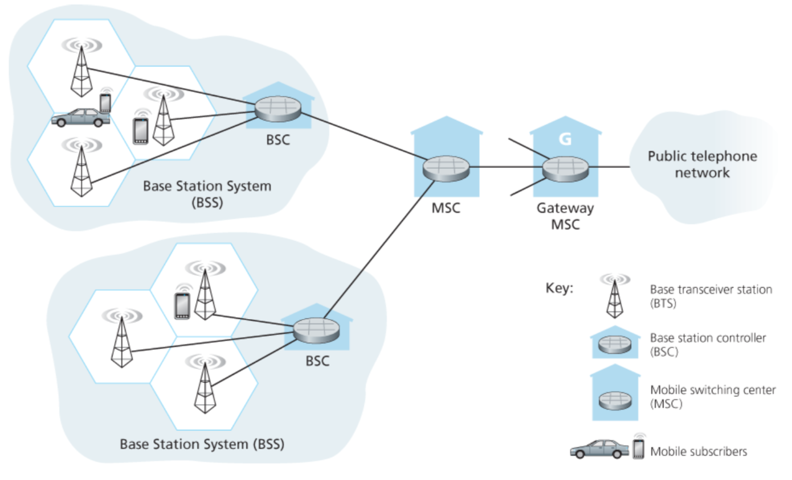
2G (voice) network architecture

Slide 25
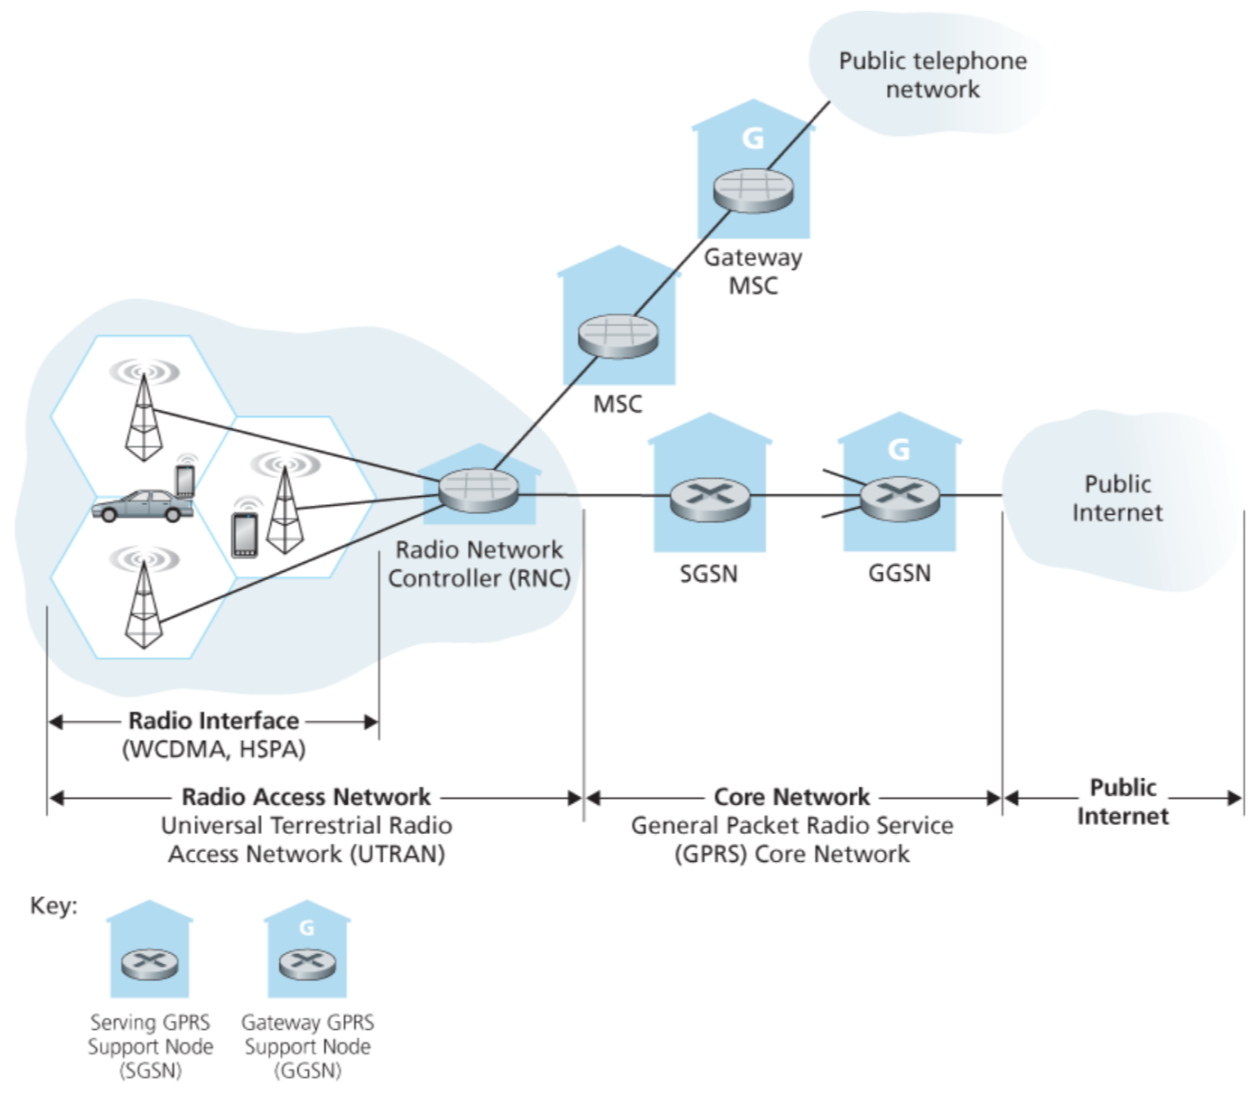
3G (voice+data) network architecture
Key insight: new cellular data
network operates in parallel
(except at edge) with existing
cellular voice network
voice network unchanged in core
data network operates in parallel

Slide 26
3G (voice+data) network architecture

Slide 27
3G versus 4G LTE network architecture
MSC
G
Public
telephone
network
3G
radio
network
controller
Gateway
MSC
G
Public
Internet
SGSN
GGSN
4G-LTE
HSS
MME
G
G
Public
Internet
S-GW
P-GW
radio access network
Universal Terrestrial Radio
Access Network (UTRAN)
Evolved Packet Core
(EPC)

Slide 28
4G: differences from 3G
all IP core: IP packets tunneled (through core IP network) from base station to gateway
no separation between voice and data – all traffic carried over IP core to gateway
Mobility
Management
Entity (MME)
Home Subscriber
Server(HSS)
(like HLR+VLR)
Serving
Gateway
(S-GW)
Packet data
network
Gateway
(P-GW)
UE
(user element)
eNodeB
(base station)
HSS
MME
control
G
G
Public
Internet
data
S-GW
P-GW
radio access network
Universal Terrestrial Radio
Access Network (UTRAN)
Evolved Packet Core
(EPC)

Slide 29
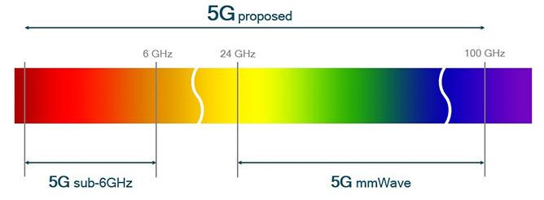
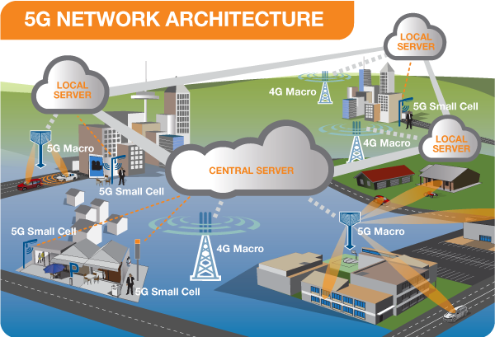
5G cellular networks

Slide 30
Mobility in Wireless Networks

Slide 31
What is mobility?
spectrum of mobility, from the network perspective:
no mobility
high mobility
mobile wireless user,
using same access
point
mobile user, connecting/ disconnecting from network using DHCP.
mobile user, passing through multiple access point while maintaining ongoing connections (like cell phone)

Slide 32
Mobility: approaches
let routing handle it: routers advertise permanent address of mobile-nodes-in-residence via usual routing table exchange.
  routing tables indicate where each mobile located
  no changes to end-systems
let end-systems handle it:
  indirect routing: communication from correspondent to mobile goes through home agent, then forwarded to remote
  direct routing: correspondent gets foreign address of mobile, sends directly to mobile

Slide 33




Mobility: vocabulary
home network: “home” of mobile
(e.g., 128.119.40/24)
home agent: entity that will perform mobility functions on behalf of mobile, when mobile is remote
wide area network
permanent address: address in home network, can always be used to reach mobile
e.g., 128.119.40.186

Slide 34
Mobility: more vocabulary
permanent address: remains constant (e.g., 128.119.40.186)
visited network: network in which mobile currently resides (e.g., 79.129.13/24)
care-of-address: address in visited network.
(e.g., 79,129.13.2)
wide area network
foreign agent: entity in visited network that performs mobility functions on behalf of mobile.
correspondent: wants to communicate with mobile

Slide 35
Mobility: approaches
let routing handle it: routers advertise permanent address of mobile-nodes-in-residence via usual routing table exchange.
  routing tables indicate where each mobile located
  no changes to end-systems
let end-systems handle it:
  indirect routing: communication from correspondent to mobile goes through home agent, then forwarded to remote
  direct routing: correspondent gets foreign address of mobile, sends directly to mobile
not
scalable
to millions of
mobiles

Slide 36
Mobility: registration
visited network
home network
1
2
wide area network
mobile contacts foreign agent on entering visited network
foreign agent contacts home agent home: “this mobile is resident in my network”
end result:
foreign agent knows about mobile
home agent knows location of mobile

Slide 37

Mobility via indirect routing
foreign agent receives packets, forwards to mobile
home agent intercepts packets, forwards to foreign agent
visited
network
home
network
3
wide area network
2
1
correspondent addresses packets using home address of mobile

Slide 38
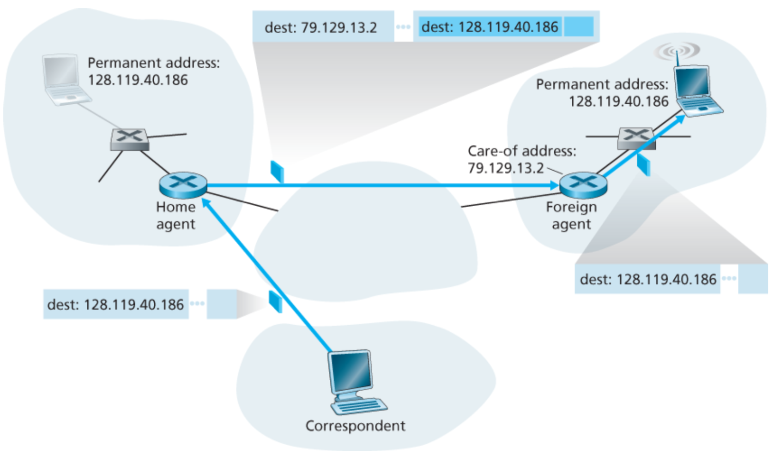
Packet encapsulation

Slide 39
Mobility via indirect routing
foreign agent receives packets, forwards to mobile
home agent intercepts packets, forwards to foreign agent
visited
network
home
network
3
wide area network
2
1
correspondent addresses packets using home address of mobile
4
mobile replies directly to correspondent

Slide 40



Indirect Routing: comments
mobile uses two addresses:
  permanent address: used by correspondent (hence mobile location is transparent to correspondent)
  care-of-address: used by home agent to forward datagrams to mobile
foreign agent functions may be done by mobile itself
triangle routing: correspondent-home-network-mobile
  inefficient when
  correspondent, mobile
  are in same network

Slide 41


Mobility via direct routing
foreign agent receives packets, forwards to mobile
correspondent forwards to foreign agent
visited
network
home
network
3
1
2
4
correspondent requests, receives foreign address of mobile
mobile replies directly to correspondent

Slide 42
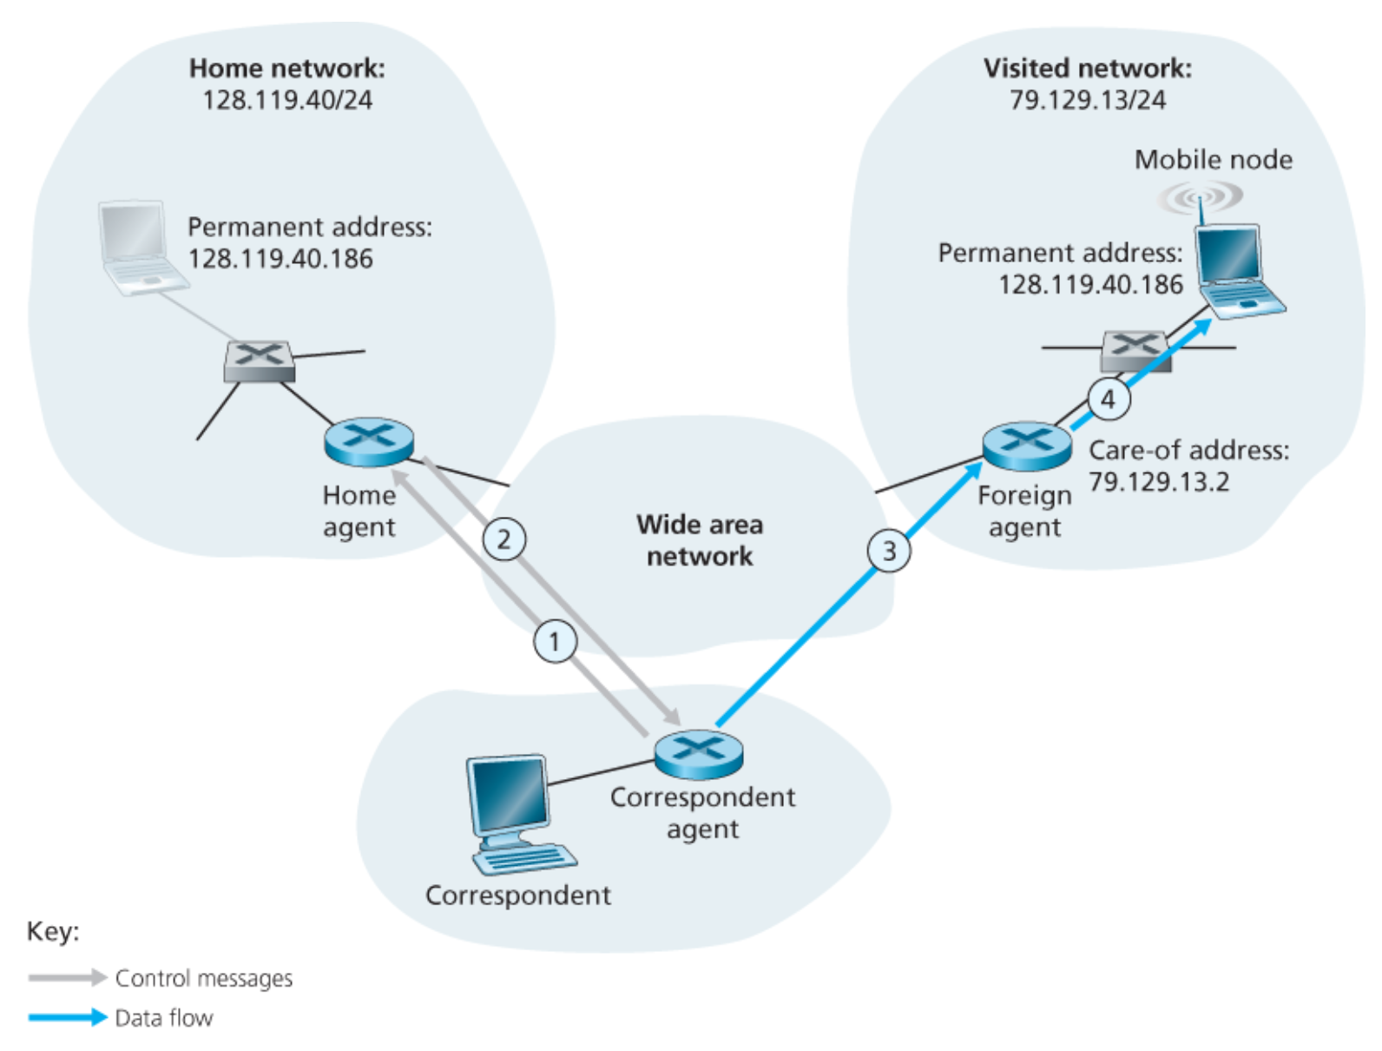
Mobility via direct routing

Slide 43
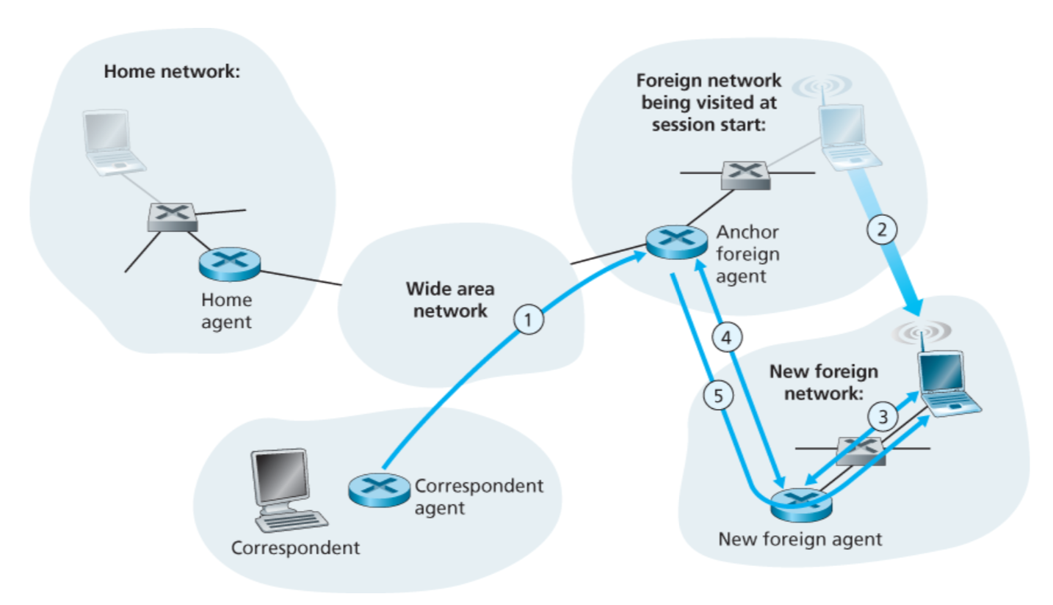
Mobility through multiple foreign networks

Slide 44
Inter-domain routing

Slide 45
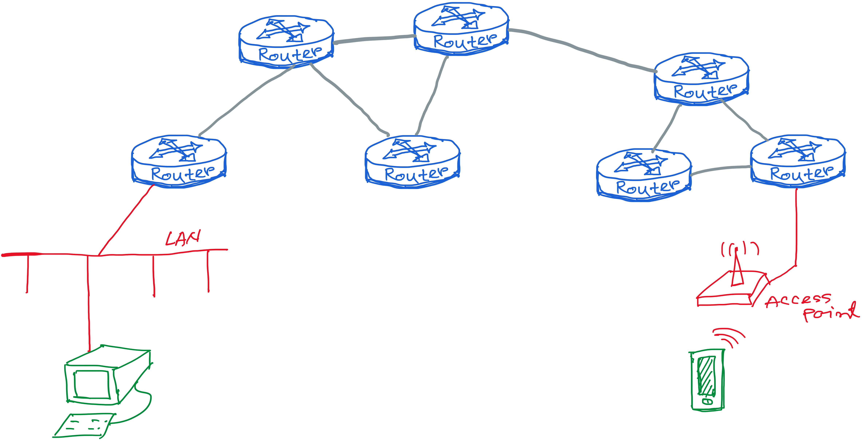
Our (improved) view of the Internet

Slide 46
Making routing scalable
our routing study thus far - idealized
all routers identical
network “flat”
… not true in practice
scale: with billions of destinations:
Can’t store all destinations in routing tables!
routing table exchange would swamp links!
administrative autonomy
internet = network of networks
each network admin may want to control routing in its own network

Slide 47
Autonomous Routing Domains
A collection of physical networks glued together
using IP, that have a unified administrative
routing policy.
Campus networks
Corporate networks
ISP Internal networks
…

Slide 48
Autonomous Systems (ASes)
An autonomous system is an autonomous routing domain
that has been assigned an Autonomous System Number (ASN).
… the administration of an AS appears to other ASes to
have a single coherent interior routing plan and presents a
consistent picture of what networks are reachable through it.
RFC 1930: Guidelines for creation, selection,
and registration of an Autonomous System

Slide 49
AS Numbers (ASNs)
ASNs are 16 and 32 bit values.
64512 through 65535 are “private”
Currently over 11,000 in use.
Genuity: 1
MIT: 3
Harvard: 11
UC San Diego: 7377
AT&T: 7018, 6341, 5074, …
UUNET: 701, 702, 284, 12199, …
Sprint: 1239, 1240, 6211, 6242, …
…
ASNs represent units of routing policy

Slide 50
Interdomain routing = routing between autonomous systems
UUNet
Sprint
134.244.0.0/16
AS 701
AS 1239
AT&T
Common Backbone
AS 7018
AT&T Research
Fidelity Investments
AS 6431
AS 11040
192.223.184.0/21
207.104.168.0/24

Slide 51
Internet approach to scalable routing
aggregate routers into regions known as “autonomous systems” (AS) (a.k.a. “domains”)
intra-AS routing
routing among hosts, routers in same AS (“network”)
all routers in AS must run same intra-domain protocol
routers in different AS can run different intra-domain routing protocol
gateway router: at “edge” of its own AS, has link(s) to router(s) in other AS’es
inter-AS routing
routing among AS’es
gateways perform inter-domain routing (as well as intra-domain routing)

Slide 52
Interconnected ASes
3c
3a
2c
3b
AS3
2a
1c
2b
AS2
1a
1b
1d
AS1
forwarding table configured by both intra- and inter-AS routing algorithm
  intra-AS routing determine entries for destinations within AS
  inter-AS & intra-AS determine entries for external destinations
Intra-AS
Routing
algorithm
Inter-AS
Routing
algorithm
Forwarding
table

Slide 53
Intra-AS Routing

Slide 54
Intra-AS Routing
also known as interior gateway protocols (IGP)
most common intra-AS routing protocols:
  RIP: Routing Information Protocol
  OSPF: Open Shortest Path First
  IGRP: Interior Gateway Routing Protocol (Cisco proprietary for decades, until 2016)

Slide 55
OSPF (Open Shortest Path First)
“open”: publicly available
uses link-state algorithm
  link state packet dissemination
  topology map at each node
  route computation using Dijkstra’s algorithm
router floods OSPF link-state advertisements to all other routers in entire AS
  carried in OSPF messages directly over IP (rather than TCP or UDP
  link state: for each attached link

Slide 56
OSPF “advanced” features
security: all OSPF messages authenticated (to prevent malicious intrusion)
multiple same-cost paths allowed (only one path in RIP)
for each link, multiple cost metrics for different ToS (e.g., satellite link cost set low for best effort ToS; high for real-time ToS)
integrated uni- and multi-cast support:
  Multicast OSPF (MOSPF) uses same topology data base as OSPF
hierarchical OSPF in large domains.

Slide 57
Hierarchical OSPF
boundary router
backbone router
backbone
area
border
routers
area 3
internal
routers
area 1
area 2

Slide 58
Hierarchical OSPF
two-level hierarchy: local area, backbone.
  link-state advertisements only in area
  each nodes has detailed area topology; only know direction (shortest path) to nets in other areas.
area border routers: “summarize” distances to nets in own area, advertise to other Area Border routers.
backbone routers: run OSPF routing limited to backbone.
boundary routers: connect to other AS’es.

Slide 59
Inter-AS tasks
suppose router in AS1 receives datagram destined outside of AS1:
  router should forward packet to gateway router, but which one?
AS1 must:
learn which dests are reachable through AS2, which through AS3
propagate this reachability info to all routers in AS1
job of inter-AS routing!
3c
3a
3b
AS3
2c
other
networks
1c
2a
other
networks
1a
2b
1b
AS2
AS1
1d

Slide 60
Inter-AS Routing

Slide 61
Internet inter-AS routing: BGP
BGP (Border Gateway Protocol): the de facto inter-domain routing protocol
  “glue that holds the Internet together”
BGP provides each AS a means to:
  eBGP: obtain subnet reachability information from neighboring ASes
  iBGP: propagate reachability information to all AS-internal routers.
  determine “good” routes to other networks based on reachability information and policy
allows subnet to advertise its existence to rest of Internet: “I am here”

Slide 62
eBGP, iBGP connections
2b
2a
2c
1b
3b
2d
1a
1c
3a
3c
AS 2
1d
3d
AS 1
eBGP connectivity
AS 3
iBGP connectivity
1c
gateway routers run both eBGP and iBGP protocols

Slide 63
BGP basics
BGP session: two BGP routers (“peers”) exchange BGP messages over semi-permanent TCP connection:
  advertising paths to different destination network prefixes (BGP is a “path vector” protocol)
when AS3 gateway router 3a advertises path AS3,X to AS2 gateway router 2c:
  AS3 promises to AS2 it will forward datagrams towards X
AS 3
3b
AS 1
1b
3a
3c
1a
1c
AS 2
2b
3d
X
1d
2a
2c
BGP advertisement:
AS3, X
2d

Slide 64
BGP basics
BGP session: two BGP routers (“peers”) exchange BGP messages over semi-permanent TCP connection:
  advertising paths to different destination network prefixes (BGP is a “path vector” protocol)
AS 3
3b
AS 1
1b
3a
3c
1a
1c
AS 2
2b
3d
1d
2a
2c
2d

Slide 65
BGP basics
BGP session: two BGP routers (“peers”) exchange BGP messages over semi-permanent TCP connection.
when AS3 gateway router 3a advertises path AS3,X to AS2 gateway router 2c:
  AS3 promises to AS2 it will forward datagrams towards X
AS 3
3b
AS 1
1b
3a
3c
1a
1c
AS 2
2b
3d
X
1d
2a
2c
BGP advertisement:
AS3, X
2d

Slide 66
Path attributes and BGP routes
advertised prefix includes BGP attributes
  prefix + attributes = “route”
two important attributes:
  AS-PATH: list of ASes through which prefix advertisement has passed
  NEXT-HOP: indicates specific internal-AS router to next-hop AS
Policy-based routing:
  gateway receiving route advertisement uses import policy to accept/decline path (e.g., never route through AS Y).
  AS policy also determines whether to advertise path to other other neighboring ASes

Slide 67
BGP path advertisement
AS3
3b
AS1
1b
3a
3c
1a
1c
AS2
2b
3d
X
1d
AS3,X
AS2,AS3,X
2a
2c
2d
AS2 router 2c receives path advertisement AS3,X (via eBGP) from AS3 router 3a
Based on AS2 policy, AS2 router 2c accepts path AS3,X, propagates (via iBGP) to all AS2 routers
Based on AS2 policy, AS2 router 2a advertises (via eBGP) path AS2, AS3, X to AS1 router 1c

Slide 68
BGP path advertisement
AS3
3b
AS1
1b
AS3,X
3a
3c
1a
1c
AS2
2b
3d
X
1d
AS3,X
AS2,AS3,X
2a
2c
2d
gateway router may learn about multiple paths to destination:
AS1 gateway router 1c learns path AS2,AS3,X from 2a
AS1 gateway router 1c learns path AS3,X from 3a
Based on policy, AS1 gateway router 1c chooses path AS3,X, and advertises path within AS1 via iBGP

Slide 69
BGP messages
BGP messages exchanged between peers over TCP connection
BGP messages:
  OPEN: opens TCP connection to remote BGP peer and authenticates sending BGP peer
  UPDATE: advertises new path (or withdraws old)
  KEEPALIVE: keeps connection alive in absence of UPDATES; also ACKs OPEN request
  NOTIFICATION: reports errors in previous msg; also used to close connection

Slide 70
BGP, OSPF, forwarding table entries
Q: how does router set forwarding table entry to distant prefix?
AS3
3b
AS1
1b
AS3,X
1
AS3,X
3a
3c
1a
2
1c
local link interfaces
at 1a, 1d
AS2
2b
3d
X
2
1d
1
AS3,X
AS2,AS3,X
2a
2c
physical link
2d
dest
interface
recall: 1a, 1b, 1d learn about dest X via iBGP from 1c: “path to X goes through 1c”
…
…
…
…
X
1
1d: OSPF intra-domain routing: to get to 1c, forward over outgoing local interface 1

Slide 71
BGP, OSPF, forwarding table entries
Q: how does router set forwarding table entry to distant prefix?
AS3
3b
AS1
1b
1
3a
3c
1a
2
1c
AS2
2b
3d
X
1d
2a
2c
2d
dest
interface
recall: 1a, 1b, 1d learn about dest X via iBGP from 1c: “path to X goes through 1c”
…
…
…
…
X
2
1d: OSPF intra-domain routing: to get to 1c, forward over outgoing local interface 1
1a: OSPF intra-domain routing: to get to 1c, forward over outgoing local interface 2

Slide 72
BGP route selection
router may learn about more than one route to destination AS, selects route based on:
  local preference value attribute: policy decision
  shortest AS-PATH
  closest NEXT-HOP router: hot potato routing
  additional criteria

Slide 73
Hot Potato Routing
AS3
3b
AS1
1b
3a
3c
1a
1c
AS2
2b
3d
X
1d
112
152
AS3,X
AS1,AS3,X
2a
263
2c
201
OSPF link weights
2d
2d learns (via iBGP) it can route to X via 2a or 2c
hot potato routing: choose local gateway that has least intra-domain cost (e.g., 2d chooses 2a, even though more AS hops to X): don’t worry about inter-domain cost!

Slide 74
A dive into the BGP policies

Slide 75
Nontransit vs. Transit ASes
Internet Service
providers (often)
have transit
networks
ISP 2
ISP 1
NET A
Nontransit AS
might be a corporate
or campus network.
Could be a “content
provider”
Traffic NEVER
flows from ISP 1
through NET A to ISP 2
(At least not intentionally!)
IP traffic

