Slide 1

Computer Networks
CMSC 417 : Spring 2024
Topic: BGP – Part2
(Textbook chapter 4)
Nirupam Roy
Tu-Th 2:00-3:15pm
CSI 2117
May 1st, 2024

Slide 2
BGP, OSPF, forwarding table entries
Q: how does router set forwarding table entry to distant prefix?
AS3
3b
AS1
1b
AS3,X
1
AS3,X
3a
3c
1a
2
1c
AS2
2b
3d
X
local link interfaces
at 1a, 1d
2
1d
1
AS3,X
AS2,AS3,X
2a
2c
physical link
2d
dest
interface
recall: 1a, 1b, 1d learn about dest X via iBGP from 1c: “path to X goes through 1c”
…
…
…
…
X
1
1d: OSPF intra-domain routing: to get to 1c, forward over outgoing local interface 1

Slide 3
BGP, OSPF, forwarding table entries
Q: how does router set forwarding table entry to distant prefix?
AS3
3b
AS1
1b
1
3a
3c
1a
2
1c
AS2
2b
3d
X
1d
2a
2c
2d
dest
interface
recall: 1a, 1b, 1d learn about dest X via iBGP from 1c: “path to X goes through 1c”
…
…
…
…
X
2
1d: OSPF intra-domain routing: to get to 1c, forward over outgoing local interface 1
1a: OSPF intra-domain routing: to get to 1c, forward over outgoing local interface 2

Slide 4
BGP route selection
router may learn about more than one route to destination AS, selects route based on:
  local preference value attribute: policy decision
  shortest AS-PATH
  closest NEXT-HOP router: hot potato routing
  additional criteria

Slide 5
A dive into the BGP policies

Slide 6
Nontransit vs. Transit ASes
Internet Service
providers (often)
have transit
networks
ISP 2
ISP 1
NET A
Nontransit AS
might be a corporate
or campus network.
Could be a “content
provider”
Traffic NEVER
flows from ISP 1
through NET A to ISP 2
(At least not intentionally!)
IP traffic

Slide 7
Selective Transit
NET B
NET C
NET A provides transit
between NET B and NET C
and between NET D
and NET C
NET A DOES NOT
provide transit
Between NET D
and NET B
NET A
NET D
IP traffic
Most transit networks transit in a selective manner…

Slide 8
Customers and Providers
provider
provider
customer
IP traffic
customer
Customer pays provider for access to the Internet

Slide 9
Customers Don’t Always Need BGP
provider
Nail up routes 192.0.2.0/24
pointing to customer
Nail up default routes 0.0.0.0/0
pointing to provider.
customer
192.0.2.0/24
Static routing is the most common way of connecting an
autonomous routing domain to the Internet.
This helps explain why BGP is a mystery to many …

Slide 10
Customer-Provider Hierarchy
provider
customer
IP traffic

Slide 11
The Peering Relationship
Peers provide transit between
their respective customers
Peers do not provide transit
between peers
Peers (often) do not exchange $$$
peer
peer
provider
customer
traffic
allowed
traffic NOT
allowed

Slide 12
Peering Provides Shortcuts
Peering also allows connectivity between
the customers of “Tier 1” providers.
peer
peer
provider
customer

Slide 13
BGP-4
BGP = Border Gateway Protocol
Is a Policy-Based routing protocol
Is the de facto EGP of today’s global Internet
Relatively simple protocol, but configuration is complex and the entire world can see, and be impacted by, your mistakes.
1989 : BGP-1 [RFC 1105]
  Replacement for EGP (1984, RFC 904)
1990 : BGP-2 [RFC 1163]
1991 : BGP-3 [RFC 1267]
1995 : BGP-4 [RFC 1771]
  Support for Classless Interdomain Routing (CIDR)

Slide 14
BGP Operations (Simplified)
Establish session on
TCP port 179
AS1
BGP session
Exchange all
active routes
AS2
While connection
is ALIVE exchange
route UPDATE messages
Exchange incremental
updates

Slide 15
Four Types of BGP Messages
Open : Establish a peering session.
Keep Alive : Handshake at regular intervals.
Notification : Shuts down a peering session.
Update : Announcing new routes or withdrawing previously announced routes.
announcement
=
prefix + attributes values

Slide 16
BGP Attributes
Value Code Reference
----- --------------------------------- ---------
1 ORIGIN [RFC1771]
2 AS_PATH [RFC1771]
3 NEXT_HOP [RFC1771]
4 MULTI_EXIT_DISC [RFC1771]
5 LOCAL_PREF [RFC1771]
6 ATOMIC_AGGREGATE [RFC1771]
7 AGGREGATOR [RFC1771]
8 COMMUNITY [RFC1997]
9 ORIGINATOR_ID [RFC2796]
10 CLUSTER_LIST [RFC2796]
11 DPA [Chen]
12 ADVERTISER [RFC1863]
13 RCID_PATH / CLUSTER_ID [RFC1863]
14 MP_REACH_NLRI [RFC2283]
15 MP_UNREACH_NLRI [RFC2283]
16 EXTENDED COMMUNITIES [Rosen]
...
255 reserved for development
Most important attributes
Not all attributes
need to be present in
every announcement
From IANA: http://www.iana.org/assignments/bgp-parameters

Slide 17
Attributes are Used to Select Best Routes
192.0.2.0/24
pick me!
192.0.2.0/24
pick me!
192.0.2.0/24
pick me!
Given multiple
routes to the same
prefix, a BGP speaker
must pick at most
one best route
(Note: it could reject
them all!)
192.0.2.0/24
pick me!

Slide 18
BGP Next Hop Attribute
12.125.133.90
12.127.0.121
AS 7018
AT&T
AS 6431
AS 12654
AT&T Research
RIPE NCC
RIS project
135.207.0.0/16
Next Hop = 12.125.133.90
135.207.0.0/16
Next Hop = 12.127.0.121
Every time a route announcement crosses an AS boundary, the Next Hop attribute is changed to the IP address of the border router that announced the route.

Slide 19
Join EGP with IGP For Connectivity
135.207.0.0/16
Next Hop = 192.0.2.1
135.207.0.0/16
10.10.10.10
AS 1
AS 2
192.0.2.1
192.0.2.0/30
Forwarding Table
destination
next hop
192.0.2.0/30
10.10.10.10
+
Forwarding Table
destination
next hop
EGP
135.207.0.0/16
10.10.10.10
destination
next hop
192.0.2.0/30
10.10.10.10
135.207.0.0/16
192.0.2.1

Slide 20
Implementing Customer/Provider and Peer/Peer relationships
Two parts:
Enforce transit relationships
  Outbound route filtering
Enforce order of route preference
  provider < peer < customer

Slide 21
Import Routes
provider route
peer route
customer route
ISP route
From
provider
From
provider
From
peer
From
peer
From
customer
From
customer

Slide 22
Export Routes
provider route
peer route
customer route
ISP route
To
provider
From
provider
To
peer
To
peer
To
customer
To
customer
filters
block

Slide 23
How Can Routes be Colored?
BGP Communities!
A community value is 32 bits
Used for signalling
within and between
ASes
By convention,
first 16 bits is
ASN indicating
who is giving it
an interpretation
community
number
Very powerful
BECAUSE it
has no (predefined) meaning
Community Attribute = a list of community values.
(So one route can belong to multiple communities)
Two reserved communities
  no_export = 0xFFFFFF01: don’t export out of AS
RFC 1997 (August 1996)
no_advertise 0xFFFFFF02: don’t pass to BGP neighbors

Slide 24
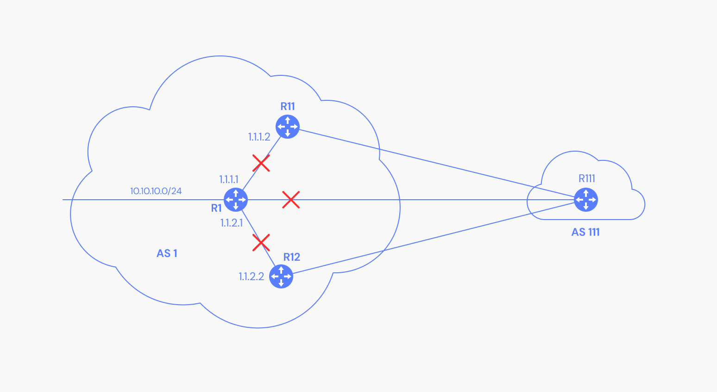
Community attribute: No_Advertise
Pic: https://www.catchpoint.com/bgp-monitoring/bgp-communities

Slide 25
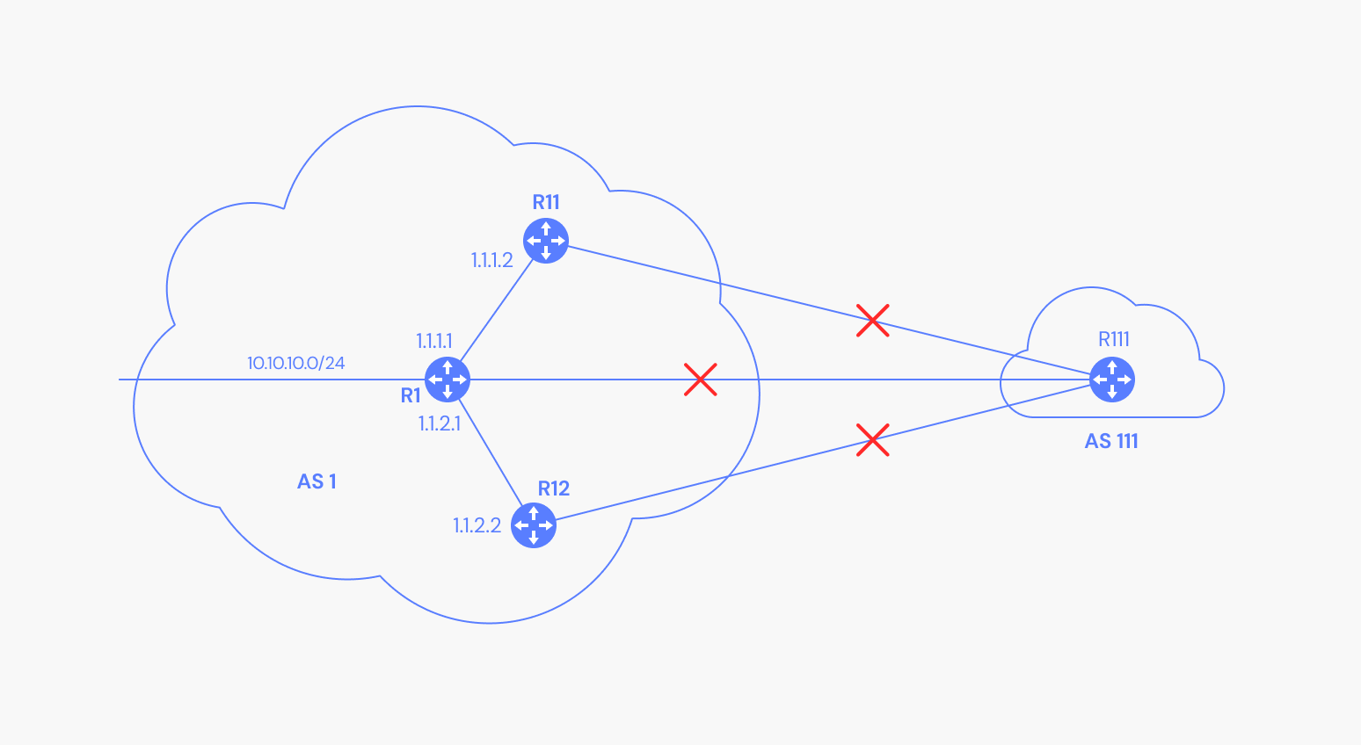
Community attribute: No_Export
Pic: https://www.catchpoint.com/bgp-monitoring/bgp-communities

Slide 26
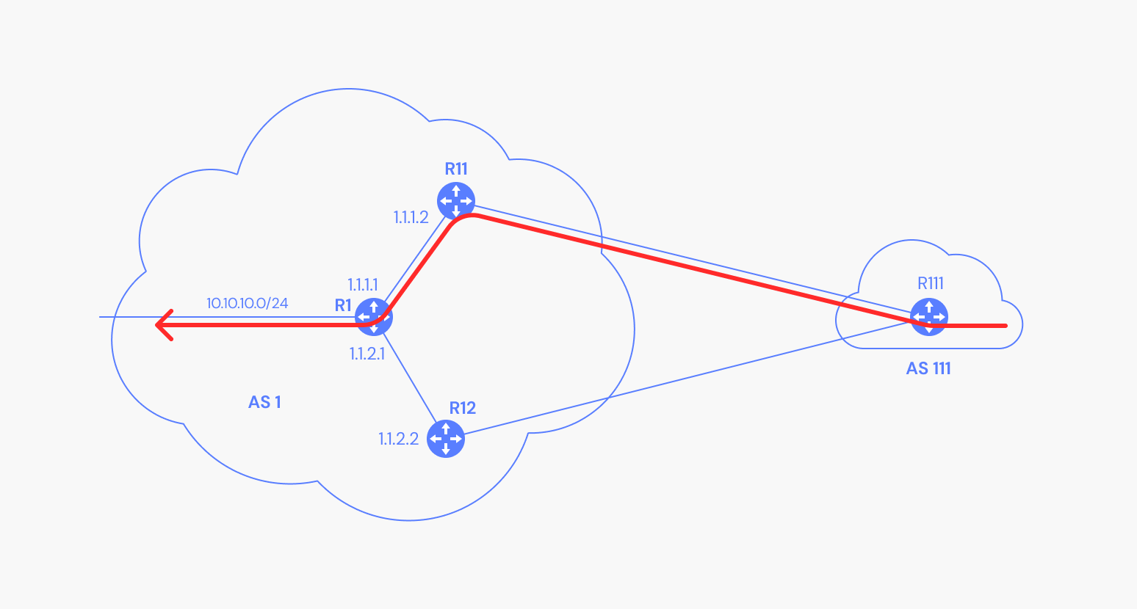
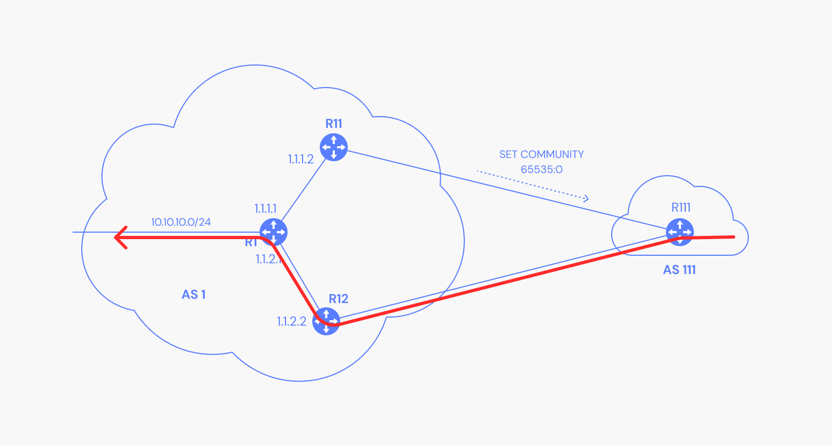
BGP Community attribute: Example
Pic: https://www.catchpoint.com/bgp-monitoring/bgp-communities

Slide 27
Tweak Tweak Tweak
For inbound traffic
  Filter outbound routes
  Tweak attributes on outbound routes in the hope of influencing your neighbor’s best route selection
For outbound traffic
  Filter inbound routes
  Tweak attributes on inbound routes to influence best route selection
outbound
routes
inbound
traffic
outbound
traffic
inbound
routes
In general, an AS has more
control over outbound traffic

Slide 28
Route Selection Summary
Highest Local Preference
Enforce relationships
Shortest ASPATH
Lowest MED
i-BGP < e-BGP
traffic engineering
Lowest IGP cost
to BGP egress
Lowest router ID
Throw up hands and
break ties

Slide 29
Local Preference Attribute
peer
peer
Local preference only used in iBGP
provider
customer
AS 4
local pref = 80
AS 3
local pref = 90
local pref = 100
AS 2
AS 1
Higher Local
preference values
are more preferred
13.13.0.0/16

Slide 30
Implementing Backup Links with Local Preference (Outbound Traffic)
AS 1
primary link
backup link
Set Local Pref = 100
for all routes from AS 1
Set Local Pref = 50
for all routes from AS 1
AS 65000
Forces outbound traffic to take primary link, unless link is down.

Slide 31
Multihomed Backups
(Outbound Traffic)
AS 1
AS 3
provider
provider
primary link
backup link
Set Local Pref = 100
for all routes from AS 1
Set Local Pref = 50
for all routes from AS 3
AS 2
Forces outbound traffic to take primary link, unless link is down.

Slide 32
ASPATH Attribute
AS 1129
135.207.0.0/16
AS Path = 1755 1239 7018 6341
Global Access
AS 1755
135.207.0.0/16
AS Path = 1239 7018 6341
135.207.0.0/16
AS Path = 1129 1755 1239 7018 6341
Ebone
AS 12654
AS 1239
135.207.0.0/16
AS Path = 7018 6341
RIPE NCC
RIS project
Sprint
AS7018
135.207.0.0/16
AS Path = 3549 7018 6341
135.207.0.0/16
AS Path = 6341
AT&T
AS 6341
AS 3549
135.207.0.0/16
AS Path = 7018 6341
AT&T Research
Global Crossing
135.207.0.0/16
Prefix Originated

Slide 33
Interdomain Loop Prevention
AS 7018
BGP at AS YYY will never accept a route with ASPATH containing YYY.
Don’t Accept!
12.22.0.0/16
ASPATH = 1 333 7018 877
AS 1

Slide 34
Traffic Often Follows ASPATH
135.207.0.0/16
ASPATH = 3 2 1
AS 1
AS 2
AS 3
AS 4
135.207.0.0/16
IP Packet
Dest =
135.207.44.66

Slide 35
… But It Might Not
AS 2 filters all
subnets with masks
longer than /24
135.207.0.0/16
ASPATH = 1
135.207.0.0/16
ASPATH = 3 2 1
135.207.44.0/25
ASPATH = 5
AS 1
AS 2
AS 3
AS 4
135.207.0.0/16
IP Packet
Dest =
135.207.44.66
From AS 4, it
may look like this
packet will take
path 3 2 1, but it
actually takes
path 3 2 5
AS 5
135.207.44.0/25

Slide 36
Shorter Doesn’t Always Mean Shorter
BGP says that
path 4 1 is better
than path 3 2 1
In fairness:
could you do
this “right” and
still scale?
Exporting internal
state would
dramatically
increase global
instability and
amount of routing
state
Duh!
AS 4
AS 3
AS 2
AS 1

Slide 37
Shedding Inbound Traffic with ASPATH Padding Hack
AS 1
provider
192.0.2.0/24
ASPATH = 2
192.0.2.0/24
ASPATH = 2 2 2
primary
backup
Padding will (usually)
force inbound
traffic from AS 1
to take primary link
customer
192.0.2.0/24
AS 2

Slide 38
Padding May Not Shut Off All Traffic
AS 1
AS 3
provider
provider
192.0.2.0/24
ASPATH = 2
192.0.2.0/24
ASPATH = 2 2 2 2 2 2 2 2 2 2 2 2 2 2
primary
backup
AS 3 will send
traffic on “backup”
link because it prefers
customer routes and local
preference is considered
before ASPATH length!
Padding in this way is often
used as a form of load
balancing
customer
192.0.2.0/24
AS 2

Slide 39
COMMUNITY Attribute to the Rescue!
AS 3: normal
customer local
pref is 100,
peer local pref is 90
AS 1
AS 3
provider
provider
192.0.2.0/24
ASPATH = 2
192.0.2.0/24
ASPATH = 2
COMMUNITY = 3:70
primary
backup
Customer import policy at AS 3:
If 3:90 in COMMUNITY then
set local preference to 90
If 3:80 in COMMUNITY then
set local preference to 80
If 3:70 in COMMUNITY then
set local preference to 70
customer
192.0.2.0/24
AS 2

Slide 40
Hot Potato Routing: Go for the Closest Egress Point
192.44.78.0/24
egress 1
egress 2
IGP distances
56
15
This Router has two BGP routes to 192.44.78.0/24.
Hot potato: get traffic off of your network as
Soon as possible. Go for egress 1!

Slide 41
Hot Potato Routing
AS3
3b
AS1
1b
3a
3c
1a
1c
AS2
2b
3d
X
1d
112
152
AS3,X
AS1,AS3,X
2a
263
2c
201
OSPF link weights
2d
2d learns (via iBGP) it can route to X via 2a or 2c
hot potato routing: choose local gateway that has least intra-domain cost (e.g., 2d chooses 2a, even though more AS hops to X): don’t worry about inter-domain cost!

Slide 42
Getting Burned by the Hot Potato
2865
Heavy
Content
Web Farm
High bandwidth
Provider backbone
17
SFO
NYC
Low bandwidth
customer backbone
56
15
San Diego
Many customers want
their provider to
carry the bits!
tiny http request
huge http reply

Slide 43
Cold Potato Routing with MEDs
(Multi-Exit Discriminator Attribute)
Prefer lower
MED values
2865
Heavy
Content
Web Farm
17
192.44.78.0/24
MED = 15
192.44.78.0/24
MED = 56
56
15
192.44.78.0/24
This means that MEDs must be considered BEFORE
IGP distance!
Note1 : some providers will not listen to MEDs
Note2 : MEDs need not be tied to IGP distance

Slide 44
Route Selection Summary
Highest Local Preference
Enforce relationships
Shortest ASPATH
Lowest MED
i-BGP < e-BGP
traffic engineering
Lowest IGP cost
to BGP egress
Lowest router ID
Throw up hands and
break ties

Slide 45
BGP Attacks/Misconfiguration

Slide 46

Prefix Hijacking
Originating someone else’s prefix
  What fraction of the Internet believes it?
4
3
5
2
7
6
1
12.34.0.0/16
12.34.0.0/16

Slide 47
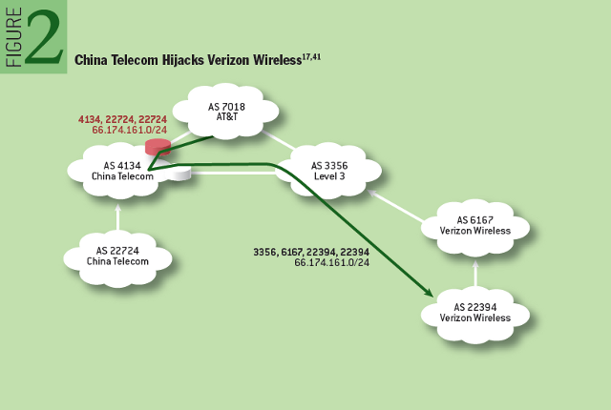
Prefix highjack
Prefix misconfiguration incident with Verizon Wireless
http://queue.acm.org/detail.cfm?id=2668966
Notes:
For 18 minutes on April 8, 2010, China Telecom launched prefix hijacks for 15 percent of the Internet’s prefixes.
While there is no evidence that this incident resulted from anything other than a misconfiguration, it provides an instructive example of a “classic” prefix hijack.

Slide 48
Sub-Prefix Hijacking
4
3
5
2
7
6
1
12.34.0.0/16
12.34.158.0/24
Originating a more-specific prefix
  Every AS picks the bogus route for that prefix
  Traffic follows the longest matching prefix

Slide 49
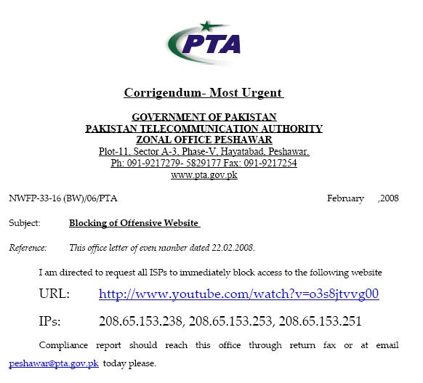
Sub-prefix hijack
  February 2008 : YouTube traffic was highjacked for a couple of hours
“The Internet”
Pakistan
Telecom
YouTube
I’m YouTube:
IP 208.65.153.0 / 22
Multinet
Pakistan
Telnor
Pakistan
Aga Khan
University
Notes:
-level of autonomous systems
-e.g., YouTube, AT&T, pakistan telecom
-routing is done on IP addresses, so when someone wants to go to YouTube they get YouTube’s IP address and YouTube announces to the world that they have the ip address and traffic is forwarded towards them. So here multinet would route to it’s provider pakistan telecom that then forwards the traffic on to youtube.
-these networks chosen for a specific reason which is that there was an incident in february 2008 pakistan telecom actually high jacked traffic going to youtube (misconfiguration).
-they announced to the world that they’re youtube and traffic destined to youtube was routed to them
-youtube was unavailable for a couple of hours as operators phone each other to figure out what was going on.

Slide 50
Pakistan Telecom: Sub-prefix hijack
  Here’s what should have happened….
“The Internet”
Collect + drop packets going to YouTube
X
Pakistan
Telecom
YouTube
I’m YouTube:
IP 208.65.152.0 / 22
Multinet
Pakistan
Telnor
Pakistan
Aga Khan
University
  Block your own customers.
Target IPs:[208.65.153.238, 208.65.153.253, 208.65.153.251]

Slide 51
Pakistan Telecom: Sub-prefix hijack
  But here’s what Pakistan ended up doing…
“The Internet”
No, I’m YouTube!
IP 208.65.153.0 / 24
Pakistan
Telecom
YouTube
I’m YouTube:
IP 208.65.152.0 / 22
Multinet
Pakistan
Telnor
Pakistan
Aga Khan
University
Notes:
Our works focuses on attacks of this flavor..

Slide 52
Pakistan Telecom: Sub-prefix hijack
  But here’s what Pakistan ended up doing…
“The Internet”
2
No, I’m YouTube!
IP 208.65.153.0 / 24
Pakistan
Telecom
1
YouTube
I’m YouTube:
IP 208.65.152.0 / 22
Multinet
Pakistan
3
Telnor
Pakistan
I’m YouTube:
IP 208.65.153.0 / 24
5
Prepended AS-Path
with its own ASN (17557) to help.
(How does it help?)
Aga Khan
University
4
I’m YouTube: IPs 208.65.153.128/25
208.65.153.0/25
Notes:
[Ref] https://www.ripe.net/publications/news/youtube-hijacking-a-ripe-ncc-ris-case-study/#:~:text=On%20Sunday%2C%2024%20February%202008,traffic%20on%20a%20global%20scale.

Slide 53
Bogus AS Paths to Hide Hijacking
Adds AS hop(s) at the end of the path
  E.g., turns “701 88” into “701 88 3”
Motivations
  Evade detection for a bogus route
  E.g., by adding the legitimate AS to the end
Hard to tell that the AS path is bogus…
  Even if other ASes filter based on prefix ownership
701
3
18.0.0.0/8
88
18.0.0.0/8

Slide 54
Path-Shortening Attacks
Remove ASes from the AS path
  E.g., turn “701 3715 88” into “701 88”
Motivations
  Make the AS path look shorter than it is
  Attract sources that normally try to avoid AS 3715
  Help AS 88 look like it is closer to the Internet’s core
Who can tell that this AS path is a lie?
  Maybe AS 88 *does* connect to AS 701 directly
701
3715
88
?

Slide 55
Attacks that Add a Bogus AS Hop
701
Add ASes to the path
  E.g., turn “701 88” into “701 3715 88”
Motivations
  Trigger loop detection in AS 3715
    Denial-of-service attack on AS 3715
    Or, blocking unwanted traffic coming from AS 3715!
  Make your AS look like is has richer connectivity
Who can tell the AS path is a lie?
  AS 3715 could, if it could see the route
  AS 88 could, but would it really care as long as it received data traffic meant for it?
88

Slide 56
Violating “Consistent Export” to Peers
Peers require consistent export
  Prefix advertised at all peering points
  Prefix advertised with same AS path length
Reasons for violating the policy
  Trick neighbor into “cold potato”
  Configuration mistake
Main defense
  Analyzing BGP updates
  … or data traffic
  … for signs of inconsistency
dest
Bad AS
BGP
data
src

Slide 57
Other Attacks
Attacks on BGP sessions
  Confidentiality of BGP messages
  Denial-of-service on BGP session
  Inserting, deleting, modifying, or replaying messages
Resource exhaustion attacks
  Too many IP prefixes (e.g., BGP “512K Day”)
  Too many BGP update messages
Data-plane attacks
  Announce one BGP routes, but use another
Notes:
512k Day: The August 2014 event, also known as the 512k Day, was caused when prominent internet service provider (ISP) Verizon dumped roughly 15,000 new routes on a 'master' table. Gigantic routers house tables, which in turn contain routes packets of data need to follow to retrieve search results and display them to users.
Roughly 512,000 routes were the norm in terms of BGP capacity during the pre-512K Day period.
[Ref] https://prefixx.net/news/512k-day#:~:text=The%20August%202014%20event%2C%20also,and%20display%20them%20to%20users.

Slide 58
Solution Techniques
Protective filtering
  Know your neighbors
Anomaly detection
  Suspect the unexpected
Checking against registries
  Establish ground truth for prefix origination
Signing and verifying
  Prevent bogus AS PATHs
Data-plane verification
  Ensure the path is actually followed

