Slide 1

CMSC 417: Computer Networks
Spring 2024
Topic: Overview of networks (cont…)
(Textbook chapter 1)
& Internetworking
(Textbook chapter 3)
Nirupam Roy
Tu-Th 2:00-3:15pm
CSI 2117
Feb 1st, 2024

Slide 2
Chapter 1: Roadmap
  What is the Internet?
  Network edge
  Network core
  Delay, Loss, Throughput in networks
  Protocol layers, service models
  History

Slide 3

How do loss and delay occur?
packets queue in router buffers
packet arrival rate to link (temporarily) exceeds output link capacity
packets queue, wait for turn
packet being transmitted (delay)
A
B
packets queueing (delay)
free (available) buffers: arriving packets
dropped (loss) if no free buffers

Slide 4
Four sources of packet delay
transmission
A
propagation
B
nodal
processing
queueing
d_{total} = d_{proc} + d_{queue} + d_{trans} + d_{prop}
d_{proc}: nodal processing
check bit errors
determine output link
typically < msec
d_{queue}: queueing delay
time waiting at output link for transmission
depends on congestion level of router

Slide 5
Four sources of packet delay
transmission
A
propagation
B
nodal
processing
queueing
d_{total} = d_{proc} + d_{queue} + d_{trans} + d_{prop}
d_{trans}: transmission delay:
L: packet length (bits)
R: link bandwidth (bps)
d_{trans} = L/R
d_{prop}: propagation delay:
d: length of physical link
v: propagation speed
d_{prop} = d/v
d_{trans} and d_{prop}
very different
Notes:
5

Slide 6
Packet Loss
queue (aka buffer) preceding link in buffer has finite capacity
packet arriving to full queue dropped (aka lost)
lost packet may be retransmitted by previous node, by source end system, or not at all
buffer
(waiting area)
A
packet being transmitted
B
packet arriving to
full buffer is lost

Slide 7
Throughput
throughput: rate (bits/time unit) at which bits transferred between sender/receiver
  instantaneous: rate at given point in time
  average: rate over longer period of time
server, with
file of F bits
to send to client
link capacity
R_{s} bits/sec
link capacity
R_{c} bits/sec
server sends bits
(fluid) into pipe
pipe that can carry
fluid at rate
R_{s} bits/sec)
pipe that can carry
fluid at rate
R_{c} bits/sec)

Slide 8
Throughput
R_{s} < R_{c} What is average end-end throughput?
R_{s} bits/sec
R_{c} bits/sec
R_{s} > R_{c} What is average end-end throughput?
R_{s} bits/sec
R_{c} bits/sec
bottleneck link
link on end-end path that constrains end-end throughput

Slide 9
Throughput: Internet scenario
per-connection end-end throughput: min(R_{c},R_{s},R/10)
in practice: R_{c} or R_{s} is often bottleneck
R_{s}
R_{s}
R_{s}
R
R_{c}
R_{c}
R_{c}
10 connections (fairly) share backbone bottleneck link R bits/sec

Slide 10
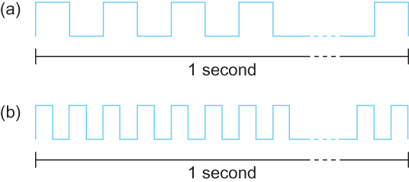
Bandwidth
Bits transmitted at a particular bandwidth can be regarded as having some width:
(a) bits transmitted at 1Mbps (each bit 1 μs wide);
(b) bits transmitted at 2Mbps (each bit 0.5 μs wide).

Slide 11
Chapter 1: Roadmap (cont…)
  What is the Internet?
  Network edge
  Network core
  Delay, Loss, Throughput in networks
  Protocol layers, service models

Slide 12
Protocol “Layers”
Networks are complex,
with many “pieces”:
  hosts
  routers
  links of various media
  applications
  protocols
  hardware, software
Question:
is there any hope of organizing structure of network?
…. or at least our discussion of networks?

Slide 13
Layering of airline functionality
ticket (purchase)
baggage (check)
gates (load)
runway (takeoff)
airplane routing
ticket (complain)
baggage (claim
gates (unload)
runway (land)
airplane routing
ticket
baggage
gate
takeoff/landing
airplane routing
airplane routing
airplane routing
departure
airport
intermediate air-traffic
control centers
arrival
airport
layers: each layer implements a service
  via its own internal-layer actions
  relying on services provided by layer below

Slide 14
Why layering?
dealing with complex systems:
explicit structure allows identification, relationship of complex system’s pieces
  layered reference model for discussion
modularization eases maintenance, updating of system
  change of implementation of layer’s service transparent to rest of system
  e.g., change in gate procedure doesn’t affect rest of system
Can layering be harmful? Give an example.

Slide 15
Internet protocol stack
application: supporting network applications
  FTP, SMTP, HTTP
transport: process-process data transfer
  TCP, UDP
network: routing of packets from source to destination
  IP, routing protocols
link: data transfer between neighboring network elements
  Ethernet, 802.11 (WiFi), PPP
physical: bits “on the wire”
application
transport
network
link
physical

Slide 16
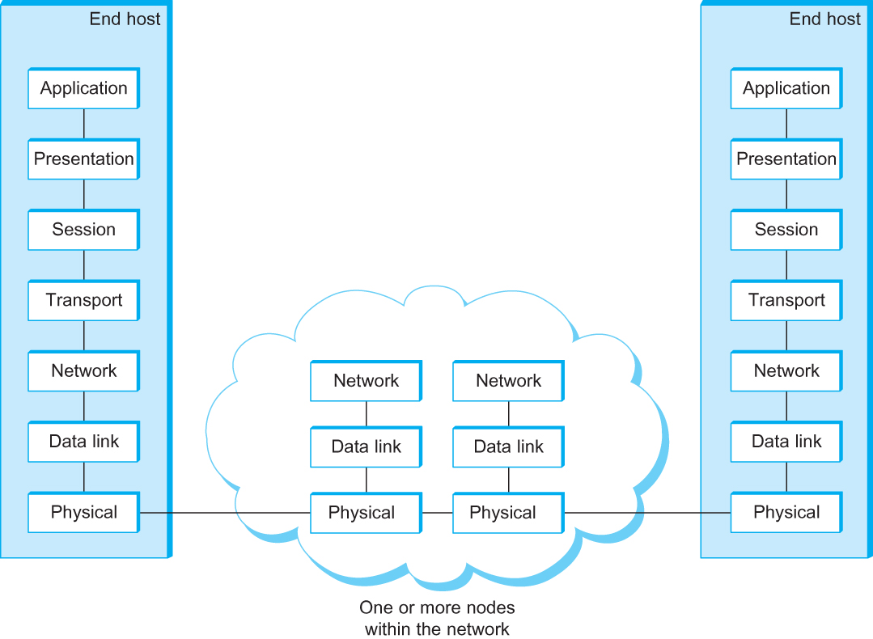
OSI Architecture
The OSI 7-layer Model
OSI – Open Systems Interconnection
(by International Organization for Standardization, ISO)

Slide 17
Description of Layers
Physical Layer
  Handles the transmission of raw bits over a communication link
Data Link Layer
  Collects a stream of bits into a larger aggregate called a frame
  Network adaptor along with device driver in OS implement the protocol in this layer
  Frames are actually delivered to hosts
Network Layer
  Handles routing among nodes within a packet-switched network
  Unit of data exchanged between nodes in this layer is called a packet
  The lower three layers are implemented on all network nodes

Slide 18
Description of Layers
Transport Layer
  Implements a process-to-process channel
  Unit of data exchanges in this layer is called a message
Session Layer
  Provides a name space that is used to tie together the potentially different transport streams that are part of a single application.
Presentation Layer
  Concerned about the format of data exchanged between peers (data formats, data encryption)
Application Layer
  Standardize common type of exchanges
  The transport layer and the higher layers typically run only on end-hosts and not on the intermediate switches and routers

Slide 19
Encapsulation
source
message
M
application
transport
network
link
physical
segment
H_{t}
M
H_{t}
datagram
H_{n}
H_{n}
H_{t}
M
frame
H_{l}
H_{n}
H_{t}
M
link
physical
switch
destination
H_{n}
H_{t}
M
network
link
physical
M
application
transport
network
link
physical
H_{l}
H_{n}
H_{t}
M
H_{n}
H_{t}
M
H_{t}
M
H_{n}
H_{t}
M
H_{l}
H_{n}
H_{t}
M
router

Slide 20
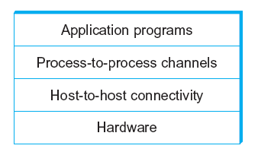
Network Architecture
Example of a layered network system

Slide 21
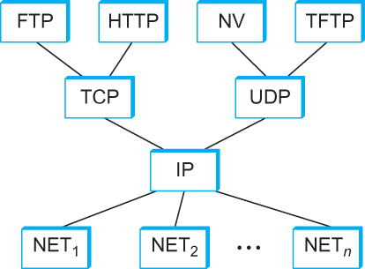
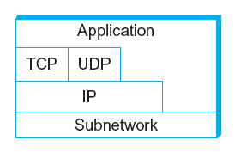
Internet Architecture
Alternative view of the Internet architecture. The “Network” layer shown here is sometimes referred to as the “sub-network” or “link” layer.
Internet Protocol Graph

Slide 22
This course: Top-Down or Bottom-up?
3
2
1
4

Slide 23
Internetworking

Slide 24
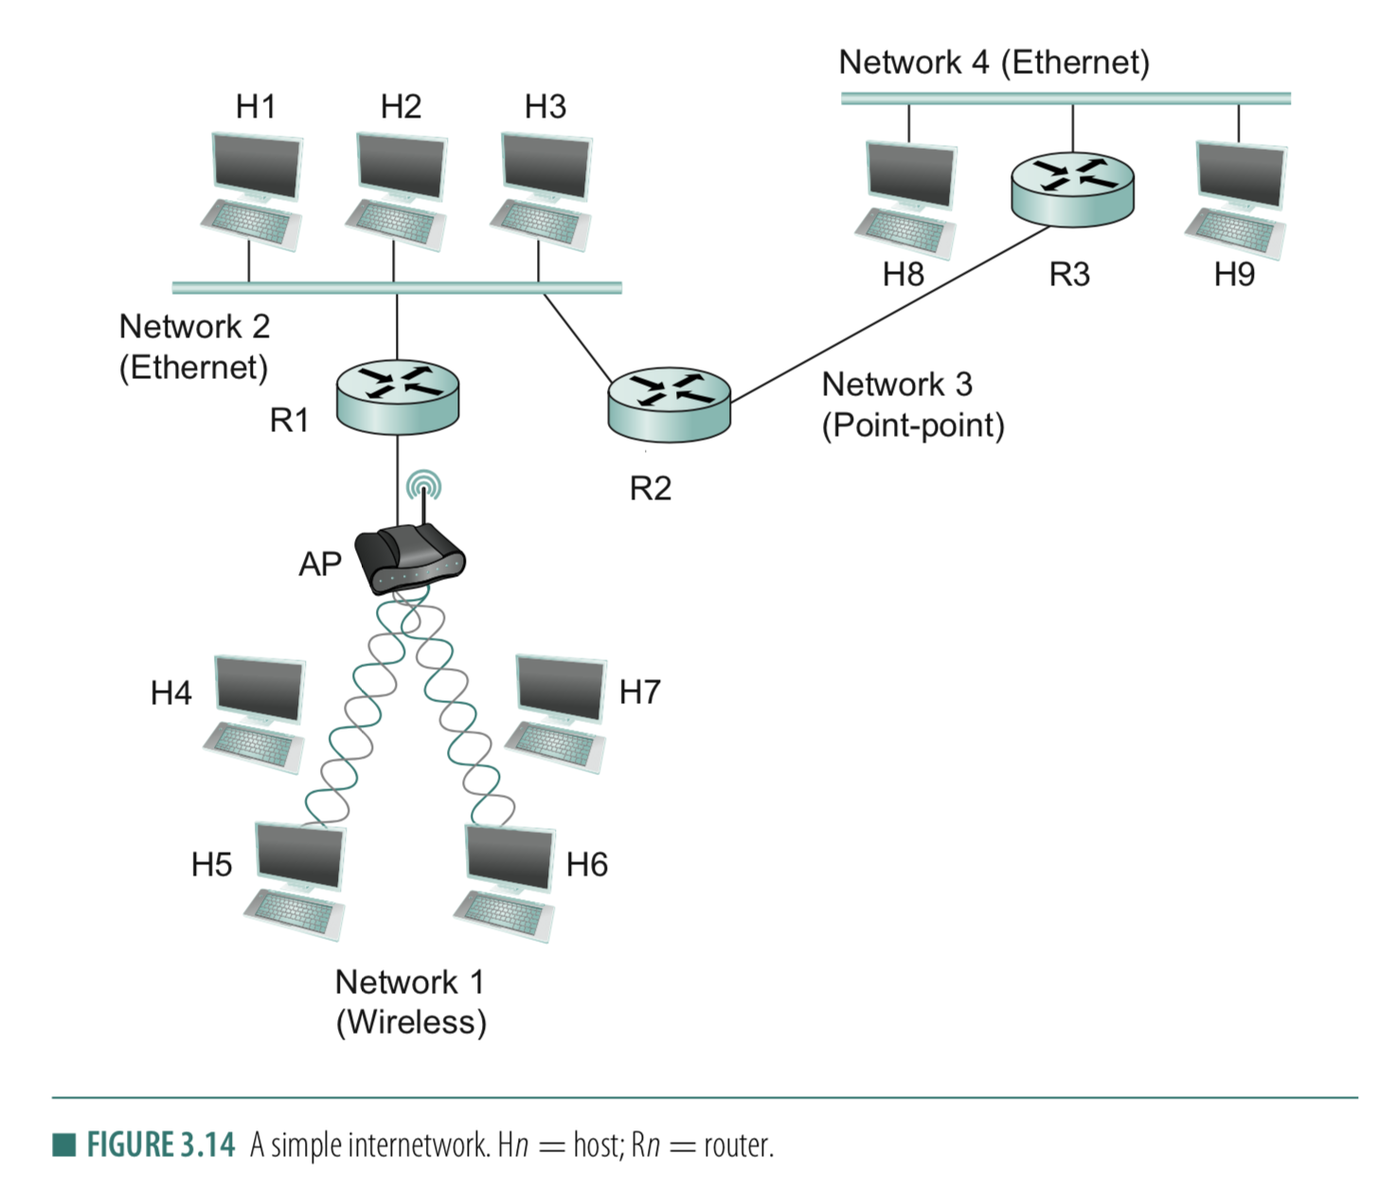
Connection between hosts
1. Addressing
– Unique identifier for global addressing
– Link name for neighbors
2. Forwarding
-- Switching packets between links
3. Routing
-- Determining paths between hosts

Slide 25
Internet Structure: Network of Networks
But if one global ISP is viable business, there will be competitors ….
…
Routers
access
net
access
net
…
access
net
access
net
access
net
access
net
ISP A
access
net
…
…
access
net
ISP B
access
net
ISP C
access
net
access
net
access
net
access
net
…
access
net
access
net
…
access
net

Slide 26
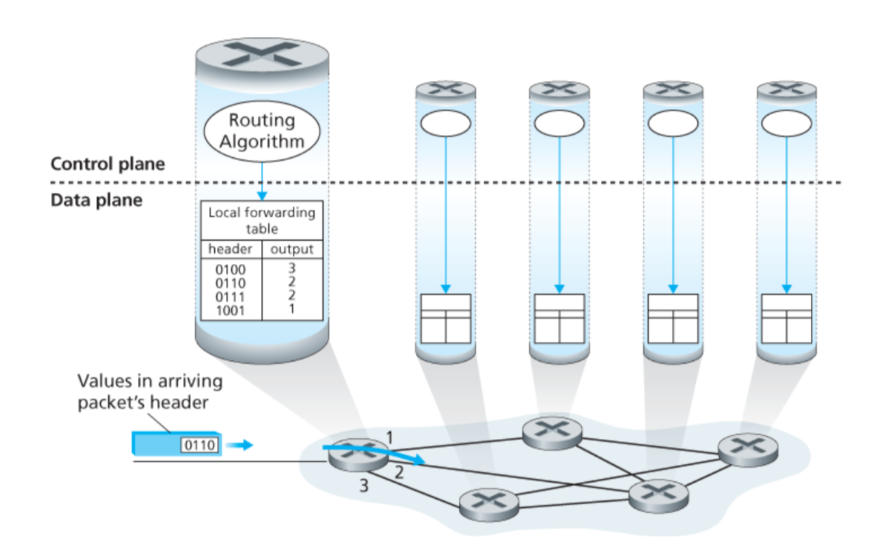
Connection between hosts

Slide 27
Connection between hosts
Using network to maintain network.
Behaves like Applications. Uses TCP/UDP packets

Slide 28
Connection between hosts
1. Addressing
– Unique identifier for global addressing
– Link name for neighbors
2. Forwarding
-- Switching packets between links
3. Routing
-- Determining paths between hosts

Slide 29
Routing protocols
Routing protocol goal: determine “good” paths (equivalently, routes), from sending hosts to receiving host, through network of routers
path: sequence of routers packets will traverse in going from given initial source host to given final destination host
“good”: least “cost”, “fastest”, “least congested”

Slide 30
Graph abstraction of the network
5
v
3
w
2
5
u
2
1
z
3
1
2
x
y
1
graph: G = (N,E)
N = set of routers = { u, v, w, x, y, z }
E = set of links ={ (u,v), (u,x), (v,x), (v,w), (x,w), (x,y), (w,y), (w,z), (y,z) }
aside: graph abstraction is useful in other network contexts, e.g.,
P2P, where N is set of peers and E is set of TCP connections

Slide 31
Graph abstraction: costs
5
c(x,x’) = cost of link (x,x’)
e.g., c(w,z) = 5
cost could always be 1, or
inversely related to bandwidth,
or related to congestion
v
3
w
2
5
u
2
1
z
3
1
2
x
y
1
cost of path (x₁, x₂, x₃,…, x_{p}) = c(x₁,x₂) + c(x₂,x₃) + … + c(x_{p-1},x_{p})
key question: what is the least-cost path between u and z ?
routing algorithm: algorithm that finds that least cost path

Slide 32
Routing
  For a simple network, we can calculate all shortest paths and load them into some nonvolatile storage on each node.
  Such a static approach has several shortcomings
    It does not deal with node or link failures
    It does not consider the addition of new nodes or links
    It implies that edge costs cannot change
  What is the solution?
    Need a distributed and dynamic protocol
    Two main classes of protocols
      Distance Vector
      Link State

Slide 33
Distance Vector Routing

Slide 34
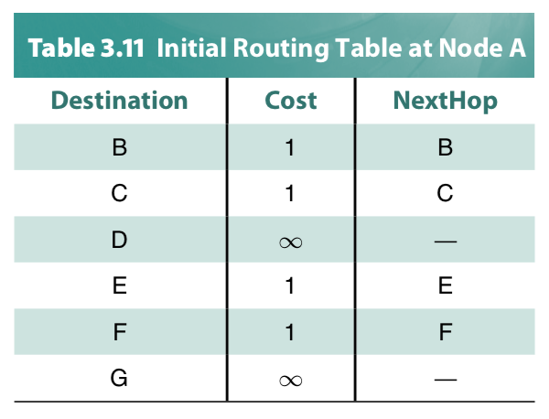
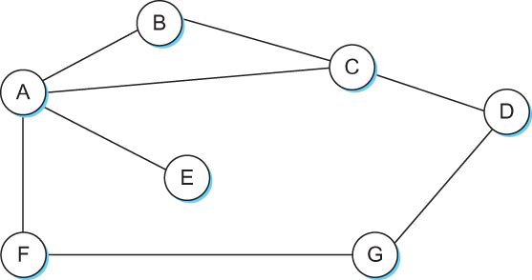
Distance Vector
Each node constructs a one-dimensional array (a vector) containing the “distances” (costs) to all other nodes and distributes that vector to its immediate neighbors
Starting assumption is that each node knows the cost of the link to each of its directly connected neighbors

Slide 35
Distance Vector Routing protocol
Advertise:
A router transmits its distance vector to each of its neighbors in a
routing packet.
2. Each router receives and saves the most recently received
distance vector from each of its neighbors.
3. Update:
A router recalculates its distance vector when:
  It receives a distance vector from a neighbor containing
  different information than before.
  b) It discovers that a link to a neighbor has gone down
  (or the cost has changed).

Slide 36
Thank you

Slide 39
Distance Vector Routing: An example
B
D
19
4
A
11
13
15
7
5
C
E

Slide 40
Distance Vector Routing: An example
Routing table at Node A
Dest | Cost | N. Hop
B
D
19
4
A
11
13
15
7
5
C
E

Slide 41
Distance Vector Routing: An example
Routing table at Node A
Dest | Cost | N. Hop
A | 0 | A
B | 19 | B
C | 7 | C
D | ∞ | --
E | ∞ | --
B
D
19
4
A
11
13
15
7
5
C
E
Know thy neighbors !!
How?

Slide 42
Round: 0
Dest | Cost | N. Hop
A | 19 | A
B | 0 | B
C | 11 | C
D | 4 | D
E | ∞ | --
Dest | Cost | N. Hop
A | ∞ | --
B | 4 | B
C | 15 | C
D | 0 | D
E | 13 | E
Dest | Cost | N. Hop
A | 0 | A
B | 19 | B
C | 7 | C
D | ∞ | --
E | ∞ | --
B
D
19
4
A
11
13
15
7
5
C
E
Dest | Cost | N. Hop
A | 7 | A
B | 11 | B
C | 0 | C
D | 15 | D
E | 5 | E
Dest | Cost | N. Hop
A | ∞ | --
B | ∞ | --
C | 5 | C
D | 13 | D
E | 0 | E

Slide 43
Round: 0
Dest | Cost | N. Hop
A | 19 | A
B | 0 | B
C | 11 | C
D | 4 | D
E | ∞ | --
Dest | Cost | N. Hop
A | ∞ | --
B | 4 | B
C | 15 | C
D | 0 | D
E | 13 | E
Let your neighbors know what you know!!
Dest | Cost | N. Hop
A | 0 | A
B | 19 | B
C | 7 | C
D | ∞ | --
E | ∞ | --
B
D
19
4
A
11
13
15
7
5
C
E
Dest | Cost | N. Hop
A | 7 | A
B | 11 | B
C | 0 | C
D | 15 | D
E | 5 | E
Dest | Cost | N. Hop
A | ∞ | --
B | ∞ | --
C | 5 | C
D | 13 | D
E | 0 | E

Slide 44
Round: 1
Dest | Cost | N. Hop
A | 19 | A
B | 0 | B
C | 11 | C
D | 4 | D
E | ∞ | --
Dest | Cost | N. Hop
A | ∞ | --
B | 4 | B
C | 15 | C
D | 0 | D
E | 13 | E
Update your routing table, if required!!
Dest | Cost | N. Hop
A | 0 | A
B | 19 | B
C | 7 | C
D | ∞ | --
E | ∞ | --
B
D
19
4
A
11
13
15
7
5
C
E
Dest | Cost | N. Hop
A | 7 | A
B | 11 | B
C | 0 | C
D | 15 | D
E | 5 | E
Dest | Cost | N. Hop
A | ∞ | --
B | ∞ | --
C | 5 | C
D | 13 | D
E | 0 | E

Slide 45
Round: 1
Dest | Cost | N. Hop
A | 19 | A
B | 0 | B
C | 11 | C
D | 4 | D
E | ∞ | --
Let’s consider updates at node A
Dest | Cost | N. Hop
A | 0 | A
B | 19 | B
C | 7 | C
D | ∞ | --
E | ∞ | --
B
D
19
4
A
11
13
15
7
5
C
E
Dest | Cost | N. Hop
A | 7 | A
B | 11 | B
C | 0 | C
D | 15 | D
E | 5 | E

Slide 46
Round: 1
Dest | Cost | N. Hop
A | 0 | A
B | 19 | B
C | 7 | C
D | ∞ | --
E | ∞ | --
B
D
19
4
A
11
13
15
7
5
C
E
Node A: Updates for B,D,E
Node B: Updates for A, E
Node C: No Updates
Node D: Updates for A
Node E: Updates for A, B
Dest | Cost | N. Hop
A | 7 | A
B | 11 | B
C | 0 | C
D | 15 | D
E | 5 | E

Slide 47
Round: 1
Dest | Cost | N. Hop
A | 19 | A
B | 0 | B
C | 11 | C
D | 4 | D
E | ∞ | --
Let’s consider updates at node A
Dest | Cost | N. Hop
A | 0 | A
B | 18 | C
C | 7 | C
D | ∞ | --
E | ∞ | --
B
D
19
4
A
11
13
15
7
5
C
E
Dest | Cost | N. Hop
A | 7 | A
B | 11 | B
C | 0 | C
D | 15 | D
E | 5 | E

Slide 48
Round: 1
Dest | Cost | N. Hop
A | 19 | A
B | 0 | B
C | 11 | C
D | 4 | D
E | ∞ | --
Let’s consider updates at node A
Dest | Cost | N. Hop
A | 0 | A
B | 18 | C
C | 7 | C
D | ∞ | --
E | ∞ | --
B
D
19
4
A
11
13
15
7
5
C
E
Dest | Cost | N. Hop
A | 7 | A
B | 11 | B
C | 0 | C
D | 15 | D
E | 5 | E

Slide 49
Round: 1
Dest | Cost | N. Hop
A | 19 | A
B | 0 | B
C | 11 | C
D | 4 | D
E | ∞ | --
Let’s consider updates at node A
Dest | Cost | N. Hop
A | 0 | A
B | 18 | C
C | 7 | C
D | 22 | C
E | ∞ | --
B
D
19
4
A
11
13
15
7
5
C
E
Dest | Cost | N. Hop
A | 7 | A
B | 11 | B
C | 0 | C
D | 15 | D
E | 5 | E

Slide 50
Round: 1
Dest | Cost | N. Hop
A | 18 | C
B | 0 | B
C | 11 | C
D | 4 | D
E | 16 | C
Dest | Cost | N. Hop
A | 22 | C
B | 4 | B
C | 15 | C
D | 0 | D
E | 13 | E
Dest | Cost | N. Hop
A | 0 | A
B | 18 | C
C | 7 | C
D | 22 | C
E | 12 | C
B
D
19
4
A
11
13
15
7
5
C
E
Node A: Updates for B,D,E
Node B: Updates for A, E
Node C: No Updates
Node D: Updates for A
Node E: Updates for A, B
Dest | Cost | N. Hop
A | 7 | A
B | 11 | B
C | 0 | C
D | 15 | D
E | 5 | E
Dest | Cost | N. Hop
A | 12 | C
B | 16 | C
C | 5 | C
D | 13 | D
E | 0 | E

Slide 51
Round: 1
Dest | Cost | N. Hop
A | 18 | C
B | 0 | B
C | 11 | C
D | 4 | D
E | 16 | C
Dest | Cost | N. Hop
A | 22 | C
B | 4 | B
C | 15 | C
D | 0 | D
E | 13 | E
When will a node send routing advertisements to its neighbors?
Dest | Cost | N. Hop
A | 0 | A
B | 18 | C
C | 7 | C
D | 22 | C
E | 12 | C
B
D
19
4
A
11
13
15
7
5
C
E
Node A: Updates for B,D,E
Node B: Updates for A, E
Node C: No Updates
Node D: Updates for A
Node E: Updates for A, B
Dest | Cost | N. Hop
A | 7 | A
B | 11 | B
C | 0 | C
D | 15 | D
E | 5 | E
Dest | Cost | N. Hop
A | 12 | C
B | 16 | C
C | 5 | C
D | 13 | D
E | 0 | E

Slide 52
Round: 1
Dest | Cost | N. Hop
A | 18 | C
B | 0 | B
C | 11 | C
D | 4 | D
E | 16 | C
Dest | Cost | N. Hop
A | 22 | C
B | 4 | B
C | 15 | C
D | 0 | D
E | 13 | E
When will a node send routing advertisements to its neighbors?
Dest | Cost | N. Hop
A | 0 | A
B | 18 | C
C | 7 | C
D | 22 | C
E | 12 | C
B
D
19
4
A
11
13
15
7
5
C
E
Node A: Updates for B,D,E
Node B: Updates for A, E
Node C: No Updates
Node D: Updates for A
Node E: Updates for A, B
Dest | Cost | N. Hop
A | 7 | A
B | 11 | B
C | 0 | C
D | 15 | D
E | 5 | E
Dest | Cost | N. Hop
A | 12 | C
B | 16 | C
C | 5 | C
D | 13 | D
E | 0 | E

Slide 53
Routing advertisements
Two circumstances when a node sends out routing advertisements:
Periodic: Automatically after some time. Why?
2) Triggered: Whenever an event makes a node to change its routing table (e.g., link fail or a new message from a neighbor).

Slide 54
Round: 2
Dest | Cost | N. Hop
A | 18 | C
B | 0 | B
C | 11 | C
D | 4 | D
E | 16 | C
Dest | Cost | N. Hop
A | 22 | C
B | 4 | B
C | 15 | C
D | 0 | D
E | 13 | E
Dest | Cost | N. Hop
A | 0 | A
B | 18 | C
C | 7 | C
D | 22 | C
E | 12 | C
B
D
19
4
A
11
13
15
7
Convergence
C
5
E
Node A: No Updates
Node B: No Updates
Node C: No Updates
Node D: No Updates
Node E: No Updates
Dest | Cost | N. Hop
A | 7 | A
B | 11 | B
C | 0 | C
D | 15 | D
E | 5 | E
Dest | Cost | N. Hop
A | 12 | C
B | 16 | C
C | 5 | C
D | 13 | D
E | 0 | E

Slide 55
Distance vector algorithm
Bellman-Ford equation (dynamic programming)
let
d_{x}(y) := cost of least-cost path from x to y
then
d_{x}(y) = min {c(x,v) + d_{v}(y) }
v
cost from neighbor v to destination y
cost to neighbor v
min taken over all neighbors v of x

Slide 56
Bellman-Ford example
5
clearly, d_{v}(z) = 5, d_{x}(z) = 3, d_{w}(z) = 3
v
3
w
2
5
u
z
B-F equation says:
2
1
3
1
2
d_{u}(z) = min { c(u,v) + d_{v}(z),
c(u,x) + d_{x}(z),
c(u,w) + d_{w}(z) }
= min {2 + 5,
1 + 3,
5 + 3} = 4
x
y
1
node achieving minimum is next
hop in shortest path, used in forwarding table

Slide 57
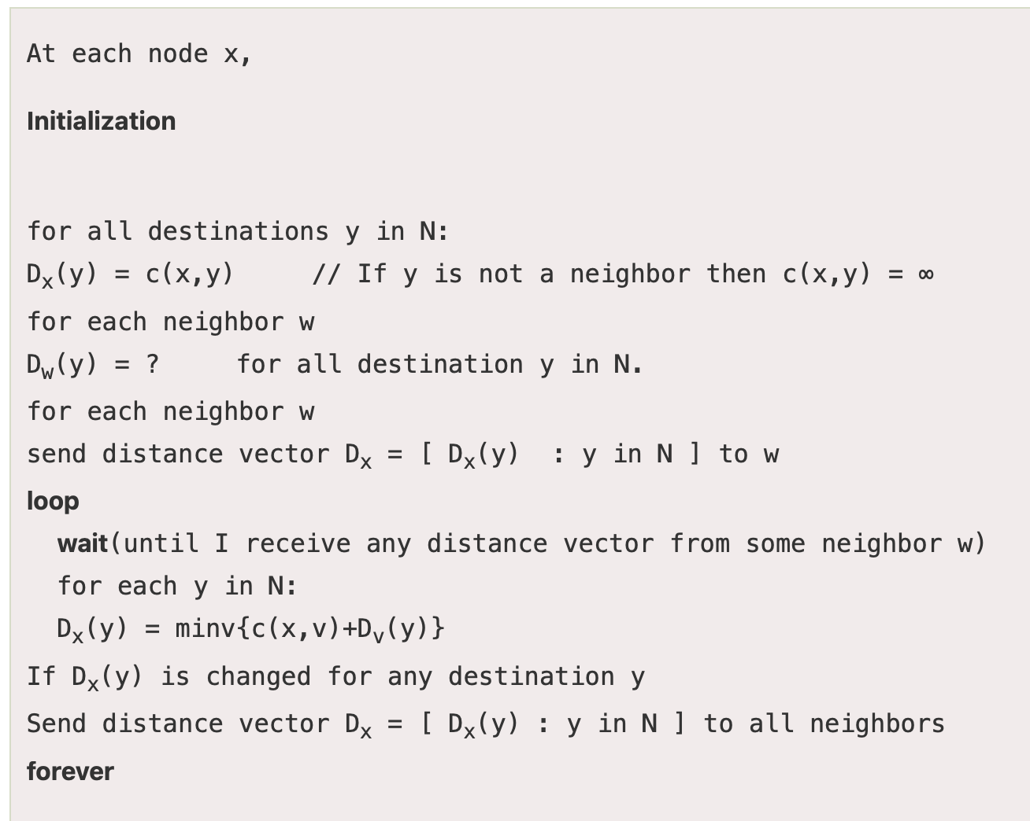
Distance vector algorithm
Putting together…
Notes:
The code is taken from: https://www.javatpoint.com/distance-vector-routing-algorithm

Slide 58
Distance vector algorithm
Putting together…
D_{x}(y) = estimate of least cost from x to y
  x maintains distance vector D_{x} = [D_{x}(y): y є N ]
node x:
  knows cost to each neighbor v: c(x,v)
  maintains its neighbors’ distance vectors. For each neighbor v, x maintains
  D_{v} = [D_{v}(y): y є N ]

Slide 59
Distance vector algorithm
key idea:
from time-to-time, each node sends its own distance vector estimate to neighbors
when x receives new DV estimate from neighbor, it updates its own DV using B-F equation:
D_{x}(y) ← min_{v}{c(x,v) + D_{v}(y)} for each node y ∊ N
under minor, natural conditions, the estimate D_{x}(y) converge to the actual least cost d_{x}(y)

Slide 60
Distance vector algorithm
iterative, asynchronous: each local iteration caused by:
local link cost change
DV update message from neighbor
distributed:
each node notifies neighbors only when its DV changes
  neighbors then notify their neighbors if necessary
each node:
wait for (change in local link cost or msg from neighbor)
recompute estimates
if DV to any dest has changed, notify neighbors

Slide 61
Distance Vector Routing protocol (Recap)
Advertise:
A router transmits its distance vector to each of its neighbors in a
routing packet.
2. Each router receives and saves the most recently received
distance vector from each of its neighbors.
3. Update:
A router recalculates its distance vector when:
  It receives a distance vector from a neighbor containing
  different information than before.
  b) It discovers that a link to a neighbor has gone down
  (or the cost has changed).

Slide 62
Routing updates (Recap)
Two circumstances when a node sends out routing advertisements:
Periodic: Automatically after some time.
2) Triggered: Whenever an event makes a node to change its routing table (e.g., link fail or a new message from a neighbor).

Slide 63
Distance Vector Routing: Link failure

Slide 64
Round: 2
Dest | Cost | N. Hop
A | 18 | C
B | 0 | B
C | 11 | C
D | 4 | D
E | 16 | C
Dest | Cost | N. Hop
A | 22 | C
B | 4 | B
C | 15 | C
D | 0 | D
E | 13 | E
Dest | Cost | N. Hop
A | 0 | A
B | 18 | C
C | 7 | C
D | 22 | C
E | 12 | C
B
D
19
4
A
11
13
15
7
5
C
E
Dest | Cost | N. Hop
A | 7 | A
B | 11 | B
C | 0 | C
D | 15 | D
E | 5 | E
Dest | Cost | N. Hop
A | 12 | C
B | 16 | C
C | 5 | C
D | 13 | D
E | 0 | E

Slide 65
Round: 3
Dest | Cost | N. Hop
A | ∞ | --
B | 0 | B
C | ∞ | --
D | 4 | D
E | ∞ | --
Dest | Cost | N. Hop
A | 22 | C
B | 4 | B
C | 15 | C
D | 0 | D
E | 13 | E
Dest | Cost | N. Hop
A | 0 | A
B | 18 | C
C | 7 | C
D | 22 | C
E | 12 | C
B
D
19
4
A
11
13
15
7
5
C
E
Node A: No Updates
Node B: No Updates
Node C: No Updates
Node D: No Updates
Node E: No Updates
Dest | Cost | N. Hop
A | 7 | A
B | ∞ | --
C | 0 | C
D | 15 | D
E | 5 | E
Dest | Cost | N. Hop
A | 12 | C
B | 16 | C
C | 5 | C
D | 13 | D
E | 0 | E

Slide 66
Round: 3
Dest | Cost | N. Hop
A | 19 | A
B | 0 | B
C | 19 | D
D | 4 | D
E | 17 | D
Dest | Cost | N. Hop
A | 22 | C
B | 4 | B
C | 15 | C
D | 0 | D
E | 13 | E
Dest | Cost | N. Hop
A | 0 | A
B | ∞ | C
C | 7 | C
D | 22 | C
E | 12 | C
Cost update
B
D
19
4
A
11
13
15
7
5
C
E
Node A: Updates for B
Node B: Updates for A,C,E
Node C: Updates for B
Node D: No Updates
Node E: Updates for B
Dest | Cost | N. Hop
A | 7 | A
B | 19 | D
C | 0 | C
D | 15 | D
E | 5 | E
Dest | Cost | N. Hop
A | 12 | C
B | 17 | D
C | 5 | C
D | 13 | D
E | 0 | E

Slide 67
Round: 4
Dest | Cost | N. Hop
A | 19 | A
B | 0 | B
C | 19 | D
D | 4 | D
E | 17 | D
Dest | Cost | N. Hop
A | 22 | C
B | 4 | B
C | 15 | C
D | 0 | D
E | 13 | E
Dest | Cost | N. Hop
A | 0 | A
B | ∞ | C
C | 7 | C
D | 22 | C
E | 12 | C
B
D
19
4
A
11
13
15
7
5
C
E
Node A: Updates for B
Node B: No Updates
Node C: No Updates
Node D: No Updates
Node E: No Updates
Dest | Cost | N. Hop
A | 7 | A
B | 19 | D
C | 0 | C
D | 15 | D
E | 5 | E
Dest | Cost | N. Hop
A | 12 | C
B | 17 | D
C | 5 | C
D | 13 | D
E | 0 | E

Slide 68
Round: 5
Dest | Cost | N. Hop
A | 19 | A
B | 0 | B
C | 19 | D
D | 4 | D
E | 17 | D
Dest | Cost | N. Hop
A | 22 | C
B | 4 | B
C | 15 | C
D | 0 | D
E | 13 | E
Dest | Cost | N. Hop
A | 0 | A
B | 19 | B
C | 7 | C
D | 22 | C
E | 12 | C
B
D
19
4
A
11
13
15
7
5
C
E
Dest | Cost | N. Hop
A | 7 | A
B | 19 | D
C | 0 | C
D | 15 | D
E | 5 | E
Dest | Cost | N. Hop
A | 12 | C
B | 17 | D
C | 5 | C
D | 13 | D
E | 0 | E

Slide 69
Distance vector: link cost changes
link cost changes:
node detects local link cost change
updates routing info, recalculates
distance vector
if DV changes, notify neighbors
1
y
4
1
x
z
50

Slide 70
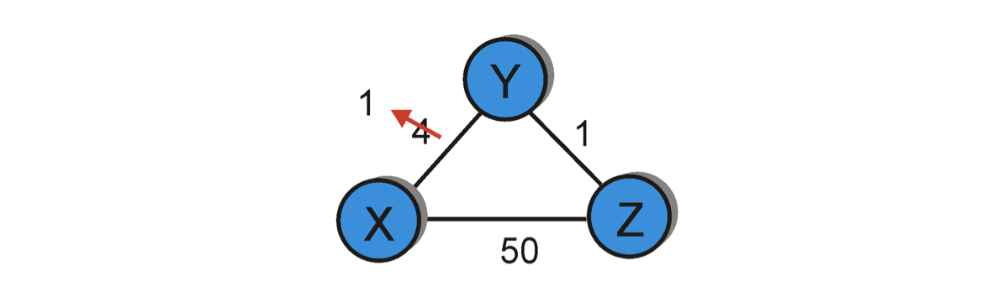
Distance vector: link cost “decreases”
Bellman-Ford algo.
considered the route
through Z (cost=51).
Dest | Cost | Hop
X | 4 | X
Y | 0 | Y
Z | 1 | Z
Dest | Cost | Hop
X | 1 | X
Y | 0 | Y
Z | 1 | Z
Dest | Cost | Hop
X | 1 | X
Y | 0 | Y
Z | 1 | Z
Dest | Cost | Hop
X | 1 | X
Y | 0 | Y
Z | 1 | Z
node Y
Dest | Cost | Hop
X | 5 | Y
Y | 1 | Y
Z | 0 | Z
Dest | Cost | Hop
X | 5 | Y
Y | 1 | Y
Z | 0 | Z
Dest | Cost | Hop
X | 2 | Y
Y | 1 | Y
Z | 0 | Z
Dest | Cost | Hop
X | 2 | Y
Y | 1 | Y
Z | 0 | Z
node Z
T1
T2
T3
T4
Cost change

Slide 71
Distance vector: link cost “increases”
Bellman-Ford algo.
considers two routes from the
saved advertisements.
<X, 60, X> -- direct link
<X, 5, Z> + d_{Z}(X) – Cost 6 link via Z
60
Dest | Cost | Hop
X | 4 | X
Y | 0 | Y
Z | 1 | Z
Dest | Cost | Hop
X | 6 | Z
Y | 0 | Y
Z | 1 | Z
Dest | Cost | Hop
X | 6 | Z
Y | 0 | Y
Z | 1 | Z
Dest | Cost | Hop
X | 8 | X
Y | 0 | Y
Z | 1 | Z
node Y
Dest | Cost | Hop
X | 5 | Y
Y | 1 | Y
Z | 0 | Z
Dest | Cost | Hop
X | 5 | Y
Y | 1 | Y
Z | 0 | Z
Dest | Cost | Hop
X | 7 | Y
Y | 1 | Y
Z | 0 | Z
Dest | Cost | Hop
X | 7 | Y
Y | 1 | Y
Z | 0 | Z
node Z
T1
T2
T3
T4
Cost change

Slide 72
Distance vector: link cost “increases”
Bellman-Ford algo.
considers two routes from the
saved advertisements.
<X, 60, X> -- direct link
<X, 5, Z> + d_{Z}(X) – Cost 6 link via Z
60
When will this looped update stop (converge)?
Dest | Cost | Hop
X | 4 | X
Y | 0 | Y
Z | 1 | Z
Dest | Cost | Hop
X | 6 | Z
Y | 0 | Y
Z | 1 | Z
Dest | Cost | Hop
X | 6 | Z
Y | 0 | Y
Z | 1 | Z
Dest | Cost | Hop
X | 8 | X
Y | 0 | Y
Z | 1 | Z
node Y
Dest | Cost | Hop
X | 5 | Y
Y | 1 | Y
Z | 0 | Z
Dest | Cost | Hop
X | 5 | Y
Y | 1 | Y
Z | 0 | Z
Dest | Cost | Hop
X | 7 | Y
Y | 1 | Y
Z | 0 | Z
Dest | Cost | Hop
X | 7 | Y
Y | 1 | Y
Z | 0 | Z
node Z
T1
T2
T3
T4
Cost change

Slide 73
Distance vector: link cost “increases”
Bellman-Ford algo.
considers two routes from the
saved advertisements.
<X, 60, X> -- direct link
<X, 5, Z> + d_{Z}(X) – Cost 6 link via Z
60
“Count-to-infinity” problem
Dest | Cost | Hop
X | 4 | X
Y | 0 | Y
Z | 1 | Z
Dest | Cost | Hop
X | 6 | Z
Y | 0 | Y
Z | 1 | Z
Dest | Cost | Hop
X | 6 | Z
Y | 0 | Y
Z | 1 | Z
Dest | Cost | Hop
X | 8 | X
Y | 0 | Y
Z | 1 | Z
node Y
Dest | Cost | Hop
X | 5 | Y
Y | 1 | Y
Z | 0 | Z
Dest | Cost | Hop
X | 5 | Y
Y | 1 | Y
Z | 0 | Z
Dest | Cost | Hop
X | 7 | Y
Y | 1 | Y
Z | 0 | Z
Dest | Cost | Hop
X | 7 | Y
Y | 1 | Y
Z | 0 | Z
node Z
T1
T2
T3
T4
Cost change

Slide 74
Count-to-infinity Problem: Solutions-1
Use some relatively small number as an approximation of infinity
For instance, in the Routing Information Protocol (RIP)—that implements DV routing-- the maximum number of hops is typically set to 15 with 16 hops considered as infinity. If a network destination is more than 15 hops away, it is considered unreachable.

Slide 75


Count-to-infinity Problem: Solutions-1
Use some relatively small number as an approximation of infinity
Maximum possible hops

Slide 76
Count-to-infinity Problem: Solutions-1
Use some relatively small number as an approximation of infinity
Maximum possible hops
“Thus, when considering even the most distant Facebook user in the Siberian tundra or the Peruvian rainforest, a friend of your friend probably knows a friend of their friend,” -- Facebook
(1) https://research.facebook.com/blog/2016/2/three-and-a-half-degrees-of-separation/
(2) Six degrees of separation: https://en.wikipedia.org/wiki/Six_degrees_of_separation

Slide 77
Count-to-infinity Problem: Solutions-2
Technique to improve the time to stabilize routing is called
split horizon
  When a node sends a routing update to its neighbors, it does not send those routes it learned from each neighbor back to that neighbor
  For example, if Z has the route (X, 5, Y) in its table, then it knows it must have learned this route from Y, and so whenever Z sends a routing update to Y, it does not include the route (X, 5) in that update

Slide 78
Distance vector: link cost “increases”
Bellman-Ford algo.
considers two routes from the
saved advertisements.
<X, 60, X> -- direct link
<X, 5, Z> + d_{Z}(X) – Cost 6 link via Z
60
Case: Split horizon
Dest | Cost | Hop
X | 4 | X
Y | 0 | Y
Z | 1 | Z
Dest | Cost | Hop
X | 6 | Z
Y | 0 | Y
Z | 1 | Z
Dest | Cost | Hop
X | 6 | Z
Y | 0 | Y
Z | 1 | Z
Dest | Cost | Hop
X | 8 | X
Y | 0 | Y
Z | 1 | Z
node Y
Dest | Cost | Hop
X | 5 | Y
Y | 1 | Y
Z | 0 | Z
Dest | Cost | Hop
X | 5 | Y
Y | 1 | Y
Z | 0 | Z
Dest | Cost | Hop
X | 7 | Y
Y | 1 | Y
Z | 0 | Z
Dest | Cost | Hop
X | 7 | Y
Y | 1 | Y
Z | 0 | Z
node Z
T1
T2
T3
T4
Cost change

Slide 79
Count-to-infinity Problem: Solutions-3
In a stronger version of split horizon, called split horizon with poison reverse
  B actually sends that back route to A, but it puts negative information in the route to ensure that A will not eventually use B to get to E
  For example, B sends the route (E, ∞) to A

Slide 80
Distance vector: link cost “increases”
Bellman-Ford algo.
considers two routes from the
saved advertisements.
<X, 60, X> -- direct link
<X, ♾, Z> + d_{Z}(X) – Cost 6 link via Z
60
Case: Split horizon
with poisoned reverse
Dest | Cost | Hop
X | 4 | X
Y | 0 | Y
Z | 1 | Z
Dest | Cost | Hop
X | 6 | Z
Y | 0 | Y
Z | 1 | Z
Dest | Cost | Hop
X | 6 | Z
Y | 0 | Y
Z | 1 | Z
Dest | Cost | Hop
X | 8 | X
Y | 0 | Y
Z | 1 | Z
node Y
Dest | Cost | Hop
X | 5 | Y
Y | 1 | Y
Z | 0 | Z
Dest | Cost | Hop
X | 5 | Y
Y | 1 | Y
Z | 0 | Z
Dest | Cost | Hop
X | 7 | Y
Y | 1 | Y
Z | 0 | Z
Dest | Cost | Hop
X | 7 | Y
Y | 1 | Y
Z | 0 | Z
node Z
T1
T2
T3
T4
Cost change

Slide 81
Distance vector: Poisoned reverse
Does poison reverse solve the general count-to-infinity problem?
It does not. It may be possible that loops involving three or more nodes (rather than simply two immediately neighboring nodes, as we shown in last example) will not be detected by the poison reverse technique.

Slide 82
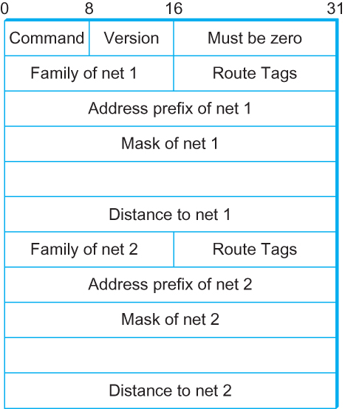
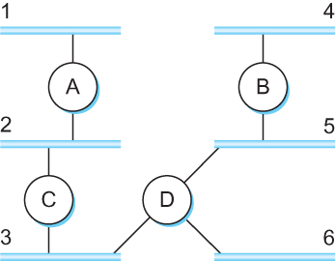
DV Implementation: Routing Information Protocol (RIP)
  Example Network
  running RIP RIPv2 Packet Format

Slide 83
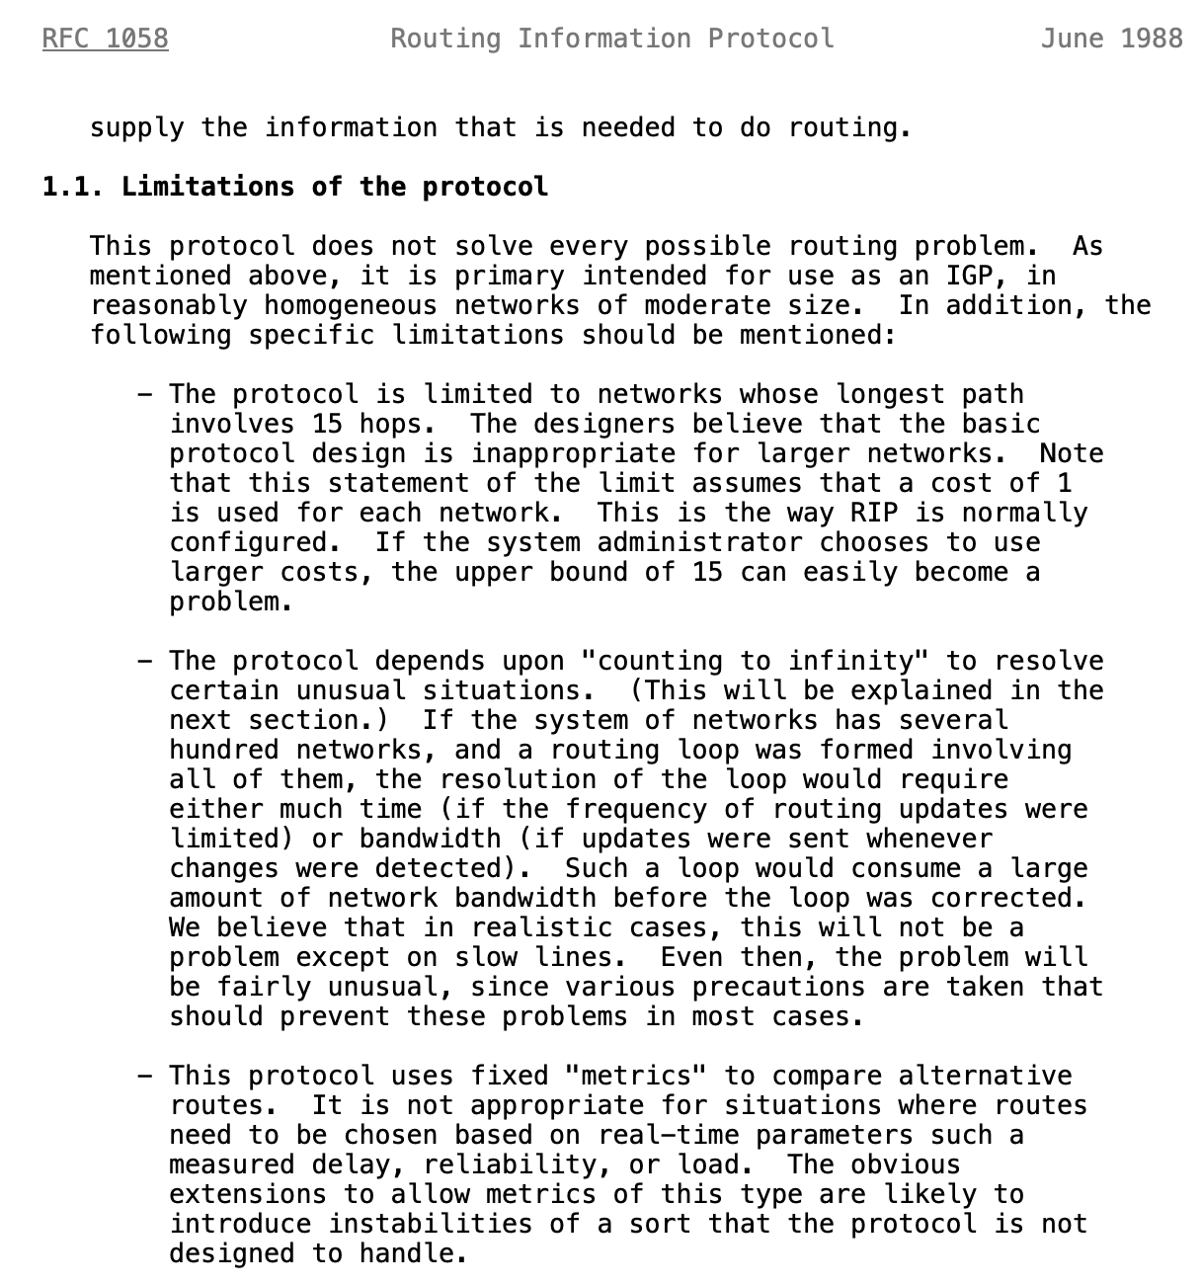
Limitations of DV routing
Notes:
What is RFC: https://www.techtarget.com/whatis/definition/Request-for-Comments-RFC

