Slide 1
CMSC 417: Computer Networks
Spring 2024
Topic: Internetworking
(Textbook chapter 3)
Nirupam Roy
Tu-Th 2:00-3:15pm
CSI 2117
Feb 6th, 2024

Slide 2
Distance Vector Routing: An example
B
D
19
4
A
11
13
15
7
5
C
E

Slide 3
Distance Vector Routing: An example
Routing table at Node A
Dest | Cost | N. Hop
B
D
19
4
A
11
13
15
7
5
C
E

Slide 4
Distance Vector Routing: An example
Routing table at Node A
Dest | Cost | N. Hop
A | 0 | A
B | 19 | B
C | 7 | C
D | ∞ | --
E | ∞ | --
B
D
19
4
A
11
13
15
7
5
C
E
Know thy neighbors !!
How?

Slide 5
Round: 0
Dest | Cost | N. Hop
A | 19 | A
B | 0 | B
C | 11 | C
D | 4 | D
E | ∞ | --
Dest | Cost | N. Hop
A | ∞ | --
B | 4 | B
C | 15 | C
D | 0 | D
E | 13 | E
Dest | Cost | N. Hop
A | 0 | A
B | 19 | B
C | 7 | C
D | ∞ | --
E | ∞ | --
B
D
19
4
A
11
13
15
7
5
C
E
Dest | Cost | N. Hop
A | 7 | A
B | 11 | B
C | 0 | C
D | 15 | D
E | 5 | E
Dest | Cost | N. Hop
A | ∞ | --
B | ∞ | --
C | 5 | C
D | 13 | D
E | 0 | E

Slide 6
Round: 0
Dest | Cost | N. Hop
A | 19 | A
B | 0 | B
C | 11 | C
D | 4 | D
E | ∞ | --
Dest | Cost | N. Hop
A | ∞ | --
B | 4 | B
C | 15 | C
D | 0 | D
E | 13 | E
Let your neighbors know what you know!!
Dest | Cost | N. Hop
A | 0 | A
B | 19 | B
C | 7 | C
D | ∞ | --
E | ∞ | --
B
D
19
4
A
11
13
15
7
5
C
E
Dest | Cost | N. Hop
A | 7 | A
B | 11 | B
C | 0 | C
D | 15 | D
E | 5 | E
Dest | Cost | N. Hop
A | ∞ | --
B | ∞ | --
C | 5 | C
D | 13 | D
E | 0 | E

Slide 7
Round: 1
Dest | Cost | N. Hop
A | 19 | A
B | 0 | B
C | 11 | C
D | 4 | D
E | ∞ | --
Dest | Cost | N. Hop
A | ∞ | --
B | 4 | B
C | 15 | C
D | 0 | D
E | 13 | E
Update your routing table, if required!!
Dest | Cost | N. Hop
A | 0 | A
B | 19 | B
C | 7 | C
D | ∞ | --
E | ∞ | --
B
D
19
4
A
11
13
15
7
5
C
E
Dest | Cost | N. Hop
A | 7 | A
B | 11 | B
C | 0 | C
D | 15 | D
E | 5 | E
Dest | Cost | N. Hop
A | ∞ | --
B | ∞ | --
C | 5 | C
D | 13 | D
E | 0 | E

Slide 8
Round: 1
Dest | Cost | N. Hop
A | 19 | A
B | 0 | B
C | 11 | C
D | 4 | D
E | ∞ | --
Let’s consider updates at node A
Dest | Cost | N. Hop
A | 0 | A
B | 19 | B
C | 7 | C
D | ∞ | --
E | ∞ | --
B
D
19
4
A
11
13
15
7
5
C
E
Dest | Cost | N. Hop
A | 7 | A
B | 11 | B
C | 0 | C
D | 15 | D
E | 5 | E

Slide 9
Round: 1
Dest | Cost | N. Hop
A | 0 | A
B | 19 | B
C | 7 | C
D | ∞ | --
E | ∞ | --
B
D
19
4
A
11
13
15
7
5
C
E
Node A: Updates for B,D,E
Node B: Updates for A, E
Node C: No Updates
Node D: Updates for A
Node E: Updates for A, B
Dest | Cost | N. Hop
A | 7 | A
B | 11 | B
C | 0 | C
D | 15 | D
E | 5 | E

Slide 10
Round: 1
Dest | Cost | N. Hop
A | 19 | A
B | 0 | B
C | 11 | C
D | 4 | D
E | ∞ | --
Let’s consider updates at node A
Dest | Cost | N. Hop
A | 0 | A
B | 18 | C
C | 7 | C
D | ∞ | --
E | ∞ | --
B
D
19
4
A
11
13
15
7
5
C
E
Dest | Cost | N. Hop
A | 7 | A
B | 11 | B
C | 0 | C
D | 15 | D
E | 5 | E

Slide 11
Round: 1
Dest | Cost | N. Hop
A | 19 | A
B | 0 | B
C | 11 | C
D | 4 | D
E | ∞ | --
Let’s consider updates at node A
Dest | Cost | N. Hop
A | 0 | A
B | 18 | C
C | 7 | C
D | ∞ | --
E | ∞ | --
B
D
19
4
A
11
13
15
7
5
C
E
Dest | Cost | N. Hop
A | 7 | A
B | 11 | B
C | 0 | C
D | 15 | D
E | 5 | E

Slide 12
Round: 1
Dest | Cost | N. Hop
A | 19 | A
B | 0 | B
C | 11 | C
D | 4 | D
E | ∞ | --
Let’s consider updates at node A
Dest | Cost | N. Hop
A | 0 | A
B | 18 | C
C | 7 | C
D | 22 | C
E | ∞ | --
B
D
19
4
A
11
13
15
7
5
C
E
Dest | Cost | N. Hop
A | 7 | A
B | 11 | B
C | 0 | C
D | 15 | D
E | 5 | E

Slide 13
Round: 1
Dest | Cost | N. Hop
A | 18 | C
B | 0 | B
C | 11 | C
D | 4 | D
E | 16 | C
Dest | Cost | N. Hop
A | 22 | C
B | 4 | B
C | 15 | C
D | 0 | D
E | 13 | E
Dest | Cost | N. Hop
A | 0 | A
B | 18 | C
C | 7 | C
D | 22 | C
E | 12 | C
B
D
19
4
A
11
13
15
7
5
C
E
Node A: Updates for B,D,E
Node B: Updates for A, E
Node C: No Updates
Node D: Updates for A
Node E: Updates for A, B
Dest | Cost | N. Hop
A | 7 | A
B | 11 | B
C | 0 | C
D | 15 | D
E | 5 | E
Dest | Cost | N. Hop
A | 12 | C
B | 16 | C
C | 5 | C
D | 13 | D
E | 0 | E

Slide 14
Round: 1
Dest | Cost | N. Hop
A | 18 | C
B | 0 | B
C | 11 | C
D | 4 | D
E | 16 | C
Dest | Cost | N. Hop
A | 22 | C
B | 4 | B
C | 15 | C
D | 0 | D
E | 13 | E
When will a node send routing advertisements to its neighbors?
Dest | Cost | N. Hop
A | 0 | A
B | 18 | C
C | 7 | C
D | 22 | C
E | 12 | C
B
D
19
4
A
11
13
15
7
5
C
E
Node A: Updates for B,D,E
Node B: Updates for A, E
Node C: No Updates
Node D: Updates for A
Node E: Updates for A, B
Dest | Cost | N. Hop
A | 7 | A
B | 11 | B
C | 0 | C
D | 15 | D
E | 5 | E
Dest | Cost | N. Hop
A | 12 | C
B | 16 | C
C | 5 | C
D | 13 | D
E | 0 | E

Slide 15
Round: 1
Dest | Cost | N. Hop
A | 18 | C
B | 0 | B
C | 11 | C
D | 4 | D
E | 16 | C
Dest | Cost | N. Hop
A | 22 | C
B | 4 | B
C | 15 | C
D | 0 | D
E | 13 | E
When will a node send routing advertisements to its neighbors?
Dest | Cost | N. Hop
A | 0 | A
B | 18 | C
C | 7 | C
D | 22 | C
E | 12 | C
B
D
19
4
A
11
13
15
7
5
C
E
Node A: Updates for B,D,E
Node B: Updates for A, E
Node C: No Updates
Node D: Updates for A
Node E: Updates for A, B
Dest | Cost | N. Hop
A | 7 | A
B | 11 | B
C | 0 | C
D | 15 | D
E | 5 | E
Dest | Cost | N. Hop
A | 12 | C
B | 16 | C
C | 5 | C
D | 13 | D
E | 0 | E

Slide 16
Routing advertisements
Two circumstances when a node sends out routing advertisements:
Periodic: Automatically after some time. Why?
2) Triggered: Whenever an event makes a node to change its routing table (e.g., link fail or a new message from a neighbor).

Slide 17
Round: 2
Dest | Cost | N. Hop
A | 18 | C
B | 0 | B
C | 11 | C
D | 4 | D
E | 16 | C
Dest | Cost | N. Hop
A | 22 | C
B | 4 | B
C | 15 | C
D | 0 | D
E | 13 | E
Dest | Cost | N. Hop
A | 0 | A
B | 18 | C
C | 7 | C
D | 22 | C
E | 12 | C
B
D
19
4
A
11
13
15
7
Convergence
C
5
E
Node A: No Updates
Node B: No Updates
Node C: No Updates
Node D: No Updates
Node E: No Updates
Dest | Cost | N. Hop
A | 7 | A
B | 11 | B
C | 0 | C
D | 15 | D
E | 5 | E
Dest | Cost | N. Hop
A | 12 | C
B | 16 | C
C | 5 | C
D | 13 | D
E | 0 | E

Slide 18
Distance vector algorithm
Bellman-Ford equation (dynamic programming)
let
d_{x}(y) := cost of least-cost path from x to y
then
d_{x}(y) = min {c(x,v) + d_{v}(y) }
v
cost from neighbor v to destination y
cost to neighbor v
min taken over all neighbors v of x

Slide 19
Bellman-Ford example
5
clearly, d_{v}(z) = 5, d_{x}(z) = 3, d_{w}(z) = 3
v
3
w
2
5
u
z
B-F equation says:
2
1
3
1
2
d_{u}(z) = min { c(u,v) + d_{v}(z),
c(u,x) + d_{x}(z),
c(u,w) + d_{w}(z) }
= min {2 + 5,
1 + 3,
5 + 3} = 4
x
y
1
node achieving minimum is next
hop in shortest path, used in forwarding table

Slide 20
Distance vector algorithm
Putting together…
Notes:
The code is taken from: https://www.javatpoint.com/distance-vector-routing-algorithm

Slide 21
Distance vector algorithm
Putting together…
D_{x}(y) = estimate of least cost from x to y
x maintains distance vector D_{x} = [D_{x}(y): y є N ]
node x:
knows cost to each neighbor v: c(x,v)
maintains its neighbors’ distance vectors. For each neighbor v, x maintains D_{v} = [D_{v}(y): y є N ]

Slide 22
Distance vector algorithm
key idea:
from time-to-time, each node sends its own distance vector estimate to neighbors
when x receives new DV estimate from neighbor, it updates its own DV using B-F equation:
D_{x}(y) ← min_{v}{c(x,v) + D_{v}(y)} for each node y ∊ N
under minor, natural conditions, the estimate D_{x}(y) converge to the actual least cost d_{x}(y)

Slide 23
Distance vector algorithm
iterative, asynchronous: each local iteration caused by:
local link cost change
DV update message from neighbor
distributed:
each node notifies neighbors only when its DV changes
neighbors then notify their neighbors if necessary
each node:
wait for (change in local link cost or msg from neighbor)
recompute estimates
if DV to any dest has changed, notify neighbors

Slide 24
Distance Vector Routing protocol (Recap)
Advertise:
A router transmits its distance vector to each of its neighbors in a
routing packet.
2. Each router receives and saves the most recently received
distance vector from each of its neighbors.
3. Update:
A router recalculates its distance vector when:
It receives a distance vector from a neighbor containing
different information than before.
b) It discovers that a link to a neighbor has gone down
(or the cost has changed).

Slide 25
Routing updates (Recap)
Two circumstances when a node sends out routing advertisements:
Periodic: Automatically after some time. [typically 30 sec.]
2) Triggered: Whenever an event makes a node to change its routing table (e.g., link fail or a new message from a neighbor).

Slide 26
Distance Vector Routing: Link failure

Slide 27
Round: 2
Dest | Cost | N. Hop
A | 18 | C
B | 0 | B
C | 11 | C
D | 4 | D
E | 16 | C
Dest | Cost | N. Hop
A | 22 | C
B | 4 | B
C | 15 | C
D | 0 | D
E | 13 | E
Dest | Cost | N. Hop
A | 0 | A
B | 18 | C
C | 7 | C
D | 22 | C
E | 12 | C
B
D
19
4
A
11
13
15
7
5
C
E
Dest | Cost | N. Hop
A | 7 | A
B | 11 | B
C | 0 | C
D | 15 | D
E | 5 | E
Dest | Cost | N. Hop
A | 12 | C
B | 16 | C
C | 5 | C
D | 13 | D
E | 0 | E

Slide 28
Round: 3
Dest | Cost | N. Hop
A | ∞ | --
B | 0 | B
C | ∞ | --
D | 4 | D
E | ∞ | --
Dest | Cost | N. Hop
A | 22 | C
B | 4 | B
C | 15 | C
D | 0 | D
E | 13 | E
Dest | Cost | N. Hop
A | 0 | A
B | 18 | C
C | 7 | C
D | 22 | C
E | 12 | C
B
D
19
4
A
11
13
15
7
5
C
E
Node A: No Updates
Node B: No Updates
Node C: No Updates
Node D: No Updates
Node E: No Updates
Dest | Cost | N. Hop
A | 7 | A
B | ∞ | --
C | 0 | C
D | 15 | D
E | 5 | E
Dest | Cost | N. Hop
A | 12 | C
B | 16 | C
C | 5 | C
D | 13 | D
E | 0 | E

Slide 29
Round: 3
Dest | Cost | N. Hop
A | 19 | A
B | 0 | B
C | 19 | D
D | 4 | D
E | 17 | D
Dest | Cost | N. Hop
A | 22 | C
B | 4 | B
C | 15 | C
D | 0 | D
E | 13 | E
Dest | Cost | N. Hop
A | 0 | A
B | ∞ | C
C | 7 | C
D | 22 | C
E | 12 | C
Cost update
B
D
19
4
A
11
13
15
7
5
C
E
Node A: Updates for B
Node B: Updates for A,C,E
Node C: Updates for B
Node D: No Updates
Node E: Updates for B
Dest | Cost | N. Hop
A | 7 | A
B | 19 | D
C | 0 | C
D | 15 | D
E | 5 | E
Dest | Cost | N. Hop
A | 12 | C
B | 17 | D
C | 5 | C
D | 13 | D
E | 0 | E

Slide 30
Round: 4
Dest | Cost | N. Hop
A | 19 | A
B | 0 | B
C | 19 | D
D | 4 | D
E | 17 | D
Dest | Cost | N. Hop
A | 22 | C
B | 4 | B
C | 15 | C
D | 0 | D
E | 13 | E
Dest | Cost | N. Hop
A | 0 | A
B | ∞ | C
C | 7 | C
D | 22 | C
E | 12 | C
B
D
19
4
A
11
13
15
7
5
C
E
Node A: Updates for B
Node B: No Updates
Node C: No Updates
Node D: No Updates
Node E: No Updates
Dest | Cost | N. Hop
A | 7 | A
B | 19 | D
C | 0 | C
D | 15 | D
E | 5 | E
Dest | Cost | N. Hop
A | 12 | C
B | 17 | D
C | 5 | C
D | 13 | D
E | 0 | E

Slide 31
Round: 5
Dest | Cost | N. Hop
A | 19 | A
B | 0 | B
C | 19 | D
D | 4 | D
E | 17 | D
Dest | Cost | N. Hop
A | 22 | C
B | 4 | B
C | 15 | C
D | 0 | D
E | 13 | E
Dest | Cost | N. Hop
A | 0 | A
B | 19 | B
C | 7 | C
D | 22 | C
E | 12 | C
B
D
19
4
A
11
13
15
7
5
C
E
Dest | Cost | N. Hop
A | 7 | A
B | 19 | D
C | 0 | C
D | 15 | D
E | 5 | E
Dest | Cost | N. Hop
A | 12 | C
B | 17 | D
C | 5 | C
D | 13 | D
E | 0 | E

Slide 32
Distance vector: link cost changes
link cost changes:
node detects local link cost change
updates routing info, recalculates distance vector
if DV changes, notify neighbors
1
y
4
1
x
z
50

Slide 33
Distance vector: link cost “decreases”
Bellman-Ford algo.
considered the route
through Z (cost=51).
Dest | Cost | Hop
X | 4 | X
Y | 0 | Y
Z | 1 | Z
Dest | Cost | Hop
X | 1 | X
Y | 0 | Y
Z | 1 | Z
Dest | Cost | Hop
X | 1 | X
Y | 0 | Y
Z | 1 | Z
Dest | Cost | Hop
X | 1 | X
Y | 0 | Y
Z | 1 | Z
node Y
Dest | Cost | Hop
X | 5 | Y
Y | 1 | Y
Z | 0 | Z
Dest | Cost | Hop
X | 5 | Y
Y | 1 | Y
Z | 0 | Z
Dest | Cost | Hop
X | 2 | Y
Y | 1 | Y
Z | 0 | Z
Dest | Cost | Hop
X | 2 | Y
Y | 1 | Y
Z | 0 | Z
node Z
T1
T2
T3
T4
Cost change

Slide 34
Distance vector: link cost “increases”
Bellman-Ford algo.
considers two routes from the
saved advertisements.
<X, 60, X> -- direct link
<X, 5, Z> + d_{Z}(X) – Cost 6 link via Z
60
Dest | Cost | Hop
X | 4 | X
Y | 0 | Y
Z | 1 | Z
Dest | Cost | Hop
X | 6 | Z
Y | 0 | Y
Z | 1 | Z
Dest | Cost | Hop
X | 6 | Z
Y | 0 | Y
Z | 1 | Z
Dest | Cost | Hop
X | 8 | X
Y | 0 | Y
Z | 1 | Z
node Y
Dest | Cost | Hop
X | 5 | Y
Y | 1 | Y
Z | 0 | Z
Dest | Cost | Hop
X | 5 | Y
Y | 1 | Y
Z | 0 | Z
Dest | Cost | Hop
X | 7 | Y
Y | 1 | Y
Z | 0 | Z
Dest | Cost | Hop
X | 7 | Y
Y | 1 | Y
Z | 0 | Z
node Z
T1
T2
T3
T4
Cost change

Slide 35
Distance vector: link cost “increases”
Bellman-Ford algo.
considers two routes from the
saved advertisements.
<X, 60, X> -- direct link
<X, 5, Z> + d_{Z}(X) – Cost 6 link via Z
60
When will this looped update stop (converge)?
Dest | Cost | Hop
X | 4 | X
Y | 0 | Y
Z | 1 | Z
Dest | Cost | Hop
X | 6 | Z
Y | 0 | Y
Z | 1 | Z
Dest | Cost | Hop
X | 6 | Z
Y | 0 | Y
Z | 1 | Z
Dest | Cost | Hop
X | 8 | X
Y | 0 | Y
Z | 1 | Z
node Y
Dest | Cost | Hop
X | 5 | Y
Y | 1 | Y
Z | 0 | Z
Dest | Cost | Hop
X | 5 | Y
Y | 1 | Y
Z | 0 | Z
Dest | Cost | Hop
X | 7 | Y
Y | 1 | Y
Z | 0 | Z
Dest | Cost | Hop
X | 7 | Y
Y | 1 | Y
Z | 0 | Z
node Z
T1
T2
T3
T4
Cost change

Slide 36
Distance vector: link cost “increases”
Bellman-Ford algo.
considers two routes from the
saved advertisements.
<X, 60, X> -- direct link
<X, 5, Z> + d_{Z}(X) – Cost 6 link via Z
60
“Count-to-infinity” problem
Dest | Cost | Hop
X | 4 | X
Y | 0 | Y
Z | 1 | Z
Dest | Cost | Hop
X | 6 | Z
Y | 0 | Y
Z | 1 | Z
Dest | Cost | Hop
X | 6 | Z
Y | 0 | Y
Z | 1 | Z
Dest | Cost | Hop
X | 8 | X
Y | 0 | Y
Z | 1 | Z
node Y
Dest | Cost | Hop
X | 5 | Y
Y | 1 | Y
Z | 0 | Z
Dest | Cost | Hop
X | 5 | Y
Y | 1 | Y
Z | 0 | Z
Dest | Cost | Hop
X | 7 | Y
Y | 1 | Y
Z | 0 | Z
Dest | Cost | Hop
X | 7 | Y
Y | 1 | Y
Z | 0 | Z
node Z
T1
T2
T3
T4
Cost change

Slide 37
When will this looped update stop (converge)?
Distance vector: link cost “increases”
Bellman-Ford algo.
considers two routes from the
saved advertisements.
<X, 60, X> -- direct link
<X, 5, Z> + d_{Z}(X) – Cost 6 link via Z
60
Dest | Cost | Hop
X | 4 | X
Y | 0 | Y
Z | 1 | Z
Dest | Cost | Hop
X | 6 | Z
Y | 0 | Y
Z | 1 | Z
Dest | Cost | Hop
X | 6 | Z
Y | 0 | Y
Z | 1 | Z
Dest | Cost | Hop
X | 8 | X
Y | 0 | Y
Z | 1 | Z
node Y
Dest | Cost | Hop
X | 5 | Y
Y | 1 | Y
Z | 0 | Z
Dest | Cost | Hop
X | 5 | Y
Y | 1 | Y
Z | 0 | Z
Dest | Cost | Hop
X | 7 | Y
Y | 1 | Y
Z | 0 | Z
Dest | Cost | Hop
X | 7 | Y
Y | 1 | Y
Z | 0 | Z
node Z
T1
T2
T3
T4
Cost change

Slide 38
“Count-to-infinity” problem: Another scenario
1
1
1
1
A
X
B
C
D
E
Small number for infinity
Triggered update and hold time
Avoiding loop while advertising

Slide 39
Count-to-infinity Problem: Solutions-1
Use some relatively small number as an approximation of infinity
For instance, in the Routing Information Protocol (RIP)—that implements DV routing-- the maximum number of hops is typically set to 15 with 16 hops considered as infinity. If a network destination is more than 15 hops away, it is considered unreachable.

Slide 40
Count-to-infinity Problem: Solutions-1
Use some relatively small number as an approximation of infinity
Maximum possible hops

Slide 41
Count-to-infinity Problem: Solutions-1
Use some relatively small number as an approximation of infinity
Maximum possible hops
“Thus, when considering even the most distant Facebook user in the Siberian tundra or the Peruvian rainforest, a friend of your friend probably knows a friend of their friend,” -- Facebook
(1) https://research.facebook.com/blog/2016/2/three-and-a-half-degrees-of-separation/
(2) Six degrees of separation: https://en.wikipedia.org/wiki/Six_degrees_of_separation

Slide 42
Count-to-infinity Problem: Solutions-2
Technique to improve the time to stabilize routing is called
split horizon
When a node sends a routing update to its neighbors, it does not send those routes it learned from each neighbor back to that neighbor
For example, if Z has the route (X, 5, Y) in its table, then it knows it must have learned this route from Y, and so whenever Z sends a routing update to Y, it does not include the route (X, 5) in that update

Slide 43
Thank you

Slide 46
Distance vector: link cost “increases”
Bellman-Ford algo.
considers two routes from the
saved advertisements.
<X, 60, X> -- direct link
<X, 5, Z> + d_{Z}(X) – Cost 6 link via Z
60
Case: Split horizon
Dest | Cost | Hop
X | 4 | X
Y | 0 | Y
Z | 1 | Z
Dest | Cost | Hop
X | 6 | Z
Y | 0 | Y
Z | 1 | Z
Dest | Cost | Hop
X | 6 | Z
Y | 0 | Y
Z | 1 | Z
Dest | Cost | Hop
X | 8 | X
Y | 0 | Y
Z | 1 | Z
node Y
Dest | Cost | Hop
X | 5 | Y
Y | 1 | Y
Z | 0 | Z
Dest | Cost | Hop
X | 5 | Y
Y | 1 | Y
Z | 0 | Z
Dest | Cost | Hop
X | 7 | Y
Y | 1 | Y
Z | 0 | Z
Dest | Cost | Hop
X | 7 | Y
Y | 1 | Y
Z | 0 | Z
node Z
T1
T2
T3
T4
Cost change

Slide 47
Count-to-infinity Problem: Solutions-3
In a stronger version of split horizon, called split horizon with poison reverse
B actually sends that back route to A, but it puts negative information in the route to ensure that A will not eventually use B to get to E
For example, B sends the route (E, ∞) to A

Slide 48
Distance vector: link cost “increases”
Bellman-Ford algo.
considers two routes from the
saved advertisements.
<X, 60, X> -- direct link
<X, ♾, Z> + d_{Z}(X) – Cost 6 link via Z
60
Case: Split horizon
with poisoned reverse
Dest | Cost | Hop
X | 4 | X
Y | 0 | Y
Z | 1 | Z
Dest | Cost | Hop
X | 6 | Z
Y | 0 | Y
Z | 1 | Z
Dest | Cost | Hop
X | 6 | Z
Y | 0 | Y
Z | 1 | Z
Dest | Cost | Hop
X | 8 | X
Y | 0 | Y
Z | 1 | Z
node Y
Dest | Cost | Hop
X | 5 | Y
Y | 1 | Y
Z | 0 | Z
Dest | Cost | Hop
X | 5 | Y
Y | 1 | Y
Z | 0 | Z
Dest | Cost | Hop
X | 7 | Y
Y | 1 | Y
Z | 0 | Z
Dest | Cost | Hop
X | 7 | Y
Y | 1 | Y
Z | 0 | Z
node Z
T1
T2
T3
T4
Cost change

Slide 49
Distance vector: Poisoned reverse
Does poison reverse solve the general count-to-infinity problem?
It does not. It may be possible that loops involving three or more nodes (rather than simply two immediately neighboring nodes, as we shown in last example) will not be detected by the poison reverse technique.

Slide 50
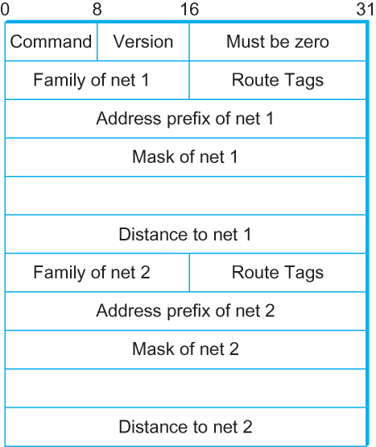
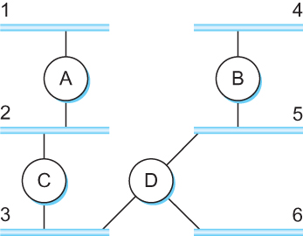
DV Implementation: Routing Information Protocol (RIP)
Example Network
running RIP RIPv2 Packet Format

Slide 51
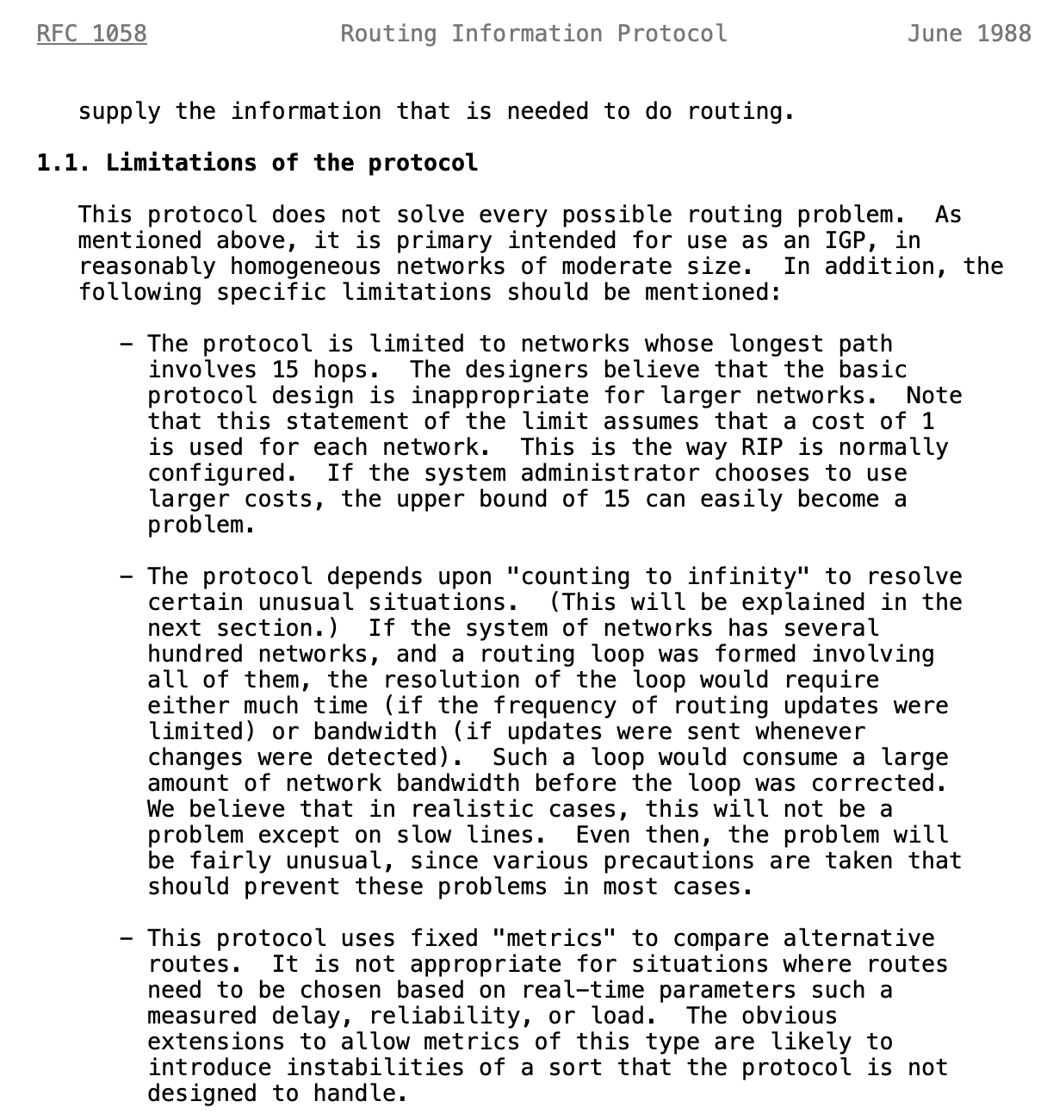
Limitations of DV routing
Notes:
What is RFC: https://www.techtarget.com/whatis/definition/Request-for-Comments-RFC

Slide 52
What is RFC?
Request for Comments (RFC):
A peer reviewed publication in a series from the
principal technical development and standards-setting
bodies for the Internet, most prominently
the Internet Engineering Task Force (IETF).
[ref] https://www.ietf.org/standards/rfcs/
How to Read an RFC: https://www.ietf.org/blog/how-read-rfc/

Slide 53
Link State Routing

Slide 54
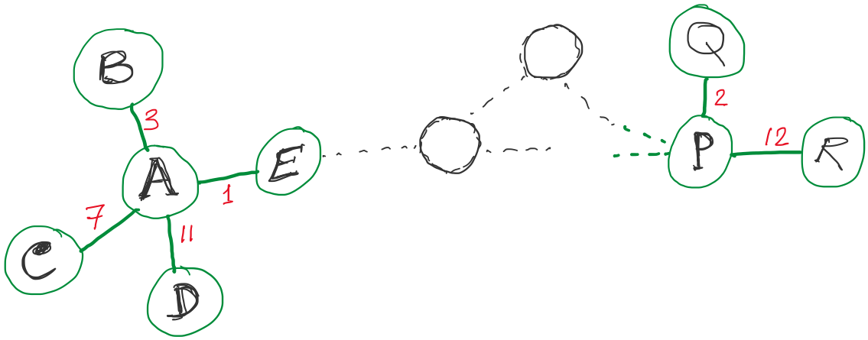
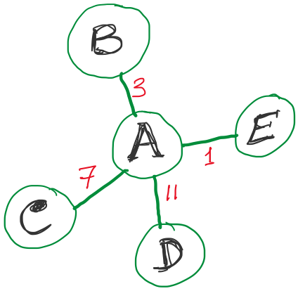
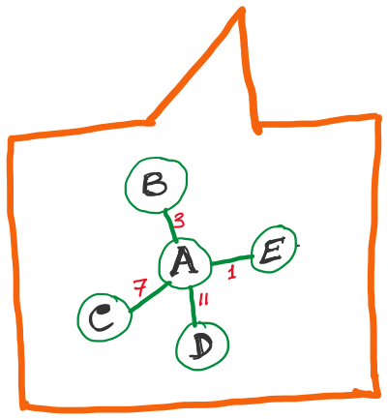
Link State Routing
Strategy:
Send to all nodes (not just neighbors) information about neighbors (not connection to all nodes).
All nodes will know the link-state information of all other nodes

Slide 55
Link State Routing
Strategy:
Send to all nodes (not just neighbors) information about neighbors (not connection to all nodes).
Link State Packet (LSP):
The ID of the node that created the LSP
(2) Costs of links to each directly connected neighbor
(3) A sequence number (SEQNO)
[To distinguish a newer LSP from the old ones]
[Smaller number == older LSP]
(4) A Time-To-Live (TTL) for this packet
[To make sure old information is eventually removed
from the network]
What is the unit of the “Time-to-Live”?

Slide 56
Link State Routing
(1) Reliable flooding
[Makes sure all nodes in the network get a copy of LSP from all other nodes]
(2) Route calculation
(Dijkstra’s shortest path algorithm)
[Calculates the shortest path from each node to all other nodes and the corresponding next-hop]

Slide 57
Link State Routing: Reliable flooding
Store most recent LSP from each node
Forward LSP to all nodes but one that sent it
Generate new LSP periodically; increment SEQNO
Start SEQNO at 0 when reboot
Decrement TTL before flooding it to neighbors.
Also age the stored LSP (decrement TTL)
Discard when TTL=0.
Goals:
Flood in minimum time
Minimize total routing traffic

Slide 58
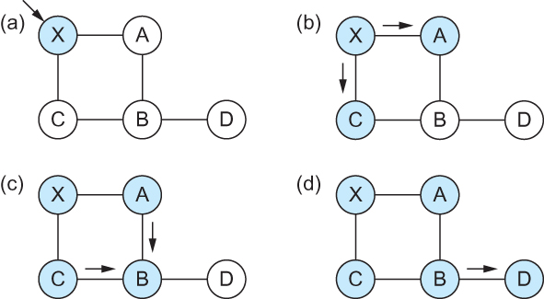
Link State
Gets two identical copies of LSP.
Accepts the one arrived first
Reliable Flooding
Flooding of link-state packets. (a) LSP arrives at node X; (b) X floods LSP to A and C; (c) A and C flood LSP to B (but not X); (d) flooding is complete

Slide 59
Link State
Reliable Flooding
Flooding of link-state packets. (a) LSP arrives at node X; (b) X floods LSP to A and C; (c) A and C flood LSP to B (but not X); (d) flooding is complete
If B receives LSP from A first, will B send the second copy received from A to C?

Slide 60
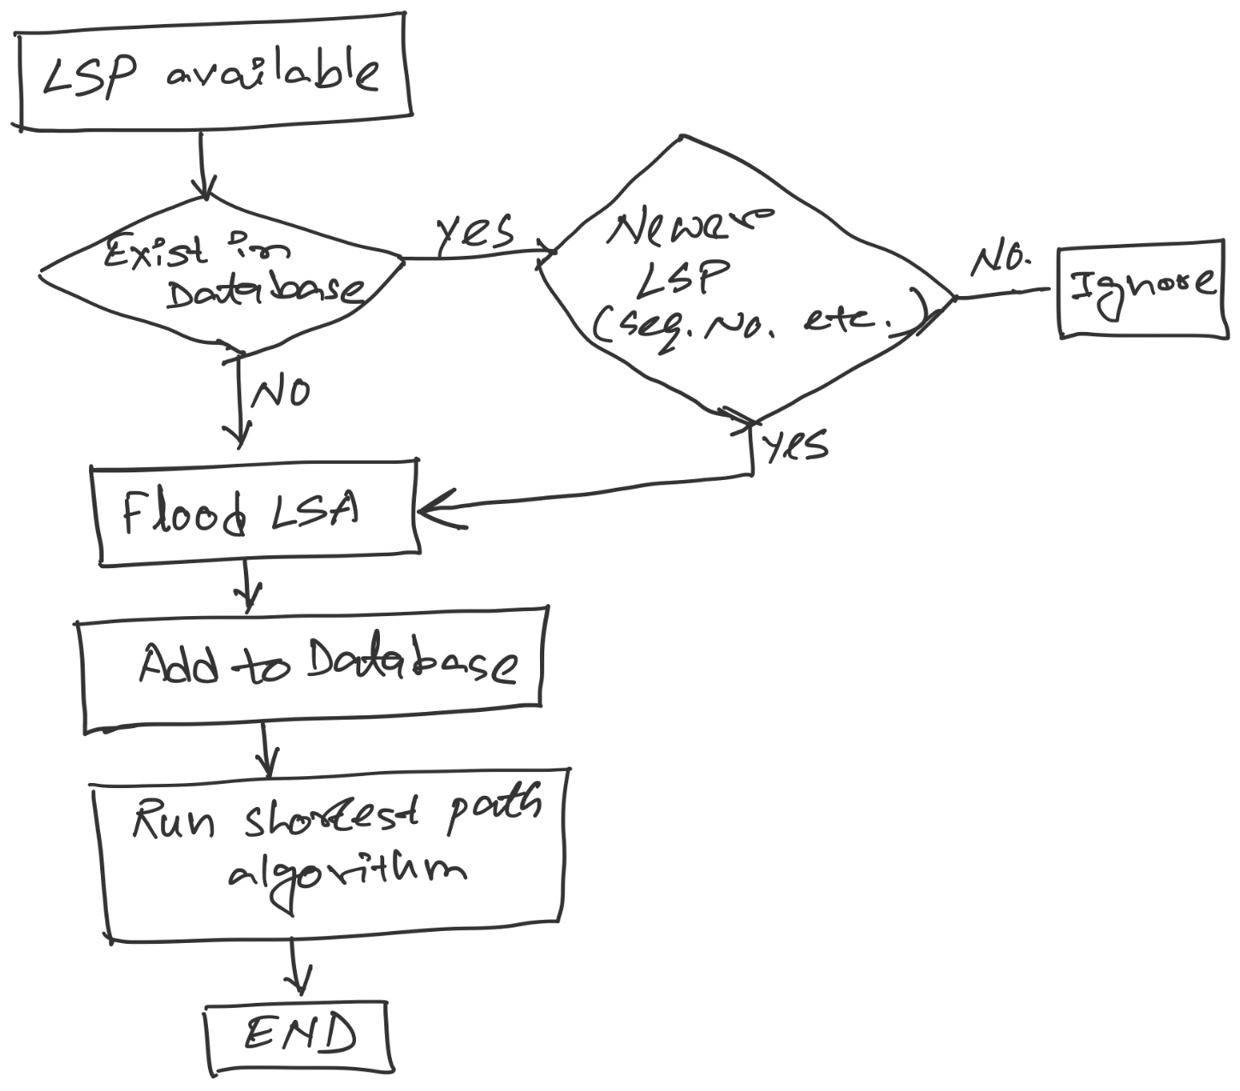
LSP processing

Slide 61
Consider this network:
B
D
19
4
A
11
13
15
7
5
C
E
After flooding every node will have the following information:
Each node has complete knowledge of the network topology
B
B
D
19
A
11
15
B
D
4
7
C
C
5
E
13
Apply shortest path algorithm to find routes
E
D
B
D
19
4
13
A
C
5
E

Slide 62
Shortest Path Routing
Dijkstra’s Algorithm - Assume non-negative link weights
N: set of nodes in the graph
l((i, j): the non-negative cost associated with the edge between nodes i, j ∈N and l(i, j) = ∝ if no edge connects i and j
Let s ∈N be the starting node which executes the algorithm to find shortest paths to all other nodes in N
Two variables used by the algorithm
M: set of nodes incorporated so far by the algorithm
C(n) : the cost of the path from s to each node n
The algorithm
M = {s}
For each n in N – {s}
C(n) = l(s, n)
while ( N ≠ M)
M = M ∪ {w} such that C(w) is the minimum
for all w in (N-M)
For each n in (N-M)
C(n) = MIN (C(n), C(w) + l(w, n))

Slide 63
Shortest Path Routing
In practice, each switch computes its routing table directly from the LSP’s it has collected using a realization of Dijkstra’s algorithm called the forward search algorithm
Specifically each switch maintains two lists, known as Tentative and Confirmed
Each of these lists contains a set of entries of the form (Destination, Cost, NextHop)

Slide 64
Consider this network:
B
D
19
4
A
11
13
15
7
5
C
E
After flooding every node will have the following information:
B
B
D
19
A
11
15
B
D
4
7
C
C
5
E
13
E
D
B
D
19
4
13
A
C
5
E

Slide 65
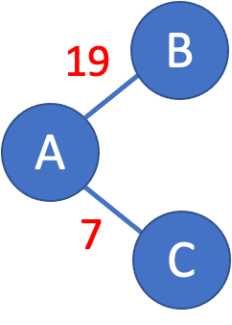
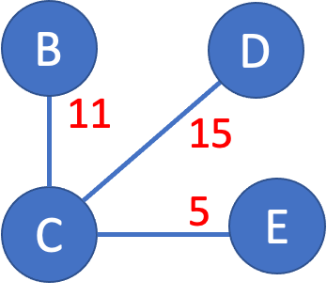
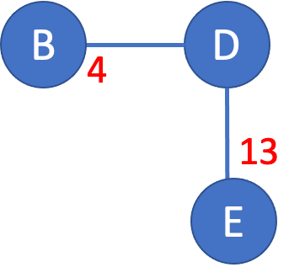
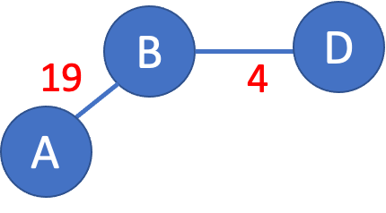
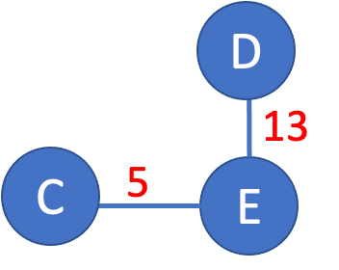
>

Slide 66
>
19
B
A
7
C

Slide 67
>
19
B
A
7
C

Slide 68
>
19
B
Unvisited nodes
A
Confirmed nodes
7
C
Tentative nodes

Slide 69
>
19
B
A
7
C

Slide 70
>
19
B
A
7
C

Slide 71
>
B
B
D
19
A
11
15
7
C
C
5
E
7

Slide 72
>
B
B
D
19
A
11
15
Update costs
7
C
C
5
E
7

Slide 73
>
B
B
D
19
A
18
22
Update costs
7
C
C
12
E
7

Slide 74
>
D
B
B
D
A
18
22
18
Update costs
22
7
C
12
E
C
12
E
7

Slide 75
>
D
B
A
18
22
7
C
12
E

Slide 76
>
D
D
B
13
A
18
22
C
5
E
7
C
12
E

Slide 77
>
D
D
B
X
13
18
22
25
A
C
5
E
7
C
12
E
No update.

Slide 78
>
18
D
B
D
B
19
4
A
18
22
A
X
7
C
12
E
No update.

Slide 79
>
18
D
B
D
B
19
4
A
18
22
22
A
X
7
C
12
E
No update.

Slide 80
>
18
D
B
D
B
19
4
A
18
22
22
A
X
7
C
12
E
No update.

Slide 81
>
D
X
B
B
D
4
A
18
22
12
E
13
7
C
E
X
No update.

Slide 82
>
D
X
B
B
D
4
A
18
22
12
E
13
7
C
E
X
No update.

Slide 83
Consider this network:
B
D
19
4
A
11
13
15
7
5
C
E
D
B
A
18
22
7
C
12
E

Slide 84
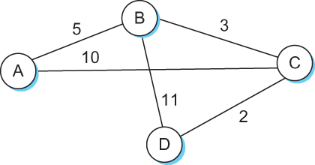
Shortest Path Routing

Slide 85
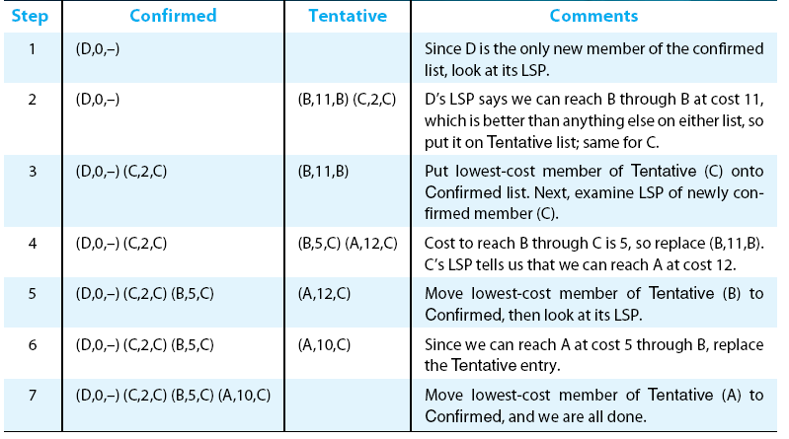
Shortest Path Routing

Slide 86
Shortest Path Routing
Dijkstra’s Algorithm
M = {s}
For each n in N – {s}
C(n) = l(s, n)
while ( N ≠ M)
M = M ∪ {w} such that C(w) is the minimum
for all w in (N-M)
For each n in (N-M)
C(n) = MIN (C(n), C(w) + l(w, n))
Confirmed list
Newly added member to the confirmed list
Tentative list

Slide 87
Shortest Path Routing
The algorithm
Initialize the Confirmed list with an entry for myself; this entry has a cost of 0
For the node just added to the Confirmed list in the previous step, call it node Next, select its LSP
For each neighbor (Neighbor) of Next, calculate the cost (Cost) to reach this Neighbor as the sum of the cost from myself to Next and from Next to Neighbor
If Neighbor is currently on neither the Confirmed nor the Tentative list, then add (Neighbor, Cost, Nexthop) to the Tentative list, where Nexthop is the direction I go to reach Next
If Neighbor is currently on the Tentative list, and the Cost is less than the currently listed cost for the Neighbor, then replace the current entry with (Neighbor, Cost, Nexthop) where Nexthop is the direction I go to reach Next
If the Tentative list is empty, stop. Otherwise, pick the entry from the Tentative list with the lowest cost, move it to the Confirmed list, and return to Step 2.

Slide 88
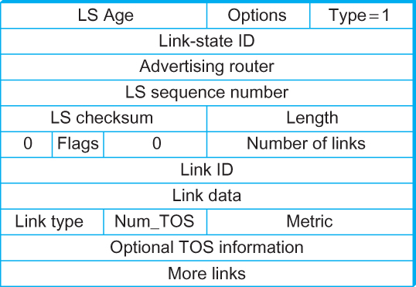
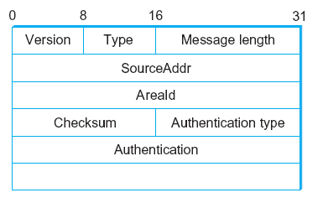
Open Shortest Path First (OSPF)
OSPF Header Format OSPF Link State Advertisement

Slide 89
Comparison of LS and DV algorithms
message complexity
LS: with n nodes, E links, O(nE) msgs sent
DV: exchange between neighbors only
convergence time varies
speed of convergence
LS: O(n²) algorithm requires O(nE) msgs
may have oscillations
DV: convergence time varies
may be routing loops
count-to-infinity problem
robustness: what happens if router malfunctions?
LS:
node can advertise incorrect link cost
each node computes only its own table
DV:
DV node can advertise incorrect path cost
each node’s table used by others
error propagate thru network

Slide 90
Comparison of LS and DV algorithms
message complexity
LS: with n nodes, E links, O(nE) msgs sent
DV: exchange between neighbors only
convergence time varies
speed of convergence
LS: O(n²) algorithm requires O(nE) msgs
may have oscillations
DV: convergence time varies
may be routing loops
count-to-infinity problem
robustness: what happens if router malfunctions?
LS:
node can advertise incorrect link cost
each node computes only its own table
DV:
DV node can advertise incorrect path cost
each node’s table used by others
error propagate thru network

