Slide 1

CMSC 417: Computer Networks
Spring 2024
Topic: Internetworking
(Textbook chapter 3)
Nirupam Roy
Tu-Th 2:00-3:15pm
CSI 2117
Feb 8th, 2024

Slide 2
Announcements

Slide 3
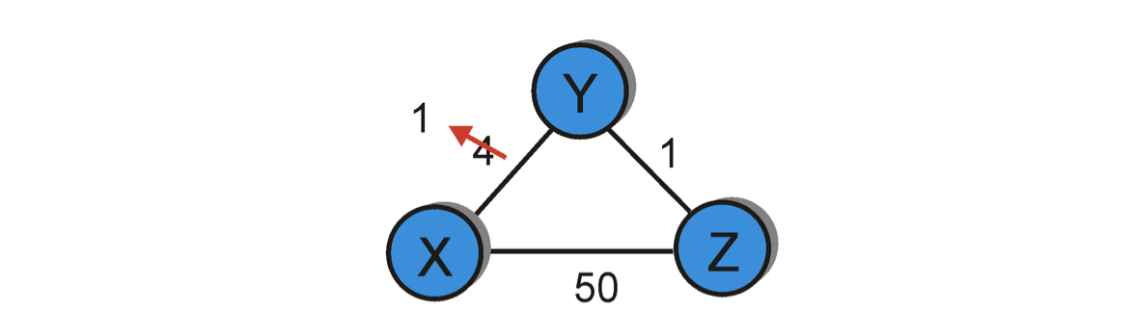
Count-to-infinity problem in DV routing.
When will this looped update stop (converge)?
Bellman-Ford algo.
considers two routes from the
saved advertisements.
<X, 60, X> -- direct link
<X, 5, Z> + d_{Z}(X) – Cost 6 link via Z
60
Dest | Cost | Hop
X | 4 | X
Y | 0 | Y
Z | 1 | Z
Dest | Cost | Hop
X | 6 | Z
Y | 0 | Y
Z | 1 | Z
Dest | Cost | Hop
X | 6 | Z
Y | 0 | Y
Z | 1 | Z
Dest | Cost | Hop
X | 8 | X
Y | 0 | Y
Z | 1 | Z
node Y
Dest | Cost | Hop
X | 5 | Y
Y | 1 | Y
Z | 0 | Z
Dest | Cost | Hop
X | 5 | Y
Y | 1 | Y
Z | 0 | Z
Dest | Cost | Hop
X | 7 | Y
Y | 1 | Y
Z | 0 | Z
Dest | Cost | Hop
X | 7 | Y
Y | 1 | Y
Z | 0 | Z
node Z
T1
T2
T3
T4
Cost change

Slide 4
“Count-to-infinity” problem: Another scenario
1
1
1
1
A
X
B
C
D
E
Small number for infinity
Triggered update and hold time
Avoiding loop while advertising

Slide 5
Count-to-infinity Problem: Solutions-1
Use some relatively small number as an approximation of infinity
For instance, in the Routing Information Protocol (RIP)—that implements DV routing-- the maximum number of hops is typically set to 15 with 16 hops considered as infinity. If a network destination is more than 15 hops away, it is considered unreachable.

Slide 6
Count-to-infinity Problem: Solutions-2
Technique to improve the time to stabilize routing is called
split horizon
  When a node sends a routing update to its neighbors, it does not send those routes it learned from each neighbor back to that neighbor
  For example, if Z has the route (X, 5, Y) in its table, then it knows it must have learned this route from Y, and so whenever Z sends a routing update to Y, it does not include the route (X, 5) in that update

Slide 7
Distance vector: link cost “increases”
Bellman-Ford algo.
considers two routes from the
saved advertisements.
<X, 60, X> -- direct link
<X, 5, Z> + d_{Z}(X) – Cost 6 link via Z
60
Case: Split horizon
Dest | Cost | Hop
X | 4 | X
Y | 0 | Y
Z | 1 | Z
Dest | Cost | Hop
X | 6 | Z
Y | 0 | Y
Z | 1 | Z
Dest | Cost | Hop
X | 6 | Z
Y | 0 | Y
Z | 1 | Z
Dest | Cost | Hop
X | 8 | X
Y | 0 | Y
Z | 1 | Z
node Y
Dest | Cost | Hop
X | 5 | Y
Y | 1 | Y
Z | 0 | Z
Dest | Cost | Hop
X | 5 | Y
Y | 1 | Y
Z | 0 | Z
Dest | Cost | Hop
X | 7 | Y
Y | 1 | Y
Z | 0 | Z
Dest | Cost | Hop
X | 7 | Y
Y | 1 | Y
Z | 0 | Z
node Z
T1
T2
T3
T4
Cost change

Slide 8
Count-to-infinity Problem: Solutions-3
In a stronger version of split horizon, called split horizon with poison reverse
  B actually sends that back route to A, but it puts negative information in the route to ensure that A will not eventually use B to get to E
  For example, B sends the route (E, ∞) to A

Slide 9
Distance vector: link cost “increases”
Bellman-Ford algo.
considers two routes from the
saved advertisements.
<X, 60, X> -- direct link
<X, ♾, Z> + d_{Z}(X) – Cost 6 link via Z
60
Case: Split horizon
with poisoned reverse
Dest | Cost | Hop
X | 4 | X
Y | 0 | Y
Z | 1 | Z
Dest | Cost | Hop
X | 6 | Z
Y | 0 | Y
Z | 1 | Z
Dest | Cost | Hop
X | 6 | Z
Y | 0 | Y
Z | 1 | Z
Dest | Cost | Hop
X | 8 | X
Y | 0 | Y
Z | 1 | Z
node Y
Dest | Cost | Hop
X | 5 | Y
Y | 1 | Y
Z | 0 | Z
Dest | Cost | Hop
X | 5 | Y
Y | 1 | Y
Z | 0 | Z
Dest | Cost | Hop
X | 7 | Y
Y | 1 | Y
Z | 0 | Z
Dest | Cost | Hop
X | 7 | Y
Y | 1 | Y
Z | 0 | Z
node Z
T1
T2
T3
T4
Cost change

Slide 10
Distance vector: Poisoned reverse
Does poison reverse solve the general count-to-infinity problem?
It does not. It may be possible that loops involving three or more nodes (rather than simply two immediately neighboring nodes, as we shown in last example) will not be detected by the poison reverse technique.

Slide 11
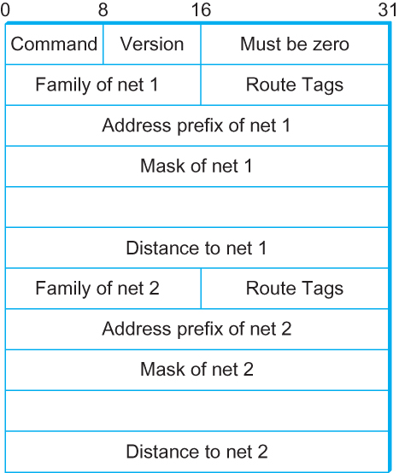
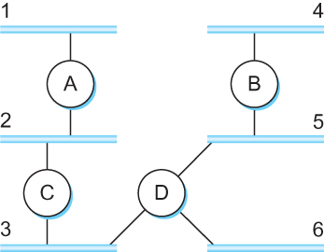
DV Implementation: Routing Information Protocol (RIP)
  Example Network
  running RIP RIPv2 Packet Format

Slide 12
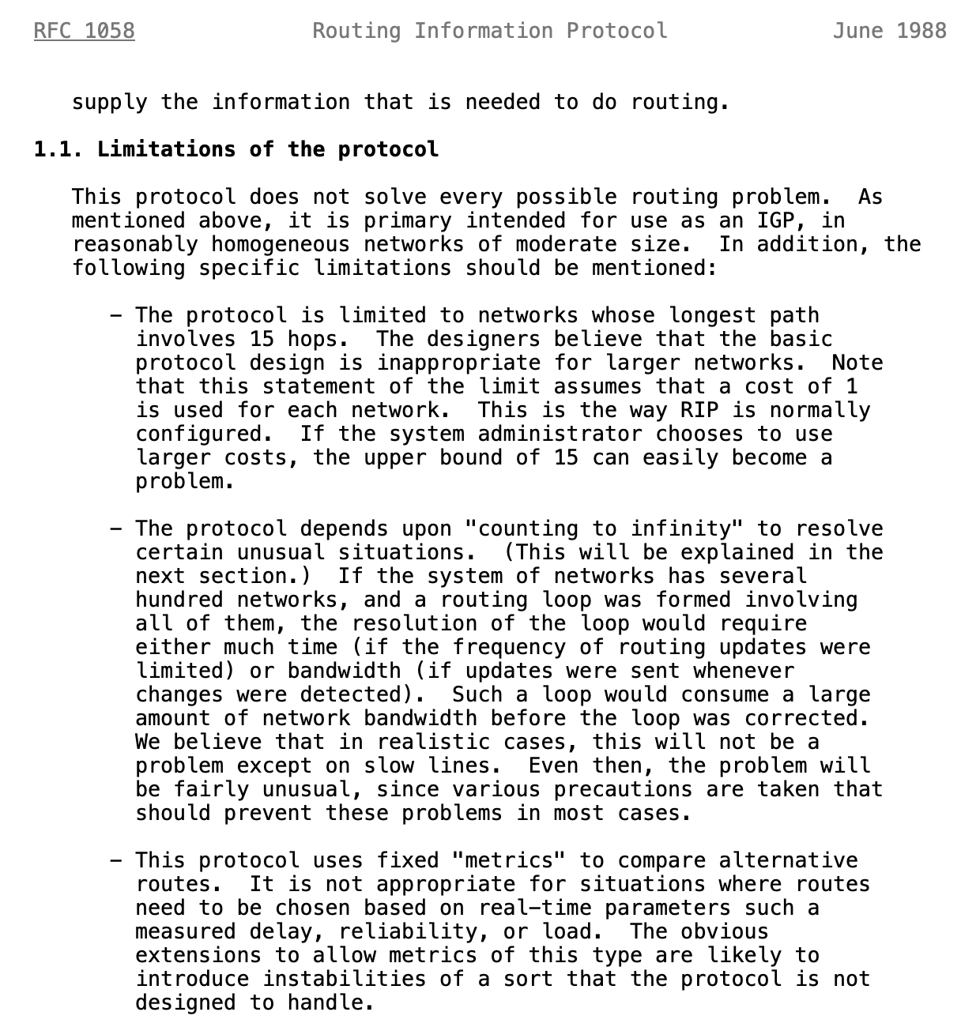
Limitations of DV routing
Small network assumption
Possibility of
routing loops
Static and
pre-determined
link costs
Notes:
What is RFC: https://www.techtarget.com/whatis/definition/Request-for-Comments-RFC

Slide 13
What is RFC?
Request for Comments (RFC):
A peer reviewed publication in a series from the
principal technical development and standards-setting
bodies for the Internet, most prominently
the Internet Engineering Task Force (IETF).
[ref] https://www.ietf.org/standards/rfcs/
How to Read an RFC: https://www.ietf.org/blog/how-read-rfc/

Slide 14
Link State Routing

Slide 15
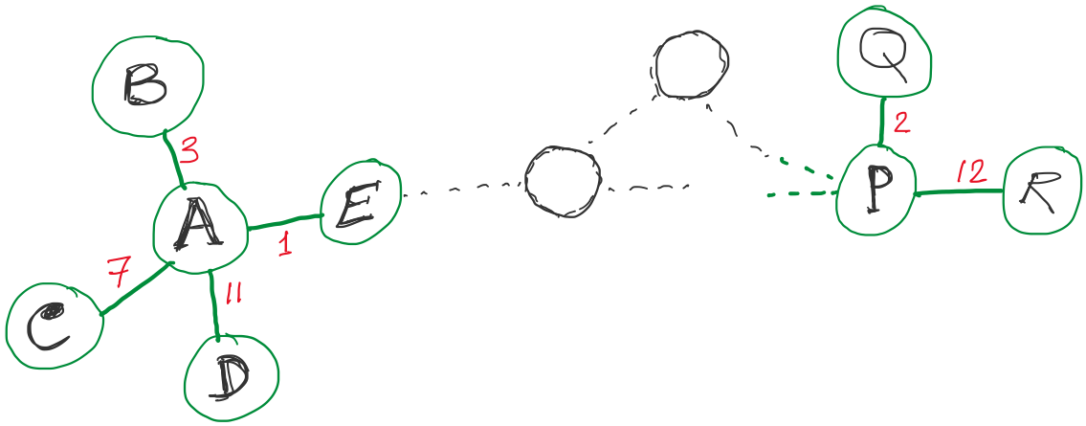
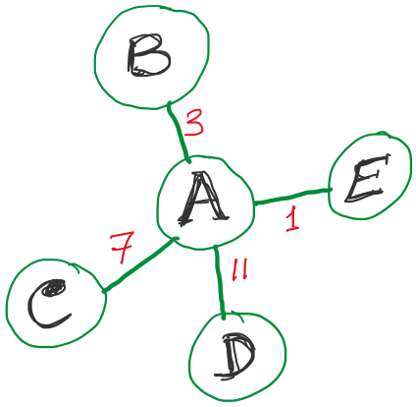
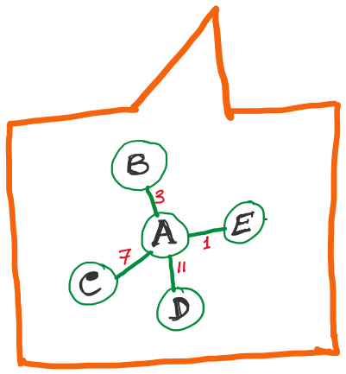
Link State Routing
Strategy:
Send to all nodes (not just neighbors) information about neighbors (not connection to all nodes).
All nodes will know the link-state information of all other nodes

Slide 16
Link State Routing
Strategy:
Send to all nodes (not just neighbors) information about neighbors (not connection to all nodes).
All nodes will know the link-state information of all other nodes

Slide 17
Link State Routing
Strategy:
Send to all nodes (not just neighbors) information about neighbors (not connection to all nodes).
Link State Packet (LSP):
  The ID of the node that created the LSP
  (2) Costs of links to each directly connected neighbor
  (3) A sequence number (SEQNO)
  [To distinguish a newer LSP from the old ones]
  [Smaller number == older LSP]
  (4) A Time-To-Live (TTL) for this packet
  [To make sure old information is eventually removed
  from the network]
What is the unit of the “Time-to-Live”?

Slide 18
Link State Routing
Strategy:
Send to all nodes (not just neighbors) information about neighbors (not connection to all nodes).
Link State Packet (LSP):
  The ID of the node that created the LSP
  (2) Costs of links to each directly connected neighbor
  (3) A sequence number (SEQNO)
  [To distinguish a newer LSP from the old ones]
  [Smaller number == older LSP]
  (4) A Time-To-Live (TTL) for this packet
  [To make sure old information is eventually removed
  from the network]
What is the unit of the “Time-to-Live”?

Slide 19
Link State Routing
(1) Reliable flooding
[Makes sure all nodes in the network get a copy of LSP from all other nodes]
(2) Route calculation
(Dijkstra’s shortest path algorithm)
[Calculates the shortest path from each node to all other nodes and the corresponding next-hop]

Slide 20
Link State Routing: Reliable flooding
Goals:
0) Ensure all nodes get LSPs from all other
Flood in minimum time
Minimize total routing traffic
  Store most recent LSP from each node
  Forward LSP to all nodes but one that sent it
  Generate new LSP periodically; increment SEQNO
  Start SEQNO at 0 when reboot
  Decrement TTL before flooding it to neighbors.
  Also age the stored LSP (decrement TTL)
  Discard when TTL=0.

Slide 21
Thank you

Slide 24
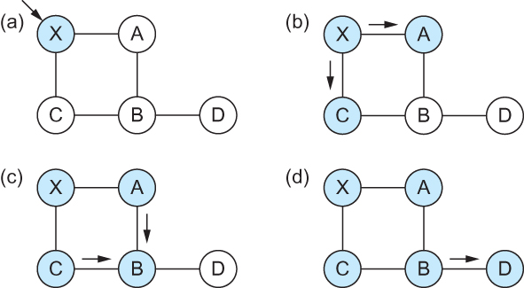
Link State
Gets two identical copies of LSP.
Accepts the one arrived first
Reliable Flooding
Flooding of link-state packets. (a) LSP arrives at node X; (b) X floods LSP to A and C; (c) A and C flood LSP to B (but not X); (d) flooding is complete

Slide 25
Link State
Reliable Flooding
Flooding of link-state packets. (a) LSP arrives at node X; (b) X floods LSP to A and C; (c) A and C flood LSP to B (but not X); (d) flooding is complete
If B receives LSP from A first, will B send the second copy received from C to A?

Slide 26
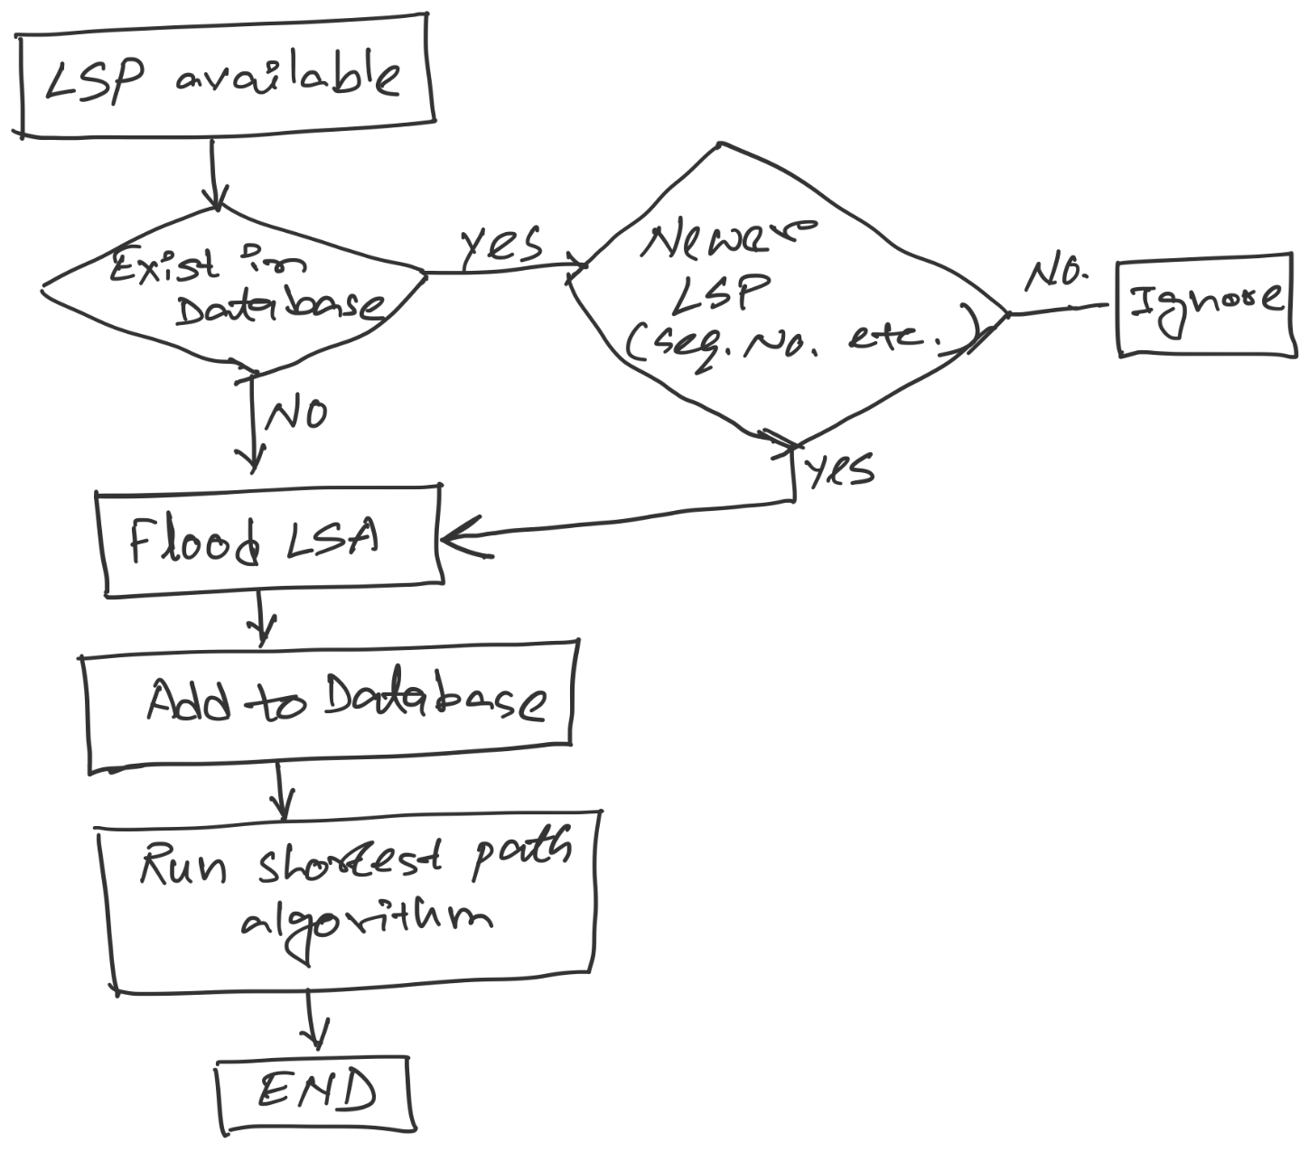
LSP processing

Slide 27
Consider this network:
B
D
19
4
A
11
13
15
7
5
C
E
After flooding every node will have the following information:
Each node has complete knowledge of the network topology
B
B
D
19
A
11
15
B
D
4
7
C
C
5
E
13
Apply shortest path algorithm to find routes
E
D
B
D
19
4
13
A
C
5
E

Slide 28
Shortest Path Routing
Dijkstra’s Algorithm - Assume non-negative link weights
  N: set of nodes in the graph
  l((i, j): the non-negative cost associated with the edge between nodes i, j ∈N and l(i, j) = ∝ if no edge connects i and j
  Let s ∈N be the starting node which executes the algorithm to find shortest paths to all other nodes in N
  Two variables used by the algorithm
    M: set of nodes incorporated so far by the algorithm
    C(n) : the cost of the path from s to each node n
    The algorithm
      M = {s}
      For each n in N – {s}
        C(n) = l(s, n)
      while ( N ≠ M)
        M = M ∪ {w} such that C(w) is the minimum
        for all w in (N-M)
        For each n in (N-M)
        C(n) = MIN (C(n), C(w) + l(w, n))

Slide 29
Shortest Path Routing
In practice, each switch computes its routing table directly from the LSP’s it has collected using a realization of Dijkstra’s algorithm called the forward search algorithm
Specifically, each switch maintains two lists, known as Tentative and Confirmed
Each of these lists contains a set of entries of the form (Destination, Cost, NextHop)

Slide 30
Consider this network:
B
D
19
4
A
11
13
15
7
5
C
E
After flooding every node will have the following information:
B
B
D
19
A
11
15
B
D
4
7
C
C
5
E
13
E
D
B
D
19
4
13
A
C
5
E

Slide 31
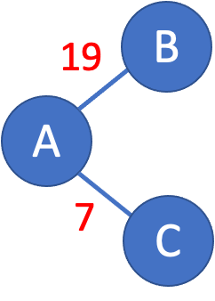
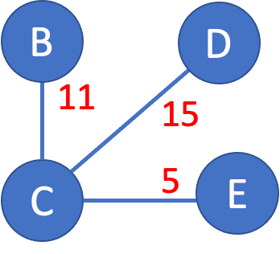
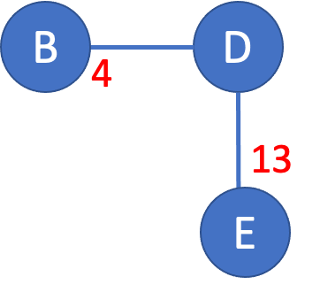
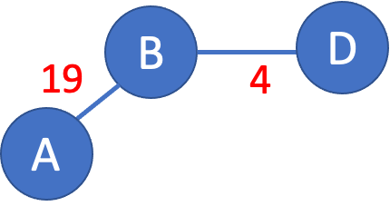
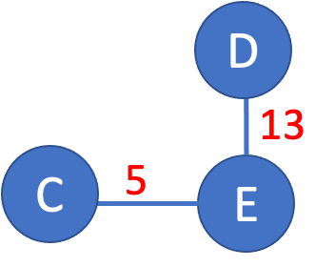
>

Slide 32
>
19
B
A
7
C

Slide 33
>
19
B
A
7
C

Slide 34
>
19
B
Unvisited nodes
A
Confirmed nodes
7
C
Tentative nodes

Slide 35
>
19
B
Unvisited nodes
A
Confirmed nodes
7
C
Tentative nodes

Slide 36
>
19
B
A
7
C

Slide 37
>
B
B
D
19
A
11
15
7
C
C
5
E
7

Slide 38
>
B
B
D
19
A
11
15
Update costs
7
C
C
5
E
7

Slide 39
>
B
B
D
19
A
18
22
Update costs
7
C
C
12
E
7

Slide 40
>
D
B
B
D
A
18
22
18
Update costs
22
7
C
12
E
C
12
E
7

Slide 41
>
D
B
A
18
22
7
C
12
E

Slide 42
>
D
D
B
13
A
18
22
C
5
E
7
C
12
E

Slide 43
>
D
D
B
X
13
18
22
25
A
C
5
E
7
C
12
E
No update.

Slide 44
>
18
D
B
D
B
19
4
A
18
22
A
X
7
C
12
E

Slide 45
>
18
D
B
D
B
19
4
A
18
22
22
A
X
7
C
12
E
No update.

Slide 46
>
18
D
B
D
B
19
4
A
18
22
22
A
X
7
C
12
E
No update.

Slide 47
>
D
X
B
B
D
4
A
18
22
12
E
13
7
C
E
X
No update.

Slide 48
>
D
X
B
B
D
4
A
18
22
12
E
13
7
C
E
X
No update.

Slide 49
B
D
19
4
A
11
13
15
7
5
C
E
D
B
A
18
22
7
C
12
E

Slide 50
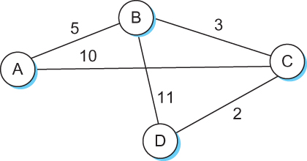
Shortest Path Routing

Slide 51
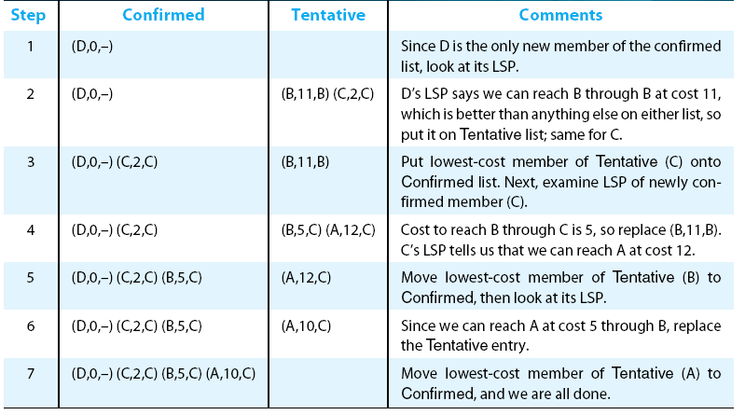
Shortest Path Routing

Slide 52
Shortest Path Routing
Dijkstra’s Algorithm
M = {s}
      For each n in N – {s}
        C(n) = l(s, n)
      while ( N ≠ M)
        M = M ∪ {w} such that C(w) is the minimum
        for all w in (N-M)
        For each n in (N-M)
        C(n) = MIN (C(n), C(w) + l(w, n))
Confirmed list
Newly added member to the confirmed list
Tentative list

Slide 53
Shortest Path Routing
The algorithm
  Initialize the Confirmed list with an entry for myself; this entry has a cost of 0
  For the node just added to the Confirmed list in the previous step, call it node Next, select its LSP
  For each neighbor (Neighbor) of Next, calculate the cost (Cost) to reach this Neighbor as the sum of the cost from myself to Next and from Next to Neighbor
    If Neighbor is currently on neither the Confirmed nor the Tentative list, then add (Neighbor, Cost, Nexthop) to the Tentative list, where Nexthop is the direction I go to reach Next
    If Neighbor is currently on the Tentative list, and the Cost is less than the currently listed cost for the Neighbor, then replace the current entry with (Neighbor, Cost, Nexthop) where Nexthop is the direction I go to reach Next
  If the Tentative list is empty, stop. Otherwise, pick the entry from the Tentative list with the lowest cost, move it to the Confirmed list, and return to Step 2.

Slide 54
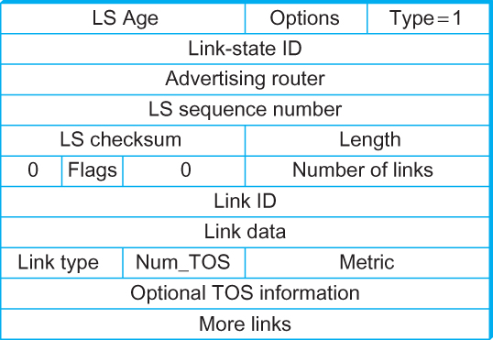
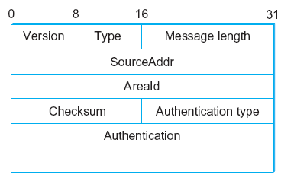
Open Shortest Path First (OSPF)
  OSPF Header Format OSPF Link State Advertisement

Slide 55
Comparison of LS and DV algorithms
message complexity
LS: with n nodes, E links, O(nE) msgs sent
DV: exchange between neighbors only
  convergence time varies
speed of convergence
LS: O(n²) algorithm requires O(nE) msgs
  may have oscillations
DV: convergence time varies
  may be routing loops
  count-to-infinity problem
robustness: what happens if router malfunctions?
LS:
  node can advertise incorrect link cost
  each node computes only its own table
DV:
  DV node can advertise incorrect path cost
  each node’s table used by others
    error propagate thru network

Slide 56
Comparison of LS and DV algorithms
message complexity
LS: with n nodes, E links, O(nE) msgs sent
DV: exchange between neighbors only
  convergence time varies
speed of convergence
LS: O(n²) algorithm requires O(nE) msgs
  may have oscillations
DV: convergence time varies
  may be routing loops
  count-to-infinity problem
robustness: what happens if router malfunctions?
LS:
  node can advertise incorrect link cost
  each node computes only its own table
DV:
  DV node can advertise incorrect path cost
  each node’s table used by others
    error propagate thru network

Slide 57
Internet Protocol

Slide 58
The Internet network layer
host, router network layer functions:
transport layer: TCP, UDP
routing protocols
path selection
RIP, OSPF, BGP
IP protocol
addressing conventions
datagram format
packet handling conventions
network
layer
forwarding
table
ICMP protocol
error reporting
router “signaling”
link layer
physical layer

Slide 59
















Network layer
Transport segment from sending to receiving host
On sending side encapsulates segments into datagrams
On receiving side, delivers segments to transport layer
Network layer protocols in every host, router
Router examines header fields in all IP datagrams passing through it
application
transport
network
data link
physical
network
data link
physical
network
data link
physical
network
data link
physical
network
data link
physical
network
data link
physical
network
data link
physical
network
data link
physical
network
data link
physical
network
data link
physical
application
transport
network
data link
physical
network
data link
physical
network
data link
physical

Slide 60
Two key network-layer functions
network-layer functions:
forwarding: move packets from router’s input to appropriate router output
routing: determine route taken by packets from source to destination
  routing algorithms
analogy: taking a trip
forwarding: process of getting through single interchange
routing: process of planning trip from source to destination

Slide 61
Network layer: data plane, control plane
Data plane
local, per-router function
determines how datagram arriving on router input port is forwarded to router output port
forwarding function
Control plane
network-wide logic
determines how datagram is routed among routers along end-end path from source host to destination host
two control-plane approaches:
  traditional routing algorithms: implemented in routers
  software-defined networking (SDN): implemented in (remote) servers
values in arriving
packet header
0111
1
3
2

Slide 62

Per-router control plane
Individual routing algorithm components in each and every router interact in the control plane
Routing
Algorithm
control
plane
data
plane
values in arriving
packet header
0111
1
3
2

Slide 63
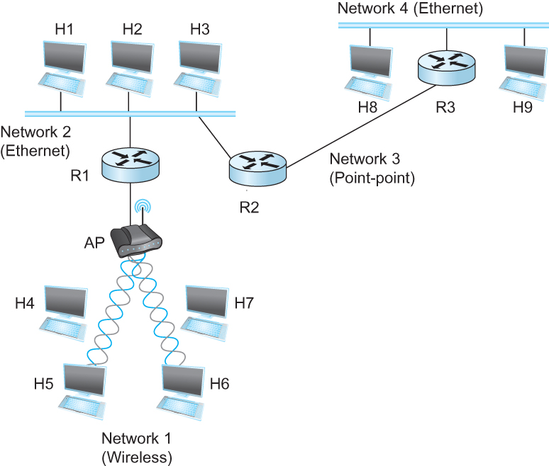
Internetworking
What is internetwork
  An arbitrary collection of networks interconnected to provide some sort of host-host to packet delivery service
  A simple internetwork where H represents hosts and R represents routers

Slide 64
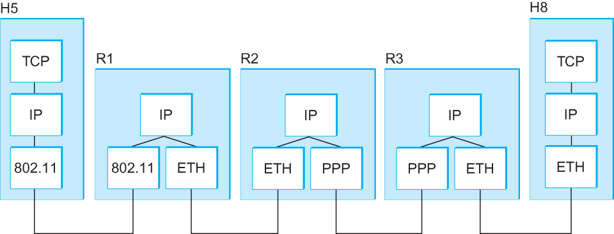
Internetworking
What is IP
  IP stands for Internet Protocol
  Key tool used today to build scalable, heterogeneous internetworks
  It runs on all the nodes in a collection of networks and defines the infrastructure that allows these nodes and networks to function as a single logical internetwork
  A simple internetwork showing the protocol layers

Slide 65
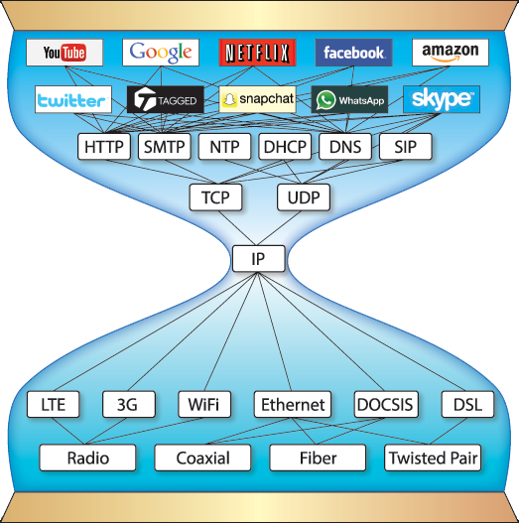
Pic courtesy: https://www.are.na/block/881873

Slide 66
IP Service Model
Packet Delivery Model
  Connectionless model for data delivery
  Best-effort delivery (unreliable service)
    packets are lost
    packets are delivered out of order
    duplicate copies of a packet are delivered
    packets can be delayed for a long time
Global Addressing Scheme
  Provides a way to identify all hosts in the network

Slide 67
IP datagram format (i.e., Packet format)
32 bits
ver
head.
len
type of
service
length
flgs
fragment
offset
16-bit identifier
Variable size header.
(20 bytes default
without options)
time to
live
upper
layer
header
checksum
32 bit source IP address
32 bit destination IP address
options (if any)
data
(variable length,
typically a TCP
or UDP segment)
Variable size data.
Data size =
(Datagram Len – Header Len)

Slide 68
IP datagram format
IP protocol version number
(4 bits)
32 bits
total datagram
length (bytes)
header length
in # of 4-bytes (4 bits)
head.
len
type of
service
ver
length
for
fragmentation/
reassembly
“type” of data
(real-time, non-real-time etc.)
fragment
offset
16-bit identifier
flgs
time to
live
upper
layer
header
checksum
max number remaining hops
(decremented at each router)
Why header only?
32 bit source IP address
32 bit destination IP address
upper layer protocol
to deliver payload to
options (if any)
e.g. timestamp,
record route
taken, specify
list of routers
to visit, Min-MTU
discovery
data
(variable length,
typically a TCP
or UDP segment)

Slide 69
IP datagram format
IP protocol version number
(4 bits)
32 bits
total datagram
length (bytes)
header length in # of bytes
(4 bits)
head.
len
type of
service
ver
length
for
fragmentation/
reassembly
“type” of data
(real-time, non-real-time etc.)
fragment
offset
16-bit identifier
flgs
time to
live
upper
layer
header
checksum
max number remaining hops
(decremented at each router)
Why header only?
32 bit source IP address
32 bit destination IP address
upper layer protocol
to deliver payload to
options (if any)
e.g. timestamp,
record route
taken, specify
list of routers
to visit.
data
(variable length,
typically a TCP
or UDP segment)

Slide 70
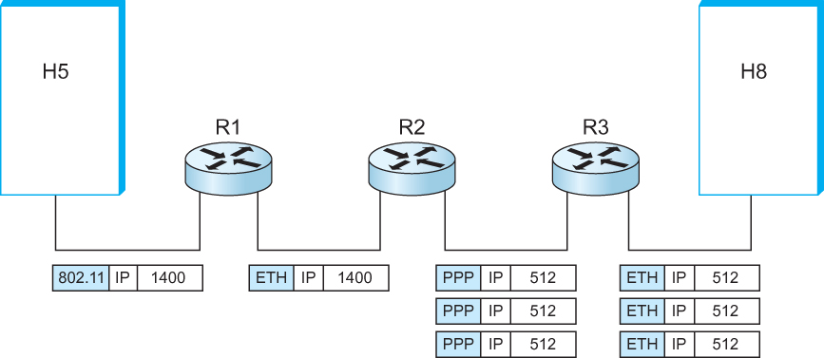
IP Fragmentation and Reassembly
  IP datagrams traversing the sequence of physical networks

Slide 71



IP Fragmentation and Reassembly
R1
R2
R3
H5
H8
Maximum Transmission Unit (MTU)

Slide 72
IP Fragmentation and Reassembly
Datagram Len=1500
?
MTU=1500
(bytes)
MTU=1500
MTU=532
R1
R2
R3
MTU=1500
Datagram Len=1500

Slide 73
IP Fragmentation and Reassembly
Fragments
Dgram Len<=532
Dgram Len<=532
Datagram Len=1500
Dgram Len<=532
MTU=1500
(bytes)
MTU=1500
MTU=532
R1
R2
R3
MTU=1500
Datagram Len=1500
Where should reassembly take place?

Slide 74
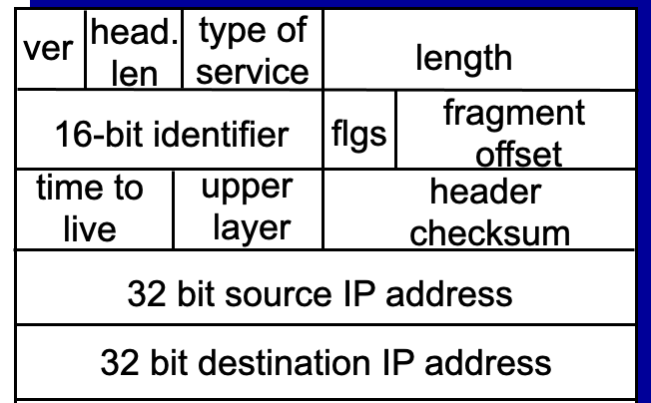
IP Fragmentation and Reassembly
Fragments
Dgram Len<=532
Dgram Len<=532
Datagram Len=1500
Dgram Len<=532
MTU=1500
(bytes)
MTU=1500
MTU=532
R1
R2
R3
MTU=1500
Datagram Len=1500
During assembly,
A. How can the destination identify all fragments of a packet?
Notes:
RFC page 24: https://www.rfc-editor.org/rfc/rfc791
The internet identification field (ID) is used together with the source and destination address, and the protocol fields, to identify datagram fragments for reassembly.

Slide 75
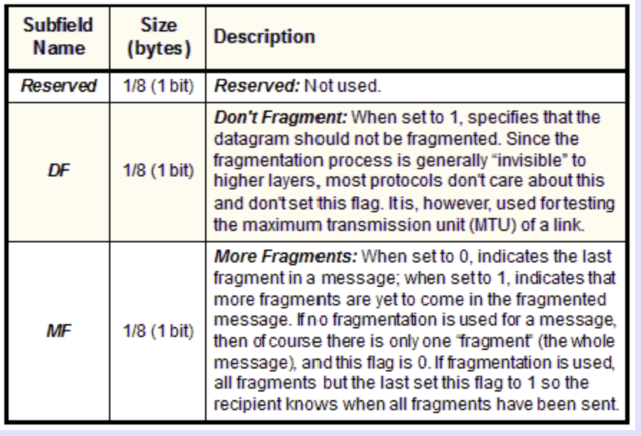
IP Fragmentation and Reassembly
Fragments
Dgram Len<=532
Dgram Len<=532
Datagram Len=1500
Dgram Len<=532
MTU=1500
(bytes)
MTU=1500
MTU=532
R1
R2
R3
MTU=1500
Datagram Len=1500
During assembly,
B. How will the destination know if the last fragment is received?
Notes:
RFC page 24: https://www.rfc-editor.org/rfc/rfc791
The internet identification field (ID) is used together with the source and destination address, and the protocol fields, to identify datagram fragments for reassembly.
If this is a whole datagram (that is both the fragment offset and the more fragments fields are zero), then it concludes that no fragmentation happened.

Slide 76
IP Fragmentation and Reassembly
Identifies the fragment location, relative to the beginning of the unfragmented data.
Fragments are counted in units of 8 octets (i.e., 8-bytes blocks).
Fragments
Dgram Len<=532
Dgram Len<=532
Datagram Len=1500
Dgram Len<=532
MTU=1500
(bytes)
MTU=1500
MTU=532
R1
R2
R3
MTU=1500
Datagram Len=1500
During assembly,
C. How will the destination know how to rearrange the data?
D. How can the destination know if a packet is unfragmented/whole?
Notes:
RFC page 24: https://www.rfc-editor.org/rfc/rfc791
The internet identification field (ID) is used together with the source and destination address, and the protocol fields, to identify datagram fragments for reassembly.
If this is a whole datagram (that is both the fragment offset and the more fragments fields are zero), then it concludes that no fragmentation happened.

Slide 77
Example: IP Fragmentation
Fragments
Dgram Len<=532
Dgram Len<=532
Datagram Len=1500
Dgram Len<=532
MTU=1500
MTU=532
R2
Header field/<info> | Value
P. Identifier | XYZ
More Frag. bit | 0
Frag. offset | 0
Header Len. | 20 (bytes)
<Data Len.> | 1400
Packer Length | 1420
Fields | Val.
P. Id
MF bit
F. off.
H. Len.
<D Len.>
Pkt Len
Frag. Pkt #1
Original Packet

Slide 78
Example: IP Fragmentation
Fragments
Dgram Len<=532
Dgram Len<=532
Datagram Len=1500
Dgram Len<=532
MTU=1500
MTU=532
R2
Header field/<info> | Value
P. Identifier | XYZ
More Frag. bit | 0
Frag. offset | 0
Header Len. | 20 (bytes)
<Data Len.> | 1400
Packer Length | 1420
Fields | Val.
P. Id | XYZ
MF bit | 1
F. off.
H. Len. | 20
<D Len.>
Pkt Len
Max. Data Len. =
Max. Packet Len. – Header Len
In integer multiple of 8-octets (8 bytes block)
Frag. Pkt #1
Original Packet

Slide 79
Example: IP Fragmentation
Fragments
Dgram Len<=532
Dgram Len<=532
Datagram Len=1500
Dgram Len<=532
MTU=1500
MTU=532
R2
Header field/<info> | Value
P. Identifier | XYZ
More Frag. bit | 0
Frag. offset | 0
Header Len. | 20 (bytes)
<Data Len.> | 1400
Packer Length | 1420
Fields | Val.
P. Id | XYZ
MF bit | 1
F. off.
H. Len. | 20
<D Len.> | 512
Pkt Len
Max. Data Len. =
Max. Packet Len. – Header Len
In integer multiple of 8-octets (8 bytes block)
Frag. Pkt #1
(532-20) = 512
Original Packet

Slide 80
Example: IP Fragmentation
Fragments
Dgram Len<=532
Dgram Len<=532
Datagram Len=1500
Dgram Len<=532
MTU=1500
MTU=532
R2
Header field/<info> | Value
P. Identifier | XYZ
More Frag. bit | 0
Frag. offset | 0
Header Len. | 20 (bytes)
<Data Len.> | 1400
Packer Length | 1420
Fields | Val.
P. Id | XYZ
MF bit | 1
F. off.
H. Len. | 20
<D Len.> | 512
Pkt Len | 532
Max. Data Len. =
Max. Packet Len. – Header Len
In integer multiple of 8-octets (8 bytes block)
Frag. Pkt #1
(532-20) = 512
Original Packet

Slide 81
Example: IP Fragmentation
Fragments
Dgram Len<=532
Dgram Len<=532
Datagram Len=1500
Dgram Len<=532
MTU=1500
MTU=532
R2
Header field/<info> | Value
P. Identifier | XYZ
More Frag. bit | 0
Frag. offset | 0
Header Len. | 20 (bytes)
<Data Len.> | 1400
Packer Length | 1420
Fields | Val.
P. Id | XYZ
MF bit | 1
F. off. | 0
H. Len. | 20
<D Len.> | 512
Pkt Len | 532
Starting 8-octet number
Max. Data Len. =
Max. Packet Len. – Header Len
In integer multiple of 8-octets (8 bytes block)
Frag. Pkt #1
(532-20) = 512
Original Packet

Slide 82
Example: IP Fragmentation
Fragments
Dgram Len<=532
Dgram Len<=532
Datagram Len=1500
Dgram Len<=532
MTU=1500
MTU=532
R2
512 bytes/8 =
64 (in 8-octets)
Header field/<info> | Value
P. Identifier | XYZ
More Frag. bit | 0
Frag. offset | 0
Header Len. | 20 (bytes)
<Data Len.> | 1400
Packer Length | 1420
Fields | Val.
P. Id | XYZ
MF bit | 1
F. off. | 0
H. Len. | 20
<D Len.> | 512
Pkt Len | 532
Fields | Val.
P. Id | XYZ
MF bit | 1
F. off. | 64
H. Len. | 20
<D Len.> | 512
Pkt Len | 532
Frag. Pkt #1
Frag. Pkt #2
Original Packet

Slide 83
Example: IP Fragmentation
Fragments
Dgram Len<=532
Dgram Len<=532
Datagram Len=1500
Dgram Len<=532
MTU=1500
MTU=532
R2
Header field/<info> | Value
P. Identifier | XYZ
More Frag. bit | 0
Frag. offset | 0
Header Len. | 20 (bytes)
<Data Len.> | 1400
Packer Length | 1420
Fields | Val.
P. Id | XYZ
MF bit | 1
F. off. | 0
H. Len. | 20
<D Len.> | 512
Pkt Len | 532
Fields | Val.
P. Id | XYZ
MF bit | 1
F. off. | 64
H. Len. | 20
<D Len.> | 512
Pkt Len | 532
Fields | Val.
P. Id | XYZ
MF bit | 0
F. off. | 128
H. Len. | 20
<D Len.> | 376
Pkt Len | 396
Frag. Pkt #1
Frag. Pkt #2
Frag. Pkt #3
Original Packet

Slide 84
Example: IP Reassembly
Fields | Val.
P. Id | XYZ
MF bit | 1
F. off. | 0
H. Len. | 20
<D Len.> | 512
Pkt Len | 532
Fields | Val.
P. Id | XYZ
MF bit | 1
F. off. | 64
H. Len. | 20
<D Len.> | 512
Pkt Len | 532
Fields | Val.
P. Id | XYZ
MF bit | 0
F. off. | 128
H. Len. | 20
<D Len.> | 376
Pkt Len | 396
Header buffer
Data buffer

Slide 85
Example: IP Reassembly
Header from
fgmt 1
(updated later)
Fields | Val.
P. Id | XYZ
MF bit | 1
F. off. | 0
H. Len. | 20
<D Len.> | 512
Pkt Len | 532
Fields | Val.
P. Id | XYZ
MF bit | 1
F. off. | 64
H. Len. | 20
<D Len.> | 512
Pkt Len | 532
Fields | Val.
P. Id | XYZ
MF bit | 0
F. off. | 128
H. Len. | 20
<D Len.> | 376
Pkt Len | 396
Header buffer
Data buffer

Slide 86
Example: IP Reassembly
Header from
fgmt 1
(updated later)
Fields | Val.
P. Id | XYZ
MF bit | 1
F. off. | 0
H. Len. | 20
<D Len.> | 512
Pkt Len | 532
Fields | Val.
P. Id | XYZ
MF bit | 1
F. off. | 64
H. Len. | 20
<D Len.> | 512
Pkt Len | 532
Fields | Val.
P. Id | XYZ
MF bit | 0
F. off. | 128
H. Len. | 20
<D Len.> | 376
Pkt Len | 396
Header buffer
0
Data from fgmt 1
64
Data from fgmt 2
128
Data from fgmt 3
What if assembly is not possible?
Data buffer

Slide 87
IP fragment and reassembly
(fragment offset)

Slide 88
IP datagram format
IP protocol version
number
32 bits
total datagram
length (bytes)
header length
(bytes)
head.
len
type of
service
ver
length
for
fragmentation/
reassembly
“type” of data
flgs
fragment
offset
16-bit identifier
max number
remaining hops
(decremented at
each router)
time to
live
upper
layer
header
checksum
32 bit source IP address
upper layer protocol
to deliver payload to
32 bit destination IP address
options (if any)
e.g. timestamp,
record route
taken, specify
list of routers
to visit.
data
(variable length,
typically a TCP
or UDP segment)

Slide 89
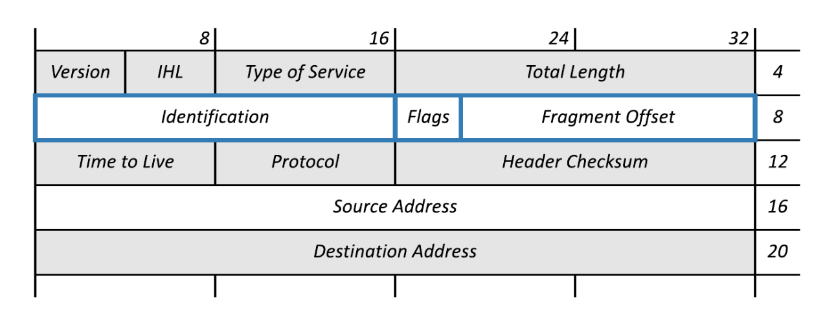
IP datagram format
3 bits
13 bits

Slide 90
IP Fragmentation and Reassembly
Each network has some MTU (Maximum Transmission Unit)
  Ethernet (1500 bytes), FDDI (4500 bytes)
Strategy
  Fragmentation occurs in a router when it receives a datagram that it wants to forward over a network which has (MTU < datagram)
  Reassembly is done at the receiving host
  All the fragments carry the same identifier in the Ident field
  Fragments are self-contained datagrams
  IP does not recover from missing fragments

Slide 91
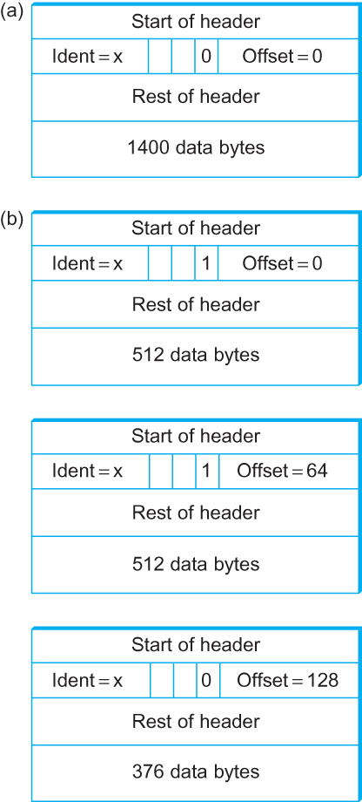
IP Fragmentation and Reassembly
Header fields used in IP fragmentation. (a) Unfragmented packet; (b) fragmented packets.

Slide 92
IP Fragmentation and Reassembly
Header fields used in IP fragmentation. (a) Unfragmented packet; (b) fragmented packets.
In terms of “8 byte blocks (i.e., octawords)”

Slide 93
IP Fragmentation and Reassembly
The offset value must be the number of 8 byte blocks of data, which means the data in the prior fragment must be a multiple of 8 bytes. The last fragment can carry data that isn’t a multiple of 8 bytes.
Header fields used in IP fragmentation. (a) Unfragmented packet; (b) fragmented packets.
In terms of “8 byte blocks (i.e., octawords)”

Slide 94
IP Fragmentation and Reassembly
Header fields used in IP fragmentation. (a) Unfragmented packet; (b) fragmented packets.

Slide 95
IP datagram format
IP protocol version
number
32 bits
total datagram
length (bytes)
header length
(bytes)
head.
len
type of
service
ver
length
for
fragmentation/
reassembly
“type” of data
flgs
fragment
offset
16-bit identifier
max number
remaining hops
(decremented at
each router)
time to
live
upper
layer
header
checksum
32 bit source IP address
upper layer protocol
to deliver payload to
32 bit destination IP address
options (if any)
e.g. timestamp,
record route
taken, specify
list of routers
to visit.
data
(variable length,
typically a TCP
or UDP segment)

Slide 96
IP Fragmentation and Reassembly
  IP datagrams traversing the sequence of physical networks

Slide 97
IP Fragmentation and Reassembly
Each network has some MTU (Maximum Transmission Unit)
  Ethernet (1500 bytes), FDDI (4500 bytes)
Strategy
  Fragmentation occurs in a router when it receives a datagram that it wants to forward over a network which has (MTU < datagram)
  Reassembly is done at the receiving host
  All the fragments carry the same identifier in the Ident field
  Fragments are self-contained datagrams
  IP does not recover from missing fragments

Slide 98
Network Addresses

Slide 99
IP Address (IPv4)
A unique 32-bit number
Identifies an interface (on a host, on a router, …)
Represented in dotted-quad notation
12
34
158
5
00001100
00100010
10011110
00000101
12:34:158:5

Slide 100
Grouping Related Hosts
The Internet is an “inter-network”
  Used to connect networks together, not hosts
  Need to address a network (i.e., group of hosts)
host
host
...
host
host
host
...
host
LAN 1
LAN 2
router
router
router
WAN
WAN
LAN = Local Area Network
WAN = Wide Area Network

Slide 101
Scalability Challenge
Suppose hosts had arbitrary addresses
  Then every router would need a lot of information
  …to know how to direct packets toward every host
1.2.3.4
5.6.7.8
2.4.6.8
1.2.3.5
5.6.7.9
2.4.6.9
host
host
...
host
host
host
...
host
LAN 1
LAN 2
router
router
router
WAN
WAN
1.2.3.4
1.2.3.5
forwarding table

Slide 102
Hierarchical Addressing in U.S. Mail
Addressing in the U.S. mail
  Zip code: 08540
  Building: 35 Olden Street
  Room in building: 306
  Name of occupant: Jennifer Rexford
Forwarding the U.S. mail
  Deliver to the post office in the zip code
  Assign to mailman covering the building
  Drop letter into mailbox for building/room
  Give letter to the appropriate person
???

Slide 103
Hierarchical Addressing: IP Prefixes
Network and host portions (left and right)
12
34
158
5
00001100
00100010
10011110
00000101
Network (24 bits)
Host (8 bits)

Slide 104
Easy to Add New Hosts
No need to update the routers
  E.g., adding a new host 5.6.7.213 on the right
  Doesn’t require adding a new forwarding-table entry
1.2.3.4
1.2.3.7
1.2.3.156
5.6.7.8
5.6.7.9
5.6.7.212
host
host
...
host
host
host
...
host
LAN 1
LAN 2
router
router
router
host
WAN
WAN
5.6.7.213
1.2.3.0/24
5.6.7.0/24
forwarding table

Slide 105
Class-full addressing

Slide 106
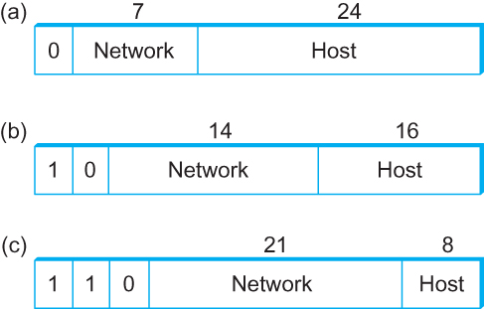
Global Addresses
Properties
  globally unique
  hierarchical: network + host
  4 Billion IP address, half are A type, ¼ is B type, and 1/8 is C type
Format
Dot notation
  10.3.2.4
  128.96.33.81
  192.12.69.77

Slide 107
Let’s assume we have 4-bit address (instead of 32 bit)
0000
0001
0010
0011
0100
0101
0110
0111
1000
1001
1010
1011
1100
1101
1110
1111
Class A (Half of all possible addresses)
Class B (1/4 of all possible addresses)
Class C (1/8 of all possible addresses)

Slide 108
Let’s assume we have 4-bit address (instead of 32 bit)
0000
0001
0010
0011
0100
0101
0110
0111
Class A (Half of all possible addresses)
Say, 1 bit for network part = 2 different networks
Say, 2 bits for host part = 4 hosts per network

Slide 109
Global Addresses
Properties
  globally unique
  hierarchical: network + host
  4 Billion IP address, half are A type, ¼ is B type, and 1/8 is C type
Format
Dot notation
  10.3.2.4
  128.96.33.81
  192.12.69.77

Slide 110
Classful Addressing
In the olden days, only fixed allocation sizes
  Class A: 0*
    Very large /8 blocks (e.g., MIT has 18.0.0.0/8)
    There can be 126 different class A networks (0 and 127 values are reserved) and (2²⁴-2) different hosts (2 values are reserved)
  Class B: 10*
    Large /16 blocks (e.g,. Princeton has 128.112.0.0/16)
  Class C: 110*
    Small /24 blocks (e.g., AT&T Labs has 192.20.225.0/24)
    2²¹ different networks possible, 254 hosts (255 is reserved for broadcast and 0 is reserved)
  Class D: 1110* for multicast groups
  Class E: 11110* reserved for future use
This is why folks use dotted-quad notation!

Slide 111
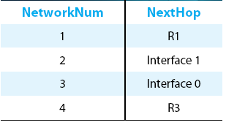
IP Datagram Forwarding
Strategy
  every datagram contains destination's address
  if directly connected to destination network, then forward to host
  if not directly connected to destination network, then forward to some router
  forwarding table maps network number into next hop
  each host has a default router
  each router maintains a forwarding table
Example (router R2)

Slide 112
IP Datagram Forwarding
Algorithm
if (NetworkNum of destination = NetworkNum of one of my interfaces) then
deliver packet to destination over that interface
else
if (NetworkNum of destination is in my forwarding table) then
deliver packet to NextHop router
else
deliver packet to default router
For a host with only one interface and only a default router in its forwarding table, this simplifies to
if (NetworkNum of destination = my NetworkNum)then
deliver packet to destination directly
else
deliver packet to default router

Slide 113
IP fragment and reassembly
(fragment offset)

Slide 114
IP datagram format
IP protocol version
number
32 bits
total datagram
length (bytes)
header length
(bytes)
head.
len
type of
service
ver
length
for
fragmentation/
reassembly
“type” of data
flgs
fragment
offset
16-bit identifier
max number
remaining hops
(decremented at
each router)
time to
live
upper
layer
header
checksum
32 bit source IP address
upper layer protocol
to deliver payload to
32 bit destination IP address
options (if any)
e.g. timestamp,
record route
taken, specify
list of routers
to visit.
data
(variable length,
typically a TCP
or UDP segment)

Slide 115
IP datagram format
3 bits
13 bits

Slide 116
IP Fragmentation and Reassembly
Each network has some MTU (Maximum Transmission Unit)
  Ethernet (1500 bytes), FDDI (4500 bytes)
Strategy
  Fragmentation occurs in a router when it receives a datagram that it wants to forward over a network which has (MTU < datagram)
  Reassembly is done at the receiving host
  All the fragments carry the same identifier in the Ident field
  Fragments are self-contained datagrams
  IP does not recover from missing fragments

Slide 117
IP Fragmentation and Reassembly
Header fields used in IP fragmentation. (a) Unfragmented packet; (b) fragmented packets.

Slide 118
IP Fragmentation and Reassembly
Header fields used in IP fragmentation. (a) Unfragmented packet; (b) fragmented packets.
In terms of “8 byte blocks (i.e., octawords)”

Slide 119
IP Fragmentation and Reassembly
The offset value must be the number of 8 byte blocks of data, which means the data in the prior fragment must be a multiple of 8 bytes. The last fragment can carry data that isn’t a multiple of 8 bytes.
Header fields used in IP fragmentation. (a) Unfragmented packet; (b) fragmented packets.
In terms of “8 byte blocks (i.e., octawords)”

Slide 120
Network Addresses

Slide 121
IP Address (IPv4)
A unique 32-bit number
Identifies an interface (on a host, on a router, …)
Represented in dotted-quad notation
12
34
158
5
00001100
00100010
10011110
00000101
12:34:158:5

Slide 122
Hierarchical Addressing: IP Prefixes
Network and host portions (left and right)
12
34
158
5
00001100
00100010
10011110
00000101
Network (24 bits)
Host (8 bits)

Slide 123
Global Addresses
Properties
  globally unique
  hierarchical: network + host
  4 Billion IP address, half are A type, ¼ is B type, and 1/8 is C type
Format
Dot notation
  10.3.2.4
  128.96.33.81
  192.12.69.77

Slide 124
IP Datagram Forwarding
Algorithm
if (NetworkNum of destination = NetworkNum of one of my interfaces) then
deliver packet to destination over that interface
else
if (NetworkNum of destination is in my forwarding table) then
deliver packet to NextHop router
else
deliver packet to default router
For a host with only one interface and only a default router in its forwarding table, this simplifies to
if (NetworkNum of destination = my NetworkNum)then
deliver packet to destination directly
else
deliver packet to default router

Slide 125
Obtaining a Block of Addresses
Internet Corporation for Assigned Names and Numbers (ICANN)
  Allocates large blocks to Regional Internet Registries
Regional Internet Registries (RIRs)
  E.g., ARIN (American Registry for Internet Numbers)
  Allocates to ISPs and large institutions
Internet Service Providers (ISPs)
  Allocate address blocks to their customers
  Who may, in turn, allocate to their customers…

Slide 126
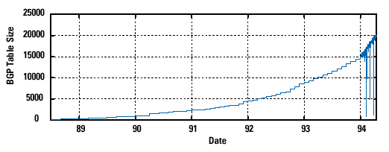
Pre-CIDR (1988-1994): Steep Growth
Growth faster than improvements in equipment capability

Slide 127
Subnetting

Slide 128
Problems with the classes of addresses
Wastage of addresses
Bigger tables to look up at routers

Slide 129
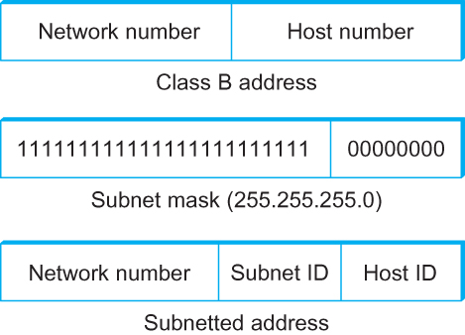
Subnetting
Add another level to address/routing hierarchy: subnet
Subnet masks define variable partition of host part of class A and B addresses
Subnets visible only within site

Slide 130
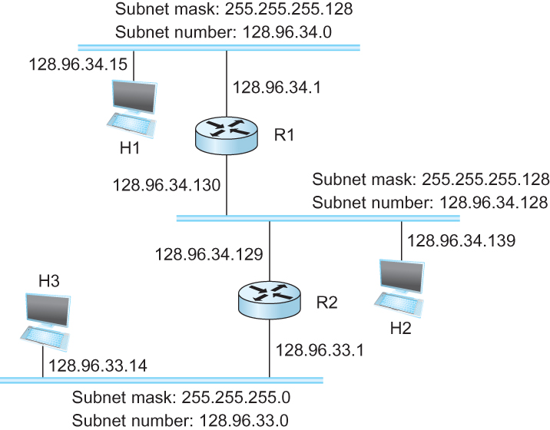
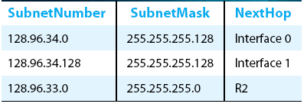
Subnetting
Forwarding Table at Router R1

Slide 131
Subnetting
Forwarding Table at Router R1
Forwarding Algorithm
D = destination IP address
for each entry < SubnetNum, SubnetMask, NextHop>
  D1 = SubnetMask & D
  if D1 = SubnetNum
    if NextHop is an interface
    deliver datagram directly to destination
    else
    deliver datagram to NextHop (a router)

Slide 132
Subnetting
Notes
Would use a default router if nothing matches
Not necessary for all ones in subnet mask to be contiguous
Can put multiple subnets on one physical network
Subnets not visible from the rest of the Internet

Slide 133
Class-less addressing: CIDR

Slide 134
IP addressing: CIDR
CIDR: Classless InterDomain Routing
  subnet portion of address of arbitrary length
  address format: a.b.c.d/x, where x is # bits in subnet portion of address
subnet
part
host
part
11001000 00010111 00010000 00000000
200.23.16.0/23
200.23.16.0–200.23.17.255

Slide 135
Classless Inter-Domain Routing (CIDR)
Use two 32-bit numbers to represent a network.
Network number = IP address + Mask
IP Address : 12.4.0.0 IP Mask: 255.254.0.0
Address
00001100
00000100
00000000
00000000
Mask
11111111
11111110
00000000
00000000
Network Prefix
for hosts
Written as 12.4.0.0/15

Slide 136
Hierarchical Address Allocation
Hierarchy is key to scalability
  Address allocated in contiguous chunks (prefixes)
  Today, the Internet has about 400,000 prefixes
12.0.0.0/16
12.1.0.0/16
:
:
:
12.3.0.0/24
12.2.0.0/16
12.3.1.0/24
12.3.0.0/16
:
:
:
:
:
12.0.0.0/8
12.3.254.0/24
12.253.0.0/19
12.253.32.0/19
:
:
12.254.0.0/16
12.253.160.0/19

Slide 137
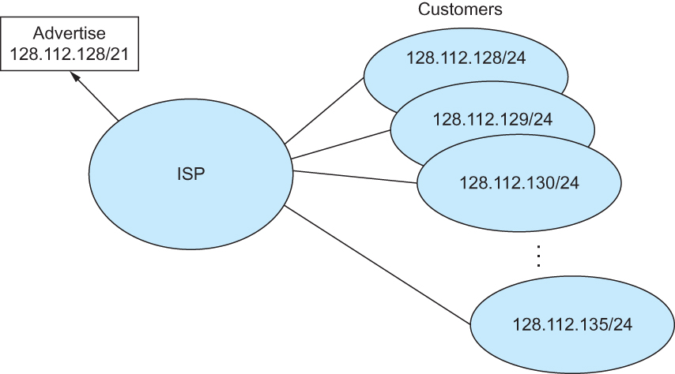
Classless Addressing
Route aggregation with CIDR

Slide 138
Separate Forwarding Entry Per Prefix
Prefix-based forwarding
  Map the destination address to matching prefix
  Forward to the outgoing interface
1.2.3.4
1.2.3.7
1.2.3.156
5.6.7.8
5.6.7.9
5.6.7.212
host
host
...
host
host
host
...
host
LAN 1
LAN
router
router
router
WAN
WAN
1.2.3.0/24
5.6.7.0/24
forwarding table

Slide 139
CIDR Makes Packet Forwarding Harder
Forwarding table may have many matches
  E.g., entries for 201.10.0.0/21 and 201.10.6.0/23
  The IP address 201.10.6.17 would match both!
201.10.0.0/21
Provider 1
Provider 2
201.10.0.0/22
201.10.4.0/24
201.10.5.0/24
201.10.6.0/23

Slide 140
Longest Prefix Match Forwarding
Destination-based forwarding
  Packet has a destination address
  Router identifies longest-matching prefix
  Cute algorithmic problem: very fast lookups
forwarding table
4.0.0.0/8
4.83.128.0/17
201.10.0.0/21
201.10.6.0/23
126.255.103.0/24
destination
201.10.6.17
outgoing link
Serial0/0.1

Slide 141
Pre-CIDR (1988-1994): Steep Growth
Growth faster than improvements in equipment capability

Slide 142
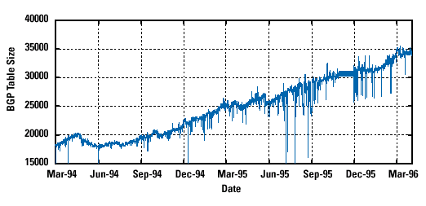
CIDR (1994-1996): Much Flatter
Efforts to aggregate

Slide 143
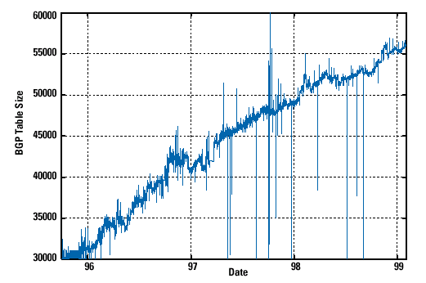
CIDR Growth (1996-1998): Roughly Linear
Good use of aggregation, and peer pressure!

Slide 144
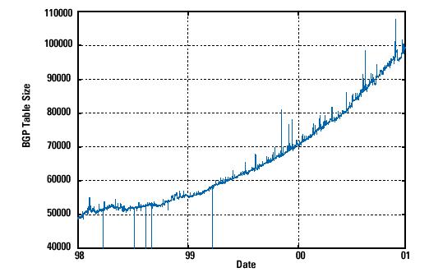
DotCom Boom (1998-2001): Steep Growth
Internet boom and increased multi-homing

Slide 145
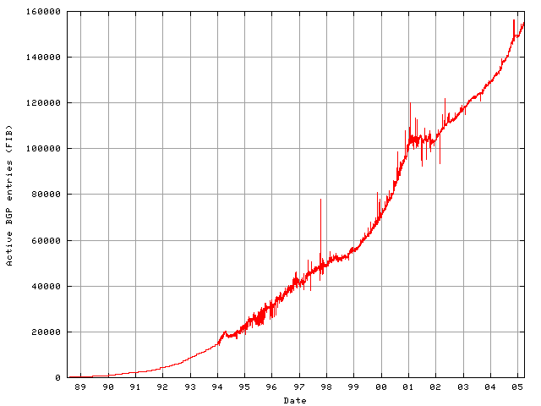
Long Term (1989-2005): Post-Boom
Today we are up to ~400,000 prefixes

Slide 146
Subnets and CIDR
Subnets “toy” example

Slide 147


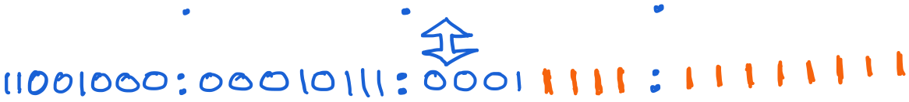
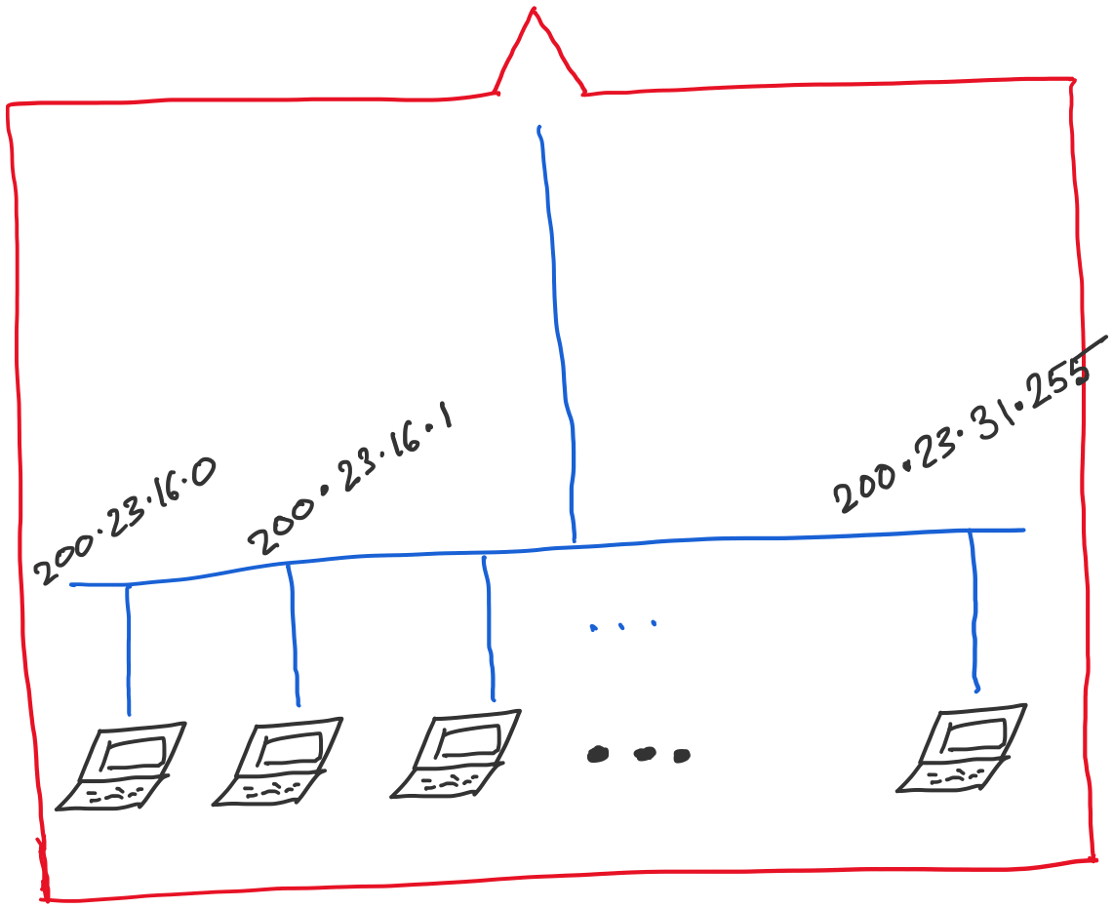
Address space assigned to you:

Slide 148
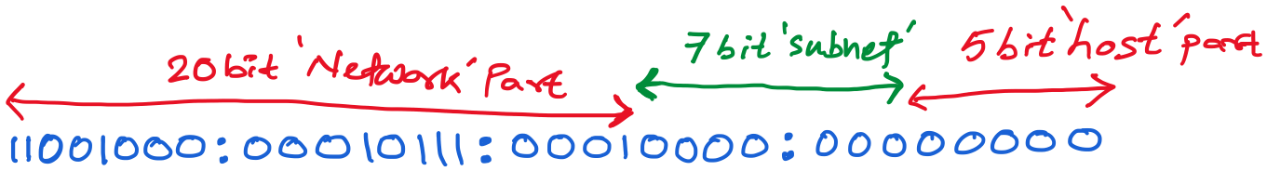
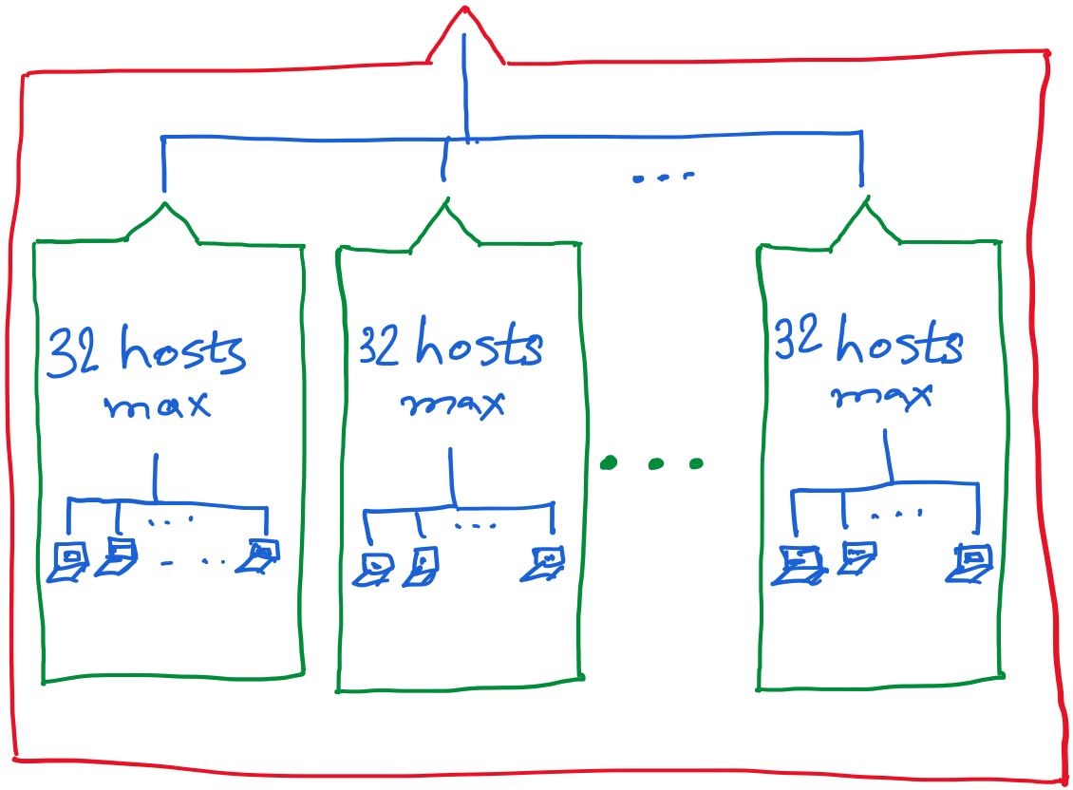

Slide 149
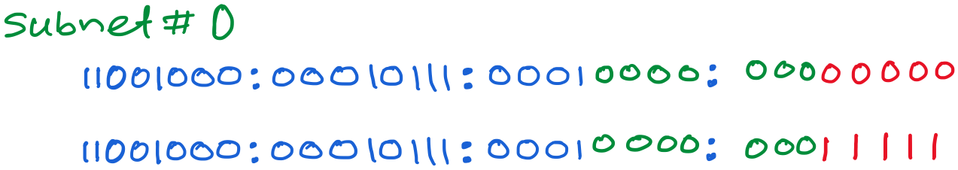
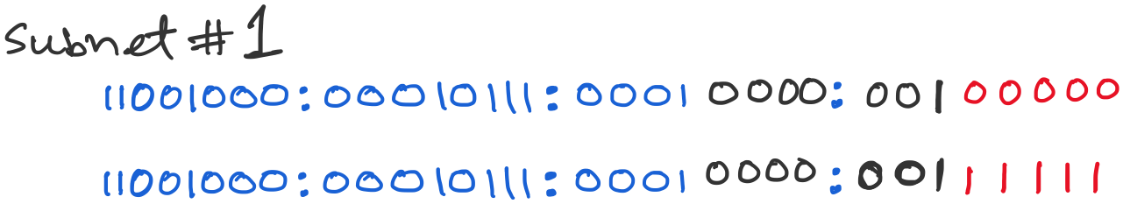
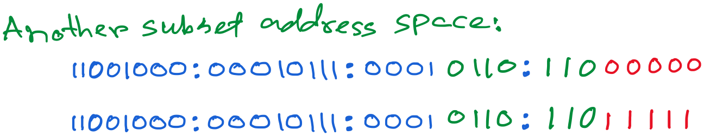

Slide 150
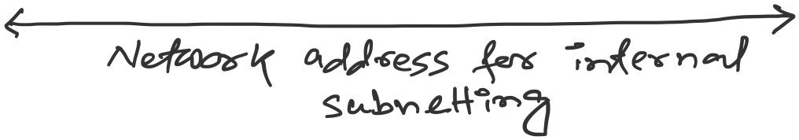

Slide 151
Getting an IP address: DHCP

Slide 152
IP addresses: how to get one?
Q: How does a host get IP address?
hard-coded by system admin in a file
  Windows: control-panel->network->configuration->tcp/ip->properties
  UNIX: /etc/…
DHCP: Dynamic Host Configuration Protocol: dynamically get address from a server
  “plug-and-play”

Slide 153
DHCP: Dynamic Host Configuration Protocol
goal: allow host to dynamically obtain its IP address from network server when it joins network
  can renew its lease on address in use
  allows reuse of addresses (only hold address while connected/“on”)
  support for mobile users who want to join network

Slide 154
DHCP: Dynamic Host Configuration Protocol
DHCP overview:
  host broadcasts “DHCP discover” msg [optional]
  DHCP server responds with “DHCP offer” msg
  host requests IP address: “DHCP request” msg
  DHCP server sends address: “DHCP ack” msg

Slide 155



DHCP client-server scenario
DHCP
server
223.1.1.0/24
223.1.1.1
223.1.2.1
223.1.1.2
arriving DHCP
client needs
address in this
network
223.1.1.4
223.1.2.9
223.1.3.27
223.1.2.2
223.1.1.3
223.1.2.0/24
223.1.3.1
223.1.3.2
223.1.3.0/24

Slide 156
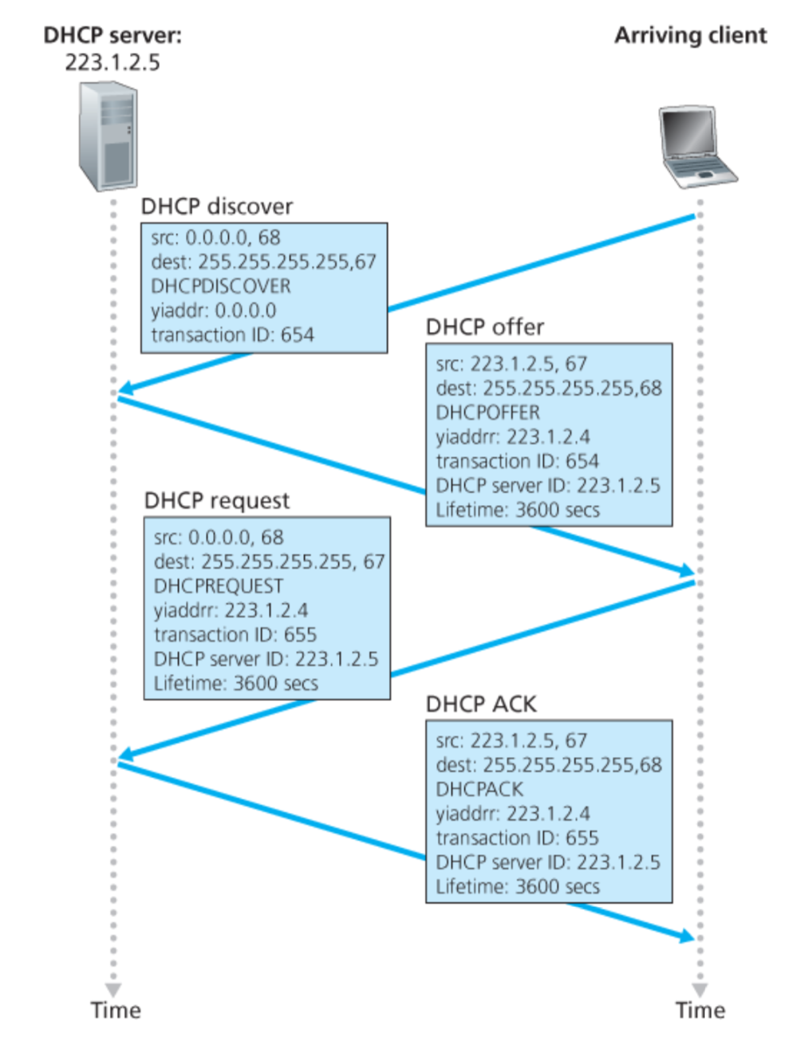
Broadcast: is there a DHCP server out there?
Broadcast: I’m a DHCP server! Here’s an IP address you can use
Broadcast: OK. I’ll take that IP address!
Broadcast: OK. You’ve got that IP address!

Slide 157
DHCP: more than IP addresses
DHCP can return more than just allocated IP address on subnet:
  address of first-hop router for client
  name and IP address of DNS sever
  network mask (indicating network versus host portion of address)

Slide 158
Dynamic Host Configuration Protocol (DHCP)
DHCP server is responsible for providing configuration information to hosts
DHCP server maintains a pool of available addresses
There is at least one DHCP server for an administrative domain (a server or a relay agent per subnet)

Slide 159
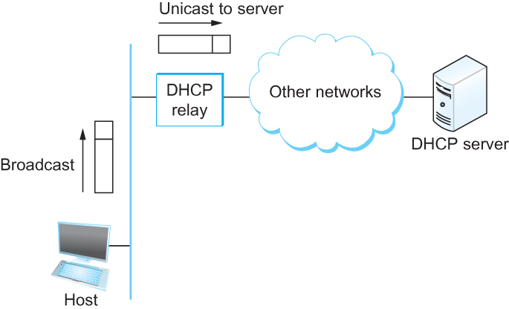
DHCP
Newly booted or attached host sends DHCPDISCOVER message to a special IP address (255.255.255.255)
DHCP relay agent unicasts the message to DHCP server and waits for the response

