Slide 1

Computer Networks
CMSC 417 : Spring 2023
Topic: Internetworking: CIDR, DHCP, NAT, ARP
(Textbook chapter 3)
Nirupam Roy
Tu-Th 2:00-3:15pm
CSI 2117
Feb 27th, 2024

Slide 2
Class-less Interdomain Routing (CIDR)
Generalizes the ideas of subnetting

Slide 3

Lessons learned from subnetting
Forwarding tab.
Forwarding tab.
223.1.1.0
223.1.1.0
223.1.2.0
223.1.2.0
223.1.1.0
223.1.3.0
223.1.3.0
ISP
223.1.2.0
223.1.3.0

Slide 4
Lessons learned from subnetting
Forwarding tab.
Forwarding tab.
223.1.1.0
223.1.1.0
223.1.2.0
223.1.2.0
223.1.1.128
223.1.1.0
223.1.3.0
223.1.3.0
223.1.1.192
ISP
223.1.2.0
223.1.3.0

Slide 5
Lessons learned from subnetting
Forwarding tab.
Forwarding tab.
223.1.1.0
223.1.1.0
223.1.2.0
223.1.2.0
223.1.1.128
223.1.1.0
223.1.3.0
223.1.3.0
223.1.1.192
ISP
Lesson 1:
Address classes are not needed. Mask can define the number of bits for the network part.
Lesson 2:
Network hierarchies can be hidden from the outside world.
Network addresses can be aggregated/summarized/combined
223.1.2.0
223.1.3.0

Slide 6
CIDR: Classless address

Slide 7
IP addressing: CIDR
CIDR: Classless InterDomain Routing
  Network portion of address of arbitrary length
  address format: a.b.c.d/x, where x is # bits in subnet portion of address
subnet
part
host
part
11001000 00010111 00010000 00000000
200.23.16.0/23
200.23.16.0–200.23.17.255
This X bit network part is often called Prefix or Network-prefix

Slide 8
IP addressing: CIDR
CIDR: Classless InterDomain Routing
  subnet portion of address of arbitrary length
  address format: a.b.c.d/x, where x is # bits in subnet portion of address
forwarding table
4.0.0.0/8
4.83.128.0/17
201.10.0.0/21
201.10.6.0/23
126.255.103.0/24

Slide 9
CIDR: Super-netting/
Route aggregation

Slide 10
Lessons learned from subnetting
Forwarding tab.
Forwarding tab.
223.1.1.0/24
223.1.1.0/24
223.1.2.0/24
223.1.2.0/24
223.1.1.0
223.1.3.0/24
223.1.3.0/24
ISP
223.1.0.0/16
223.1.2.0
223.1.3.0

Slide 11
Lessons learned from subnetting
Forwarding tab.
Forwarding tab.
223.1.1.0/24
223.1.0.0/16
223.1.2.0/24
223.1.1.0
223.1.3.0/24
ISP
223.1.0.0/16
223.1.2.0
223.1.3.0

Slide 12
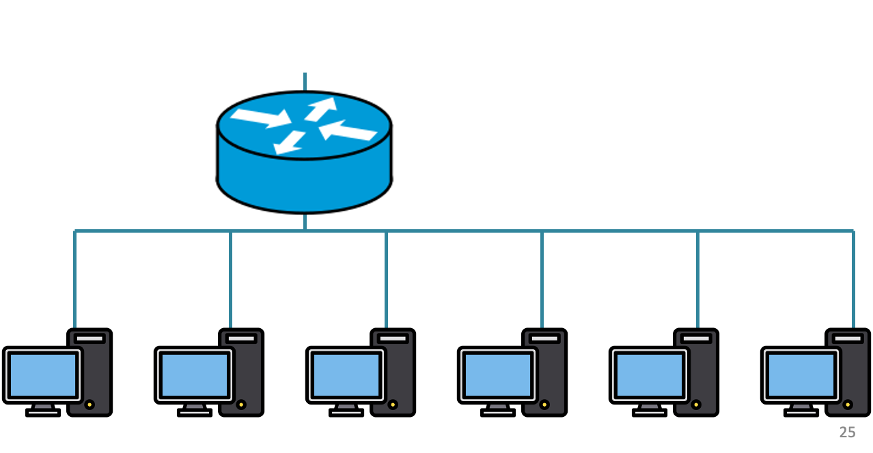
200.20.1.0/24
200.20.2.0/24
200.20.0.0/24

Slide 13
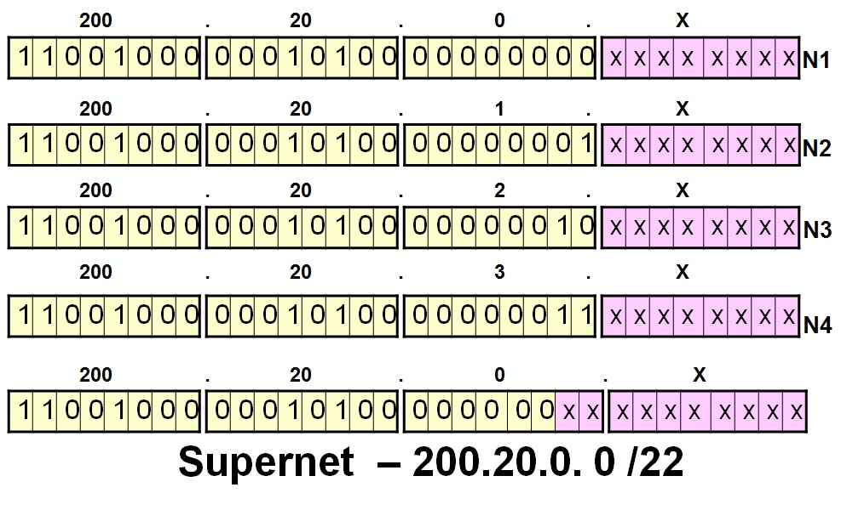
200.20.1.0/24
200.20.2.0/24
200.20.0.0/24

Slide 14
Route aggregation
200.20.1.0/24
200.20.2.0/24
200.20.0.0/24

Slide 15
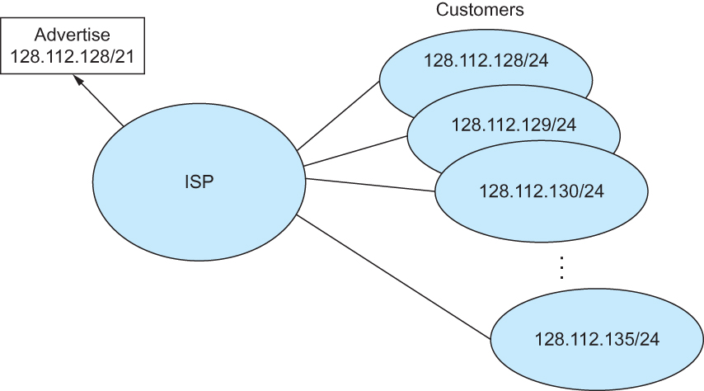
Route aggregation with CIDR

Slide 16
Classless Inter-Domain Routing (CIDR)
Use two 32-bit numbers to represent a network.
Network number = IP address + Mask
IP Address : 12.4.0.0 IP Mask: 255.254.0.0
Address
00001100
00000100
00000000
00000000
Mask
11111111
11111110
00000000
00000000
Network Prefix
for hosts
Written as 12.4.0.0/15

Slide 17
Hierarchical Address Allocation
Hierarchy is key to scalability
  Address allocated in contiguous chunks (prefixes)
  Today, the Internet has about 400,000 prefixes
12.0.0.0/16
12.1.0.0/16
:
:
:
12.3.0.0/24
12.2.0.0/16
12.3.1.0/24
12.3.0.0/16
:
:
:
:
:
12.0.0.0/8
12.3.254.0/24
12.253.0.0/19
12.253.32.0/19
:
:
12.254.0.0/16
12.253.160.0/19

Slide 18
Separate Forwarding Entry Per Prefix
Prefix-based forwarding
  Map the destination address to matching prefix
  Forward to the outgoing interface
1.2.3.4
1.2.3.7
1.2.3.156
5.6.7.8
5.6.7.9
5.6.7.212
host
host
...
host
host
host
...
host
LAN 1
LAN
router
router
router
WAN
WAN
1.2.3.0/24
5.6.7.0/24
forwarding table

Slide 19
CIDR Makes Packet Forwarding Harder
201.10.0.0/21
Provider 1
201.10.0.0/22
201.10.4.0/24
201.10.5.0/24
201.10.6.0/23

Slide 20
CIDR Makes Packet Forwarding Harder
201.10.0.0/21
Provider 1
Provider 2
Multi-homing
201.10.0.0/22
201.10.4.0/24
201.10.5.0/24
201.10.6.0/23

Slide 21
CIDR Makes Packet Forwarding Harder
Forwarding tab.
201.10.0.0/21
Provider 1
Provider 2
Multi-homing
201.10.0.0/22
201.10.4.0/24
201.10.5.0/24
201.10.6.0/23

Slide 22
CIDR Makes Packet Forwarding Harder
Forwarding tab.
201.10.0.0/21
201.10.6.0/23
201.10.0.0/21
Provider 1
Provider 2
Multi-homing
201.10.0.0/22
201.10.4.0/24
201.10.5.0/24
201.10.6.0/23

Slide 23
CIDR Makes Packet Forwarding Harder
Forwarding table
201.10.0.0/21
11001001.00001010.00000000.00000000/21
201.10.6.0/23
11001001.00001010.00000110.00000000/23
A packet with dest. Addr.: 201.10.6.17
11001001.00001010.00000110.00010001

Slide 24
CIDR Makes Packet Forwarding Harder
Forwarding table may have many matches
  E.g., entries for 201.10.0.0/21 and 201.10.6.0/23
  The IP address 201.10.6.17 would match both!
201.10.0.0/21
Provider 1
Provider 2
201.10.0.0/22
201.10.4.0/24
201.10.5.0/24
201.10.6.0/23

Slide 25
Longest Prefix Match Forwarding
Destination-based forwarding
  Packet has a destination address
  Router identifies longest-matching prefix
  Cute algorithmic problem: very fast lookups
forwarding table
4.0.0.0/8
4.83.128.0/17
201.10.0.0/21
201.10.6.0/23
126.255.103.0/24
destination
201.10.6.17
outgoing link

Slide 26
Getting an IP address:
DHCP Protocol

Slide 27
IP addresses: how to get one?
Q: How does a host get its IP address?
hard-coded by system admin in a file
  Windows: control-panel->network->configuration->tcp/ip->properties
  UNIX: /etc/…
DHCP: Dynamic Host Configuration Protocol: dynamically get address from a server
  “plug-and-play”

Slide 28
DHCP: Dynamic Host Configuration Protocol
goal: allow host to dynamically obtain its IP address from network server when it joins network
  can renew its lease on address in use
  allows reuse of addresses (only hold address while connected/“on”)
  support for mobile users who want to join network

Slide 29
DHCP: Dynamic Host Configuration Protocol
DHCP overview:
  host broadcasts “DHCP discover” msg
  DHCP server responds with “DHCP offer” msg
  host requests IP address: “DHCP request” msg
  DHCP server sends address: “DHCP ack” msg

Slide 30



DHCP client-server scenario
DHCP
server
223.1.1.0/24
223.1.1.1
223.1.2.1
223.1.1.2
arriving DHCP
client needs
address in this
network
223.1.1.4
223.1.2.9
223.1.3.27
223.1.2.2
223.1.1.3
223.1.2.0/24
223.1.3.1
223.1.3.2
223.1.3.0/24

Slide 31
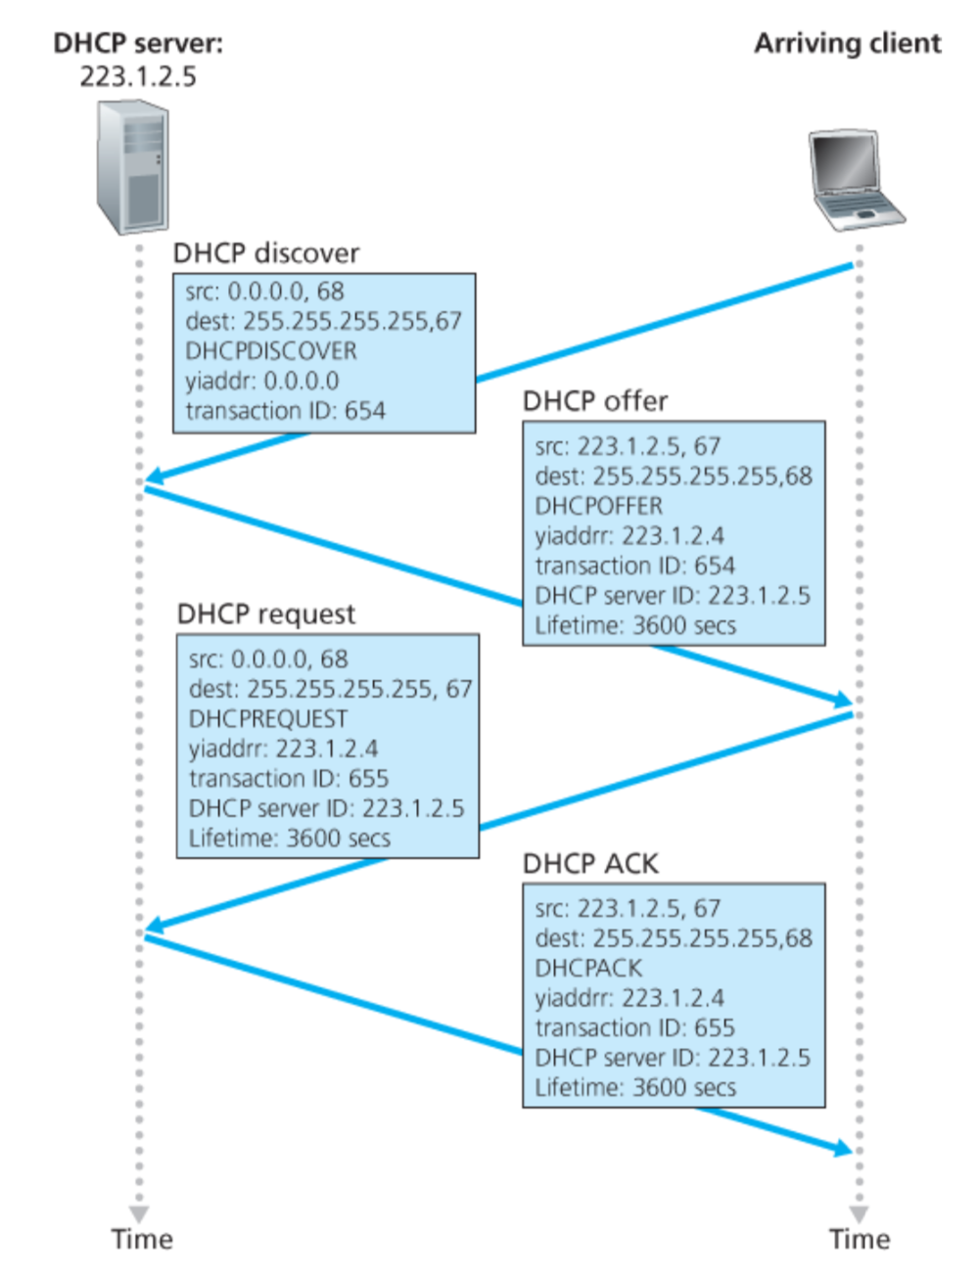
Broadcast: is there a DHCP server out there?

Slide 32
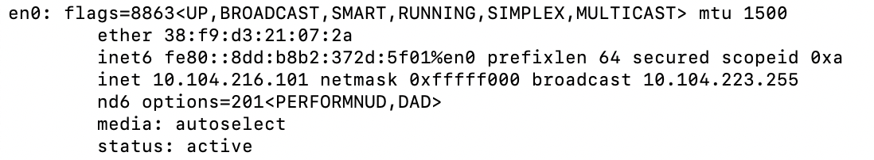
A note on the “broadcast address”

Slide 33
inet 10.104.216.101 ➔ 00001010.01101000.11011000.01100101
netmask ff:ff:f0:00 ➔ 11111111.11111111.11110000.00000000
broadcast 10.104.223.255 ➔
00001010.01101000.11011111.11111111

Slide 34
Broadcast: is there a DHCP server out there?
Which protocol would you use to exchange these DHCP protocol messages?

Slide 35
Broadcast: is there a DHCP server out there?
Broadcast: I’m a DHCP server! Here’s an IP address you can use
Broadcast: OK. I’ll take that IP address!
Broadcast: OK. You’ve got that IP address!

Slide 36
Broadcast: is there a DHCP server out there?
Broadcast: I’m a DHCP server! Here’s an IP address you can use
Broadcast: OK. I’ll take that IP address!
Broadcast: OK. You’ve got that IP address!

Slide 37
Broadcast: is there a DHCP server out there?
Broadcast: I’m a DHCP server! Here’s an IP address you can use
Broadcast: OK. I’ll take that IP address!
Broadcast: OK. You’ve got that IP address!

Slide 38
Broadcast: is there a DHCP server out there?
Broadcast: I’m a DHCP server! Here’s an IP address you can use
Broadcast: OK. I’ll take that IP address!
Broadcast: OK. You’ve got that IP address!

Slide 39
Broadcast: is there a DHCP server out there?
Broadcast: I’m a DHCP server! Here’s an IP address you can use
Broadcast: OK. I’ll take that IP address!
Broadcast: OK. You’ve got that IP address!

Slide 40
Broadcast: is there a DHCP server out there?
Broadcast: I’m a DHCP server! Here’s an IP address you can use
Broadcast: OK. I’ll take that IP address!
Broadcast: OK. You’ve got that IP address!

Slide 41
Broadcast: is there a DHCP server out there?
Broadcast: I’m a DHCP server! Here’s an IP address you can use
Broadcast: OK. I’ll take that IP address!
Broadcast: OK. You’ve got that IP address!

Slide 42
Broadcast: is there a DHCP server out there?
Broadcast: I’m a DHCP server! Here’s an IP address you can use
Broadcast: OK. I’ll take that IP address!
Broadcast: OK. You’ve got that IP address!

Slide 43
Broadcast: is there a DHCP server out there?
Broadcast: I’m a DHCP server! Here’s an IP address you can use
Broadcast: OK. I’ll take that IP address!
Broadcast: OK. You’ve got that IP address!

Slide 44
Broadcast: is there a DHCP server out there?
Broadcast: I’m a DHCP server! Here’s an IP address you can use
Broadcast: OK. I’ll take that IP address!
Broadcast: OK. You’ve got that IP address!

Slide 45
Broadcast: is there a DHCP server out there?
Broadcast: I’m a DHCP server! Here’s an IP address you can use
Broadcast: OK. I’ll take that IP address!
Broadcast: OK. You’ve got that IP address!

Slide 46
Broadcast: is there a DHCP server out there?
Broadcast: I’m a DHCP server! Here’s an IP address you can use
Broadcast: OK. I’ll take that IP address!
Broadcast: OK. You’ve got that IP address!

Slide 47
Broadcast: is there a DHCP server out there?
Broadcast: I’m a DHCP server! Here’s an IP address you can use
Broadcast: OK. I’ll take that IP address!
Broadcast: OK. You’ve got that IP address!

Slide 48
Broadcast: is there a DHCP server out there?
Broadcast: I’m a DHCP server! Here’s an IP address you can use
Broadcast: OK. I’ll take that IP address!
Broadcast: OK. You’ve got that IP address!

Slide 49
Broadcast: is there a DHCP server out there?
Broadcast: I’m a DHCP server! Here’s an IP address you can use
Broadcast: OK. I’ll take that IP address!
Broadcast: OK. You’ve got that IP address!

Slide 50
Broadcast: is there a DHCP server out there?
Broadcast: I’m a DHCP server! Here’s an IP address you can use
Broadcast: OK. I’ll take that IP address!
Broadcast: OK. You’ve got that IP address!

Slide 51
Thank you

Slide 54
DHCP: more than IP addresses
DHCP can return more than just allocated IP address on subnet:
  address of first-hop router for client
  name and IP address of DNS sever
  network mask (indicating network versus host portion of address)

Slide 55
Dynamic Host Configuration Protocol (DHCP)
DHCP server is responsible for providing configuration information to hosts
DHCP server maintains a pool of available addresses
There is at least one DHCP server for an administrative domain (a server or a relay agent per subnet)

Slide 56
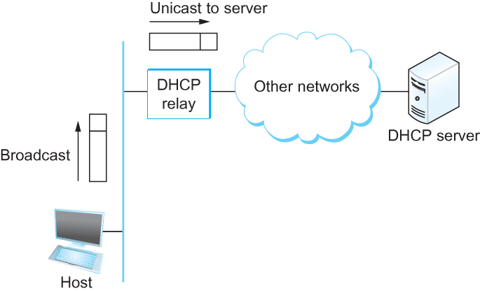
DHCP relay
Newly booted or attached host sends DHCPDISCOVER message to a special IP address (255.255.255.255)
DHCP relay agent unicasts the message to DHCP server and waits for the response

Slide 57
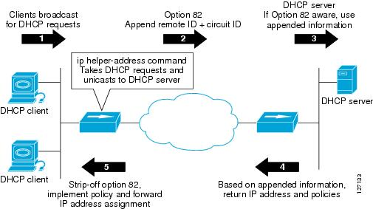
DHCP relay

Slide 58
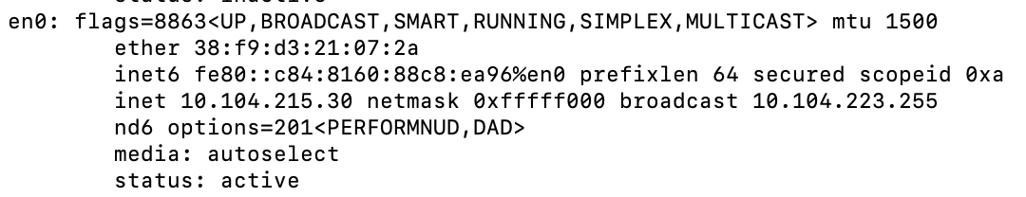
Check your IP addresses
(ifconfig/ipconfig)

Slide 59
Check your IP addresses
(ifconfig/ipconfig)

Slide 60
Private Address Space
&
NAT

Slide 61
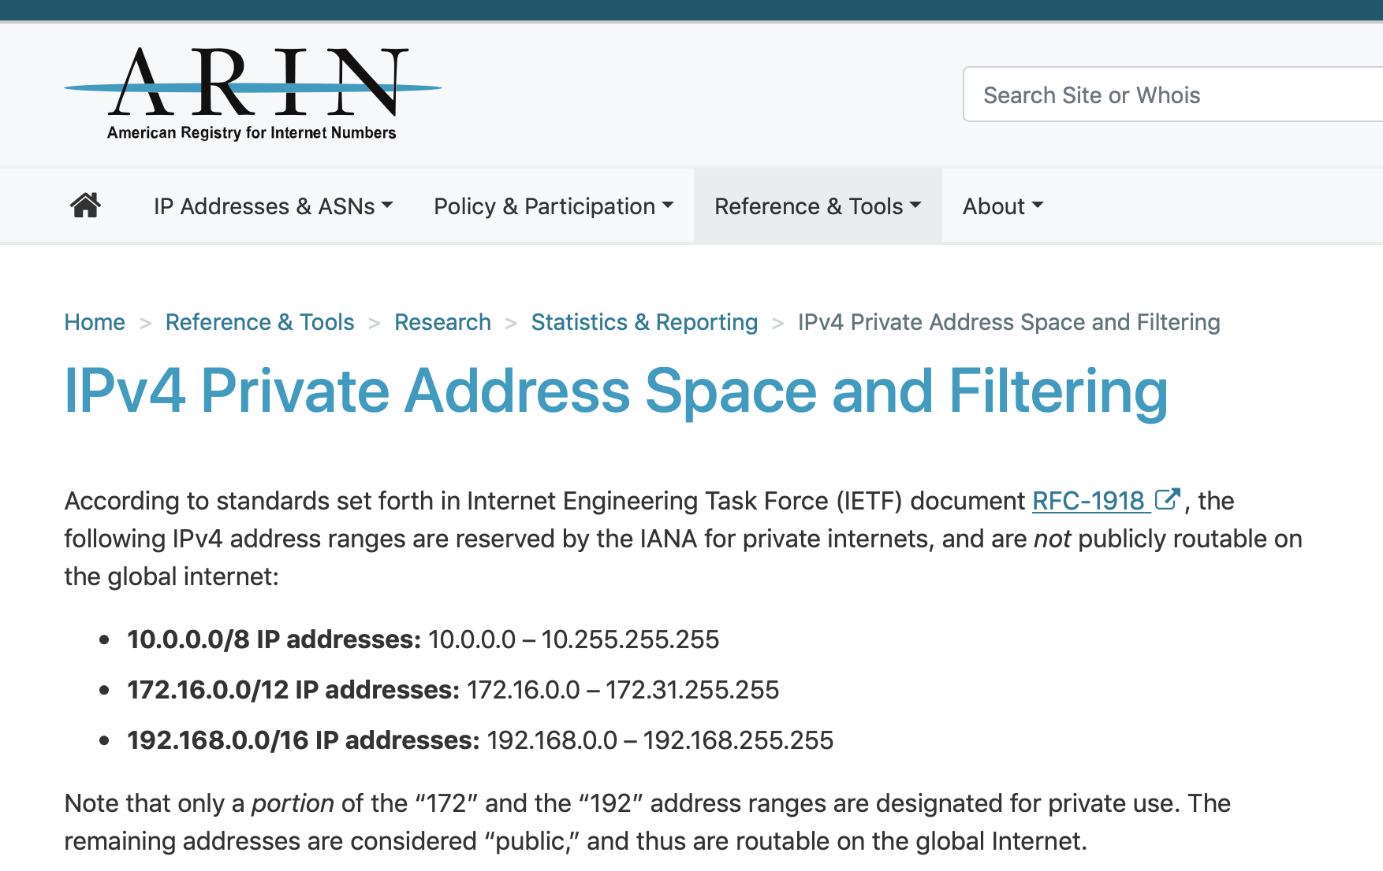

Slide 62
NAT: network address translation
rest of
Internet
local network
(e.g., home network)
10.0.0.0/24
10.0.0.1
10.0.0.4
10.0.0.2
138.76.29.7
10.0.0.3
all datagrams leaving local
network have same single source NAT IP address: 138.76.29.7,different source port numbers
datagrams with source or
destination in this network
have 10.0.0.0/24 address for
source, destination (as usual)

Slide 63
NAT: network address translation
NAT translation table
WAN side addr LAN side addr
2: NAT router
changes datagram
source addr from
10.0.0.1, 3345 to
138.76.29.7, 5001,
updates table
1: host 10.0.0.1
sends datagram to
128.119.40.186, 80
138.76.29.7, 5001 10.0.0.1, 3345
…… ……
S: 10.0.0.1, 3345
D: 128.119.40.186, 80
10.0.0.1
1
2
S: 138.76.29.7, 5001
D: 128.119.40.186, 80
10.0.0.4
10.0.0.2
138.76.29.7
S: 128.119.40.186, 80
D: 10.0.0.1, 3345
4
S: 128.119.40.186, 80
D: 138.76.29.7, 5001
3
10.0.0.3
4: NAT router
changes datagram
dest addr from
138.76.29.7, 5001 to 10.0.0.1, 3345
3: reply arrives
dest. address:
138.76.29.7, 5001

Slide 64
NAT: network address translation
motivation: local network uses just one IP address as far as outside world is concerned:
  range of addresses not needed from ISP: just one IP address for all devices
  can change addresses of devices in local network without notifying outside world
  can change ISP without changing addresses of devices in local network
  devices inside local net not explicitly addressable, visible by outside world (a security plus)

Slide 65
NAT: network address translation
implementation: NAT router must:
  outgoing datagrams: replace (source IP address, port #) of every outgoing datagram to (NAT IP address, new port #)
    . . . remote clients/servers will respond using (NAT IP address, new port #) as destination addr
  remember (in NAT translation table) every (source IP address, port #) to (NAT IP address, new port #) translation pair
  incoming datagrams: replace (NAT IP address, new port #) in dest fields of every incoming datagram with corresponding (source IP address, port #) stored in NAT table

Slide 66
NAT: network address translation
implementation: NAT router must:
  outgoing datagrams: replace (source IP address, port #) of every outgoing datagram to (NAT IP address, new port #)
    . . . remote clients/servers will respond using (NAT IP address, new port #) as destination addr
  remember (in NAT translation table) every (source IP address, port #) to (NAT IP address, new port #) translation pair
  incoming datagrams: replace (NAT IP address, new port #) in dest fields of every incoming datagram with corresponding (source IP address, port #) stored in NAT table

Slide 67
NAT: network address translation
16-bit port-number field:
  Over 60,000 simultaneous connections with a single LAN-side address!
NAT challenges:
  violates end-to-end argument
    NAT possibility must be taken into account by app designers, e.g., P2P applications
  NAT traversal: what if client wants to connect to server behind NAT?

Slide 68
Network-specific address
(IP address) vs
LAN-specific address
(HW address)

Slide 69

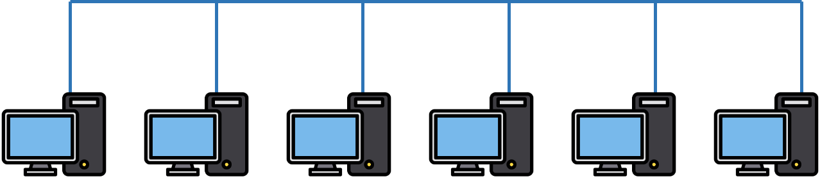

Two perspectives of addresses:
(1)Network-to-network & (2)machine-to-machine
Destination
Router
Source

Slide 70
application
transport
network
link
physical
Router
Source

Slide 71
network
link
physical
application
transport
network
link
physical
Router
Source

Slide 72
network
link
physical
Router
Hierarchical address for addressing networks
(IP address)

Slide 73
network
link
physical
application
transport
network
link
physical
Router
Source

Slide 74
Flat address for addressing machines at the link-layer
(MAC address)
network
link
physical
application
transport
network
link
physical
Router
Source

Slide 75
Address Resolution Protocol (ARP)

Slide 76
MAC addresses and ARP
32-bit IP address:
  network-layer address for interface
  used for layer 3 (network layer) forwarding
MAC (or LAN or physical or Ethernet) address:
  function: used “locally” to get frame from one interface to another physically-connected interface (same network, in IP-addressing sense)
  48 bit MAC address (for most LANs) burned in NIC ROM, also sometimes software settable
  e.g.: 1A-2F-BB-76-09-AD
hexadecimal (base 16) notation
(each “numeral” represents 4 bits)

Slide 77
MAC addresses and ARP
each adapter on LAN has unique LAN addr. or MAC addr.
1A-2F-BB-76-09-AD
LAN
(wired or
wireless)
adapter
71-65-F7-2B-08-53
58-23-D7-FA-20-B0
0C-C4-11-6F-E3-98

Slide 78
MAC addresses (more)
MAC address allocation administered by IEEE
manufacturer buys portion of MAC address space (to assure uniqueness)
analogy:
  MAC address: like Social Security Number
  IP address: like postal address
MAC flat address ➜ portability
  can move LAN card from one LAN to another
IP hierarchical address not portable
  address depends on IP subnet to which node is attached

Slide 79


ARP: address resolution protocol
Question: how to determine
interface’s MAC address, knowing its IP address?
ARP table: each IP node (host, router) on LAN has table
  IP/MAC address mappings for some LAN nodes:
< IP address; MAC address; TTL>
  TTL (Time To Live): time after which address mapping will be forgotten (typically 20 min)
137.196.7.78
1A-2F-BB-76-09-AD
137.196.7.23
137.196.7.14
LAN
71-65-F7-2B-08-53
58-23-D7-FA-20-B0
0C-C4-11-6F-E3-98
137.196.7.88

Slide 80
ARP protocol: same LAN
A wants to send datagram to B
  B’s MAC address not in A’s ARP table.
A broadcasts ARP query packet, containing B's IP address
  destination MAC address = FF-FF-FF-FF-FF-FF
  all nodes on LAN receive ARP query
B receives ARP packet, replies to A with its (B's) MAC address
  frame sent to A’s MAC address (unicast)
A caches (saves) IP-to-MAC address pair in its ARP table until information becomes old (times out)
  soft state: information that times out (goes away) unless refreshed
ARP is “plug-and-play”:
  nodes create their ARP tables without intervention from net administrator

Slide 81
Address Translation Protocol (ARP)
Map IP addresses into physical addresses
  destination host
  next hop router
Techniques
  encode physical address in host part of IP address
  table-based
ARP (Address Resolution Protocol)
  table of IP to physical address bindings
  broadcast request if IP address not in table
  target machine responds with its physical address
  table entries are discarded if not refreshed
  Query message include the physical address of the sending host. Why?

Slide 82
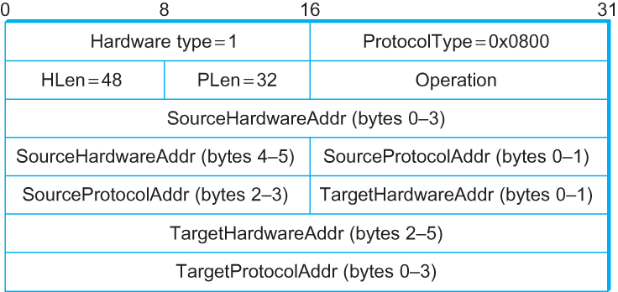
ARP Packet Format
  HardwareType: type of physical network (e.g., Ethernet)
  ProtocolType: type of higher layer protocol (e.g., IP)
  HLEN & PLEN: length of physical and protocol addresses
  Operation: request or response
  Source/Target Physical/Protocol addresses

Slide 83
Internet Control Message Protocol (ICMP)

Slide 84
Internet Control Message Protocol (ICMP)
Defines a collection of error messages that are sent back to the source host whenever a router or host is unable to process an IP datagram successfully
  Destination host unreachable due to link /node failure
  Reassembly process failed
  TTL had reached 0 (so datagrams don't cycle forever)
  IP header checksum failed
ICMP-Redirect
  From router to a source host
  With a better route information

Slide 85
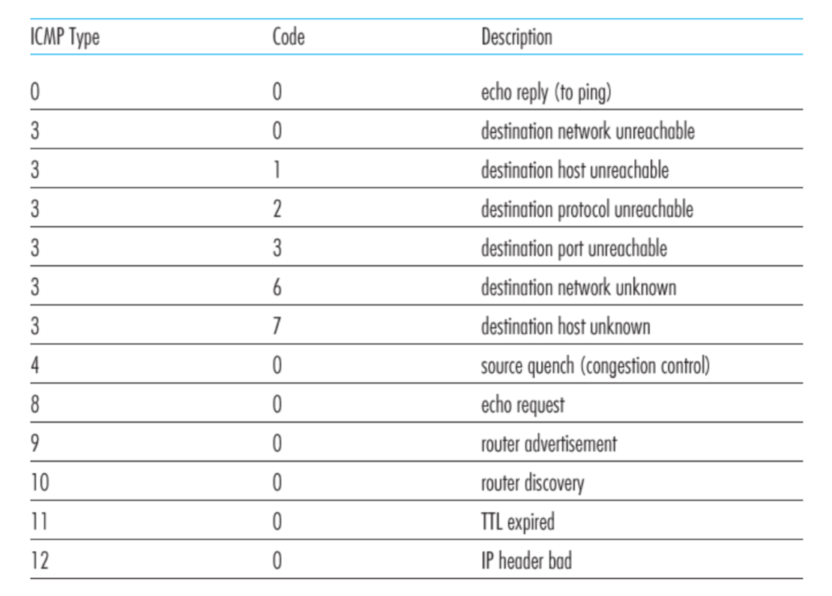
ICMP message types

Slide 86
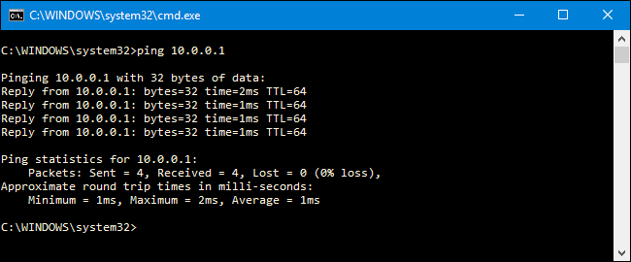
Ping example

