Slide 1

Computer Networks
CMSC 417 : Spring 2025
Topic: Transport layer
(Textbook 5)
Nirupam Roy
Tu-Th 2:00-3:15pm
CSI 2117
March 24th, 2025

Slide 2
Connection-less mux/demux:
- User Datagram Protocol (UDP)
Connection-oriented mux/demux:
- Transmission Control Protocol (TCP)

Slide 3
Connectionless demultiplexing
When host receives UDP segment:
  checks destination port number in segment
  directs UDP segment to socket with that port number
IP datagrams with different source IP addresses and/or source port numbers directed to same socket
Create sockets with port numbers:
DatagramSocket mySocket1 = new DatagramSocket(99111);
DatagramSocket mySocket2 = new DatagramSocket(99222);
UDP socket identified by two-tuple:
(dest IP address, dest port number)

Slide 4
Connectionless demux (cont)
DatagramSocket serverSocket = new DatagramSocket(6428);
P2
P1
P3
P1
SP: 6428
SP: 6428
DP: 9157
DP: 5775
SP: 9157
SP: 5775
client
IP: A
DP: 6428
server
IP: C
DP: 6428
Client
IP:B
SP provides “return address”

Slide 5
Connection-oriented demux
TCP socket identified by 4-tuple:
  source IP address
  source port number
  dest IP address
  dest port number
recv host uses all four values to direct segment to appropriate socket
Server host may support many simultaneous TCP sockets:
  each socket identified by its own 4-tuple
Web servers have different sockets for each connecting client
  non-persistent HTTP will have different socket for each request

Slide 6
Connection-oriented demux (cont)
= socket
= process
P1
P4
P5
P6
P2
P1
P3
SP: 5775
DP: 80
S-IP: B
D-IP:C
SP: 9157
SP: 9157
client
IP: A
DP: 80
server
IP: C
DP: 80
Client
IP:B
S-IP: A
S-IP: B
D-IP:C
D-IP:C

Slide 7
Connection-oriented demux: Threaded Web Server
= socket
= process
P1
P4
P2
P1
P3
SP: 5775
DP: 80
S-IP: B
D-IP:C
SP: 9157
SP: 9157
client
IP: A
DP: 80
server
IP: C
DP: 80
Client
IP:B
S-IP: A
S-IP: B
D-IP:C
D-IP:C

Slide 8
(2) Abstraction of services

Slide 9
IP Protocol Stack: Key Abstractions
Application
Applications
Transport
Streams of data
Messages
Network
Best-effort global packet delivery
Best-effort local packet delivery
Link
Transport layer is where we “pay the piper”
  Provide applications with good abstractions
  Without support or feedback from the network

Slide 10
End-to-end Protocols
(UDP, TCP)

Slide 11
End-to-end Protocols
Common properties that a transport protocol can be expected to provide
  Guarantees message delivery
  Delivers messages in the same order they were sent
  Delivers at most one copy of each message
  Supports arbitrarily large messages
  Supports synchronization between the sender and the receiver
  Allows the receiver to apply flow control to the sender
  Supports multiple application processes (Mux/DeMux)

Slide 12
End-to-end Protocols
Typical limitations of the network on which transport protocol will operate
  Drop messages/Packet loss
  Reorder messages/Out of order delivery
  Deliver duplicate copies of a given message
  Limit messages to some finite size
  Deliver messages after an arbitrarily long delay

Slide 13
User Datagram Protocol (UDP)

Slide 14
UDP: User Datagram Protocol [RFC 768]
Bare minimum Internet transport protocol
“best effort” service, UDP segments may be:
  lost
  delivered out of order to app
connectionless:
  no handshaking between UDP sender, receiver
  each UDP segment handled independently of others

Slide 15
User Datagram Protocol (UDP)
Datagram messaging service
  Demultiplexing: port numbers
  Detecting corruption: checksum
Lightweight communication between processes
  Send and receive messages
  Avoid overhead of any ordered, reliable delivery
SRC port
DST port
length
checksum
DATA

Slide 16
UDP: more
often used for streaming multimedia apps
  loss tolerant
  rate sensitive
other UDP uses
  DNS
  SNMP
reliable transfer over UDP: add reliability at application layer
  application-specific error recovery!
32 bits
Length, in
bytes of UDP
segment,
including
header
source port #
dest port #
length
checksum
Application
data
(message)
UDP segment format

Slide 17
UDP checksum
Goal: detect “errors” (e.g., flipped bits) in transmitted segment
Sender:
treat segment contents as sequence of 16-bit integers
checksum: addition (1’s complement sum) of segment contents
sender puts checksum value into UDP checksum field
Receiver:
compute checksum of received segment
check if computed checksum equals checksum field value:
  NO - error detected
  YES - no error detected.
Is UDP service == IP service ??

Slide 18
Recall encapsulation

Slide 19
Advantages of UDP
Fine-grain control
  UDP sends as soon as the application writes
No connection set-up delay
  UDP sends without establishing a connection
No connection state
  No buffers, parameters, sequence #s, etc.
Small header overhead
  UDP header is only eight-bytes long

Slide 20
Popular Applications That Use UDP
Multimedia streaming
  Retransmitting packets is not always worthwhile
  E.g., phone calls, video conferencing, gaming, IPTV
Simple query-response protocols
  Overhead of connection establishment is overkill
  E.g., Domain Name System (DNS), DHCP, etc.
“Address for www.cnn.com?”
“12.3.4.15”

Slide 21
How to introduce reliability in transport?

Slide 22
What are the expectations from a reliable packet delivery system?
Guaranteed delivery
Ordered delivery
At-most one copy of the message
(any or all of the above)

Slide 23
What are the features of the underlying ‘best effort’ network?
Packet loss
Out of order delivery
Multiple copies
Delay variations
A non-zero probability of packet delivery

Slide 24
Transmission Control Protocol (TCP)

Slide 25
TCP “Segments”
Host A
Byte 1
Byte 2
Byte 3
Byte 80
Segment sent when:
Segment full (Max Segment Size),
Not full, but times out, or
“Pushed” by application.
TCP Data
TCP Data
Host B
Byte 1
Byte 2
Byte 3
Byte 80

Slide 26
Sequence Number
Host A
ISN (initial sequence number)
Byte 81
Sequence number =
ISN+ # of the 1st byte the segment
TCP Data
TCP Data
Host B

Slide 27
Sequence Number
Host A
ISN (initial sequence number)
Byte 81
Sequence number =
ISN+ # of the 1st byte the segment
TCP Data
TCP Data
Host B
How are acknowledgements identified?

Slide 28
TCP Header

Slide 29
Acknowledgement Number
Host A
ISN (initial sequence number)
Byte 81
Sequence number =
ISN+ # of the 1st byte the segment
TCP Data
ACK number ==
Next expected Seq number
TCP Data
Host B

Slide 30
Starting and Ending a Connection:
TCP Handshakes
(Three-Way Handshake)

Slide 31
Establishing a TCP Connection
A
B
SYN
SYN ACK
Each host tells its ISN to the other host.
ACK
Data
Data
Three-way handshake to establish connection
  Host A sends a SYN (open) to the host B
  Host B returns a SYN acknowledgment (SYN ACK)
  Host A sends an ACK to acknowledge the SYN ACK

Slide 32
TCP Header
32 bits
Source port
Destination port
Sequence number
Flags:
SYN
FIN
RST
PSH
URG
ACK
Acknowledgment
HdrLen
0
Flags
Advertised window
Checksum
Urgent pointer
Options (variable)
Data

Slide 33
TCP Header
Notes:
The TCP Header Length (also known as Data Offset) is a 4-bit field in the TCP header, which defines the size of the TCP header in 32-bit (4-byte) words.
How It Works
The 4-bit field allows values from 0 to 15.
Each unit in this field represents 4 bytes (32 bits).
The minimum TCP header size is 20 bytes (when the field is 5, meaning 5 × 4 = 20 bytes).
The maximum TCP header size is 60 bytes (when the field is 15, meaning 15 × 4 = 60 bytes).

Slide 36
Step 1: A’s Initial SYN Packet
A’s port
B’s port
A’s Initial Sequence Number
Flags:
SYN
FIN
RST
PSH
URG
ACK
Acknowledgment
20
Flags
Advertised window
0
Checksum
Urgent pointer
Options (variable)
A tells B it wants to open a connection…

Slide 39
Step 2: B’s SYN-ACK Packet
B’s port
A’s port
B’s Initial Sequence Number
Flags:
SYN
FIN
RST
PSH
URG
ACK
A’s ISN plus 1
20
Flags
Advertised window
0
Checksum
Urgent pointer
Options (variable)
B tells A it accepts, and is ready to hear the next byte…
… upon receiving this packet, A can start sending data

Slide 42
Step 3: A’s ACK of the SYN-ACK
A’s port
B’s port
Sequence number
Flags:
SYN
FIN
RST
PSH
URG
ACK
B’s ISN plus 1
20
Flags
Advertised window
0
Checksum
Urgent pointer
Options (variable)
A tells B it is okay to start sending
… upon receiving this packet, B can start sending data

Slide 44
What is really happening?
Exchange of ISNs
(a) Alice --> Bob SYNchronize with my Initial Sequence Number of X
(b) Alice <-- Bob I received your syn, I ACKnowledge that I am ready for [X+1]
(c) Alice <-- Bob SYNchronize with my Initial Sequence Number of Y
(d) Alice --> Bob I received your syn, I ACKnowledge that I am ready for [Y+1]
Piggybacking information
(a) Alice --> Bob : SYN
(b) Alice <-- Bob : SYN+ACK
(c) Alice --> Bob : ACK
Can data piggyback on 3-way handshake packets?
Notes:
TCP is a bi-directional communication protocol, which means either end ought to be able to send data reliably. Both parties need to establish an ISN, and both parties need to acknowledge the other's ISN.
Piggyback: Data can piggyback on the TCP three-way handshake, a technique often called "TCP Fast Open" (TFO).

Slide 45
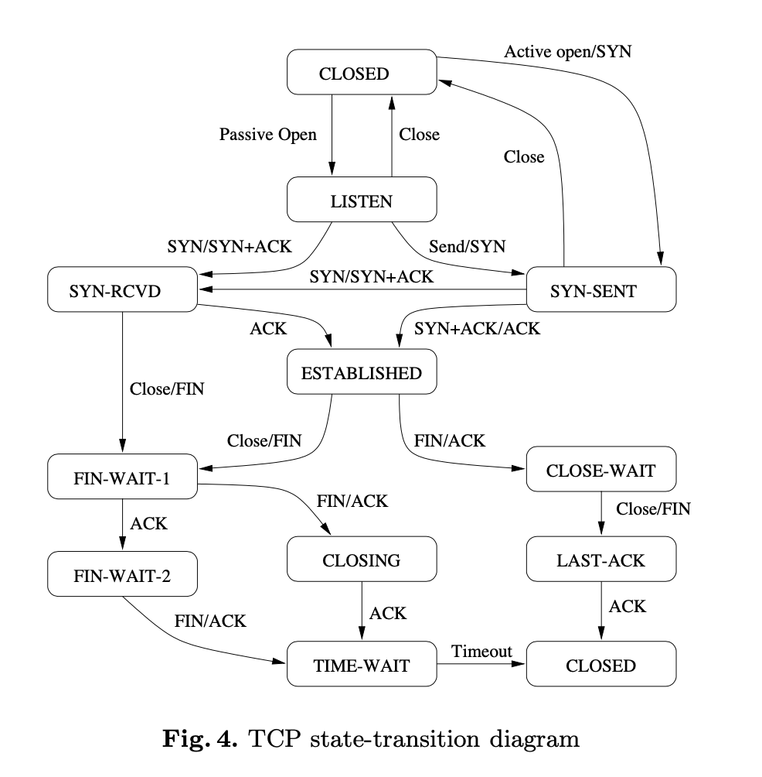
[Ref] Efficient Reachability Analysis of Hierarchical Reactive Machines

Slide 46
What if the SYN Packet Gets Lost?
Suppose the SYN packet gets lost
  Packet is lost inside the network, or
  Server rejects the packet (e.g., listen queue is full)
Eventually, no SYN-ACK arrives
  Sender sets a timer and wait for the SYN-ACK
  … and retransmits the SYN if needed
How should the TCP sender set the timer?
  Sender has no idea how far away the receiver is
  Some TCPs use a default of 3 or 6 seconds

Slide 47
SYN Loss and Web Downloads
User clicks on a hypertext link
  Browser creates a socket and does a “connect”
  The “connect” triggers the OS to transmit a SYN
If the SYN is lost…
  The 3-6 seconds of delay is very long
  The impatient user may click “reload”
User triggers an “abort” of the “connect”
  Browser “connects” on a new socket
  Essentially, forces a fast send of a new SYN!

Slide 48
Tearing Down the Connection
B
ACK
SYN
SYN ACK
Data
ACK
FIN
ACK
FIN
ACK
A
time
Closing (each end of) the connection
  Finish (FIN) to close and receive remaining bytes
  And other host sends a FIN ACK to acknowledge

Slide 49
Tearing Down the Connection
B
ACK
SYN
SYN ACK
Data
ACK
FIN
ACK
FIN
ACK
A
time
Closing (each end of) the connection
  Finish (FIN) to close and receive remaining bytes
  And other host sends a FIN ACK to acknowledge
  Reset (RST) to close and not receive remaining bytes

Slide 50
Sending/Receiving the FIN Packet
Sending a FIN: close()
  Process is done sending data via the socket
  Process invokes “close()” to close the socket
  Once TCP has sent all the outstanding bytes…
  … then TCP sends a FIN
Receiving a FIN: EOF
  Process is reading data from the socket
  Eventually, the attempt to read returns an EOF

Slide 51
TCP Header: PSH and URG flags
Notes:
The TCP PSH (Push) flag is a control flag used to indicate that the receiving device should deliver the data to the receiving application as soon as possible, rather than buffering it.

Slide 52
TCP Header: PSH and URG flags
Notes:
The URG (Urgent) flag is another control flag in TCP, which is used to indicate that some data in the packet is urgent and requires immediate attention. However, unlike the PSH flag, the URG flag is rarely used in modern applications.
Example Scenario:
In Telnet or SSH, if a user presses Ctrl+C, the OS should immediately terminate a running command. The key press is sent with the URG flag and processed ahead of buffered data.

Slide 53
Reliable Delivery on a Lossy Channel With Bit Errors

Slide 54
Challenges of Reliable Data Transfer
Over a perfectly reliable channel
  Easy: sender sends, and receiver receives
Over a channel with bit errors
  Receiver detects errors and requests retransmission
Over a lossy channel with bit errors
  Some data are missing, and others corrupted
  Receiver cannot always detect loss
Over a channel that may reorder packets
  Receiver cannot distinguish loss from out-of-order

Slide 55
Retransmission hints
Acknowledgments from receiver
  Positive: “okay” or “uh huh” or “ACK”
  Negative: “please repeat that” or “NACK”
Retransmission by the sender
  After not receiving an “ACK”
  After receiving a “NACK”
Timeout by the sender (“stop and wait”)
  Don’t wait forever without some acknowledgment

Slide 56
TCP Support for Reliable Delivery
Detect bit errors: checksum
  Used to detect corrupted data at the receiver
  …leading the receiver to drop the packet
Detect missing data: sequence number
  Used to detect a gap in the stream of bytes
  ... and for putting the data back in order
Recover from lost data: retransmission
  Sender retransmits lost or corrupted data
  Two main ways to detect lost packets

Slide 57
TCP Acknowledgments
Host A
ISN (initial sequence number)
Sequence number = ISN+1st byte
TCP Data
ACK sequence number = next expected byte
TCP Data
Host B

Slide 58
Automatic Repeat reQuest (ARQ)
ACK and timeouts
  Receiver sends ACK when
  it receives packet
  Sender waits for ACK
  and times out
Simplest ARQ protocol
  Stop and wait
  Send a packet, stop and wait until ACK arrives
Sender
Receiver
Packet
Timeout
ACK
Time

Slide 59
Automatic Repeat reQuest (ARQ)
We will discuss two variations
  1. Stop and Wait
  2. Sliding window

Slide 60
Reliable Delivery on a Lossy Channel With Bit Errors
Stop-and-Wait Protocol

Slide 61
Sender
Receiver
Packet
Timeout
ACK
Time

Slide 62
A few design decisions
  1. Unique packet identifiers: Why and how
  2. Duplicate packets: Why and how to eliminate
  3. Timeout: picking the ideal value

Slide 63
A few design decisions
  1. Unique packet identifiers: Why and how
  2. Duplicate packets: Why and how to eliminate
  3. Timeout: picking the ideal value

Slide 64
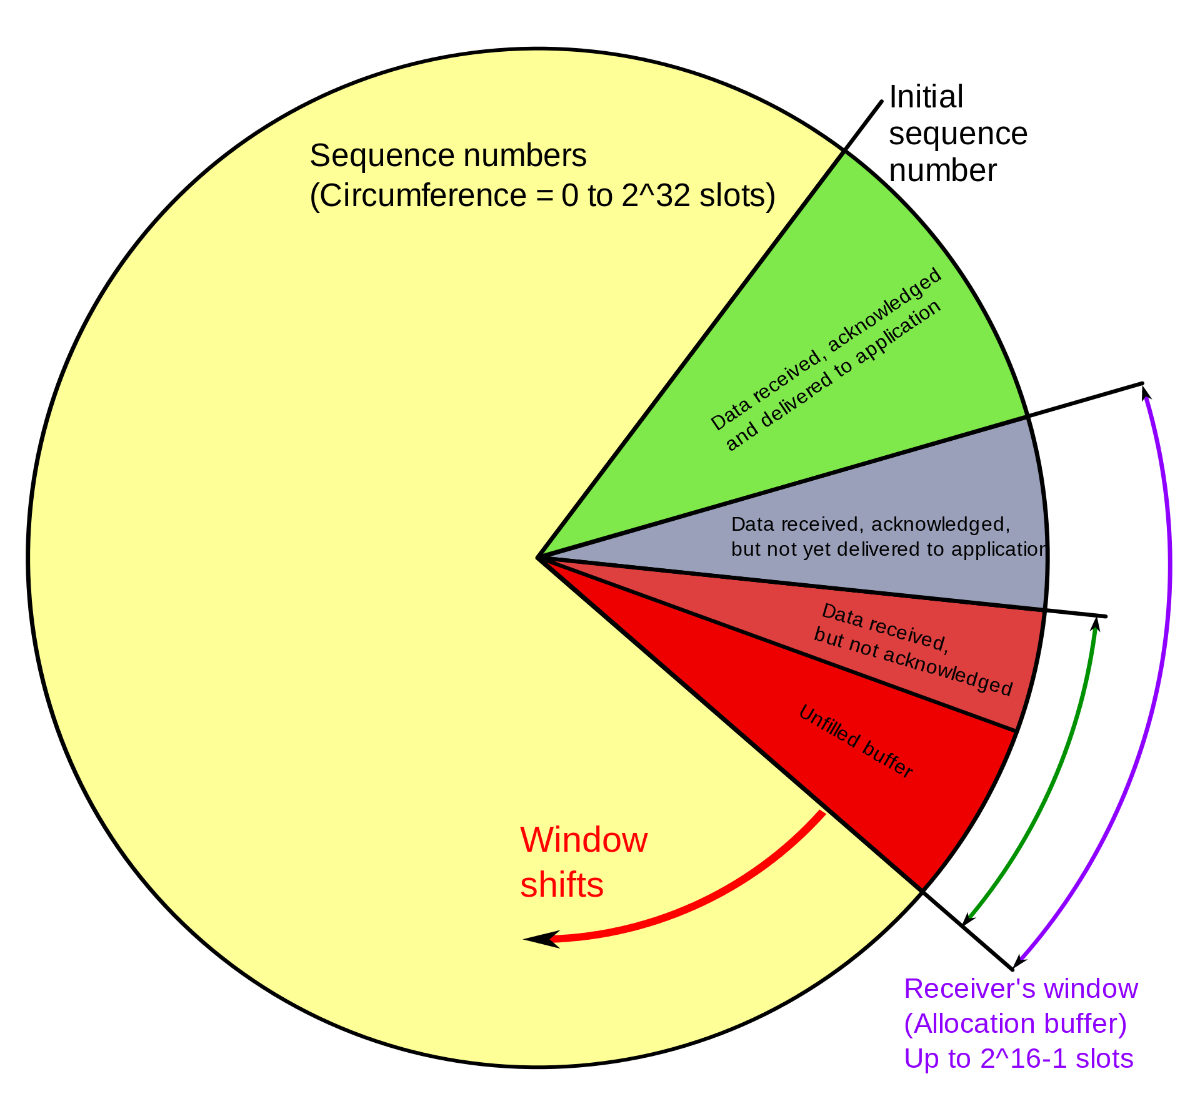
PC: https://en.wikipedia.org/wiki/Transmission_Control_Protocol

Slide 65
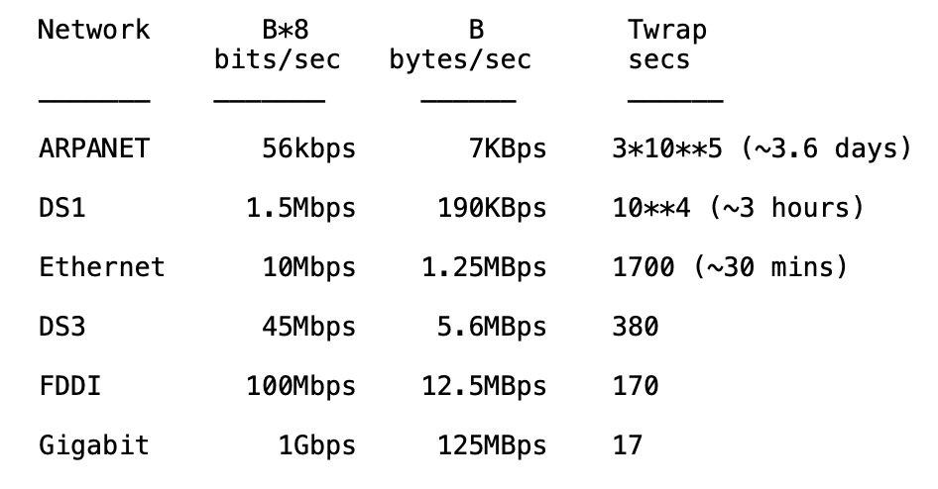
Wrap around is possible
REF: RFC 1323

Slide 66
Wrap around-aware sequence number comparison
If A and B are sequence numbers,
A < B if 0 < (B - A) < 2**31,
computed in unsigned 32-bit arithmetic
PAWS: Protect Against Wrapped Sequence Numbers
(RFC 1323) – Use sequence number and timestamps.
REF: RFC 1323

Slide 67
A few design decisions
  1. Unique packet identifiers: Why and how
  2. Duplicate packets: Why and how to eliminate
  3. Timeout: picking the ideal value

Slide 68
A few design decisions
  2. Duplicate packets: Why and how to eliminate
  - Receiver maintain the last in-sequence byte number in a variable, say rcv_seqnum
  - If the Receiver receives a packet with seq number less than or equal to rcv_seqnum

Slide 69
A few design decisions
  2. Duplicate packets: Why and how to eliminate
  - Receiver maintain the last in-sequence byte number in a variable, say rcv_seqnum
  - If the Receiver receives a packet with seq number less than or equal to rcv_seqnum
  >>It sends an ACK for that packet, and discards the packet
  - If the Receiver receives a packet with seq number (rcv_seqnum+1):

Slide 70
A few design decisions
  2. Duplicate packets: Why and how to eliminate
  - Receiver maintain the last in-sequence byte number in a variable, say rcv_seqnum
  - If the Receiver receives a packet with seq number less than or equal to rcv_seqnum
  >>It sends an ACK for that packet, and discards the packet
  - If the Receiver receives a packet with seq number (rcv_seqnum+1):
  >> It sends an ACK for that packet, and includes the packet to the application buffer
  - What if the receiver gets a packet with seq number greater than (rcv_seqnum+1) ?

Slide 71
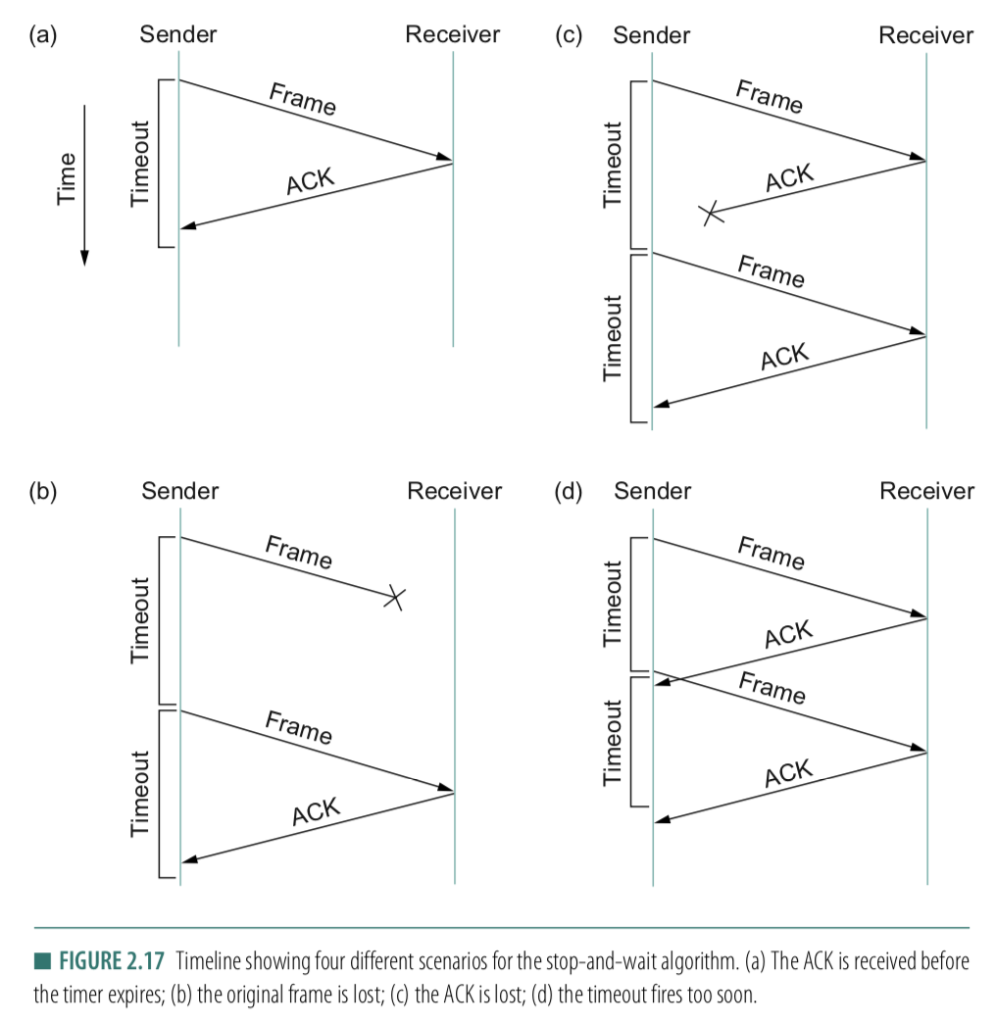
A few design decisions
  3. Timeout: picking the ideal value
  - What if the timeout is too small?
  - What if the timeout is too large?
  - Round-Trip time (RTT)

Slide 72
A few design decisions
  1. Unique packet identifiers: Why and how
  2. Duplicate packets: Why and how to eliminate
  3. Timeout: picking the ideal value

Slide 73
Reasons for Retransmission
Packet
Packet
Packet
Timeout
Timeout
ACK
Timeout
ACK
Packet
Packet
Packet
ACK
Timeout
Timeout
Timeout
ACK
ACK
Packet lost
ACK lost
DUPLICATE
PACKET
Early timeout
DUPLICATE
PACKETS
Notes:
Application may get duplicates in the case of early timeouts

Slide 74
How Long Should Sender Wait?
Sender sets a timeout to wait for an ACK
  Too short:
  >> wasted retransmissions
  Too long:
  >> excessive delays when packet lost

Slide 75
How Long Should Sender Wait?
Sender sets a timeout to wait for an ACK
  Too short:
  >> wasted retransmissions
  Too long:
  >> excessive delays when packet lost
TCP sets timeout as a function of the RTT
  Expect ACK to arrive after a “round-trip time”
  … plus a fudge factor to account for queuing
But, how does the sender know the RTT?

Slide 76
How Long Should Sender Wait?
Sender sets a timeout to wait for an ACK
  Too short:
  >> wasted retransmissions
  Too long:
  >> excessive delays when packet lost
TCP sets timeout as a function of the RTT
  Expect ACK to arrive after a “round-trip time”
  … plus a fudge factor to account for queuing
But, how does the sender know the RTT?
  Running average of delay to receive an ACK

Slide 77
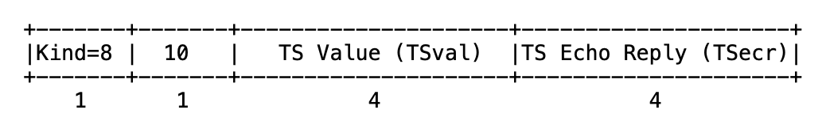
TCP timestamp

Slide 78
TCP timestamp
Sender’s current time

Slide 79
TCP Timestamp Option (10 bytes)
Sender’s current time
Copied timestamp from the packet
being acknowledged.
(valid only when the packet contains an ACK.
i.e., the ACK bit is set in TCP header).

Slide 80
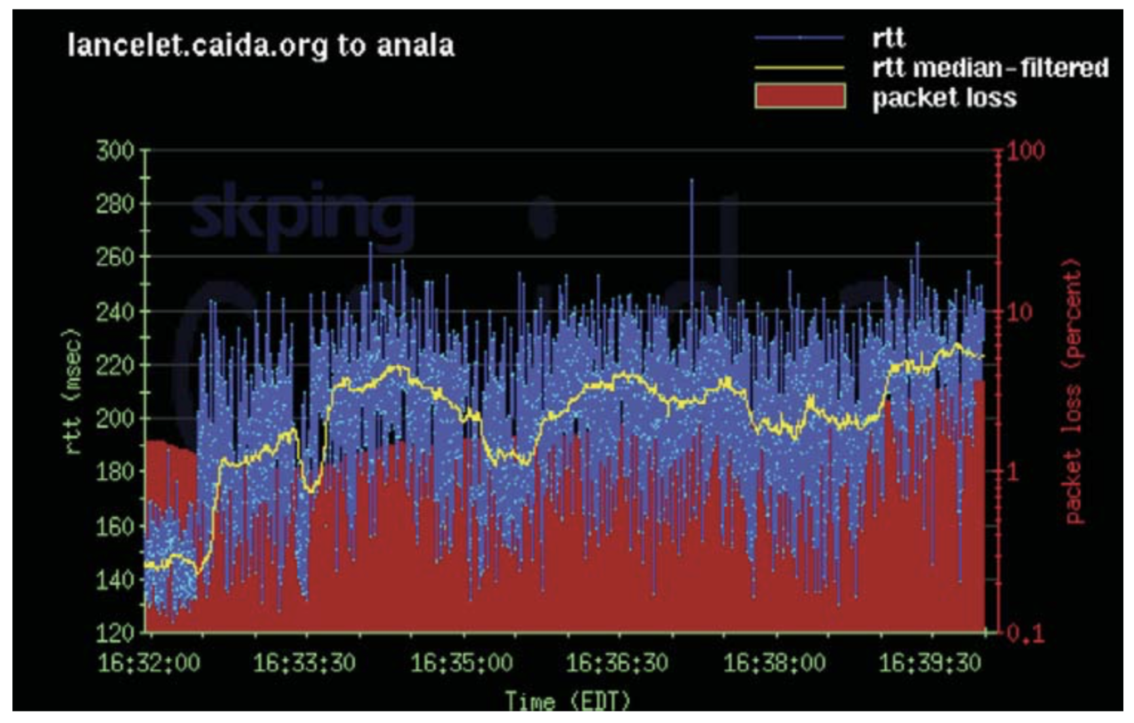
Example RTT Estimation

Slide 81
Reliable Delivery on a Lossy Channel With Bit Errors
TCP Flow control: Sliding Window Protocol

Slide 82
Motivation for Sliding Window
Stop-and-wait is inefficient
  Only one TCP segment is “in flight” at a time
  Especially bad for high “delay-bandwidth product”
bandwidth
delay

Slide 83
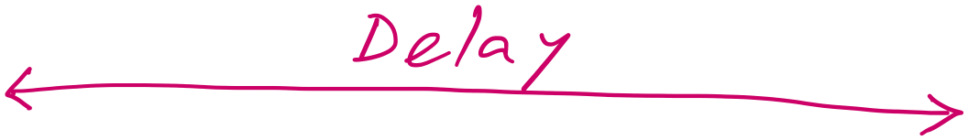
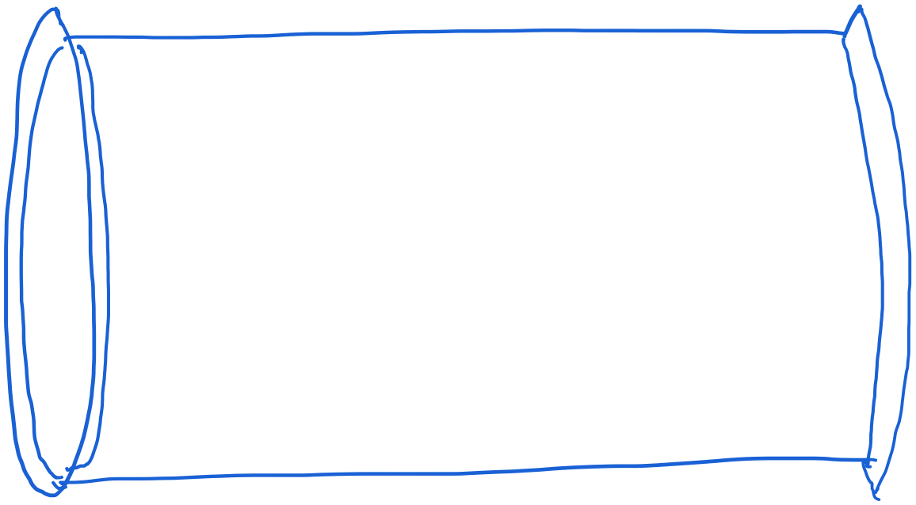
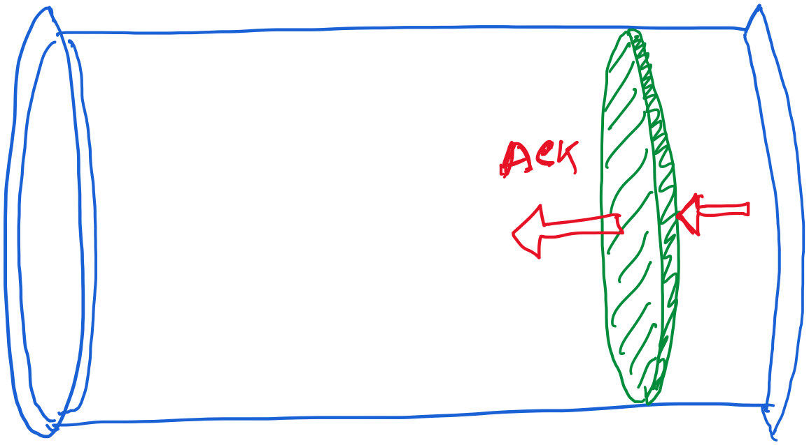
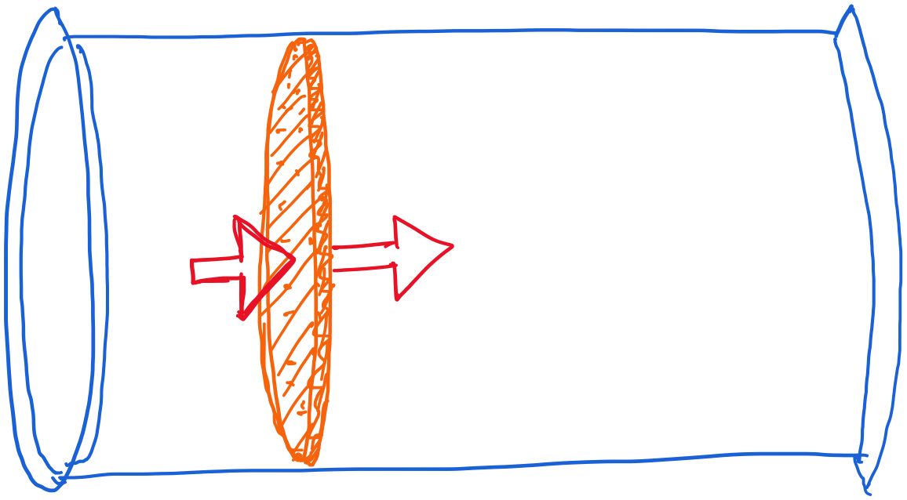
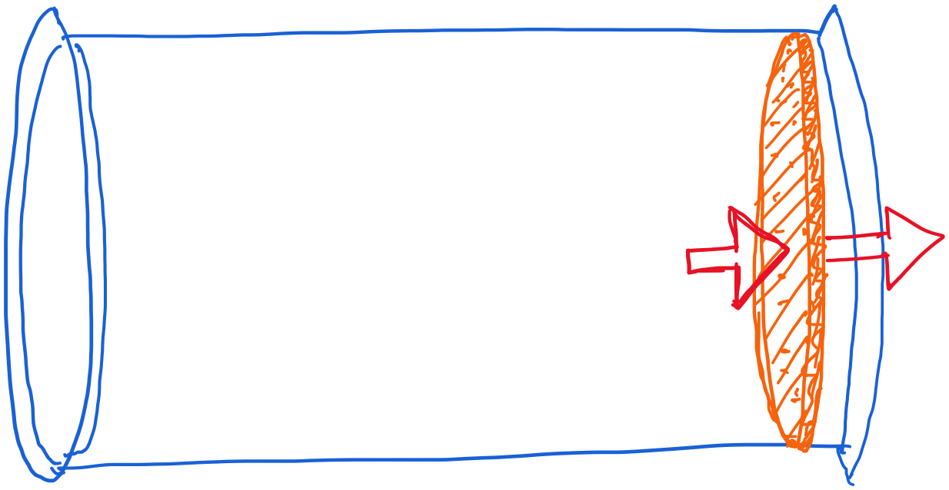
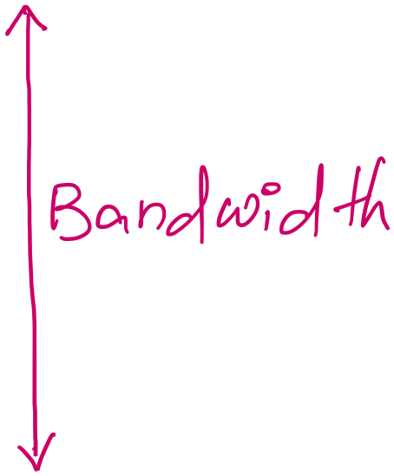
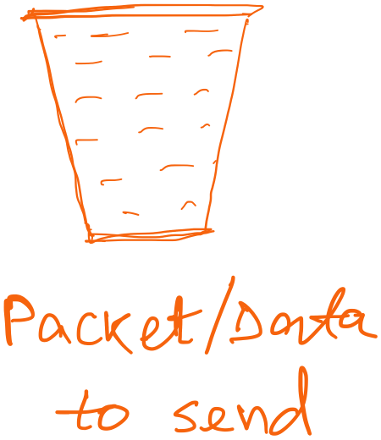
Revisiting “delay X bandwidth”

Slide 84
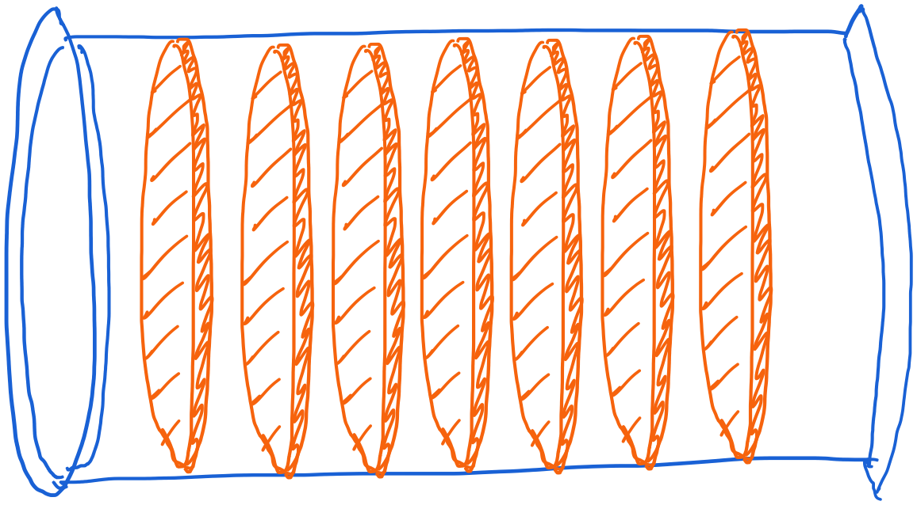
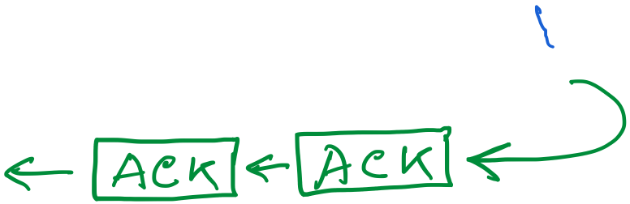
Revisiting “delay X bandwidth”

Slide 85
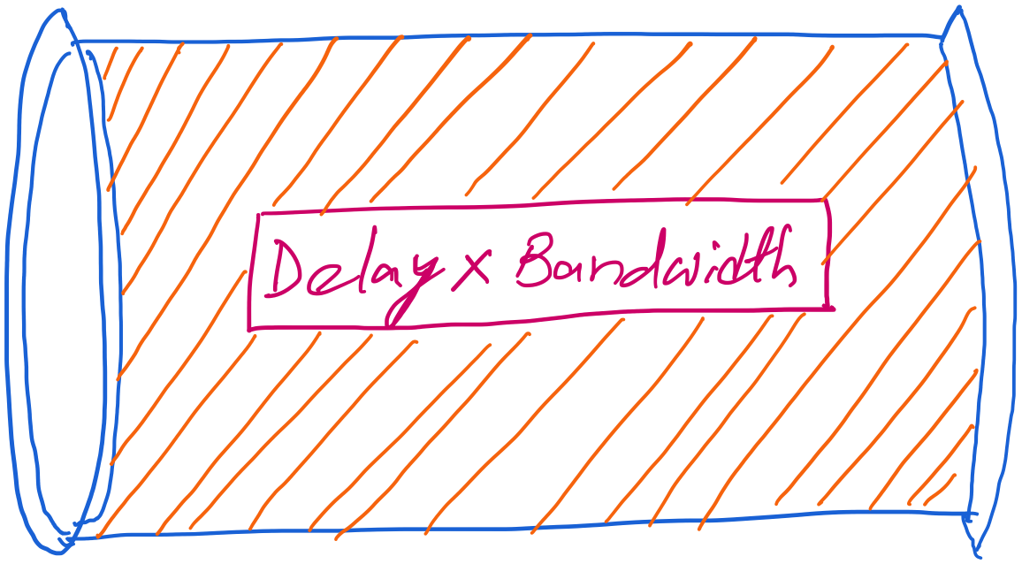
Revisiting “delay X bandwidth”

Slide 86
Revisiting “delay X bandwidth”
Consider two-way delay
or round-trip delay

Slide 87
Revisiting “delay X bandwidth”
Sender
Receiver
Packet
Round-trip delay
ACK
Time

Slide 88
stop-and-wait operation
sender
receiver
first packet bit transmitted, t = 0
last packet bit transmitted, t = L / R
first packet bit arrives
RTT
last packet bit arrives, send ACK
ACK arrives, send next
packet, t = RTT + L / R
Packet size = L bits
Network bandwidth = R bits-per-sec

Slide 89
Performance – an implementation of stop-and-wait
Stop-and-wait works, but performance stinks
ex: 1 Gbps link, 15 ms prop. delay, 8kbit (8000 bit) packet:
  U _{sender}: utilization – fraction of time sender busy sending
  1KB pkt every 30 msec -> 33kB/sec thruput over 1 Gbps link
  network protocol limits use of physical resources!

Slide 90
stop-and-wait operation
sender
receiver
first packet bit transmitted, t = 0
last packet bit transmitted, t = L / R
1kB packet per 30.008 msec
first packet bit arrives
RTT
last packet bit arrives, send ACK
ACK arrives, send next
packet, t = RTT + L / R
Packet size = L bits
Network bandwidth = R bits-per-sec

Slide 91
stop-and-wait operation
sender
receiver
first packet bit transmitted, t = 0
last packet bit transmitted, t = L / R
1kB packet per 30.008 msec
first packet bit arrives
RTT
last packet bit arrives, send ACK
~33KB/sec throughput over a 1GBPS link!!
ACK arrives, send next
packet, t = RTT + L / R
Packet size = L bits
Network bandwidth = R bits-per-sec

Slide 92
stop-and-wait operation
sender
receiver
first packet bit transmitted, t = 0
last packet bit transmitted, t = L / R
1kB packet per 30.008 msec
first packet bit arrives
RTT
last packet bit arrives, send ACK
~33KB/sec throughput over a 1GBPS link!!
ACK arrives, send next
packet, t = RTT + L / R
Network protocol limits the full utilization of physical resources.
Transport-layer vs Link-layer capacity gap
Packet size = L bits
Network bandwidth = R bits-per-sec

Slide 93
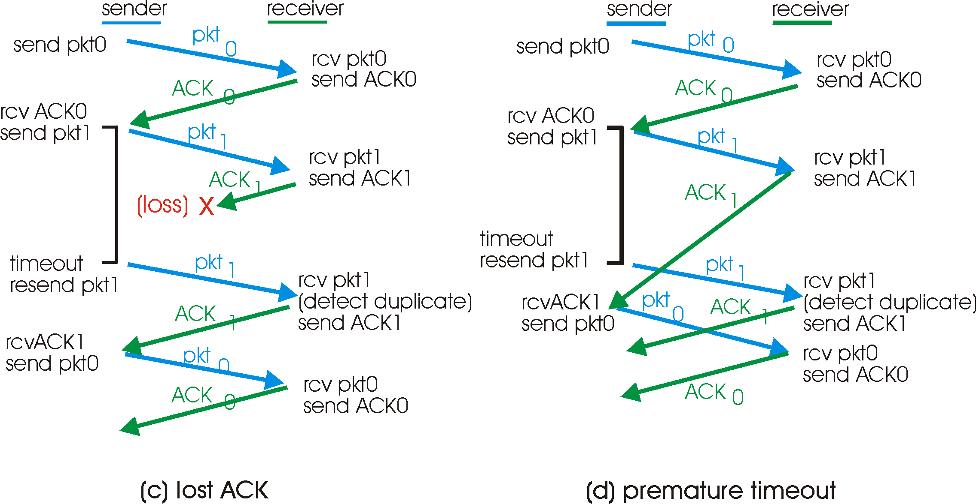
A problem in rdt3.0

Slide 94
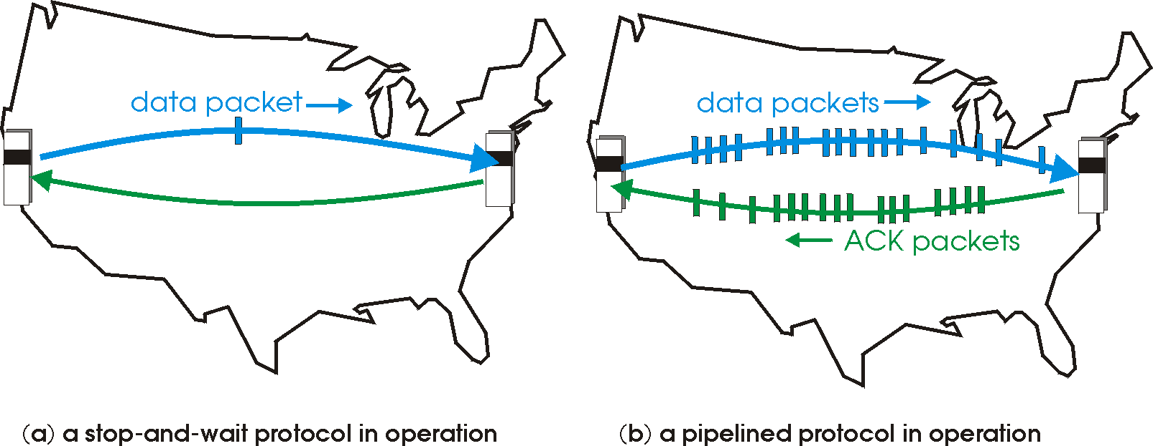
Pipelined protocols
Pipelining: sender allows multiple, “in-flight”, yet-to-be-acknowledged pkts
  range of sequence numbers must be increased
  buffering at sender and/or receiver
Two generic forms of pipelined protocols (or sliding window protocol) depending on the retransmission strategy: go-Back-N, selective repeat

Slide 95
Pipelining: increased utilization
sender
receiver
first packet bit transmitted, t = 0
last bit transmitted, t = L / R
first packet bit arrives
RTT
last packet bit arrives, send ACK
last bit of 2nd packet arrives, send ACK
last bit of 3rd packet arrives, send ACK
ACK arrives, send next
packet, t = RTT + L / R
Increase utilization
by a factor of 3!

Slide 96
Some Pipelining Protocols
Go-back-N: overview
sender: up to N unACKed pkts in pipeline
receiver: only sends cumulative ACKs
  doesn’t ACK pkt if there’s a gap
sender: has timer for oldest unACKed pkt
  if timer expires: retransmit all unACKed packets
Selective Repeat: overview
sender: up to N unACKed packets in pipeline
receiver: ACKs individual pkts
sender: maintains timer for each unACKed pkt
  if timer expires: retransmit only unACKed packet

Slide 97
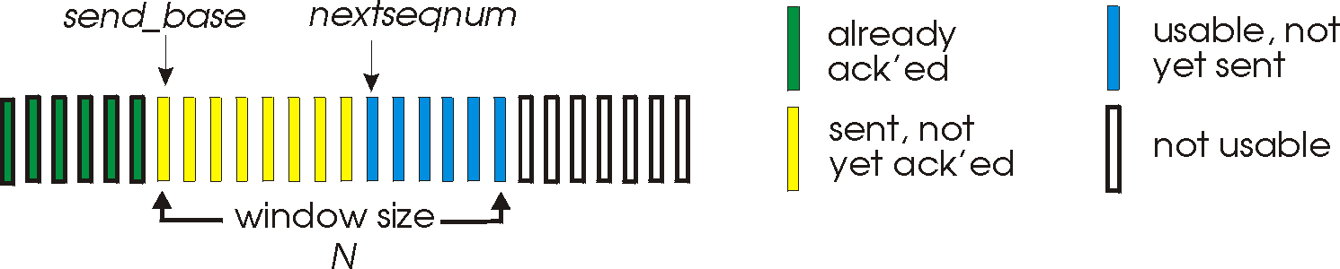
Go-Back-N
Sender:
k-bit seq # in pkt header
“window” of up to N, consecutive unACKed pkts allowed
ACK(n): ACKs all pkts up to, including seq # n - “cumulative ACK”
  may receive duplicate ACKs (see receiver)
timer for each in-flight pkt
timeout(n): retransmit pkt n and all higher seq # pkts in window

Slide 98
Revisiting “delay X bandwidth”
Sender
Receiver
Round-trip delay
Time

Slide 99
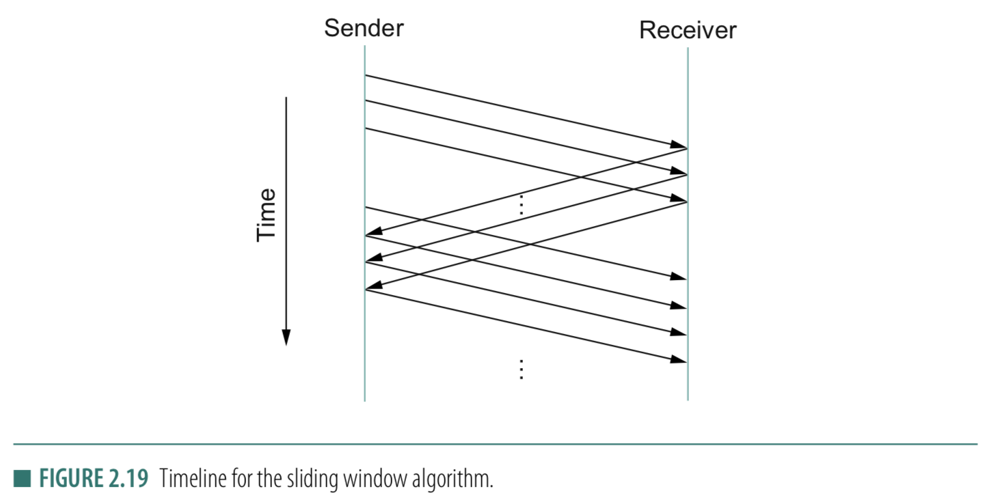
Stop-and-wait
Sliding Window
Sender
Receiver
Packet
Timeout
ACK
Time

Slide 100
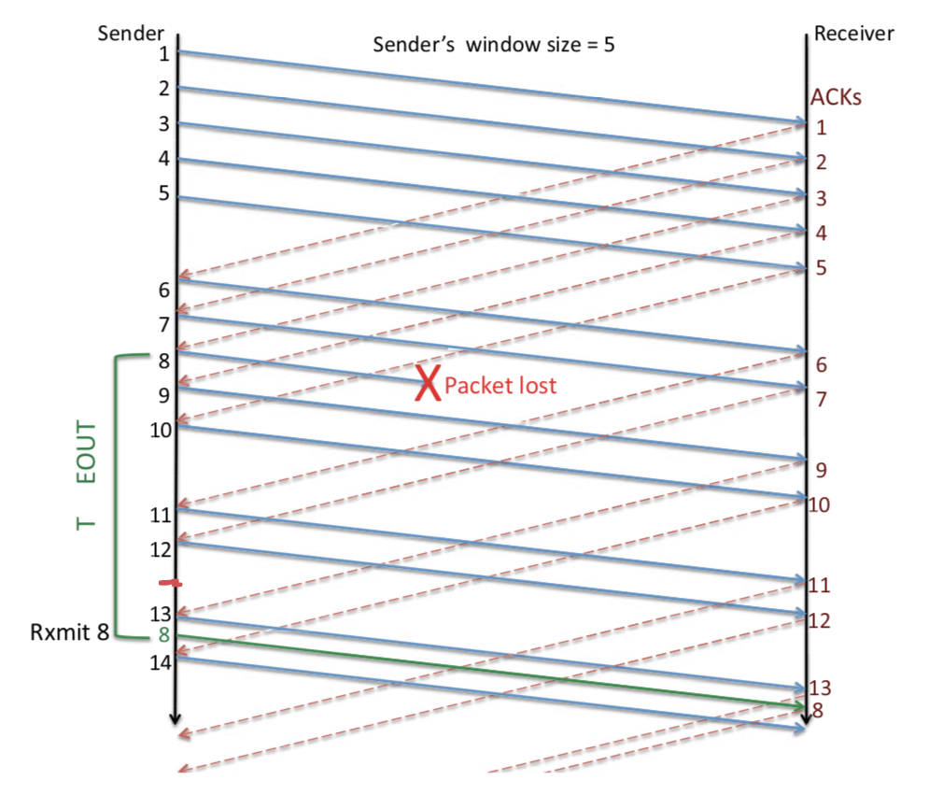
Sliding Window: Lost Packet/ACK

Slide 101
Sliding Window Protocol

Slide 102
Sliding Window: A series of packets to be sent reliably
Window = # pkt in flight
Pkt:1
Pkt:2
Pkt:3
Pkt:4
Pkt:5
Pkt:6
Pkt:7
Pkt:8
Sent
Sent
Sent

Slide 103
Sliding Window: A series of packets to be sent reliably
Window = # pkt in flight
Pkt:1
Pkt:2
Pkt:3
Pkt:4
Pkt:5
Pkt:6
Pkt:7
Pkt:8
Sent
Sent
Sent
ACK

Slide 104

Sliding Window: A series of packets to be sent reliably
Window = # pkt in flight
Pkt:1
Pkt:2
Pkt:3
Pkt:4
Pkt:5
Pkt:6
Pkt:7
Pkt:8
Sent
Sent
Packet 1 is delivered

Slide 105
Sliding Window: A series of packets to be sent reliably
Window = # pkt in flight
Pkt:1
Pkt:2
Pkt:3
Pkt:4
Pkt:5
Pkt:6
Pkt:7
Pkt:8
Sent
Sent
Packet 1 is delivered. Slide the window.

Slide 106
Sliding Window: A series of packets to be sent reliably
Window = # pkt in flight
Pkt:1
Pkt:2
Pkt:3
Pkt:4
Pkt:5
Pkt:6
Pkt:7
Pkt:8
Sent
Sent
Sent
Packet 1 is delivered. Slide the window.

Slide 107
Sliding Window: A series of packets to be sent reliably
Sender
Receiver
Time

